Slide 1
Medieval Europe – Kingdoms and Christianity:
The Byzantine Empire

Slide 2
Main Idea
The Byzantine Empire, once the eastern half of the Roman Empire, was held together for centuries by strong leaders, profitable trade, and the influence of Christianity.

Slide 3
A New Rome
Byzantine Empire
The eastern section of the former Roman empire
Constantinople = capital
Controlled trade between Asia and Europe
Protected by the seas

Slide 4
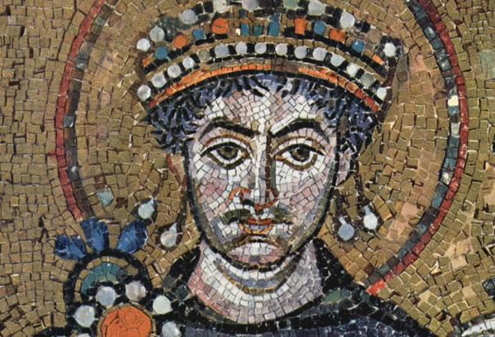
Justinian I
Justinian becomes emperor of Byzantium in 527
Wants to restore empire
Revives and updates laws

Slide 6
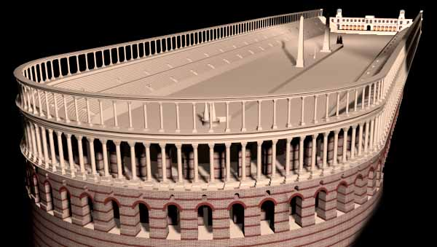
Nika Revolt
Greens and the Blues
Resented Justinian’s & Theodora’s reforms
Constantinople in flames
Slaughtered at the Hippodrome

Slide 7
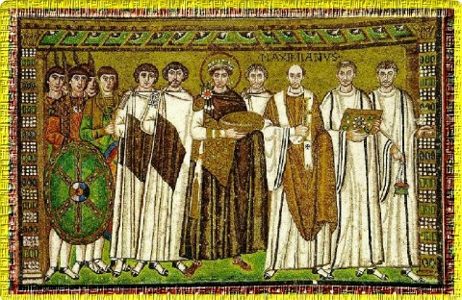
Laws for the Empire
Justinian’s Code – Corpus Juris Civilis
1.) The Code – Roman laws
2.) The Digest – quoted and summarized great Roman thinkers
3.) The Institutes – textbook on how to use the laws
4.) The Novellae – new laws

Slide 8
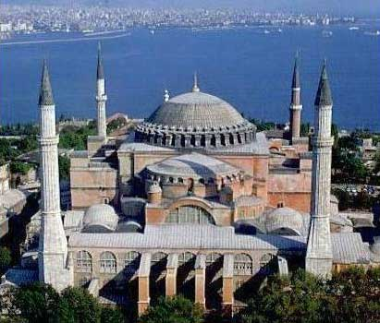
Religion and the Arts
Christianity influenced art, architecture, and literature
Hagia
Sophia

Slide 9
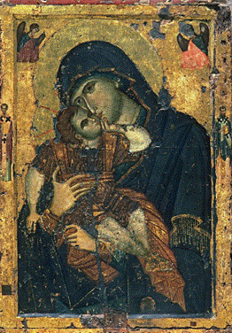
Religious Conflicts
Controversy over use of icons
Too close to idol worship
Iconoclasts
Objected use of icons

Slide 10
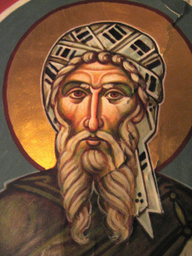
Religious Conflicts
Emperor Leo III
Forbade use of holy images
Western clergy unhappy

Slide 11
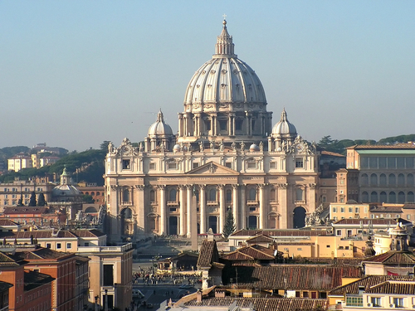
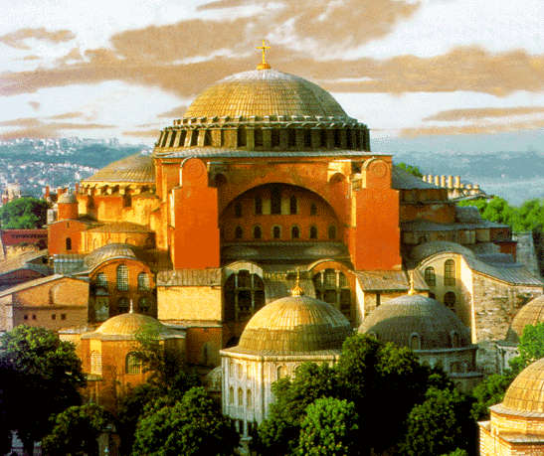
Religious Conflicts
Christianity develops differently in Eastern and Western Roman Empires
Two churches disagree over religious doctrines

Slide 12
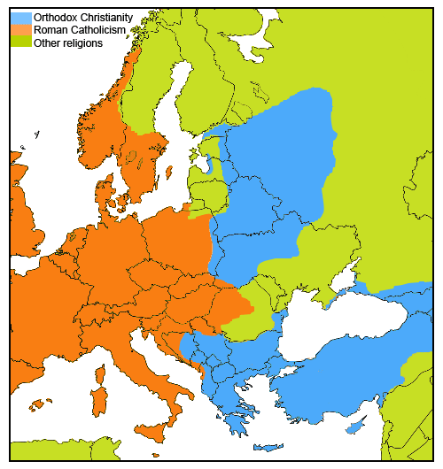
Religious Conflicts
1054 – The Great Schism
Churches split
East = Orthodox Church
West = Roman Catholic Church

Slide 13
Religious Conflicts
What events led to The Great Schism (the division of the church) in 1054?
Pope and patriarch excommunicate each other over religious doctrines
Great distance between two empires caused a lack of communication
Roman pope claimed superiority over other patriarchs

Slide 14
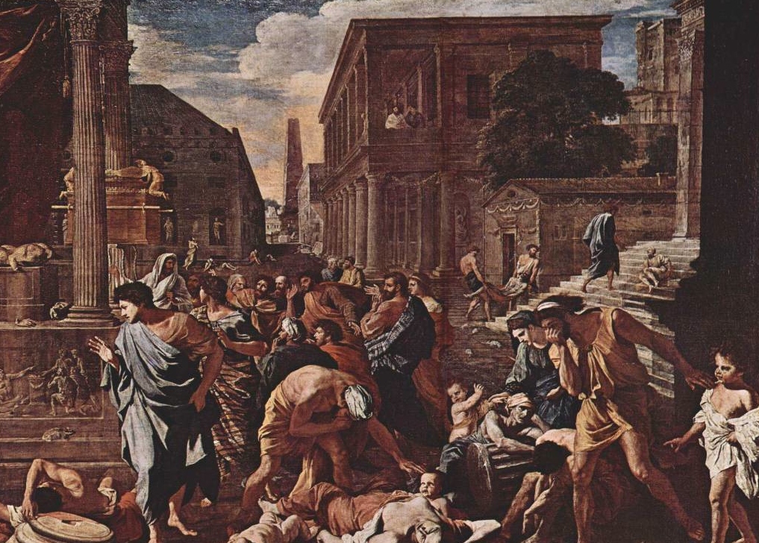
Empire Declines
Riots
The Plague

Slide 15
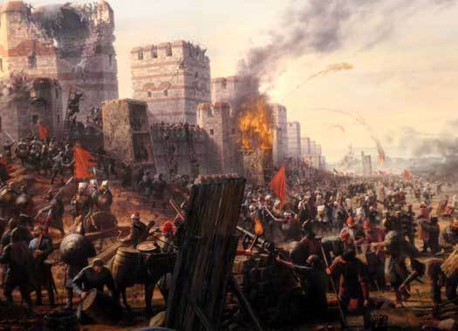
Empire Declines
Foreign Enemies
Justinian’s death in 565
Internal Weaknesses

Slide 16
Medieval Europe – Kingdoms and Christianity:
Christianity in Western Europe

Slide 17
Main Idea
The spread of Christianity, largely through the work of missionaries and monk, helped unify western Europe after the collapse of the Roman Empire.

Slide 18
Christian European Society
Medieval
Middle Ages
After fall of Rome
Many people’s lives filled with hardship
Christendom
Linked a common religion and community

Slide 19
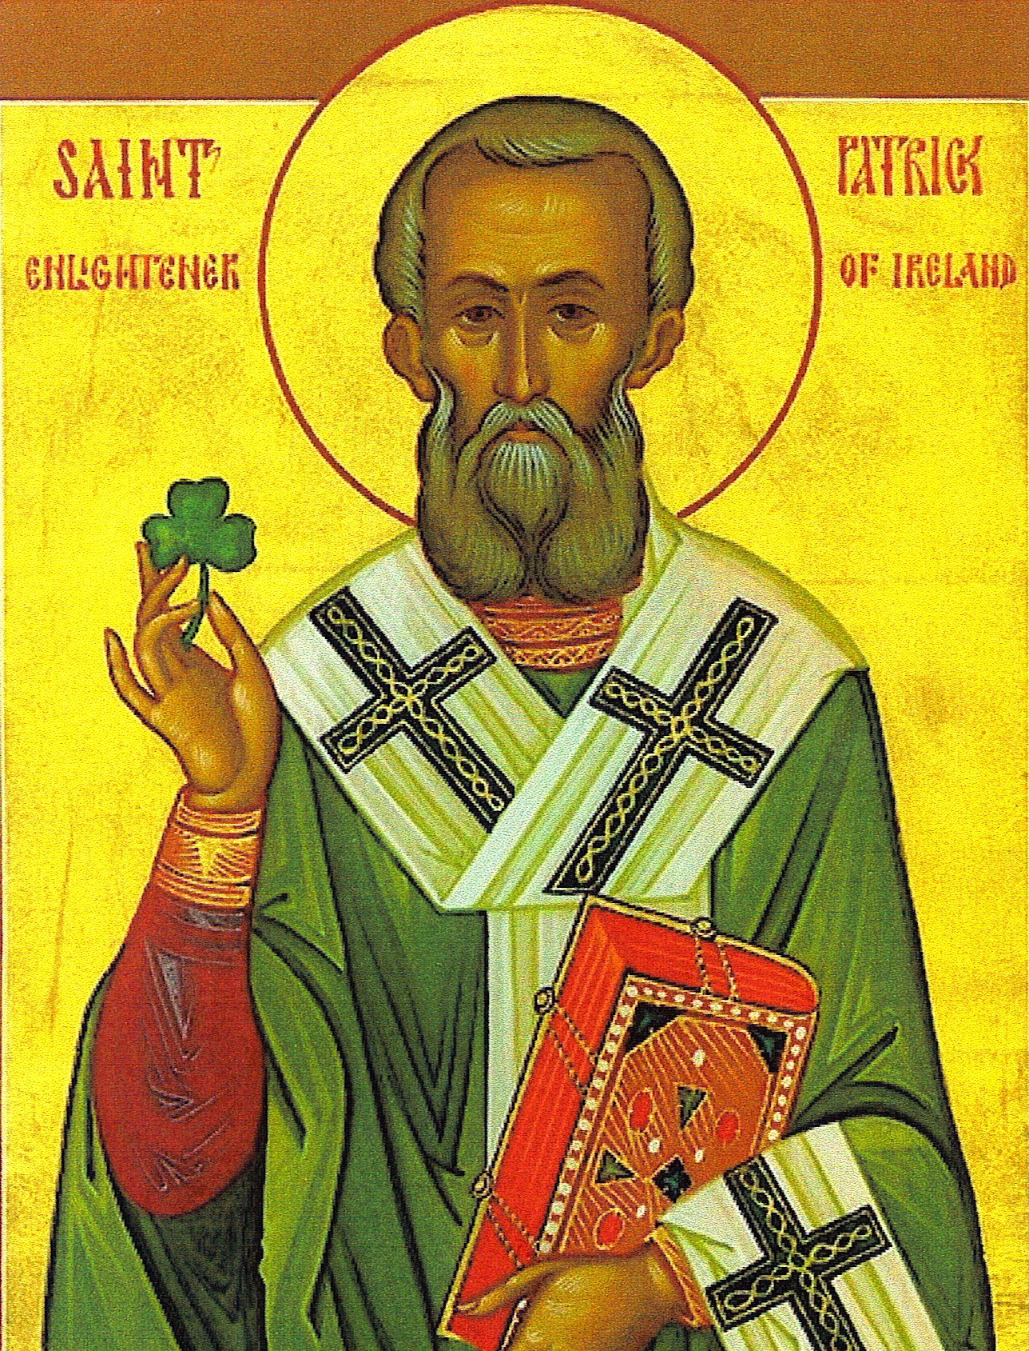
Spreading Christianity
Appeal of Christianity
Patrick
Went from Britain to Ireland to preach
Helped convert nearly all of Ireland

Slide 20
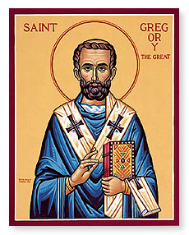
Strengthening the Papacy
Gregory the Great
Changed views on papacy
Pope supreme patriarch of the church
Supported missionary work and monasticism

Slide 21
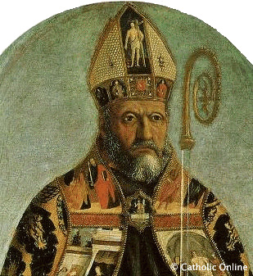
Sharing Beliefs
Conflicts over interpretation
Augustine of Hippo
City of God

Slide 22
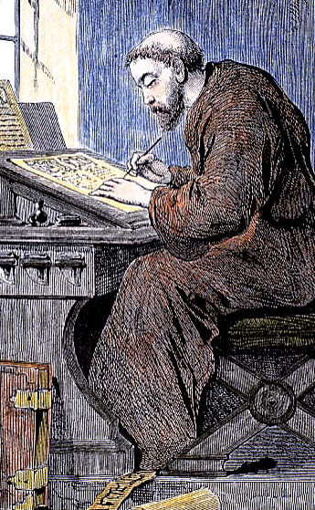
Monks and Monasteries
Monasticism
Monks
Strict code of rules
Lived in monasteries (typically)
Abbot
Vows
Combination of prayer and labor

Slide 23
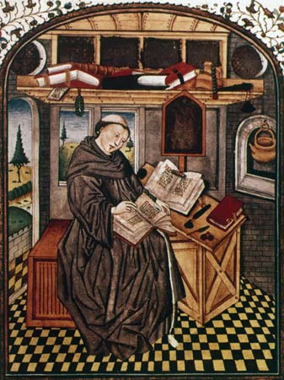
Monks and Monasteries
Helped preserve knowledge
Scholars
Copied manuscripts
Ran schools

