Slide 1
The Ancient Near East
4000 BCE - 550BCE

Slide 2
Main Idea
The first known civilization arose in Mesopotamia, and its culture and innovations influenced later civilizations in the region for thousands of years

Slide 3
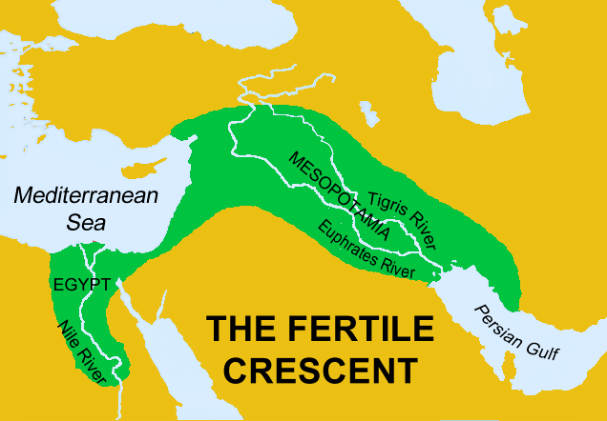
Geography Promotes Civilization
Fertile Crescent
Between Mediterranean Sea and Persian Gulf
Rich soil from silt
Mesopotamia
“between the rivers”
Tigris and Euphrates
Well suited for agriculture

Slide 4
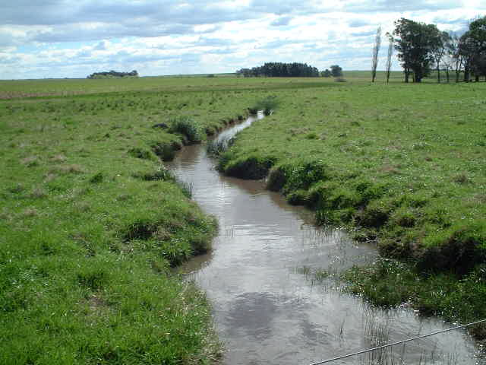
Geography Promotes Civilization
Problems:
Little rain
Rivers could overflow
Hot, dry summers
Solutions:
Basins
Dikes
Allocate resources
Assign jobs

Slide 5
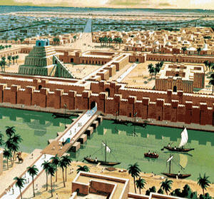
Sumer
First civilization
Sumerians
3000 BCE – Large cities emerge

Slide 6
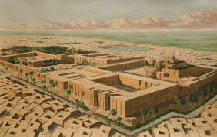
Sumer
City-state
Political unit with own government
Ziggurat
Temple
Practiced polytheism

Slide 7
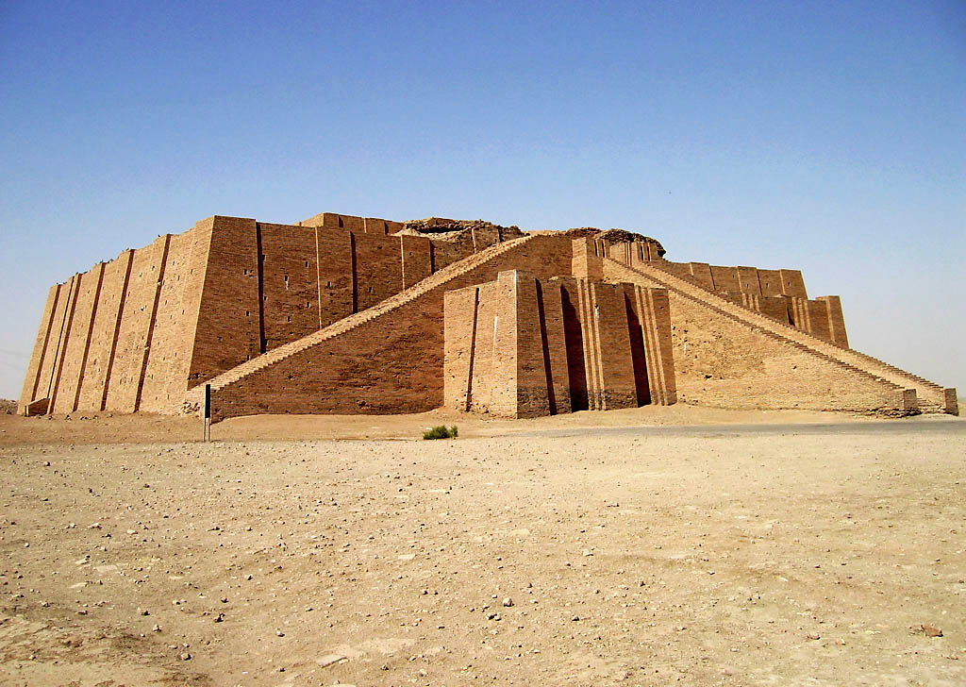

Slide 8
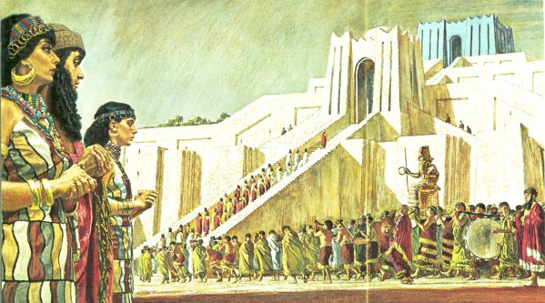
Sumer
Strong emphasis on religion
War chiefs begin to rule as kings
Kings would serve as gods’ representative
Could/Would form a dynasty

Slide 9
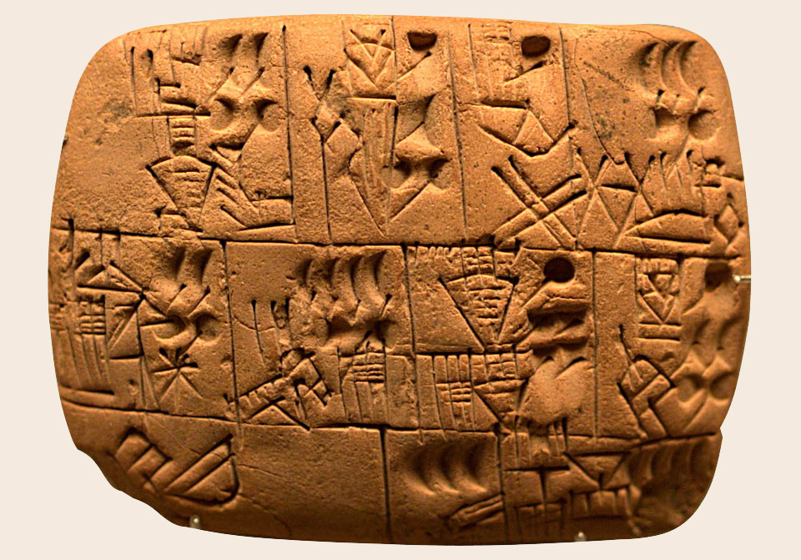
Sumerian Culture
Developed first writing system
Cuneiform
Wedge like symbols on clay tablets
Kept business accounts, records, laws, & literature
The Epic of Gilgamesh

Slide 10
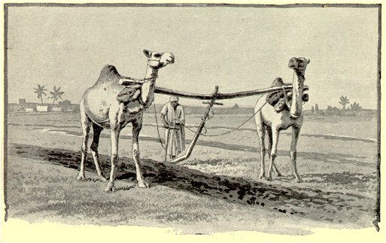
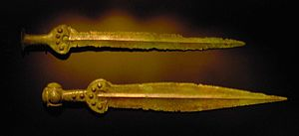
Sumerian Culture
Developed math system
Invented the wheel
Invented the plow
Learned how to use bronze

Slide 11
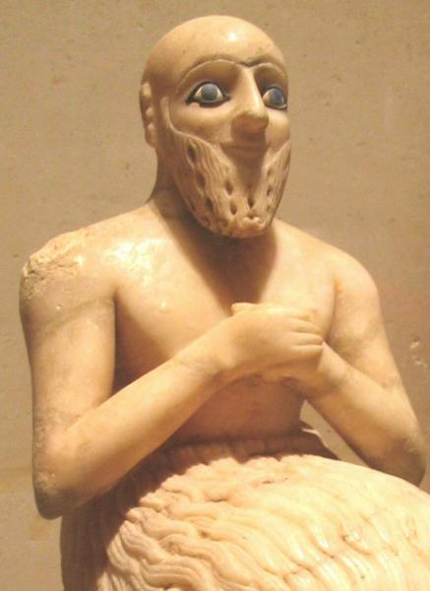
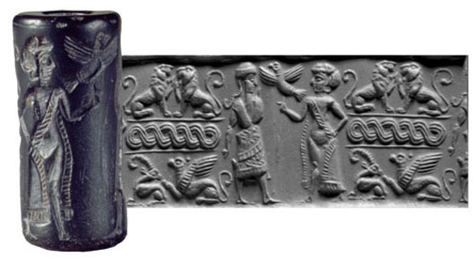
Sumerian Culture
Art
Arches, ramps, and columns
Cylinder seals

Slide 12
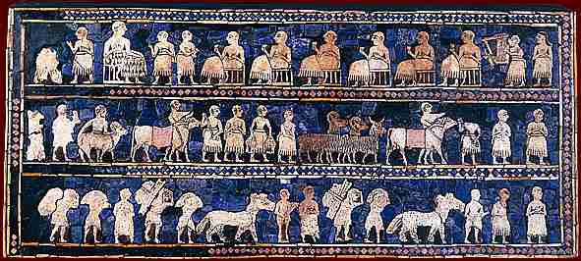
Sumerian Culture
Had to trade for materials
Distinct social hierarchy
King
Priests
Landowners & Merchants
Artisans, farmers, laborers
Slaves

Slide 13
Empires in Mesopotamia
Frequent warfare weakened Sumer’s city states
Invading peoples conquered the region
Adapted aspects of Sumerian culture

Slide 14
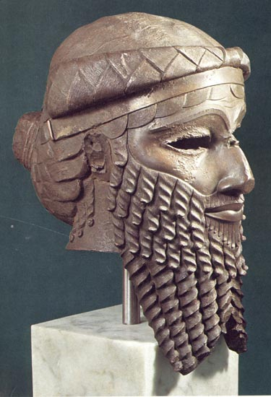
Sargon’s Empire
Akkadians
Sargon I
First ruler to create a permanent army
Conquered all of Sumer and northern Mesopotamia
Formed world’s first empire
Mediterranean Sea to Persian Gulf

Slide 15
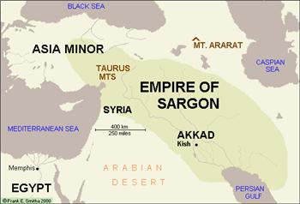
Sargon’s Empire
Adopted cuneiform
Kept power of the priesthood
Lasted 140 years
Tribes from the East capture Akkad

Slide 16
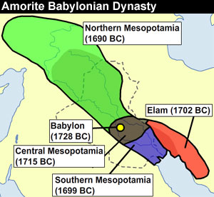
Babylonian Empire
Amorites
Settled near modern Baghdad, Iraq

Slide 17
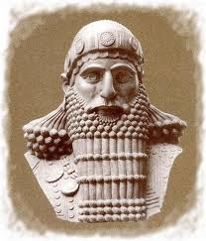
Hammurabi
King of Babylon – 1792 BCE
Brilliant warrior
Great administrator
Created Babylonian Empire

Slide 18
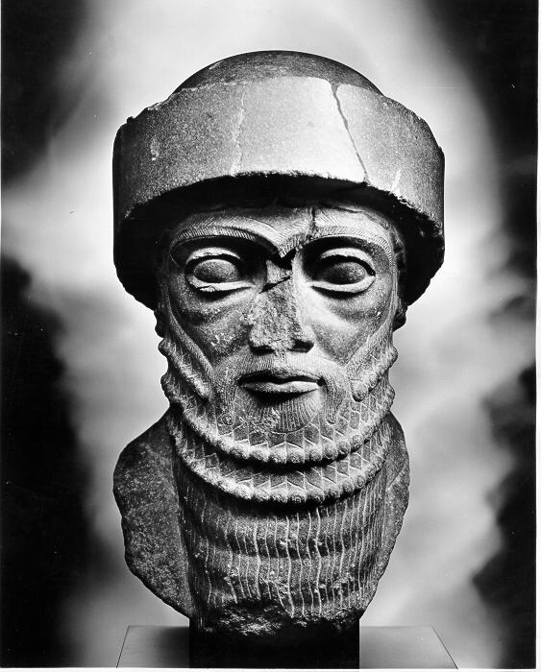
Hammurabi
Building Projects
Tax-collection
Increased Trade
Absorbed elements of previous cultures

Slide 19
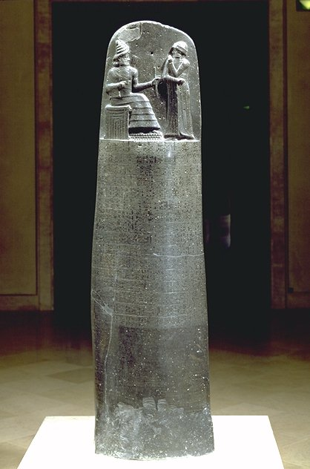
Hammurabi
Code of laws – Hammurabi’s Code
Written down for all to see
“An eye for an eye…”

Slide 20
The Ancient Near East: Fertile Crescent Empires
4000 BCE - 550BCE

Slide 21
Main Idea
Nomadic tribes from the mountains and deserts moved into the Fertile Crescent region drawn by its wealth. These Indo-European invaders introduced new technologies to the Fertile Crescent while adapting earlier technologies developed by the civilizations they encountered

Slide 22
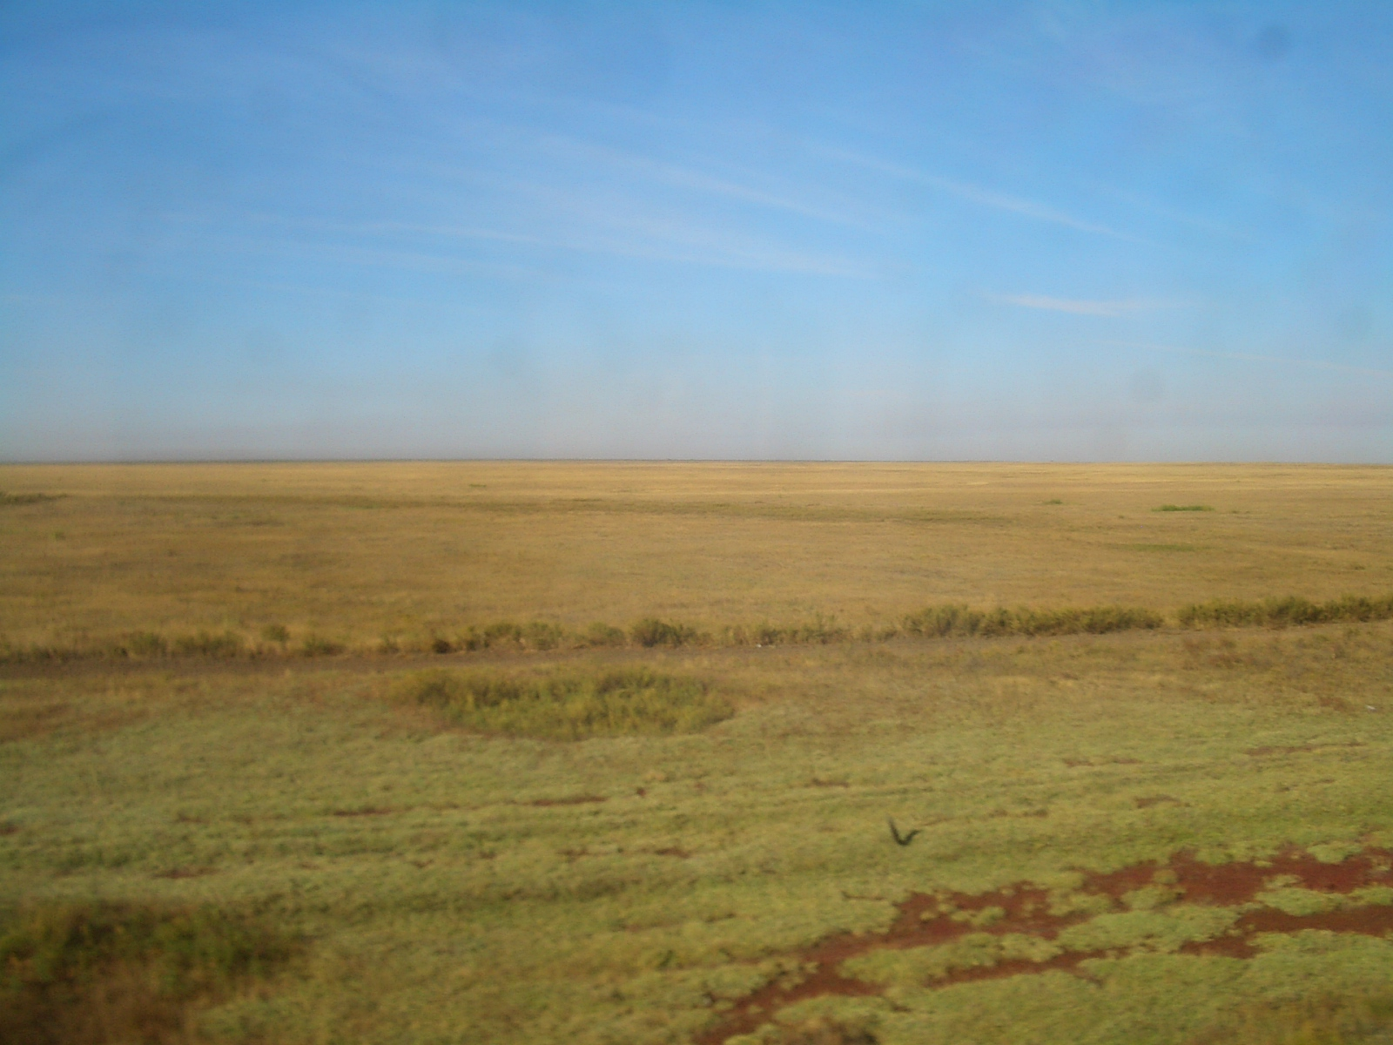
Indo-Europeans
Semi-nomadic
Spoke related languages
Migrated from the steppes (arid grasslands) north of the Black Sea
Driven by drought, conflicts, or lack of resources

Slide 23
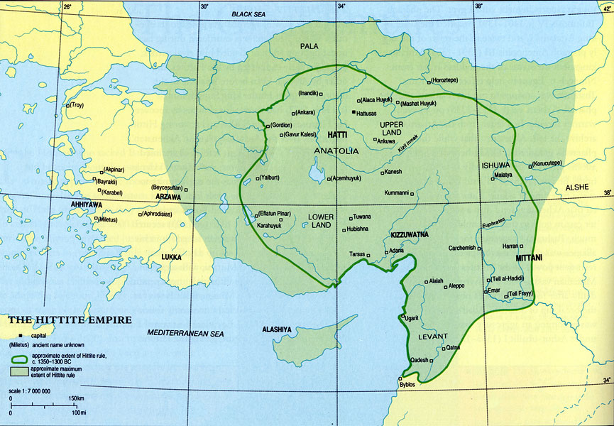
The Hittites
Approximately 2000 BCE
Settled in Asia Minor (modern day Turkey)
Very war driven

Slide 24
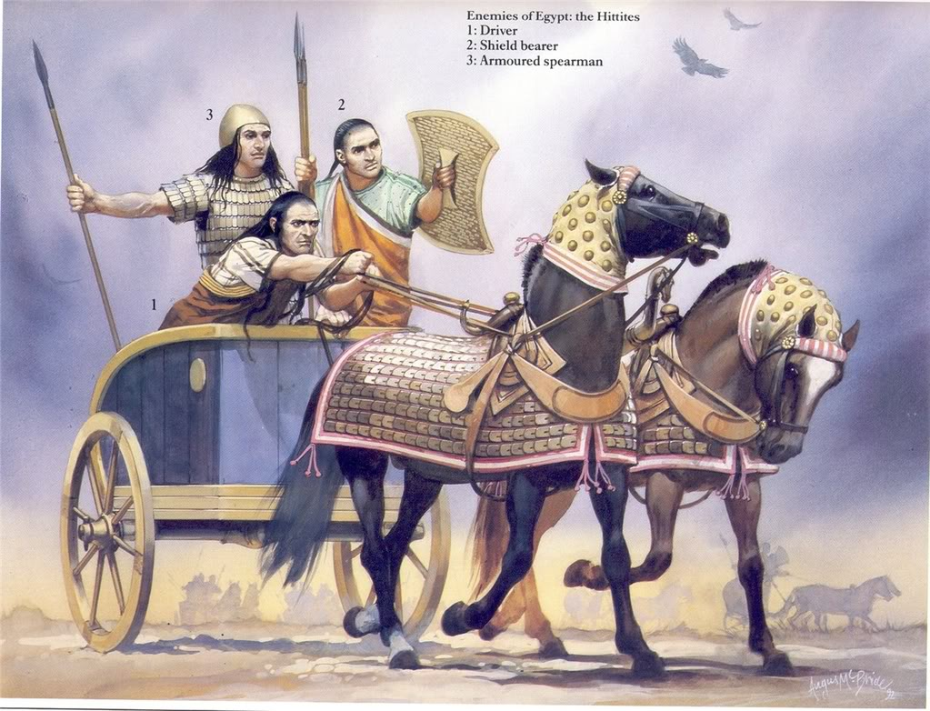
Hittite Military Might
Horse-drawn war chariot
Held three
Driver, fighter, shield
Sacked Babylon

Slide 25
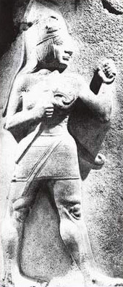
Hittite Culture
Blended culture
Cuneiform
Law code similar to Hammurabi
First to master ironworking techniques
Fell to “sea people” around 1200 BCE

Slide 26
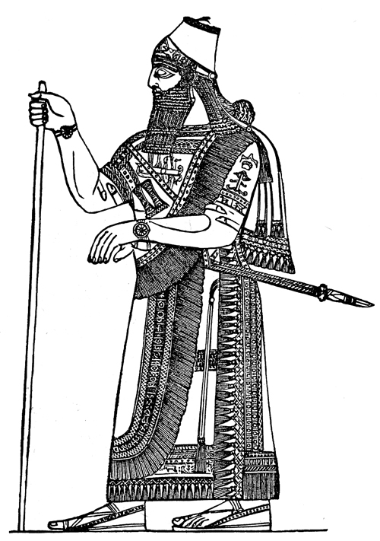
Assyrians
Northern Mesopotamia
Along the upper Tigris River
Grew and raised cattle & barley
Adopted aspects of Sumerian culture

Slide 27
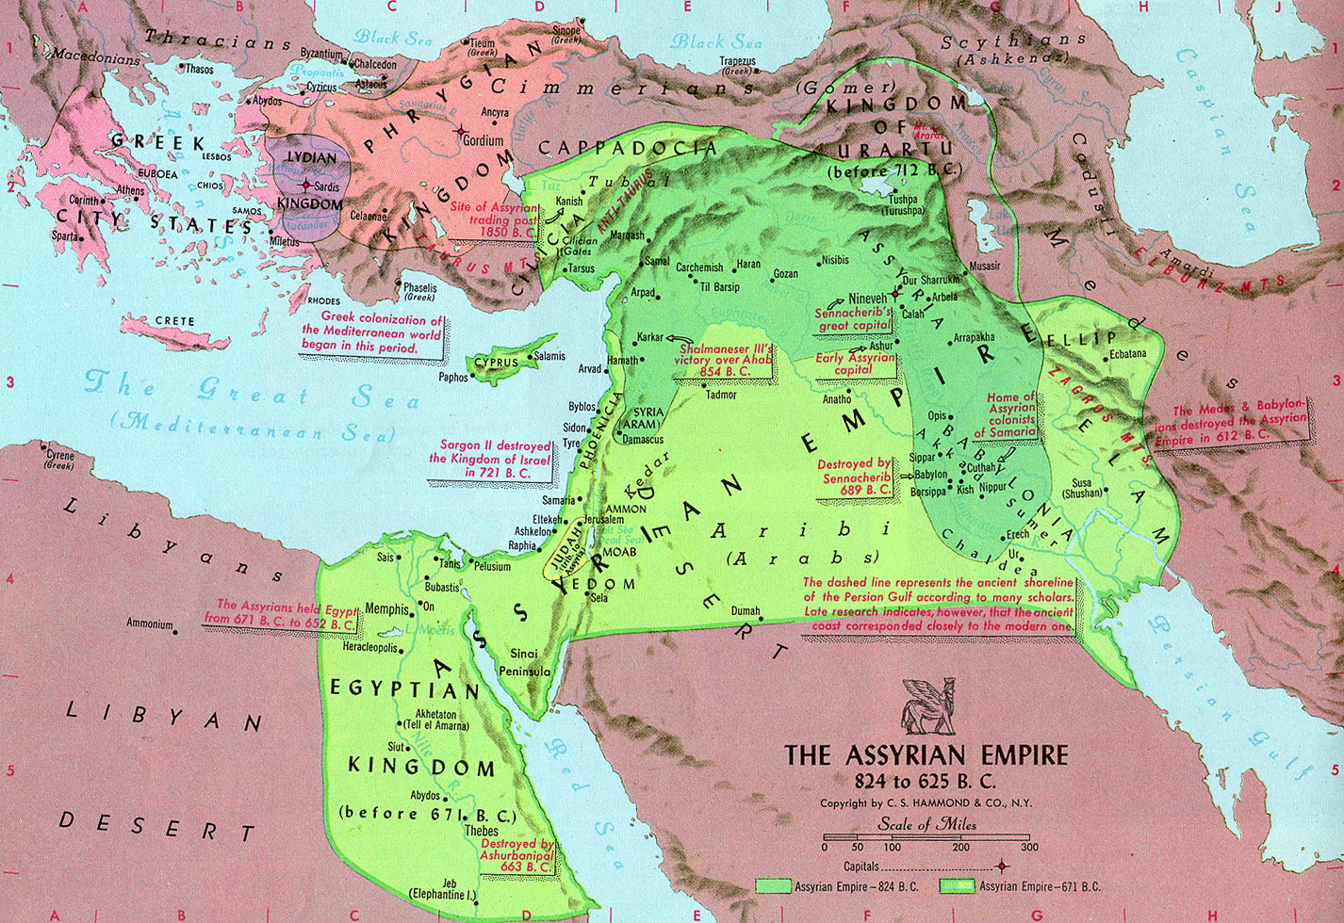
Assyrians
Land received good rainfall
Along major trade routes
Often invaded
Built an empire TWICE

Slide 28
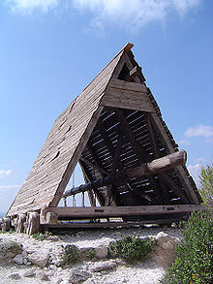
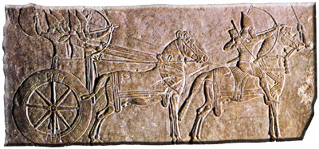
Assyrian War Machine
Power relied on its military
Armed with iron weapons

Slide 29
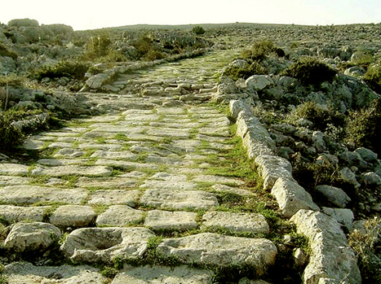
Assyrian Rule
Kings ruled through local leaders
Developed a system of roads

Slide 30
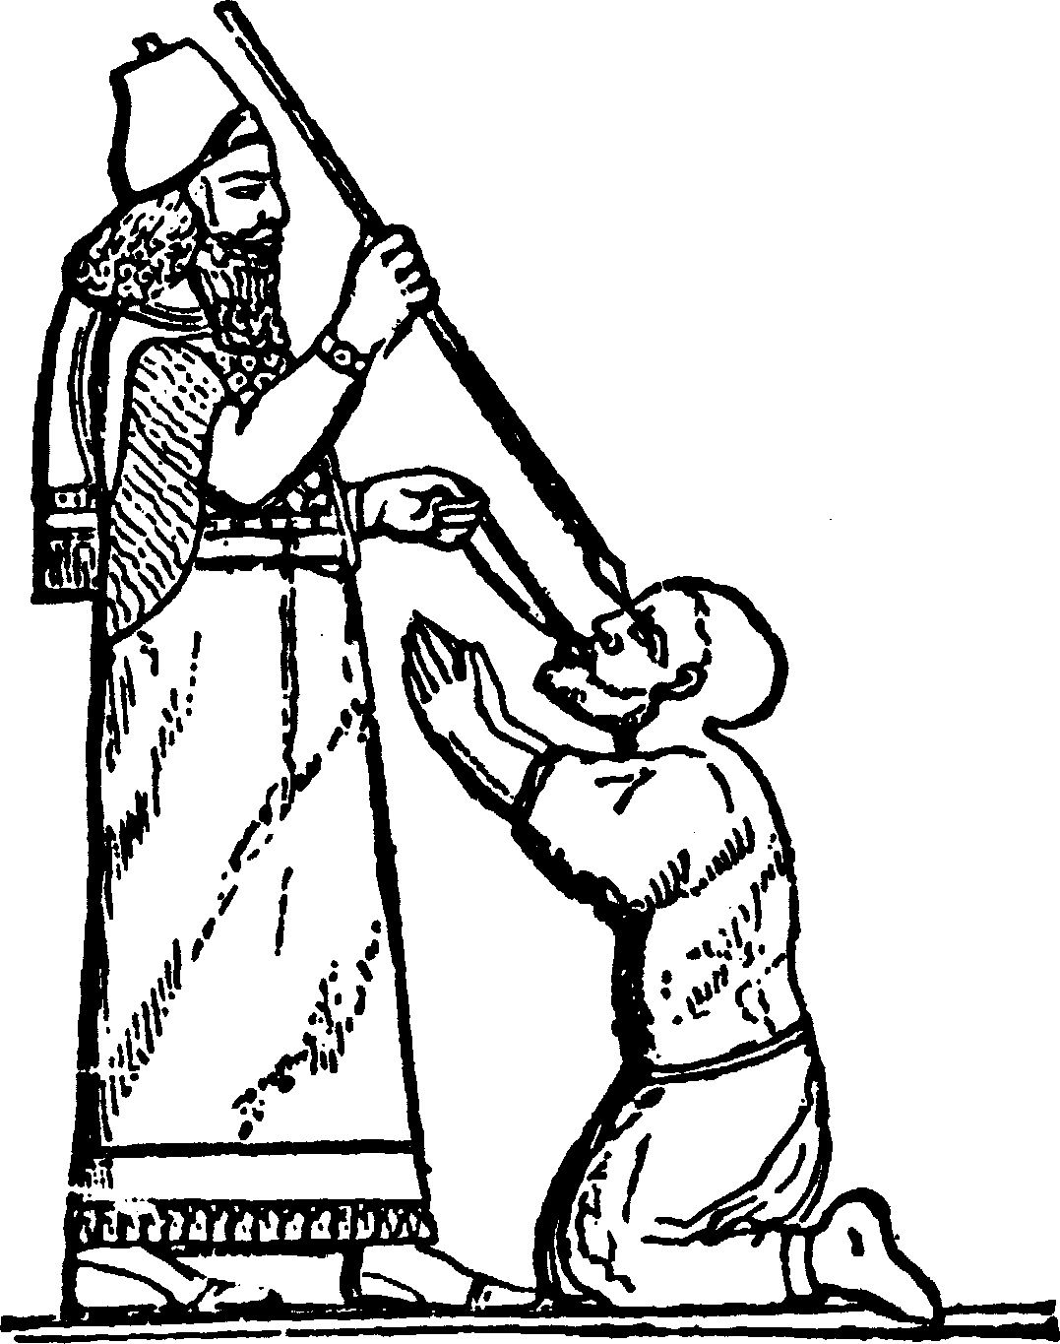
Assyrian Rule
Maintained peace by ruling with an “iron fist”
Started a library containing more the 20,000 cuneiform tablets

Slide 31
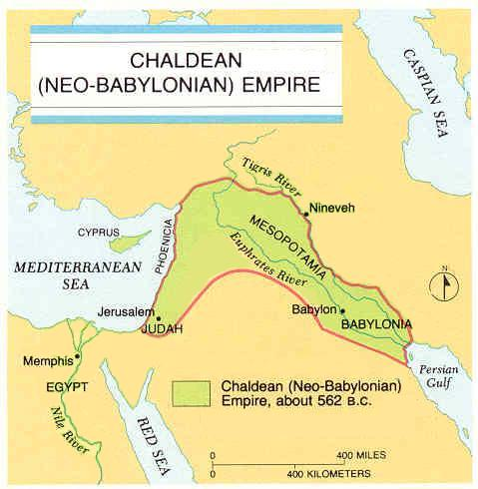
Chaldeans
From southern Mesopotamia
Empire lasted only 100 years

Slide 32
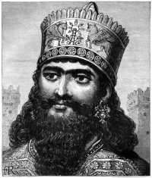
Chaldeans
Nebuchadnezzar II
Greatest Chaldean king
Warrior & builder
Conquered Jerusalem
Rebuilt Babylon
The Hanging Gardens

Slide 34
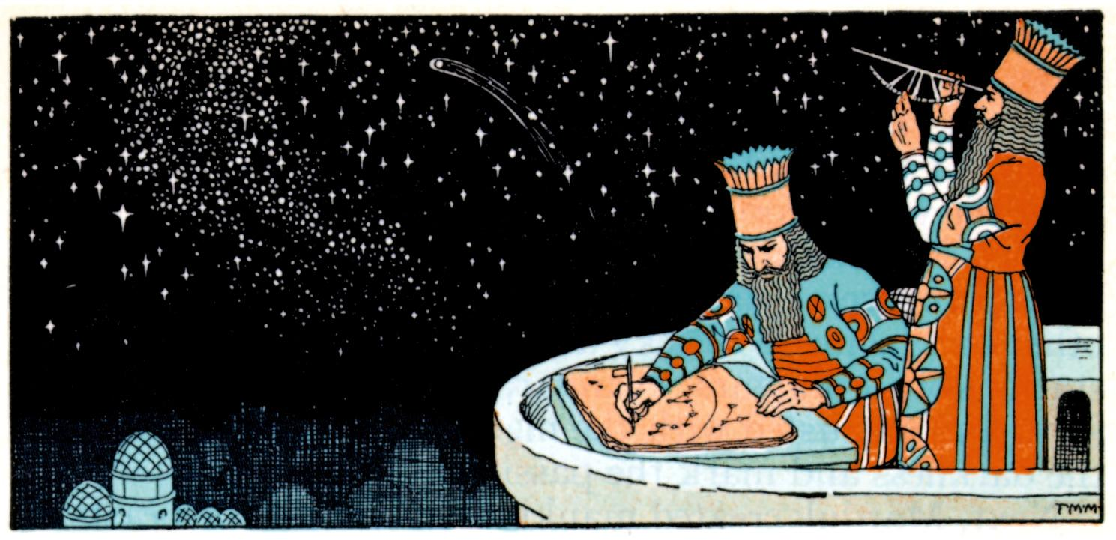
Chaldeans
Studied Sumerian language
Built temples to Sumerian gods
Developed a calendar
Astronomy
Used to track economic, political, & weather

Slide 35
Phoenicians
Western edge of the Fertile Crescent (present day Lebanon)
Used trade (not farming)

Slide 36
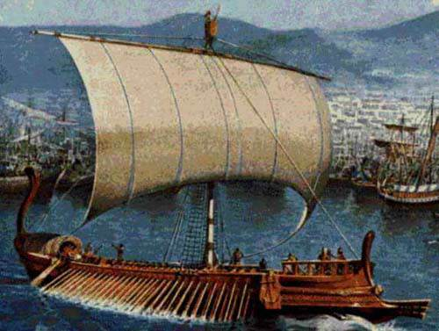
Growth of a Trading Society
Expert sailors & merchants
Traveled as far as Straight of Gibraltar, possibly even Britain
Founded colonies on trade routes
Carthage

Slide 37
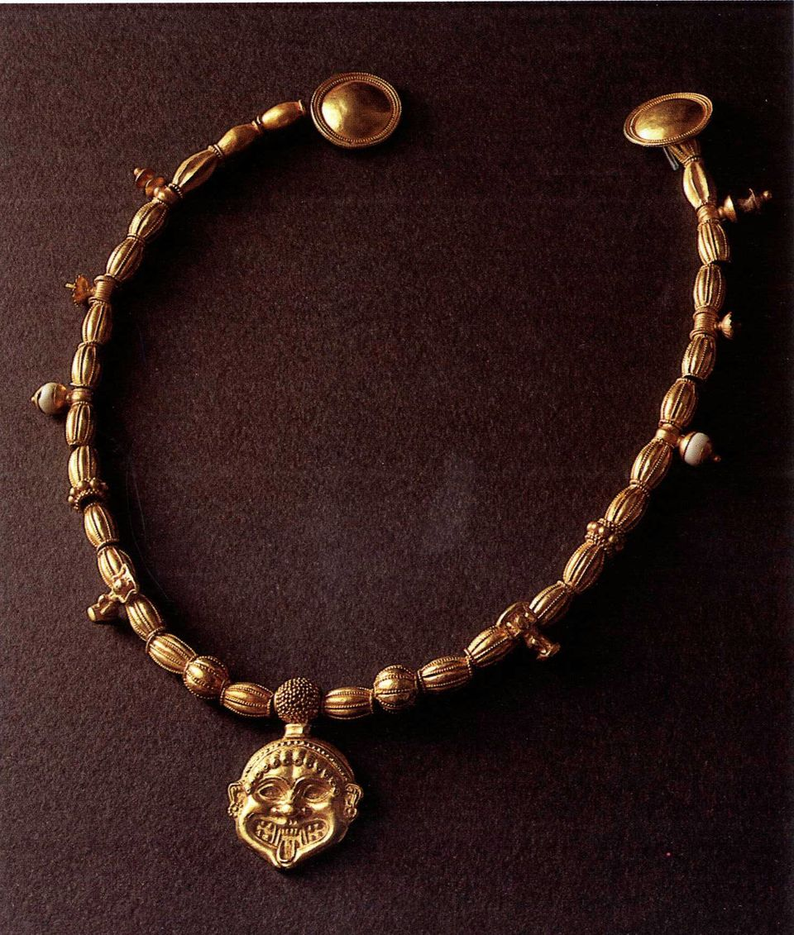
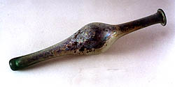
Growth of a Trading Society
Exported:
Timber
Dyes
Silverwork
Slaves
Invented glassblowing

Slide 38
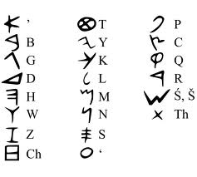
Growth of a Trading Society
Developed own alphabet
22 letters
All consonants
Adopted by others through trade
Made writing easier
Predecessor to Greek alphabet (which is the predecessor to our modern alphabet)

Slide 39
The Ancient Near East: The Hebrews and Judaism

Slide 40
Main Idea
The ancient Hebrews and their religion, Judaism, have been a major influence on Western civilization.

Slide 41
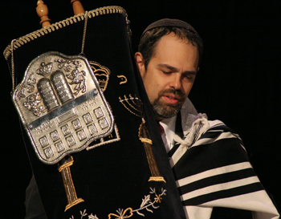
The Early Hebrews
Moved into Fertile Crescent between 2000 and 1500 BCE
Judaism

Slide 42
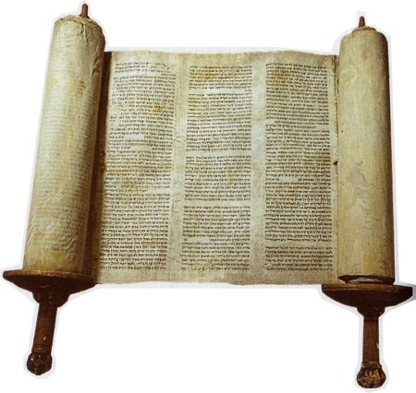
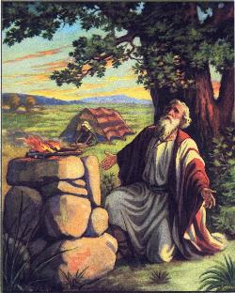
The Hebrew Fathers
The Torah
Five books (first part of the Hebrew Bible)
Most sacred text
Abraham
Formed a covenant with God
Abandoned polytheism for a Promised Land

Slide 43
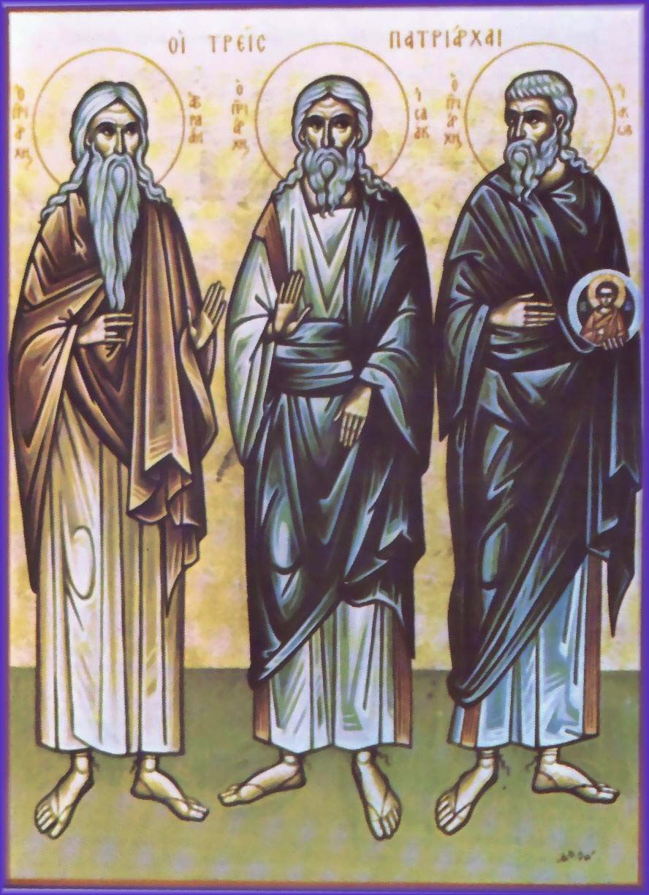
The Hebrew Fathers
Abraham’s descendents formed the Twelve Tribes of Israel
Abraham, Isaac, & Jacob considered the patriarchs

Slide 44
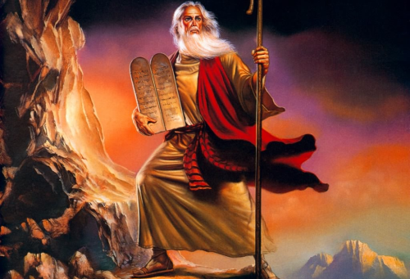
Moses and the Exodus
Slaves in Egypt
Moses
Born Israelite, raised in pharaoh's palace
God told him to lead Israelites out of Egypt
Asked pharaoh for Israelites freedom
***

Slide 45
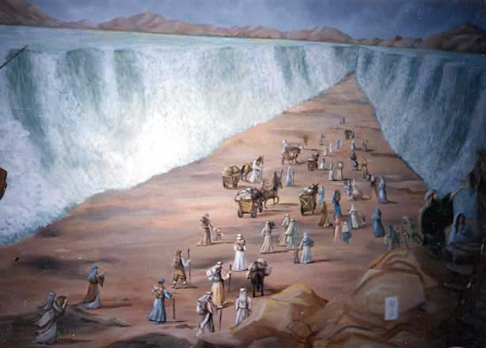
Moses and the Exodus
Exodus
Led the Israelites out of Egypt
Celebrate Passover in remembrance
Wandered the desert for years
Mount Sinai
The 10 moral laws (The Ten Commandments)
Formed a new covenant with God

Slide 46
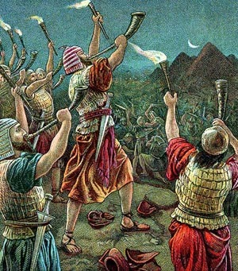
The Kingdom of Israel
Settled in scattered communities
No central government
Chose judges to enforce laws and settle disputes

Slide 47
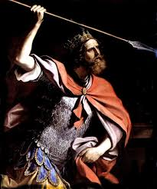
The Kingdom of Israel
Attacked by the Philistines
Saul
Israel’s first king
Chosen for military leadership

Slide 48
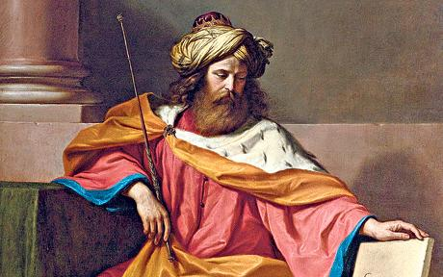
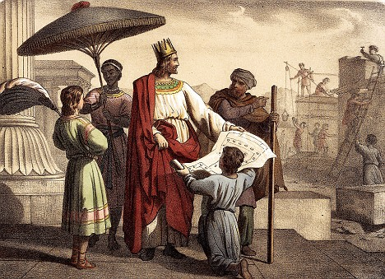
The Kingdom of Israel
David
2nd king
Unified the Twelve Tribes with Jerusalem as the capital
Solomon
David’s son
Kingdom reached the height of its wealth and influence

Slide 49
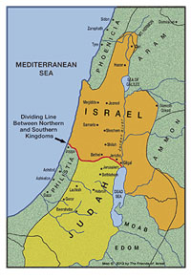
Division and Conquest
Death of Solomon
Ripped into two
Kingdom of Israel
Kingdom of Judah

Slide 50
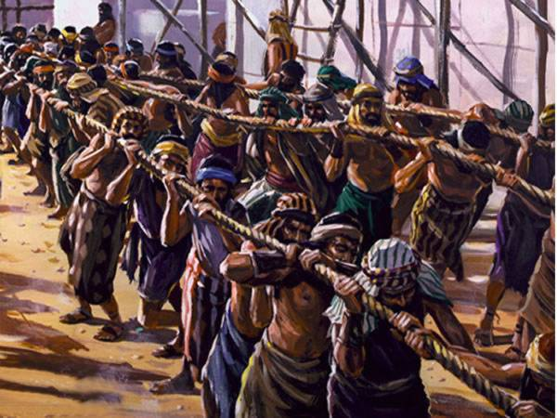
Division and Conquest
Kingdom of Judah
589 BCE – fell to the Chaldeans
Brought to Babylon as slaves
Destroyed Solomon's temple
Kingdom of Israel
722 BCE – fell to the Assyrians
Scattered across their empire
Diaspora

Slide 51
The Teachings of Judaism
Monotheism
Worshipped ONE God (Yahweh)
Possibly the first monotheistic religion

Slide 52
The Teachings of Judaism
Justice and Righteousness
Treat others with kindness and fairness
Do what is right and proper
Strong code of ethics

Slide 53
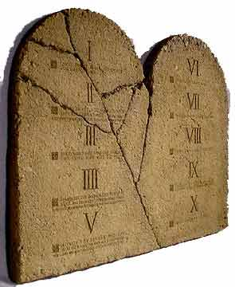
The Teachings of Judaism
Obedience to the Law
The Ten Commandments
Mosaic law
Guides many areas of Jewish life

Slide 54
The Teachings of Judaism
Jewish Sacred Texts
Laws and beliefs recorded in several sacred texts
Torah
Prophets
Contains teachings, writings, lessons, history
Talmud
Explanations and interpretations

