Slide 1
Why Citizenship

Slide 2
Bellwork:
What are some traditions and customs of the United States?

Slide 3
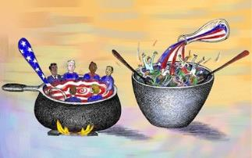
Who are Americans?
The United States is a nation of immigrants.
An immigrant is someone who comes to live in another country
How does being a nation of immigrants affect our traditions and customs?
Melting pot- customs and traditions blended into American society
Salad bowl – retain unique customs
Is diversity in America good or bad?
Despite our differences, there are 3 values we share as Americans
Equality
Liberty
Justice
E pluribus unum – “Out of many, one”

Slide 5
Immigration Policy
1880’s US pass laws limiting immigration
In the 1920’s a broader set of laws were passed.
Quotas established based on nationality
In 1965, a major revision of immigration law occurred. National quotas were abolished for a preference system and a limit of 170,000 visas per year.
The Immigration Act of 1990 sets a total annual quota of immigrants at 675,000
The goal was to increase the number of skilled workers
There were family-sponsored preferences, employee-based preferences, and diversity visa.

Slide 6
Citizenship
A citizen is a legally recognized member of a country.
The Naturalization Act of 1790 declared that “all free white persons” who had immigrated to the United States, had sworn that they wished to reside permanently in the country, and had done so for at least one year “shall be entitled to the rights of citizenship.” However, participatory citizenship was limited to white men that owned land.
Dred Scott v. Stanford (1857) declared that all blacks -- slaves as well as free -- were not and could not become citizens of the United States
In 1868 the 14th amendment was ratified.
In 1920 women got the right to vote

Slide 7
How do you get to be a US citizen?
There are two ways to become a US citizen
Native-born
Naturalization – the legal process by which an alien may become a citizen
To go through the naturalization process, an alien must have a permanent resident card.
The U.S. only allows approximately 675,000 people to obtain green cards.
Once a green card is obtained, legal aliens can work, pay taxes, own property, go to school
They cannot vote, hold political office, or serve on juries

Slide 8
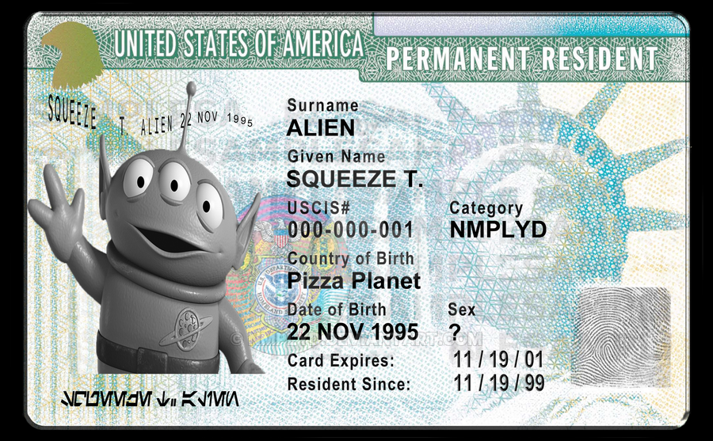

Slide 9
Becoming a citizen: Native-born
Amendment XIV, Section 1, Clause 1
“ All persons born or naturalized in the United States, and subject to the jurisdiction thereof, are citizens of the United States and of the State wherein they reside.”
You are native-born if you were born in the United States, District of Columbia, a territory of the United States, or in a U.S. military base overseas
Born overseas yet two parents are a United States citizen and at least 1 has lived in the U.S. at one time
Born abroad and at least one parent is a US citizen that lived in the US 5 years before you were born
You are NOT a citizen if you are born in the US and your parents are foreign ambassadors or diplomats
Born outside of US

Slide 10
Becoming a citizen
An immigrant who comes to the United States is an alien.
To become a legal alien, the immigrant must go through the naturalization process.
To apply for naturalization you must have a permanent resident card and reside in the US for a certain number of years
This process includes:
1. Prepare to apply by getting a permanent visa and determine eligibility
2. Apply. This includes getting a passport photo, completing an application, and paying a filing fee.
3. Get fingerprinted
4. Interview – this includes a civics and English test
5. Take the oath of allegiance

Slide 12
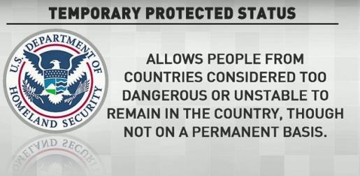
Becoming a citizen
Illegal Immigrants
Lack legal immigration documents
Immigration Reform and Control Act of 1986 legalized undocumented residents that met certain requirements.
Refugees
Refugees are usually fleeing persecution, wars, political conflicts and other crises.
Year quotas are set

Slide 13
Citizen or Not
Camille was born while her French parents were vacationing in Chicago.
Carlos was born in Puerto Rico of Spanish citizens who were visiting relatives.
Terry’s American parents were working and living in Greece when he was born.
Ingrid was born in Washington, DC, where her father was serving as diplomats for Denmark.
Sam was born on the US military base at Okinawa, Japan to parents that are Japanese citizens.

Slide 14
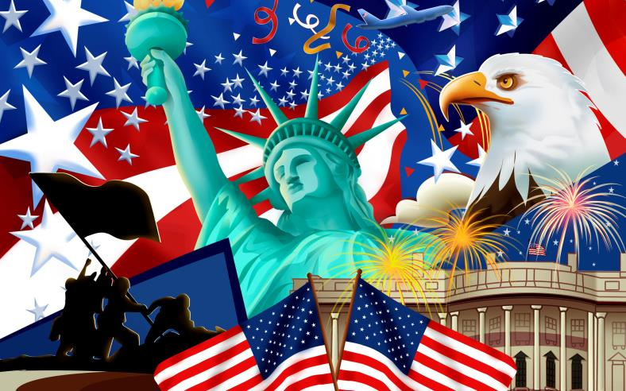
American People Today

Slide 15
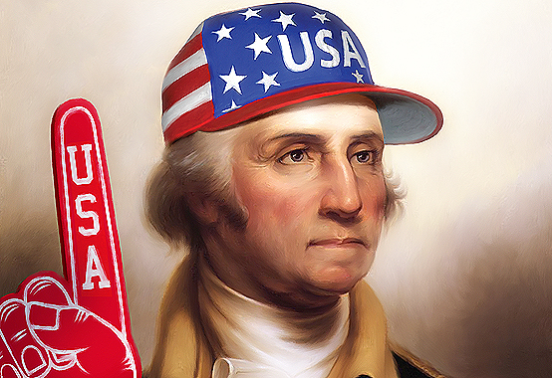
Bellwork
Should Natural Born citizens have to take a test in order to have full citizenship? Why or why not?

Slide 16
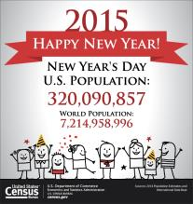
The Census
Census – an official, periodic counting of a population.
US census is taken every ten years.
Census information is used mainly to find out how many people live in each state.
Tracks the number of people who live in an area and shows the rate at which the population is growing or shrinking
Affects US Congress
Census also collects demographic information

Slide 17
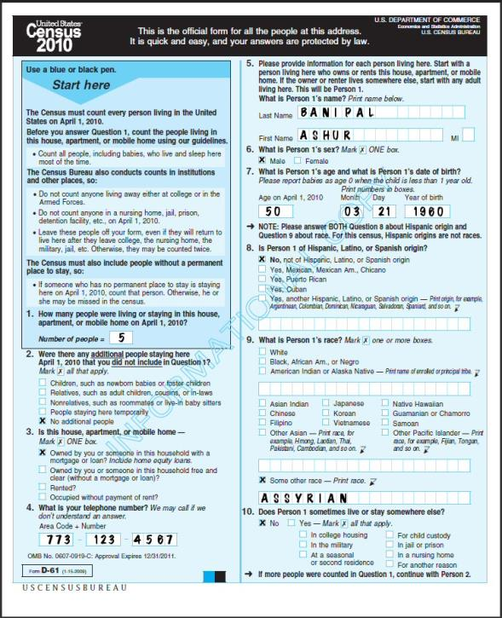

Slide 18
Population Changes
Natural increase in population
Naturally increases when birthrate is greater than death rate
Birthrate: annual number of live births per 1000
Death rate: annual number of deaths per 1000
Changing households
Changing women’s roles
An older population
More diverse population

Slide 19
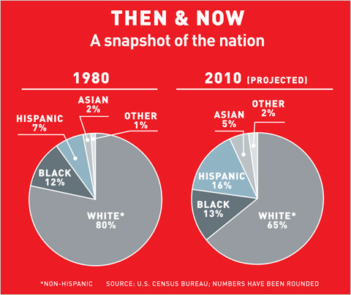

Slide 20
The duties and responsibilities of a citizen

Slide 21
Rights
Rights are guaranteed by the laws and Constitution of the United States.
Rights include:
Freedom to express yourself.
Freedom to worship as you wish.
Right to a prompt, fair trial by jury.
Right to vote in elections for public officials.
Right to apply for federal employment requiring U.S. citizenship.
Right to run for elected office.
Freedom to pursue “life, liberty, and the pursuit of happiness.

Slide 22
Duties of Citizenship
In return for having the privileges of a citizen, there are certain duties a citizen must do.
These duties are crucial to making our democratic government work.
Duties are things that citizens are required to do by law.
Duties include:
Paying taxes
Attend school
Obey laws
Selective service
http://www.sss.gov/PDFs/WhoMustRegisterchart.pdf
Jury duty

Slide 23
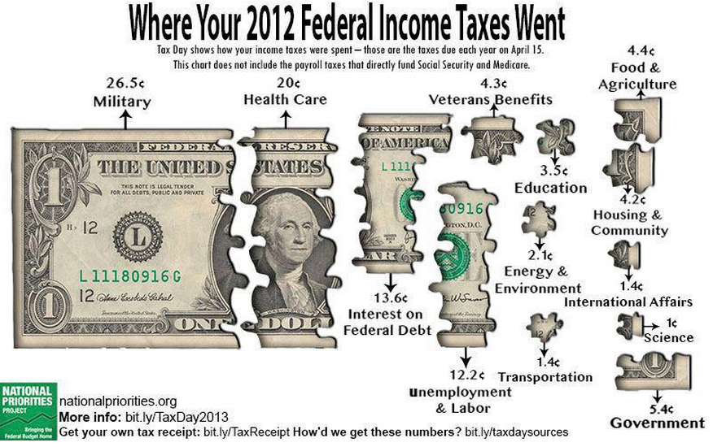

Slide 24
Responsibilities
Responsibilities are things citizens should do, but are NOT required to do.
These include
Voting
Volunteering
Being informed
Community activism
Protecting and respecting other’s rights
An increase in the level of citizen participation results in a more representative government.

Slide 25
Suffrage
The ability to vote is one of the most important responsibilities as a citizen.
However, equal voting rights have not always existed.
15th Amendment: Gave African-American males the right to vote
19th Amendment: Gave women the right to vote
24th Amendment: Cannot condition the right to vote on payment of poll tax
26th Amendment: prohibits states and federal government from raising the voting age over 18

Slide 26
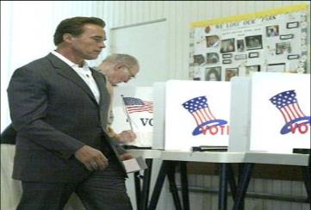
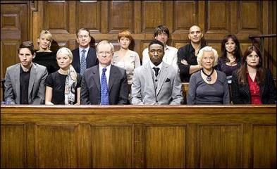
Costs and Benefits of Civic Participation
Civic Participation | Costs | Benefits
1. Jury Duty | Time, Money, Pressure, Emotional Guilt, Personal Threats | Ensures fair trials for everyone; judicial system works; justice for people, victims, society
2. Voting | Time, Energy | Get voice out, give consent to government, country functions as it was intended to

Slide 27
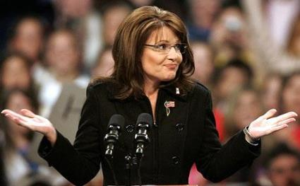
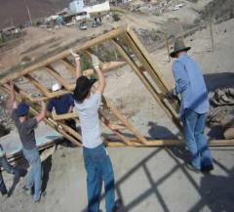
Costs and Benefits of Civic Participation
Civic Participation | Costs | Benefits
3. Seeking/Running for Office | Time, Energy, Money, Loss of Privacy, Personal Attacks | Changing society, helping people, getting your voice heard, inspiration
4. Volunteerism | Time, No Pay | Helping out others/community, satisfaction of helping, making positive difference, save government $$$ = less taxes

Slide 28
Responsibilities
Civic responsibilities vs. Personal responsibilities
Things you personally have an obligation to do
Personal responsibilities include:
Fiscal
Time
Moral
Civil rights movement of the 1960s: Legal and moral responsibilities conflicted.

Slide 29
Common Good
Although we are granted certain rights as citizens of the United States, sometimes citizens’ personal desires, interests, and involvement are subordinate to the good of the nation.
USA Patriot Act
Uniting and Strengthening America by Providing Appropriate Tools Required to Intercept and Obstruct Terrorism Act of 2001
Sedition
Eminent Domain

