Slide 1
Ancient Greece:
Early Greece

Slide 2
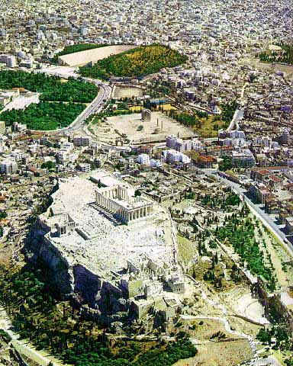
Greek City-States
Polis (city-state)
Basic political unit of Greece
Developed independently
Own government
Own laws
Own customs

Slide 3
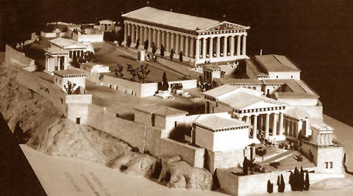
Life in the Polis
Center of daily life and culture
Loyal to their polis
Corinth
Athens
Sparta

Slide 4
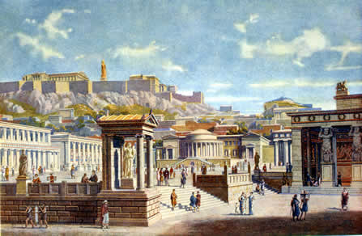
Life in the Polis
Acropolis
high area in center – fortifications
Agora
Marketplace
Houses, Shops, Temples, Recreation
Defensive wall

Slide 5
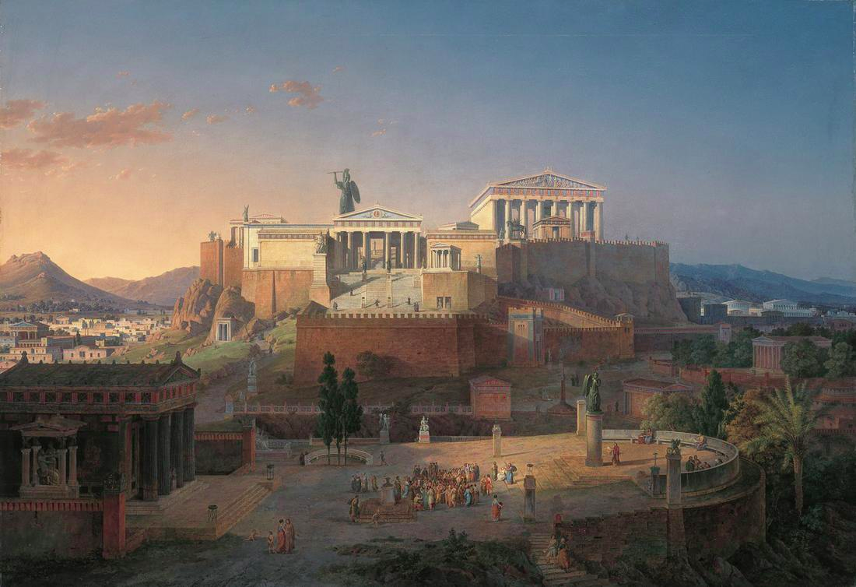

Slide 6
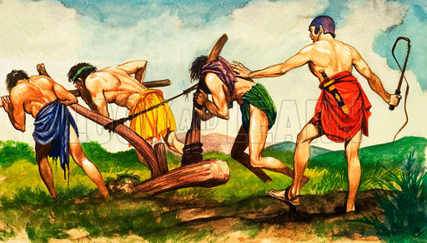
The Might of Sparta
One of the mightiest city-states
Seized control of surrounding towns
Helots (state slaves)
Outnumbered Spartans 7:1

Slide 7
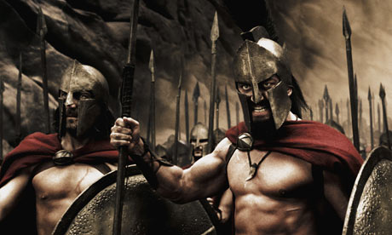
The Might of Sparta
Fighting = order in society
Kept helots in check
Harsh lifestyle
Trained from birth

Slide 8
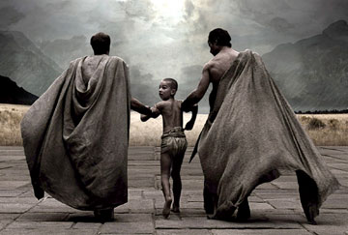
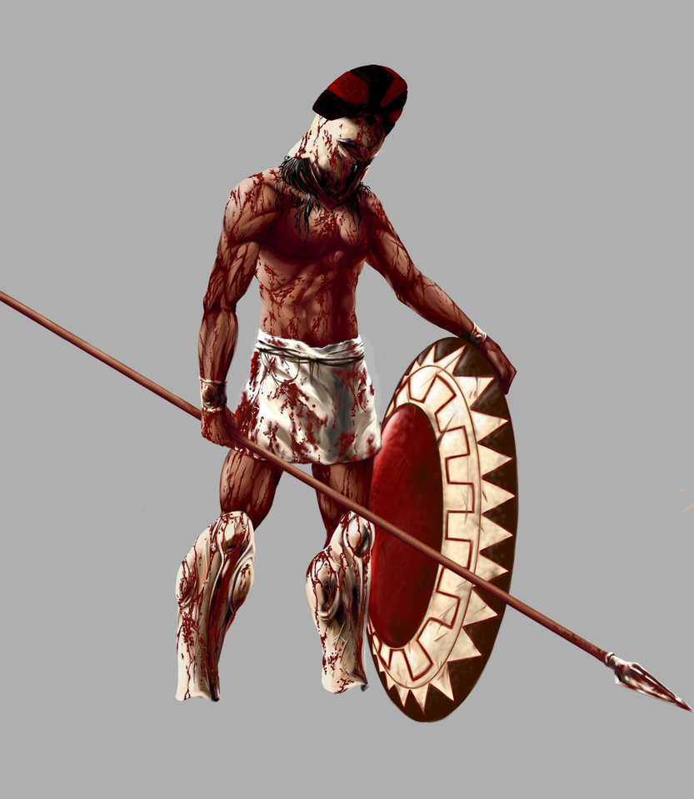
The Might of Sparta
Birth – Age 6: Taught physical and mental toughness from mother
Age 7: Combat school
Age 20: Hoplites (foot soldiers)
Age 30: Became citizens

Slide 9
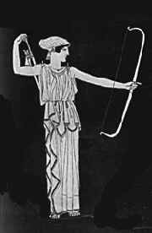
Spartan Women
Very important in society
Trained in gymnastics
Fit to bear strong children
Could own property

Slide 10
Ancient Greece:
The Classical Age

Slide 11
Main Idea
The Classical Age of ancient Greece was marked by great achievements, including the development of democracy, and by ferocious wars.

Slide 12
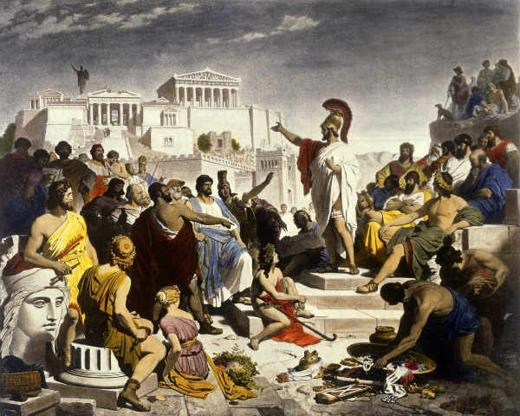
Athenian Democracy
World’s first democracy
Gov’t run by the people
Developed around 500 BCE

Slide 13
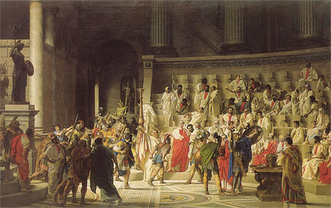
The Development of Democracy
Developed slowly over centuries
Kings -> Aristocrats -> Democracy

Slide 14
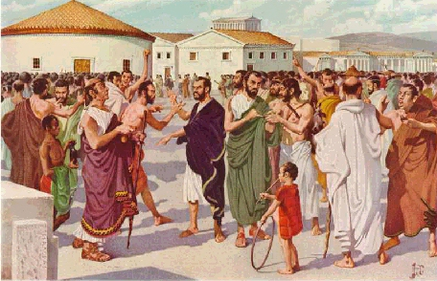
The Development of Democracy
Most subjects poor
Gap between rich & poor = conflict

Slide 15
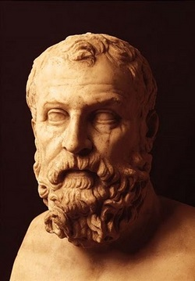
The Development of Democracy
Official named Draco reformed city laws
Used harsh punishments
Made things worse
Draconian

Slide 16
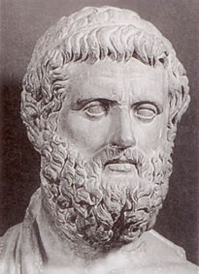
The Development of Democracy
Solon
590s BCE - Revised Draco’s laws
All men could:
Take part of the assembly
Serve on juries
Only wealthy could run for office

Slide 17
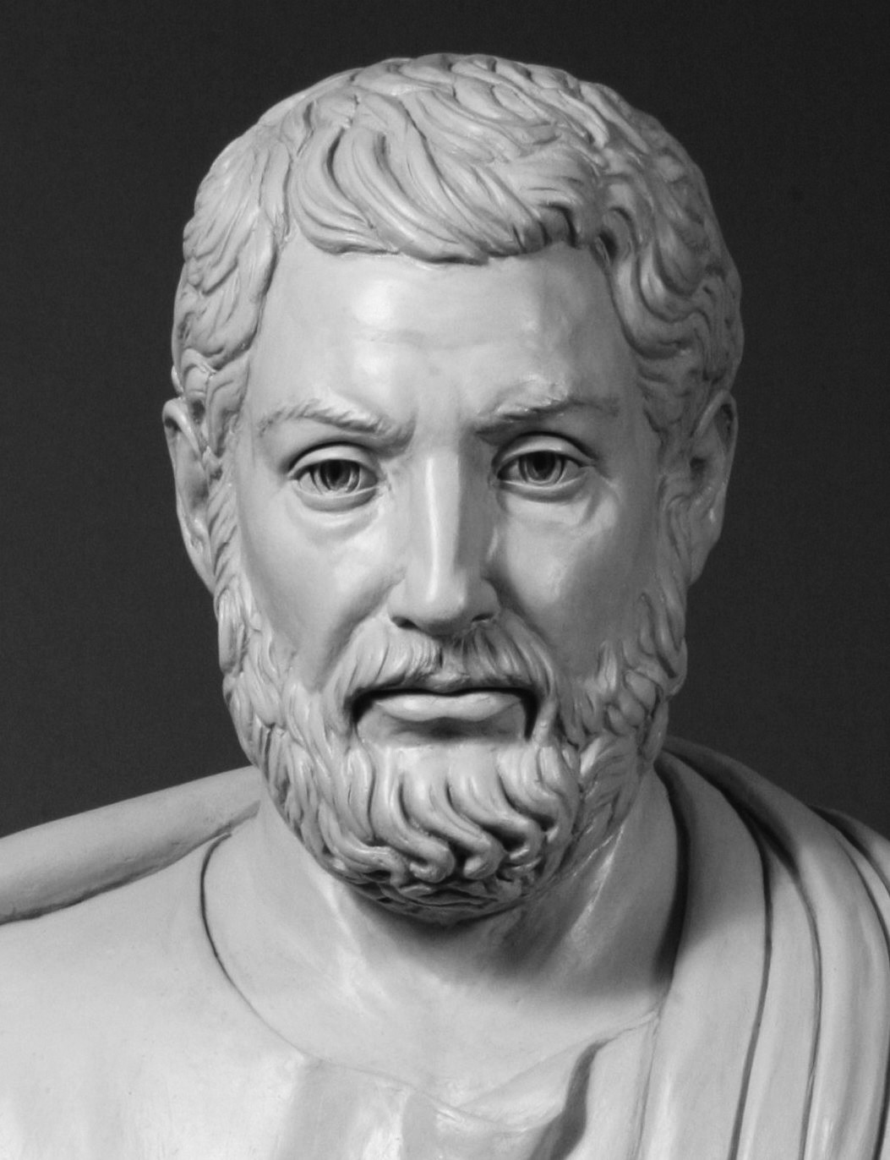
The Development of Democracy
Cleisthenes
Divided Athens into 10 Tribes, based on location
Made new groups basis for elections
Each elected one general to lead army
Each elected 50 men to serve on Council

Slide 18
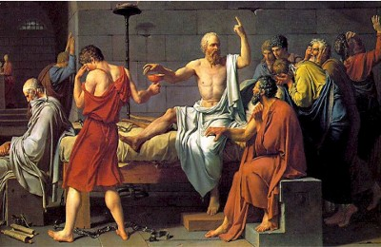
The Nature of Athenian Democracy
Allowed to vote:
Free males
Over age 20
Completed military training
Women, children, and immigrants had no vote

Slide 19
The Nature of Athenian Democracy
Had to:
Vote in all elections
Serve in office if elected
Serve on juries
Serve in military during war

Slide 20
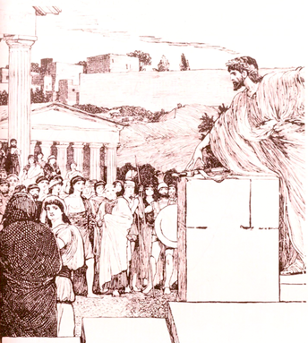
The Three Bodies of Athenian Democracy
Assembly
All people eligible for government
Made laws
Direct democracy

Slide 21
The Three Bodies of Athenian Democracy
Council of 500
Write the laws
Then voted on by the assembly

Slide 22
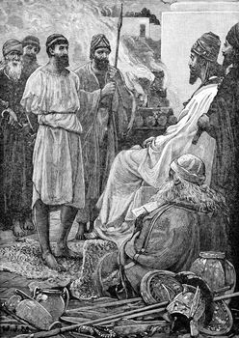
The Three Bodies of Athenian Democracy
Court system
Heard trials
Sentenced criminals
Chosen from the assembly

Slide 23
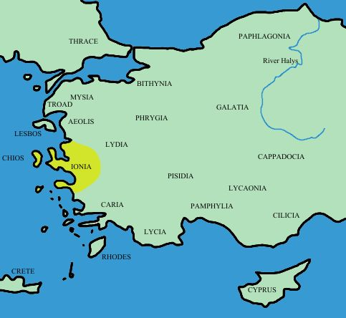
Causes of the Persian Wars
Ionia (Greek colony)
Fell under Persian rule
Rebelled
Asked Greece for help
Persians wanted to seek revenge against Ionia’s allies

Slide 24
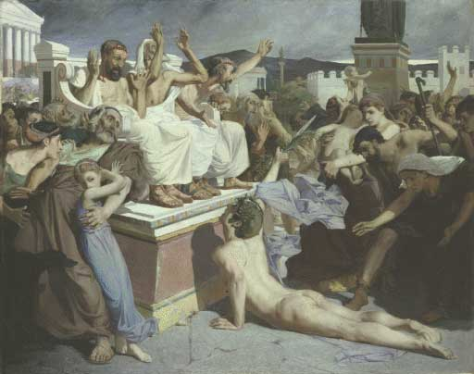
The Persian Invasions
490 BCE – First Persian Invasion
Battle of Marathon
Persians retreated
Athenian messenger ran to Athens

Slide 25
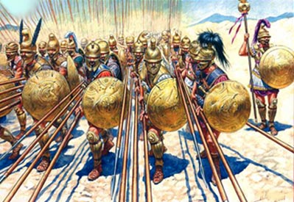
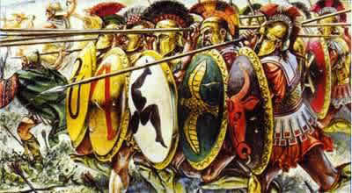
The Persian Invasions
Phalanx
Tight formation
Wall of shields
Shoulder to shoulder

Slide 26
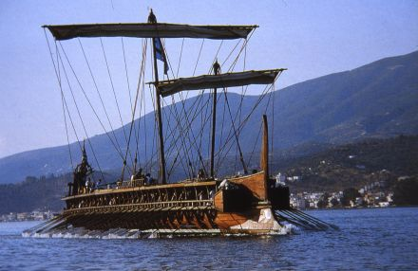
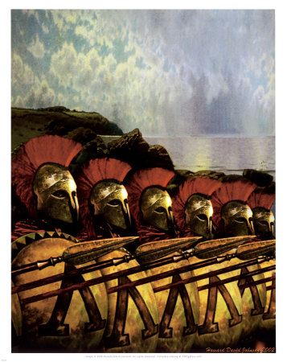
The Persian Invasions
480 BCE – Second Persian Invasion
Athens allied with Sparta
Athenian navy
Spartan army

Slide 27
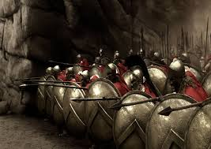
The Persian Invasions
Battle at Thermopylae
Small band of Spartan warriors
Hoped to slow down Persians

Slide 28
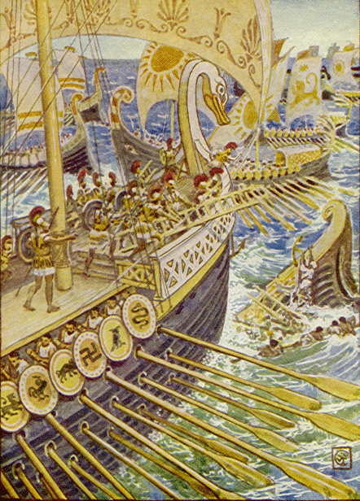
The Persian Invasions
Lured Persian fleet into Straight of Salamis
Large ships – couldn’t maneuver as well
Cut down by the Greeks
Changed the nature of the war
Persians stuck in Greece
Forced to agree to peace

Slide 29
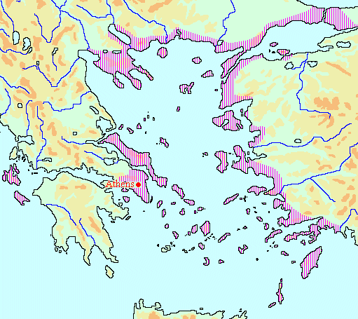
The Golden Age of Athens
City-states form Delian League
Alliance of “equals”
Athens actually in charge
Athens grows in power
League members grow unhappy

Slide 30
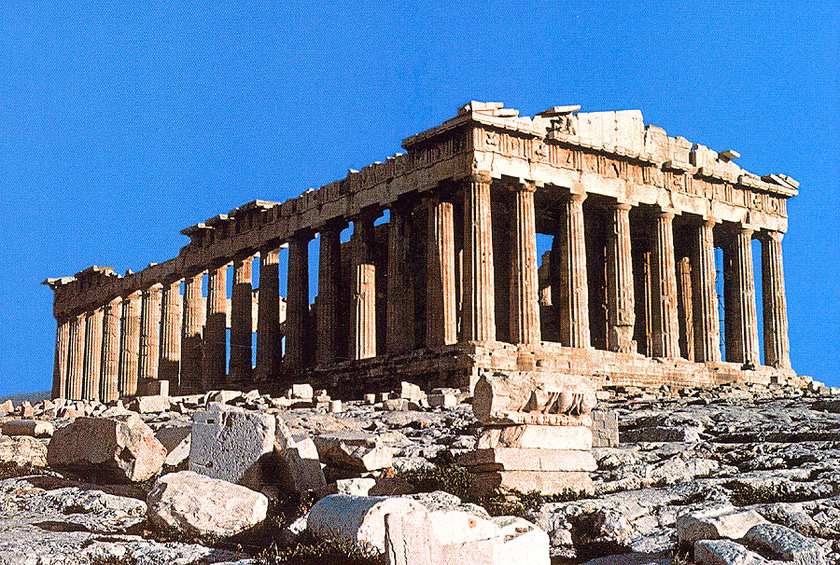
The Golden Age of Athens
Rebuilt Athens after Persian war
Funded by Delian League
Rebuilt acropolis
The Parthenon

Slide 31
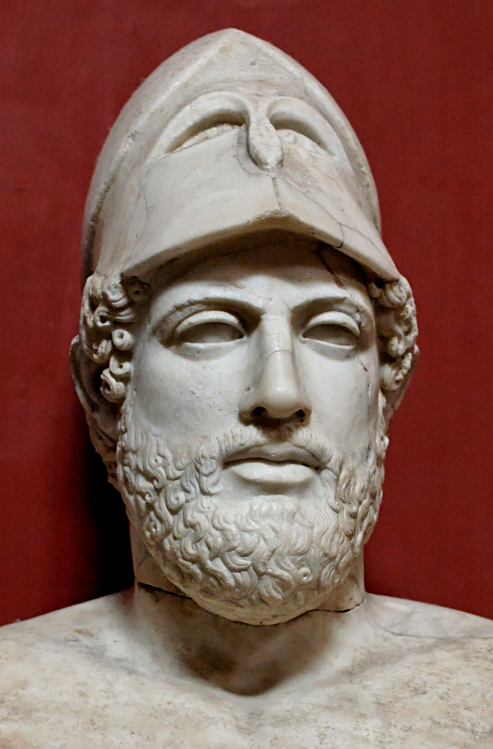
The Golden Age of Athens
Pericles
Elected general
Champion of democracy
Payment to participate
Spread democracy to other parts of Greece

Slide 32
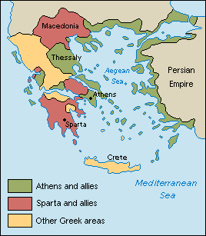
The Peloponnesian League
Sparta head of league
Tension between the two leagues
Athens & Sparta declare war

Slide 33
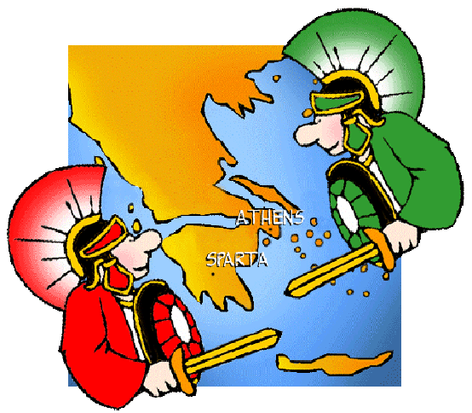
The Peloponnesian War
Beginning – neither side had an advantage
Sparta dominated land, Athens the sea

Slide 34
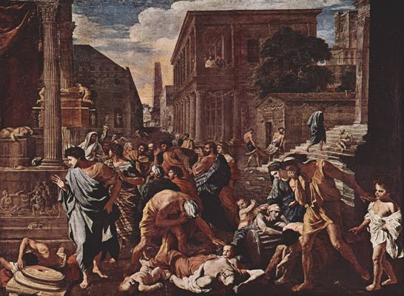
The Peloponnesian War
430 BCE – Plague strikes Athens
Sparta destroys Athenian fleet
Athens left in shambles

Slide 35
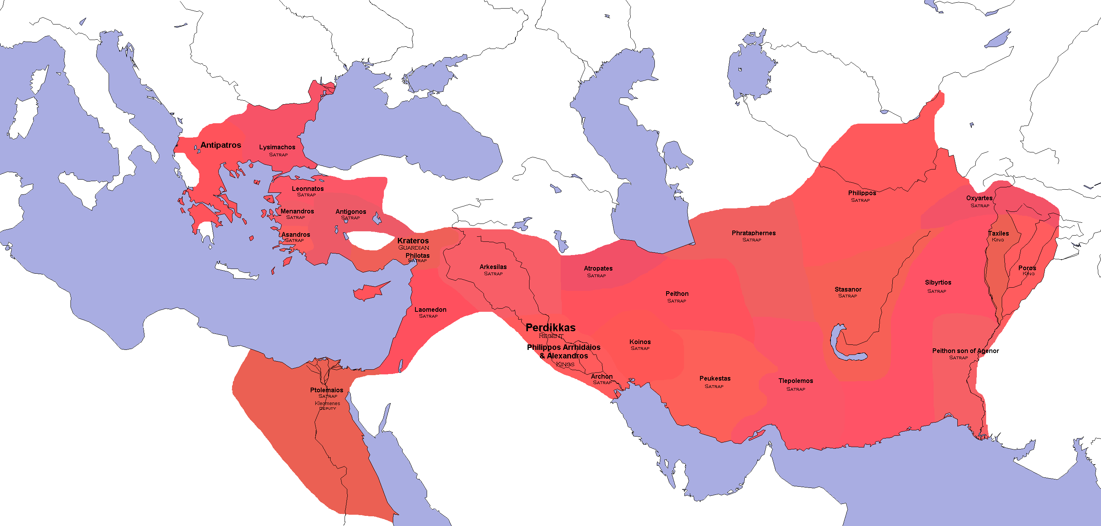
The Peloponnesian War
Sparta attempts to dominate Greece
Still strained from war with Athens
Thebes defeats Sparta
Long cycle of warfare
340 BCE – Macedonia controls all of Greece

