Slide 1
Nile Civilizations:
The Kingdom of Egypt

Slide 2
Main Idea
Egypt was one of the most stable and long lasting civilizations of the ancient world.

Slide 3
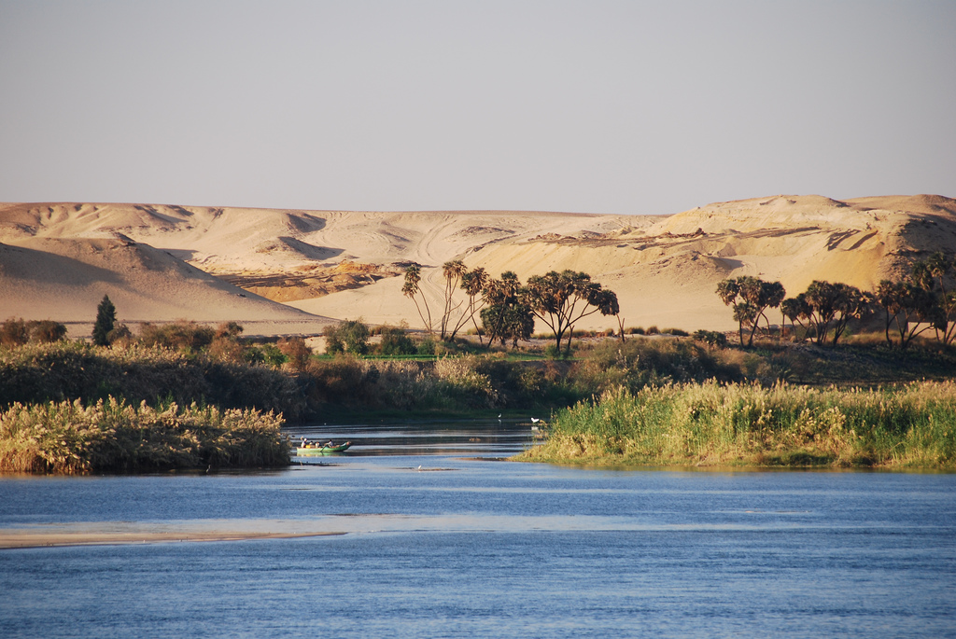
Geography
Nile River
Longest river in the world
4,000 miles
Flows through the Sahara desert
Floods every year

Slide 4
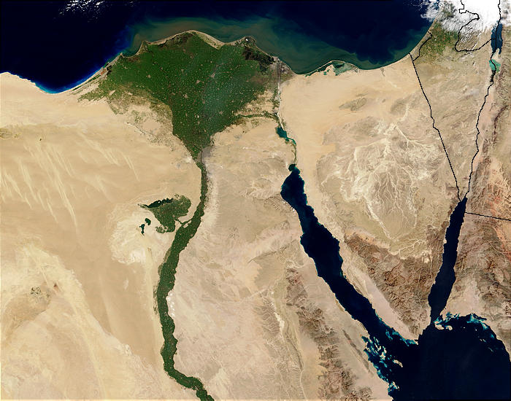
Geography
Floods predictable
Narrow band of fertile soil
Rich black silt
Nile Delta

Slide 5
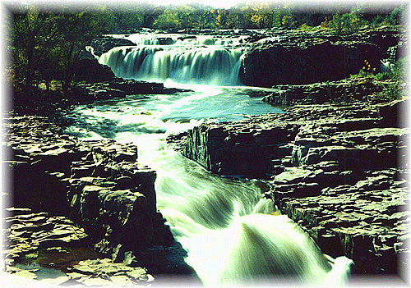
Geography
“Black land” & “Red land”
Sahara & Nile natural barriers
Difficult to invade
Cataracts

Slide 6
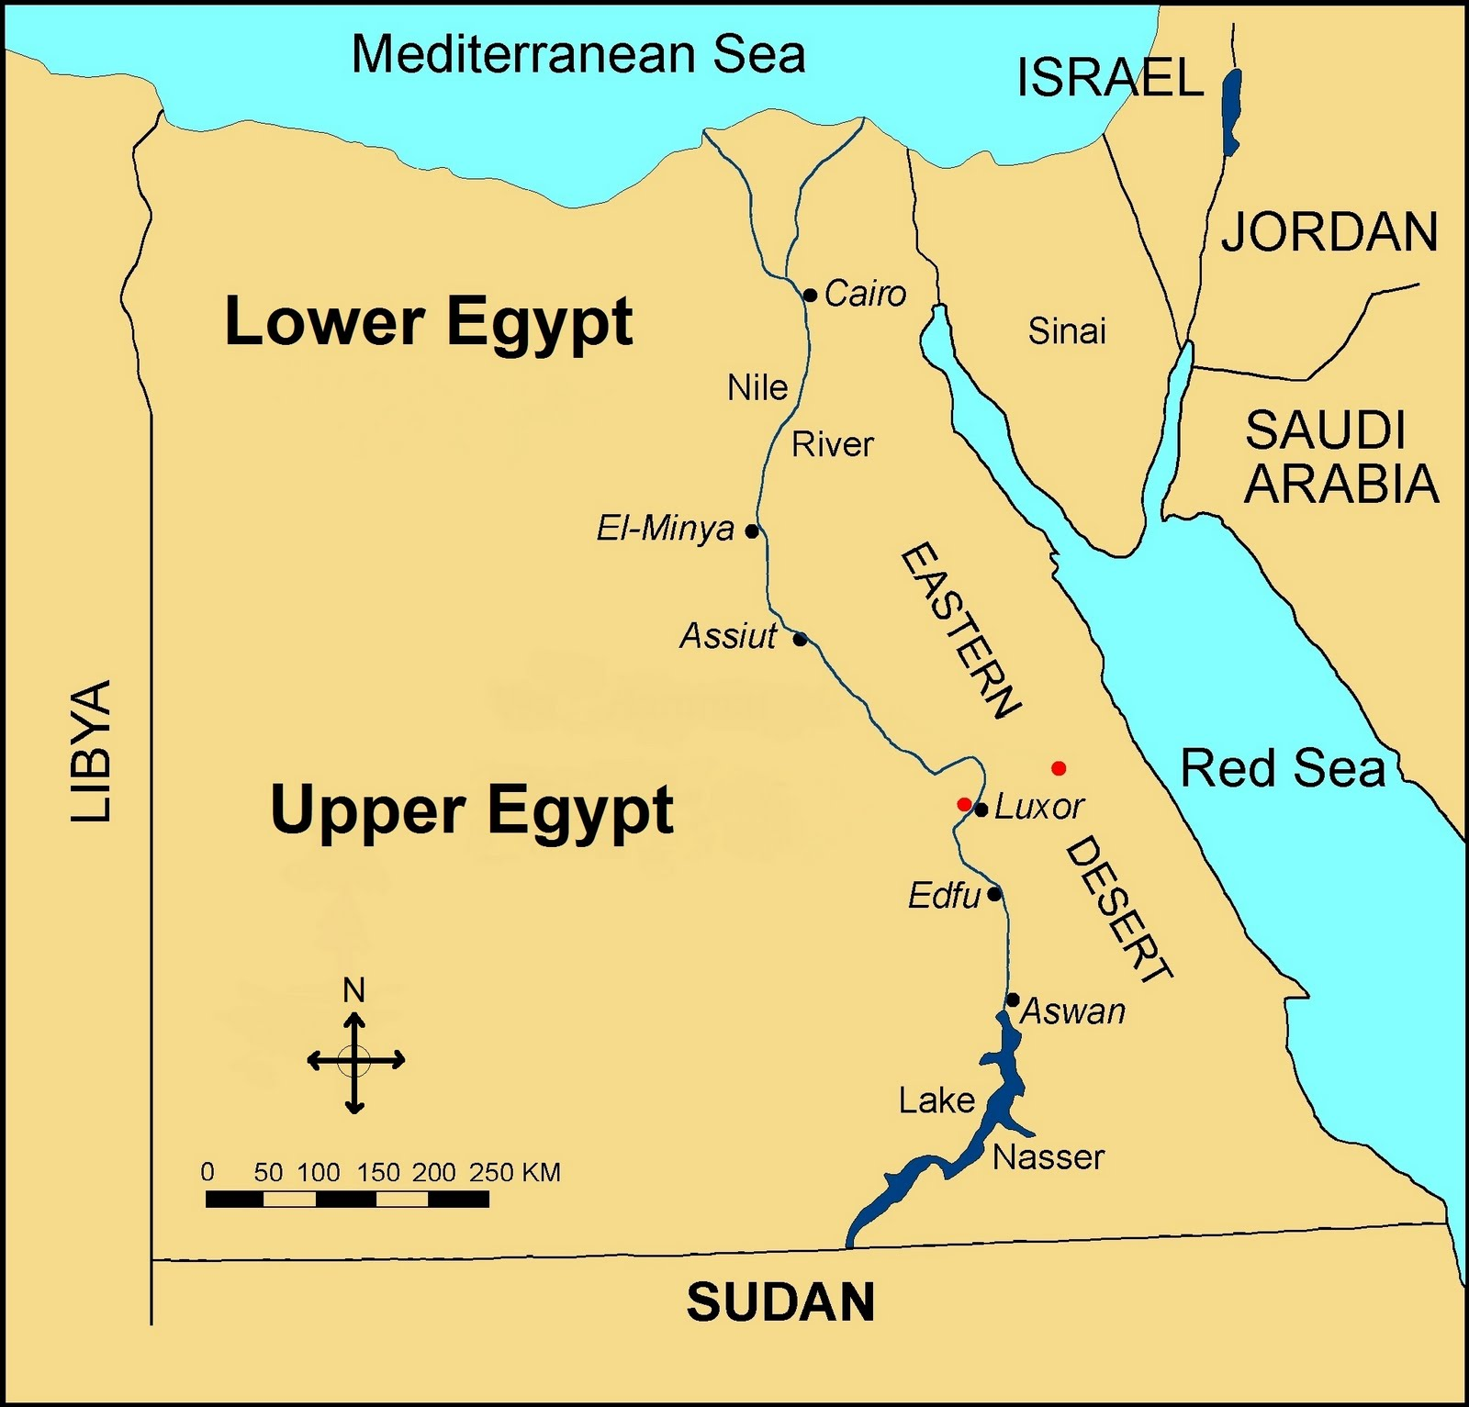
Two Kingdoms
5000 BCE – first farming villages
Consolidated into 2 kingdoms
Different dialects & customs
Lower Egypt (northern kingdom)
Upper Egypt (south of the delta)

Slide 7
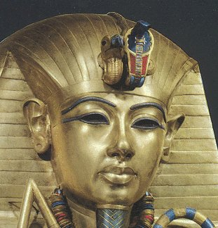
Unification
3100 BCE – 2 kingdoms unified
Menes
Ruler from Upper Egypt conquered the north
Adopted symbols of both
Vulture & Cobra
Red & White crown
Egypt’s first dynasty

Slide 8
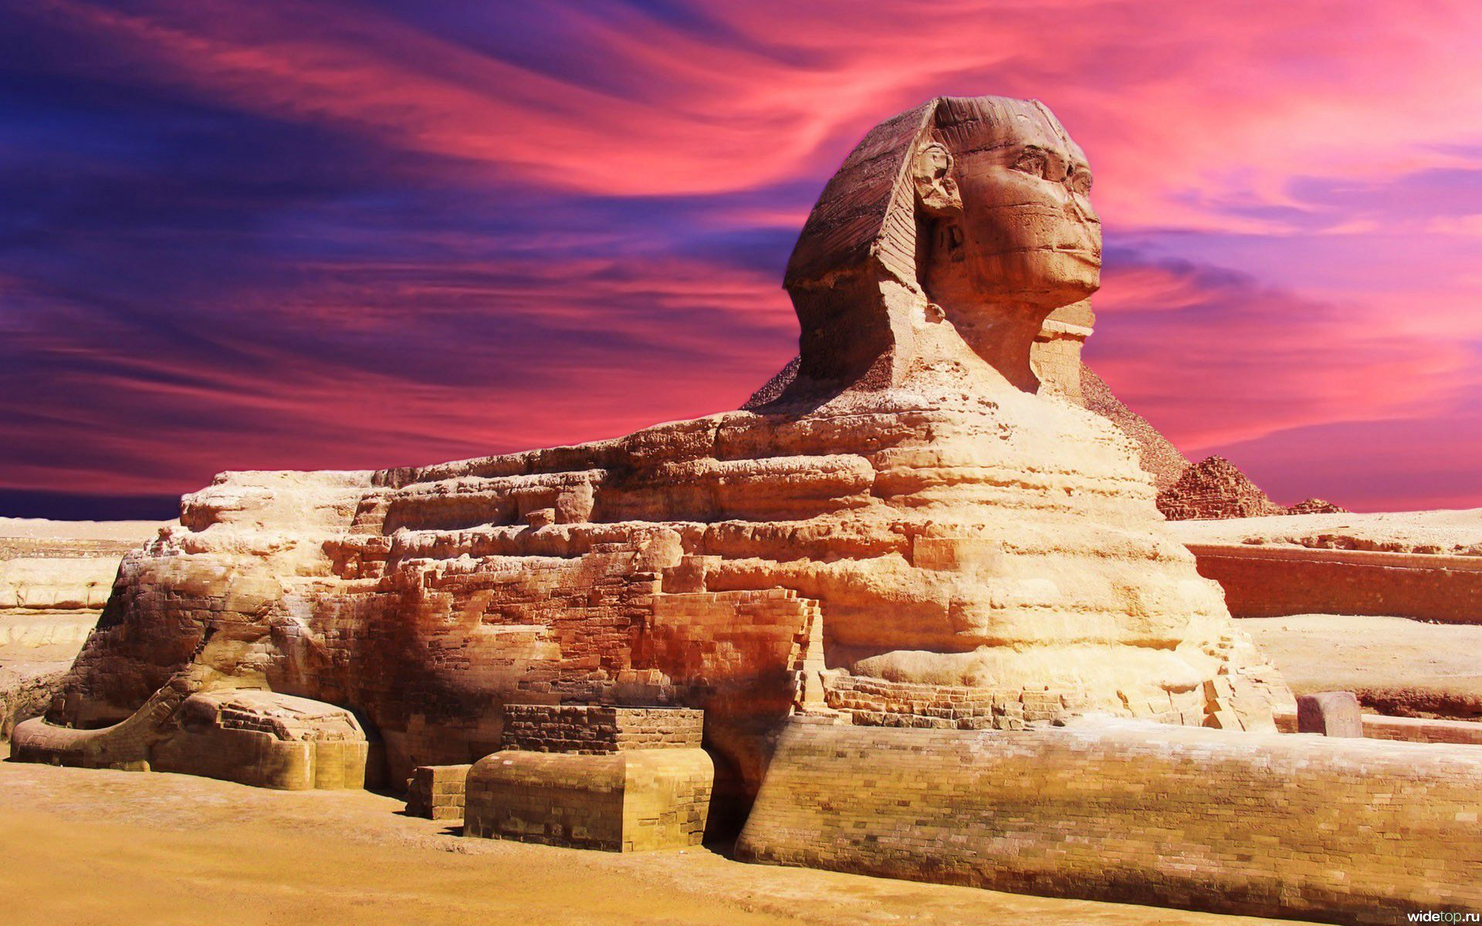
The Old Kingdom
2650 BCE
Rise of the Third dynasty
Stable
Lasted 500 years

Slide 9
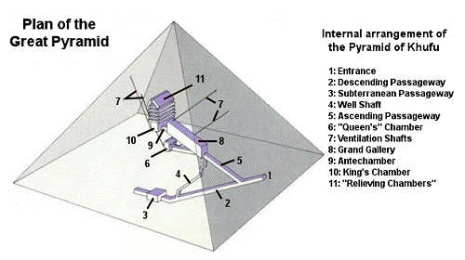
The Pyramids
Most built during Old Kingdom
Pyramids of Giza
Built as tombs for kings
Hollow chambers inside or below
Deadly traps

Slide 10
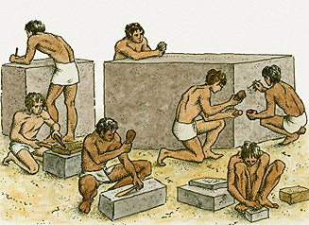
The Pyramids
Designs change over time
Great deal of planning and skill
Long to construct
Built from inside out
Built by peasants & slaves

Slide 11
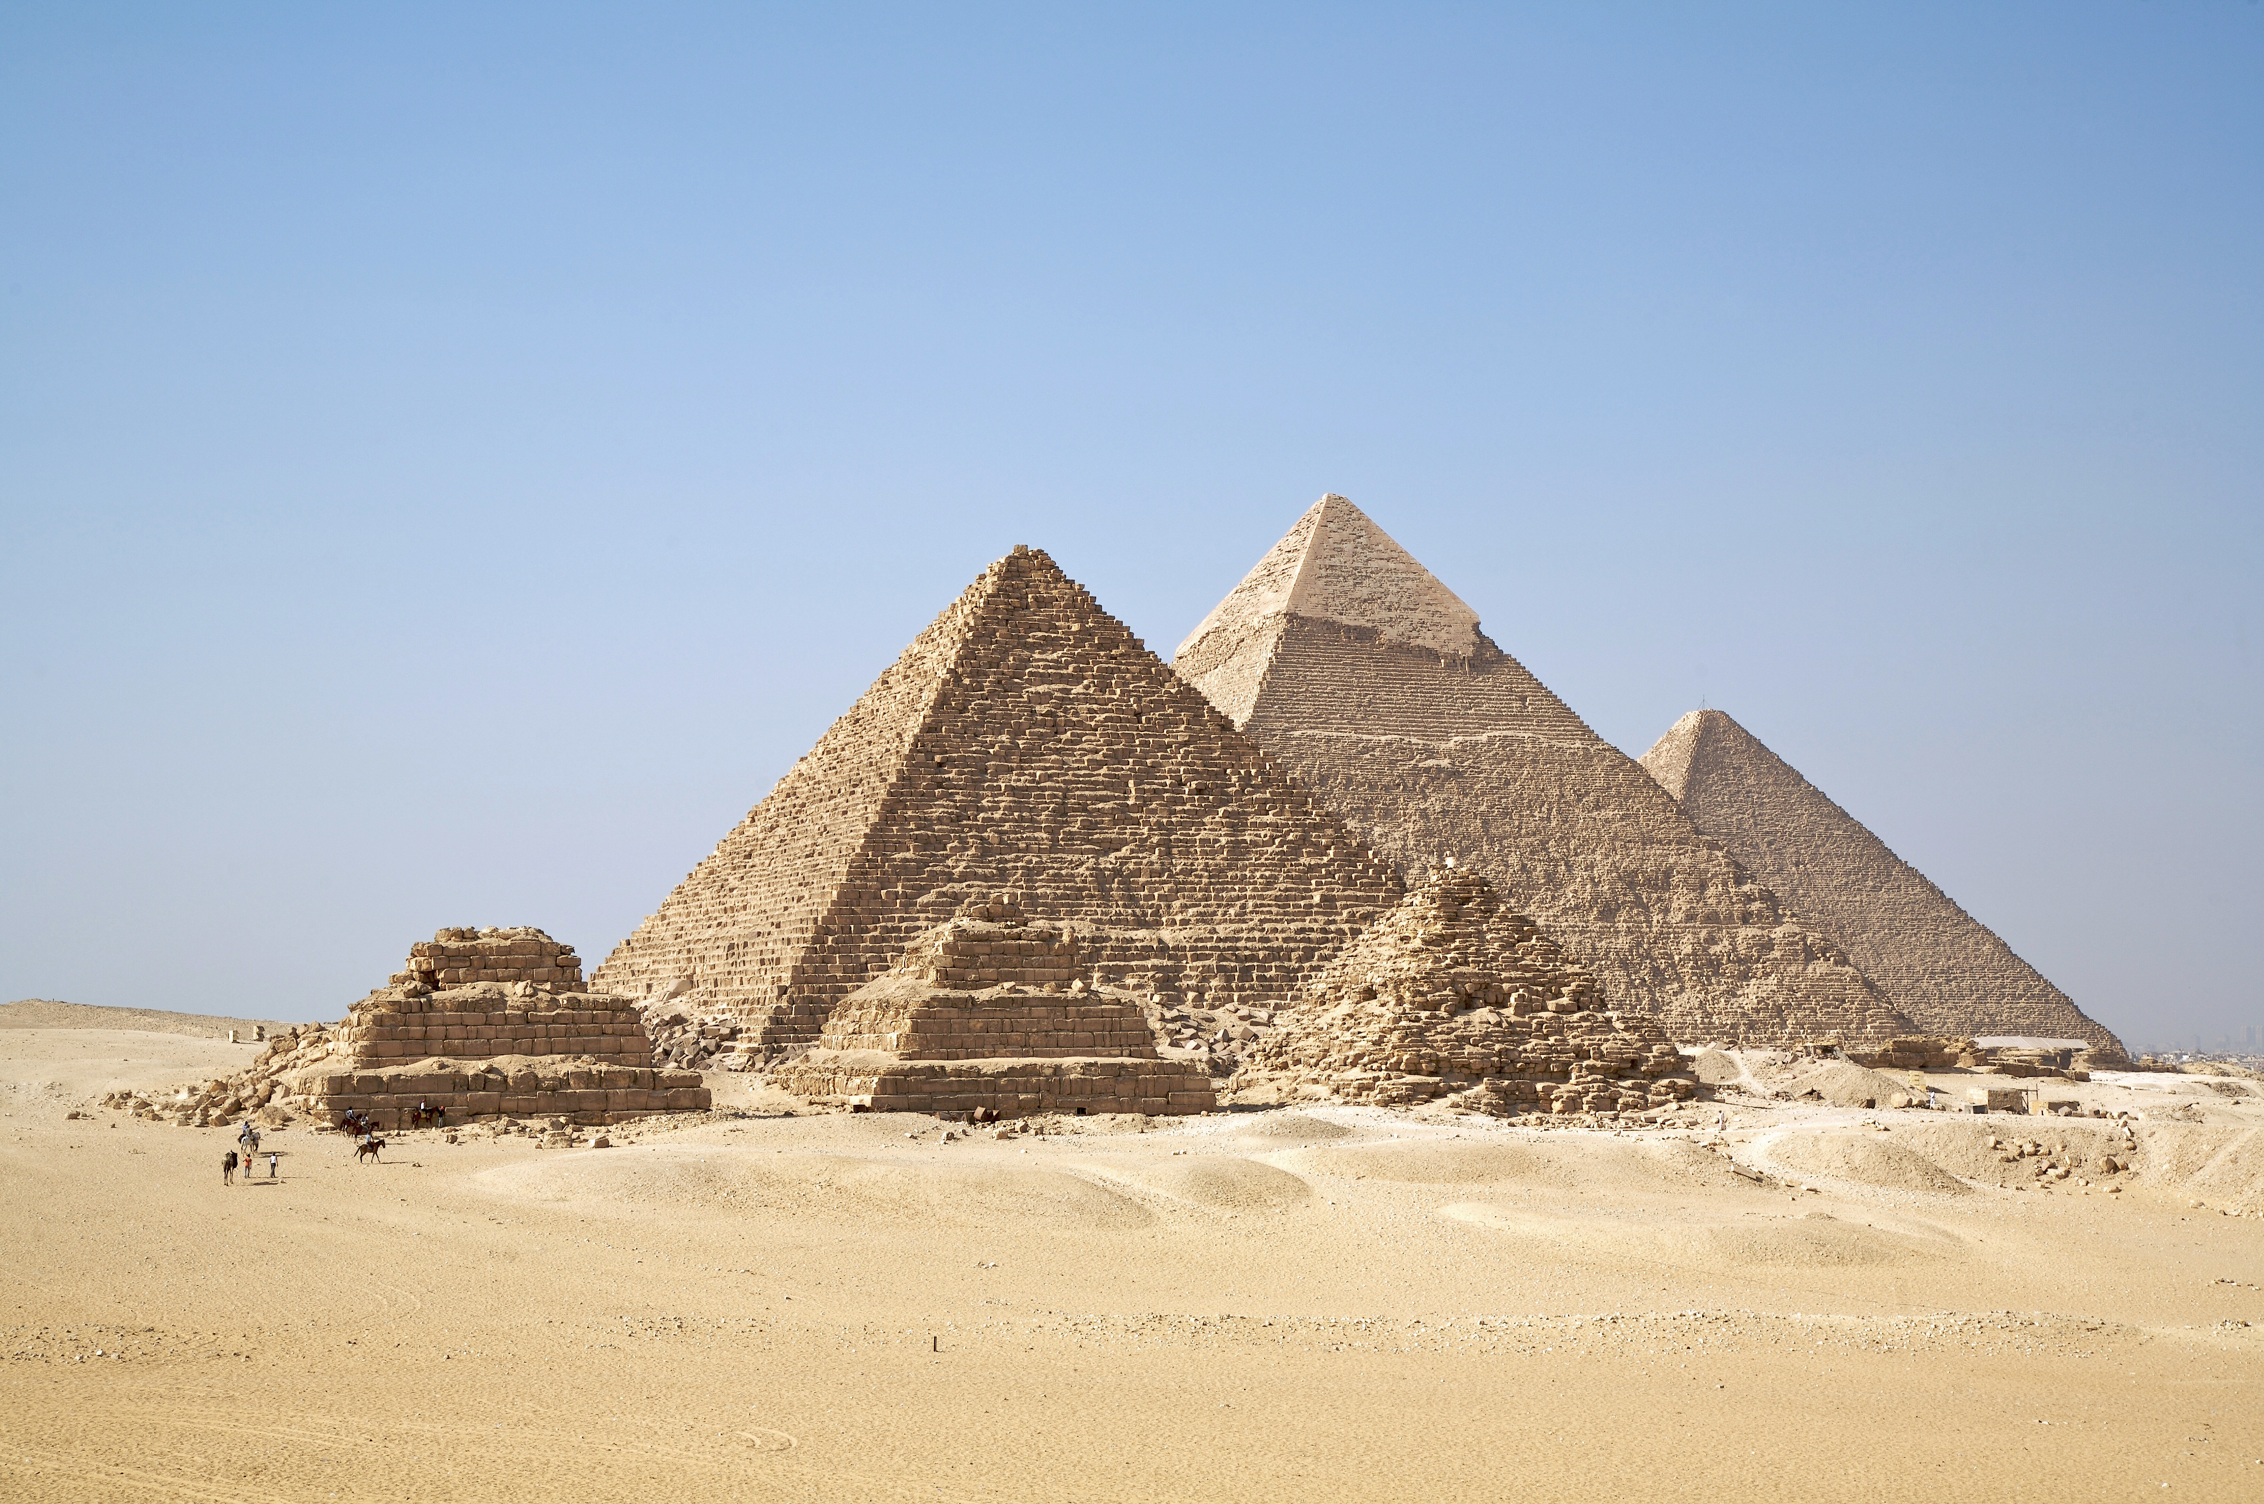

Slide 12
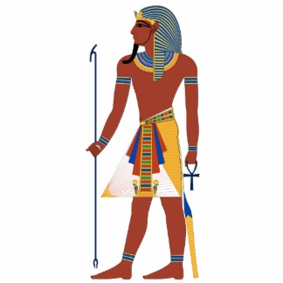
The Pharaohs
Pharaoh – “great house”
Absolute power
Owned all the land
Word was law
Leader of army

Slide 13
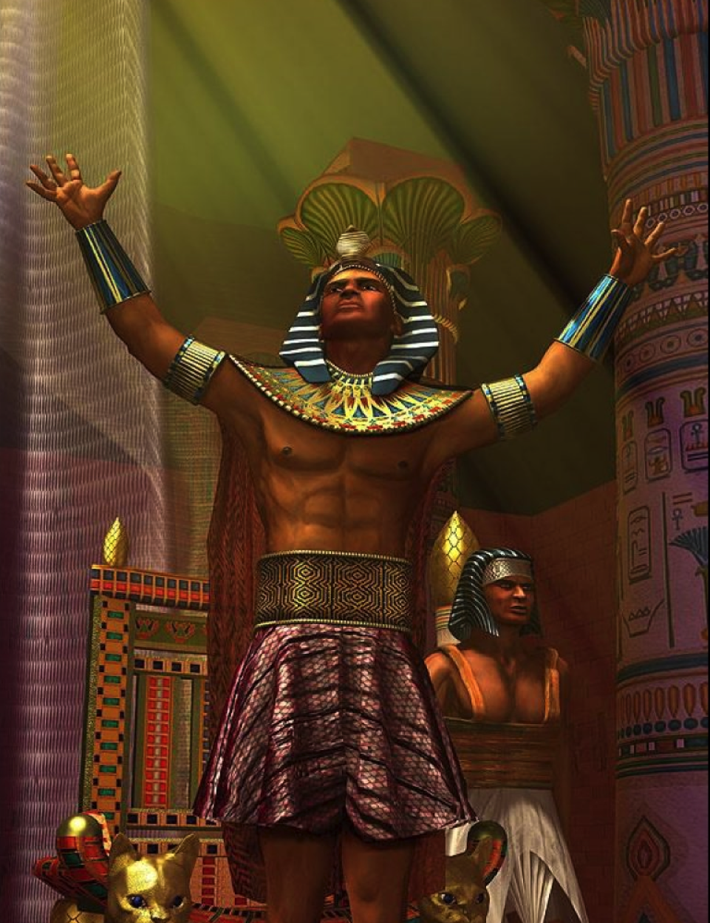
The Pharaohs
Believed pharaoh was a god in human form
Responsible for Egypt’s prosperity
Sun would rise
Nile would flood
Theocracy

Slide 14
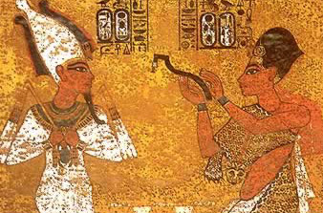
Egyptian Bureaucracy
Kingdom to big to rule alone
Bureaucracy
Mostly relatives of pharaoh
Acted on will of pharaoh
Quite powerful
Vizier

Slide 15
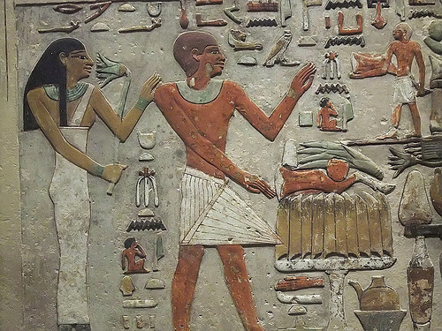
The Middle Kingdom
Pharaohs lose power
Local nobles take control
Order and stability disappear
Economic problems, invasions, & civil wars
Famine & disease

Slide 16
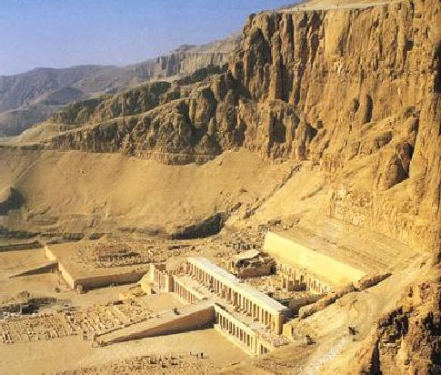
The Middle Kingdom
2055 BCE
New dynasty brings stability
Trade
Improved defenses
1650 BCE – Hyksos invade and conquer

Slide 17
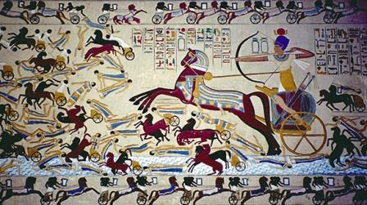
The New Kingdom
Hyksos ruled for 100 years
Army from Thebes rise up and drive out Hyksos
Reign marks beginning of the New Kingdom

Slide 18
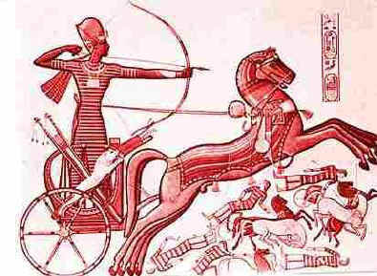
Securing Egypt
Built a powerful military
First permanent army
Foot soldiers, archers, chariots
Conquered surrounding areas to serve as a buffer

Slide 19
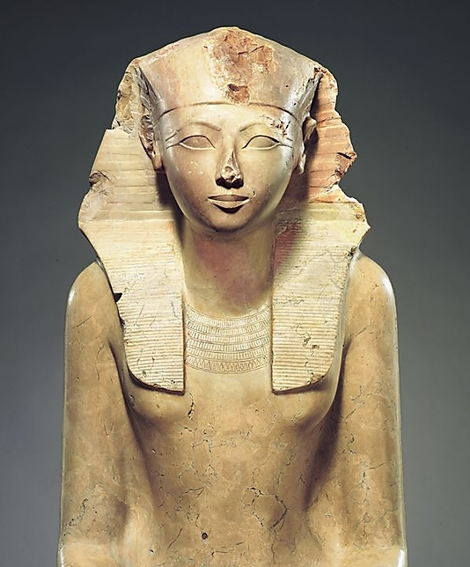
Reign of Hatshepsut
1500 BCE – Hatshepsut
Regent turned pharaoh
First woman to proclaim herself pharaoh
Increased territory & trade
When died – nephew tried to remove all traces

Slide 20
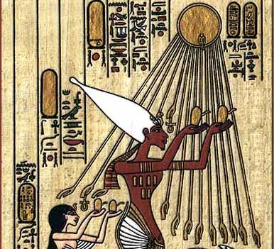
Monotheism in Egypt
Amenhotep IV (Akhenaten)
Banned worship of any gods but Aten (sun god)
Destroyed images (of other gods)
Stripped power from priests (of other gods)

Slide 21
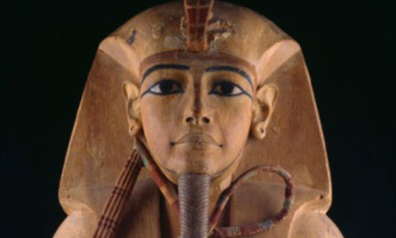
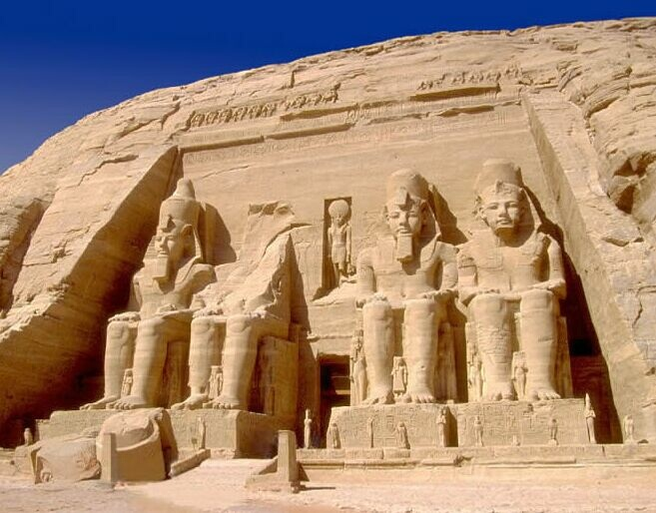
Ramses the Great
Ramses II
Ended conflict with the Hittites
Ruled for 60 years
Great wealth
Temples & monuments

Slide 22
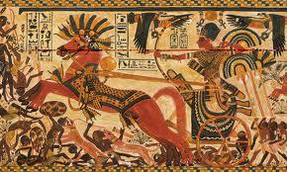
Egypt’s Decline
Internal power struggles
Broke into small states
Invasions of foreign powers
Sea Peoples, Libyans, Kushities, Assyrians, Persians, Greeks, Room

