Slide 1
Electing Leaders

Slide 2
Political Spectrum

Slide 3
Political Spectrum
There are two “tests” which are most often used, the first is readiness to change and the second is how involved is the government.
Readiness to change:
Radical: Favors a radical or basic change. Quite impatient and would quickly support a revolution to bring about the desired change.
Liberal: Is ready to move forward and accept change but would be considered a reformer rather than a revolutionary.
Conservative: Is quite content with things the way they are.
Reactionary: Wants change also, but wants to retreat into the past and restore the order of things the way they used to be
Government involvement:
The more involved the government, the further left the concept – the less involved the government, the further right the concept

Slide 4
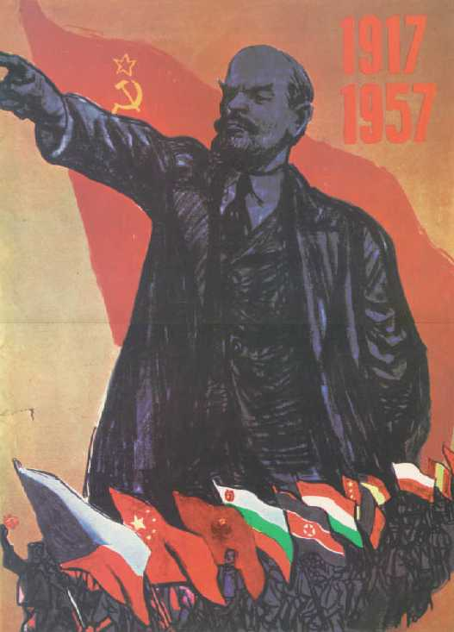
What is a Radical?
Seen as being on the far left of the political spectrum, radicals call for wide-sweeping rapid change in the basic structure of the political, social, or economic system.
They may be willing to resort to extreme methods to bring about change, including the use of violence and revolution.
V.I. Lenin: Mastermind of the Russian Revolution and Father of the Soviet Union

Slide 5
What is a Liberal?
Liberals believe that the government should be actively involved in the promotion of social welfare of a nation’s citizens.
They usually call for peaceful, gradual change within the existing political system.
They reject violent revolution as a way of changing the way things are, often called the status quo.
LBJ

Slide 6
What is a Moderate?
Moderates may share viewpoints with both liberals and conservatives.
They are seen as tolerant of other people’s views, and they do not hold extreme views of their own.
They advocate a “go-slow” or “wait-and-see” approach to social or political change.
Sen. Joe Lieberman (D-CT) is generally seen as a moderate.

Slide 7
What is a Conservative?
People who hold conservative ideals favor keeping things the way they are or maintaining the status quo if it is what they desire.
Conservatives are usually hesitant or cautious about adopting new policies, especially if they involve government activism in some way.
They feel that the less government there is, the better.
They agree with Jefferson’s view that “the best government governs least.”
Sen. Barry Goldwater (R-AZ) is widely regarded as the father of the modern conservative movement

Slide 8
What is a Reactionary?
Sitting on the far right of the ideological spectrum, reactionaries want to go back to the way things were—the “good ol’ days.” Often reactionaries are willing to use extreme methods, such as repressive use of government power, to achieve their goals.
The term “reactionary is generally negative. A positive way to say the same thing is “arch-conservative.”
Hitler’s Mein Kampf is a typical reactionary manifesto

Slide 9
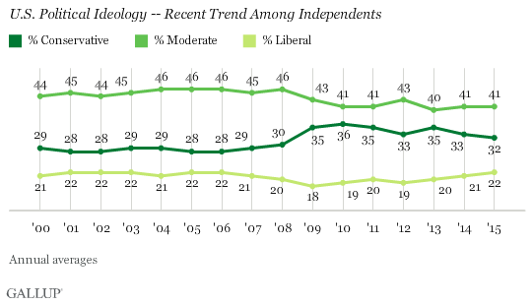

Slide 10
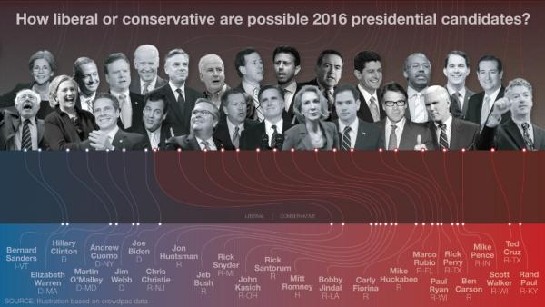

Slide 11
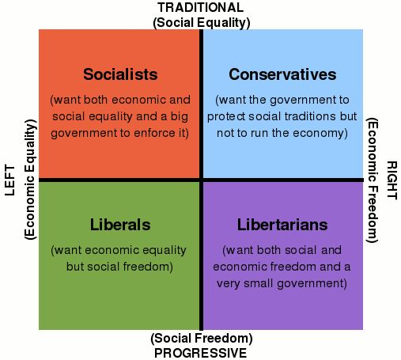

Slide 12
Plot yourself on the political spectrum. Why do you fall there? (be specific)

Slide 13
Bellwork
Why is there little participation in voting and government involvement in the US?

Slide 15
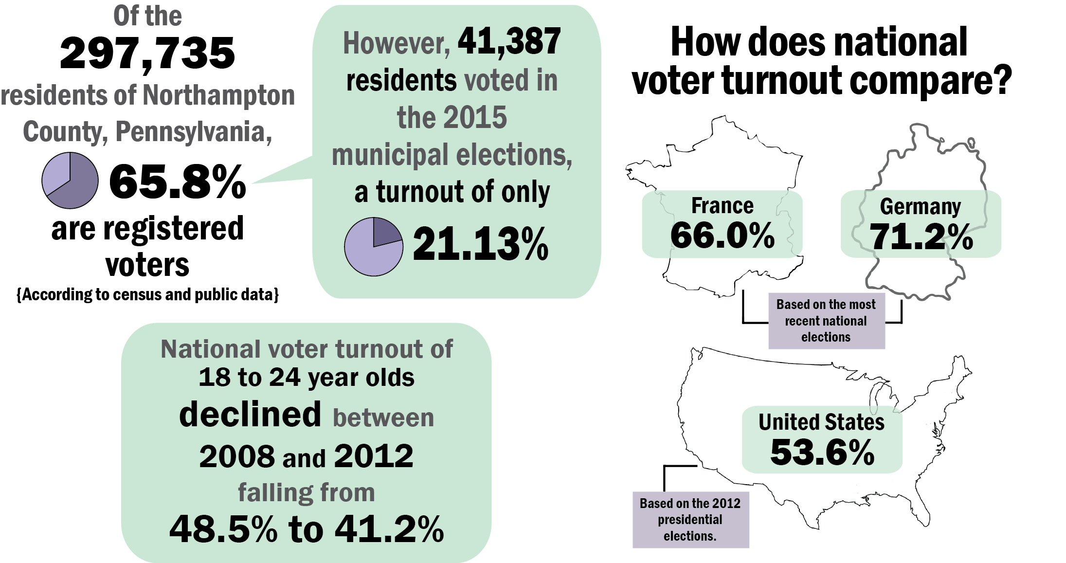

Slide 16
Political Parties
In democratic countries, citizens often join or support a political party.
A political party is a group of citizens with similar views on public issues who work together to put their ideas into effective government action.
Political parties try to convince voters to elect candidates who support the party’s ideas.
Political parties often take different positions on key issues.
Depending upon their views, parties can be placed on a political spectrum.
Political spectrum refers to system of classifying different political positions

Slide 17
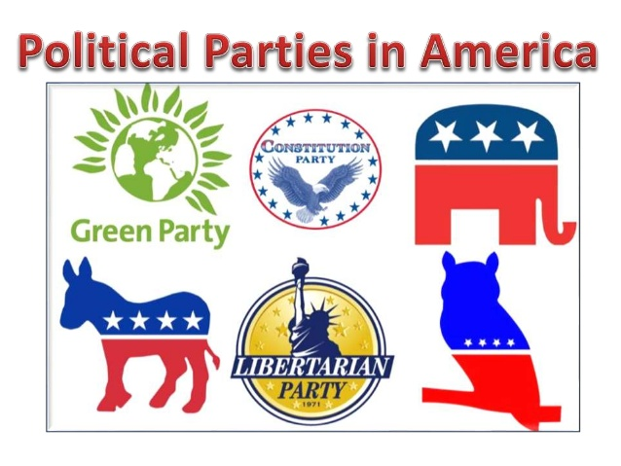
Which party do you belong to?
On a sheet of notebook paper write down whether you think you are a Republican or a Democrat and one sentence why you think your party affiliation aligns with that party.

Slide 18
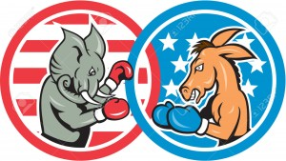
Two-Party System
In the United States we have a two party system, which means that we have two main political parties.
Smaller parties usually do not have a significant impact on national politics.
Each party tries to attract as many voters as possible; neither party wants to offer policies that might be considered too extreme because it will fail to please a majority of the voters.
The two main political parties are the Democratic Party and the Republican Party.

Slide 19
Which party do you belong to?
On a sheet of notebook paper write down whether you think you are a Republican or a Democrat and one sentence why you think your party affiliation aligns with that party.
Take this online quiz to determine where you fit
http://www.pbs.org/newshour/spc/vote2012/quiz/

Slide 20
Two Party System
Democrats
Republican
Liberal
Big federal government
Favor political and social reform, usually government-driven
favor increased federal services (welfare, social security, Medicare, student-loans)
Government intervention in the economy
Government involvement in protecting the environment
Liberals tend to support less military.
Conservative
Small federal government
Tend to believe a large government threatens people’s freedoms
Support limited government involvement in economic issues (laissez-faire)
Tend to believe social problems handled on a smaller scale

Slide 21
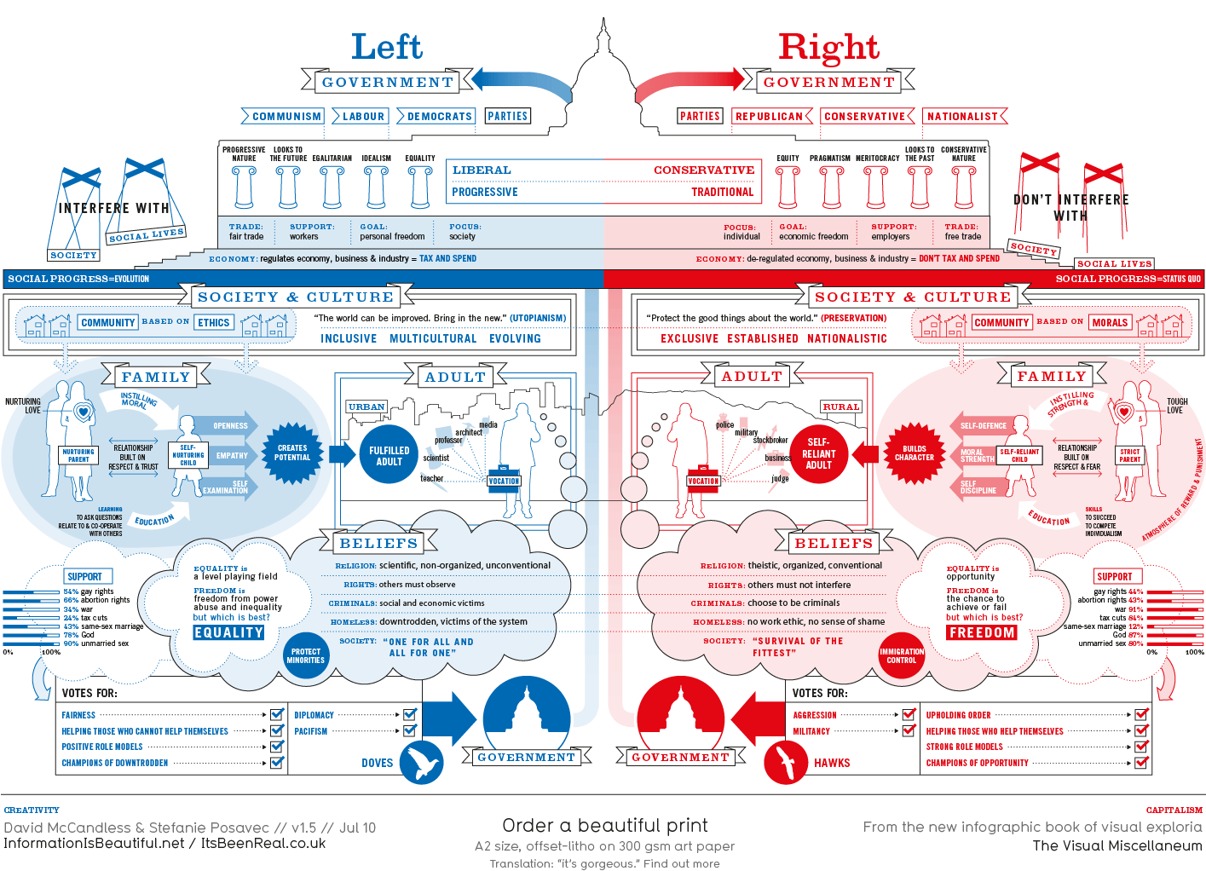

Slide 22
Party Position
A party’s platform is a statement of the party’s views and policies on important issues. It sets out the party’s program for actions to address the nation’s problems.
Platform: list of the values and actions which are supported by a political party or candidate to appeal to the general public.
Each part of the platform is called a plank.
Example: Platform may have a general statement that the party pledges to lower the crime rate. A plank related to that issue might call for increasing funds for police departments.

Slide 23
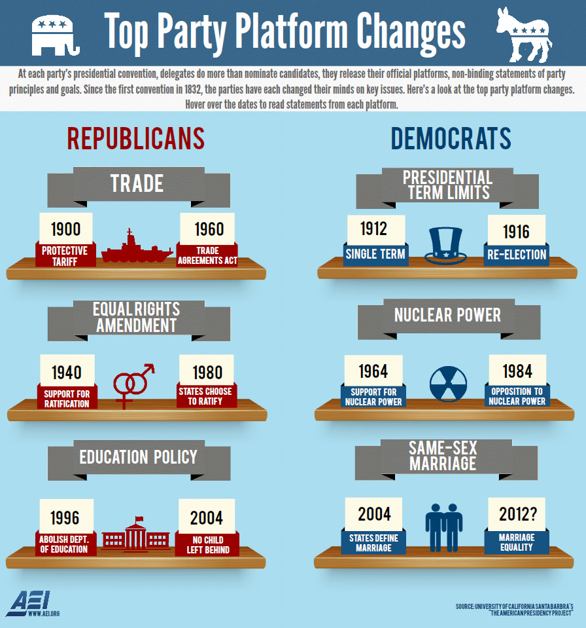

Slide 24
Bellwork
What are the positives and negatives to a two party system?

Slide 25
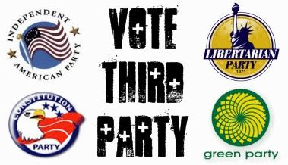
Third Parties
Although the Democratic and Republican party dominate the US political system, a number of third parties do exist.
Third parties are political parties organized as opposition to the existing parties in a two-party system
Examples:
Libertarian
Green
America First
Citizen’s Party
Working Families

Slide 26
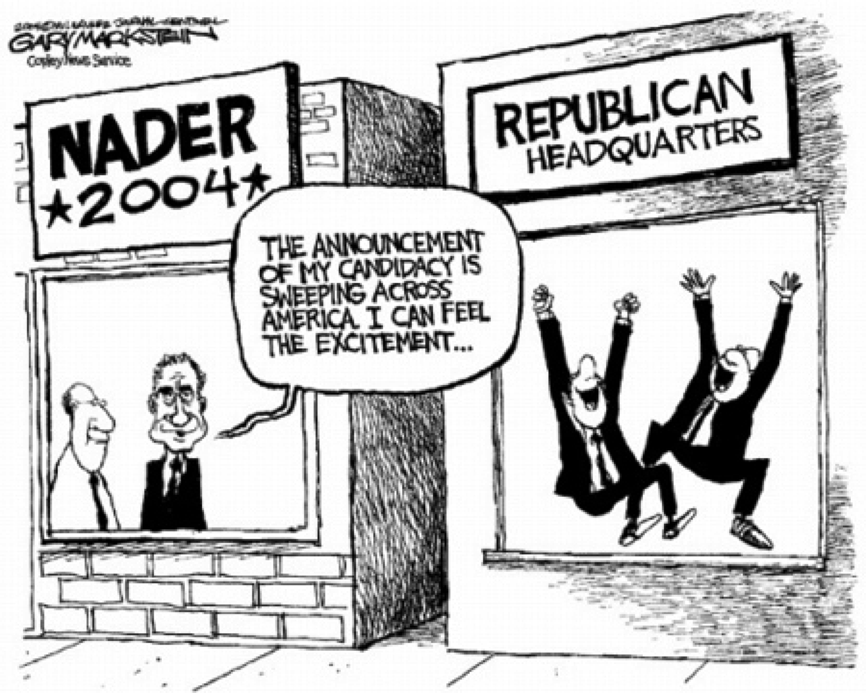

Slide 27
Bellwork
Would you ever vote for a third party? Why or why not?

Slide 28
Party Organization
Political parties exist for one reason: to nominate and elect candidates to office.
An effective party must be well organized – have leaders, committees, and workers able to carry out the party’s program.
Parties must be organized at the federal, state, and local level.
The party must nominate its candidates for office and plan its campaign strategies to get these candidates elected.
The planning for each political party is done through a series of committees.

Slide 29
Bellwork
What steps must someone take in order to get elected?

Slide 30
National Committees
The largest party committee is the national committee. Members of the national committee may be elected by a state convention, elected by voters in a statewide election, or chosen by the state committee.
The National Committee is the official central organization of a party and helps plan the party’s national nominating convention.
Selects the date, location, and rules for the party’s national nominating convention
The party’s presidential candidate often chooses the national committee chairperson.
The party chooses its presidential and vice presidential candidates at this official party meeting.

Slide 31
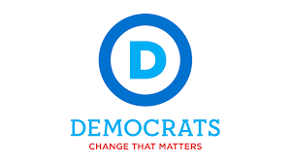

Slide 32
State Committees
Each party has a state committee in each of the 50 states.
The committee supervises the party organization in each state. It raises money and organizes campaigns to help candidates win elections.
The committee’s chairperson is a key party member in the state. He or she is often a member of the national committee.

Slide 33
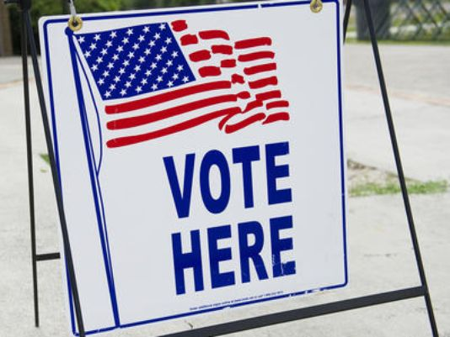
Local Organization
Committees at the local level are responsible for conducting local campaigns. They raise money for the party and party candidates.
For elections, counties, cities and wards are divided into voting districts called precincts.
In each precinct, voters all vote at the same polling place. A polling place is where voting takes place.

Slide 34
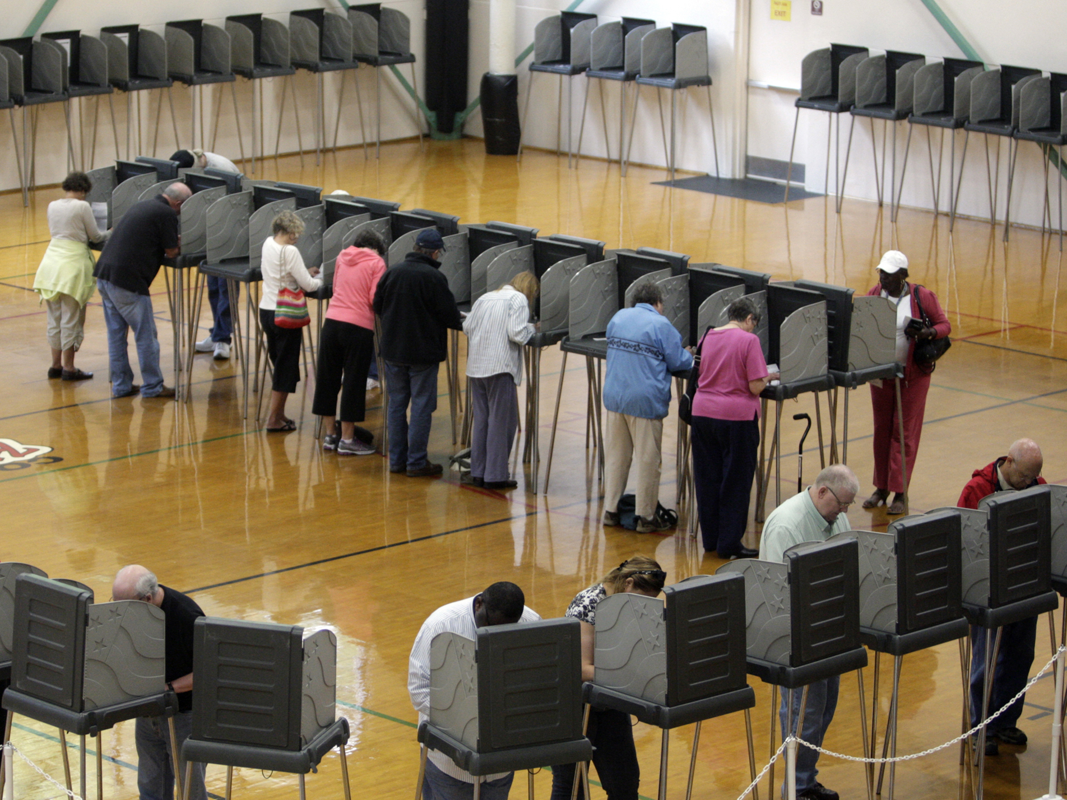

Slide 35
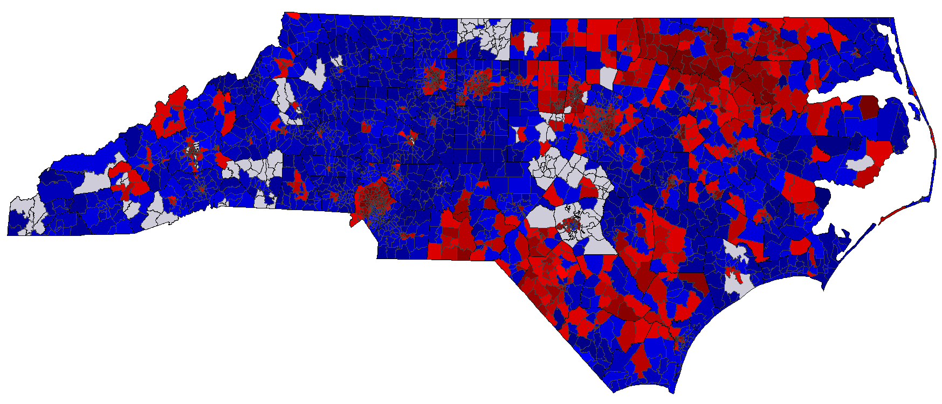

Slide 36
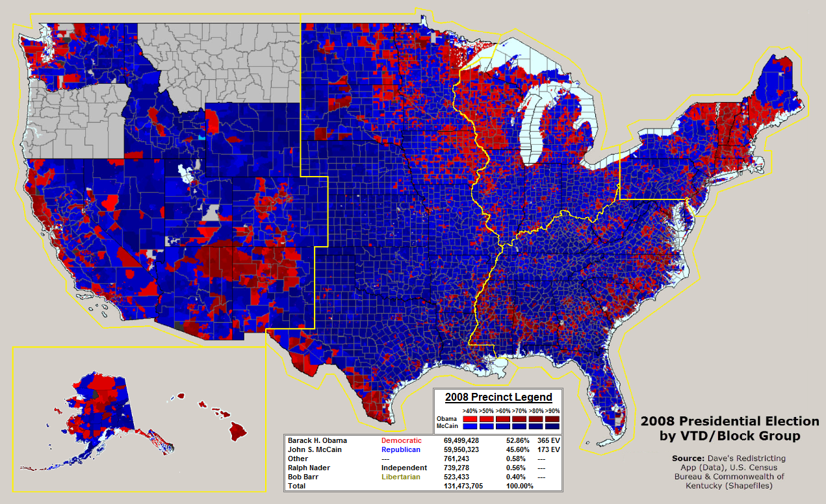

Slide 37
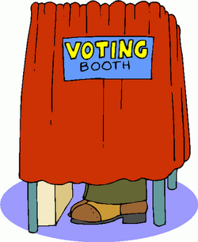
Remember our voting amendments:
15: Prohibits denial of suffrage based upon race
19: Grants women’s suffrage
23: DC gets representation in the electoral college
24: Eliminated the poll tax
26: Right to vote for those who are 18

Slide 38
Becoming a Voter
When they reach the age of 18, US citizens become eligible to vote in national, state, and local elections.
Each state decides the qualifications for registering to vote and voting.
When registering to vote a person may be asked to register as a member of a political party.
A citizen may change parties later.
Citizens may also register as independent voters, meaning they are not members of a political party.

Slide 39
Elections
Most states hold two types of elections.
Primary
General
Primary election – where voters choose the party candidates who will run in the later general election.
General election – where voters choose their leaders from the candidates offered by all the political parties.

Slide 40
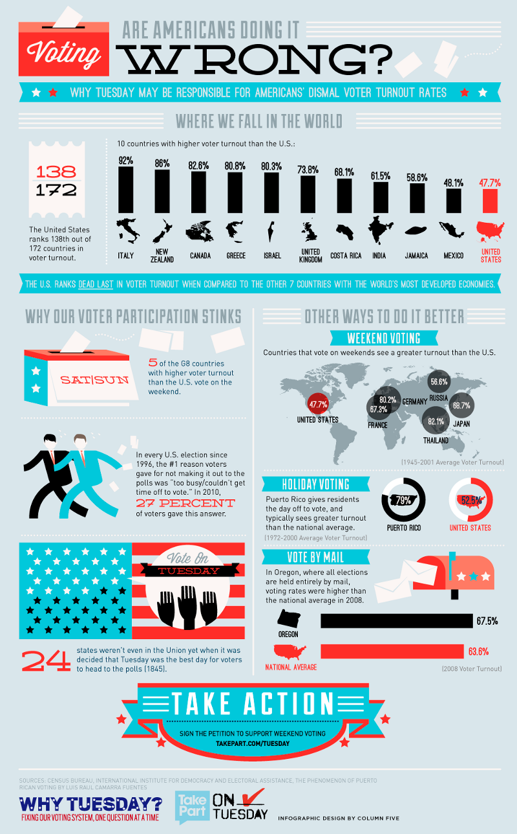

Slide 41
Primary Elections
Two main types of a primary elections are closed primary and an open primary.
Closed: only those voters who are registered in a particular party can vote to choose the party’s candidates.
Open: voters may vote for the candidates of either major party, whether or not the voter belongs to the party.
NC: Closed primary unless unaffiliated
In most states, whoever receives the most votes wins the primary election. In some states, the winner must receive a majority, or more than half, of the votes.

Slide 42
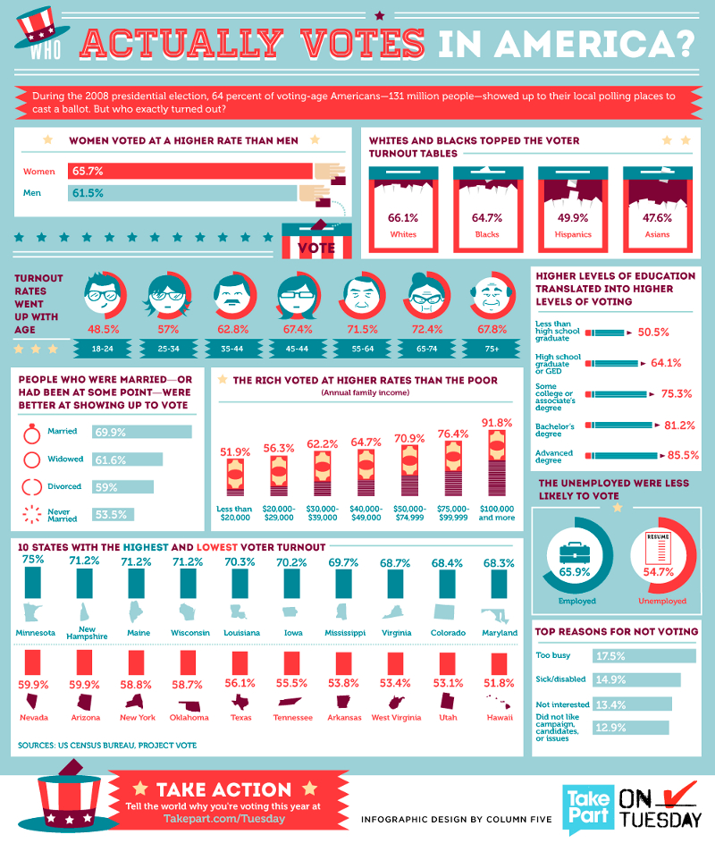

Slide 43
Independent
An independent candidate – one who does not belong to a political party-can have his or her name printed on the general election ballot if enough supporters sign a petition.
Independent candidates usually only receive local, grassroots support and are not elected as often as major-party candidates.

Slide 44
General Election
Congress set the date for the general election of the president and Congress the first Tuesday following the first Monday of November.
3 USC § 1“The electors of President and Vice President shall be appointed, in each State, on the Tuesday next after the first Monday in November, in every fourth year succeeding every election of a President and Vice President.”
Presidential elections take place every four years and Congressional elections occur every two years.
Are elected in even-numbered years.

Slide 45
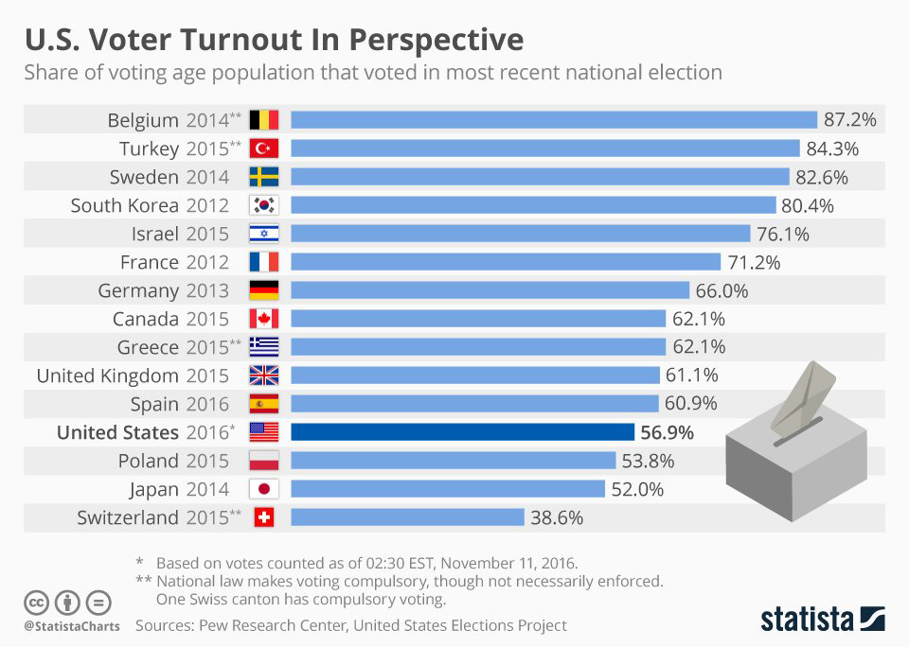

Slide 46
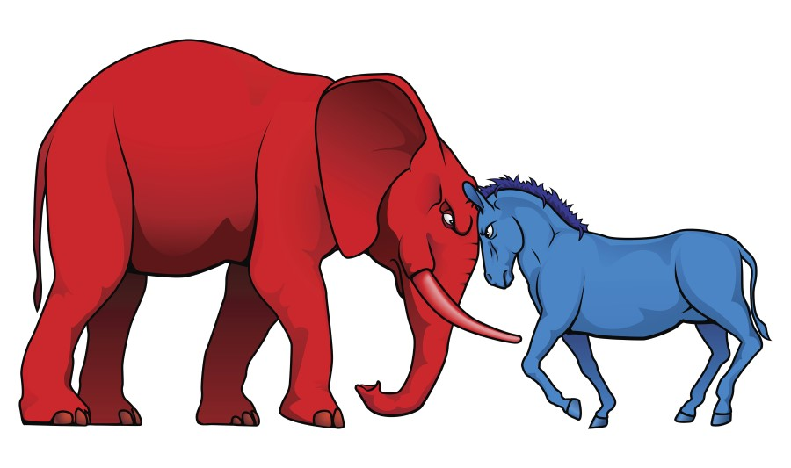
Bellwork
How do political parties effect elections?

Slide 47
Voting
During the first part of the 1800s, voting was usually done by voice vote.
In 1888, the United States adopted the secret ballot.
A secret ballot is a paper ballot that lists the names of the candidates. A voter marks his or her ballot in private.
Polling places are usually open from the early morning until the evening on election day.
Some voters vote straight ticket, while others vote split ticket.
Straight – vote for all the candidates of one party
Split – choosing candidates of more than one party

Slide 48
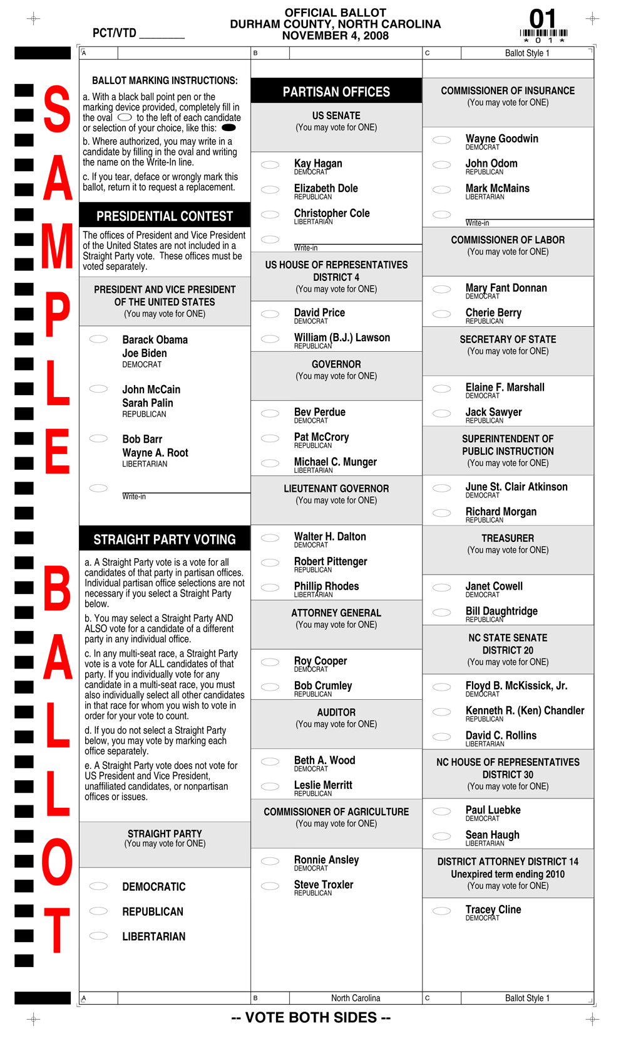

Slide 49
Nomination Process
Winning the primaries is not the end of the process of becoming a presidential candidate.
Before a candidate gets to the White House, he or she must win his or her party’s nomination at a political convention.
In each state, members of each political party choose delegates to go their party’s convention to nominate candidates.
Each party’s national nominating convention is held during the summer of the presidential election year.

Slide 51
Selecting Candidates
Candidate are officially chosen at the national nominating conventions.
To win the nomination a candidate must receive a majority of the convention delegates’ votes.
The candidate who wins the majority of votes wins his or her party’s nomination.

Slide 52
National Conventions

Slide 53
Electoral College
http://www.youtube.com/watch?v=bCjWPo70XZY

Slide 54
The Electoral College
When you vote in a presidential election, your vote is part of the popular vote. The popular vote is the vote of the citizens of a country.
Presidents are not elected by popular vote. Your vote is actually for people called electors.
An elector is a person chosen from each state who formally select the president and vice president.
The group of all the electors is called the electoral college.
By adding up the electoral votes for each of the states won by each candidate, we can tell who will be elected as the next president.

Slide 55
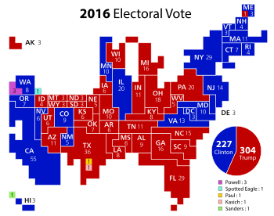

Slide 56
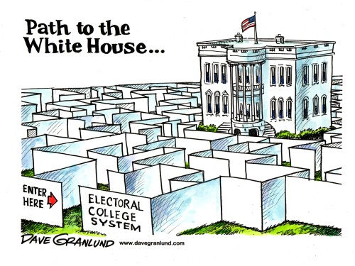
Electoral College
There are 538 electors in the electoral college. Each state has number of electors equal to the total number of senators and representatives that it has in Congress.
DC, which has no representatives in Congress, has three electoral votes.
Before the presidential election, each political party in every state selects electors who vote for the party’s presidential candidate.
Since 1828 political practice has been for the electors to vote for the candidate who won their state’s popular vote.
NC Gen. Stat. § 163-212
Besides Maine and Nebraska, each state has a winner-take all system.

Slide 57
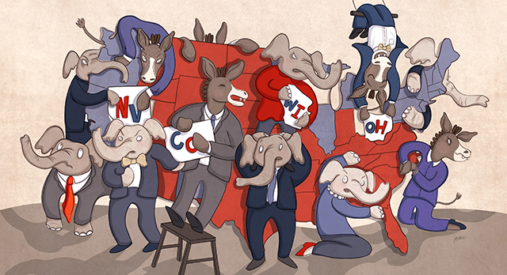
Electoral College
A few weeks after election day, electors meet and cast their ballots. The electors vote and mail their Certificate of Votes.
3 USC § 7 “The electors of President and Vice President of each State shall meet and give their votes on the first Monday after the second Wednesday in December next following their appointment at such place in each State as the legislature of such State shall direct.”
The results are then sent to and counted by Congress on January 6.
The candidate who receives a majority – 270 or more- of the electoral votes wins.
If no presidential candidate receives a majority of the electoral votes, the House chooses the president.

Slide 59
How many votes?
To become president a candidate needs 270 electoral votes.
Can you win the popular vote but lose the electoral college?
Bush: 271; 50,456,002
Gore: 266; 50,999,897
2016
Trump: 306; 62,985,106 45.94%
Clinton: 232; 65,853,625 48.03%
http://www.opensecrets.org/states/stateinfluence.php?option=2&rel=1
Presidential Election,

Slide 60
What is the effect?
Introduces bias to the campaign because each state gets two electors regardless of population, the less populated states are overrepresented.
US population: 313.9 Million/538 = 1 vote per 583,487 people
NC: 9,752,073 = 16 votes
Wyoming: 576,412 = 1 vote
Candidates will focus on winning states where the polls show there to be a close contest.
Swing states
Florida; Ohio; Pennsylvania; Virginia
http://www.youtube.com/watch?v=bXc-mwhDTFw

Slide 61
Presidential Inauguration
The inauguration of the president is a ceremonial event marking the commencement of a new four-year term of a president of the United States.
The day a presidential inauguration occurs is known as “Inauguration Day” and occurs on January 20th.
http://www.youtube.com/watch?v=f4RzFiF3z78

Slide 62
Writing Prompt
Create an argumentative writing about whether we should keep the Electoral College.
Make sure you addresses both sides of the issue
The electoral is needed because…
The electoral college is unnecessary because…
Your writing should be at least two paragraphs and include a topic sentence, supporting details, and a concluding sentence.

