Slide 1
Enlightenment and Revolution:
The Scientific Revolution

Slide 2
Main Idea
New ways of thinking led to remarkable discoveries during the Scientific Revolution.

Slide 3
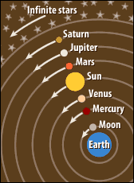
Old Views
Geocentric theory
Planets revolve around the Earth
Proposed by Aristotle
Upheld by the church

Slide 4
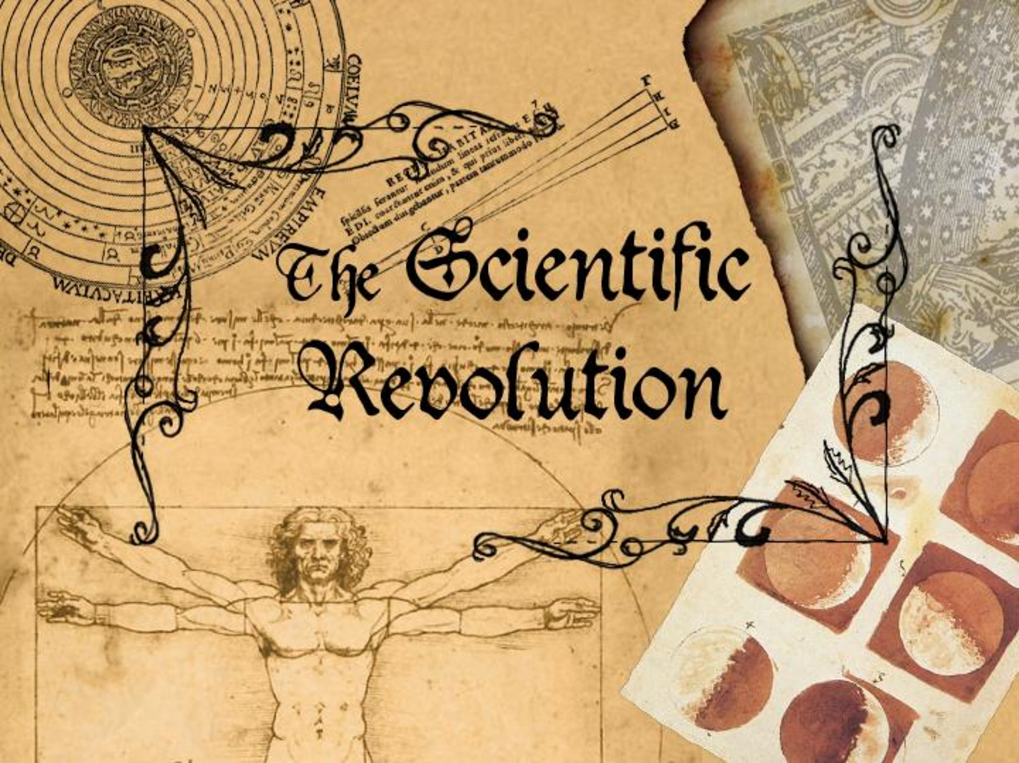
New Viewpoints
Scientific Revolution
Scholars in Europe learned about advances in Arab world
Began challenging traditional authorities
The Age of Exploration
Find new people, animals, & ideas
Study world more closely

Slide 5
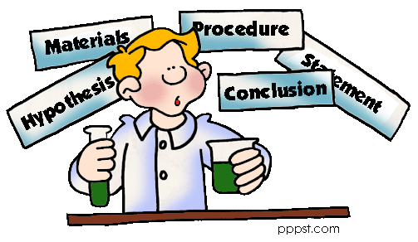
The Scientific Method
Scientific method
1. Identify problem
2. Form a hypothesis that can be tested
3. Perform experiments
4. Record the results
5. Form a conclusion

Slide 6
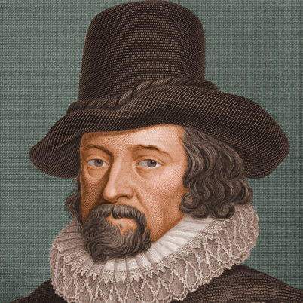
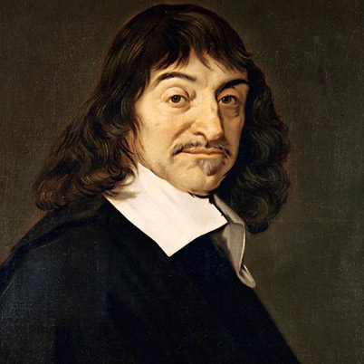
The Scientific Method
Francis Bacon
Rene Descartes

Slide 7
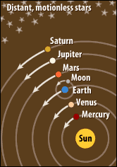
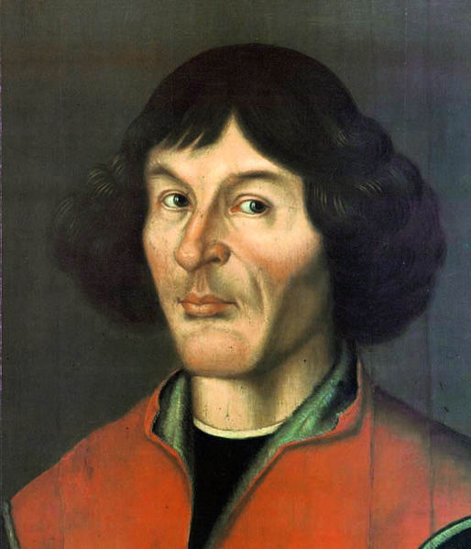
Discoveries in Astronomy, Physics, and Math
Nicolaus Copernicus
Heliocentric theory
Sun is the center of the universe

Slide 8
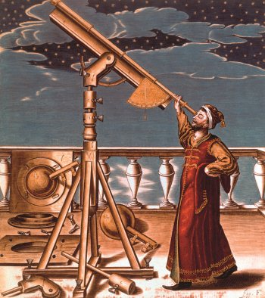
Discoveries in Astronomy, Physics, and Math
Galileo
First to build a telescope used for astronomy
First to observe Saturn, craters on the moon, sunspots
Confirms planets orbit the sun

Slide 9
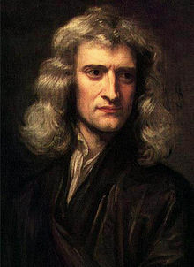
Discoveries in Astronomy/Physics/Math
Sir Isaac Newton
Developed the law of universal gravitation
Gravity affects objects in the universe as well on as earth
Gravity keeps planets in orbit
Developed calculus

Slide 10
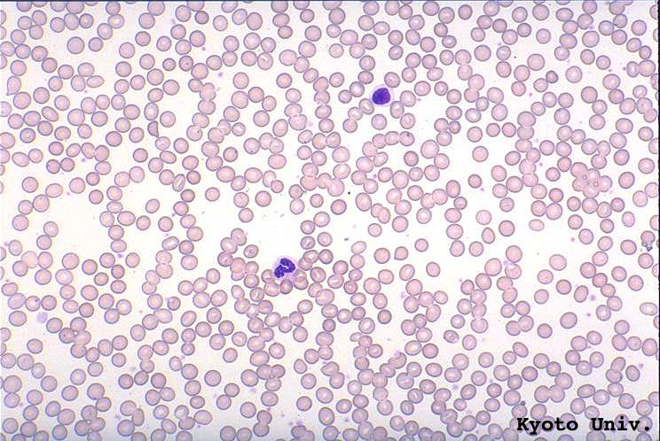
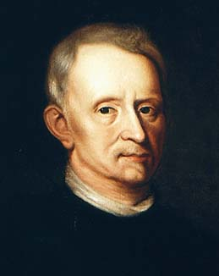
Discoveries in Biology
Antony van Leeuwenhoek
Developed magnifying lens (microscope)
First to describe appearance of bacteria & red blood cells
Robert Hooke
First to describe appearance of plants
Created the term cell

Slide 11
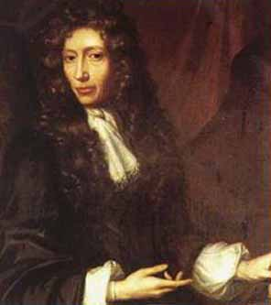
Discoveries in Chemistry
Robert Boyle
First to define an element
Boyle’s law
Describes how temperature, volume, and pressure affect gases

Slide 12
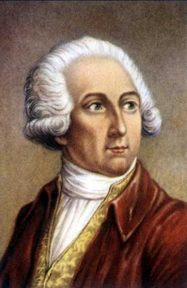
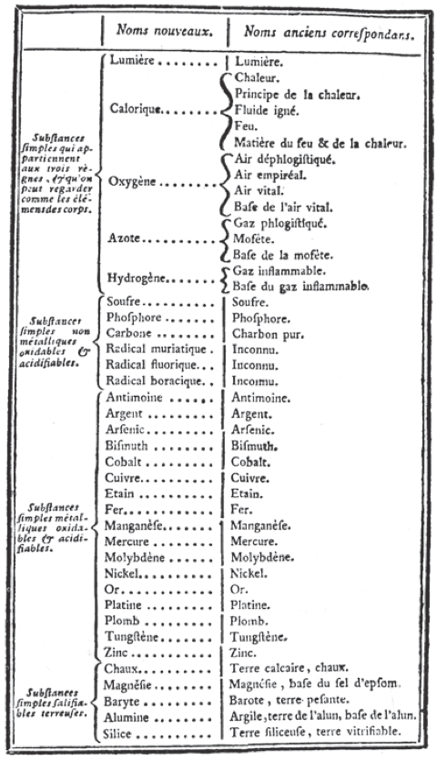
Discoveries in Chemistry
Antoine-Laurent Lavoisier
Law of Conservation of Mass
Matter could not be created or destroyed
Introduced the metric system
First periodic table

Slide 13
Science and the Church
Conflicts between the church and science
Church = explained world through inspiration and revealed truth
Science = explained the world through the accumulation of facts and logical reasoning

Slide 14
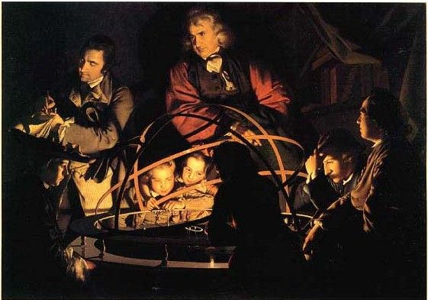
Science and Society
Reflected in art
Anatomy
Architecture
Community
Could reason solve poverty, war, and ignorance

Slide 15
Causes of the Scientific Revolution
Exploration and expansion of trade
Continuing study of ancient authorities
Development of the Scientific method

Slide 16
Effects of the Scientific Revolution
Beginnings of modern science
Belief in progress and the power of reason
New view of the universe as a well-ordered system

Slide 17
Enlightenment and Revolution:
The Enlightenment

Slide 18
Main Idea
European thinkers developed new ideas about government and society during the Enlightenment.

Slide 19
The Age of Reason
Enlightenment / Age of Reason
Fueled by the Scientific Revolution
Viewed reason as best way to understand truth/world & solve problems
Rapid spread of ideas

Slide 20
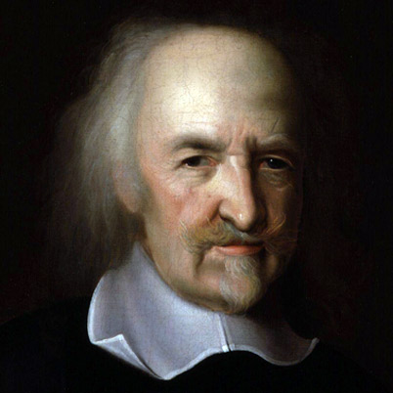
New Views on Government
Thomas Hobbes
Leviathan
Believed people needed governments to impose order
Social contract
People should agree to give up some freedoms in exchange for peace, safety, and order

Slide 21
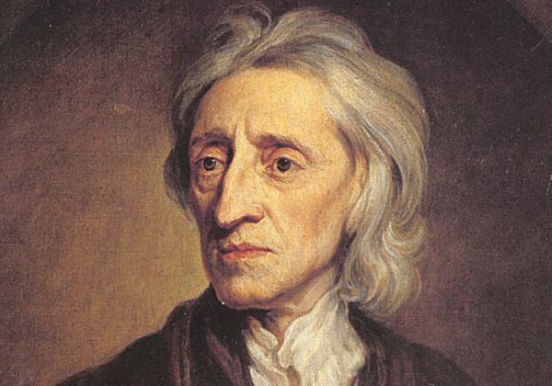
New Views on Government
John Locke
Argued all people were born equal with the natural rights of life, liberty, and property
Purpose of government was to protect people’s natural rights
People consented to the government, whose power was limited by laws

Slide 22
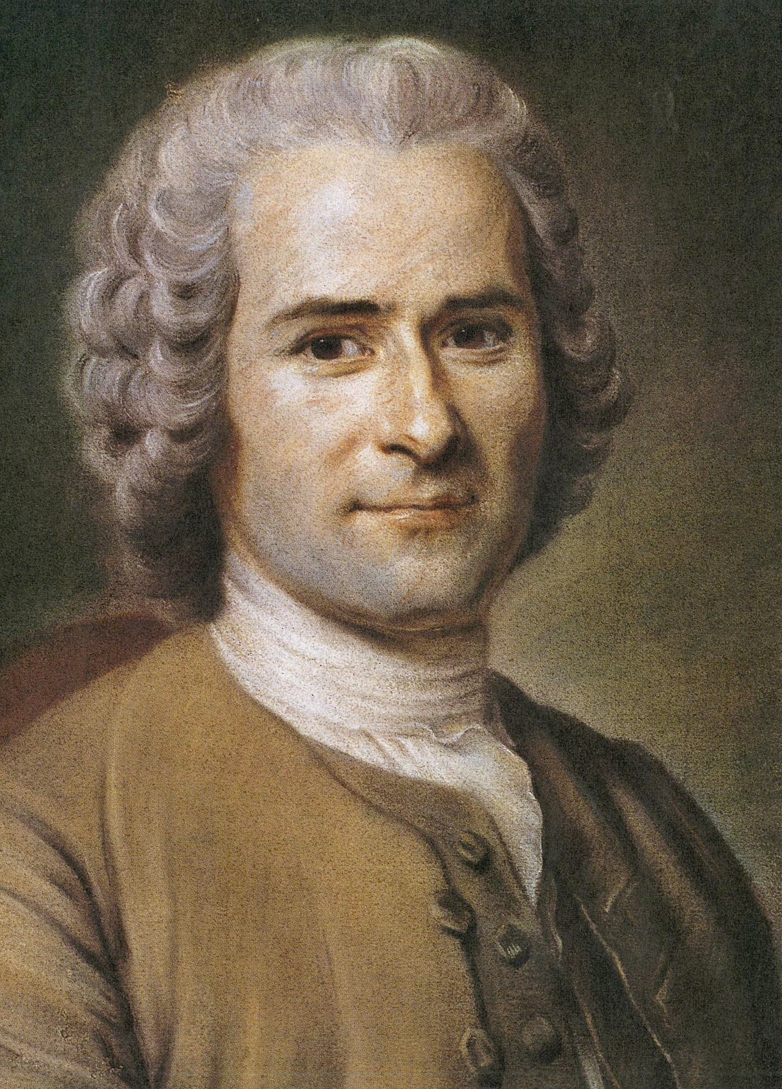
New Views on Government
Jean-Jacques Rousseau
Believed government should work for the benefit of the common good, not for the wealthy few
Individuals should give up freedoms for the benefit of the whole
All people were equal

Slide 23
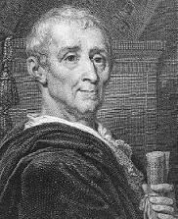
New Views on Government
Baron de Montesquieu
Best form of government had a separation of powers
Allowed each branch of government to serve as a check against the power of the others

Slide 24
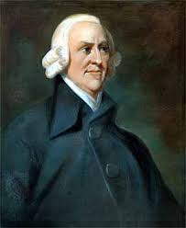
New Views on Society
Adam Smith
The Wealth of Nations
Business activities should take place in a free market
Laissez-faire economics

Slide 25
Key Enlightenment Ideas
The ability to reason is what makes humans unique
Reason can be used to solve problems and improve people’s lives
Reason can free people from ignorance, superstition, and unfair government
Human behavior is governed by natural laws

Slide 26
Enlightenment and Revolution:
The American Revolution

Slide 27
Main Idea
Enlightenment ideas led to revolution, independence, and a new government for the United States.

Slide 28
Change and Crisis
1770 – 2.1 million people in the colonies
Allowed a large measure of independence
Each colony had its own government
Started to identify more closely with colonies than Britain

Slide 29
Change and Crisis
French and Indian War
Stamp Act
Intolerable Acts
Boston Massacre
Boston Tea Party

Slide 30
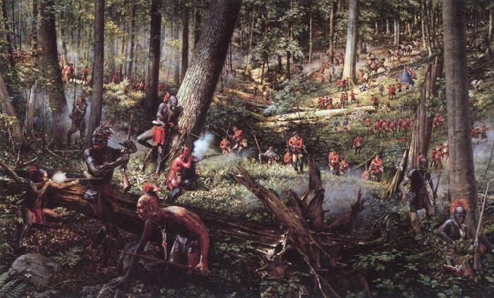
The French and Indian War
Seven Years War
Between France and England
Control of colonies
England wanted to be paid since they “protected” the colonists

Slide 31
Raising Revenue
Sugar Act
Currency Act
Stamp Act
Crackdown on smuggling
Quartering Act

Slide 32
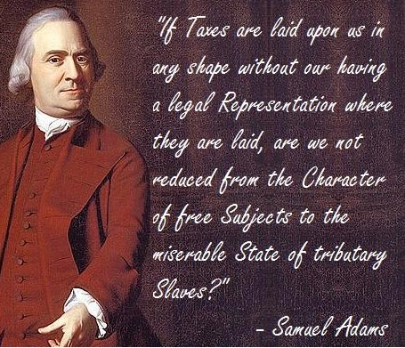
Taxation without Representation
Colonists used to being independent
Felt taxes unfair – without their consent
Wanted representation in Parliament
Boycotts

Slide 33
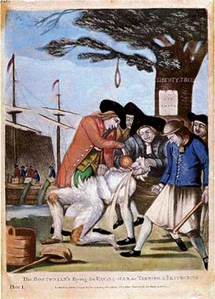
Townshend Acts
Tax on imports
Lead, paint, paper, glass, & tea
More taxation without representation
Writs of assistance
Customs officials could search colonial homes for smuggled goods without permission

Slide 34
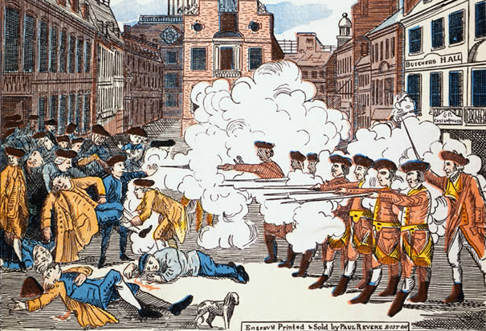
The Boston Massacre
March 5, 1770
Crowd fired upon by British soldiers
5 killed, 6 wounded
Crispus Attucks

Slide 35
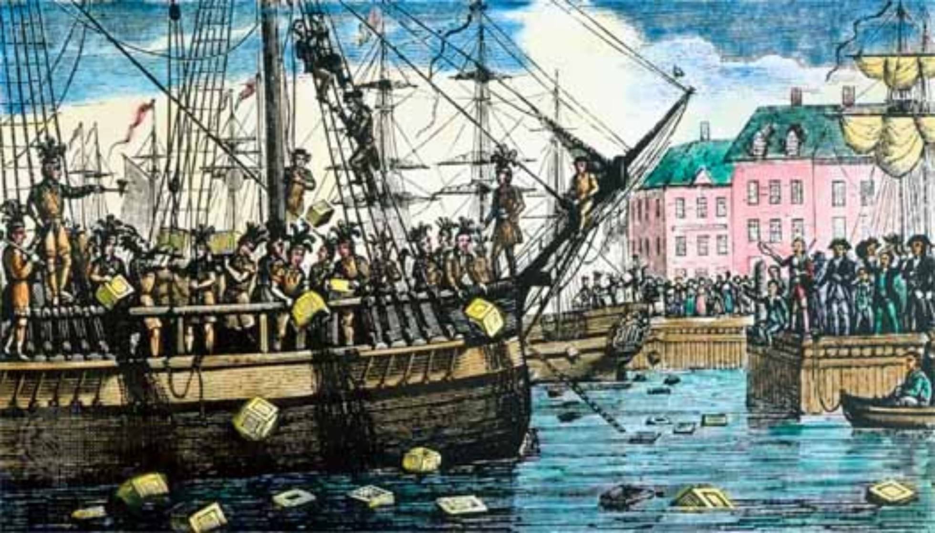
The Tea Act and the Intolerable Acts
Colonists hated the new tax on tea
Triggered the Boston Tea Party as a sign of rebellion
Dressed up as Indians, boarded ships, dumped tea into the harbor
Coercive Acts/Intolerable Acts
Closed port of Boston
Stricter royal control

Slide 36
Revolutionary Ideas
Should have all rights British citizens have
Rights that date back to the Magna Carta
John Locke
Concept of natural rights

Slide 37
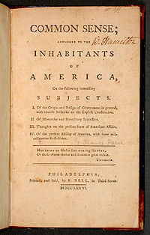
Common Sense
1776 – Thomas Paine publishes pamphlet
Condemned monarchy – called for independence
Helped public support towards revolution

Slide 38
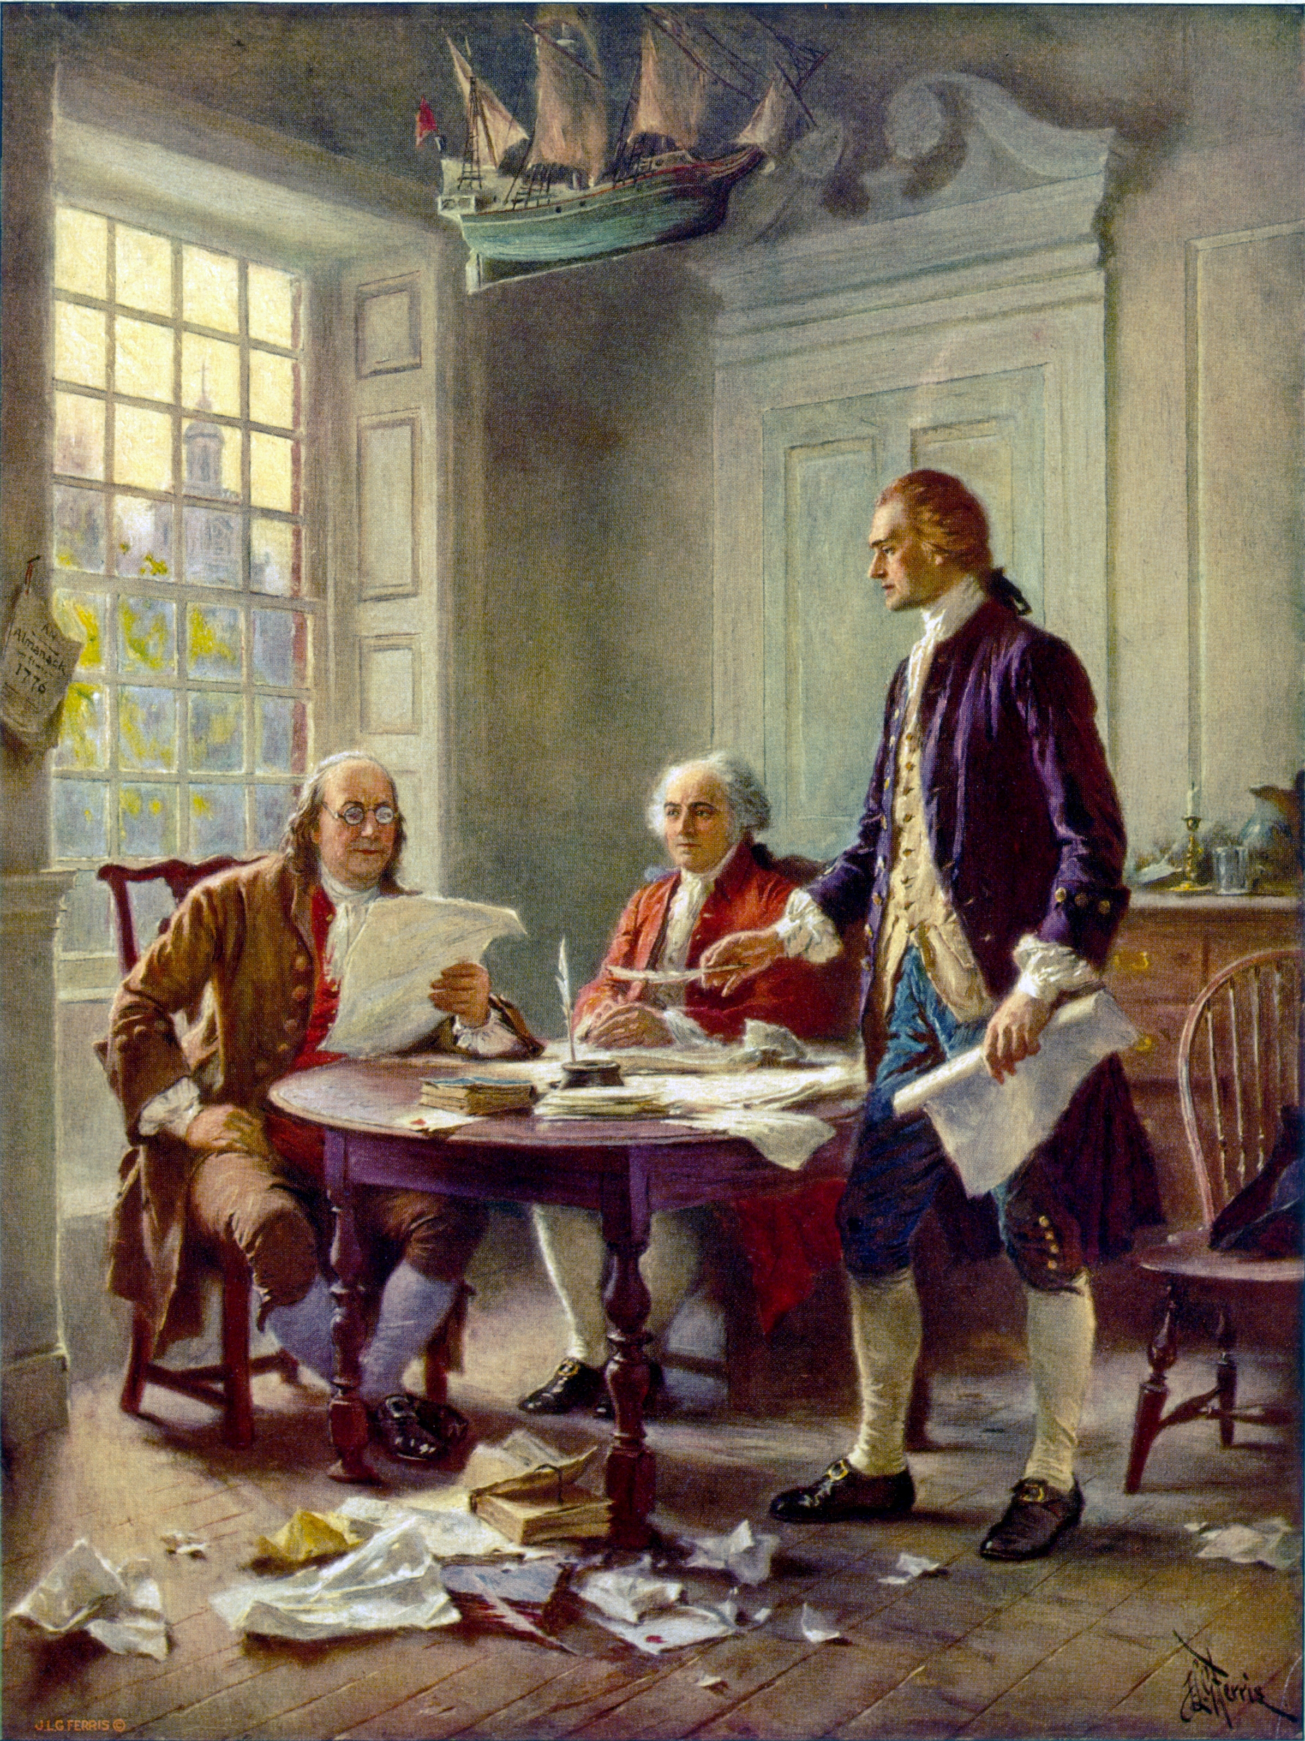
The Declaration of Independence
June 1776 – Continental Congress appoints committee to draw up Declaration of Independence
Thomas Jefferson, Ben Franklin, John Adams, Roger Sherman, & Robert Livingston
July 4 1776 – Declaration approved by Congress

Slide 39
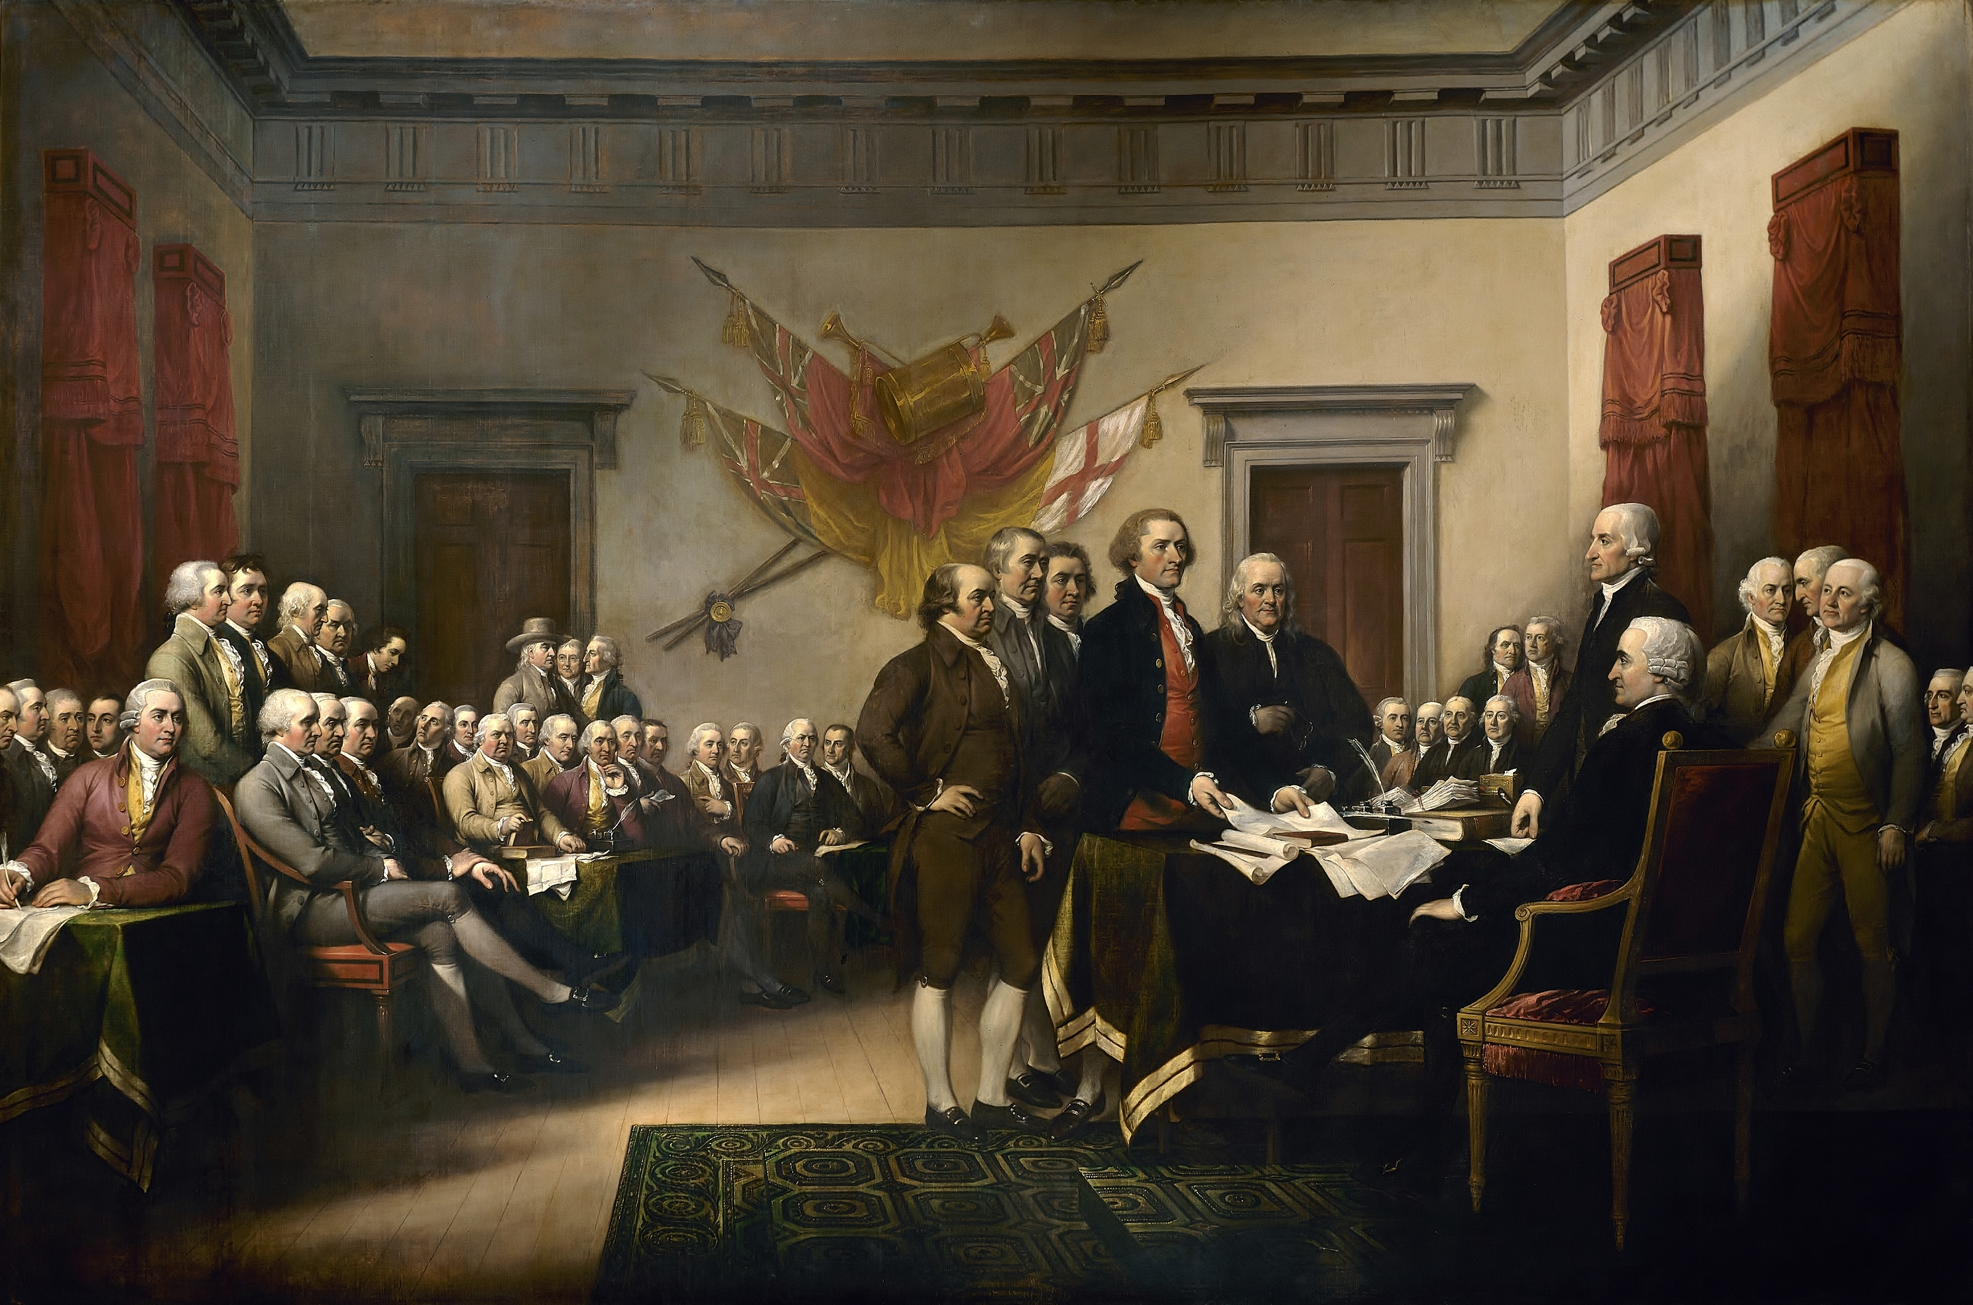
The Declaration of Independence
Lists reasons for separation from Great Britain
Taxation
Power comes from those who are governed
Statement of American ideals
Purpose of government is to protect human rights

Slide 40
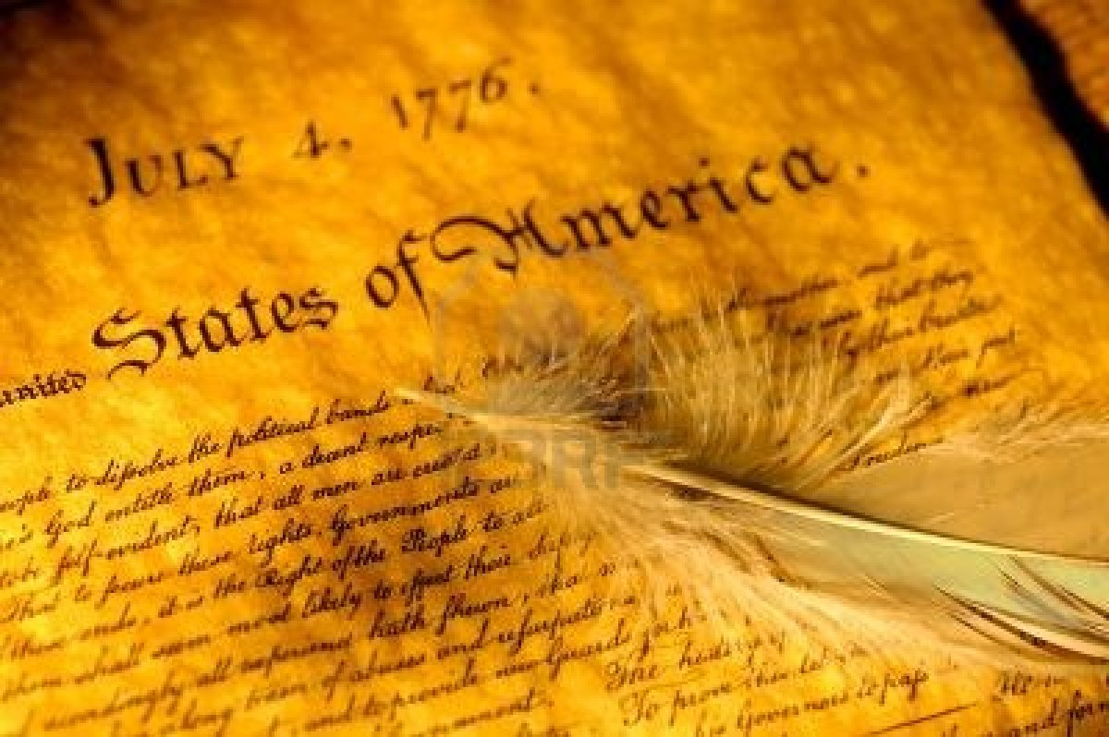
The Declaration of Independence
Equal under the law
Rights to life, liberty, & pursuit of happiness

Slide 41
The Declaration of Independence
“We hold these truths to be self-evident, that all men are created equal, that they are endowed by their Creator with certain unalienable Rights, that among these are Life, Liberty, and the pursuit of Happiness.”

Slide 42
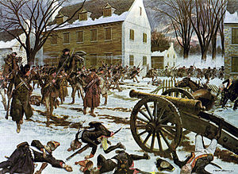
The American Revolution
Battle of Trenton & Princeton
Battle of Saratoga
France, Spain, & Holland joins patriots (supplies)
Brutal in the south
1781 – low on money & supplies

Slide 43
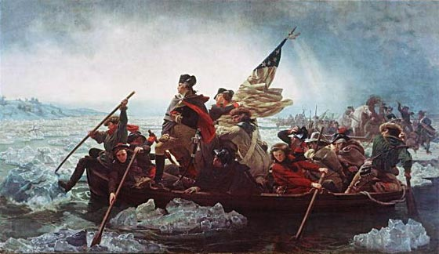

Slide 44
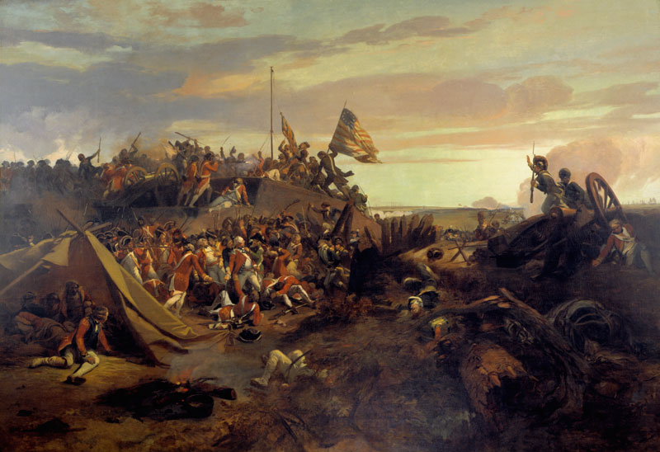
The American Revolution
Battle of Yorktown
Last major battle
Cornwallis trapped by Washington
Treaty of Paris of 1783

Slide 45
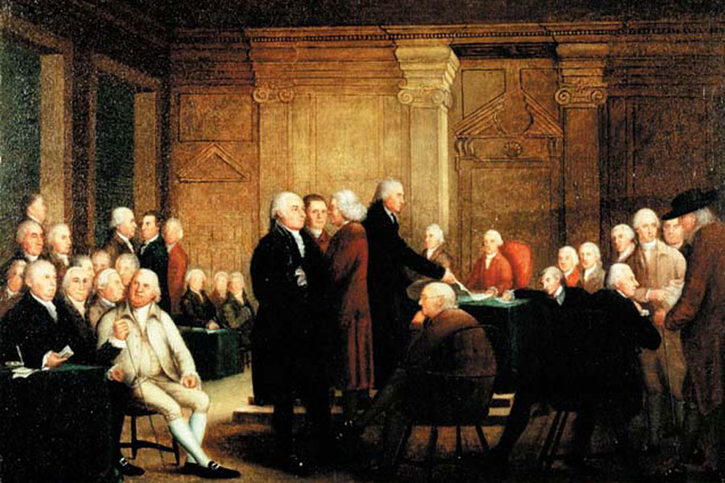
The Articles of Confederation
1777 – Continental Congress adopts the Articles of Confederation
1781 – Approved by the 13 states
1783 – War ends, officially a confederation called the United States of America

Slide 46
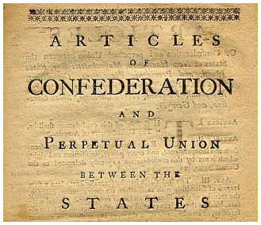
The Articles of Confederation
Framers made the national government weak: avoid abuses of power
Central government very limited

Slide 47
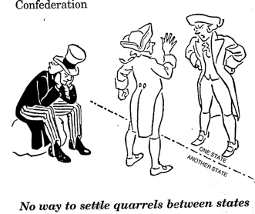
Weaknesses of the Articles
Congress - Hard to pass laws
Needed 9 of 13 states
No executive branch (president)
No national courts
Disputes over boundaries

Slide 48
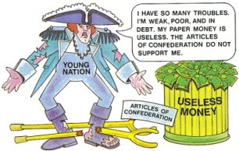
Weaknesses of the Articles
Couldn’t pay country’s debts
Couldn’t pay soldiers
Couldn’t raise revenue
Looked weak to other nations

Slide 49
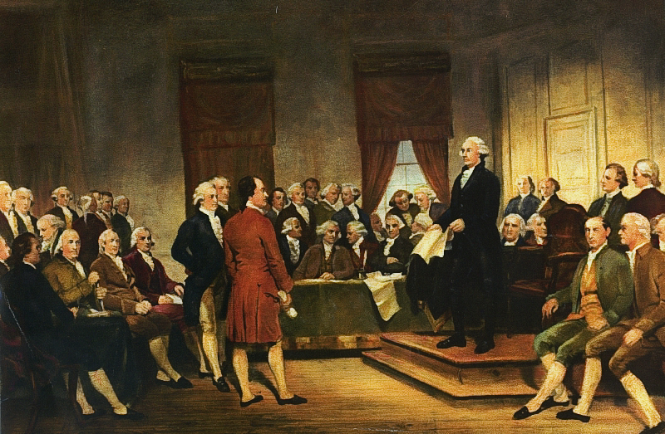
The Constitutional Convention & History
Constitutional Convention (1787)
Held in secret
What we know from James Madison’s journal
World’s oldest constitution still in use today
Original framers influenced by the past

Slide 50
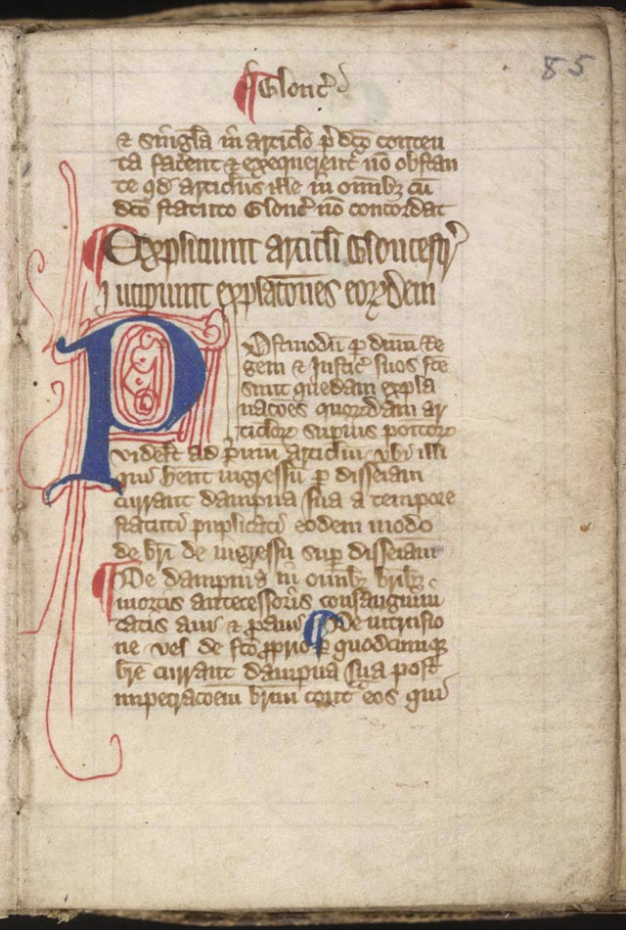
The Constitutional Convention & History
Magna Carta
1215 – “Great Charter”
Guaranteed that free people could not be arrested, put in prison, or forced to leave their nation
Trail by jury
Protected rights of Parliament against the monarch

Slide 51
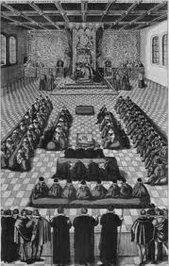
The Constitutional Convention & History
English Bill of Rights
1698
Right to petition
Right to fair punishment
Parliamentary Government
Parliament – lawmaking body of Great Britain
Bicameral (two parts)
Prime minister

Slide 52
The Constitutional Convention & History
Central government needed more power, but states should keep powers needed to govern own affairs
Needed to come to a compromise
Federalism (federal system)
Divides government’s power between national and state government

Slide 53
The Great Compromise
Virginia Plan - Large states favored legislature based on size of states population
New Jersey Plan - Small states wanted each state to have and equal number of votes
Settled on a bicameral lawmaking body – Congress
Senate
House of Representatives

Slide 54
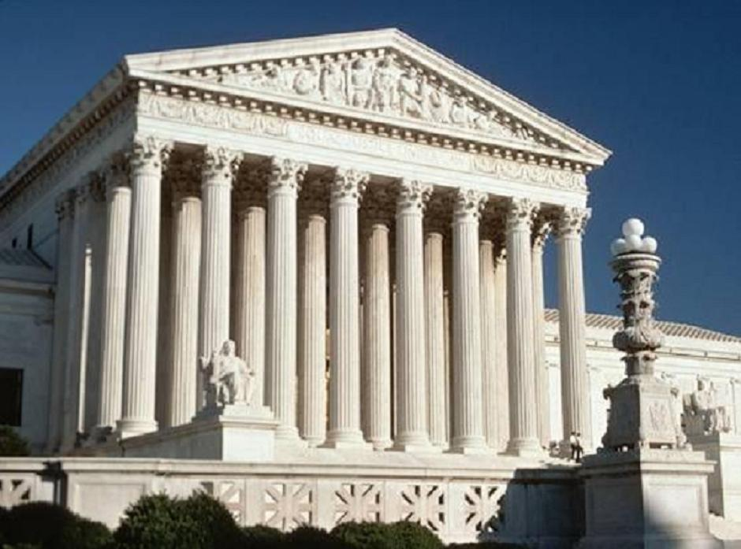
Government Becomes Stronger
National government could now:
Print money
Raise armed forces
Regulate trade among states & foreign nations
Set taxes
Supreme Court also established

Slide 55
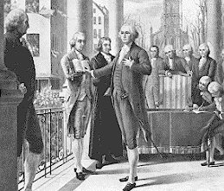
Government Becomes Stronger
Most of the states ratified in 1787 and 1788
North Carolina and Rhode Island – did not approve until after it went into affect
April 30, 1789 – George Washington sworn in as first President

Slide 56
Impact of American Government
Successful revolution impact on other governments (especially France)
Louis XVI supported American Revolution
Expensive
Economic problems
French Revolution in 1789 inspired by the American Revolution

