Slide 1
Entering the World Stage:
Roosevelt and Latin America

Slide 2
Main Idea
The United States began to exert its influence over Latin America in the wake of the Spanish-American War.

Slide 3
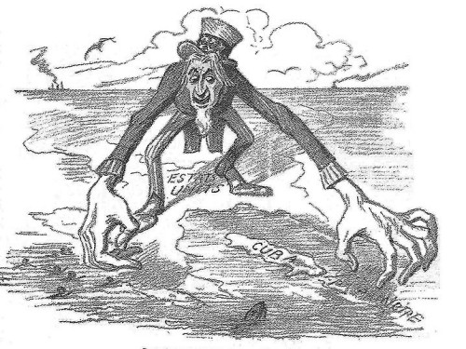
U.S. Control Over Cuba
Pres. William McKinley set up a military government in Cuba
Oversaw the drafting of a new Cuban Constitution (1901)

Slide 4
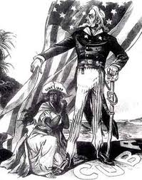
U.S. Control over Cuba
Platt Amendment
Limited Cuba’s ability to sign treaties with other nations
Gave U.S. right to intervene in Cuban affairs
Right to set up military bases
Made Cuba a U.S. protectorate

Slide 5
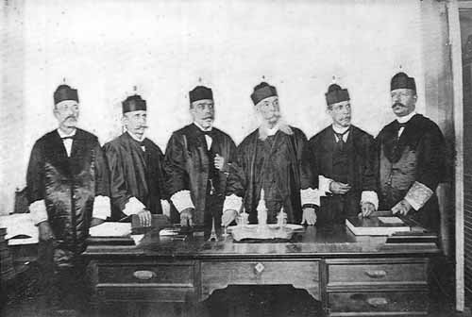
Governing Puerto Rico
Set up a military government (governed as a territory)
Foraker Act
U.S. would appoint a governor and upper house of legislature
Puerto Rican voters elected the lower house

Slide 6
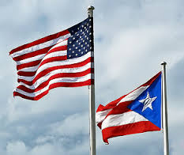
Governing Puerto Rico
1917 - Granted Puerto Ricans U.S. citizenship and ability to elect all legislative representatives
1952 - Became a self-governing commonwealth

Slide 7
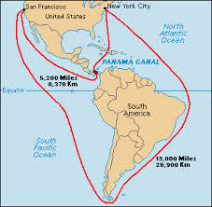
The Panama Canal
Wanted a faster way to travel from the Atlantic and Pacific
The United States bought the rights to build the canal
Roosevelt supported a revolution and quickly recognized the new government
A treaty gave the U.S. complete control of the Canal Zone

Slide 8
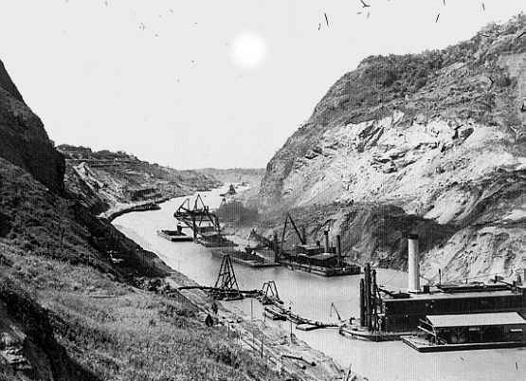
The Panama Canal
Harsh working conditions, material shortages, malaria, and the yellow fever hampered construction
August 1914 - the SS Ancon
First ship to pass through the canal

Slide 9
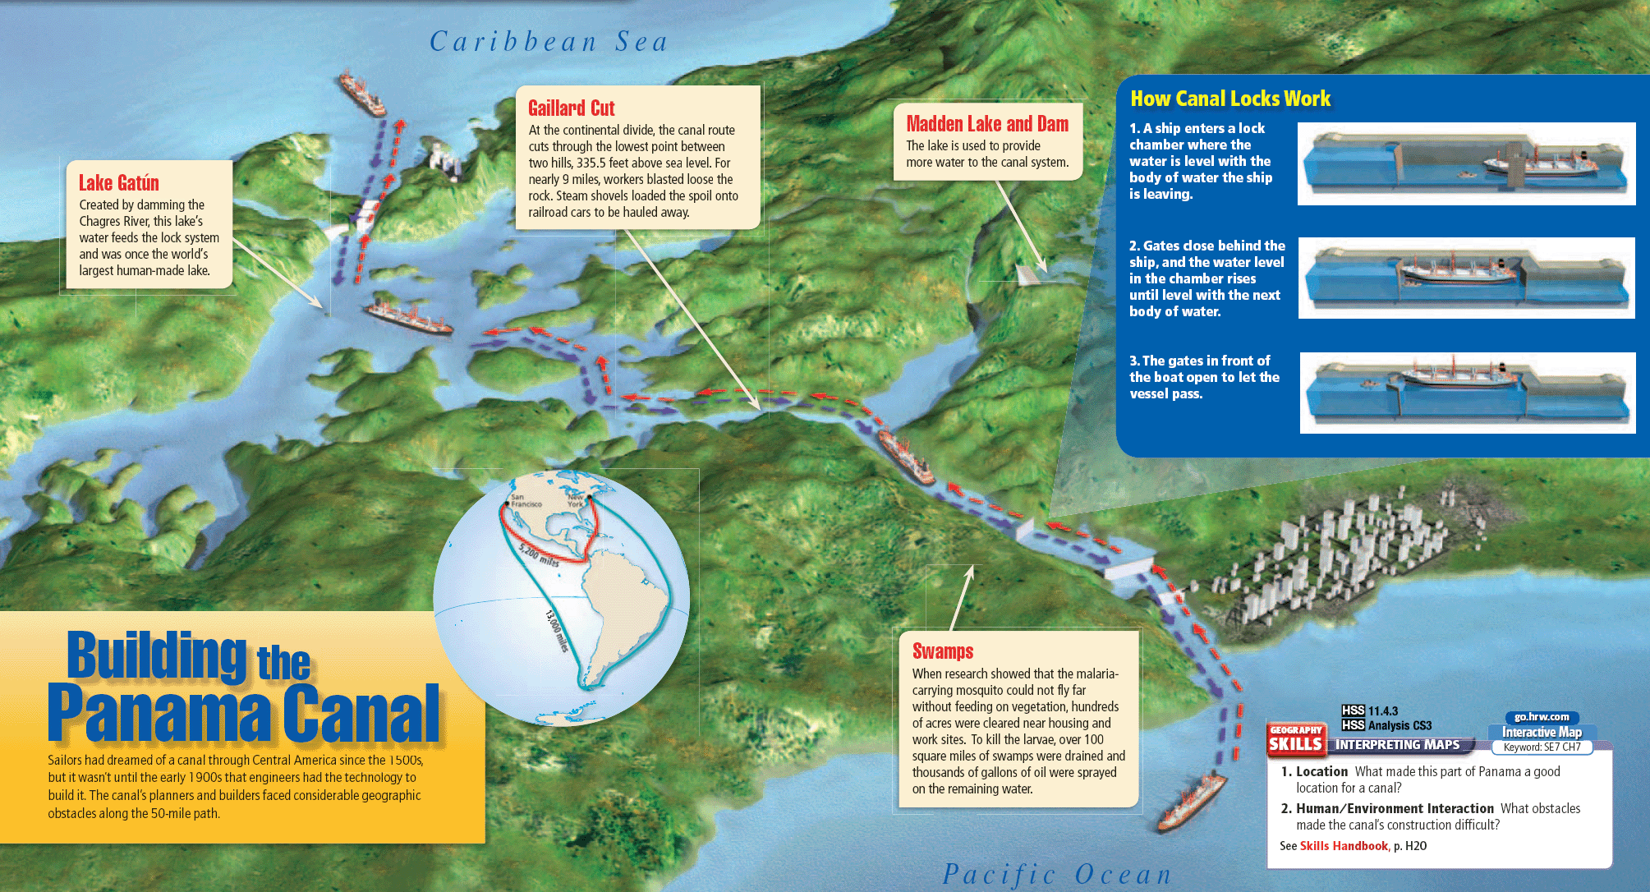

Slide 10
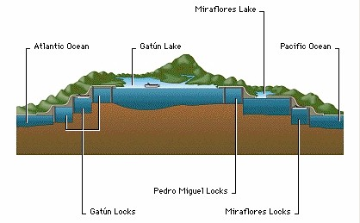
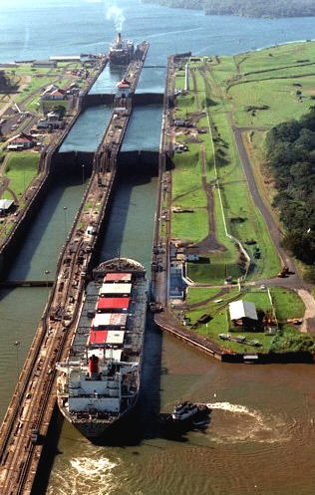
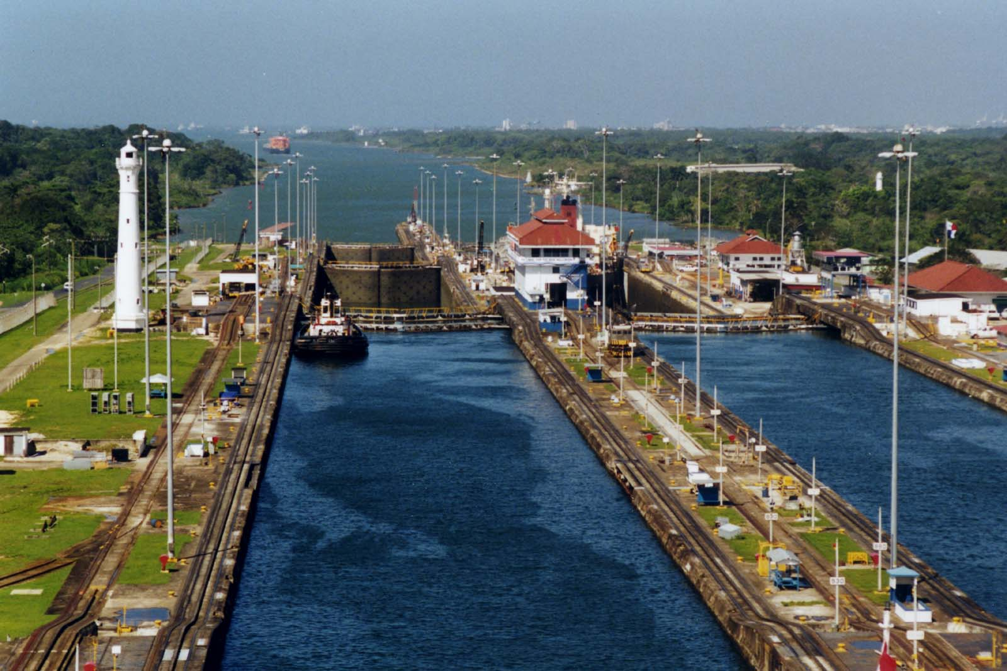

Slide 11
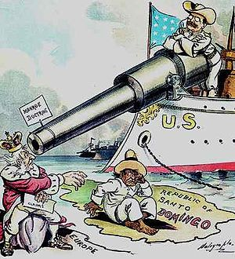
The Roosevelt Corollary
1823 - The Monroe Doctrine
Declared the Western Hemisphere off-limits to European nations
After the SA War, U.S. could now back up with military strength
Added the Roosevelt Corollary

Slide 12
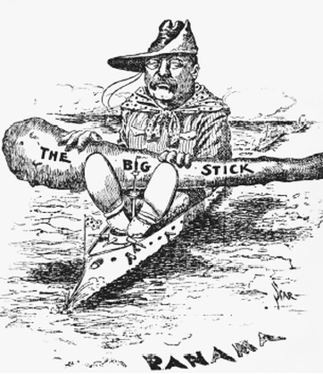
The Roosevelt Corollary
The Roosevelt Corollary
The U.S. could intervene in the internal affairs of Latin American nations
Would use force to prevent European interference

Slide 13
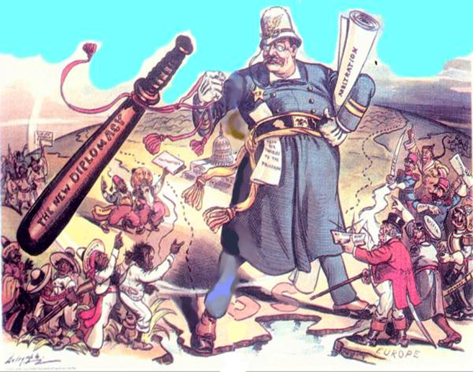
Reshaping U.S. Diplomacy
Big-stick diplomacy
Strive for peace while keeping other nations aware of U.S. military power
“speak softly, and carry a big stick; you will go far”

Slide 14
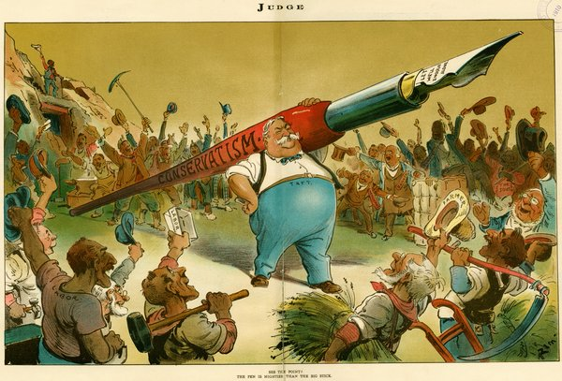
Reshaping U.S. Diplomacy
Dollar diplomacy
Policy of promoting American economic interests in other countries
Use economic power to achieve American goals
Americans had bought out European loans in Latin America

Slide 15
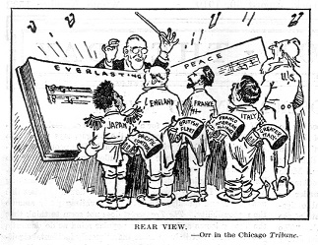
Reshaping U.S. Diplomacy
Moral diplomacy
Used persuasion and American ideals to advance the nation’s interests in other countries

Slide 16
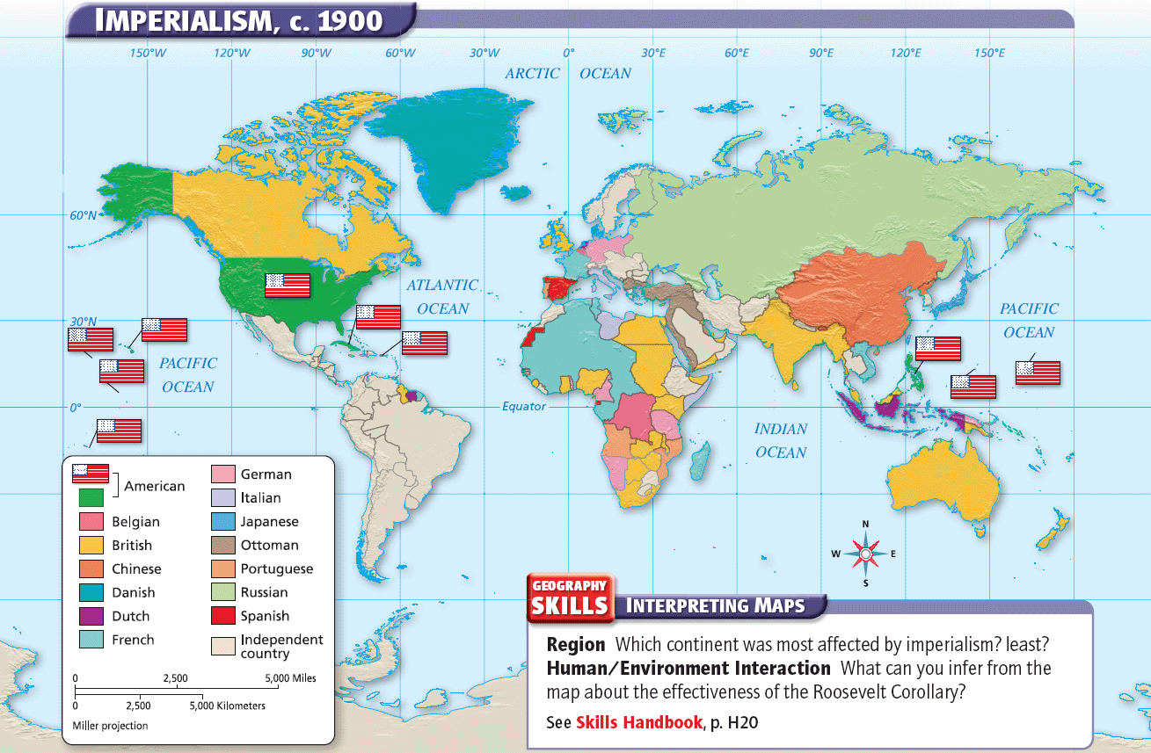

Slide 17
Entering the World Stage:
Wilson and the Mexican Revolution

Slide 18
Main Idea
American intervention in Mexico’s revolution caused strained relations between the two neighbors.

Slide 19
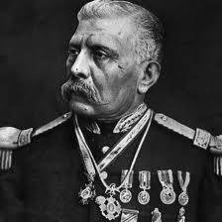
Dictatorship Sparks a Revolution
1877-1910 - Dictator Porfirio Díaz
Brought stability to Mexico
Modernized Mexico
Jailed his opponents
Did not allow freedom of the press
Most lived in poverty

Slide 20
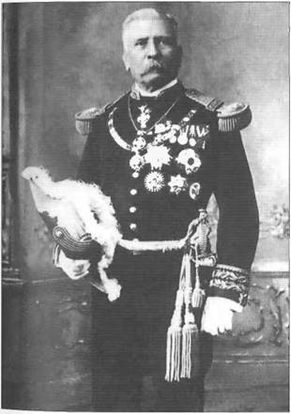
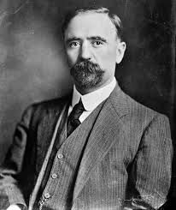
Dictatorship Sparks a Revolution
1910 election -
Díaz controlled the outcome of the election
Jailed his opponent, Francisco Madero
1 million votes Vs. 200

Slide 21
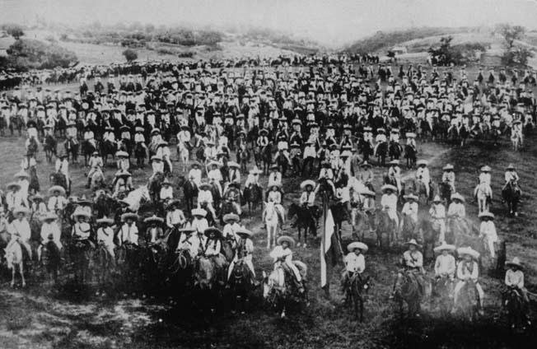
Dictatorship Sparks a Revolution
When released, Madero flees to Texas, declares himself president, and calls for a Mexican Revolution
Series of uprisings in different parts of the country
South – Emiliano Zapata – seized land by force
Wanted land to be returned to native peoples
North – Francisco “Pancho” Villa – led a revolt against Diaz
Diaz resigns – flees to France

Slide 22
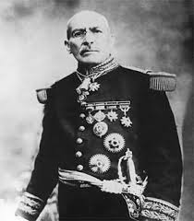
Dictatorship Sparks a Revolution
1911 - Madero was elected president of Mexico
1913 - Overthrown by Victoriano Huerta
European nations recognized Huerta’s government, the U.S. did not

Slide 23
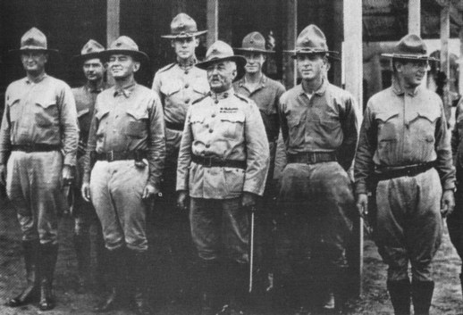
The United States Intervenes
Tampico incident
Nine U.S. soldiers were arrested in Mexico
Quickly released & Mexican officials apologized
U.S. demanded a formal apology and a salute to the American flag
Congress approved the use of force against Mexico

Slide 24
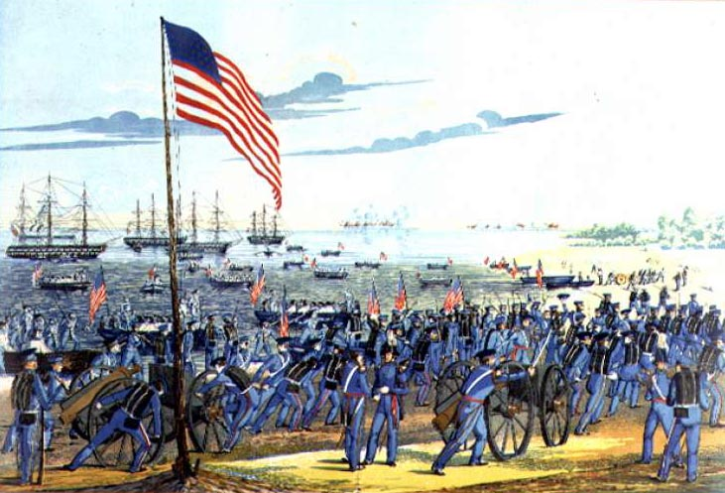
The United States Intervenes
Battle of Veracruz
Wilson orders U.S. Navy to seize the city
17 Americans, 300 Mexicans died
Occupied for the next six months

Slide 25
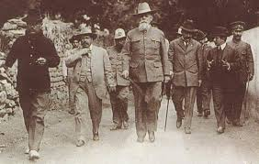
The United States Intervenes
War was avoided due to mediation by Argentina, Brazil, and Chile
Huerta struggled to stay in power
Resigned and fled to Spain

Slide 26
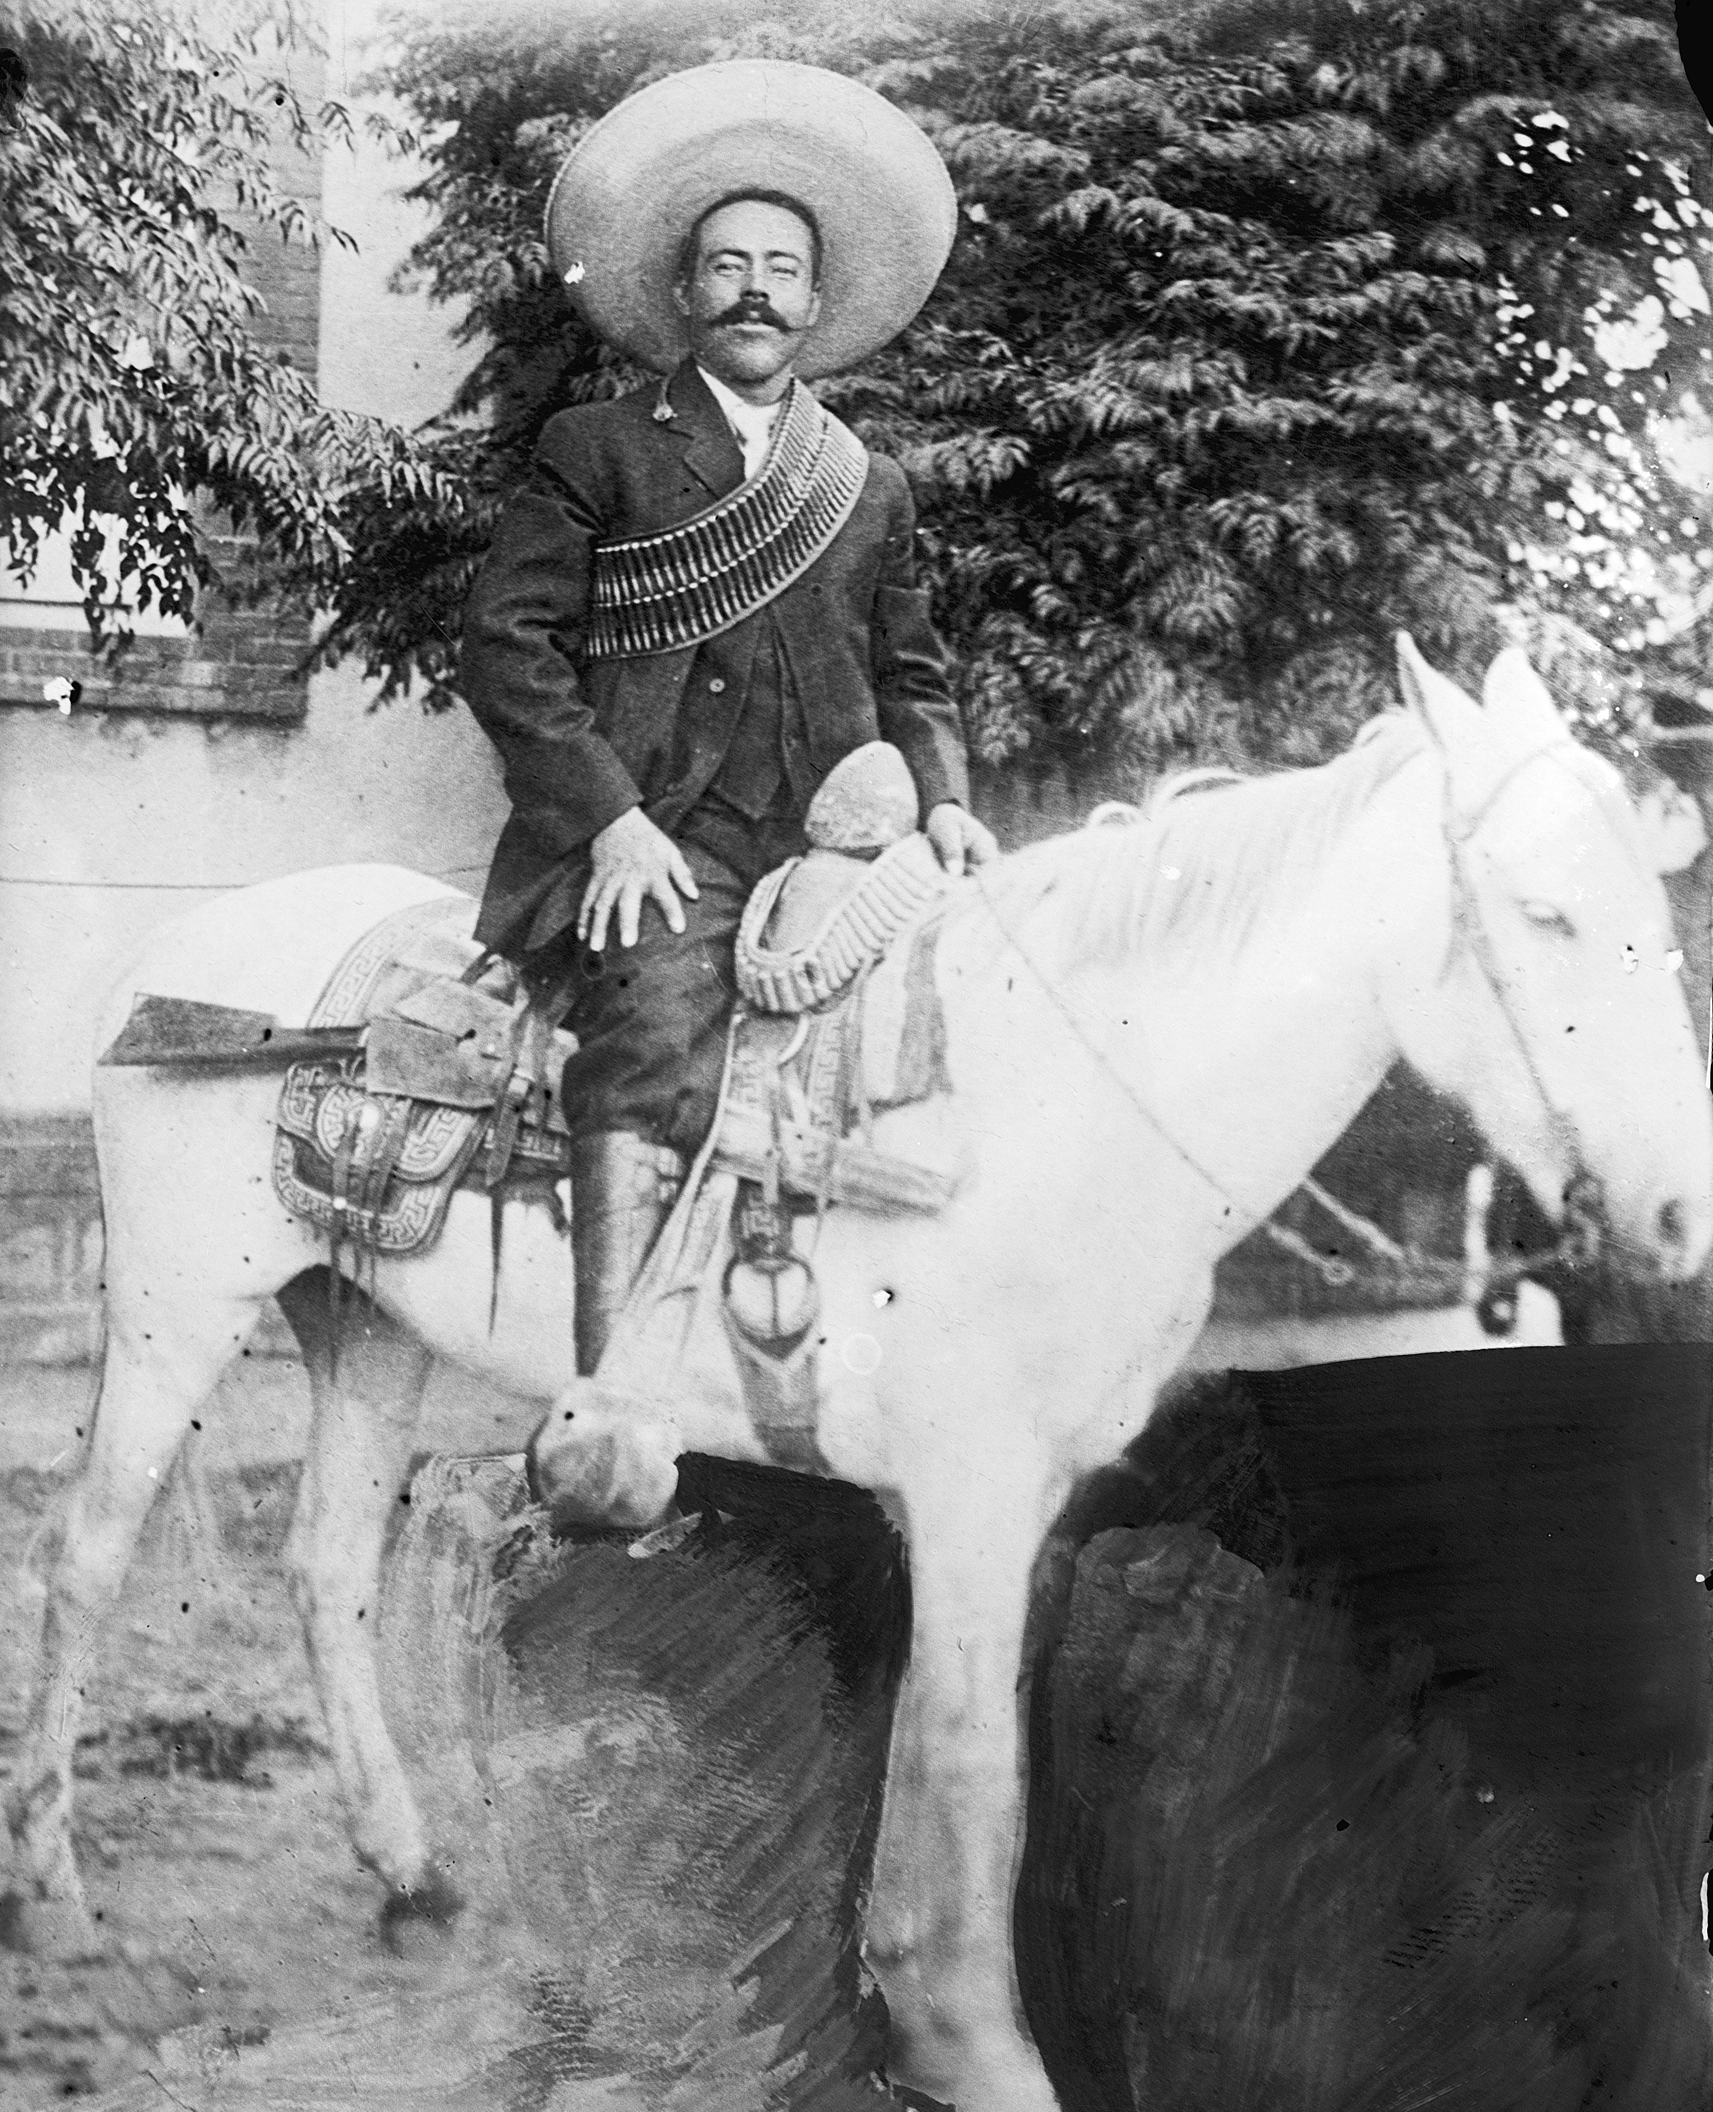
The Revolution Concludes
1914 - Venustiano Carranza declared himself leader
Villa attacks the small town of Columbus, New Mexico
First armed invasion of the continental United States since the War of 1812

Slide 27
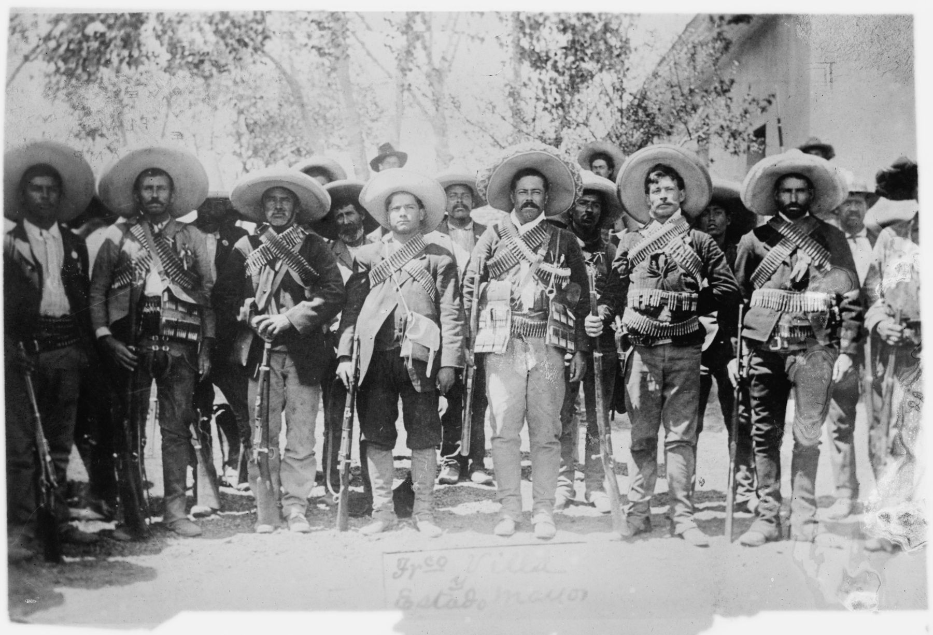
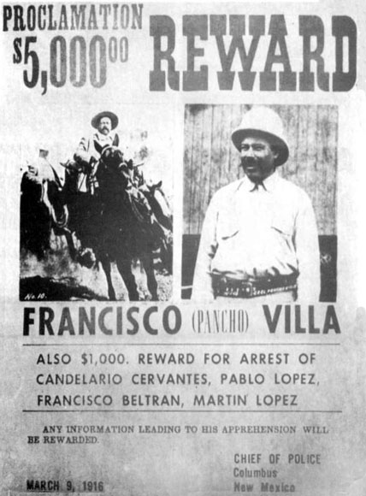
The Revolution Concludes
President Wilson ordered more than 10,000 troops into Mexico to search for Villa
Relations between Mexico and the United States were strained

Slide 28
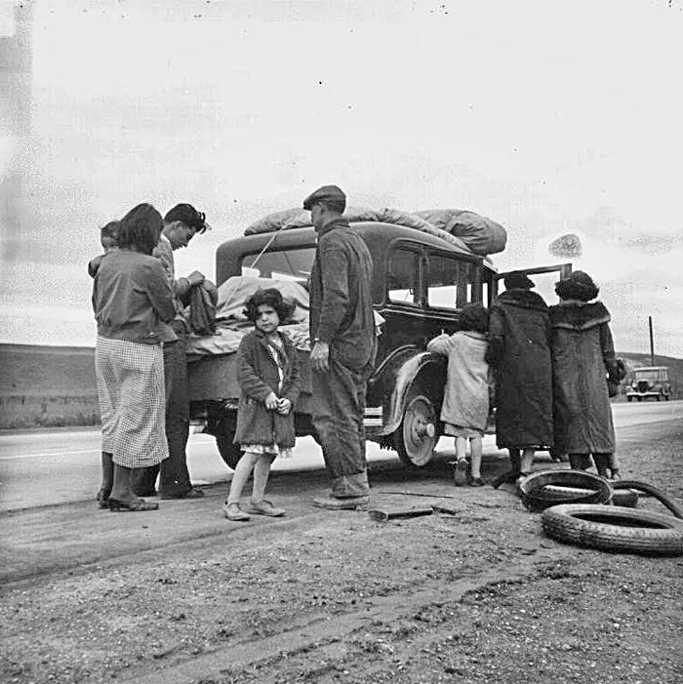
The Revolution Concludes
Fighting in Mexico continued until 1920
Many Mexicans immigrated to the United States in search of a more stable life

Slide 30
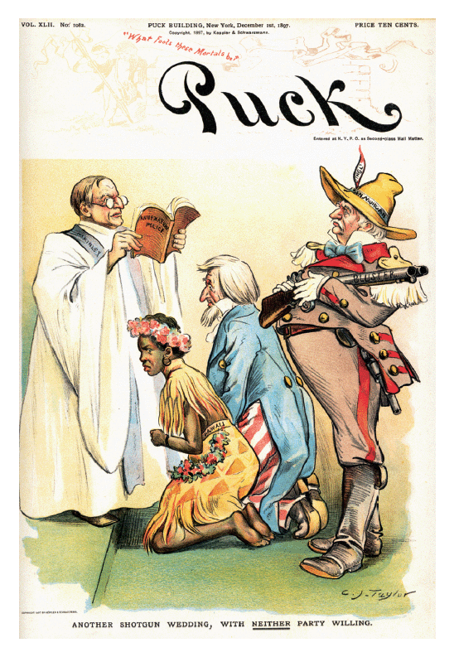

Slide 31
Click on the window to start video

