Slide 1
Entering the World Stage:
The Spanish-American War

Slide 2
Main Idea
A quick victory in the Spanish-American War gave the United States a new role as a world power.

Slide 3
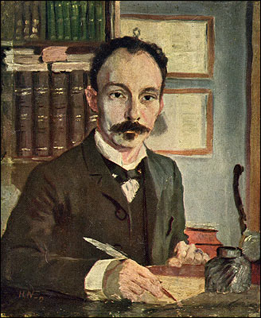
Unrest in Cuba
1868 - Cubans revolt against Spain
Spain exiles revolutionary leaders
José Marti
1895 – Cubans revolt
Ruthless tactics to suppress
the revolt

Slide 4
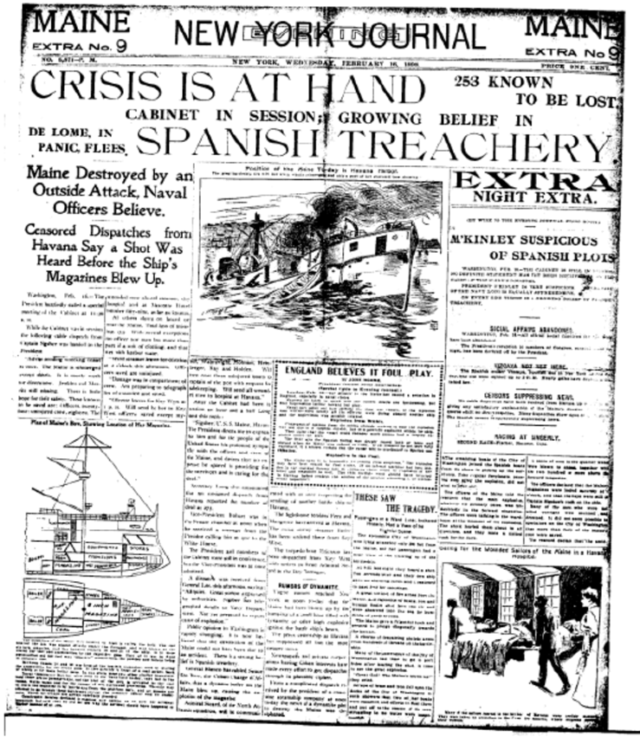
Americans Get War Fever
Yellow journalism
Reporting of exaggerated stories to increase sales

Slide 5
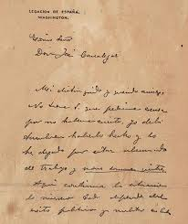
Americans Get War Fever
de Lome letter
A letter written by the Spanish minister to the U.S
Ridiculed President McKinley

Slide 6
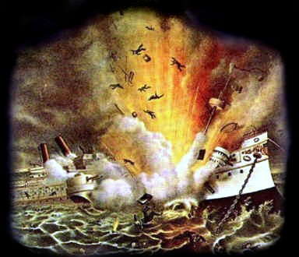
Americans Get War Fever
The battleship USS Maine blew up in Havana harbor
Blamed on Spain
“Remember the Maine!”

Slide 7
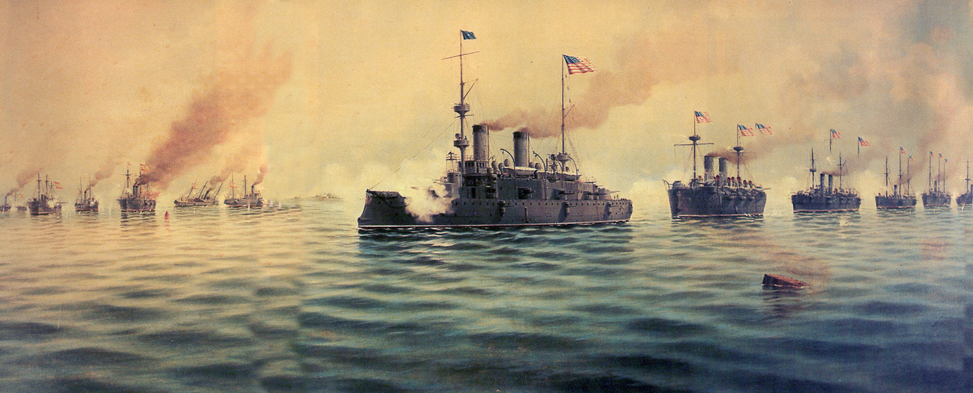
The Course of the War: The Philippines
Commodore George Dewey was sent orders to prepare for war against Spain
Dewey engaged the Spanish fleet in Manila Bay
U.S. had advantage

Slide 8
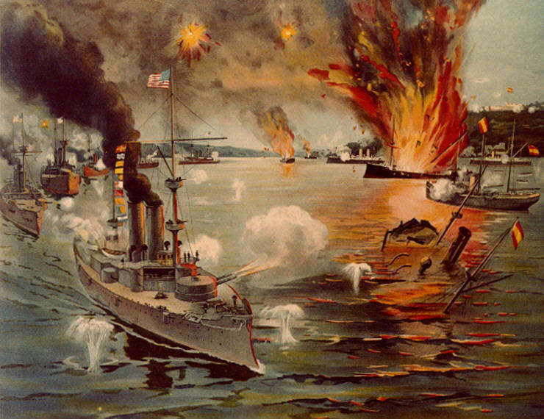
The Course of the War: The Philippines
Filipino rebels had already been fighting Spain
Emilio Aguinaldo
Surrounded by Dewey (at sea) and Aguinaldo (on land), Spanish forces surrendered

Slide 9
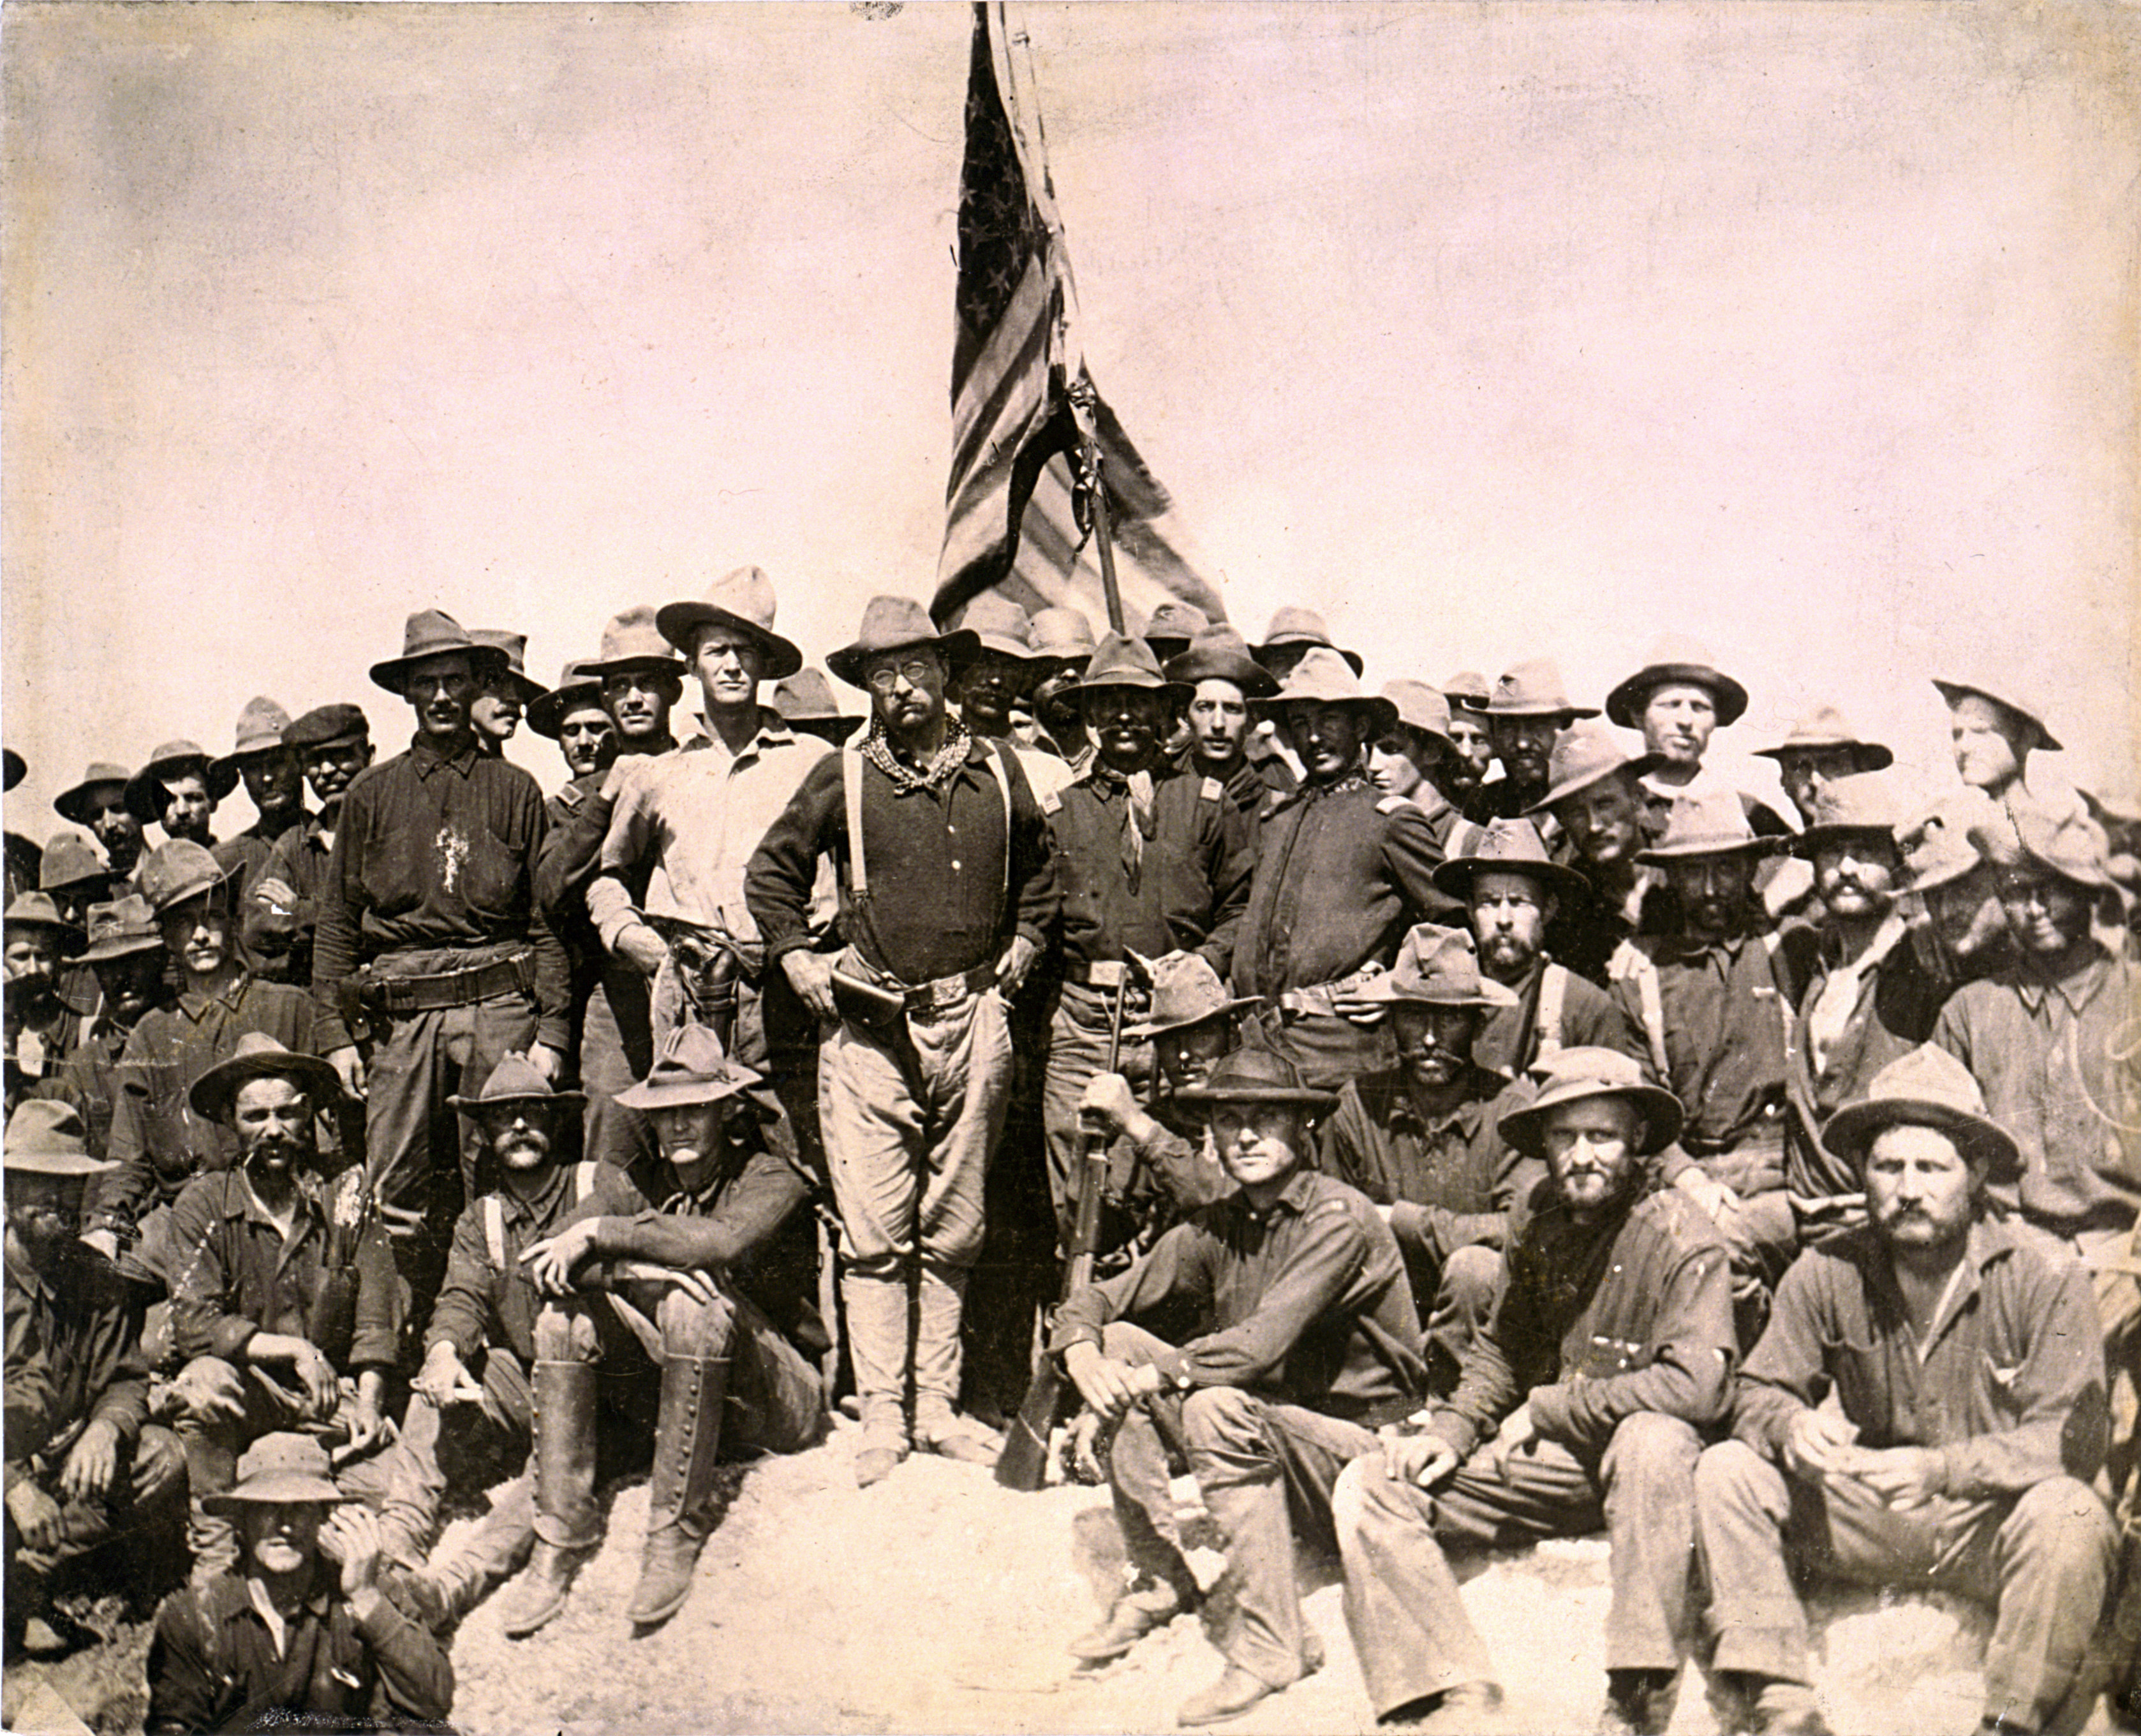
The Course of the War: Cuba
U.S. War Department was unprepared for war in Cuba.
American strategy was to control the port city of Santiago
Rough Riders
A “cavalry” regiment organized by Theodore Roosevelt
Volunteers

Slide 10
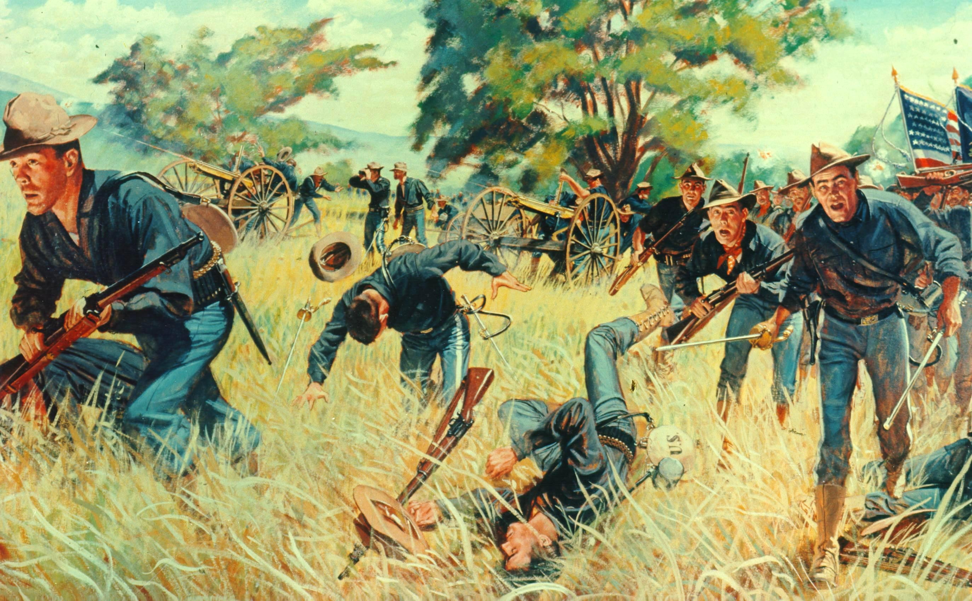
The Course of the War: Cuba
Battle of San Juan Hill
Helped gain control of the city
Led by the Buffalo Soldiers, the Rough Riders, and regulars

Slide 11
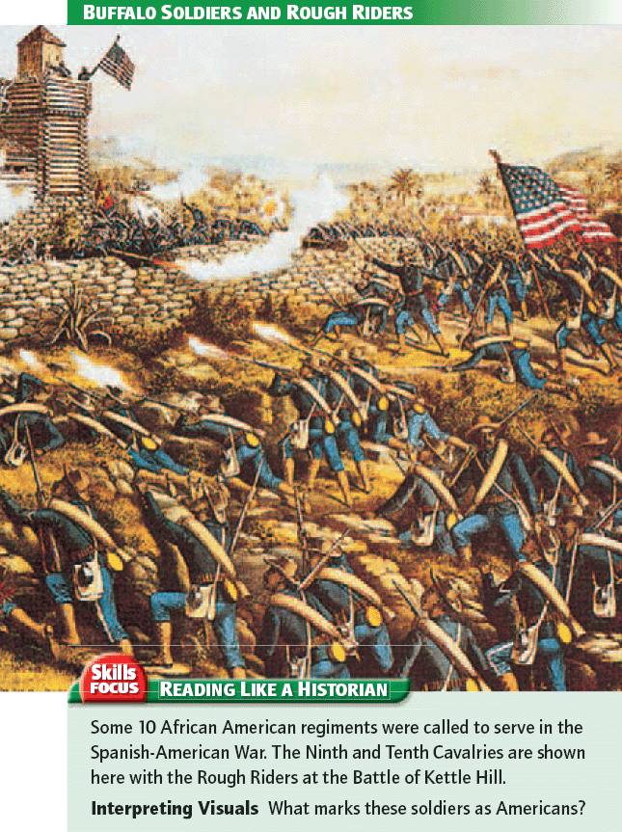

Slide 12
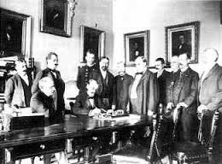
The Course of the War: Cuba
The U.S. Navy sank the entire Spanish fleet off the coast of Cuba
Spanish forces defeated in Puerto Rico
Lasting only 4 months - Spain surrenders

Slide 13
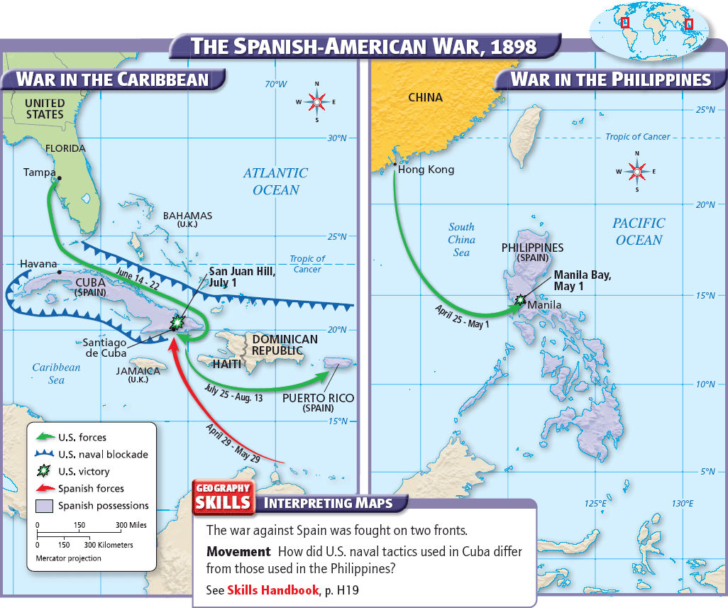

Slide 14
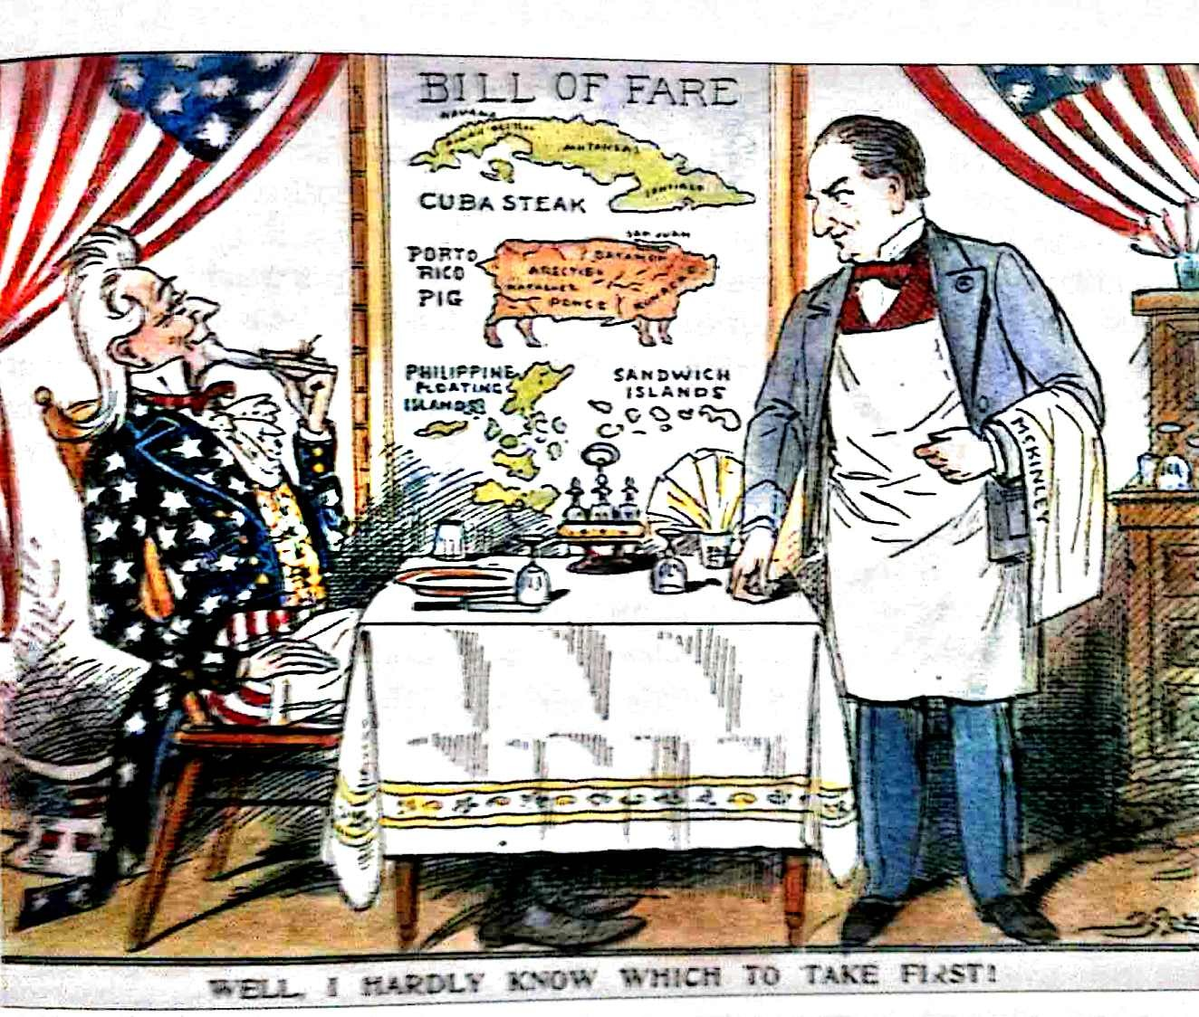
Consequences of the War
Elevated the American position in the world
Spain gave up all claims to Cuba
The United States gained territory in Puerto Rico and Guam
Spain turned over the Philippines for $20 million

Slide 15
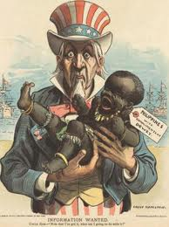
Annexing the Philippines
Pro Annexation:
The U.S. had a duty to spread its values overseas
Economic and strategic value
Anti Annexation:
Would violate the ideal of self-government
Believed would increase immigration

Slide 16
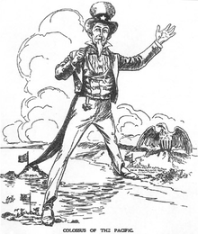
Annexing the Philippines
The U.S. Senate annexed the Philippines
Filipino independence fighters battled U.S. soldiers for three years
On July 4, 1946, the United States finally granted full independence to the Philippines

