Slide 1
Exploration and Expansion:
Voyages of Discovery

Slide 2
Main Idea
During the 1400s and 1500s European explorers – Inspired by greed, curiosity, and the desire for glory and aided by new technologies – sailed to many previously unknown lands.

Slide 3
The Age of Exploration
DRIVEN BY THE “3 G’s”
Driven by the search for wealth (GOLD)
Spices, silk, perfume, jade, silver, gold
Driven by fame (GLORY)
Driven by the hope to spread their faith (GOD)
Curiosity

Slide 4
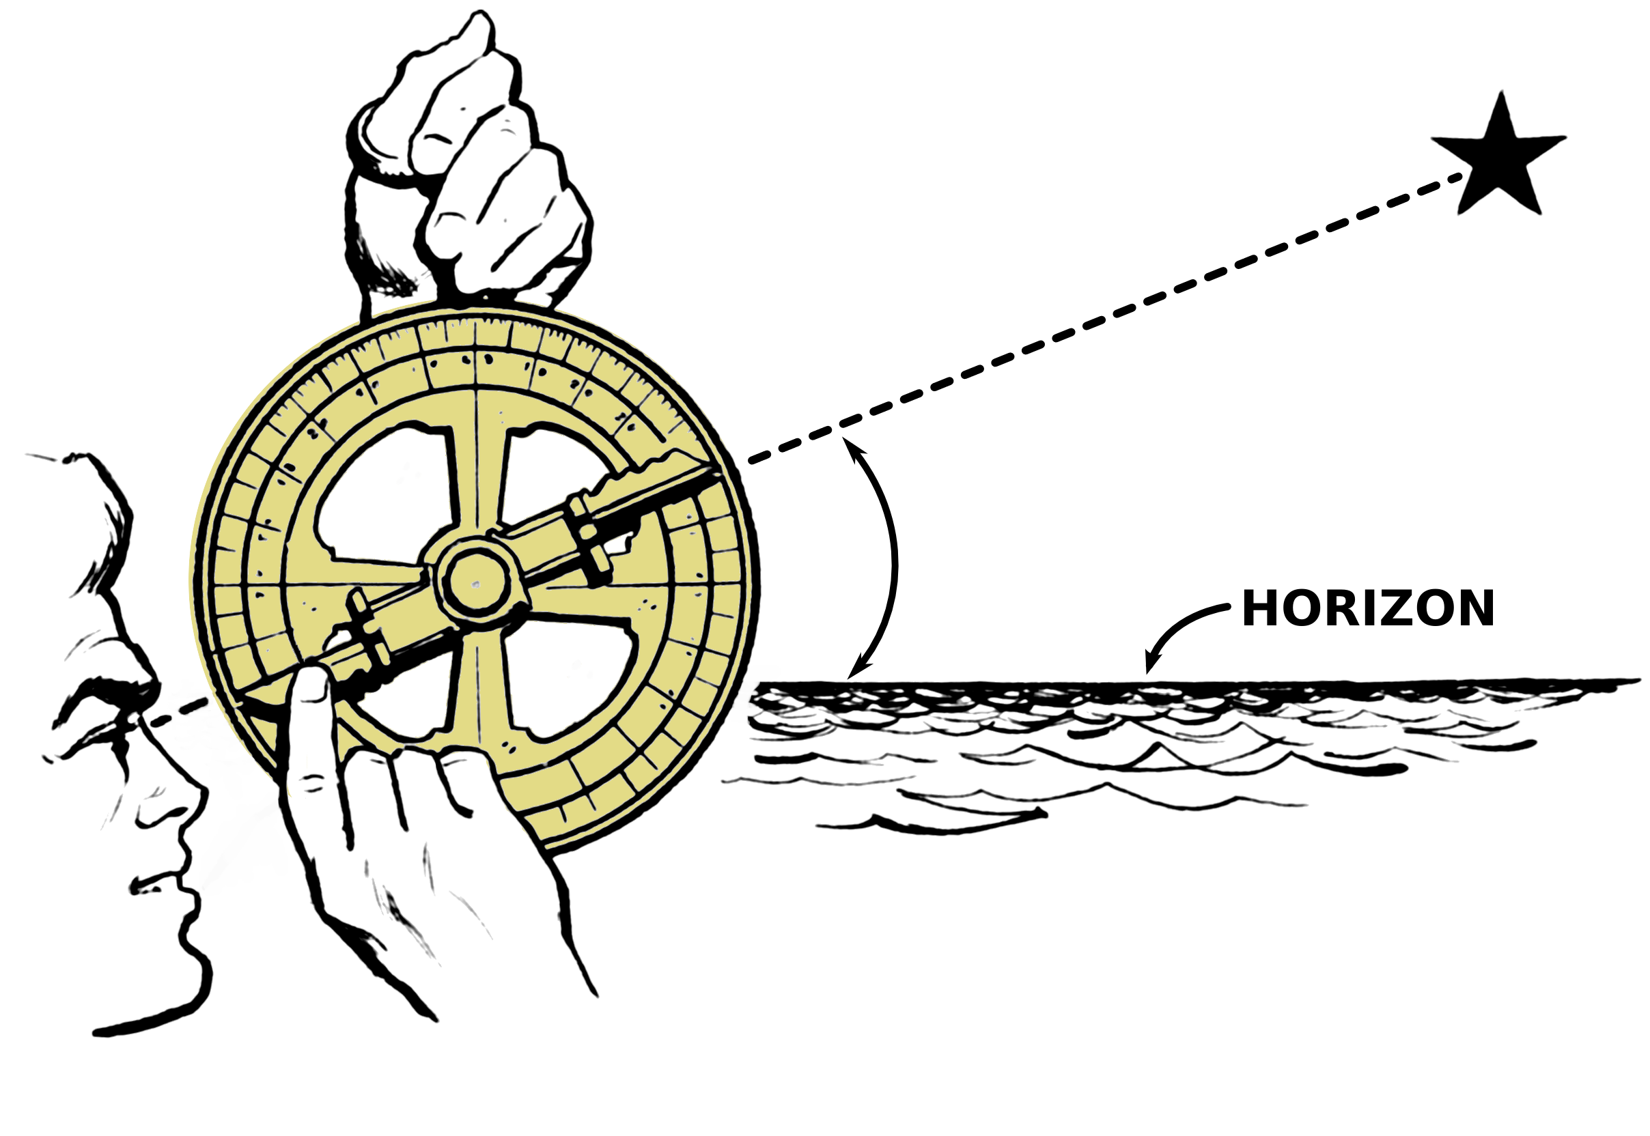
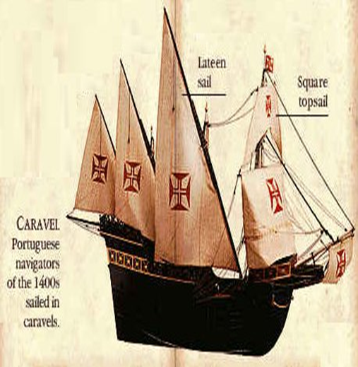
Advances in Technology
Compass & astrolabe
Advanced shipbuilding
Caravel

Slide 5
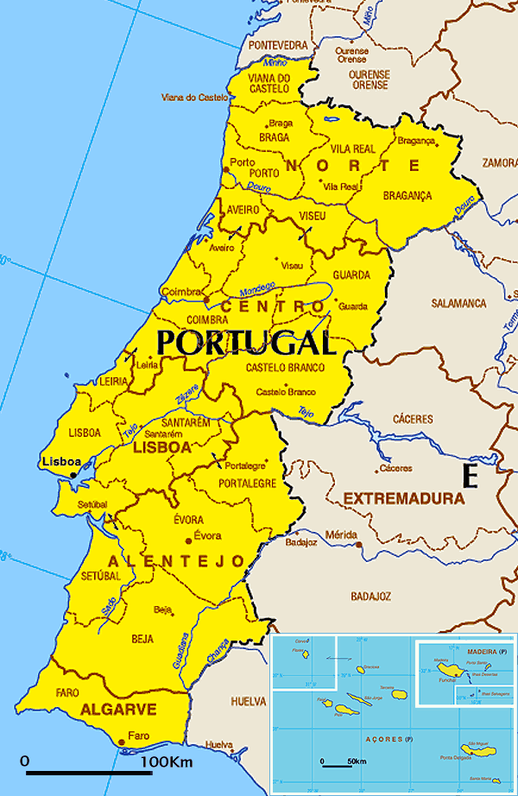
The Portuguese
First country to start large-scale voyages
Established trade centers along the way
Goal: Find water route around Africa to India

Slide 6
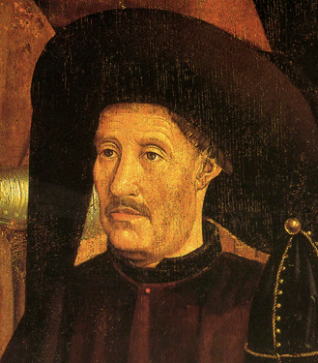
The Portuguese
Henry the Navigator
Started small court
Sailors, mapmakers, astronomers
Funded explorations

Slide 7
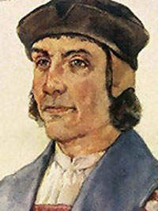
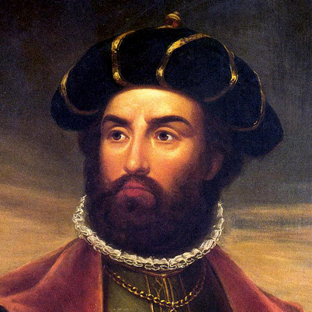
The Portuguese
Bartolomeu Dias
First to attempt to sail around Africa
Vasco da Gama
Sails around the Cape of Good Hope to India

Slide 8
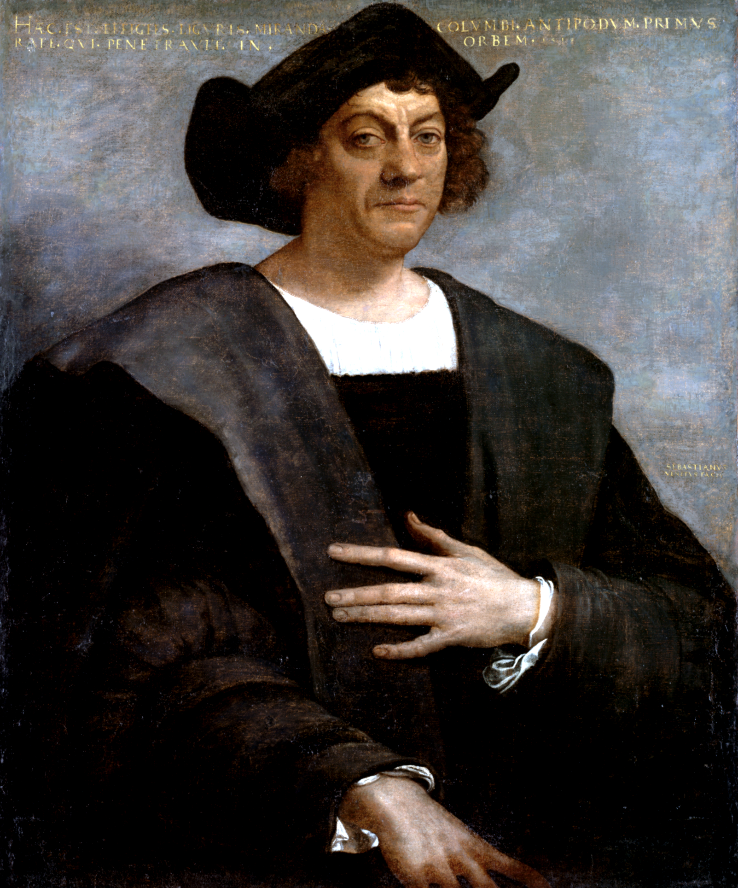
The Spanish
Christopher Columbus
Believed could sail west and reach China
Landed in the Caribbean

Slide 9
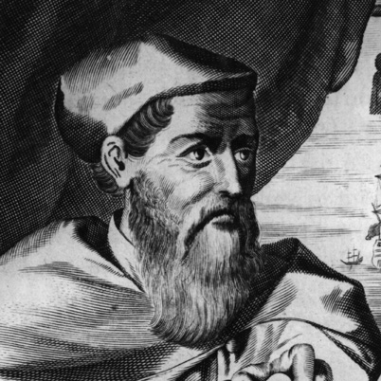
The Spanish
Amerigo Vespucci
Discovered Columbus was wrong – actually new land

Slide 10
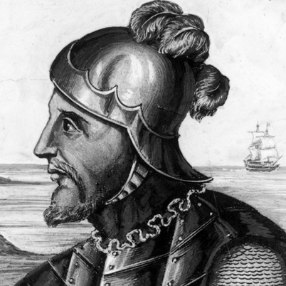
The Spanish
Vasco Nunez de Balboa
Expedition across the Isthmus of Panama
First European to see the Pacific Ocean

Slide 11
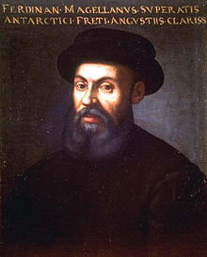
The Spanish
Ferdinand Magellan
Sails west around the world
Crew was the first to circumnavigate the world

Slide 12
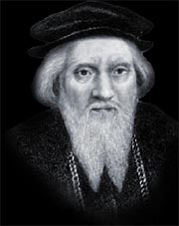
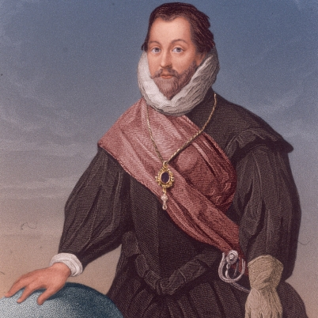
The English
Looking for the Northeast Passage
John Cabot
Sailed to Canada
Sir Francis Drake
Circumnavigates the globe

Slide 13
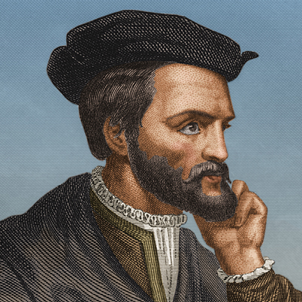
The French
Want to find Northwest Passage
Jacques Carter
Sails into the St. Lawrence River
Claims all land along the river as province of New France (Canada)

Slide 14
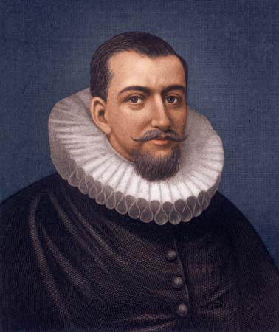
The Dutch
Powerful trading nation
Established trade with Asia
Involved in exploration of Americas
Henry Hudson

Slide 16
Exploration and Expansion:
Conquest and Colonies

Slide 17
Main Idea
The countries of Europe established colonies in the lands they had discovered but, in some cases, only after violently conquering the native people who had lived there.

Slide 18
Spain Builds an Empire
First country to successfully settle in the Americas
Conquered two of the greatest native empires
Aztecs & Incas

Slide 19
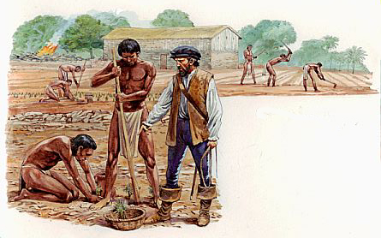
Spain Builds an Empire
Introduced encomienda system
Colonists given land and number of Native Americans
Required to teach workers about Christianity

Slide 20
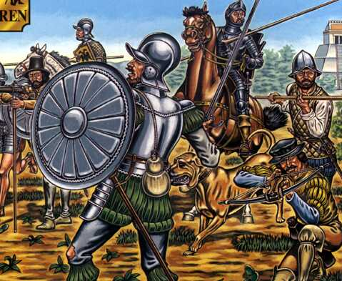
Spain Builds an Empire
Conquistador – “conqueror”
Spanish military leaders who fought against native peoples of the Americas

Slide 21
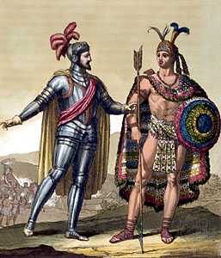
Spain Builds an Empire
Hernan Cortes
Led conquest into Mexico
Aztecs

Slide 22
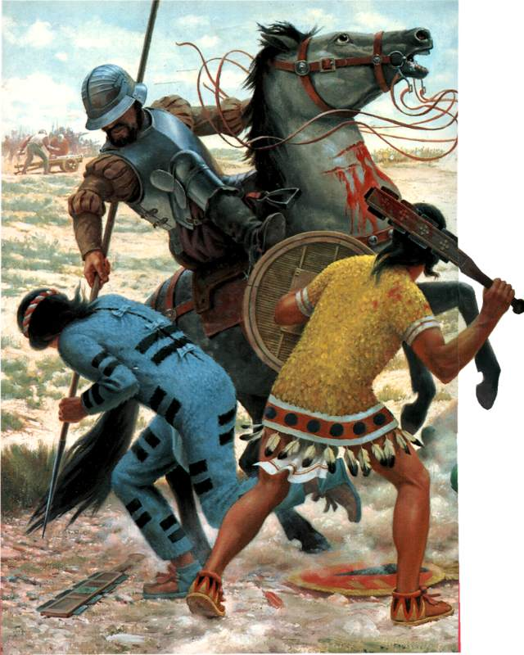
Spain Builds an Empire
Cortes’ advantages:
Native American allies
Metal weapons/armor/guns
Horses
Disease

Slide 23
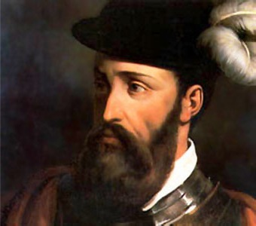
Spain Builds an Empire
Francisco Pizarro
Led expedition to Peru
Destroyed Inca and took over

Slide 24
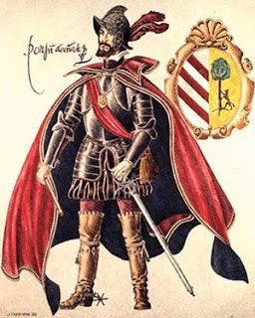
Spain Builds an Empire
Viceroys
Officials chosen by Spanish king to oversee new lands in America
Colonial economy based on mining and farming

Slide 25
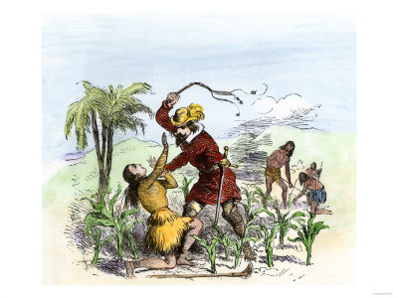
Spain Builds an Empire
Used Native Americans for labor
Disease and mistreatment
Population dropped 90%
50 million to 4 million
Bartolome de Las Casas
Reformer for Native Americas
Recommended replacing with slaves

Slide 26
The Portuguese
Treaty of Tordesillas – 1494
Drew an imaginary line through the Atlantic
Everything west of line would belong to Spain
Everything east of line would belong to Portugal

Slide 28
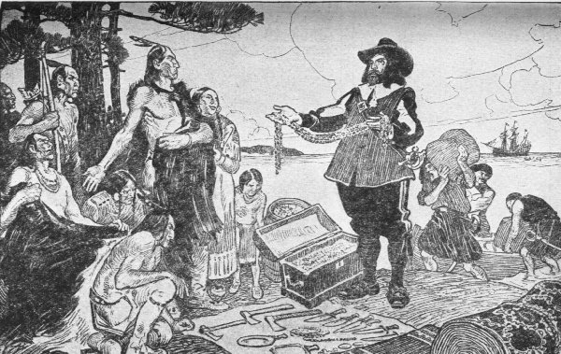
The French
Colonies in New France (Canada)
Hoped would be source of gold & silver
Valuable trade goods (fishing and furs)

Slide 29
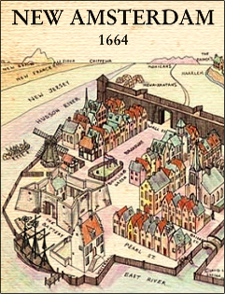
The Dutch
Mostly interested in trade
New Netherland (Hudson River valley)

Slide 30
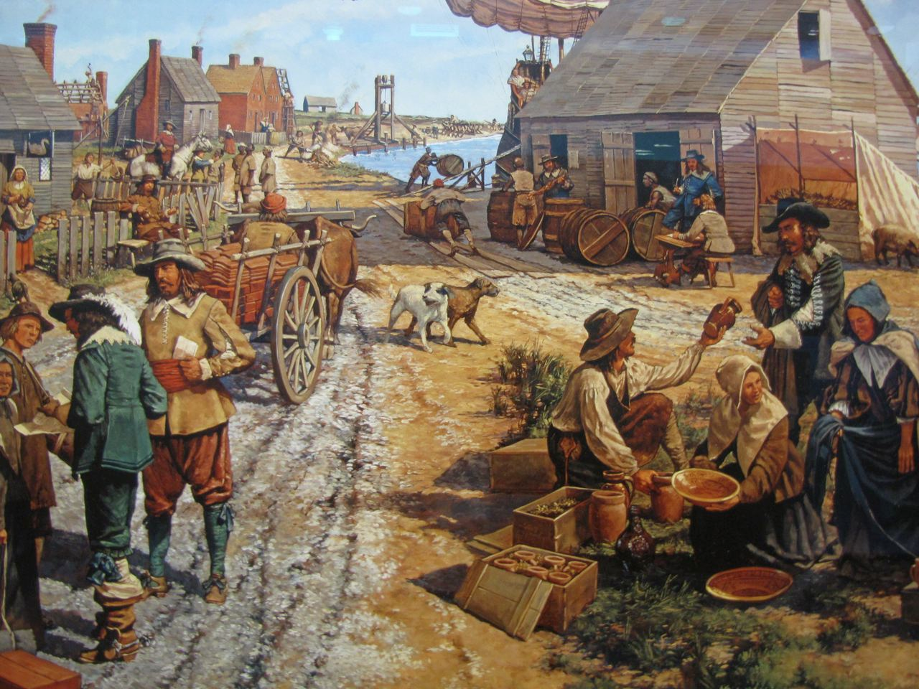
The English
Roanoke
1607 - Jamestown
80% of settlers died
1620 – Pilgrims in New England

Slide 32
Exploration and Expansion:
New Patterns of Trade

Slide 33
Main Idea
The creation of colonies in the Americas and elsewhere led to the exchange of new types of goods, the establishment of new patterns of trade, and new economic systems in Europe.

Slide 34
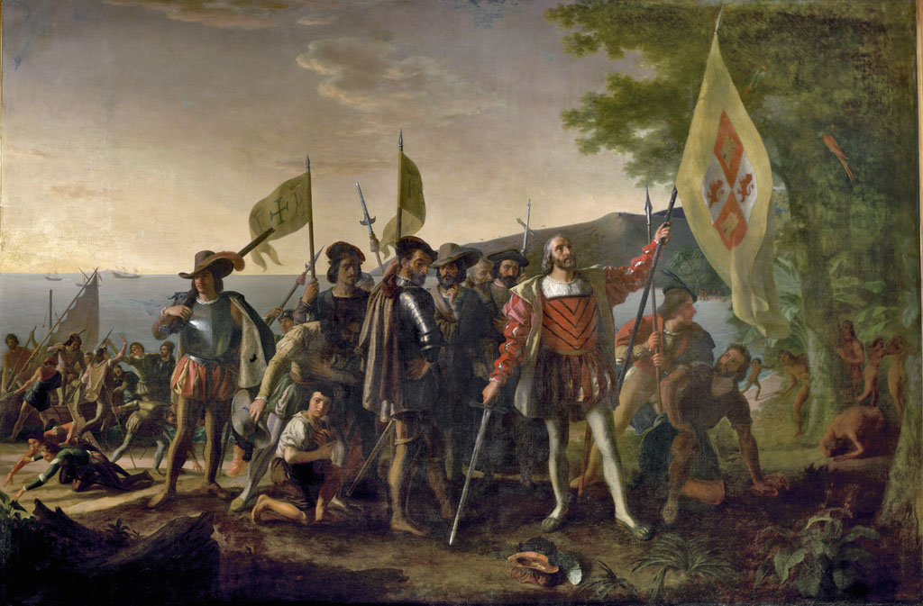
The Columbian Exchange
Columbian Exchange
Transfer of plants, animals, and disease between the Americas and Europe, Asia, and Africa
Began with the voyages of Columbus

Slide 35
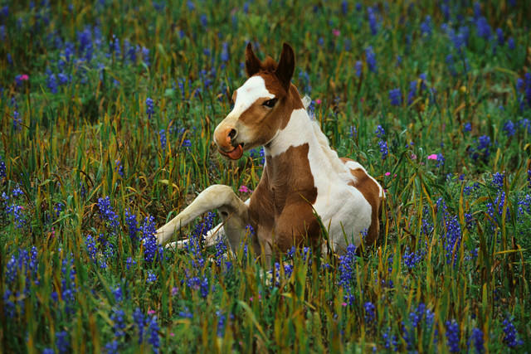
The Columbian Exchange
Europe had coffee, oranges, rice, cattle, horses
“New World” had potatoes, corn, turkeys
Colonists brought new foods back to Europe and brought familiar foods back to colonies
Beasts of Burden: horses

Slide 37
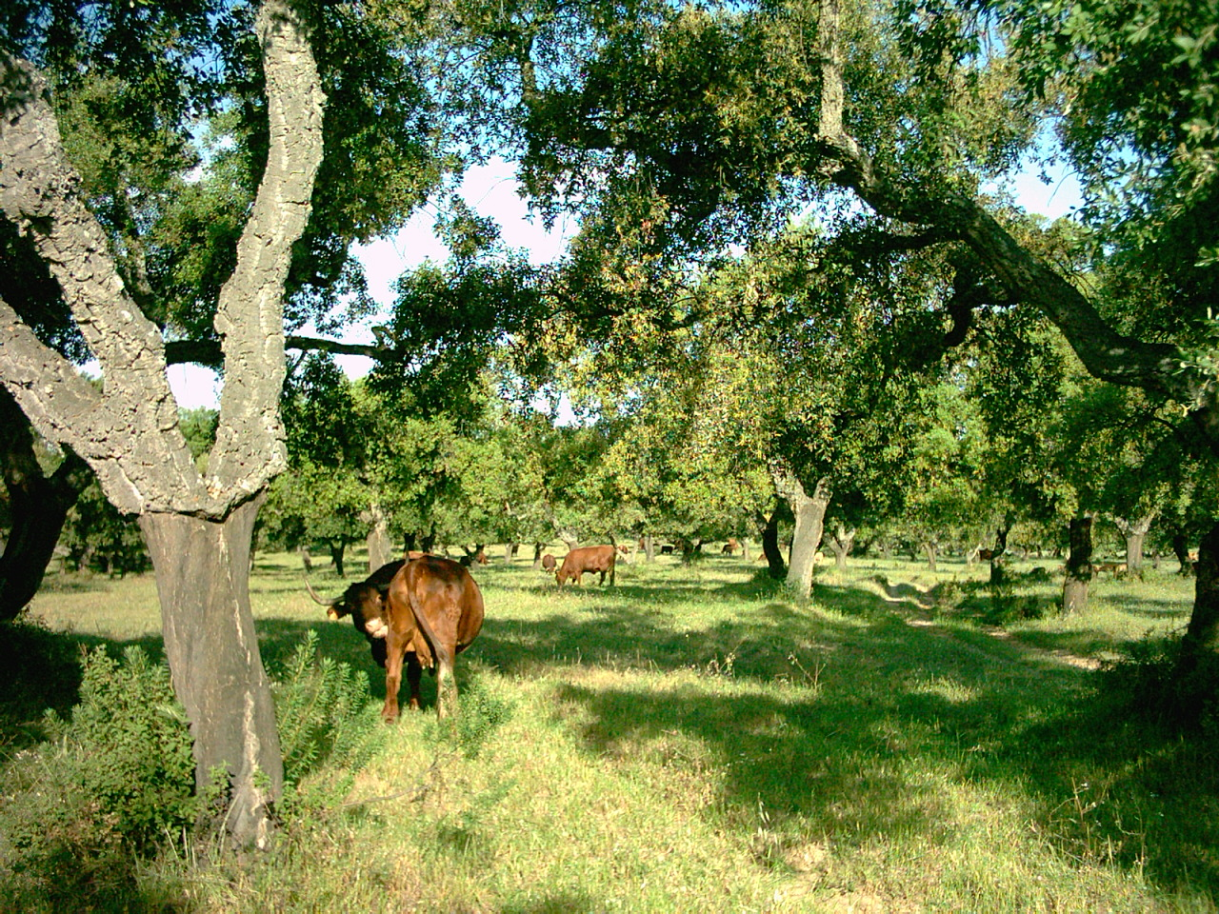
The Columbian Exchange
Dependence on new foods
Changes in diet/cuisines
Changed economy

Slide 38
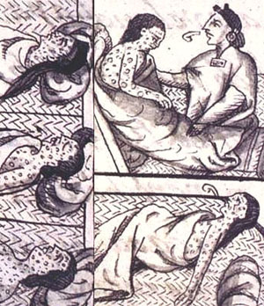
The Columbian Exchange
Diseases brought to Americas
Native Americans had no natural resistance
1492 –13 million
1600 – 2 million
1900 – 500,000

Slide 39
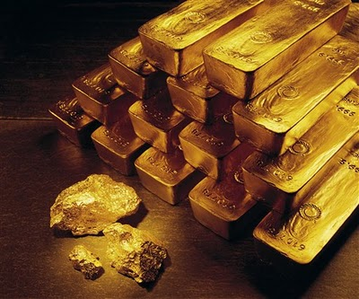
Mercantilism
Mercantilism
New economic policy
Nation’s strength depended on its wealth
Wealth measured in gold and silver
In order to gain wealth, had to take from another
Wealthy nation could build a strong military to protect itself and expand its influence

Slide 40
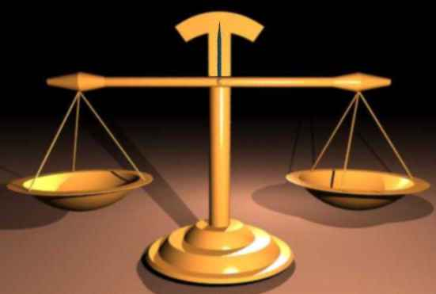
Balance of Trade
Balance of trade
Could build wealth in two ways:
1.) Extract gold and silver from mines
2.) Sell more goods than it bought from foreign countries

Slide 41
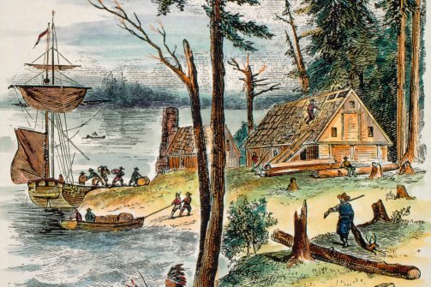
Colonies & Impact
Colonial empires essential to mercantilist system
New source of raw materials
New markets for goods
Colonies existed only to benefit the home country

Slide 42
The Rise of Capitalism
Capitalism
Economic activity carried on by private individuals or organizations in order to seek a profit

Slide 43
Exploration and Expansion:
The Atlantic Slave Trade

Slide 44
Main Idea
Between the 1500s and the 1800s millions of Africans were captured, shipped across the Atlantic Ocean, and sold as slaves in the Americas.

Slide 45
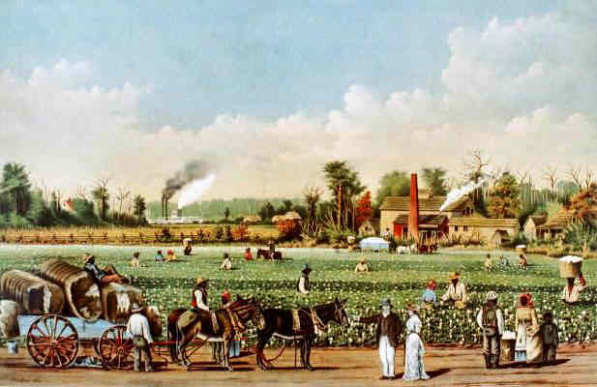
Origins of the Slave Trade
Shortage of labor in the Americas
Plantations
Estates where cash crops were grown on a large scale
Native Americans -> Indentured Servants -> Slaves

Slide 46
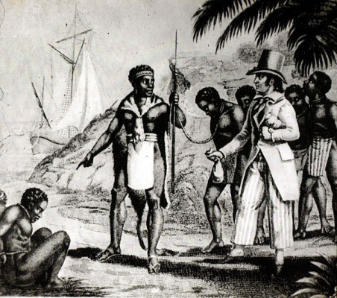
Origins of the Slave Trade
Millions of Africans
Mostly from the coast of West Africa
Forcibly taken in raids or traded by rulers for firearms

Slide 47
The Atlantic Slave Trade
Triangular Trade
1.) Ships carry European goods to Africa for slaves
Guns, rum , textiles
2.) Middle passage
Africans to Americas to be sold
3.) Carried American products to Europe
Sugar, tobacco, rice

Slide 49
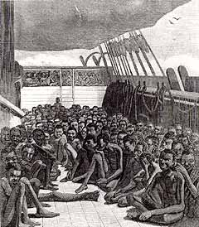
The Middle Passage
Terrible
Chained together
Dark, dirty, cramped quarters below the ship
Couldn’t sit or stand
Journey lasted 3-6 weeks
10-20% did not survive voyage

Slide 51
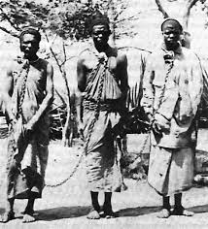
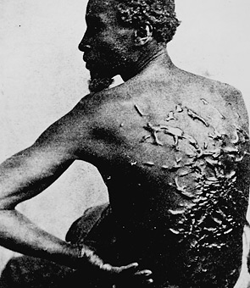
Slavery in the Colonies
Carried all over the Americas
Worked in plantations, mines, towns, and the countryside
Harsh living conditions
Physical and degrading punishments

Slide 52
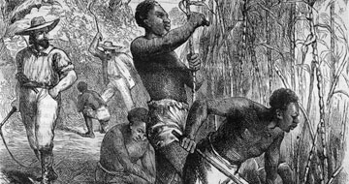
Slavery in the Colonies
Slaves considered property
No rights, no freedoms
Slaveholders controlled most conditions

Slide 53
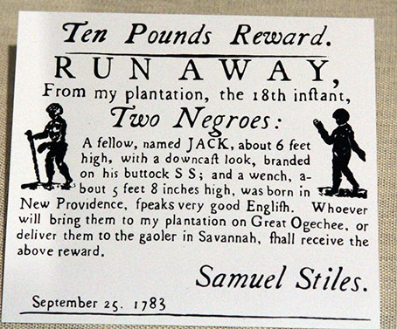
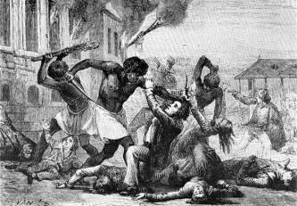
Slavery in the Colonies
Forms of resistance:
Kept cultural traditions alive
Religion for strength and hope
Slowing down work
Destroying equipment
Revolts
Runaway

Slide 54
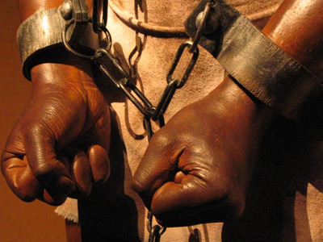
Effects of the Slave Trade
Lasted 400 years
15-20 million Africans shipped to Americas
Deprived millions of their freedom
Doomed their descendants

Slide 55
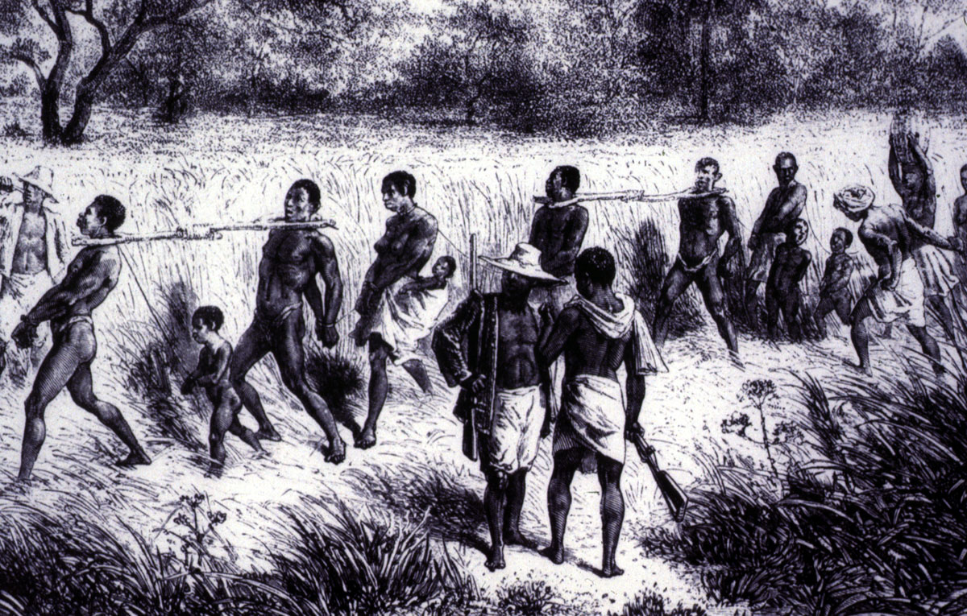
Effects of the Slave Trade
Effects on Africa:
Raiders captured many of strongest young people
Divided Africans

Slide 56
Effects of the Slave Trade
African Diaspora
People of African descent spread throughout Americans and Western Europe

