Slide 1
The French Revolution and Napoleon:
The Revolution Begins

Slide 2
Main Idea
Problems in French society led to a revolution, the formation of a new government, and the end of the monarchy.

Slide 3
Causes of the Revolution
Inequalities in society
Ideas of Enlightenment writers
Poor leadership from Louis XVI
Financial crisis
Widespread hunger and record cold

Slide 4
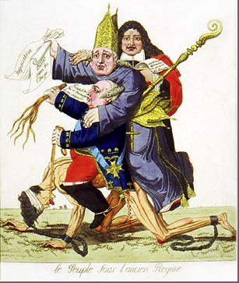
Causes of the Revolution
Social and political structure created inequalities in French society
The Old Order
King at the top
3 social groups, called estates (1,2,3)

Slide 5
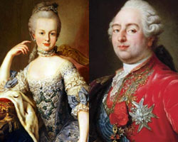
Causes of the Revolution
King Louis XVI & Marie-Antoinette
Unpopular
Frivolous & self-indulgent
Disconnected

Slide 6
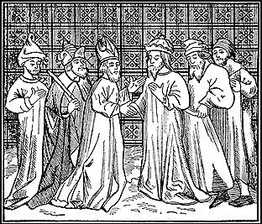
Causes of the Revolution
First Estate
1% of the population
Roman Catholic clergy
Didn’t have to pay taxes
Different set of rules
Owned large pieces of land

Slide 7
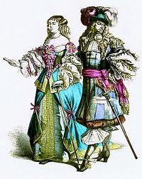
Causes of the Revolution
Second Estate
2% of the population
Key positions in government and military
The nobles

Slide 8
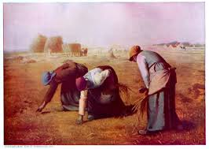
Causes of the Revolution
Third Estate
97% of the population
1.) Bourgeoisie
2.) Artisans
3.) Sans culottes
4.) Peasants/farmers

Slide 9
Causes of the Revolution
France deeply in dept
Borrowed money for wars
King spent lavishly
Tried to tax the estates
Worst winter in 80 years

Slide 10
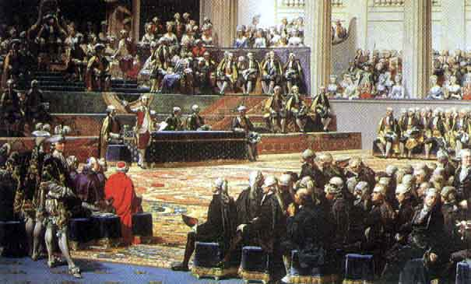
The Revolution
Meeting of the Estates-General
Each estate given one vote
Third estate wanted more representation
Locked out of the meeting

Slide 11
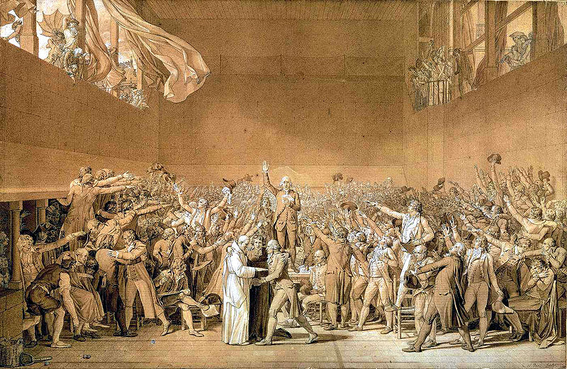
The Revolution
Third Estate proclaimed themselves a legislature – the National Assembly
Tennis Court Oath
Would not leave until had written a constitution for France

Slide 12
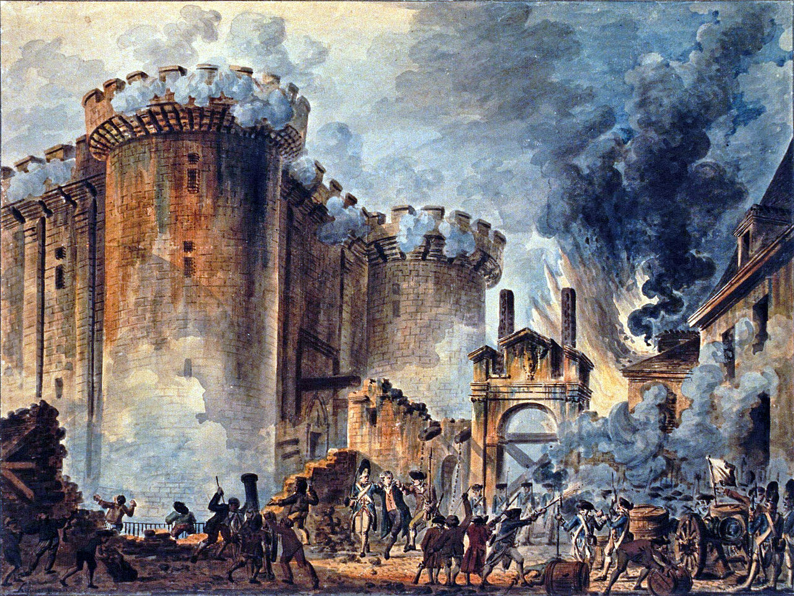
The Revolution
Louis orders troops to Paris and Versailles
National Assembly fears king would use force to end meetings
July 14, 1789 - Mob storms the Bastille

Slide 13
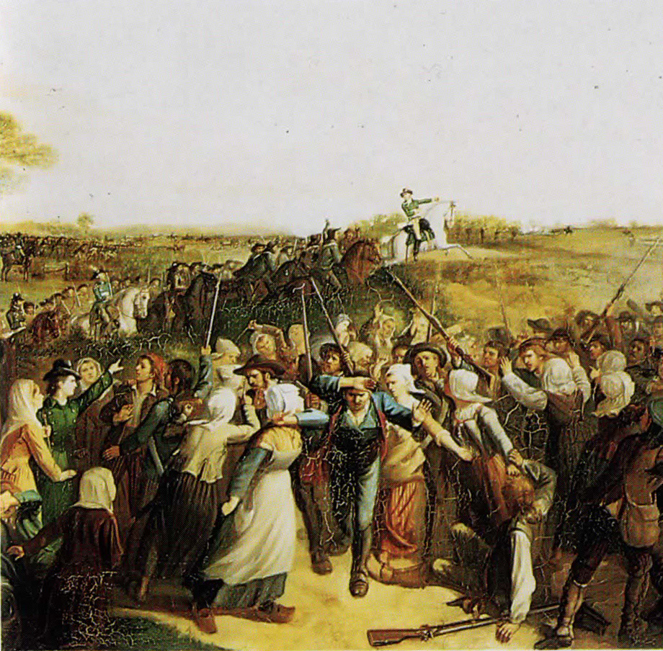
The Revolution
The Great Fear
Feared king would punish them and end Revolution
False rumors and panic throughout France
Peasants destroy records & destroy nobles houses

Slide 14
Creating a New Nation
National Assembly eliminates feudal dues and services
Declaration of the Rights of Man and of the Citizen
“liberty, equality, fraternity”
English Bill of Rights, American Dec. of Independence, Enlightenment philosophers

Slide 15
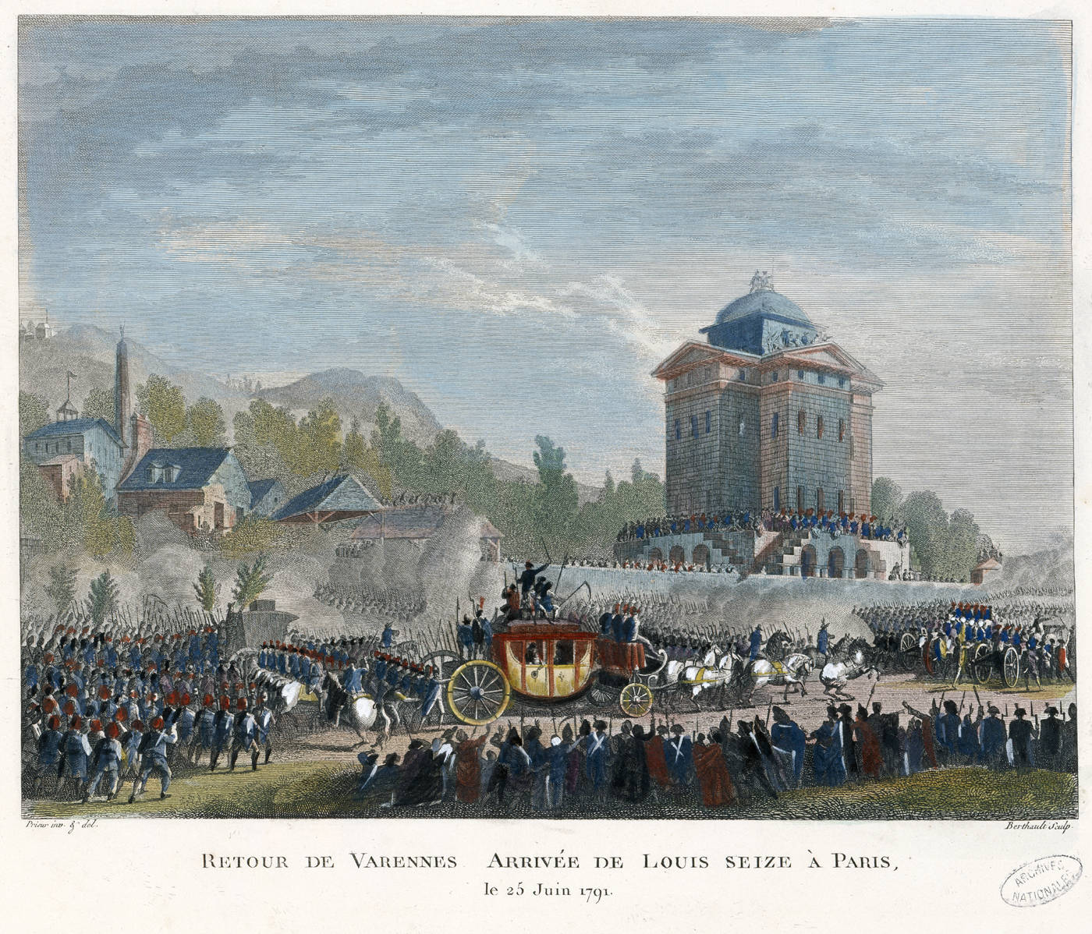
Creating a New Nation
Crowd breaks into palace of Versailles
Feared Louis would still try to end Revolution
Demanded bread
Louis returns to Paris
Tuileries Palace

Slide 16
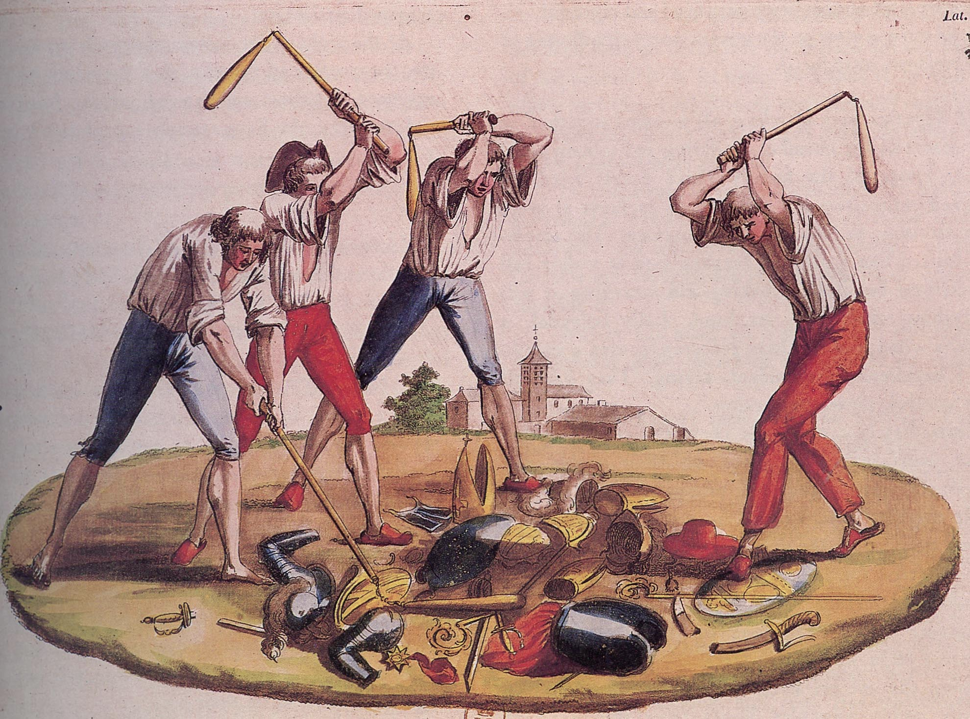
Creating a New Nation
Seized church lands
Sold to pay off debt
Religious orders disbanded
Clergy now public employees

Slide 17
Creating a New Nation
National convention created
New elected legislature
Abolished monarchy
Declare France a republic

Slide 18
The French Revolution and Napoleon:
The Republic

Slide 19
Main Idea
An extreme government changed French society and tried through harsh means to eliminate its critics within France.

Slide 20
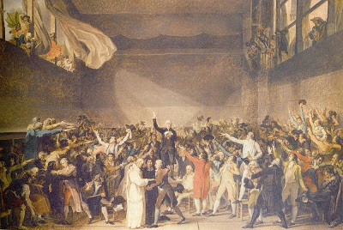
A Radical Government
Different political factions within the National Convention
No formal Organization
The Mountain
Montagnards & Jacobin
The Girondins
The Plain

Slide 21
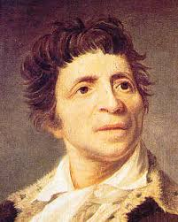
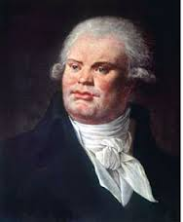
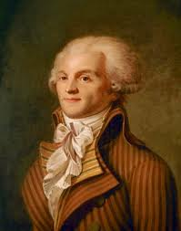
A Radical Government
Jean-Paul Marat
Georges-Jacques Danton
Maximilien Robespierre

Slide 22
A Radical Government
King placed on trial & sentenced to die
Guillotine
Other European countries reacted with horror
“republic founded on blood”

Slide 23
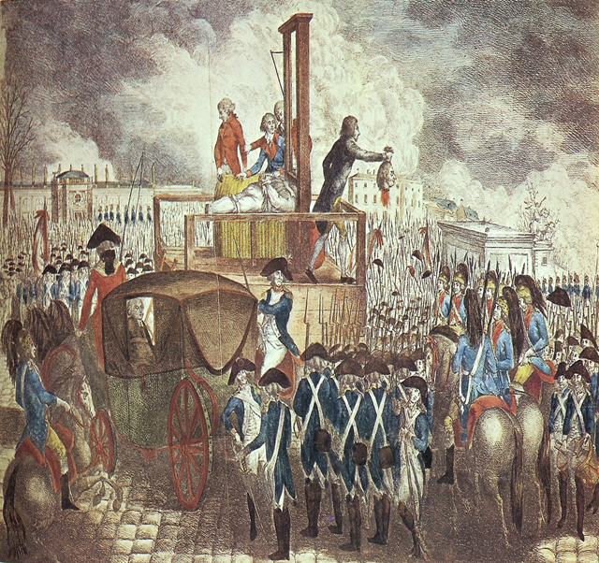

Slide 24
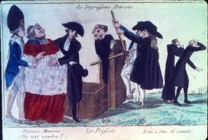
A Radical Government
Transform French society
Anticlerical feelings
Metric system
New Calendar
New clothing

Slide 25
The Reign of Terror
Counterrevolution
Revolution against a government that was established by a revolution
Feared losing control
Feared other European countries disdain could turn into war

Slide 26
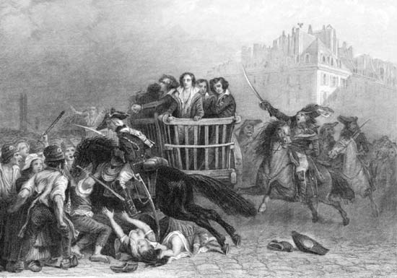
The Reign of Terror
Reign of Terror
Series of accusations, trials, and executions
Wave of fear throughout the country
Established because of the counterrevolution

Slide 27
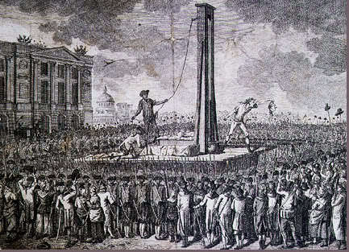
The Reign of Terror
Resistance to the government
Catholics opposed anticlerical moves
Those suspected of counterrevolutionary activity
Suspects had few rights
Revolutionary Tribunal
Death by guillotine

Slide 28
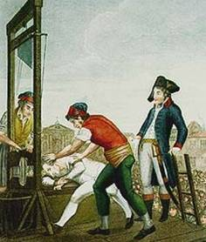
The Reign of Terror
Every class, occupation, gender persecuted
Even those who launched Reign of Terror fell victim
Over 300,000 arrested; 17,000 executed

Slide 29
After the Terror
Wrote new constitution
Restricted voting rights
Only men who owned property
The Directory
Governing board of 5 men
No real power – weak and corrupt
France still had financial problems and no real control

Slide 30
The French Revolution and Napoleon:
Napoleon’s Europe

Slide 31
Main Idea
Napoleon Bonaparte rose through military ranks to become emperor over France and much of Europe.

Slide 32
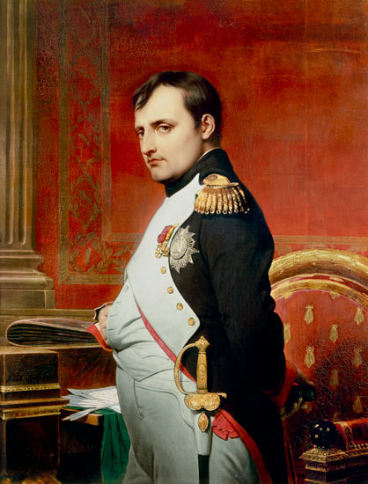
Napoleon’s Rise to Power
Napoleon Bonaparte
Ambitious
French Rev. gave chance to rise in power
Brilliant military leader
Victories against the British, Austrians, Italians

Slide 33
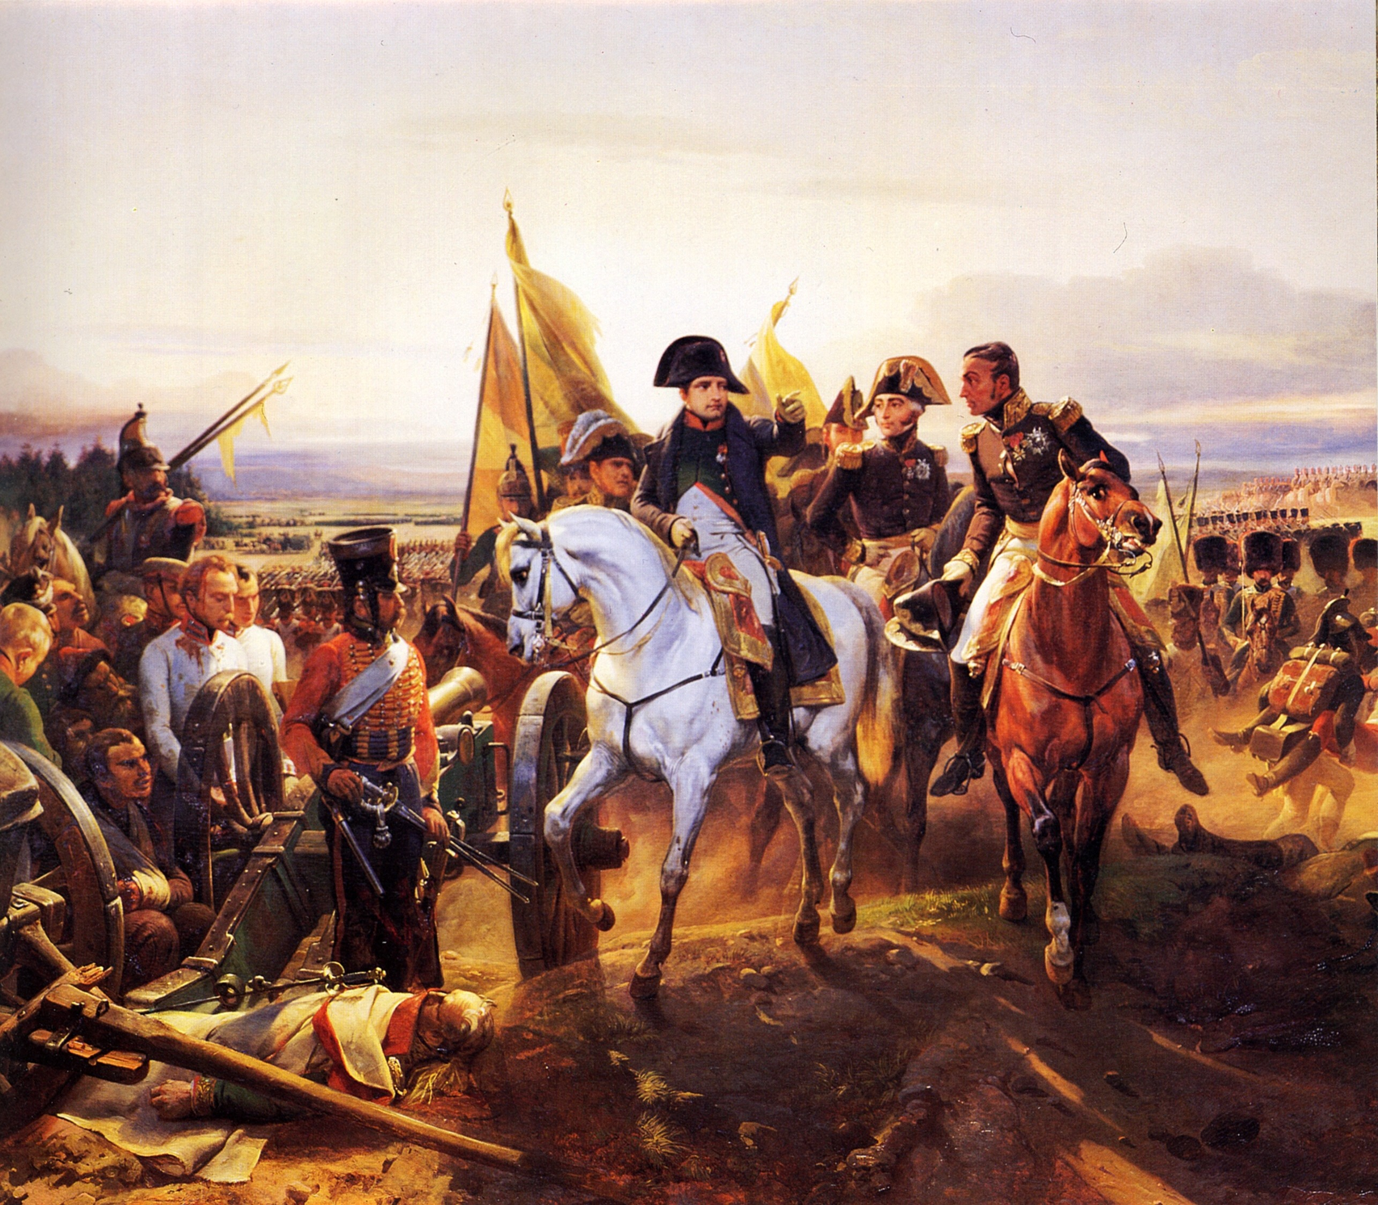
Napoleon’s Rise to Power
Military success:
Stops mob in Paris
Victory over British at Toulon
Victory over Austrians & Italians in Italy
Covers up his failures
Celebrated as a national hero

Slide 34
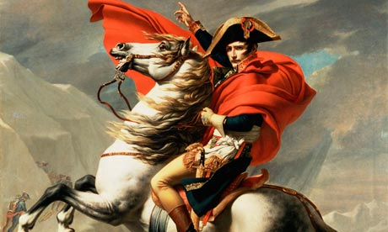
Napoleon Seizes Power
Supporters of Napoleon organize a coup d'état
Forced transfer of power
Consulate replaced the Directory as government of France
Napoleon voted first Consul
Napoleon now a dictator

Slide 35
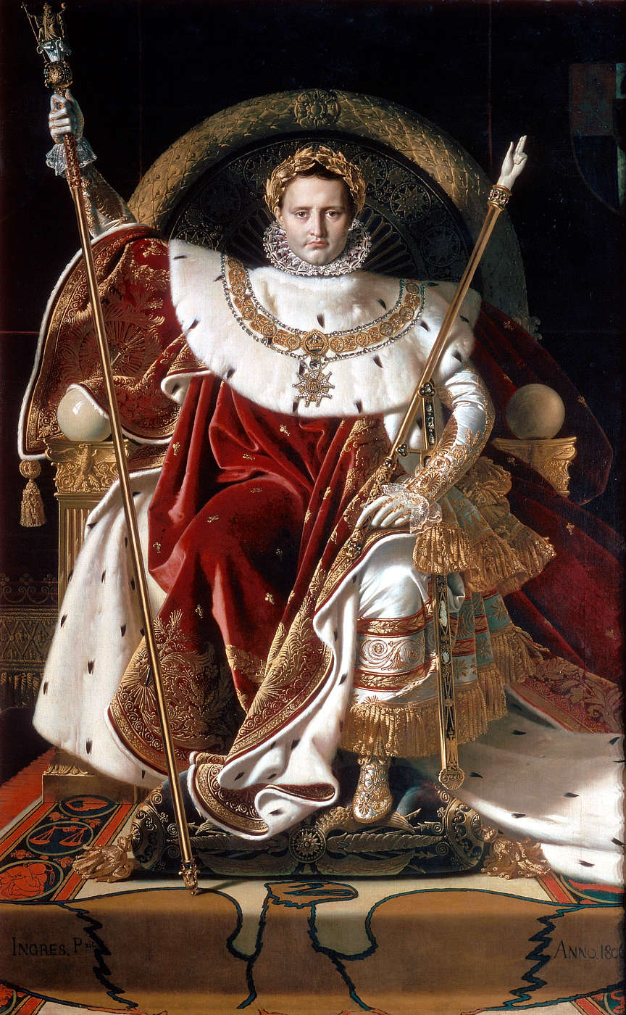
Emperor Napoleon
1804 - Issues a plebiscite
Question put before all voters
Did they want to declare France an empire?
Emperor Napoleon I
Takes crown from Pope

Slide 36
Emperor Napoleon
Wanted to build an empire
Sells Louisiana Territory to the United States

Slide 37
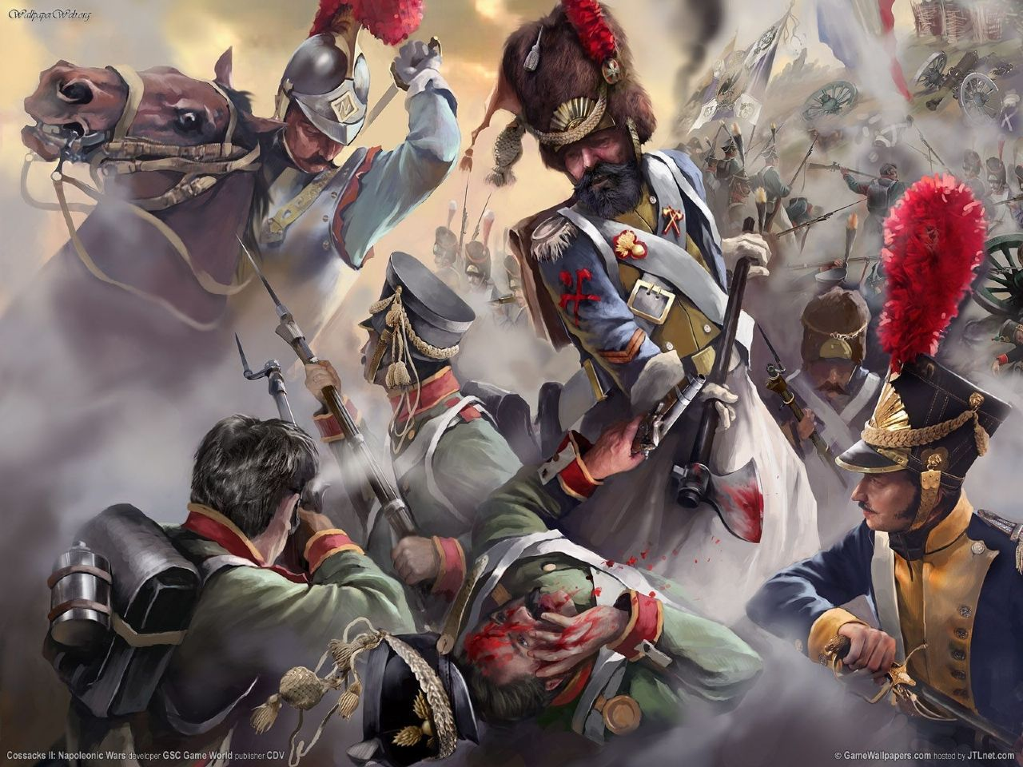
Emperor Napoleon
Napoleonic Wars
France becomes the dominant Euro power
Great Britain France’s greatest enemy
Battle of Trafalgar
Battle of Austerlitz

Slide 38
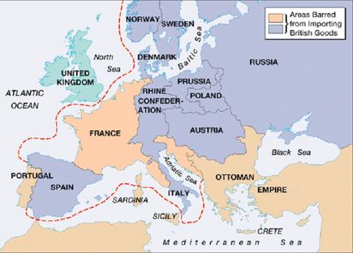
Emperor Napoleon
Continental System
Prohibited French or allied ships from trading with Britain
Blockade
The Peninsular War

Slide 39
Emperor Napoleon
Takes control of Europe through treaties, alliances, and victories in battles
Only nations free of his control – Great Britain, Sweden, Portugal, and Ottoman Empire
Would put relatives in positions of power in newly conquered areas

Slide 41
Napoleon’s Policies
Reformed Church-State relations
The Concordat
Recognized influence of church
Economic Reforms
Bank of France
Efficient tax collection

Slide 42
Napoleon’s Policies
Napoleonic Code
Uniform laws across the nation
Promoted order and authority
Censored freedom of speech & press
Only applied to male citizens

Slide 43
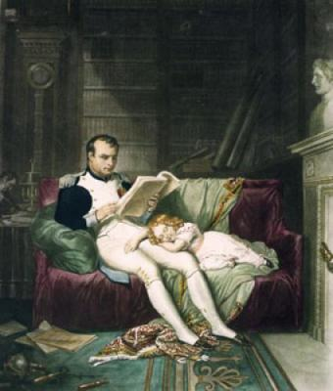
Napoleon’s Policies
Educational reforms
Strong state depended on strong leaders
Network of high schools, universities, and technical schools

Slide 44
Napoleon’s Legacy
Revolutionary and democratic ideas in government
Equality before the law
Helped spread nationalism
Sense of identity and unity as a people
Loyalty for one’s country

Slide 45
The French Revolution and Napoleon:
Napoleon’s Fall and Europe’s Reaction

Slide 46
Main Idea
After defeating Napoleon, the European allies sent him into exile and held a meeting in Vienna to restore order and stability to Europe.

Slide 47
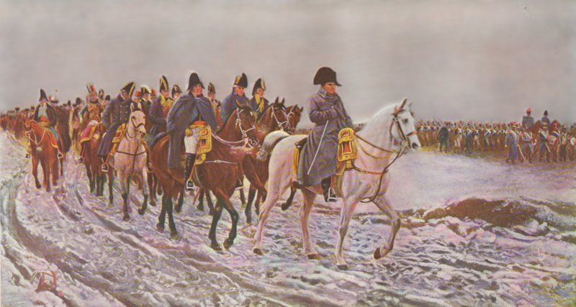
Disaster and Defeat
Napoleon decides to invade Russia
600,000 troops invade (during the summer)
New recruits
Supplies lost/spoiled
Disease
Desertion
Hunger

Slide 48
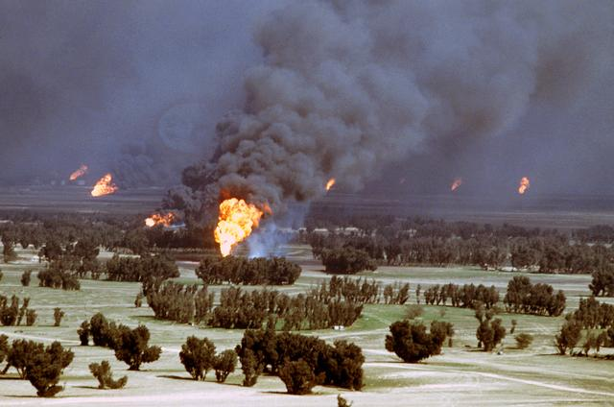
Disaster and Defeat
Scorched earth policy
As troops advanced, Russians would withdraw
Would set fire to fields so French troops would have nothing they could use
Finally reaches Moscow
Moscow was in flames
Had to return back to France

Slide 49
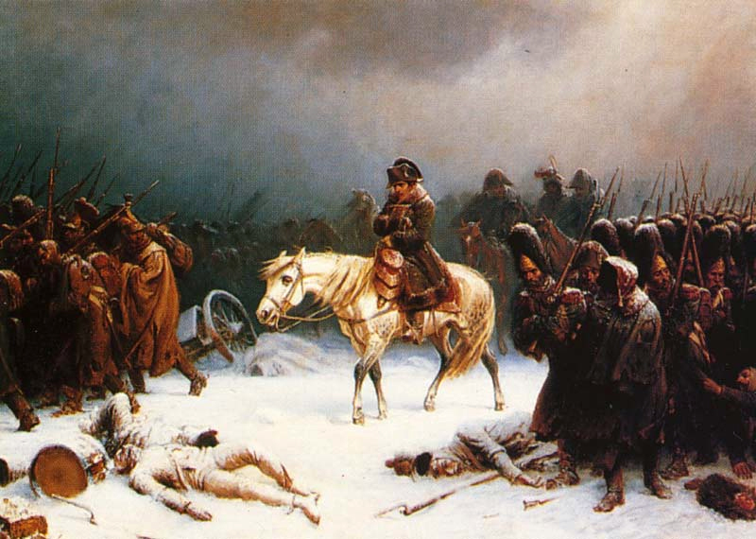
Disaster and Defeat
Harsh Russian winter
Most terrifying enemy
Starvation and exhaustion
Killed thousands
94,000 returned

Slide 50
Disaster and Defeat
Disaster in Russia gave enemies hope
Battle of Leipzig
Clear defeat for Napoleon
Napoleon forced to give up throne
Exiled to the island of Elba

Slide 51
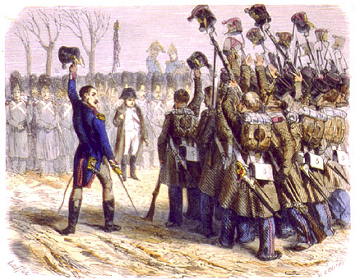
The Last Campaigns
Napoleon waits for opportunity to return
Allies establish monarchy in France
After a year - decides to return
Hundred Days
Renewed glory for Napoleon

Slide 52
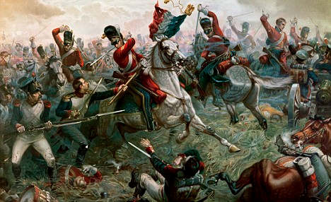
The Last Campaigns
The Battle of Waterloo
Britain, German, Prussian, and Dutch troops against Napoleon
Casualties of 50,000
Crushing defeat
End of Napoleonic Wars & Napoleons career

Slide 53
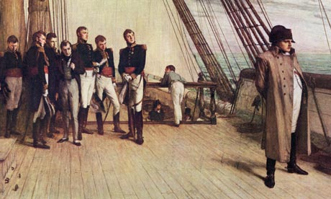
The Last Campaigns
Tries to escape to America
Captured
Exiled to Saint Helena
Never escaped
Died six years later

Slide 54
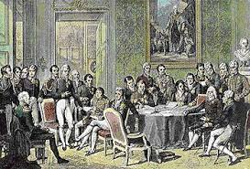
The Congress of Vienna
Plan to restore order and stability to Europe
Make sure France could never again rise to such power
Put down revolution wherever it might appear
Restored several monarchies

Slide 55
The Congress of Vienna
Redrew the map of Europe
Changed national borders to strengthen nations near France
Countries that aided France lost territory, those that fought gained territory
Indemnity
Payments to other countries to compensate them for damages

Slide 57
The Revolution’s Legacy
Monarchs no longer secure in their positions
People realized they could change their governments and destinies
Spread of Enlightenment ideas

