Slide 1
The Great Depression:
The Great Crash

Slide 2
Main Idea
The stock market crash of 1929 revealed weaknesses in the American economy and triggered a spreading economic crisis

Slide 3
The Appearance of Prosperity
Overall economy performed well
Gross national product (GNP) rose 30%
Total value of all goods and services
Overall unemployment remained low
Union membership slowed
Welfare capitalism
Prosperity encouraged workers to buy new products and enjoy leisure activities

Slide 4
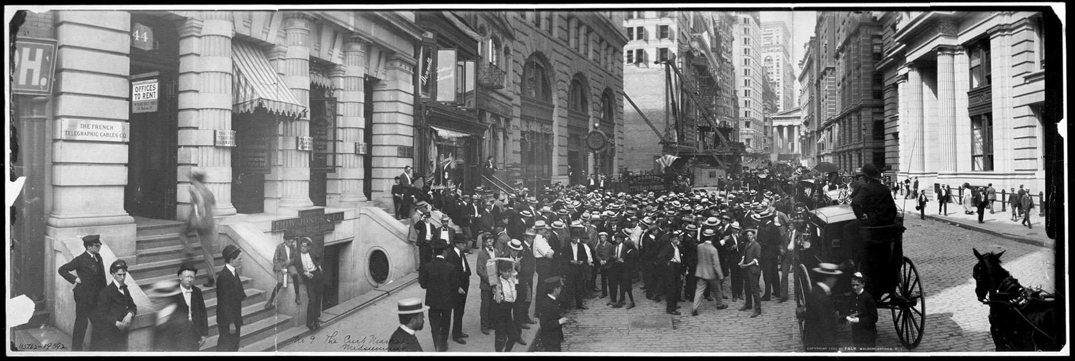
The Appearance of Prosperity
The stock market performed very well in the 1920s
The value of stocks traded quadrupled over nine years
Made people think the market would never drop
Public’s confidence in the gov.’t was very high

Slide 5
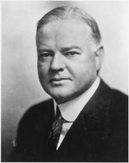
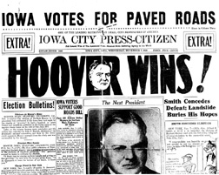
The Election of 1928
When Coolidge didn’t run for reelection, Republicans chose Herbert Hoover
Served on Harding and Coolidge’s cabinets
Reputation as a business-like administrator
Hoover easily won the election

Slide 6
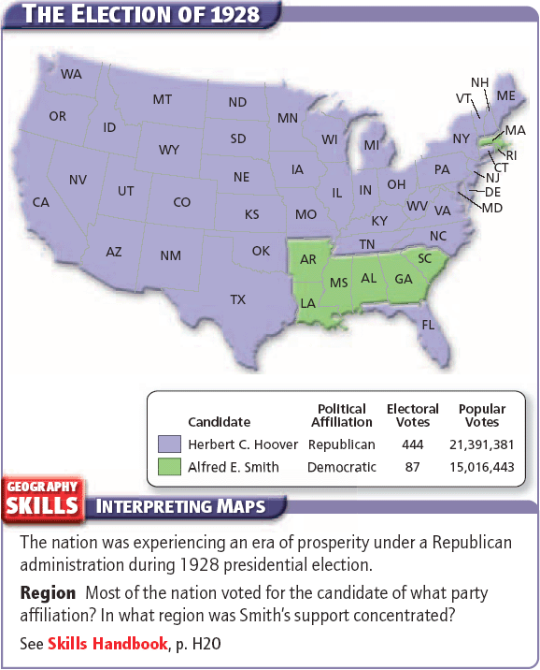

Slide 7
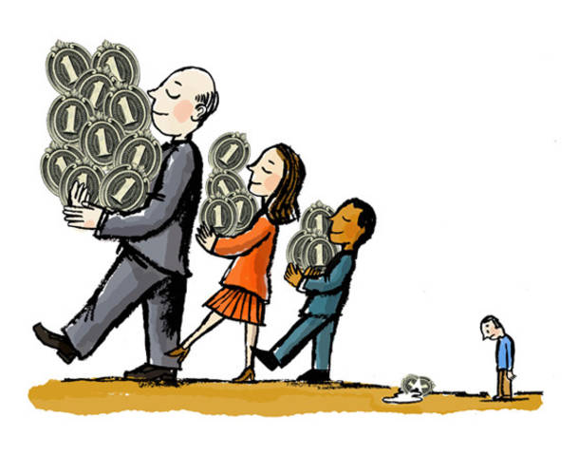
Economic Weaknesses
While many Americans enjoyed good fortune in the 1920s, many serious problems bubbled underneath the surface:
The uneven distribution of wealth
Rising prices
By 1929 over 70% of U.S. families had too low an income for a good standard of living
No savings
Many people reached their credit limits
Purchases slowed

Slide 8
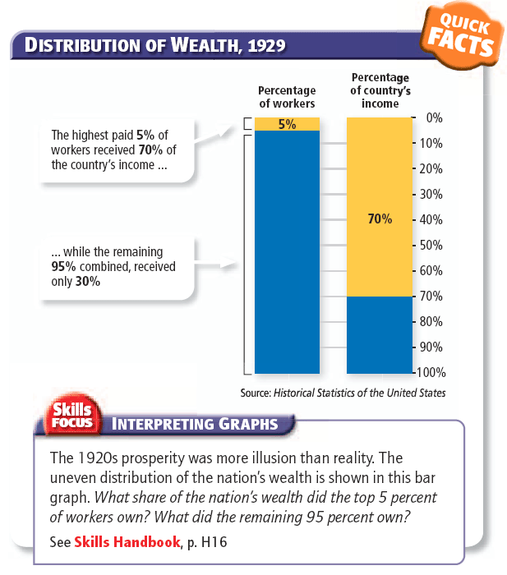

Slide 9
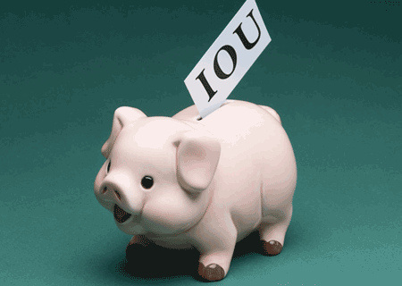
Credit and the Stock Market
Investors increasingly used credit to buy stocks as the market rose
Investors were buying on margin
Buying stocks with loans from stockbrokers, intending to pay brokers back when they sold the stock
Buying on margin was risky

Slide 10
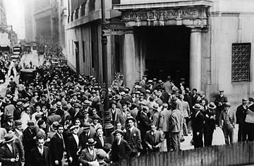
The Stock Market Crashes
Many people were beginning to see trouble as consumer purchasing fell and rumors of a collapse circulated
Fall 1929 - Fearing that stocks might go down – many investor began to sell off their stocks
Huge sell off with no buyers
Stock prices plunged – more panic

Slide 11
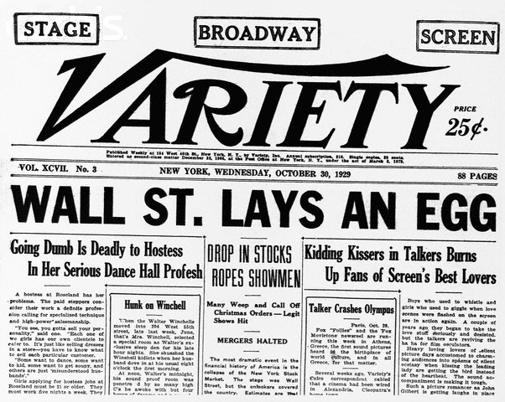
The Stock Market Crashes
Black Tuesday – October 29, 1929
Investors sold off 16 million shares
Stocks flood the market
Prices collapsed
Stock market crashed

Slide 13
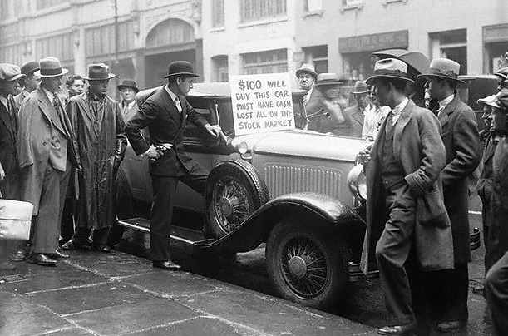
Effects of the Crash
Many individual investors ruined
Margin buyers were hit the hardest
Investors were forced to sell their stocks for far less than they had paid

Slide 14
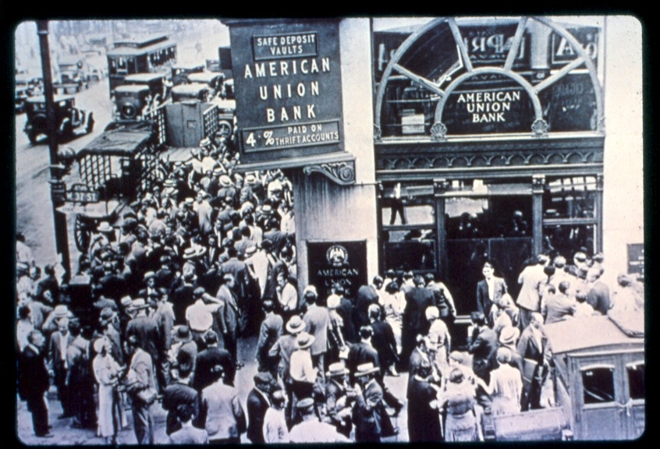
Effects of the Crash
The crash triggered a banking crisis
Bank runs
Investments
Many banks went out of business

Slide 15
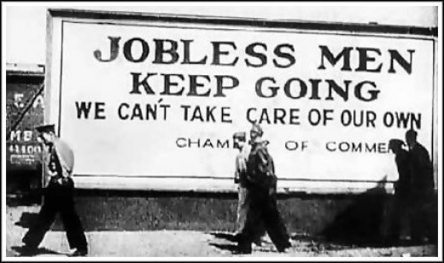
More Effects of the Crash
The crash crushed businesses
Banks couldn’t lend money
Consumers cut back their spending
Companies were forced to lay off workers
American wages dropped by $4 billion and nearly 3 million people lost their jobs

Slide 16
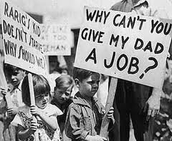
More Effects of the Crash
Europe was still struggling from WWI
Borrowed money from American banks
Banks now want their money back
High tariffs made foreign goods expensive
Less able to export their products
Forced to fire workers

Slide 17
The Great Depression:
Americans Face Hard Times

Slide 18
Main Idea
The Great Depression and the natural disaster known as the Dust Bowl produced economic suffering on a scale the nation had never seen before

Slide 19
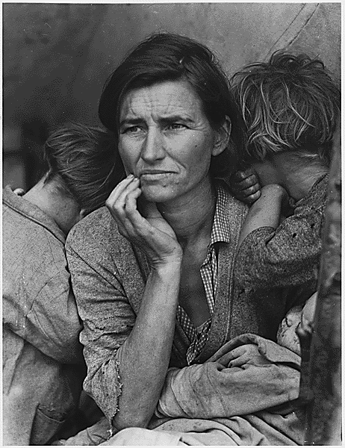
Great Depression by the Numbers
The Great Depression
The worst economic downturn in history
The stock market collapse
Bank “runs” and bank failures
Wiped out billions in savings
Farm failures
Unemployment

Slide 20
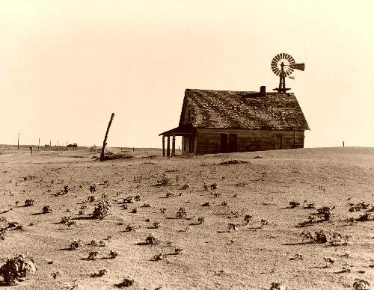
Farm Failures
Widespread joblessness and poverty cut down on the demand for food
Farmers unable to sell food they produced
Many borrowed money from banks to pay for land and equipment
As incomes dropped, farmers couldn’t pay back their loans
Foreclosure occurs when a lender takes over ownership of a property from an owner who has failed to make loan payments

Slide 21
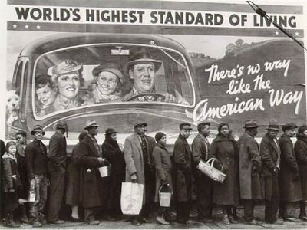
Unemployment
The year following the crash of October 1929 saw a sharp drop in economic activity and a steep rise in unemployment
By 1933 - the GNP dropped over 40%
Unemployment reached a staggering 25% percent

Slide 23
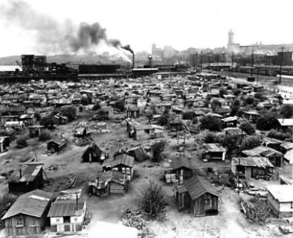
The Human Impact of the Great Depression
Job loss resulted in poverty for most Americans
Begged door to door, relied on soup kitchens and bread lines
Hoovervilles
Makeshift shantytowns
Named after President Hoover who many blamed for the Great Depression

Slide 24
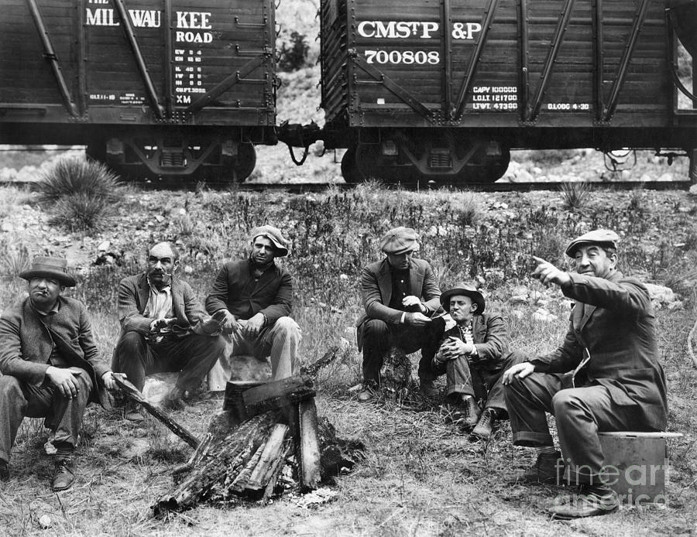
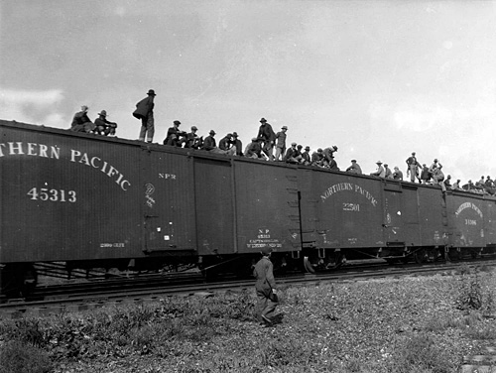
The Human Impact of the Great Depression
Hoboes
Homeless person
Typically traveling in search of work
Mostly men

Slide 25
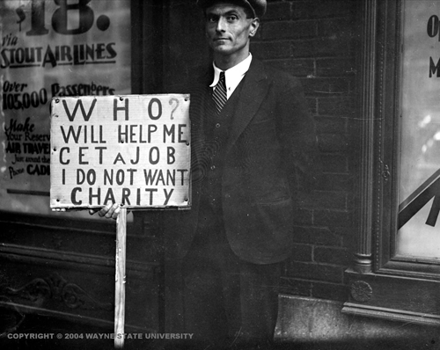
The Emotional Impact of the Depression
Unemployed often felt that they failed as people
Accepting handouts deeply troubled many proud Americans
High suicide rates
Many felt the nation had failed the hardworking citizens who had helped build it

Slide 26
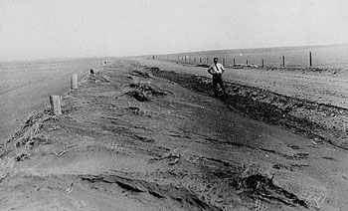
Devastation in the Dust Bowl
In 1931 rain stopped falling across much of the Great Plains region
Drought
Period of below average rainfall
Lasted for several years
Millions of people had fled the area

Slide 27
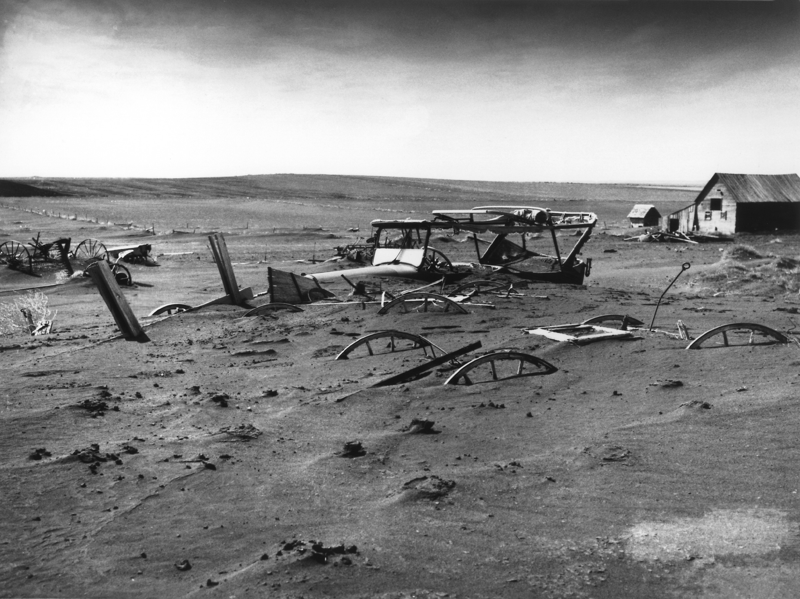
Devastation in the Dust Bowl
Land once covered with protective grasses was now bare, with no vegetation to hold the soil in place
Wind storms stripped the rich topsoil and blew it hundreds of miles
Dust mounds choked crops and buried farm equipment
The Dust Bowl
Nickname for the Great Plains regions hit by drought and dust storms

Slide 29
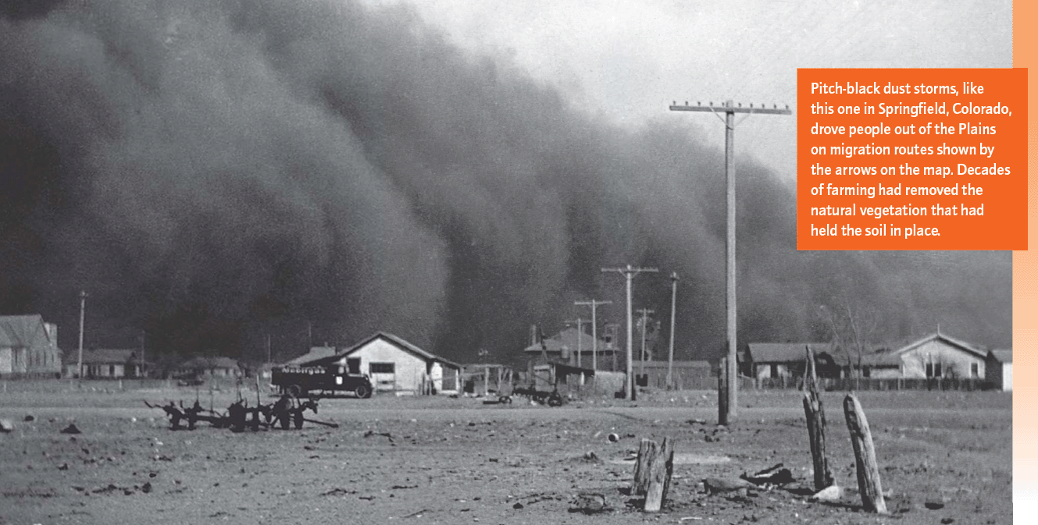

Slide 30
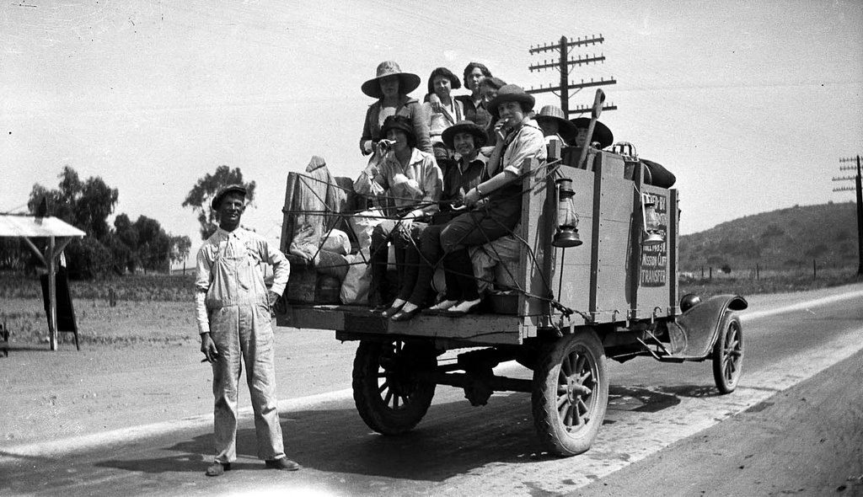
Fleeing the Plains
2.5 million people had left the Great Plains states
Okies
Nickname for a farmer who left the Dust Bowl in search of work
Many settled in camps and sought work on farms
Countless migrants met hardship and discrimination

Slide 31
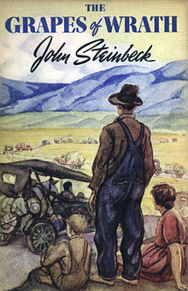
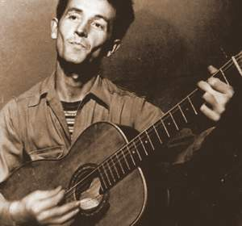
Fleeing the Plains
The plight of the migrants captured the imagination of some of America’s greatest writers and artists
John Steinbeck
Woody Guthrie
For much of the decade, the Depression defied most government efforts to defeat it, and Americans had to fend for themselves

Slide 32
The Great Depression:
Hoover as President

Slide 33
Main Idea
Herbert Hoover came to office with a clear philosophy of government, but the events of the Great Depression overwhelmed his responses

Slide 34
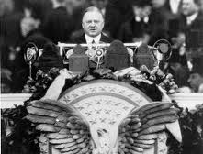
Hoover’s Philosophy
Herbert Hoover favored as little government intervention as possible
Believed unnecessary government threatened prosperity and the spirit of the American people
“Rugged individualism”
Thought it was important not to destroy people’s belief in their own responsibility and power

Slide 35
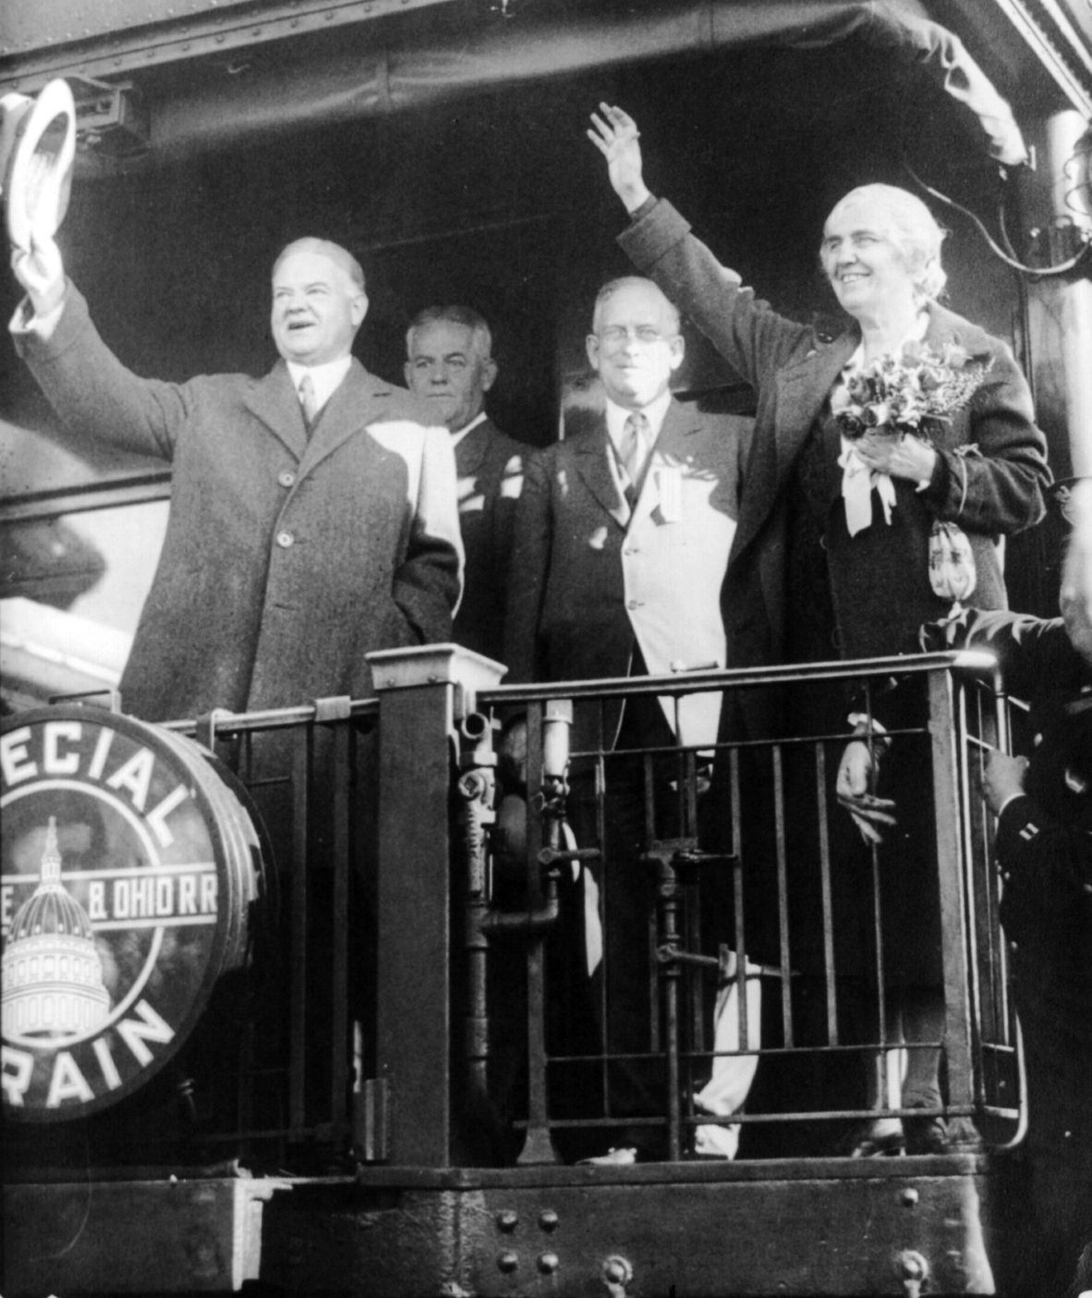
The “Associative State”
Hoover’s “associative state”
Thought businesses should form voluntary associations
Would make the economy more fair and efficient
Skilled government specialists would then cooperate with the associations

Slide 36
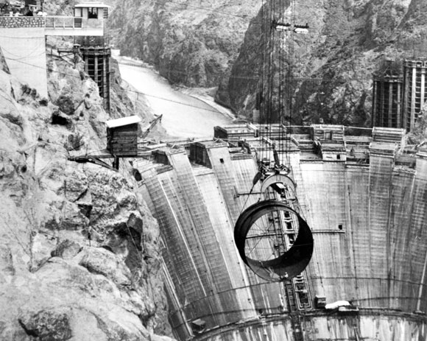
The “Associative State”
Hoover Dam
Harnessed the Colorado River to provide electricity and supply water to parts of seven states
Demonstrated Hoover’s beliefs in business and government
Funded by the federal government
Built and designed by six independent companies

Slide 37
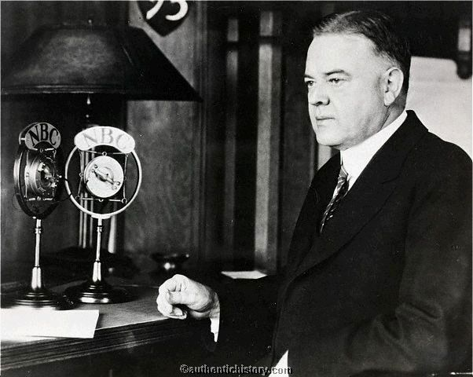
Hoover’s Response to the Great Depression
Hoover’s core beliefs—that government should not provide direct aid, but find ways to help people help themselves—shaped his presidency
Cooperative: an organization owned and controlled by its members, who work together for a common goal
After the crash, Hoover continued to believe in voluntary action

Slide 38
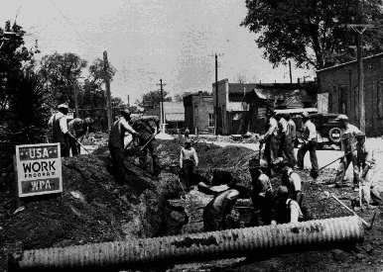
Hoover’s Response to the Great Depression
Businesses cut jobs and wages
State and local governments cut programs and laid off workers
1932 - the Reconstruction Finance Corporation
Program that provided $2 billion in direct government aid to banks and institutions
The Federal Home Loan Bank
Program to encourage home building

Slide 39
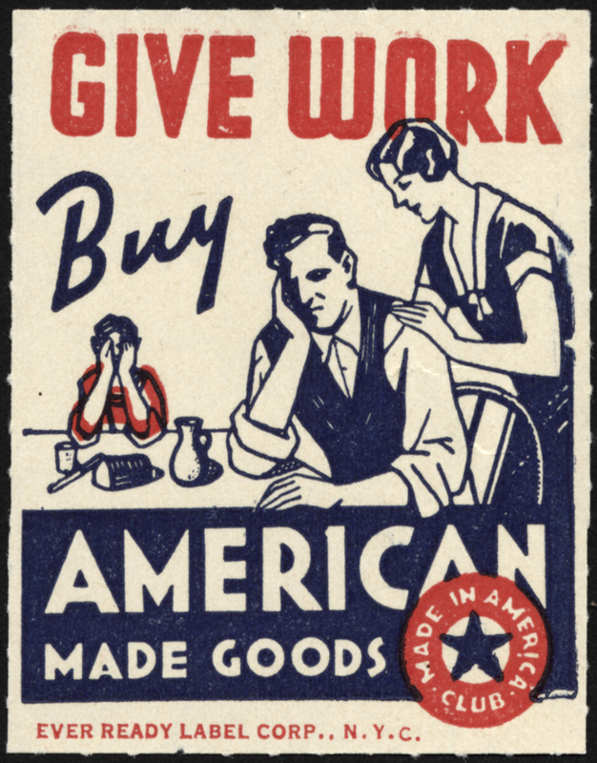
The Smoot-Hawley Tariff Act
1930 - Smoot-Hawley Tariff Act
Extremely high tariff on farm products and manufactured goods
A total disaster
European nations responded with tariffs on American goods
International trade fell dramatically

Slide 40
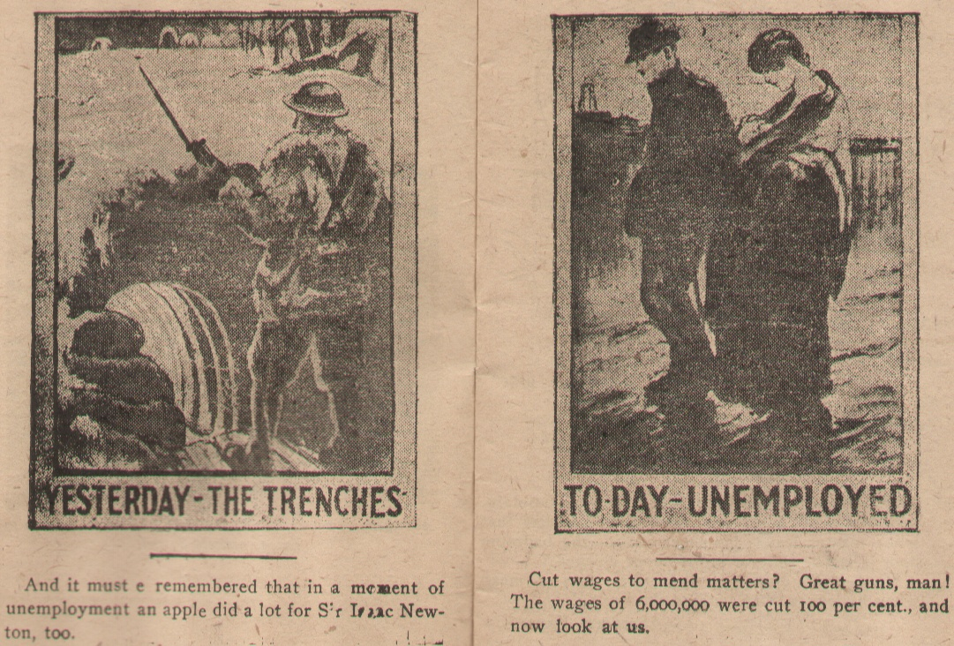
The Nation Responds to Hoover
Hoover’s optimistic claims about the economy undermined his credibility
Just a few months after the crash he announced: “I am convinced we have passed the worst”
Many Americans came to question Hoover’s compassion
Wondered why he was willing to give billions of dollars to banks and businesses but not to offer direct relief to individuals

Slide 41
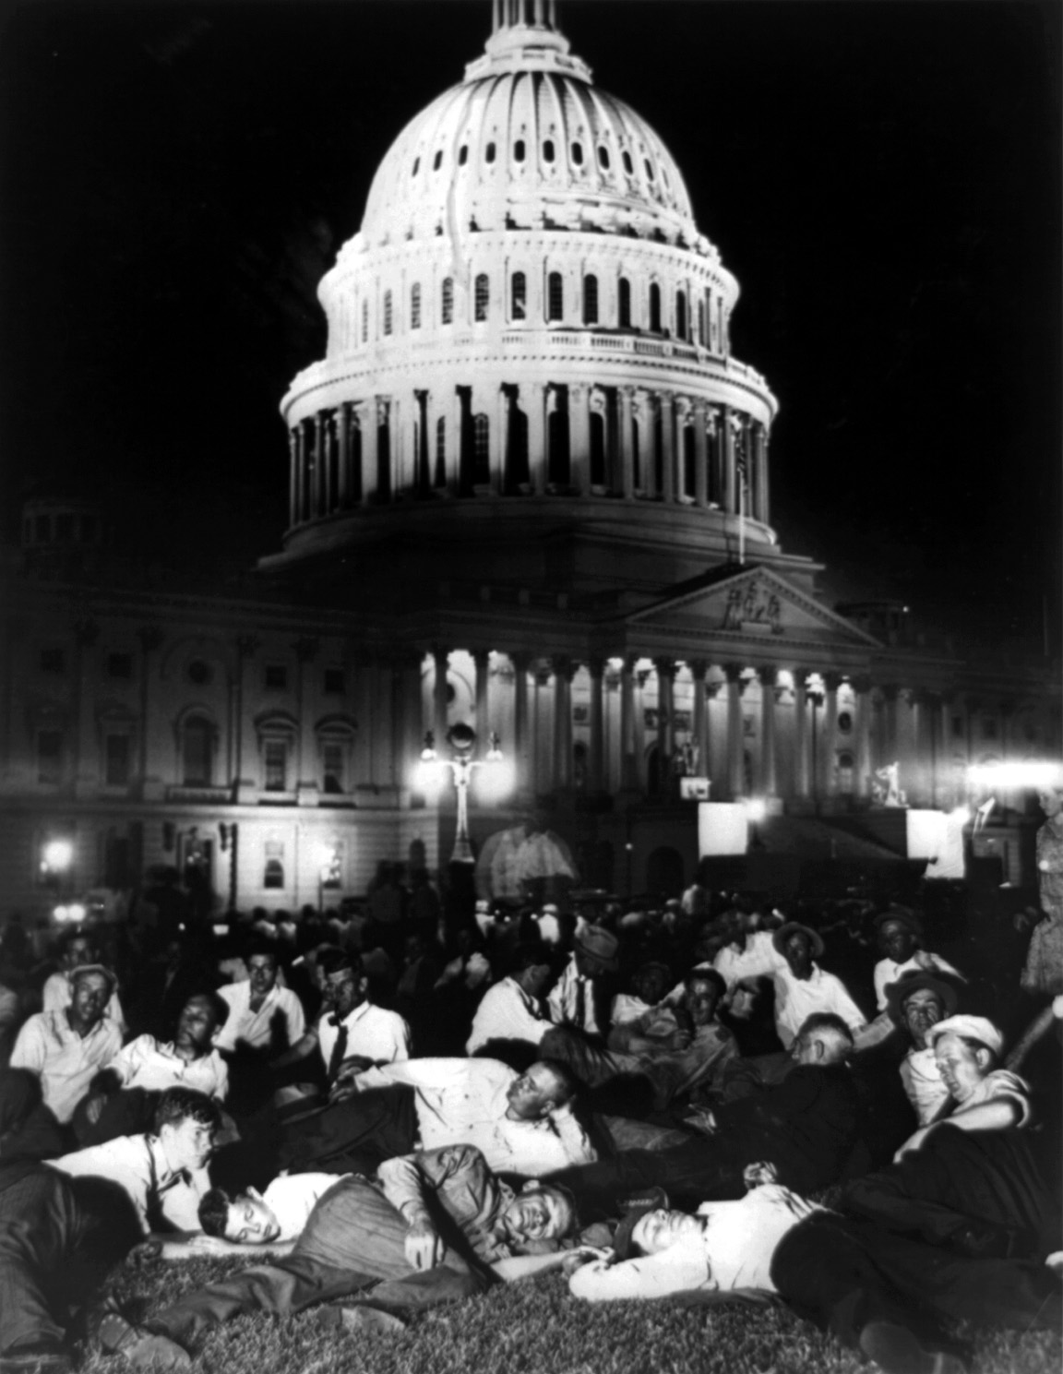
The Bonus Marchers
May 1932 - WWI veterans set up camp near the capital
Wanted the government to pay a veteran’s bonus
The bonus was not due for many years
Needed the money

Slide 42
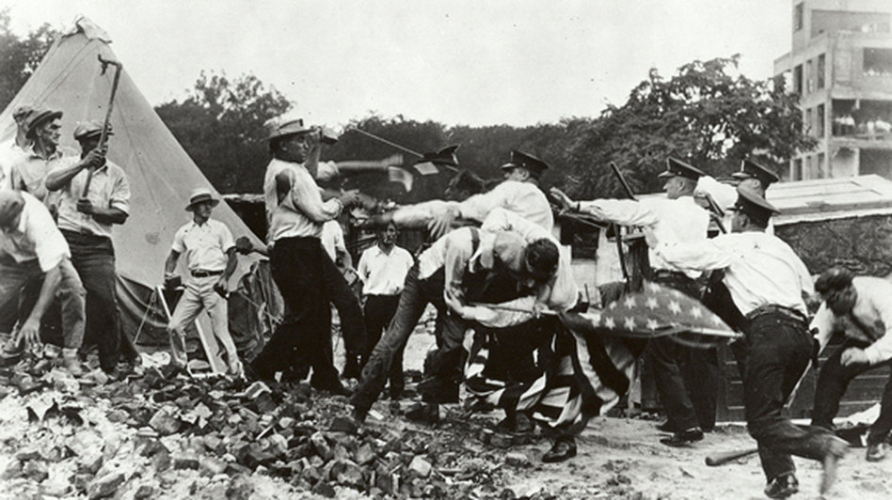
The Bonus Marchers
Congress refused
July - police and U.S. soldiers began clearing the area of veterans
Violence erupted
Many Americans were greatly disturbed by the sight of soldiers using weapons against homeless veterans

Slide 43
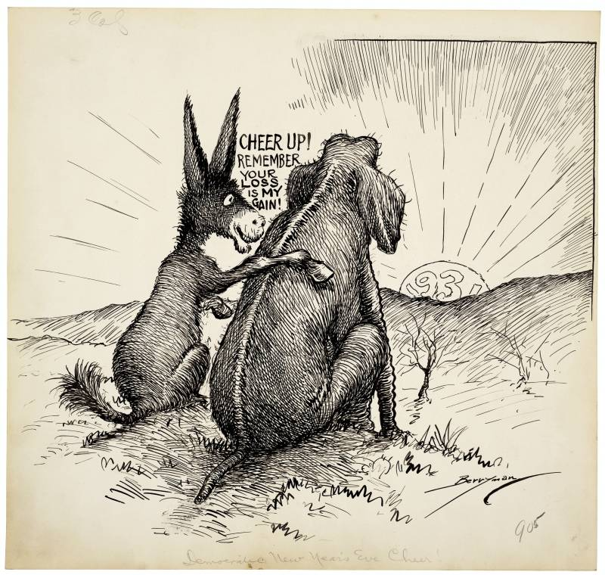
The Voters React
1932 - Trying to balance the budget, Hoover pushed for a tax increase
Was highly unpopular
Voters wanted more government spending to aid the poor
The 1930 Congressional election provided early signs that the public was fed up with Republicans and President Hoover
The Great Depression showed few signs of ending

Slide 44
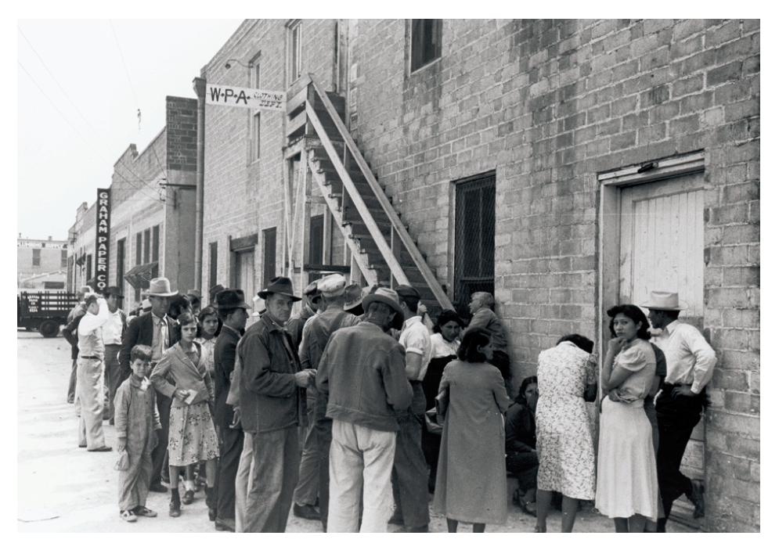

Slide 46
Click on the window to start video

