Slide 1
Ancient Greece:
Alexander the Great & Hellenistic Greece

Slide 2
Main Idea
Alexander the Great formed a huge empire, spread Greek culture into Egypt and many parts of Asia, and paved the way for a new civilization to develop in those areas.

Slide 3
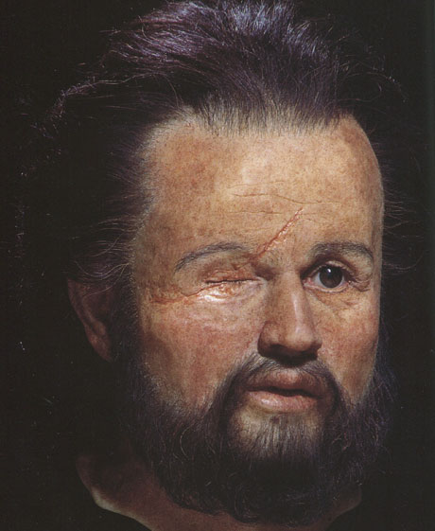
The Rise of Macedonia
359 BCE - Phillip II
Reorganized army
Conquered most of Greece
Couldn’t take Sparta
Assassinated – son takes over
Alexander the Great

Slide 4
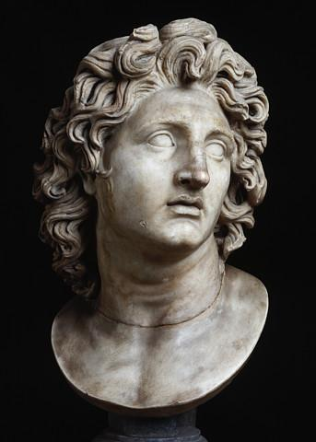
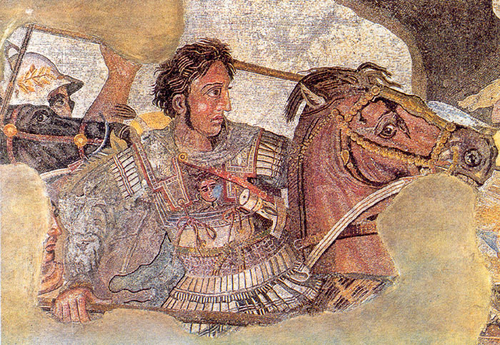
Alexander the Great
King at age 20
Trained to rule since birth
Father – Phillip II
Teacher – Aristotle

Slide 5
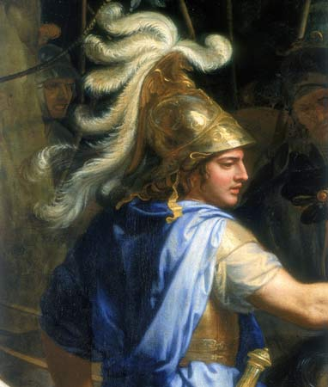
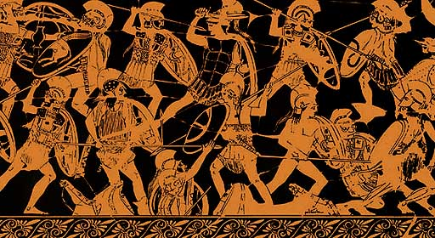
Alexander the Great
Reestablished control of Greece
Harsh punishments
Burns Thebes to the ground, people sold as slaves

Slide 6
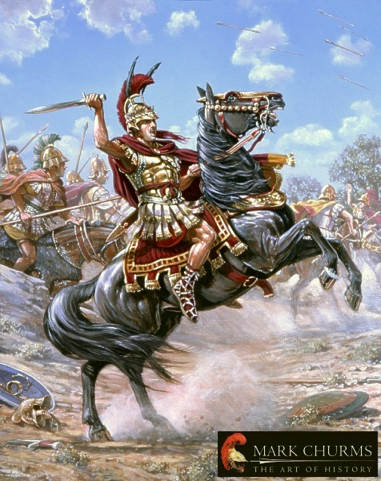
Alexander the Great
Wants to build an empire
Takes major territory from the Persians
Asia Minor
Takes control of Babylon
Egypt
Welcomed as liberator
Named pharaoh

Slide 7
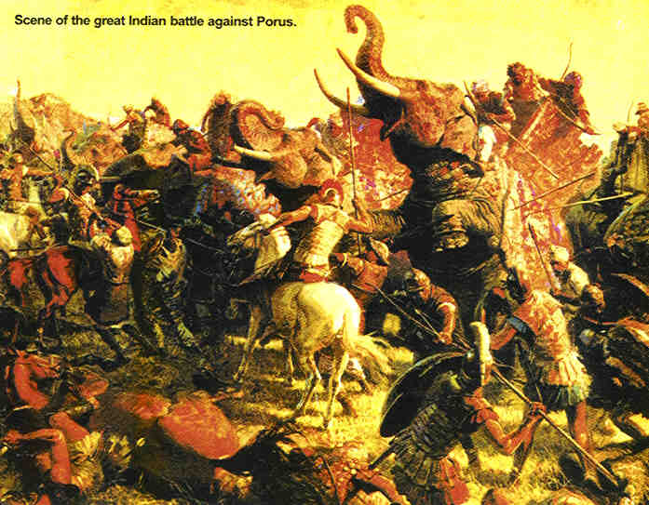
Alexander the Great
Kept pushing his army further
Fights in Central Asia
Fights in Indus
Soldiers wanted to go home
Battle of Gaugamela

Slide 8
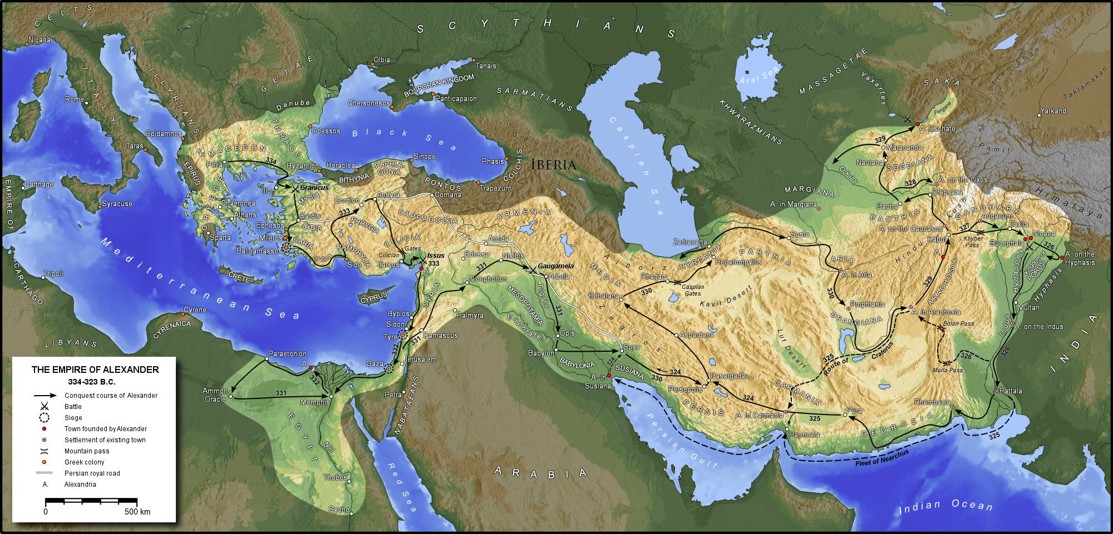

Slide 9
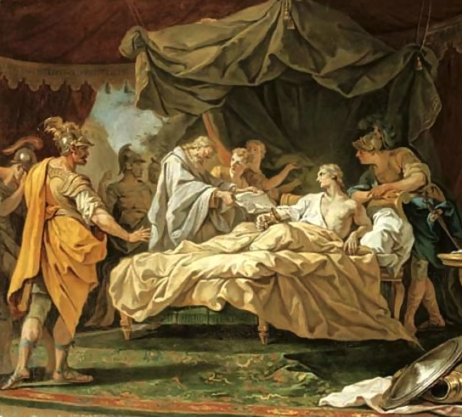
Alexander the Great
Largest empire world had ever seen (at the time)
323 BCE – Age 33 – Falls ill & dies
Died without an heir
Generals begin fighting for control
Empire divided into three

Slide 10
The New Hellenistic World
Hellenic
Purely Greek culture
Hellas – name Greeks used for their country
Hellenistic
New type of culture created
Blended Greek with ideas from Persia, Egypt, & Central Asia

Slide 11
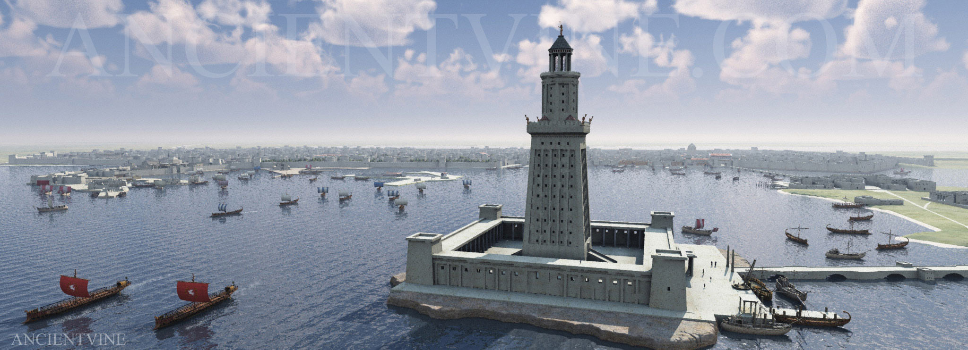
The Hellenistic World
Alexander intentionally attempted to blend cultures
Encouraged marriages to Persians
Appointed officials from other countries
Encourage resettlement in newly conquered cities/areas
Alexandria

Slide 12
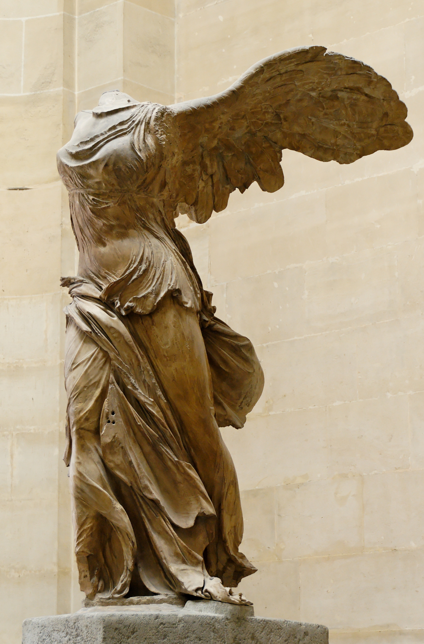
The Hellenistic World
Changes in government
Monarchy
City-state no longer major political unit
Woman given more rights
Education
Property

