Slide 1
The Industrial Revolution:
A New Kind of Revolution

Slide 2
Main Idea
In the 1700s, conditions in Great Britian led to the rapid growth of the textile industry, which in turn led to huge changes in many other industries.

Slide 3
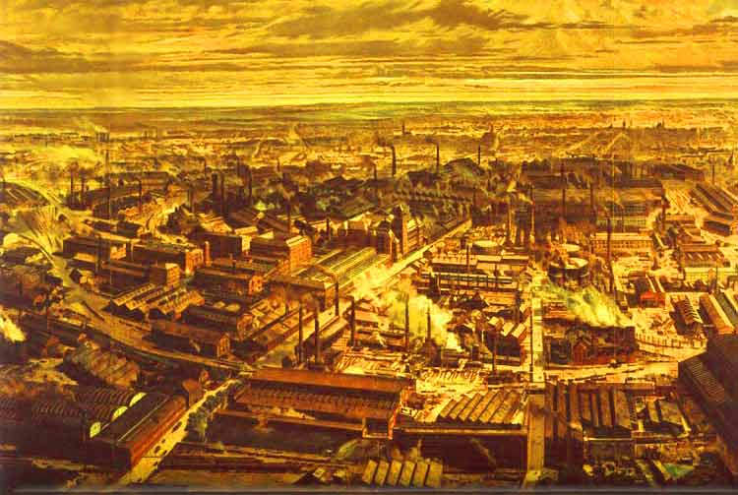
A New Kind of Revolution
Industrial Revolution
Period of rapid growth in the use of machines in manufacturing and production
Starts in Great Britain

Slide 4
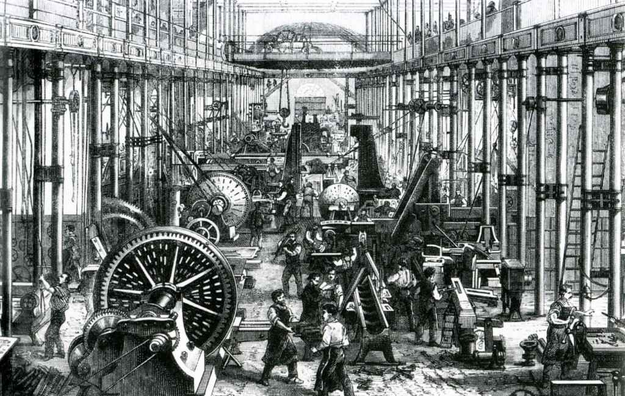
Factors for Sucess
Why Great Britain?
Exploration and colonialism
Seapower
Political stability
Government support
Growth of private investment

Slide 5
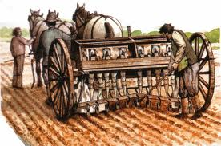
Agricultural Factors
Improved farming methods
Seed drill
Improved livestock breeding methods
Better varieties of crops
Increased food supply = increase in population

Slide 6
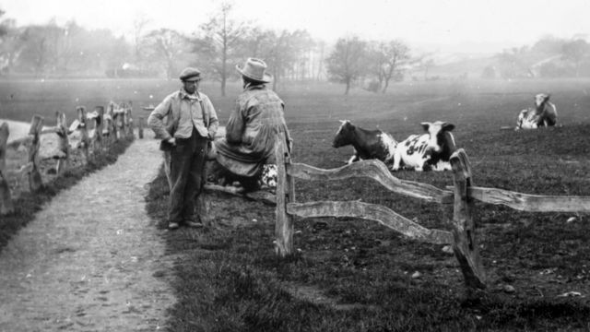
Agricultural Factors
Enclosure movement
Combined small fields to create large farms and fenced them
More efficient farming methods
Further increased food supplies
Poor farmers had to leave farms to find jobs in the city

Slide 7
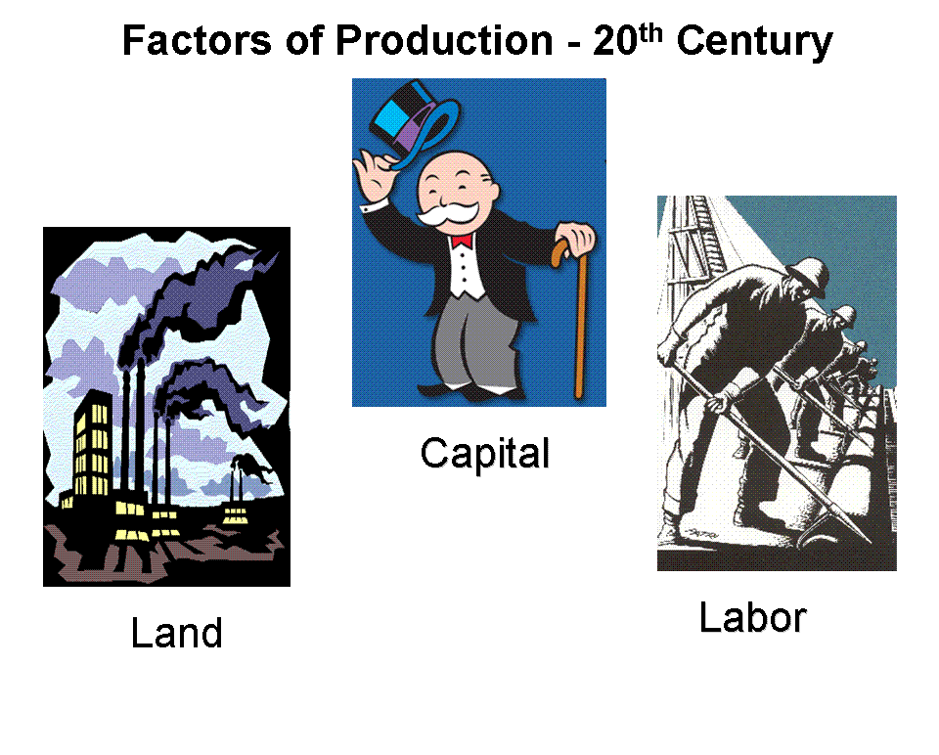
Britain’s Big Advantage
Factors of production
Land (natural resources), labor, capital
Had resources needed for industry
Had growing population
Had money to spend, and human capital

Slide 8
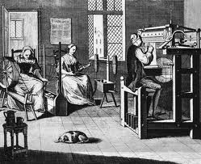
Revolution in Textiles
Revolution began with the textile (cloth-making) industry
Cottage industry
Craft occupation performed in the home
Transformed by industrialization
Process of changing to power-driven machinery

Slide 9
Revolution in Textiles
Fabric made of wool or cotton
Supply increased
Enclosure movement (wool)
Colonies in India and North America (cotton)
Increased slavery

Slide 10
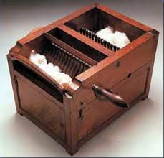
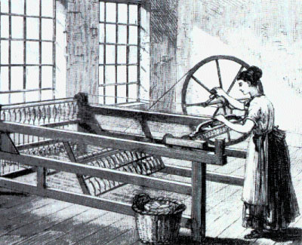
Revolution in Textiles
Eli Whitney & the cotton gin
James Hargreaves & the spinning jenny
John Kay & the flying shuttle

Slide 11
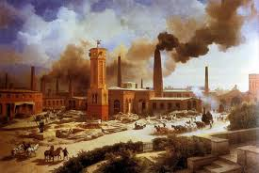
Revolution in Textiles
New machines too big for weaver’s cottage
Factory
Large buildings constructed specially for the purpose of housing industrial machines
1770 – 50,000 bolts of cloth
1800 – 400,000

Slide 12
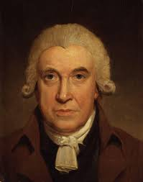
Steam Powers the Revolution
British inventers learned how to harness to force of steam to drive machines
James Watt
Develops a faster, more efficient steam engine
Factories no longer had to be built near water

Slide 13
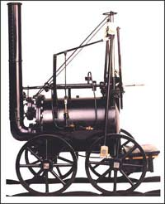
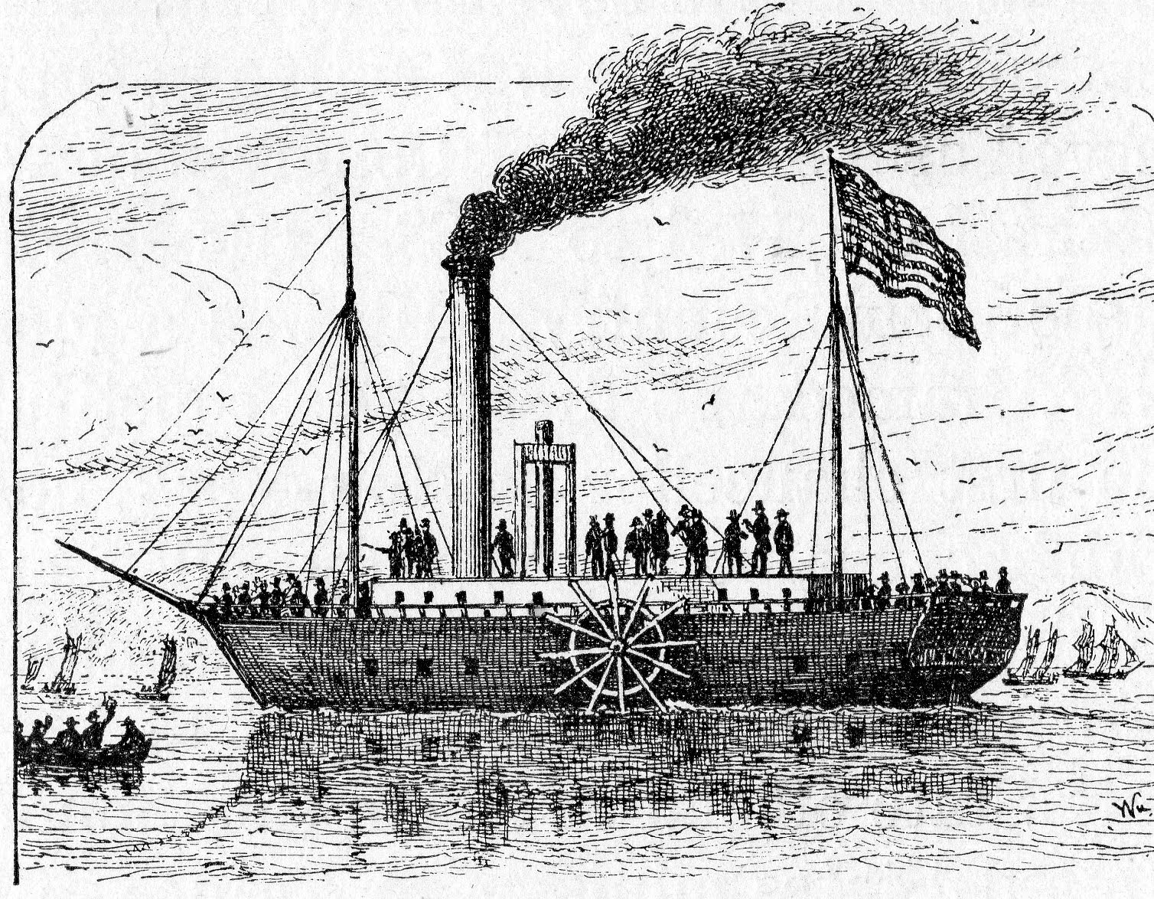
Steam Powers the Revolution
Steam provided a revolution in transportation
1802 – Richard Trevithick – first locomotive
Made possible the fast shipment of finished goods to faraway markets
1807 – Robert Fulton – developed the steamship

Slide 14
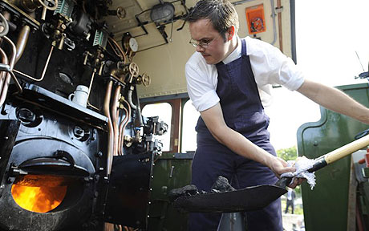
Steam Powers the Revolution
Steam engines needed a lot of fuel
Short on wood (need for farming)
Started using coal
As more factories depended on steam, the coal business grew

Slide 15
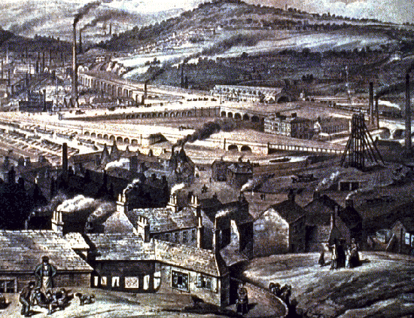
Steam Powers the Revolution
1800 – Great Britain producing 80% of Europe’s coal
Factories built near coal mines
Landscapes changed into boom towns
Working in the mines was dangerous
Child labor

Slide 16
Industrialization Spreads
Industrialization spreads to western Europe and the United States
Did not spread quickly to all parts of the world (Asia)
Britain outlawed export of certain machines & forbade some craftsmen from leaving the country

Slide 17
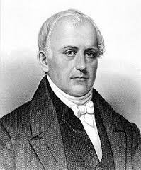
Industry Comes to America
Samuel Slater
Millworker
Disguised as a farmworker – comes to America
Rebuilds machines from memory
Textile mill technology spread rapidly throughout the United States

Slide 18
The Industrial Revolution:
Factories and Workers

Slide 19
Main Idea
The transition from cottage industries changed how people working in factories, what life was like in factory towns, labor conditions, and eventually, processes within factories.

Slide 20
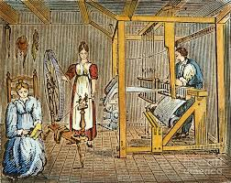
Production before Factories
Work began in cottage industries
Dealt directly with merchants
Could control work schedule and product quality
Family life revolved around business

Slide 21
Problems for Cottage Industries
Family could be ruined
Fire / Flood
Demanded a range of technical skills
Took a long time to learn
Only adults had strength for some jobs
Weaving on a loom

Slide 22
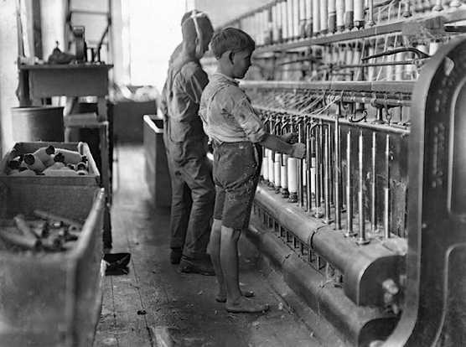
Working in a Factory
Work divided into several separate, easily learning tasks
Adults & children (6 and up) could learn jobs
Mostly adult men

Slide 23
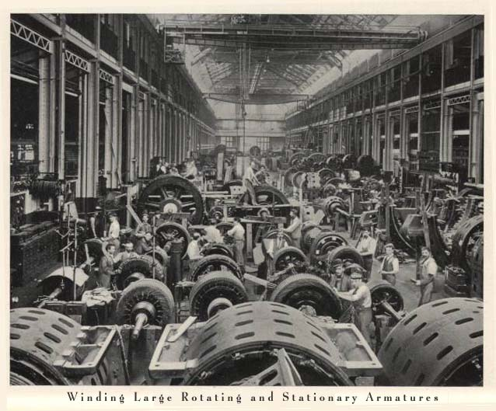
Working in a Factory
Dangerous work
Severe injuries common
Long workdays
Poor sanitation
Bad ventilation
Noisy

Slide 24
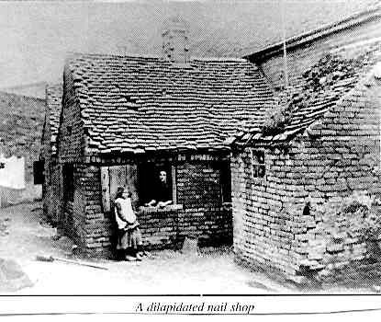
Life in Factory Towns
Whole towns grew up around factories
At first near water, then coal mines
Some companies provided housing
Shoddy, close packed

Slide 25
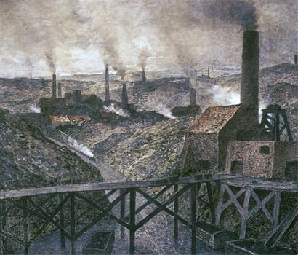
Life in Factory Towns
Thick soot
Smoke
Poisonous chemicals
Pollution
“Black country”

Slide 26
The Factory System and Workers
Factory system required large amounts of capital
3 levels of participants
Wealthy investors & owners
Mid-level employees to run factories
Low-level employees to run the machines

Slide 27
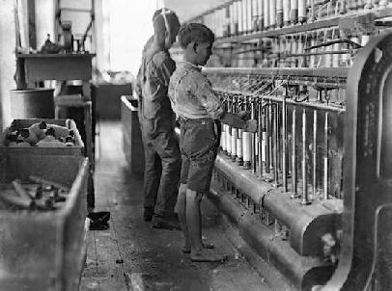
The Factory System and Workers
Workers easy to find
Former farmers
Immigrants
Preferred hiring women and children
Little incentive to improve performance

Slide 28
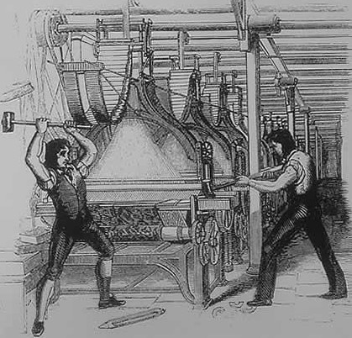
Cottage Workers’ Unrest
Cottage industry workers going out of business
Turned to violence
Luddite movement
The Luddites
Opposed machines – “hurtful to the commonality”
Burned factories & destroyed machines

Slide 29
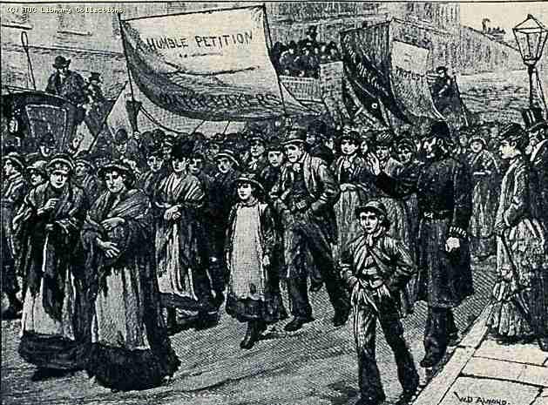
Changing Labor Conditions
Government took no action
Workers started to organize
Labor unions
Organizations representing workers’ interests
Strikes
Work stoppages
Used to urge employers to raise wages and improve conditions

Slide 30
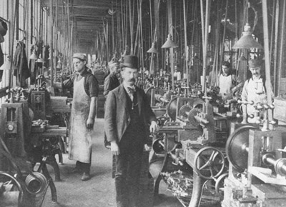
A New Class of Workers
Growth of the middle class
Workers in the middle income range
Managers
Accountants
Engineers
Mechanics

Slide 31
Factories and Mass Production
Mass production
System of manufacturing large numbers of identical items
More consumer goods available to more people

Slide 32
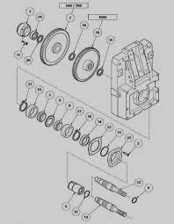
Factories and Mass Production
Interchangeable parts
Identical machine-made parts
Made production and repair more efficient

Slide 33
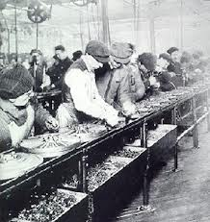
Factories and Mass Production
Assembly line
Product moves from worker to worker, as each one performs a step ion the manufacturing process (division of labor)

Slide 34
Effects of the Factory System: Before
Goods were produced in the home
Work required a wide range of skills
Children did chores at home with the family
Families worked directly with merchants
Few people were members of the middle class

Slide 35
Effects of the Factory System: After
Goods were produced in factories
Work required a few easily learned skills
Children were employed in large numbers in factories
Workers dealt with managers and, sometimes, factory owners
More people joined the middle class

Slide 36
The Industrial Revolution:
New Ideas in a New Society

Slide 37
Main Idea
The Industrial Revolution inspired new ideas about economics and affected society in many ways.

Slide 38
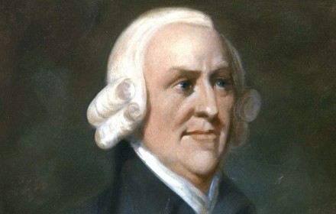
New Ideas about Economics
Laissez-faire economics
“free to do”
Governments should not interfere in business
Adam Smith
The Wealth of Nations
Market economy
The “invisible hand”

Slide 39
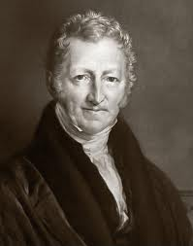
New Ideas about Economics
Thomas Malthus
Population would always grow faster than food production
Poverty and misery would never go away
Ideas used to justify low wages and limit charity

Slide 40
New Ideas about Economics
Entrepreneur
Someone who starts a new business
Invests or starts a new business
Risk of boom or bust

Slide 41
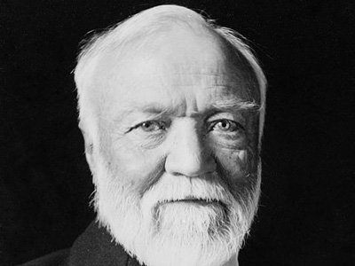
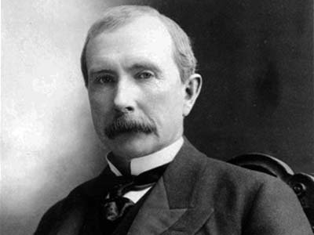
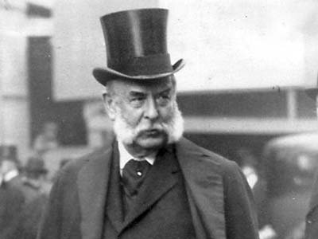
New Ideas about Economics
Andrew Carnegie
Led expansion of the American steel industry
John D. Rockefeller
Oil tycoon
J.P. Morgan
Finance

Slide 42
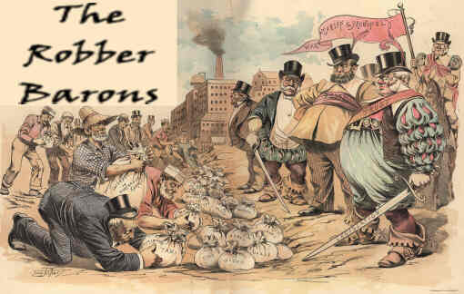
New Ideas about Economics
“Robber barons”
Built giant corporations that drove out their competitors
Admired for contributions to human progress
Criticized for treatment of workers

Slide 43
Competing Economic Views
Robert Owen
Socialism
Instead of individuals, society or government should own all property and control industry
Opposite of capitalism

Slide 44
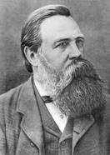
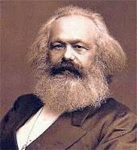
Competing Economic Views
Friedrich Engels and Karl Marx
Claimed that as capitalism grew, more workers would sink into poverty
In time workers would rebel, seize control, and govern themselves

Slide 45
Competing Economic Views
Communism
System that the government owns the means of production and controls economic planning

Slide 46
Effects on Society
Idea of “separate spheres”
Woman in the home and man in the workplace
An increase in wealth
Standard of living improved for industrialized countries
Increased leisure time

Slide 47
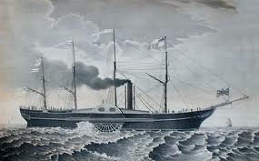
Effects on Society
Great Britain, France, Germany become leaders in global economy
Mass produced ships and weapons
United States slowly gained global political power

Slide 48
Life in the Industrial Age

Slide 49
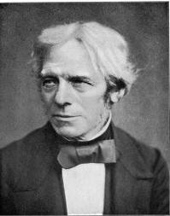
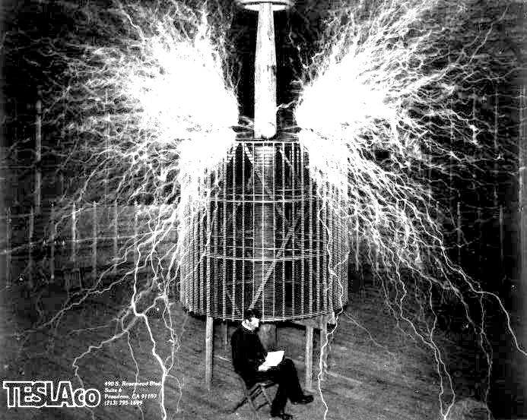
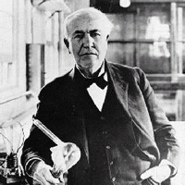
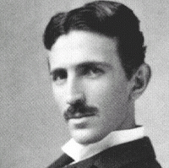
Advances in Technology
Electric Power
Michael Faraday
Thomas Edison
Transformed industry and daily life

Slide 50
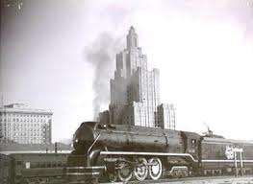
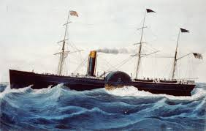
Advances in Technology
Transportation
Increased long-distance travel
Trains
Steamships

Slide 51
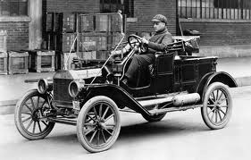
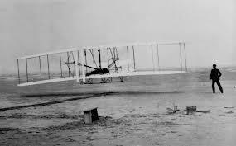
Advances in Technology
Transportation (cont.)
Automobile
Henry Ford
Affordable cars: Model T
Airplane
Wilbur and Orville Wright

Slide 52
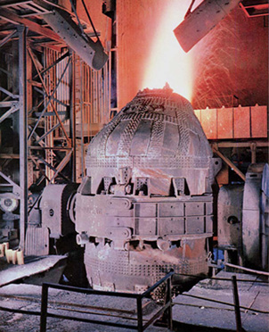
Advances in Technology
Improved steel production
Bessemer process
Forced air through molten metal to burn out carbon and other impurities
Made stronger steel
Helped increase production

Slide 53
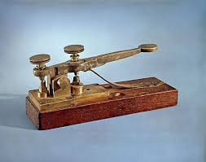
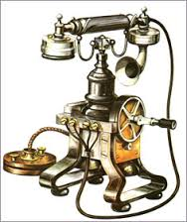
Advances in Technology
Communication:
Telegraph
Samuel Morse
Telephone
Alexander Graham Bell
Radio and Phonograph
Guglielmo Marconi

Slide 54
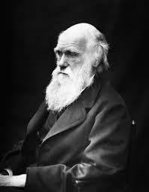
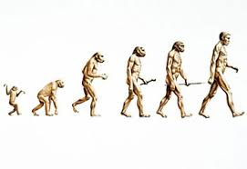
Scientific and Medical Achievements
New Ideas
Charles Darwin
On the Origin of Species
Natural selection
Theory of Evolution
Controversial

Slide 55
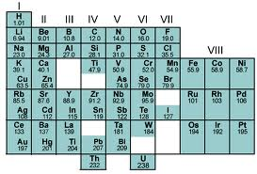
Scientific and Medical Achievements
New Ideas (cont.)
Concept of atoms
John Dalton
Modern atomic theory
Dmitri Mendeleyev
Periodic Table

Slide 56
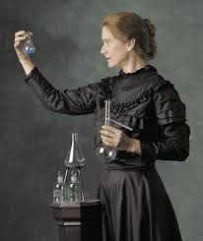
Scientific and Medical Achievements
New Ideas (cont.)
Marie and Pierre Curie
Radioactivity
Albert Einstein
Theory of relativity

Slide 57
Scientific and Medical Achievements
Medical Breakthroughs:
Louis Pasteur
Pasteurization
Anesthetic
Antiseptic
Building of modern hospitals

Slide 58
Scientific and Medical Achievements
Social Sciences:
Development of psychology
Ivan Pavlov
Conditioning
Sigmund Freud
Psychoanalysis

Slide 59
Scientific and Medical Achievements
Social Sciences (cont.):
Development of:
Archaeology
Anthropology
Sociology

Slide 60
Daily Life
Urbanization
Growth in the proportion of people living in towns and cities
Large migrations to cities
Growth of industry = more jobs & opportunities
Immigration

Slide 61
Daily Life
Improvements in city infrastructure
Modernized water and sewer systems
Electricity
Construction
City crowding

Slide 62
Daily Life
Improved education
Increased leisure time and activities
Higher incomes, more free time
Public transportation
Public funding of cultural activities

