Slide 1
The Age of Imperialism: The British in India

Slide 2
Main Idea
One of the first examples of European imperialism in Asia, the British rule over India changed Indian politics, economics, and society and led to the rise of Indian nationalism.

Slide 3
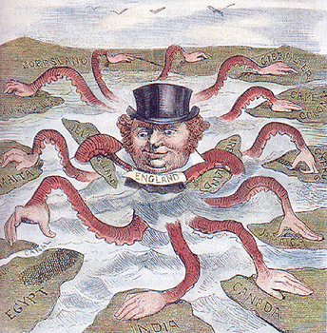
Setting the Stage
Imperialism
Process of one people ruling or controlling another
Extend country’s power and influence with diplomacy or force

Slide 4
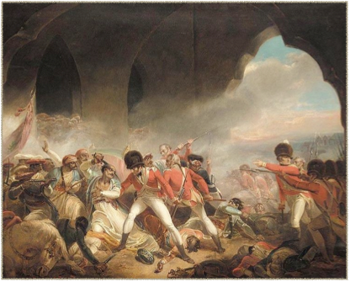
Setting the Stage
1.) Advances in technology gave huge advantage for Europeans
Machine guns
Exploding shells
Steam-powered gun boats
2.) Weakening empires
Faced limited resistance

Slide 5
British East India Company
British East India Company
Controlled trade between Britain, India, and East Asia
Carried out imperialism in India
Ruled India in the name of Great Britain

Slide 6
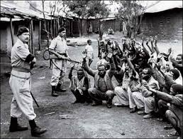
British East India Company
Manipulated rulers
Needed British support to keep throne
Kept rulers from cooperating
Swept in with own armies

Slide 7
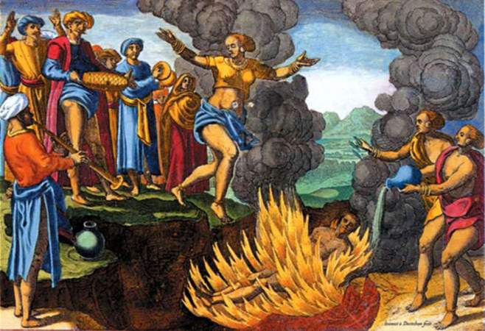
British East India Company
New education system
English language
British laws
Banned certain customs
Sati
Christian missionaries

Slide 8
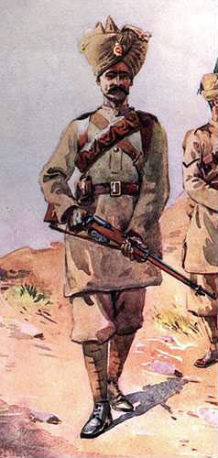
British East India Company
Sepoy Mutiny
Sepoys = Indian soldiers who fought in British army
Triggered by new rifle
Extreme brutality
Ended rule of East India Company, now British government

Slide 9
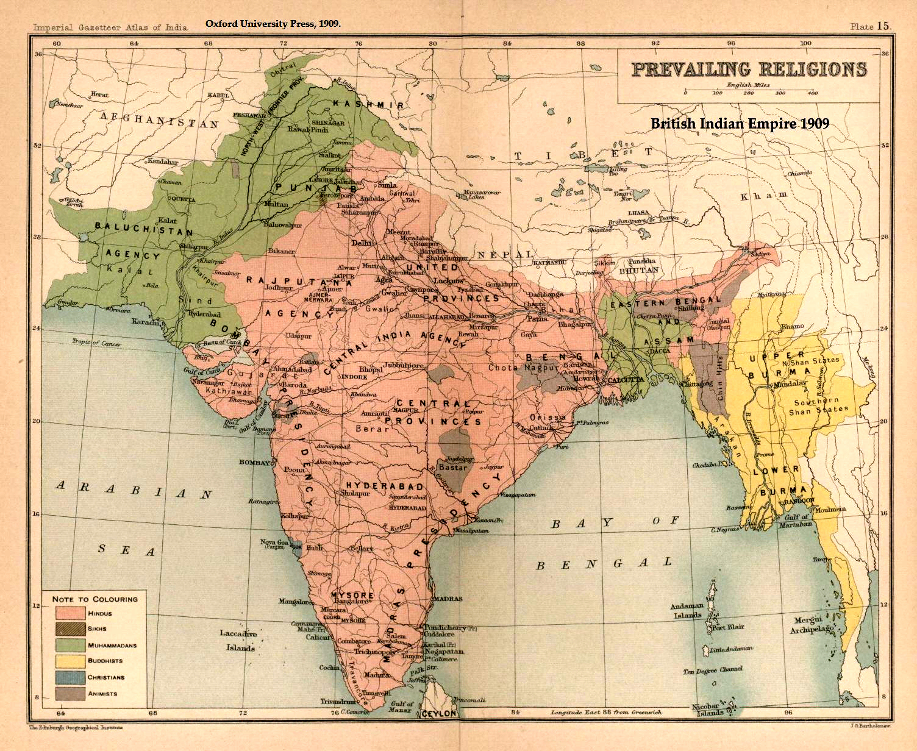
India as a British Colony
Most important colony
“jewel in the crown”
Source of frustration and humiliation for Indians
Feelings of nationalism

Slide 10
India as a British Colony
British Raj (RAHZH) rule
Administration = Indian Civil Service (ICS)
Most officials British
British believed themselves superior
Segregated neighborhoods
Believed Indians couldn’t govern themselves

Slide 11
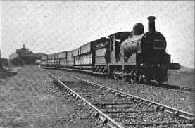
India as a British Colony
Invested in transportation
Move troops
Sell British products
Source of raw materials
Cotton, tea, indigo
Source of money (taxes)
Devastated India’s preexisting industry

Slide 12
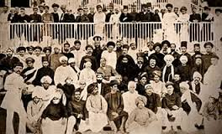
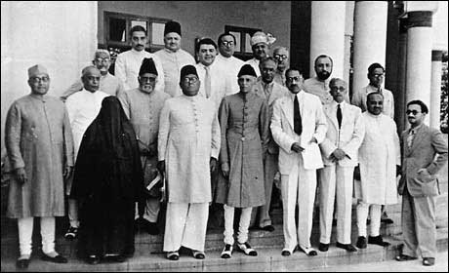
India as a British Colony
Rise in nationalism
Indian National Congress
Swadeshi boycotts
Muslim league

Slide 13
The Age of Imperialism: East Asia and the West

Slide 14
Main Idea
While Western nations focused their imperial ambitions on East Asia, the reactions and results differed in China, Japan, and Southeast Asia.

Slide 15
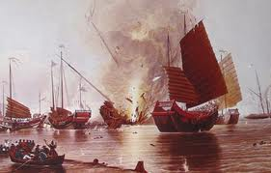
The Opium War
The Opium War
Guangzhou
Unequal treaties
Extraterritoriality

Slide 16
READ PAGES 747-753!
Focus on foreign influences in Asia (trade, colonies, nationalism, wars, etc.)

Slide 17
The Age of Imperialism: Imperialism in Latin America

Slide 18
Main Idea
Imperialism in Latin America involved the United States and European nations seeking to strengthen their political and economic influence over the region.

Slide 19
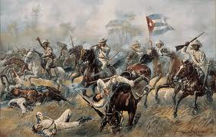
Growing U.S. Influence
Cuban fighting for independence from Spain
U.S. battleship – Maine – explodes in Havana’s harbor
Spanish-American War
Over in 3 months
U.S. receives Puerto Rico & Guam
Purchases Philippines

Slide 20
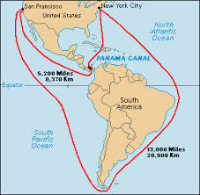
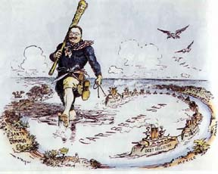
Growing U.S. Influence
Panama Canal
Monroe Doctrine (1823)
Americas off limits to European imperialism except for colonies that already existed
Roosevelt Corollary
Added to Monroe Doctrine
Would use military force to keep Europeans out

Slide 21
READ PAGES 762-765!
Focus on foreign influences in Mexico and Latin America (Civil Wars, American policies, foreign aid, shifts in power. etc.)

Slide 22
The Age of Imperialism: The Scramble for Africa

Slide 23
Main Idea
In the late 1800s and early 1900s, European powers claimed land in much of Africa.

Slide 24
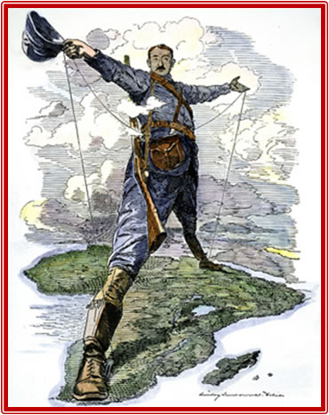
The New Imperialism
The “Scramble for Africa”
European powers rapidly divided Africa
Example of new imperialism
Worked to directly govern large areas
Driven by economic, political, and culture motives

Slide 25
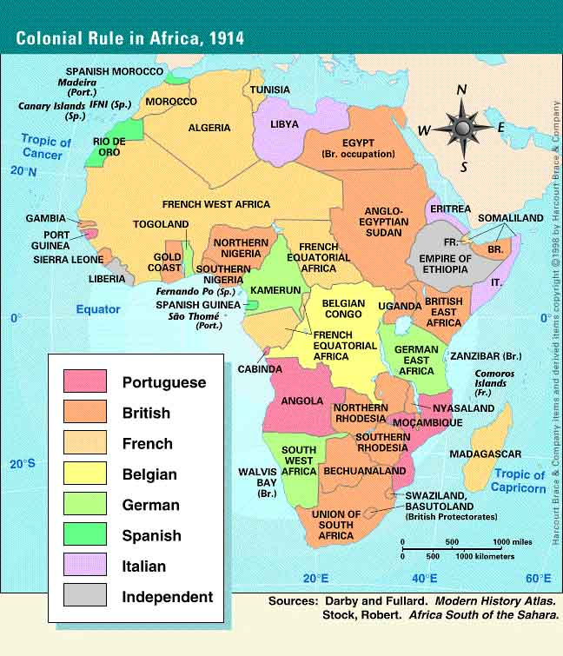

Slide 26
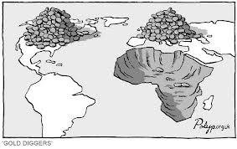
Economic Interests
Originally the slave trade
Raw materials
Industrial Revolution
Ambitious individuals
Develop mines, plantations, and trading routes

Slide 27
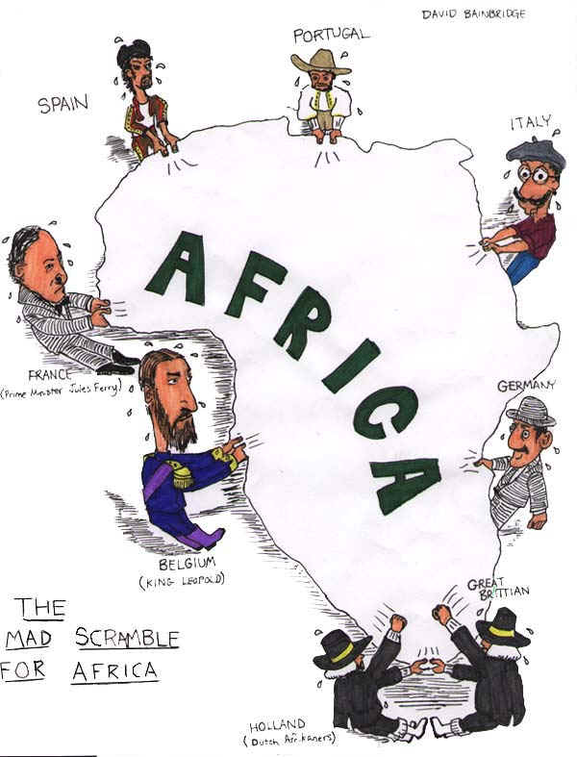
Political Competition
Struggles for power in Europe
Britain, France, Germany, Italy
Nationalism
Control colonies = more respect

Slide 28
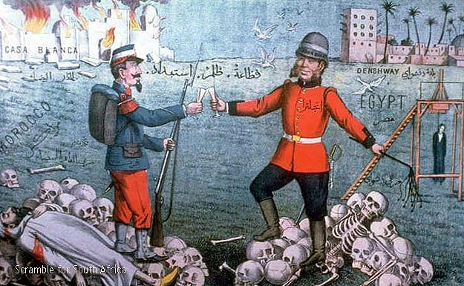
Cultural Motives
Social Darwinism
Certain nations or races are more fit than others
Natural selection
Used as a defense of imperialism

Slide 29
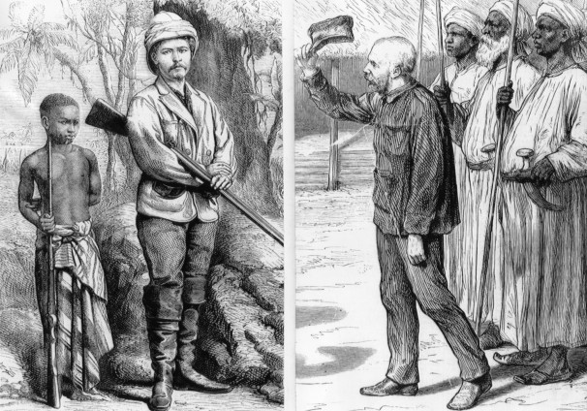
Cultural Motives
Felt superior to non-Europeans
Biologically superior over other races
Believed rule in Africa was justified
Teaching them good government, customs, values

Slide 30
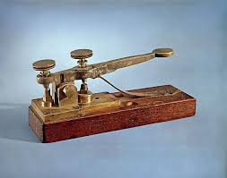
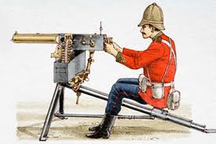
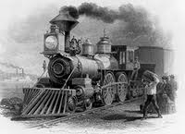
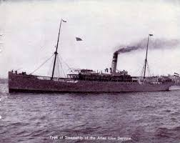
European Claims in Africa
Scientific advances helped control Africa
Quinine
Protected from malaria
Automatic machine gun
Telegraphs
Railroads
Steamships

Slide 31
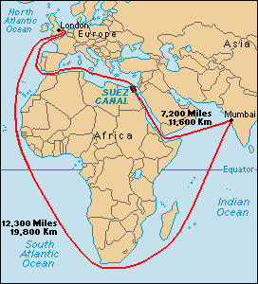
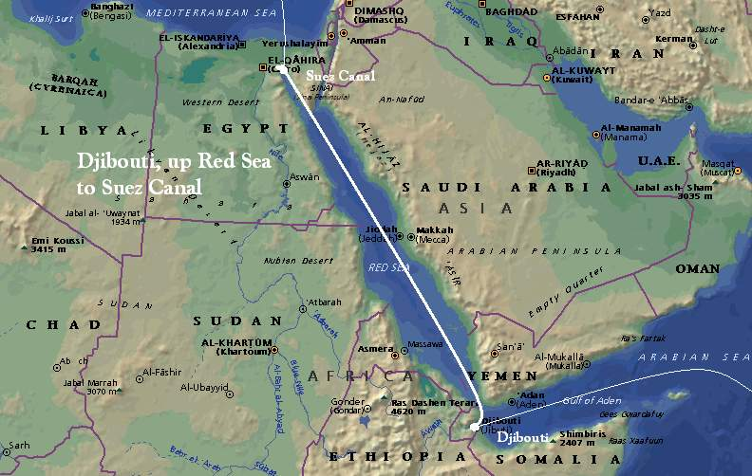
European Claims in Africa
Suez Canal
Linked Mediterranean with the Red Sea
Shortened trip from Europe to Indian Ocean

Slide 32
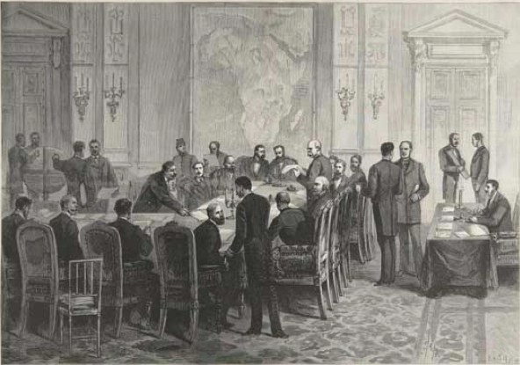
European Claims in Africa
Berlin Conference
When European nation claimed a new African territory:
Had to notify other nations
Had to prove it could control the territory

Slide 33
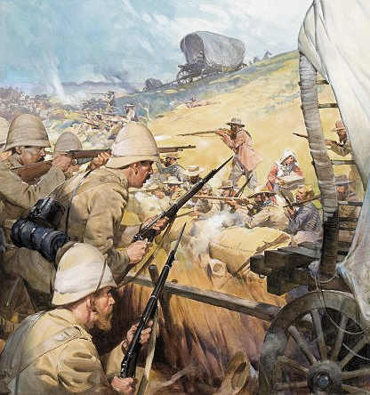
European Claims in Africa
Boer War
Discovery of gold
British vs. Dutch
Guerilla tactics
Concentration camps

Slide 34
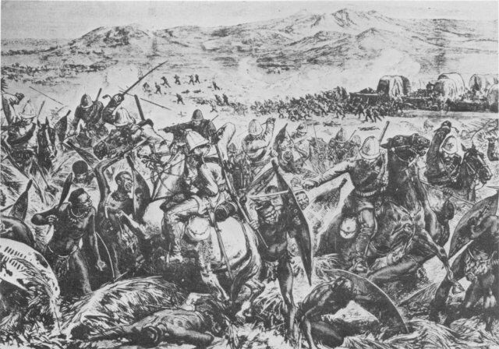
African Resistance
Africans fiercely resisted European powers
The Zulus
Battle of Adwa
Maji Maji Rebellion
By 1914, only Ethiopia and Liberia remained independent

Slide 35
New Imperialism in Africa: Causes
European nations needed new raw materials
European leaders wanted power and land
Europeans believed in Social Darwinism

Slide 36
New Imperialism in Africa: Effects
Africans lost their land and independence
Many Africans died resisting the Europeans

