Slide 1
River Valley Civilizations:
Hinduism & Buddhism

Slide 2
Main Idea
Buddhism, which teaches people that they can escape the suffering of the world through the Buddha’s teachings, developed in India and spread to other pasts of Asia and the world.

Slide 3
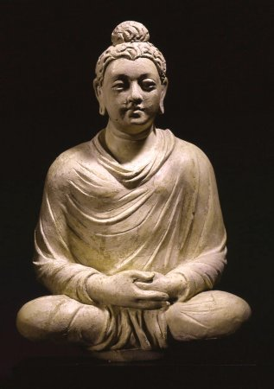
Life of the Buddha
Buddhism
Siddhartha Guatama
Born 500s BCE
Prince of small kingdom (present day Nepal)
Changed when realized people grew old, got sick, & died
Gave up possessions & left palace

Slide 4
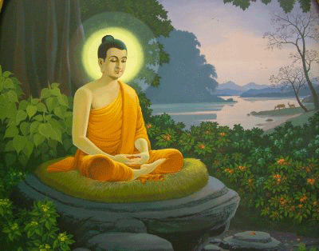
Life of the Buddha
Sought “enlightenment” for six years
Lived in forest, begged for food
Studied with gurus and monks
Sat under a tree, determined not to arise until he solved world’s problems (reached enlightenment)
Transformation into Buddha
Stayed under tree for seven weeks

Slide 5
The Teachings of Buddhism
The Four Noble Truths:
1.) Suffering is a part of human life. No one can escape from suffering while alive
2.) Suffering comes from people’s desires for pleasure and material goods
3.) Overcoming these desires during life eventually brings suffering to an end
4.) Desires can be overcome by following the Eightfold Path

Slide 6
The Teachings of Buddhism
The Eightfold Path
Series of steps that Buddhists belief leads to enlightenment
1.) Right view
2.) Right attitude
3.) Right speech
4.) Right action
5.) Right livelihood
6.) Right effort
7.) Right mindfulness
8.) Right concentration

Slide 7
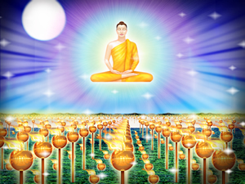
The Teachings of Buddhism
Nirvana
A state of perfect peace, soul free from suffering
Middle Way
Another expression for Eightfold path
Live in moderation, avoiding the extremes of either comfort or discomfort in search of nirvana

Slide 8
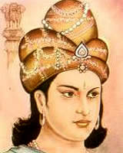
The Spread of Buddhism
Teachings not written down until 1st century BCE
Emperor Ashoka
Helped spread throughout India
Sent missionaries out beyond India

Slide 9
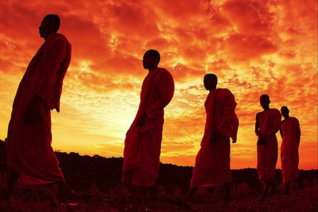
The Spread of Buddhism
Ashoka’s missionaries
Sri Lanka
North into lands of Himalayas
East into lands of Asia
Trade
Helped slowly spread to rest of Asia
China, then eventually Korea and Japan

Slide 10
Main Idea
The religion of Hinduism developed and evolved over a long time in India, giving rise to a variety of beliefs and practices and to other religions, including Jainism.

Slide 11
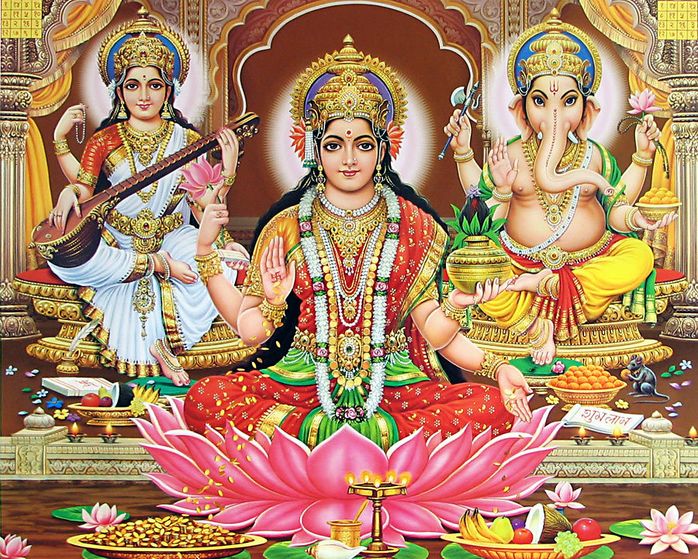
Basic Teachings of Hinduism
Hinduism
One of world’s oldest religions
Still practiced by most people in India today
No founder
Practice varies

Slide 12
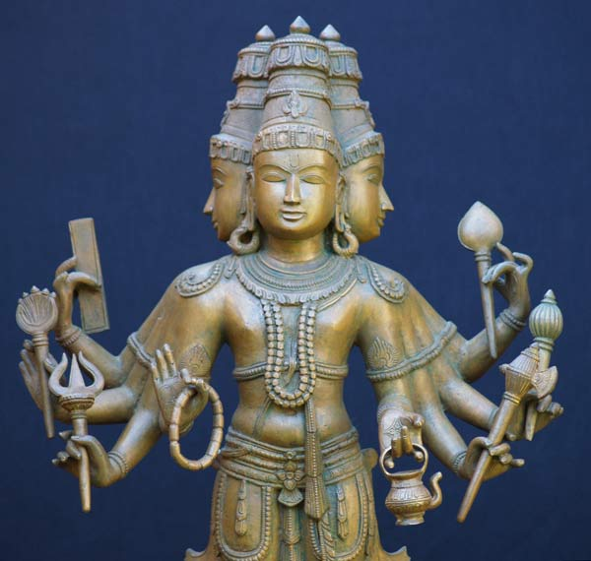
Basic Teachings of Hinduism
Brahman
Eternal being that created and preserves the world
All encompassing
Human mind not capable of understanding it
Atman
Soul
Shapes personality
Can not be destroyed

Slide 13
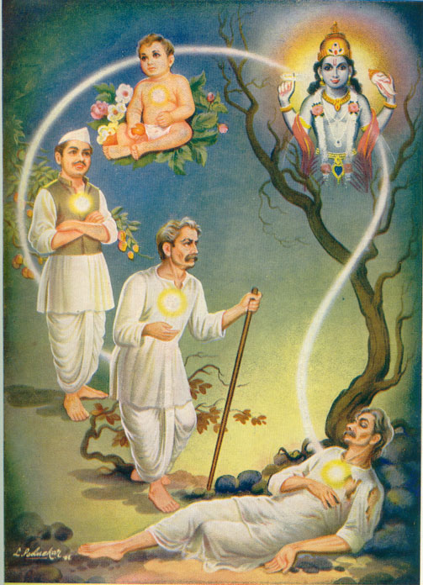
Basic Teachings of Hinduism
Reincarnation (samsara)
Cycle of birth, death, rebirth
Karma
Sum effect of peoples actions; determines your reincarnation

Slide 14
Basic Teachings of Hinduism
Moksha
Escape from the cycle – ultimate goal
Dharma
Way to achieve moksha
Set of spiritual duties and obligations

Slide 15
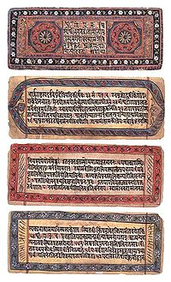
Sacred Texts and Practices
Several sacred texts
The Vedas
Bhagavad Gita
Sacred epics

Slide 16
Sacred Texts and Practices
Practices vary
Worship everywhere/anywhere
Meditate/yoga
Pilgrimage
Images of a deva (image of a god)
Could offer food, drink, or gifts

Slide 17
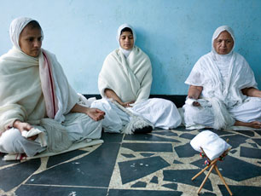
Jainism
500 BCE
Broke away from Hinduism
Less emphasis on rituals
Achieve moksha by giving up worldly things and controlling actions
Ahisma
non violence

