Slide 1
Influences on the law

Slide 2
Bellwork
How do candidates raise money?

Slide 3
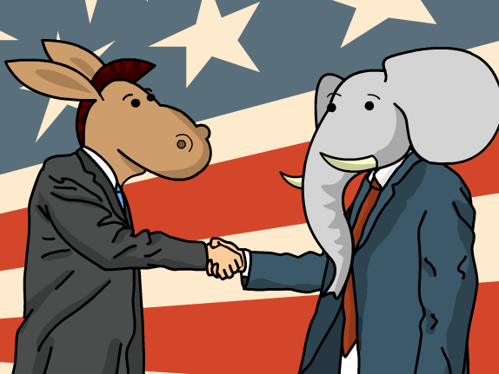
Influences on the law
The role of Congress is to create laws.
Where can ideas for laws originate?
Laws have been influenced by many different sources.
These influences include:
political parties
constituents
interest groups
lobbyists
Public opinion
the media

Slide 4
Political parties and laws
The main goals of political parties are to get voters that will elect officers from their party. With members in office, parties are able to get legislation based on issues important to them.
Leadership positions in Congress are assigned on a party basis.
Party leaders facilitate legislative policy priorities of the party.
The Majority party selects committee chairs who promote the party’s legislative priorities in committee and appoints and controls the standing committees.

Slide 5
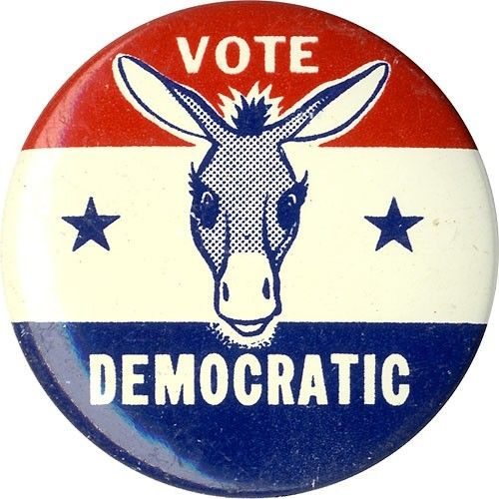
Political parties and legislation
Republicans
Democrats
House GOP passed the ENFORCE Act
Senate Democrats had an “all-night talkathon” to draw attention to global warming

Slide 6
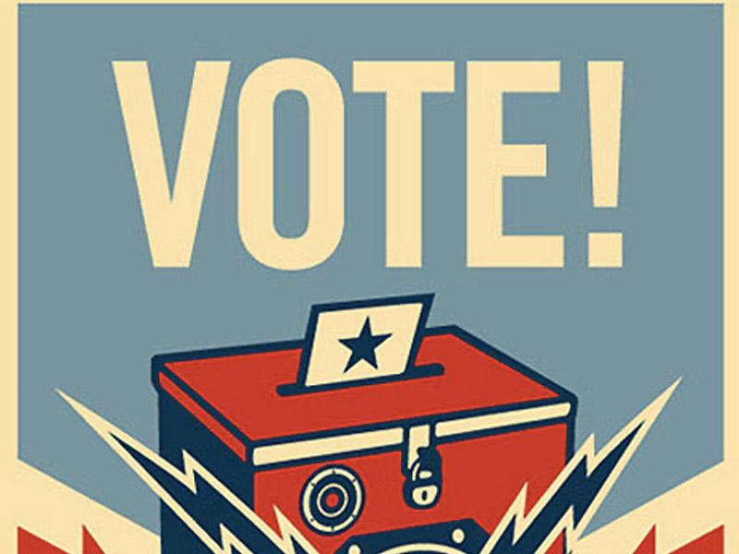
Four ways citizens can participate
A constituent is someone represented in government by the person he or she voted for.
Citizens can influence legislation in many ways.
Speaking out on a public issue
Participate in a community action group
Work on a political campaign
Vote

Slide 7
Financing Campaigns
Private Financing
Voters, business groups, labor unions, and other organizations contribute money to the political party they believe best represents their interests.
Congress passed the Federal Election Campaign Act (FECA) in 1971.
In 2002, Congress passed the Bipartisan Campaign Reform Act
Public Financing
The FECA created the Presidential Election Campaign Fund. By checking a box on their federal income tax forms, Americans can contribute to the election fund.
$3 Tax check-off
http://www.fec.gov/pages/brochures/contriblimits.shtml

Slide 9
What is an interest group
Interest groups are organizations of people with a common interest that try to influence government policies and decisions.
Interest groups are not the same as political parties. Both seek to influence government, but interest groups are more concerned with influencing public policies.
Some interest groups are formed solely for the purpose of promoting a favorable resolution to a single issue. However, most are formed to serve the interests of their members on a variety of issues.
http://votesmart.org/interest-groups#.UyYcUyirmfQ

Slide 11
Types of interest groups
Interest groups attempt to influence public policy by lobbying, which is the process by which they attempt to persuade legislators to support, oppose, or to propose a particular bill.
A person who is paid by an interest group to represent that group’s interests is called a lobbyist.
Many interest groups hire lobbyists to represent them.
Most lobbyists are located in DC.
Some are former members of the state legislature
Other are lawyers, PR experts, journalists, or specialists in a field.

Slide 12
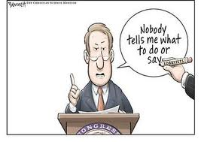
Lobbyists influence government
Lobbyists work with Congress
Lobbyists argue in support of bills they favor and against bills the oppose.
Sometimes they ask members of Congress to sponsor a bill
Lobbyists supply information for the bill
Lobbyists influence public opinion
Interest groups place advertisements in the mass media in support of their positions.
The groups often promise to help government officials in their next election.
Sometimes interest groups urge local groups and individuals to send letters and emails to public officials.

Slide 13
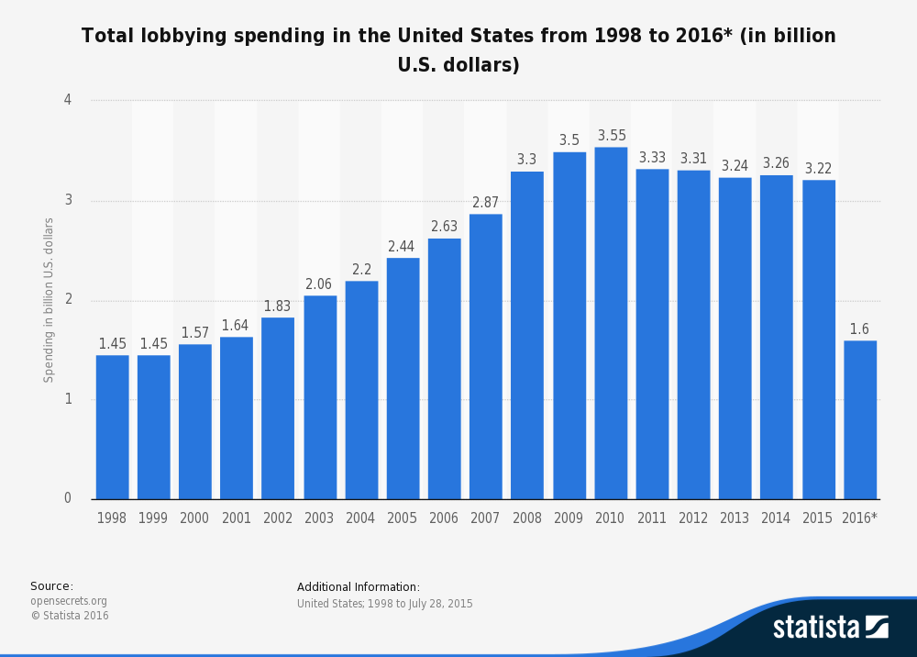

Slide 14
Lobbyists influence government
Lobbyists attempt to lobby the executive
Provide information, policy proposals, and by attempting to influence the decisions of agency heads.
Lobbyists use the judiciary
Use the courts to influence policy.
Interest groups bring lawsuits and they often submit amicus curiae briefs to courts in an attempt to present their views on an issue and persuade the court’s ruling on the case in question.
http://www.youtube.com/watch?v=8ugo8q1l-4s

Slide 15
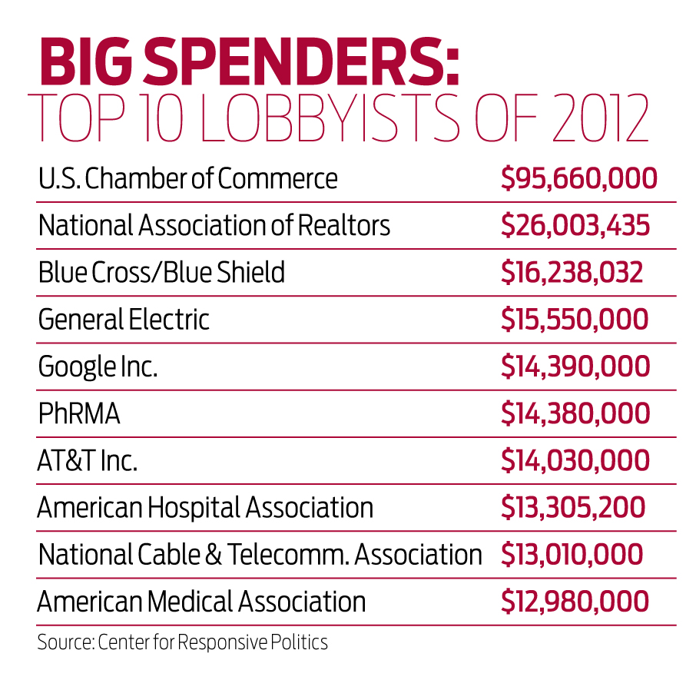

Slide 16
Interest groups
Federal and state governments require lobbyists to register and indicate who they are working for and how much money they spend on their lobbying efforts.
Interest groups are unable to contribute funds directly to candidates, but may contribute to political action committees. PACS collect contributions and use that money to fund candidates that they favor.

Slide 17
PACs Spending
Theoretically independent of interest groups, PACs can solicit donations from group members and then give that money to candidates they support.
FEC prohibits corporations and labor organizations from making contributions to influence federal elections.
A PAC can only give $5,000 in an election campaign to each candidate during an election, but they can give money to as many candidates as they wish.
They can also give up to $15,000 annually to any national party committee, and $5,000 annually to any other PAC.
PACs may receive up to $5,000 from any one individual, PAC, or party committee per calendar year
http://www.opensecrets.org/pacs/toppacs.php?cycle=2012&party=A

Slide 18
PAC vs. Super PAC
Super PACs may not make contributions to candidates’ campaigns or parties but may engage in unlimited political spending independently of the campaigns
They do make independent expenditures in federal races - running ads or sending mail or communicating in other ways with messages that specifically advocate the election or defeat of a specific candidate
There are no limits or restrictions on the sources of funds that may be used for these expenditures
Corporations may contribute to Super
These committees file regular financial reports with the FEC which include their donors along with their expenditures
http://www.opensecrets.org/pacs/superpacs.php?cycle=2012

Slide 19
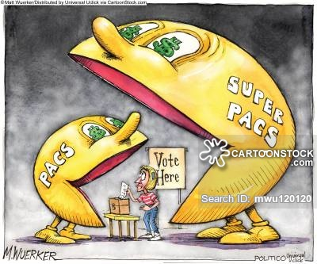

Slide 20
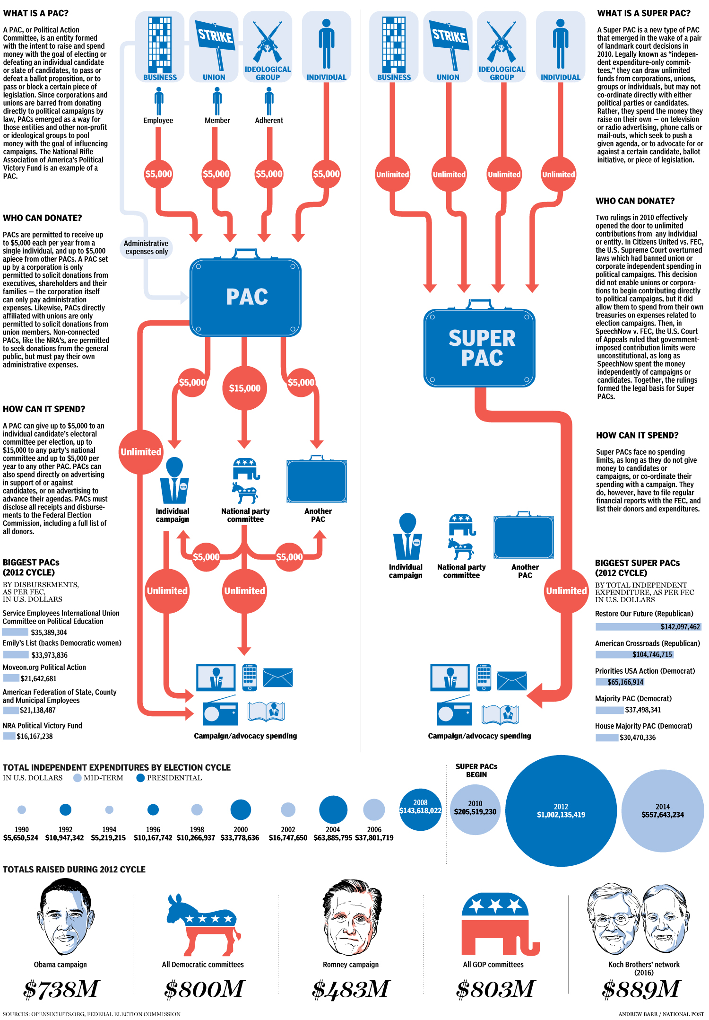

Slide 21
Interest Groups
Look up your group’s assigned interest group. What does that group represent and provide an example of legislation that group may advocate for.
1 – AARP
2 – NRA
3 – NAACP
4 - NOW
5 – Sierra Club
6 – National Association of Wheat Growers
7 – PETA
8 – U.S English

Slide 22
Bellwork
What is the biggest factor in politicians making their decisions?

Slide 23
public opinion
On any particular issue, there may be many diverse opinions, each one held by a different group.
Each group then makes up a “public.”
Public opinion is the total of the opinions held concerning a particular issue.
Opinions are influenced by many factors.
Family
Friends
Experience/age
Teachers
Clubs
http://www.youtube.com/watch?v=VO12p1n39BE

Slide 24
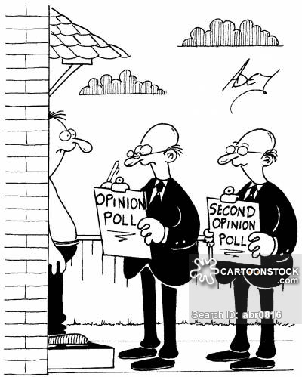
Measuring public opinion
Government officials are responsible for carrying out the wishes of the people.
The government finds out what the public wants by measuring public opinion in a poll or survey.
Polls are used to find out what people think about specific issues and politicians and their policies.
A sample should be chosen that is representative of the public. An unrepresentative poll can cause errors in the poll’s results.

Slide 25
How public opinion is shaped
Much of the information we need to make good decisions about public issues comes from the mass media.
Mass media are forms of communication that transmit information to large numbers of people.
Mass media includes printed media and electronic media.
Simply having access to information does not always mean you are well informed. Effective citizenship requires you to think critically about what you see, hear, and read.
To participate fully in the democratic process you must be will informed and recognize the difference between fact and opinion.

Slide 26
Propaganda
Many ideas in the mass media are directed at us for a purpose. Someone or some group is urging us to do something.
Propaganda is information, especially. of a biased or misleading nature, used to promote or publicize a particular political cause or point of view
http://www.youtube.com/watch?v=ohoXZ6EcneA

Slide 27
Propaganda techniques
Testimonial
Seeking endorsements from famous people
Law requires that an endorsement reflect the celebrity’s honest experience and opinion
Bandwagon
If you can win people over to your ideas, eventually more people will come over to your side.
This method appeals to people’s desire to do what their friends and neighbors are doing.
Name calling
Name calling is using an unpleasant label or description to harm a person, group, or produce

Slide 28
Propaganda techniques
Glittering generalities
Uses words or vague statements that sound good but have little real meaning.
Political candidates use glittering generalities because these statements tell voters nothing about what the candidate really believes
Terms such as “freedom” and “patriotism” frequently used
Plain folks appeal
Many candidates describe themselves as being plain, hardworking citizens and understand the problems of the average citizen.
Card stacking
Uses facts that support only one side of a particular product, idea, or candidate.
Technique stacks the cards against the truth

