Slide 1
The Interwar Years: Unrest in Asia

Slide 2
Main Idea
During the chaotic years following World War I, nationalist feeling increased in Asia and Africa. The resulting unrest continued into the 1930s.

Slide 3
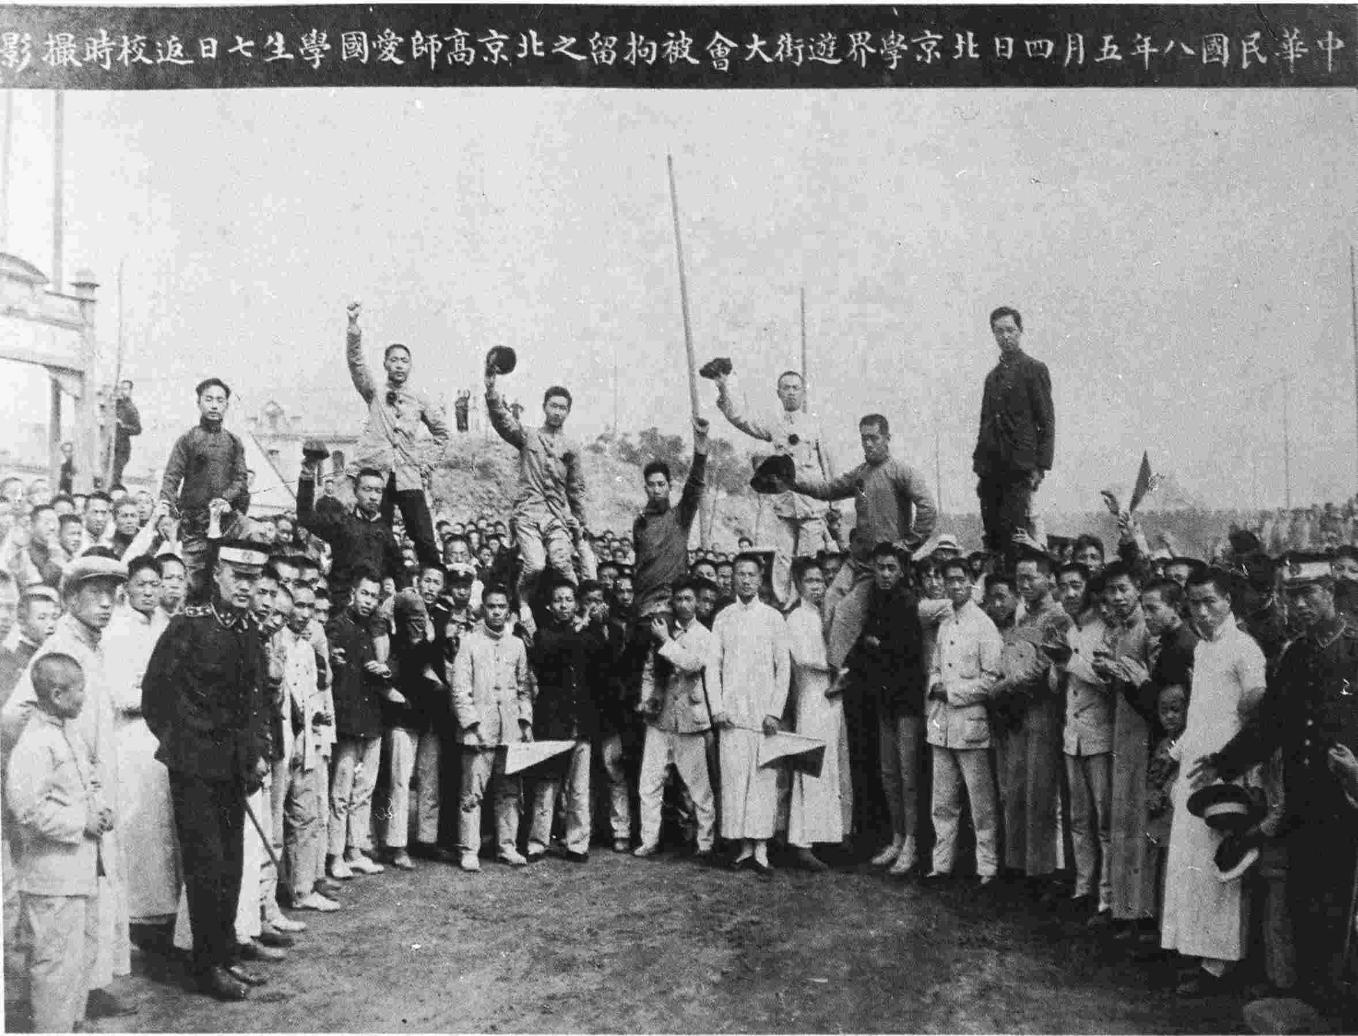
China After World War I
China declares war on Germany (1917)
Hoping would regain German-controlled Chinese's territories
Given to Japan
May Fourth Movement (1919)
Protests and strikes swept the country

Slide 4
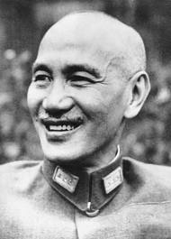
China After World War I
1921 – Communist Party of China formed
Allied with Guomindang nationalists to fight the warlords
Chiang Kai-Shek (Jiang Jieshi)
Leader of the nationalists/Guomindang
Chinese Civil War
Communists vs. Guomindang

Slide 5
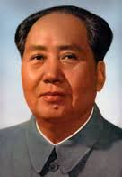
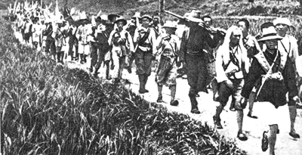
China After World War I
Mao Zedong
Leads 100,000 Communist supporters on a 6,000 mile walk through China
The Long March
Wanted to find a safe place for Chinese Communists beyond Guomindang control

Slide 6
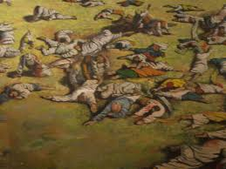
Changes in India
Increasing tension between Indians and British
Served in WWI – but gained nothing
Anger and unrest grew
1919 – Rowlatt Acts
British could deal harshly with opposition

Slide 7
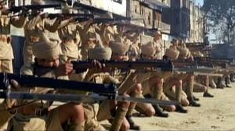
Changes in India
Amritsar Massacre
Protest at the city of Amritsar
British open fire on a large crowd of peaceful, unarmed demonstrators
400 killed
Helped convince Indians they must rid themselves of British rule

Slide 8
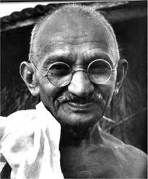
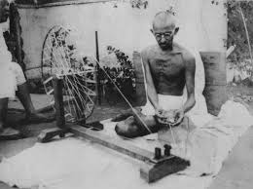
Changes in India
Mohandas Gandhi
Organized protests against Britain
2 important concepts
Ahimsa – non-violence towards living things
Civil disobedience – refusal to obey unjust laws
Encouraged boycotts

Slide 9
The Middle East
Arab nationalists wanted to create an independent Arab state
Jewish national movement – Zionism
Hoped to rebuild a Jewish state in ancient Jewish homeland
Balfour Declaration
British government declared its support for a Jewish homeland in Palestine

Slide 10
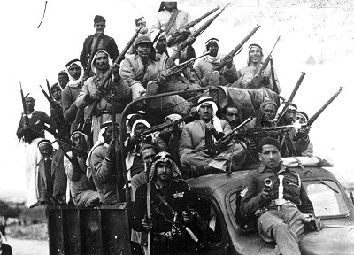
The Middle East
Instead of fulfilling the Arab and Jewish hopes – French and British mandates were established
Arabs and Jews unhappy
Thousands of Arabs and Jews moved to Palestine
Tensions increased – violence between the two groups breaks out

Slide 11
Nationalism in Africa
Believed had earned independence from European control through their wartime sacrifices
War caused economic hardship
No Africans involved in Treaty of Versailles
Gave away German colonies to other countries instead of independence

Slide 12
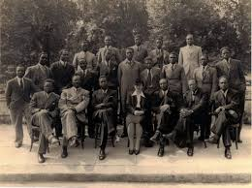
Nationalism in Africa
Pan-African Congresses
Organized by people of African heritage around the world
Lead to a series of demands for reforms and African independence
No real progress until after WWII

Slide 13
The Interwar Years: The Great Depression

Slide 14
Main Idea
In the late 1920s an economic depression started in the United States and quickly spread around the globe, causing great hardship and creating ideal conditions for political unrest.

Slide 15
The U.S. Economy in the 1920s
During WWI – U.S. farms and factories supplied much of the world with food and supplies
Economic growth throughout most of the 1920s
Mostly in industry
Cars, radios, vacuums, washing machines, etc.
Stock markets rose almost 400%

Slide 16
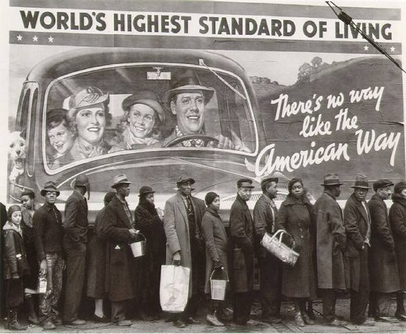
The U.S. Economy in the 1920s
New wealth not distributed evenly
Richest 1% earned 19% of nation’s income
Many Americans using credit to buy consumer goods
Many consumers reaching the limit of their credit
Couldn’t buy any more products

Slide 17
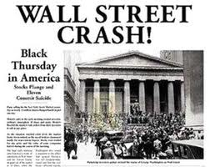
The U.S. Economy in the 1920s
Fall 1929 - Fearing that stocks might go down – many investor began to sell off their stocks
Black Tuesday – October 29, 1929
Investors sold off 16 million shares
Stocks flood the market
Prices collapsed
Stock market crashed

Slide 18
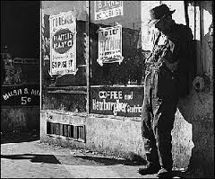
The Depression Spreads
The Great Depression
Severe worldwide depression that followed the collapse of the U.S. stock market
Prices and wages fell
Business activity slowed
Unemployment rose
Rise in poverty
Minimal government response

Slide 19
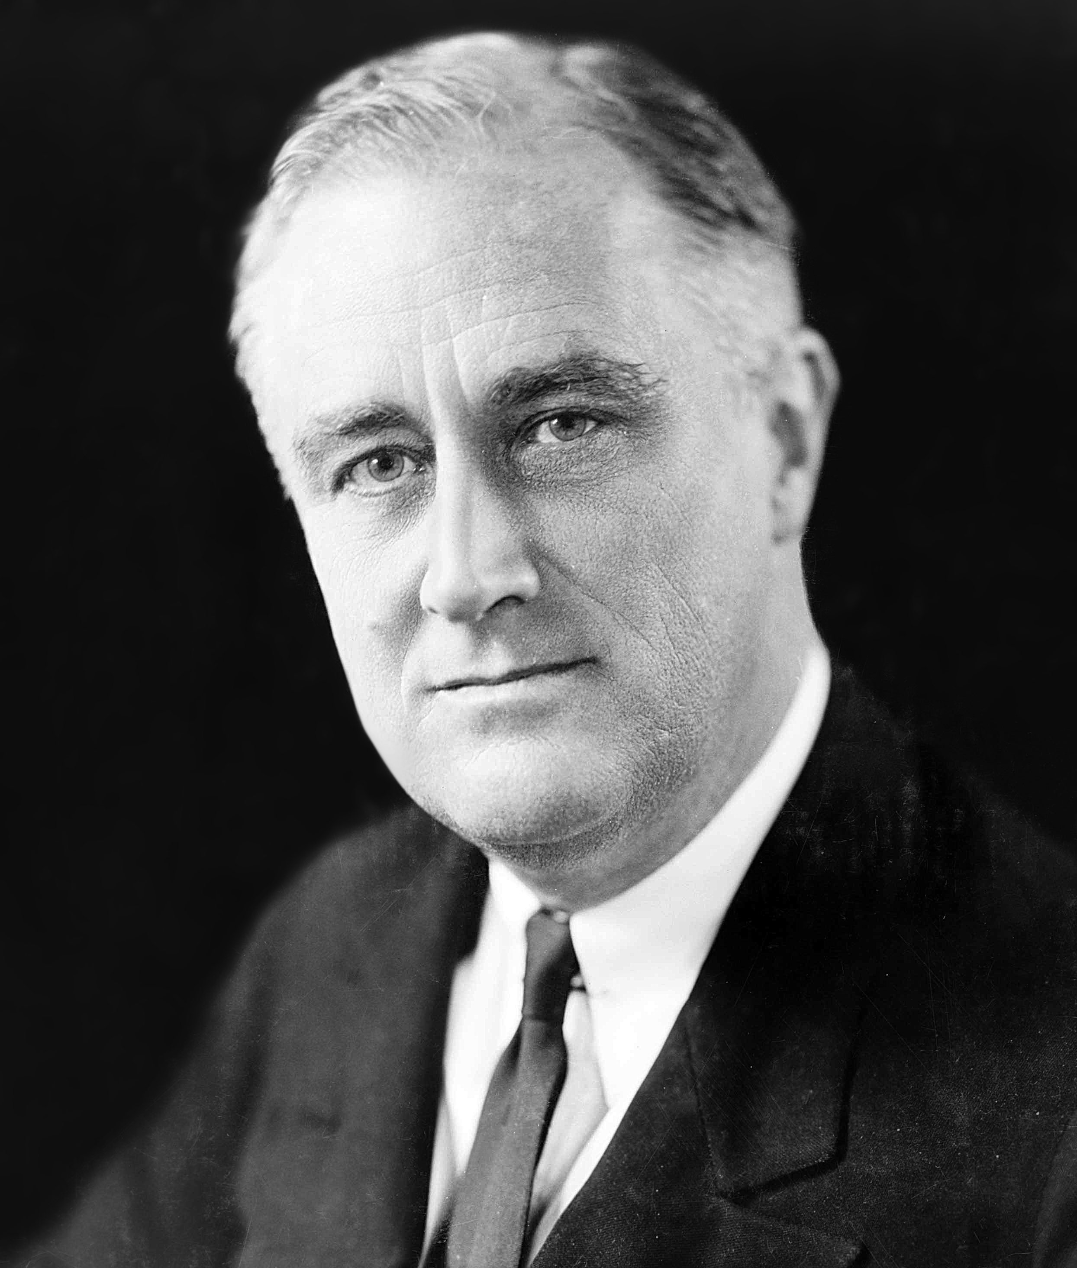
The Depression Spreads
Franklin Delano Roosevelt (FDR)
Elected president (1932)
Believed government spending could help start an economic recovery

Slide 20
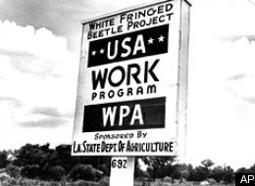
The Depression Spreads
New Deal
Program aimed at fighting the Great Depression
Public work programs
Relief programs
Welfare
New regulations to reform and protect the stock and banking markets

Slide 21
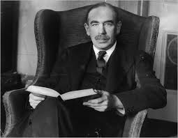
New Economic Theories
John Maynard Keynes
Believed governments could limit or even prevent economic downturns by spending money
Even if it meant unbalanced budget
Spending would help increase economic output

Slide 22
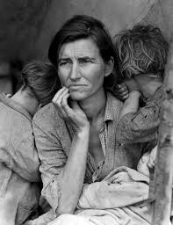
The Worldwide Depression
American businesses:
Majority of the world’s industrial output
Leading importer and lender of money
Therefore – The Great Depression soon spread around the world
Many countries already struggling from the effects of WWI

Slide 23
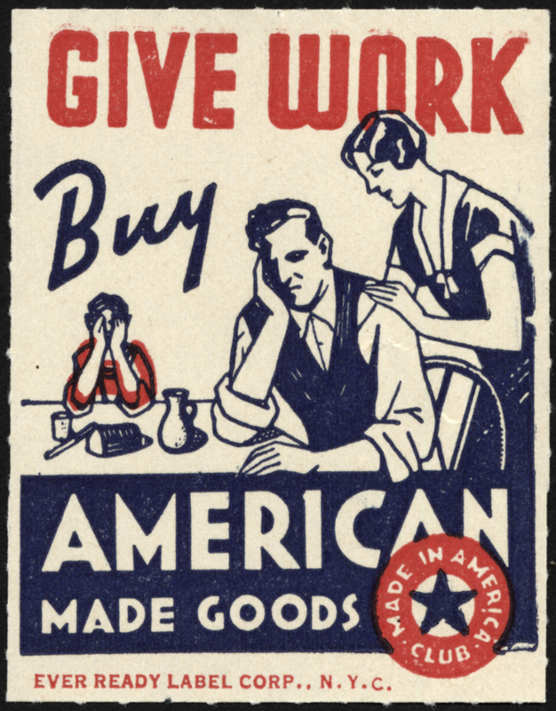
The Worldwide Depression
Smoot-Hawley Tariff Act
Placed heavy taxes on imported goods
Attempt to encourage Americans to buy products made in the U.S.
Backfired:
Other countries increased their own tariffs
Trade slowed
Prices dropped John Green

Slide 24
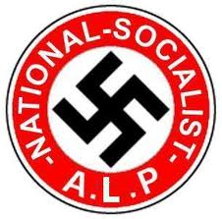
The Worldwide Depression
Unrest and political instability grew
Formation of several new governments
Extremist political groups gained strength
National Socialist Party (Nazi)
Italy fell under a dictator

Slide 25
The Interwar Years: Japanese Imperialism

Slide 26
Main Idea
A modernized Japan emerged from World War I as one of the world’s leading powers. Dreams of empire, however, led the country in a dangerous direction.

Slide 27
Japan in the 1920s
After WWI – Japan was one of world’s strongest nations
Rapid industrialization created problems
Industries experienced slowdowns
Didn’t have that natural resources needed to supply modern industry
Social changes
New political parties
Began to question traditional Japanese values

Slide 28
Growing Military Influence
The Great Depression caused many to lose faith in government
Looked to Japanese military for leadership
Military wanted a united Japan
A society devoted to the emperor and to the glory of the nation ruled by military leadership
Began to question cooperation with the West

Slide 29
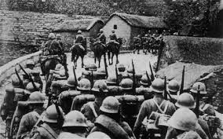
Japanese Aggression
Began promoting fighting sprit of troops
Government begins to be dominated by the military
Series of assassinations
Manchurian Incident
Decided to conquer Manchuria region of northeastern China
Had rich national resources
Forms Manchukuo

Slide 30
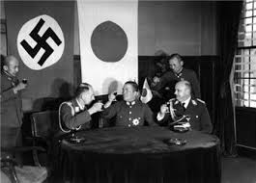
Japanese Aggression
League of Nations condemns Japan’s actions in Manchuria
Japan withdraws from the league
Anti-Comintern Pact
Agreement with Germany (eventually Italy as well)
Would work together to oppose the spread of communism

Slide 31
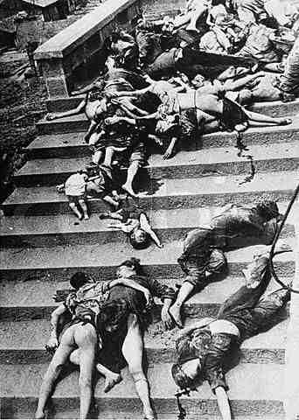
Japanese Aggression
Begin taking more territory from China
Triggers the Second Sino-Japanese War
Nanjing Massacre
After capturing city of Nanking Japanese troops go on a rampage
Killed 100,000 soldiers and citizens
War eventually becomes part of WWII

Slide 32
The Interwar Years: Dictators in Europe

Slide 33
Main Idea
The political and social unrest that followed World War I helped totalitarian dictators rise to power in Europe.

Slide 34
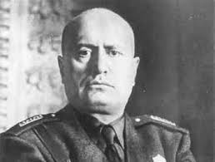
Mussolini’s Italy
Benito Mussolini
Il Duce
Wanted to build Italian empire
Founder of the National Fascist Party

Slide 35
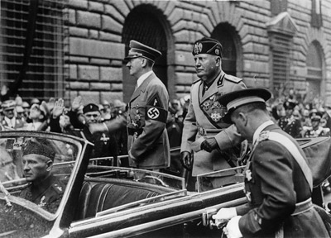
Mussolini’s Italy
Fascism
Authoritarian form of government that places the good of the nation above all else
Above individual needs and rights
Envisions an aggressive state
Rule by a dictator

Slide 36
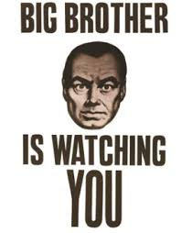
Mussolini’s Italy
Used threats, violence, and politics to take power
Outlawed all opposition
Totalitarianism
Government that controls all aspects of life
Thoughts, feelings, and behaviors
Propaganda
Establishment of festivals

Slide 37
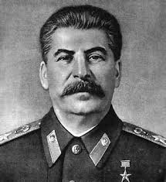
Stalin’s Soviet Union
Joseph Stalin
Takes power after Lenin dies
Worked to make Soviet Union a totalitarian state
Wanted to modernize Soviet economy

Slide 38
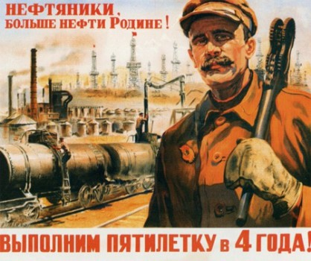
Stalin’s Soviet Union
The Five-Year Plans
Factories and mines had production goals set by the state
Centralized planning
Opposite of capitalism

Slide 39
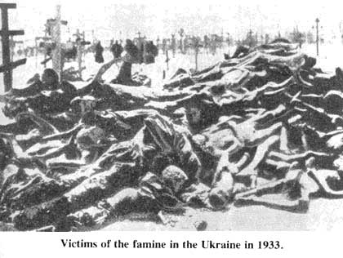
Stalin’s Soviet Union
Combined farms to from larger, mechanized farms (collectivization)
Took back land from the peasants
Those who resisted where executed or sent to labor camps
When Ukraine resisted – let millions die from starvation

Slide 40
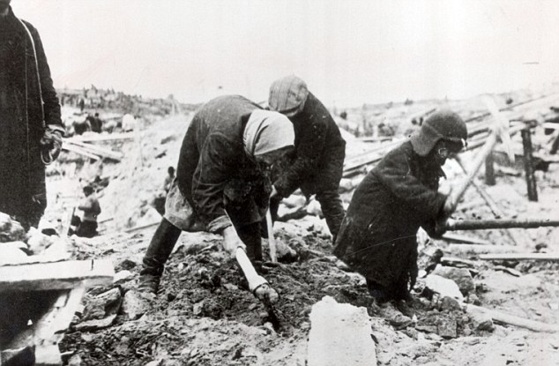
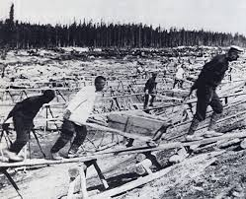
Stalin’s Soviet Union
Gulag
System of labor camps
Based in Siberia
Often died in harsh conditions

Slide 41
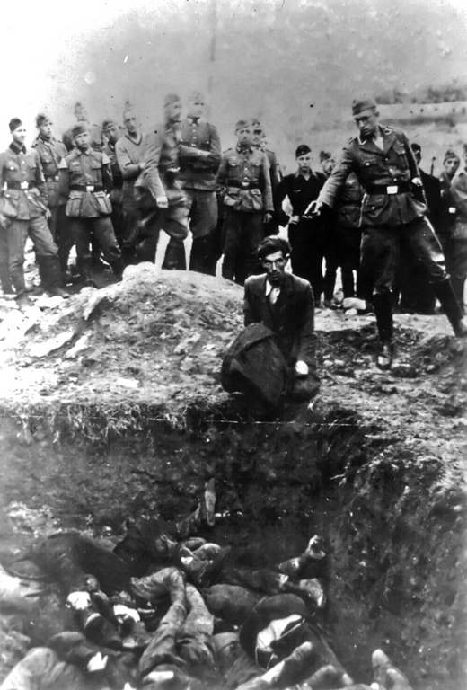
Stalin’s Soviet Union
Stalin feared plots against his rule
The Great Purge
Stalin attacked real and imagined opponents of his rule
Thousands executed or sent to the Gulag
Communist leaders, military officers, & ordinary citizens

Slide 42
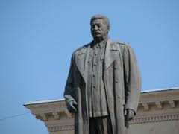
Stalin’s Soviet Union
Promoted Stalin and removed opposition
Children taught attitudes and beliefs leaders wanted them to have
Religion discouraged
Images of Stalin everywhere

Slide 43
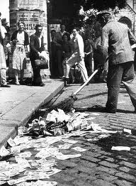
Postwar Germany
After WWI – formed new government – the Weimar Republic
Very unpopular
Blamed for the the humiliating Versailles treaty and economic problems
Hit hard by the Great Depression
Inflation
Unemployment

Slide 44
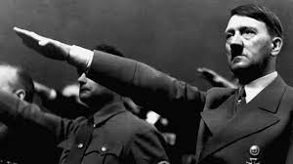
Hitler’s Germany
Adolf Hitler
1889 - Born in Austria
Served in German army during WWI
Joined the Nationalist Socialist Party – the Nazi Party
Had a talent for public speaking and leadership

Slide 45
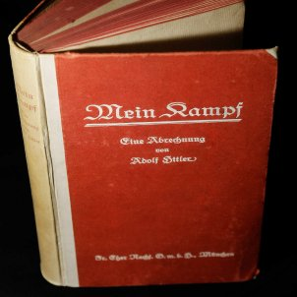
Hitler’s Germany
Attempts to overthrow Germany’s government
Fails – put in prison
While in prison writes Mein Kampf
Described major political ideas
Nationalism
Racial superiority of the Germans/Aryans

Slide 46
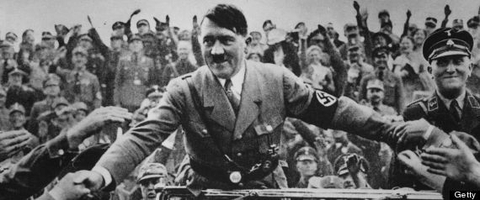
Hitler’s Germany
Economic effects of the Great Depression helped his cause
People desperate for a strong leader
Promised to rebuild military
Spoke of a German empire and a “master race”
1933 – Hitler appointed chancellor
Begins to crush his opposition
Intimidates or arrests opponents

Slide 47
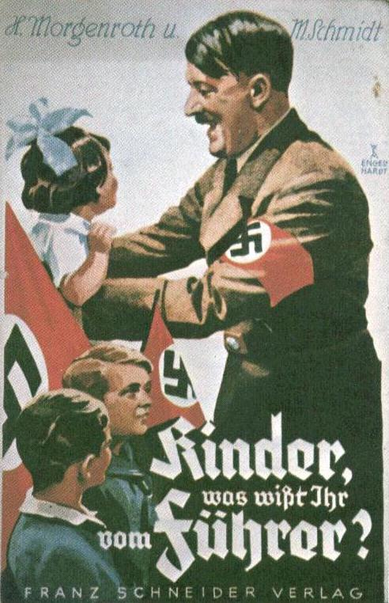
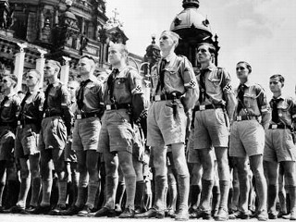
Hitler’s Germany
Begins to take form of a totalitarian regime
Nazi propaganda
Glorify Hitler as the Fuhrer (“leader”)
Nazi youth organizations
Wage controls and massive government spending
Helps reduce unemployment

Slide 48
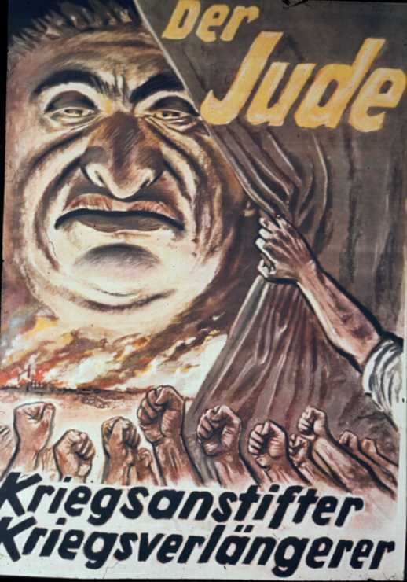
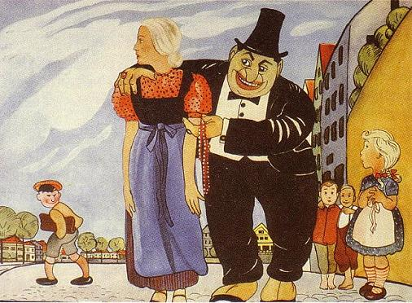
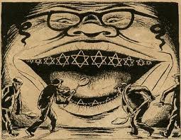
Hitler’s Germany
Anti-Semitism
Hostility toward or prejudice against Jews
Blamed Jews for many of Germany’s problems
Combined prejudice based on religion with hatred based on ancestry

Slide 49
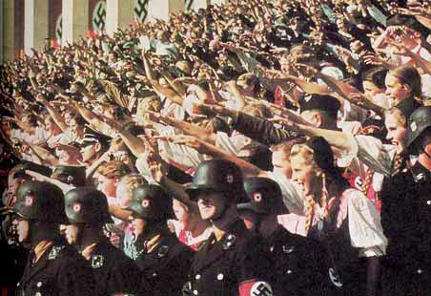
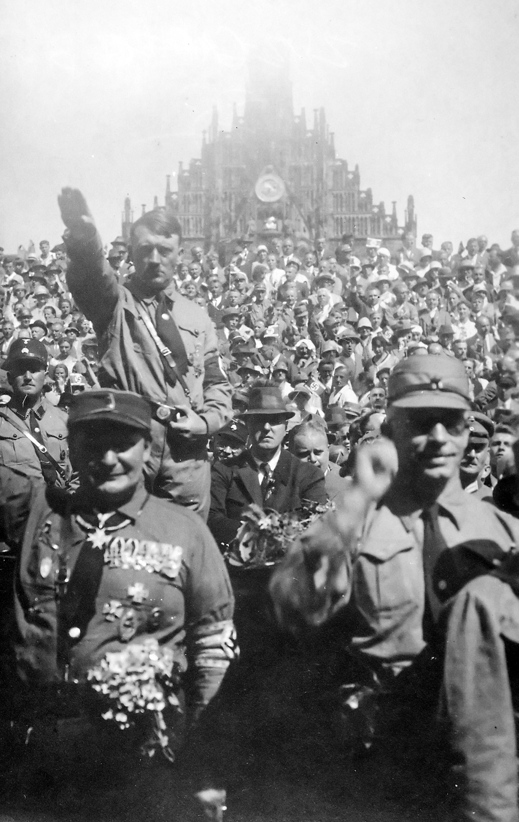
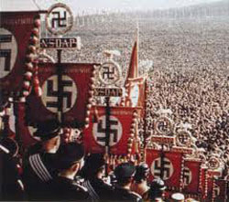
Hitler’s Germany
Nuremberg Laws
Created a separate legal status for German Jews
Eliminated citizenship, property, and civil rights
Defined a person as Jewish based on the ancestry, not religion

Slide 50
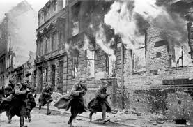
Hitler’s Germany
Kristallnacht
Night of Broken Glass
Nazis encourage anti-Jewish riots across Germany and Austria
Destroy thousands of Jewish businesses and temples
100 killed

