Slide 1
Judicial Branch

Slide 2
Bellringer:
What is the role of the Supreme Court?

Slide 3
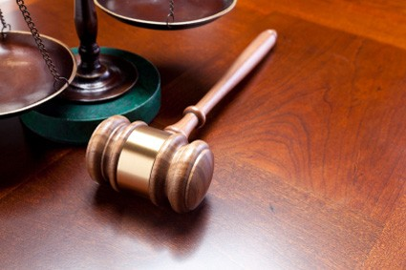
Federal Courts
In Article III, Section 1 provides “the judicial power of the United States shall be vested in one Supreme Court, and in such inferior courts as Congress may from time to time establish.”
There are three levels of federal courts.
Highest: Supreme Court
Second: Court of Appeals
Lowest: District Court
Each level of the federal court system is given jurisdiction in several different kinds of cases.
Jurisdiction is the scope of authority that a court has to hear and decide a case that had been properly brought before it.

Slide 4
Cases Heard in Federal Courts
Cases involving the Constitution
Violations of Federal Law
Controversies between States
Disputes between parties from different states
Suits involving the federal government
Cases involving foreign governments and treaties
Cases based on admiralty and maritime law
Cases involving US diplomats
In most of these cases federal courts have exclusive jurisdiction. However, in some circumstances the state and federal courts have concurrent jurisdiction.

Slide 5
US District Courts
The lowest level of federal courts is the US district courts.
District courts are the trial courts and they are courts of original jurisdiction.
Original jurisdiction: authority to hear a case for the first time
District courts are the only federal courts in which a jury trial is held. They determine the facts for the case.
Only federal courts where witnesses testify and juries hear cases.
District courts are the fact finding courts
Federal district courts are the “local: courts in the federal court system. There are at least one in each state.

Slide 6
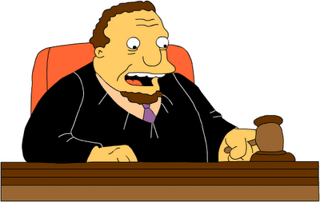
Federal Judges
Judges do NOT make law, judges apply the relevant law to the case.
The Constitution sets forth no particular qualifications for federal judges.
All federal judges are appointed for life by the president and must be approved by the Senate.
Federal judges can be removed only by Impeachment by Congress.

Slide 7
Salary
Chief Justice, Supreme Court | $223,500
Associate Justices, Supreme Court | $213,900

Slide 8
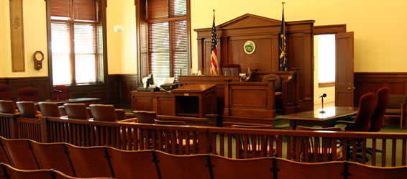
US Court of Appeals
After a trial in the district court, the losing party may appeal to the next level of court.
The second level of the federal court system are the courts of appeals. These courts have appellate jurisdiction
Appellate jurisdiction: power to review decisions made by lower courts.
The federal courts of appeals are divided into 12 circuits. Each court of appeals have 6-28 judges
13th appeals court has nationwide jurisdiction to hear special cases such as those involving patent law.

Slide 9
US Courts of Appeals
Courts of appeals do NOT hold trials. Instead a panel of at least three judges makes a decision on the case.
Appellate judges examine the records of the district court trial and hear oral arguments from the attorneys. The judges are to determine whether the law was interpreted and applied correctly.
Judges reach their decision by majority vote.
Three possible outcome:
Uphold decision of lower court
Reverse decision of lower court
Remand the case back to the lower court to be tried again
Sometimes after the court’s decision, another appeal is made.

Slide 10
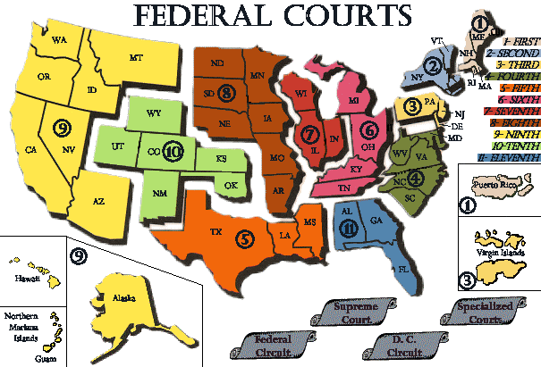

Slide 11
US Supreme Court
The highest court in the land is the Supreme Court, which meets in Washington D.C.
The Supreme Court is mainly an appeals court, but does have original jurisdiction in two instances.
Disputes between diplomatic representatives of other countries
Cases in which a state is a party
The decision of the Supreme Court is final and can not be appealed.

Slide 12
The Federal System

Slide 14
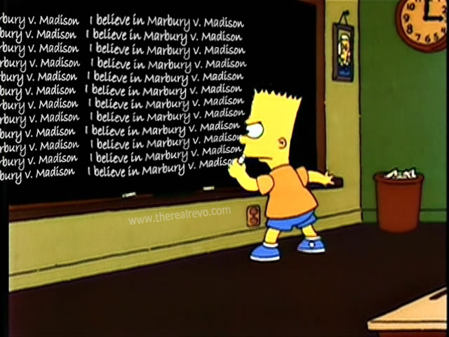
Power of Judicial Review
The Supreme Court has the power of judicial review. It is the Court’s power to decide whether a law or presidential action is in agreement with the Constitution.
If the Court decides that law conflicts with the Constitution, that law is declared unconstitutional.
The power of judicial review was established in Marbury v. Madison.

Slide 15
Choosing Cases
More than 8000 cases are filed with the Supreme Court each year.
Court only hears 80-150 cases
It is up to the Court to decide whether or not to hear a case. At least four of the nine justices need to decide to hear a case.
Those wanting to appeal a case to the Supreme Court file a petition for writ of certiorari
A writ of certiorari is an order for a lower court to deliver its record to be reviewed.
If the Court does not grant a writ of cert, the decision of lower court remains
Court will generally hear cases that deal with important constitutional issues or where is an important circuit split.

Slide 16
Hearing and Deciding Cases
The Supreme Court hears cases by oral argument.
Lawyers for the parties in a case have 30 minutes each to present their arguments. Then justices spend their time reading briefs and considering what was said in court.
When they are ready to vote, each justice gets one vote and decisions are made by simple majority.
After deliberation and voting, the Court delivers its opinion.
An opinion explains the reasoning that led to the decision. The court’s opinion is binding on all lower courts.
Precedent: Provides lower courts with guidelines on how they should rule in similar cases.

Slide 17
Types of Opinions
Majority opinion
Opinion that represents the views of the majority
States the facts of the case, the holding, and reasons for the decision
Concurring opinion
A written opinion by one or more judges of a court which agrees with the decision made by the majority of the court, but states different reasons as the basis for his or her decision.
Dissenting opinion
When justices disagree with the majority opinion.
A written opinion by one or more judges expressing disagreement with the majority opinion of the court which gives rise to its judgment.
While dissenting opinions are not binding on courts, they can sometimes become law in later cases.

Slide 18
Us v. Nixon
Executive privilege is the power claimed by the president to resist certain subpoenas and other interventions by the legislative and judicial branches.
The Supreme Court conceded that there is indeed a privilege for "confidential executive deliberations" about matters of policy having nothing to do with national security. This privilege is constitutionally based, deriving form the separation of powers.
However, the Court held that this privilege is not absolute but can be overcome if a judge concludes that there is a compelling governmental interest in getting access to the otherwise privileged conversations, as in the case of the Nixon tapes.

Slide 19
Bellwork
How does a case get to the Supreme Court?

Slide 20
Checks and balances

Slide 21
Checks and balances
To keep any one branch from becoming too powerful, the Constitution also includes a system of checks and balances.
Each branch of government is able to check, or restrain, the power of the others.
Checks and balances is a mechanism to limit the power of the federal government to avoid abuses.
http://www.youtube.com/watch?v=T_foQoCHQq8

Slide 22
Executive branch
Headed by the president
Role: Enforce laws
Checks on Legislative Branch
Propose laws
Veto laws
Call special sessions of Congress
Makes appointments
Negotiates treaties
Check on Judicial Branch
Appoints federal judges
Grant pardons to federal offenders

Slide 23
Legislative branch
Also known as Congress = House and Senate
Checks on Executive Branch
Impeach/remove = house/senate
Appropriate money
Declare war
Ratify treaties (Senate)
Confirm appointments (Senate)
Override veto
Checks on Judicial Branch
Create lower courts
Impeach/remove judges
Propose amendments to overrule judges decision
Approve judges (Senate)

Slide 24
Judicial branch
Also known as the judiciary
Three federal courts:
District Court
Court of Appeals
Supreme Court
Checks on Legislative:
Declare laws unconstitutional
Checks on Executive:
Declare acts of president unconstitutional

