Slide 1
Legislative branch

Slide 2
Bellwork
What is the difference between express and implied powers?

Slide 3
The senate and the house of representatives
Members of congress

Slide 4
Two houses
Congress is the law making body of the federal government.
Article I, Section 1
“All legislative Powers herein granted shall be vested in a Congress of the United States, which shall consist of a Senate and House of Representatives.”
A bicameral legislature was created to ensure that both large states and small states were fairly represented.

Slide 5
House of representatives
The number of representatives each state can elect to the House is based on the state’s population.
Census determines how representatives will be distributed
Each state is entitled to at least one representative.
DC, Guam, and the Virgin Islands each have one nonvoting delegate in the House.
The house has 435 members.
All representatives are elected for 2 year terms.
Elections for members of the House of Representatives are held in November of each even-numbered year.

Slide 7
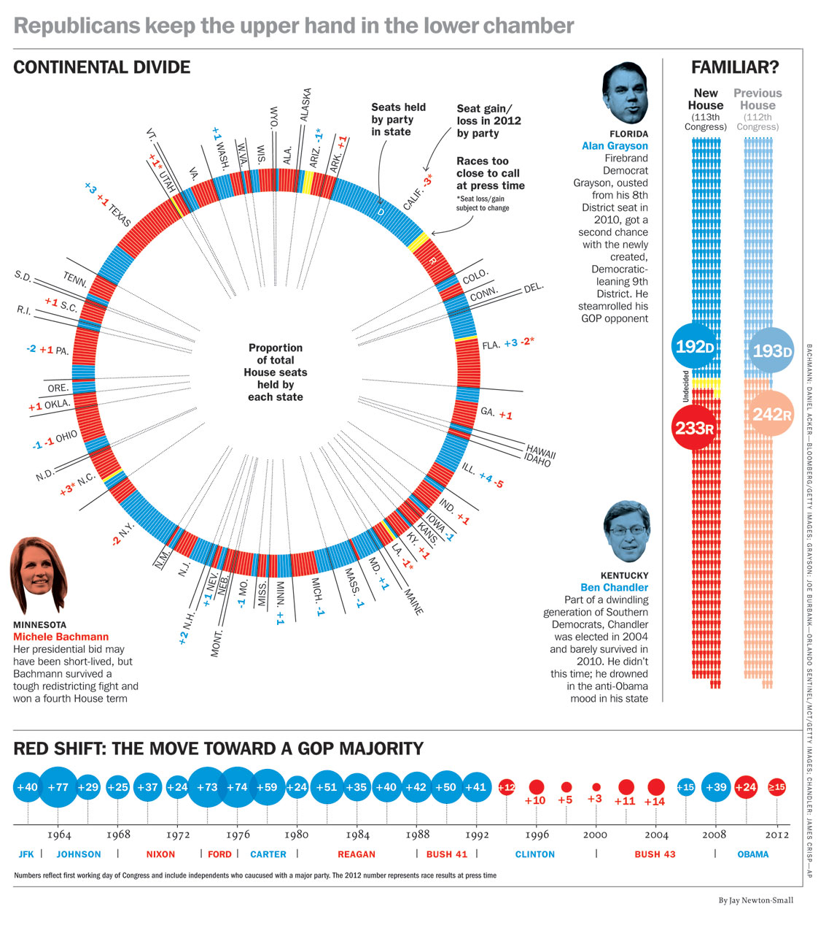

Slide 8
Qualifications
In order to be eligible to run for the House of Representatives, there are certain qualifications that must be met.
25 years of age
US citizen for at least 7 years
Reside in state where elected
Members must also agree to uphold a code of conduct in order to be eligible to hold office

Slide 9
The senate
The senate is smaller than the House of Representatives with only 100 members.
Each state is represented by 2 senators, regardless of population.
Senators are elected to Congress for 6 year terms.
Elections are held in November of each even-numbered year.
Only 1/3 of the Senate’s membership comes up for election every two years.
This ensures that at least 2/3 of senators have prior experience

Slide 11
Qualifications
In order to be eligible to run for the House of Representatives, there are certain qualifications that must be met.
30 years of age
US citizen for at least 9 years
Reside in state where elected
Members must also agree to uphold a code of conduct in order to be eligible to hold office

Slide 12
Consecutive terms?
In 1995 in the case of U.S. Term Limits, Inc. v. Thorton, the Supreme Court held
“ State-imposed restrictions…violate a third idea central to this basic principle: that the right to choose representatives belong not to the States, but to the people…The Congress of the United States, therefore, is not a confederation of nations in which separate sovereigns are represented by appointed delegates, but is instead a body composed of representatives of the people.” – Justice Stevens

Slide 13
Salary and benefits
As of January 2013, each member of Congress receives a yearly salary of $174,000.
Members of Congress have offices in the Capitol building a receive an allowance to pay staff members.
Members of Congress receive free trips to their home state, an allowance for local district offices, and a stationary allowance.
They also have the franking privilege, meaning they mail item for free.

Slide 14
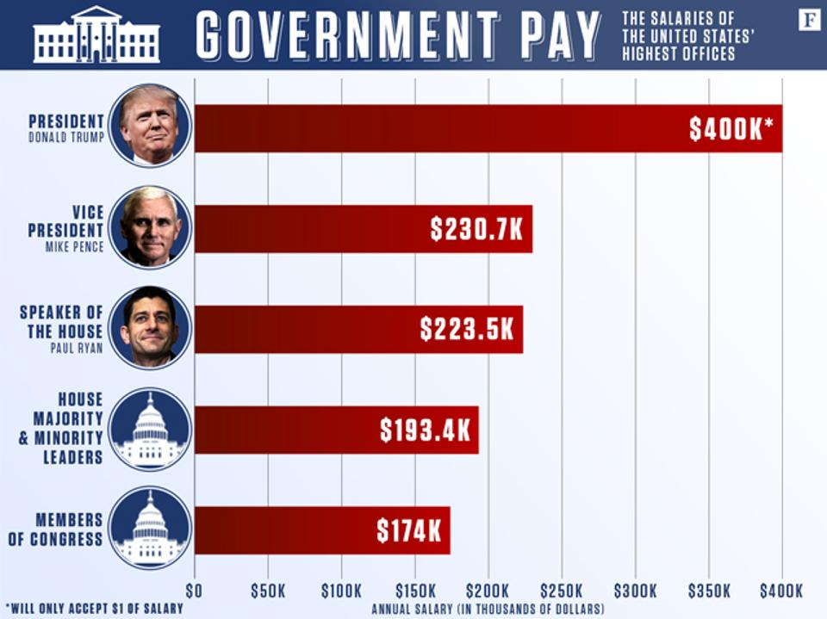

Slide 15
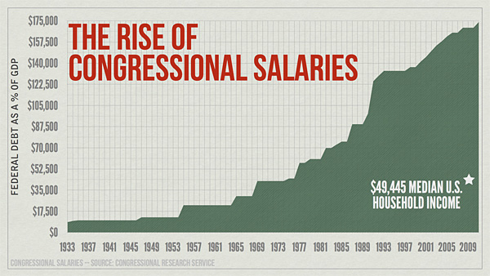
Salary and Benefits Leadership
House Majority/Minority Leaders: $193,400
Speaker of the House: $223,500
Cabinet members: $199,700

Slide 16
Rules of conduct
Both houses of Congress have the right to decide who shall be seated as members.
Sometimes members of the Senate or House questions the qualifications of a newly elected member of Congress. The member may not be seated until an investigation is made.
The House and Senate have passed codes of conduct for their members.
If a member of Congress violates the code of conduct, the Constitution allows both chambers of Congress to discipline its members.

Slide 17
Code of conduct
“Each House may determine the Rules of its Proceedings, punish its Members for disorderly Behavior, and, with the Concurrence of two thirds, expel a Member” Article I, section 5, clause 2.
A person accused of a serious offense might be expelled from office.
Expulsion means that a person must give up his or her seat
Expulsion requires a 2/3 vote of the senators or representatives
Less serious offense may bring a vote of censure, or formal disapproval
A censured member must stand alone at the front of the House or Senate and listen as the charges against him or her are read

Slide 18
Powers of congress

Slide 19
The powers of congress
Some of the powers of Congress have been expressly granted, or delegated by the Constitution.
Express powers: Powers that Congress has that are specifically listed in the Constitution.
Other powers are implied by the language of the Constitution.
Implied powers: Congressional powers found under the Necessary and Proper Clause; these powers are not specifically written in the Constitution.

Slide 21
Article I, section 8
…Power To lay and collect Taxes, Duties…provide for the common Defense and general Welfare…
To borrow Money on the credit of the United States
To regulate Commerce with foreign Nations, and among the several States…
To establish an uniform Rule of Naturalization
To coin Money
To provide for the Punishment of counterfeiting the Securities and current Coin
To establish Post Offices
To promote the Progress of Science and useful Arts…exclusive right
Constitute Tribunals inferior to the supreme Court
To define and punish Piracies and Felonies… on the high Seas
To declare War
To raise and support Armies
To provide and maintain a Navy
To make Rules for the Government and Regulation of the land and naval Forces
To provide for calling forth the Militia to execute the Laws of the Union
To provide for organizing, arming, and disciplining, the Militia
To exercise exclusive Legislation…over the seat of government

Slide 22
Delegated powers
Article I, Section 8, lists the powers delegated to Congress. These powers can be group into 5 categories.
Financing Government
Regulating and Encouraging American Trade and Industry
Defending the Country
Creating Lower Courts
Providing for Growth

Slide 23
Delegated powers
Financing Government
Congress is granted the power to finance the federal government.
In order to pay for government programs and defense, Congress has the authority to raise and collect taxes.
Congress can borrow money on behalf of the United States
Congress can also mandate spending on specific items: legislatively directed spending, commonly known as "earmarks," specifies funds for a particular project.
Regulating and Encouraging American Trade and Industry
Congress helps with business by regulating trade with foreign countries and among the states.
Congress passes laws that protect the rights of inventors

Slide 24
Delegated powers
Defending the Country
Congress has the power to declare war
To raise and maintain armed forces
Creating Lower Courts
Congress has the power to pass certain laws. To ensure that these laws are upheld, Congress has set up a system of national courts
Providing for Growth
Congress can pass laws to regulate immigration and naturalization.
Congress is also given the power to govern the country’s territories and admit new states

Slide 25
Implied powers
The Constitution states that Congress has the power to “make all laws which shall be necessary and proper for carrying into execution the foregoing powers.”
The powers Congress has exercised under this clause are called implied powers
Congress established national military academies to train officers for the armed forces
War Powers Resolution of 1973
Civil and criminal penalties for failure to pay tax
Federal Kidnapping Act
The necessary and proper clause allows Congress to stretch delegated powers to cover many other areas.
Elastic clause

Slide 27
Special powers
The Constitution gives each house certain special powers.
The House of Representatives
Must start all bills for raising revenue
Sole power to impeach public officials
Chooses the president if no candidate receives enough electoral votes
Senate
Holds impeachment trials
Selects vice president if no candidate receives enough electoral votes
All treaties with foreign nations must be approved by 2/3 vote
Certain high officials appointed by president must be confirmed by Senate

Slide 28
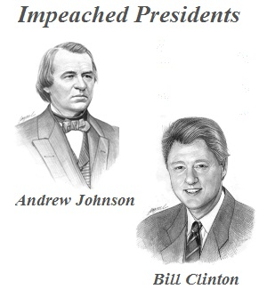
Impeachment power
Congress has the power to impeach federal officials charged with serious crimes and bring them to trial.
To impeach is to charge a public official with wrongdoing.
Each chamber has its own role in the process.
Two Presidents have been impeached
Andrew Johnson (1868) – acquitted by the Senate
William Clinton (1998) – acquitted by the Senate

Slide 29
Impeachment Power
The charges against an accused offical must be drawn up in the House of Representatives.
If a majority of the representatives vote in favor of the list of charges, the official is impeached or formally accused. The individual will then be put on trial
The trial on the impeachment charges is held in the Senate.
Vice president usually acts as the judge; if the president is impeached, chief justice presides over the trial
2/3 of the Senate must find the official guilty before he or she can be dismissed from office.
The Senate may also vote on whether to prohibit the president from holding future public office.

Slide 30
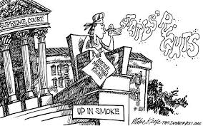
Limits on Power
The Constitution places limits on powers granted to Congress.
The 10th Amendment reserves some powers for the state governments.
These reserved powers include:
State’s authority to regulate and conduct elections
Create and administer schools
Establish marriage laws

Slide 31
Limits on power
The Constitution also specifically forbids Congress from:
Passing ex post facto laws
Passing bills of attainder
Suspending the writ of habeas corpus
Favoring trade of a state
Granting titles of nobility
Withdrawing money without a law

Slide 32
Bellwork
Does Congress have too much power? Why or why not?

Slide 33
How congress is organized

Slide 34
Terms and sessions
Under the 20th Amendment, a term of Congress begins at noon on January 3 of every odd numbered year.
Changed from March 4th to January 3rd
Ratified in 1933
The 115th Congress, began on January 3, 2017, and would end on January 3, 2019
Each term of Congress is divided into two sessions, one for each year of the term.
Each session begins on January 3 (unless Congress chooses another date).

Slide 35
Terms and session
When Congress finishes its legislative work, both houses adjourn and the session is ended.
In unusual circumstances the president may call one or both houses back into a special session after they have adjourned.
Although each house usually meets by itself to conduct business, the two houses occasionally meet together in what is called a joint session.

Slide 36
Organization of congress
The Constitution has only three rules about how Congress should be organized.
It directs the House of Representatives to select a presiding officer and other officers
It names the vice president of the United States as the president of the Senate
It calls for the selection of a senator to preside in the vice president’s absence.

Slide 37
Organization of congress
Prior to the start of the congressional session, the parities meet in a caucus.
Members of Congress will meet in caucuses to pursue common legislative objectives.
A caucus is an informal group of members who share similar legislative or policy interests.
Numerous congressional caucuses have been organized, ranging from the large Party Conferences to smaller caucuses for varying causes.
The political party with the most members in each house is the majority party; the political party that has the fewest members is the minority party.

Slide 38
Organization of the senate
“The Vice President of the United States shall be President of the Senate, but shall have no Vote, unless they be equally divided” Article I, Section 3
The President of the Senate is the vice president
The vice president of the United States does not usually preside over the daily meetings of the Senate.
Instead, the majority party elects one of its members to be the president pro tempore.

Slide 39
Organization of the house
The person who presides over the House when it is in session is the Speaker of the House.
The Speaker exerts power over the legislative process
Determines when bills will be debated and voted on
Appoints members of committees
Determines which legislation is assigned to each committee
Other duties include administering the oath of office to Members, calling the House to order, and recognizing members to speak on the House floor.
The Speaker is generally chosen by the majority party from its most senior members.
When political ideology of the President and Speaker differ, the Speaker’s public role tends to increase.

Slide 40
Organization
There are also similarities between the organization of each chamber.
Both the House and Senate have floor leaders, the majority leaders and minority leaders.
The floor leaders are assisted by the party whips.
Whip: an official in a political party whose job it is to count votes, encourage party loyalty, and ensure party’s members are present for votes
Floor leaders and whips are selected elected by their respective parties in closed door caucuses.

Slide 42
Organization
Each chamber also contains committees.
Standing committees – permanent committees
Ex: appropriations
Special committees – established for a specific purpose
Ex: Senate special committee on aging
Joint committees – permanent committees that include members of both chambers
Ex: Joint Committee on Printing
The role of the committee is to investigate and hold hearings on bills.
Each committee has one or more subcommittees that may consider legislation before it is take up by the full committee.

Slide 43
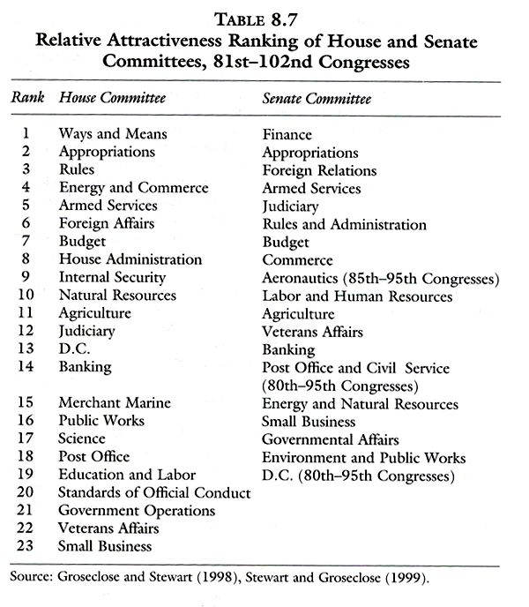

Slide 44
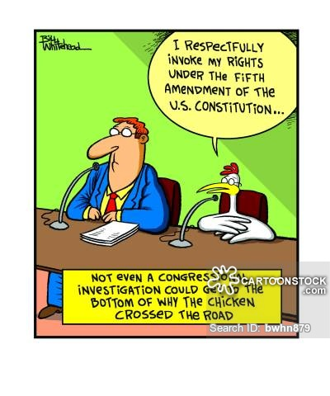
Organization
After each congressional election, political parties assign newly elected Representatives and Senators to standing committees.
Appointments are made by steering committee of the party
Each committee and subcommittee has a chairperson and ranking minority member.
The most important factor for committee and chairperson assignments is seniority.
Seniority: a privileged position earned by longer service
The committee chairperson has the duty of scheduling hearings, hiring staff, appointing subcommittees, and managing committee bills when they are brought before the full House

Slide 45
Web quest
Speaker of the House
House majority and minority leader
House majority and minority whip
President of the Senate
President Pro Tempore
Senate majority and minority leader
Senate majority and minority leader
Standing committee of House and Senate

Slide 46
Speaker of the house
“The House of Representatives shall choose their Speaker and other Officers” Article I, section 2
Paul Ryan
Second in line of presidential succession

Slide 47
House of representatives floor leaders
Majority Leader – Kevin McCarthy
Minority Leader – Nancy Pelosi

Slide 48
House Whips
Majority Whip – Steve Scalise
Minority Whip – Steny Hoyer

Slide 49
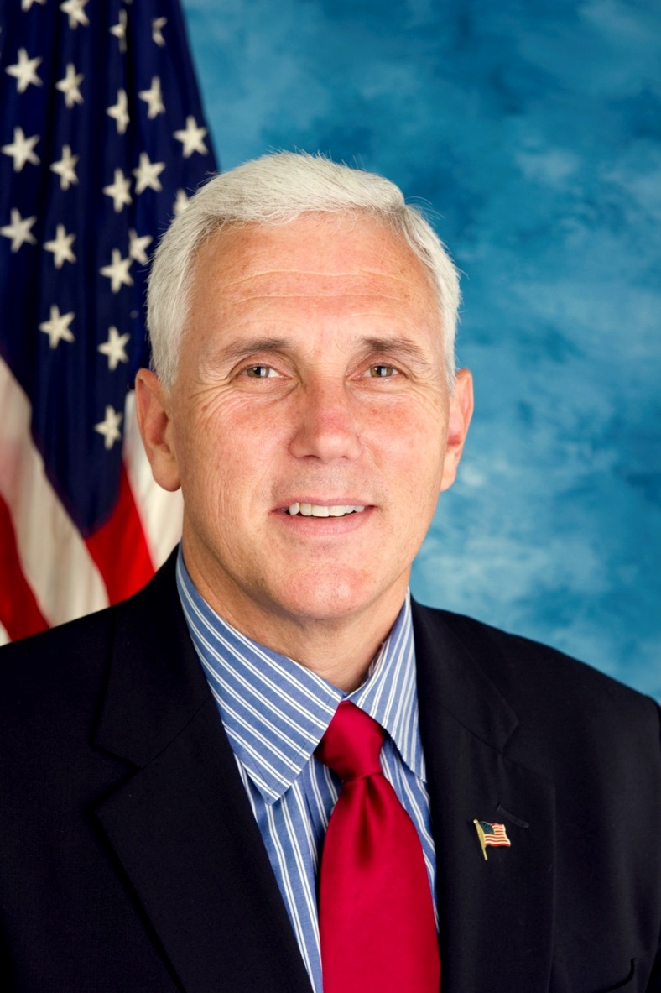
President of senate
Article 1, Section 3, Clause 4: The Vice President shall be President of the Senate.
Mike Pence
First in line of presidential succession

Slide 50
President pro tempore
Article I, Section 3, Clause 5: “The Senate shall choose their other officers, and also a president pro tempore.”
Orrin Hatch
Third in line of presidential succession

Slide 51
Senate floor leaders
Minority Leader – Harry Reid
Majority Leader – Mitch McConnell

Slide 52
Senate whips
Minority Whip – Dick Durbin
Majority Whip – John Cornyn

