Slide 1
Apportionment

Slide 2
Bellwork
How are the House and Senate in conflict with each other?

Slide 3
Apportionment
Every 10 years, after the census is taken, Congress determines how the seats in the House are to be apportioned.
Apportionment: the process by which legislative seats are distributed among units entitled to representation
If a state’s population decreases, the number of representatives may decrease. States whose population increases may be entitled to more representatives.
Voters elect their representatives according the Congressional district in which they live. Each state’s legislature is responsible for dividing the state into has many congressional districts as it has members.

Slide 4
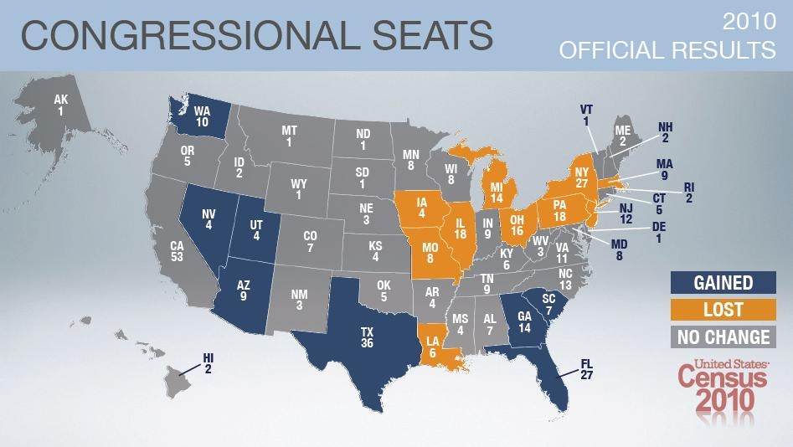

Slide 5
Apportionment
Many of these congressional districts have very oddly shaped boundaries. A practice called gerrymandering is often the reason.
Gerrymandering is the practice of drawing district lines that favor a particular political party, politician, or group of people.
For example, a state legislature made up of mostly one party might draw district lines that place a majority of its supporters in as many districts as possible.

Slide 6
Reynolds v. sims (1964)
Reynolds v. Sims is a Supreme Court case that ruled that state legislature districts had to be roughly equal in population.
Jefferson County taxpayers, voters, and residents challenged the apportionment of the Alabama legislature under the Equal Protection Clause of the 14th Amendment.
Supreme Court decided the apportionment was a violation of the Equal Protection clause by some votes counting more than others.
Established the “one-person, one-vote” principle.

Slide 7
NC Congressional Districts
NC’s 12th Congressional District was considered to be an example of gerrymandering. It was drawn in 1992 as one of two minority-majority districts.
The shape of the district was challenged as a violation of the Equal Protection Clause.
In Reno v. Shaw, the Supreme Court held that the apportionment was racially neutral on its face, but in such an odd shape that it could have been drawn for racial purposes.
The Court ultimately remanded the case, but established the precedent that districts can not be drawn strictly based upon race.

Slide 8
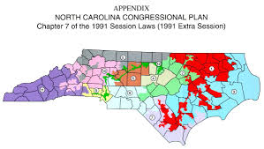
Reno v. Shaw

Slide 9
NC Congressional Districts
NC redrew congressional districts after the 2010 election.
NC’s congressional maps were debated and revised.
The congressional maps were granted approval by the DOJ, but lawsuits were still filed over aspects of the plans.
State Democrats, NAACP, and other advocacy groups filed suit alleging violation of the state and US Constitution.

Slide 10
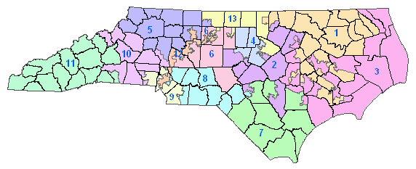

Slide 11
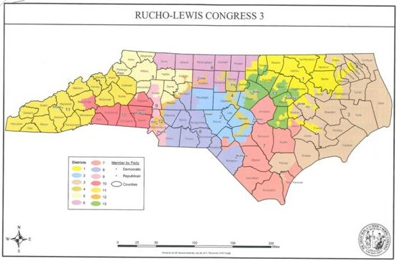

Slide 12
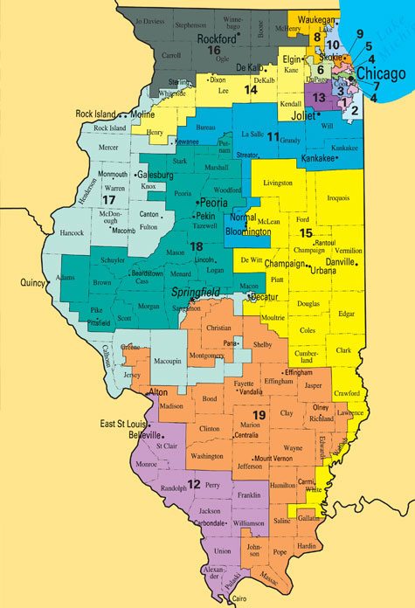

Slide 13
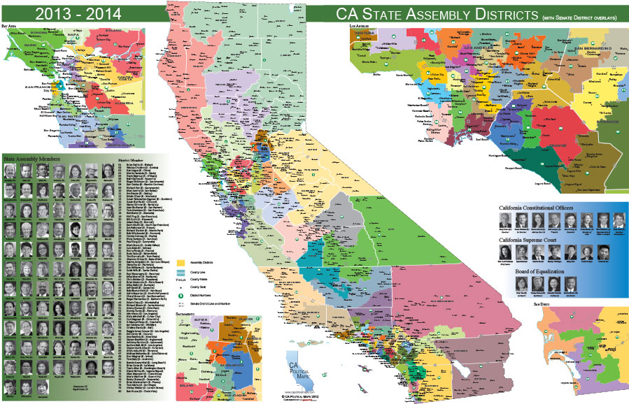

Slide 14
Lawmaking

Slide 15
Bellwork
Should Gerrymandering be illegal? Why or why not?

Slide 16
Appropriation Bills
An appropriation bill is a bill that authorizes the government to spend money.
Federal funds come from three main sources
Income tax
Payroll tax
Corporate income tax
Appropriation bills determine how those funds will be spend on discretionary spending.

Slide 17
Source of legislation
Ideas for bills originate from several sources, including:
US citizens
organized groups
congressional committees
members of Congress
the president.
When a large number of constituents, citizens of a Congress member’s district, requests a law the Congress member usually listens.
If the member of Congress agrees, he or she introduces a bill that reflects the constituent's ideas.

Slide 18
Bill becomes law
After a bill has been introduced it will be referred to a committee according to its subject matter.
The committee will typically refer the bill to a subcommittee.
The subcommittee may request reports, hold hearings, mark up the bill, and report the legislation to the full committee
If the bill passes the subcommittee with a favorable vote, it is sent back to the full committee for further consideration, hearings, amendment and vote.
If a committee votes out or "reports favorably" a bill back to the House or Senate, it is then "calendared" or scheduled for floor debate and vote in the full chamber.
Each measure sent to the full chamber by the committee is accompanied by a committee report on the legislation.

Slide 19
House acts on bill
In the house, bills will go to the Rules Committee before reaching the House floor. The Rules Committee adopt rules that will govern the procedures under which the bill is debated.
The Committee of the Whole (House acting as one)debates and amends the bill.
Debate is guided by the Sponsoring Committee and time is divided equally between proponents and opponents.
Amendments must be relevant to subject of the bill.
The bill is reported back to the House and voted on.
A quorum is needed in order to conduct business.
A quorum call is a vote to make sure there are enough members present.
If there is not a quorum, the House will adjourn or send the Sergeant at Arms to get missing members.
If the bill passes the House it goes on to the Senate.

Slide 20
The senate acts on the bill
After committee hearings and revisions, the bill is scheduled on the legislative calendar.
Debate in the Senate is unlimited unless cloture is invoked. Unless cloture is invoked, Senators can use a filibuster to defeat a measure by “talking it to death.”
Filibuster is the term for extended debate or other procedures used to prevent a vote on a bill in the Senate
Cloture can be invoked by presentation of a petition and if 3/5 of the full Senate voting in favor.
3/5 = 60 senators
A quorum of senators is needed to conduct business.
A quorum is 51
After senators finish their debate on the bill, a vote is taken.

Slide 21
Conference committee
When a bill passes the House and the Senate in identical form, it is ready to be sent to the president.
If the two houses pass different versions of the same bill the bill is sent to a conference committee to reconcile any differences.
A conference committee is made up of equal number of senators and representatives who work to reach a compromise on the bill.
The compromise bill is sent back to both houses, which usually approve the work of the conference committee.

Slide 22
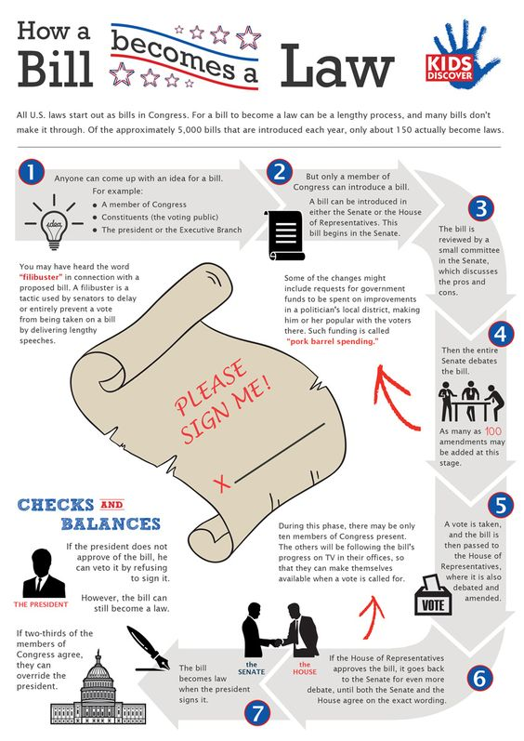

Slide 23
What comes next?
After much debate, HR2245, a multi-billion tax package, passes the House.
The House and Senate have passed two different versions of a bill on Medicare.
The House Agriculture Committee decides to consider HR6532, a bill on stem cell research.
A compromise bill on the National Park System has passed both houses.

