Slide 1
Life at the Turn of the 20th Century:
New Immigrants

Slide 2
Main Idea
A new wave of immigrants came to the United States in the late 1800s, settling in cities and troubling some native-born Americans.

Slide 3
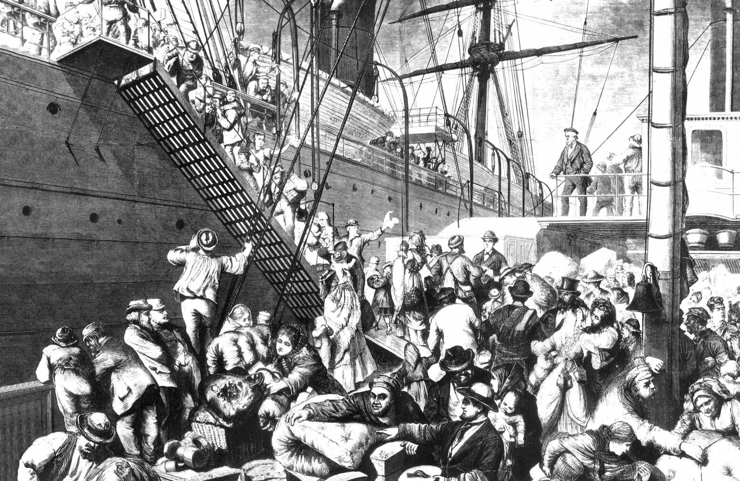
The Old Immigrants
1800-1900: 10 million immigrants
Northern and Western Europe
Mostly Protestant Christians
Cultures similar to the original settlers

Slide 4
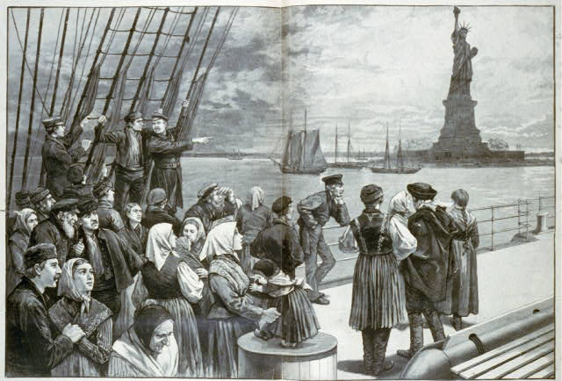
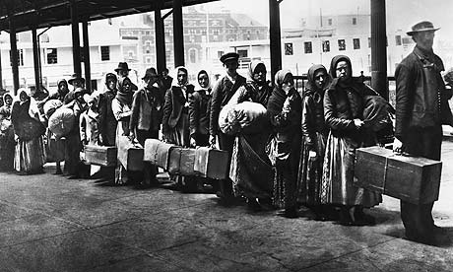
The New Immigrants
1880 to 1910: 18 million
Southern and Eastern Europe
Roman Catholics, Orthodox Christians, and Jews
Smaller numbers came from East Asia

Slide 6
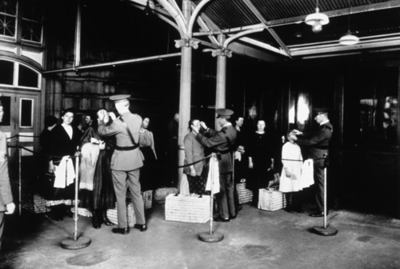
Coming to America
The decision to come involved the entire family
They had to pass an inspection to board
Provide identification
Background check
Prove they had some money
Medical examination

Slide 7
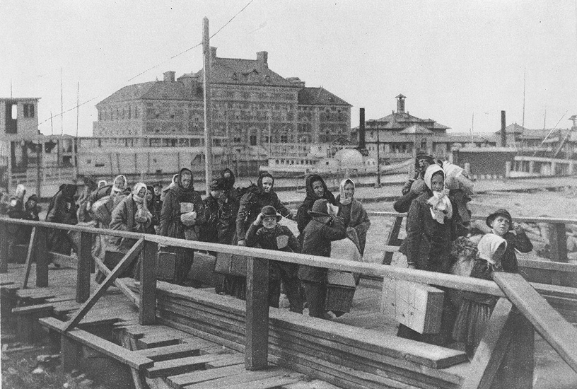
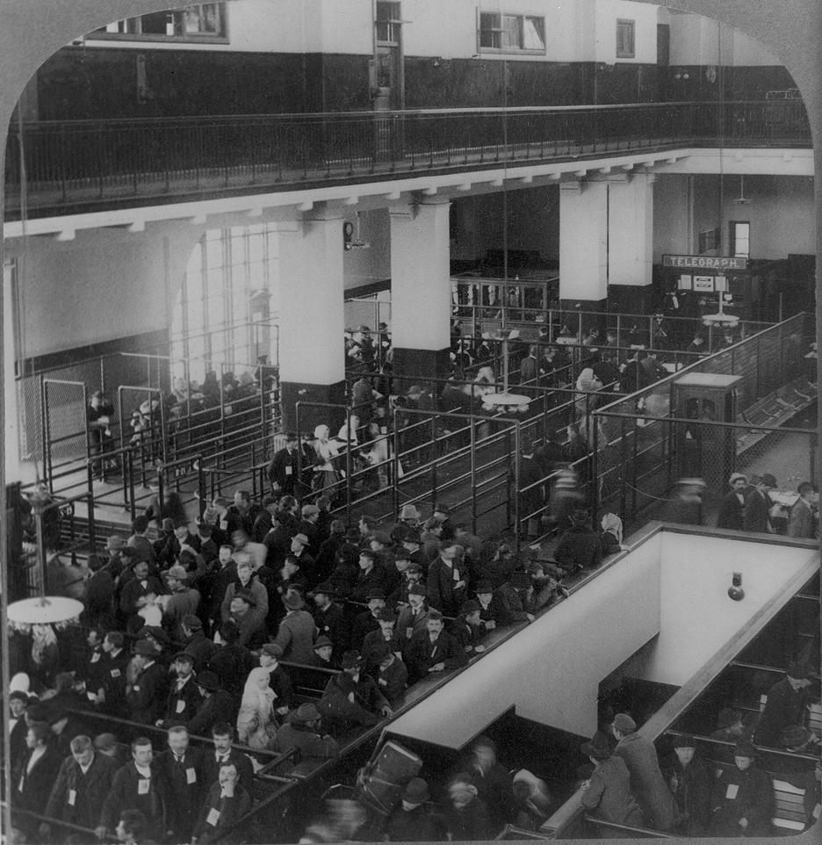
Coming to America
Ellis Island*
NYC harbor
1892 – Opened as an immigration station
112 million immigrants
Had to pass inspection before allowed to enter

Slide 8
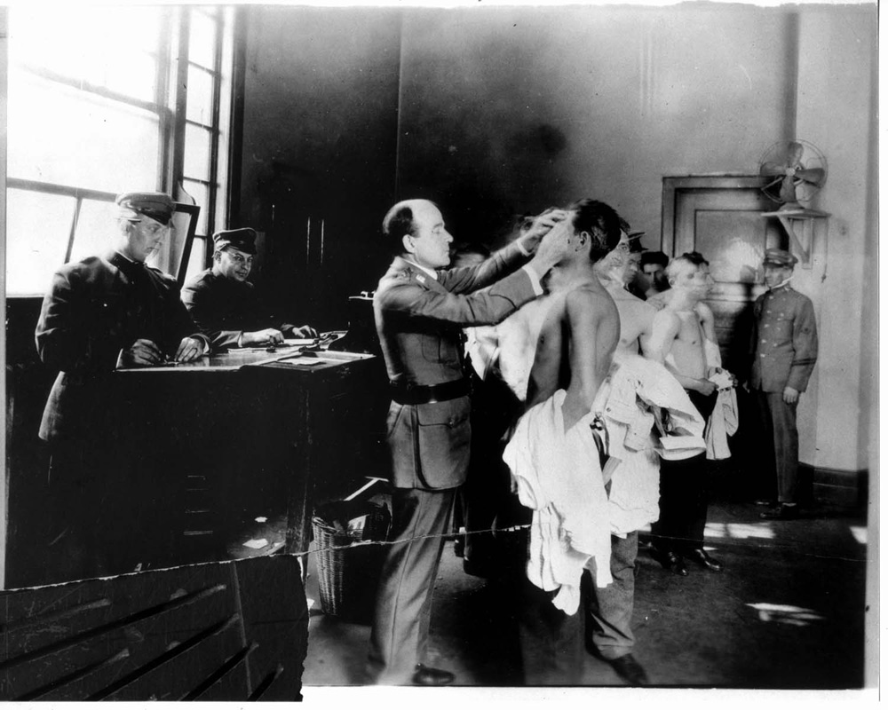
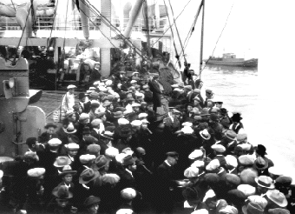
Coming to America
Angel Island
San Francisco
Many Chinese immigrants were detained
Prison-like conditions while awaiting a ruling
Poverty and discrimination awaited many newcomers

Slide 9
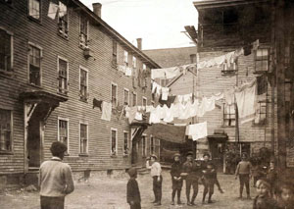
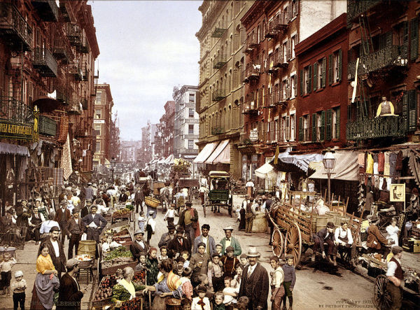
Building Urban Communities
Most settled in crowded cities
Took low-paying, unskilled jobs
Many lived in poor housing in slums

Slide 10
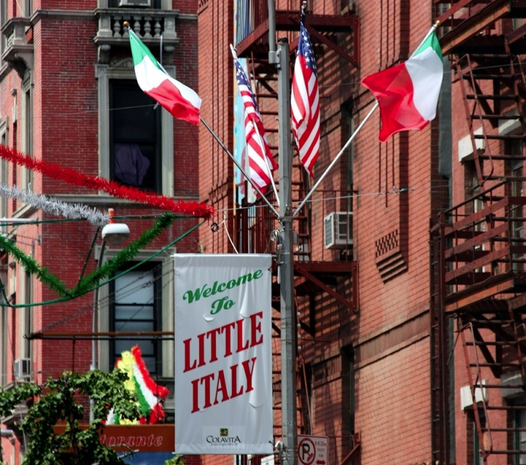
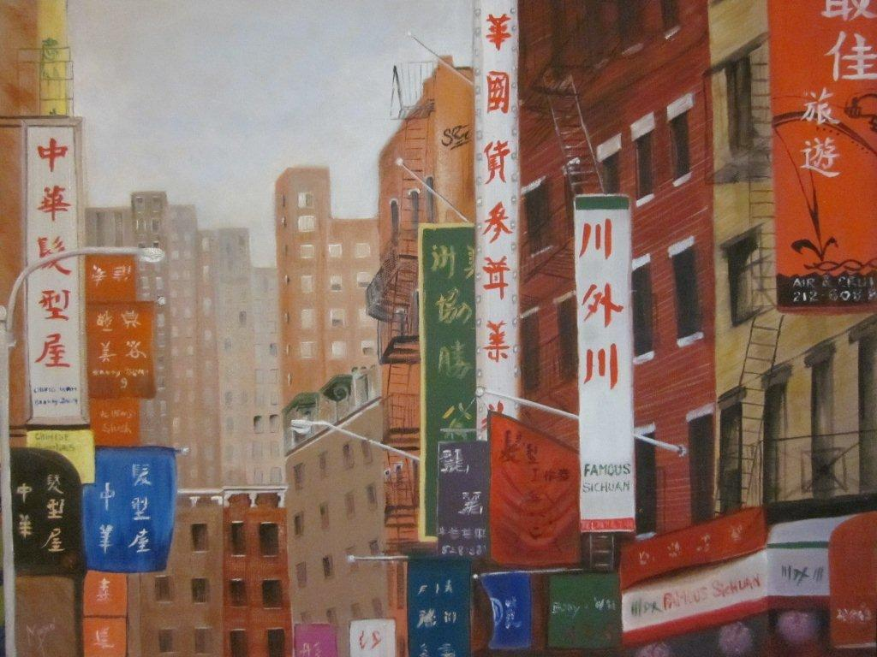
Building Urban Communities
Immigrants settled near others from their homeland
Cities became a patchwork of ethnic clusters

Slide 11
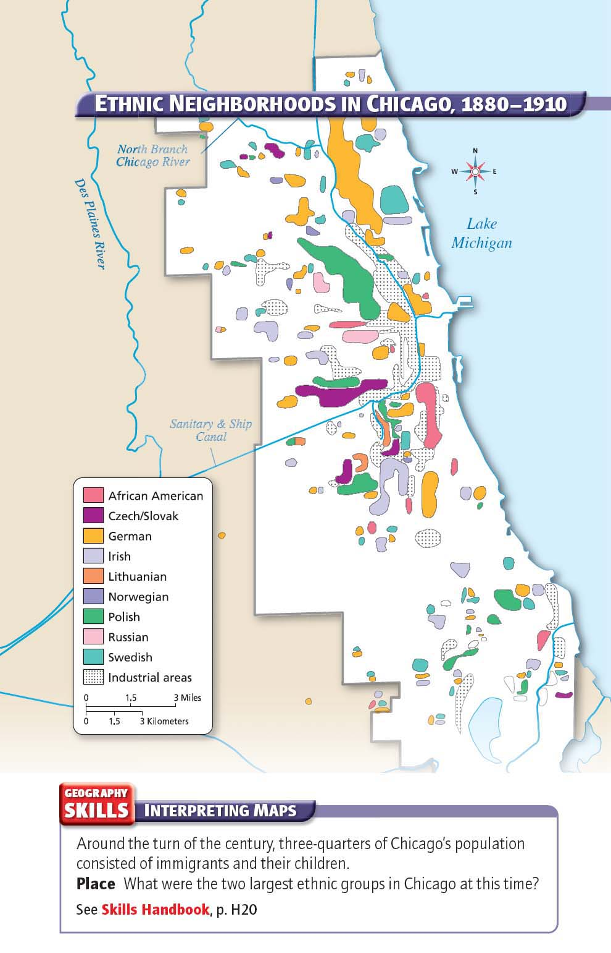

Slide 12
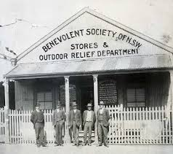
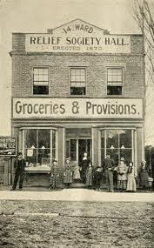
Building Urban Communities
Benevolent societies
Aid organizations to help new immigrants
Obtain jobs
Health care
Education

Slide 13
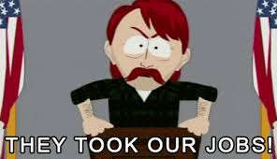
Nativists Respond
Nativists
Americans who opposed immigration
Believed that they brought crime and poverty
Accepted jobs for lower wages
Wanted to close America’s doors to immigration

Slide 14
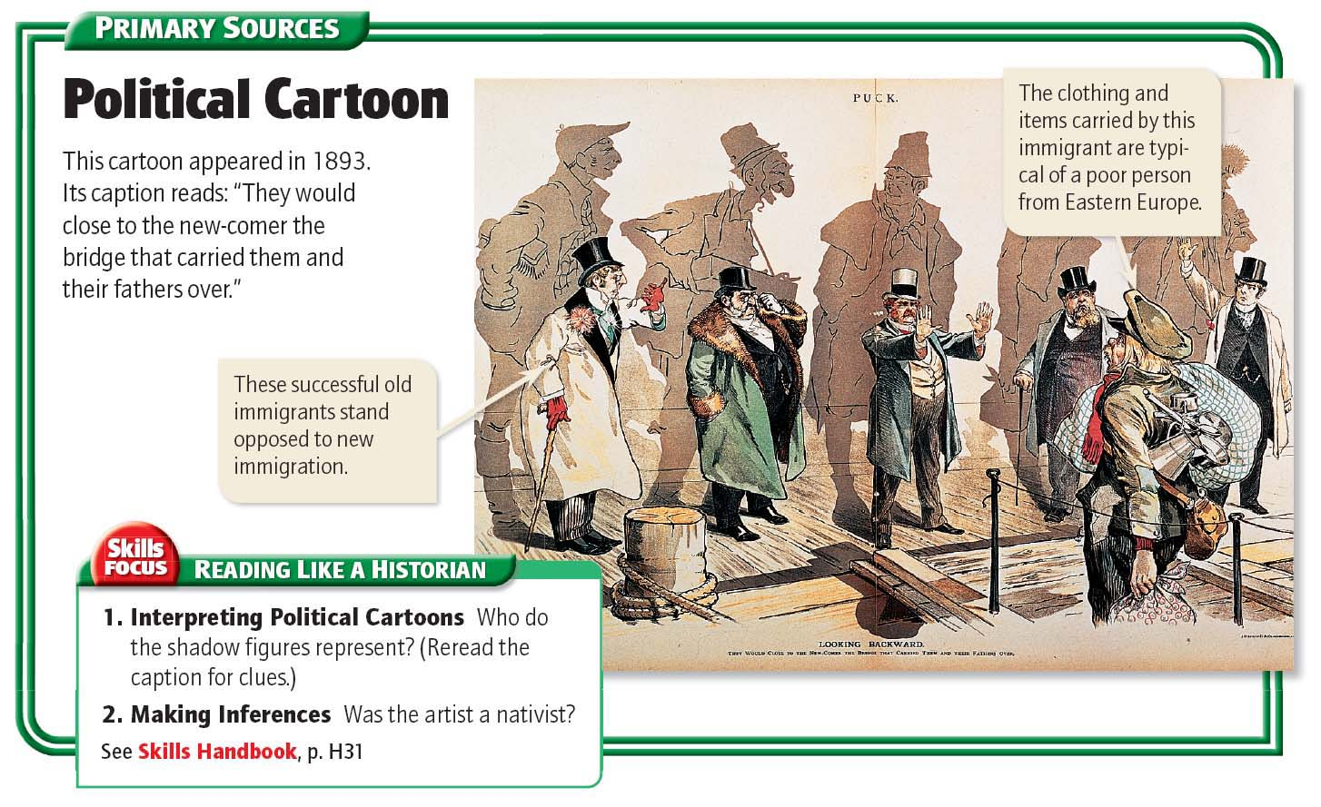

Slide 15
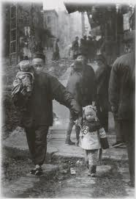
Limiting Chinese Immigration
Chinese workers were tolerated during good times, but with a worsening economy
Chinese workers were not allowed state jobs
Local governments could ban them from communities or restrict them to certain areas

Slide 16
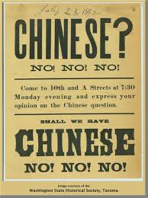
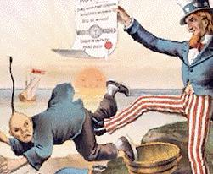
Limiting Chinese Immigration
1882 - Chinese Exclusion Act
Banned Chinese immigration for 10 years
None of the Chinese in the U.S. would be allowed citizenship
Renewed in 1892
Chinese immigration was banned indefinitely in 1902

Slide 17
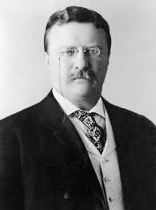
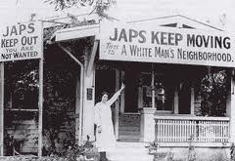
Limiting Japanese Immigration
Japanese students in San Francisco were segregated
Gentlemen’s Agreement
Theodore Roosevelt negotiated with Japan:
No unskilled workers from Japan
Japanese children could attend schools with other children

Slide 18
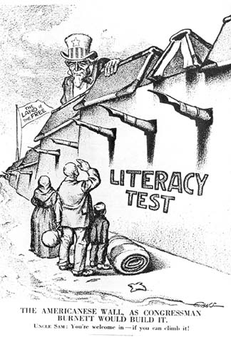
Other Immigrants
Nativists opposed immigration from Southern and Eastern Europe
Claimed these folks were poor, illiterate, and non-Protestant and could not blend into American society
Literacy tests
Some did support Americanization

Slide 19
Life at the Turn of the 20th Century:
Urban Life

Slide 20
Main Idea
In cities in the late 1800s, people in the upper, middle, and lower classes lived different kinds of lives because of their different economic situations.

Slide 21
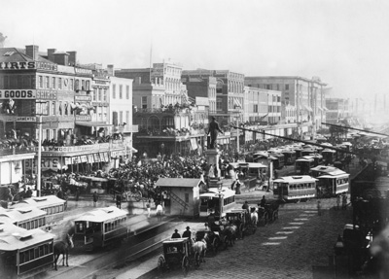
American Cities Change
Before industrialization:
Cities had no tall buildings
Most people lived within distance of their work, schools, shops, and churches

Slide 22
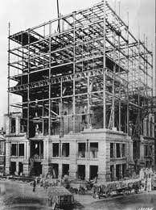
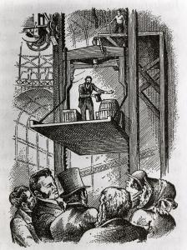
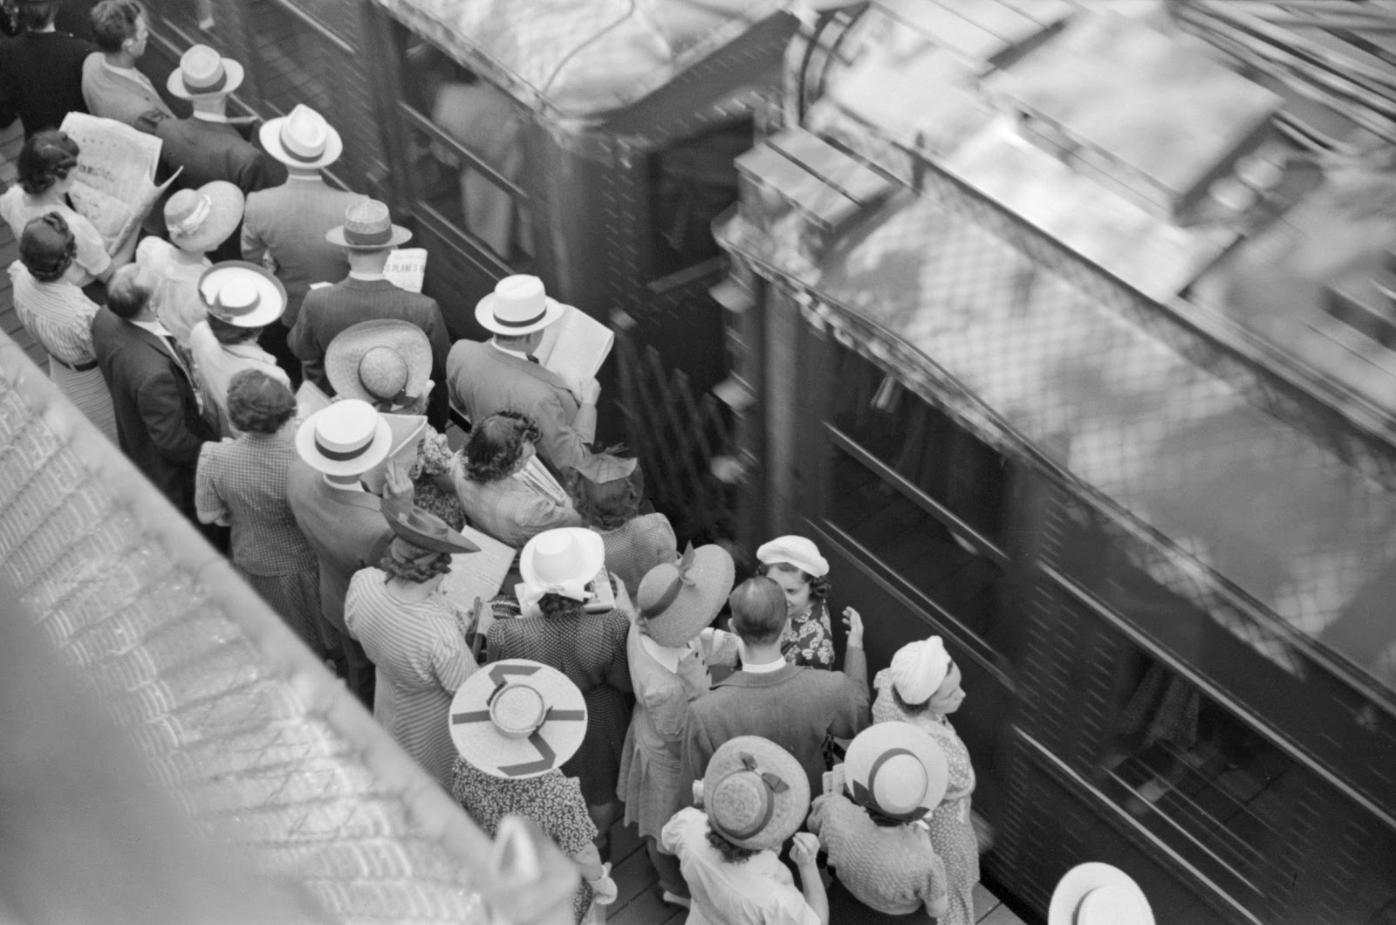
American Cities Change
In the late 1880s, they ran out of room and started to build up
Steel frames
Elisha Otis’s safety elevator
Mass transit
People moved father away from the city

Slide 23
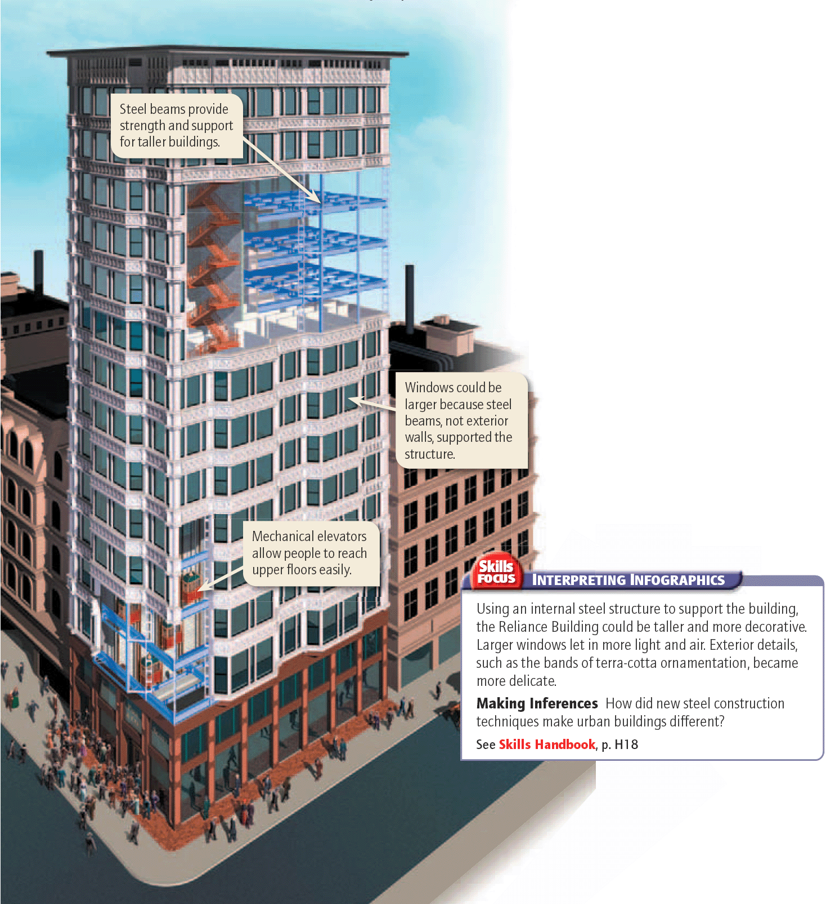

Slide 25
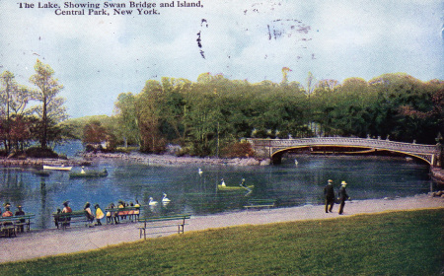
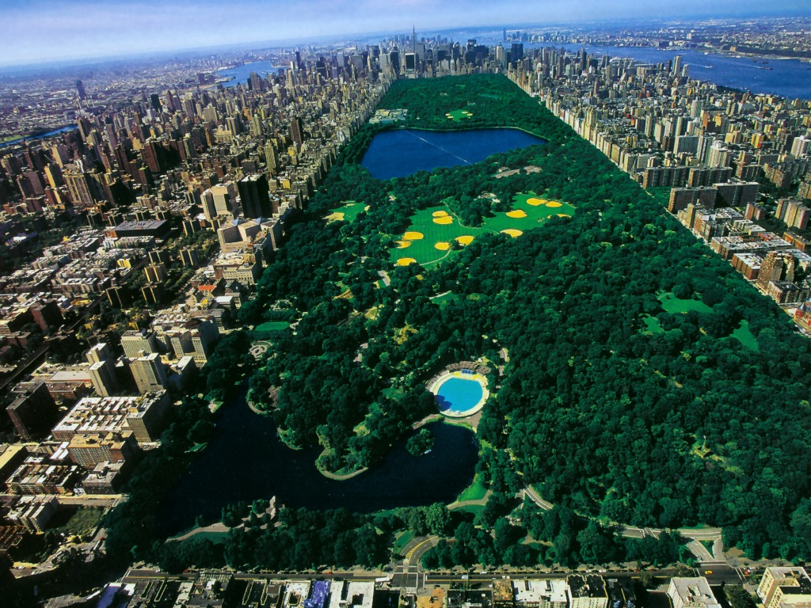
American Cities Change
Urban planning was used to map out the best use of space in cities
Frederick Law Olmsted
New York’s Central Park

Slide 26
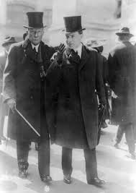
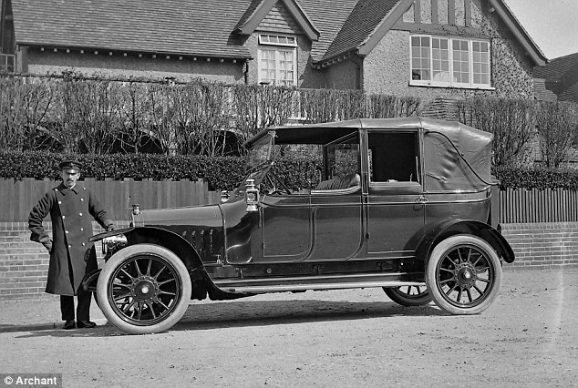
Class Differences: The Wealthy
The wealthy in America:
Made money from industry and business
Made a point of displaying their wealth

Slide 27
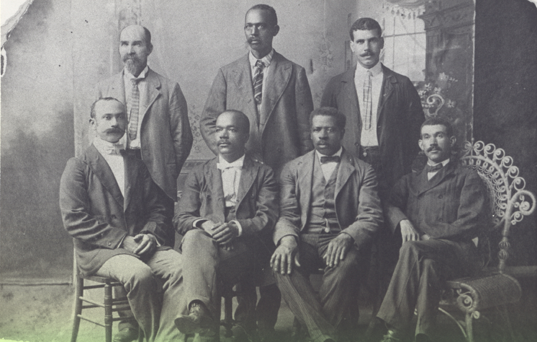
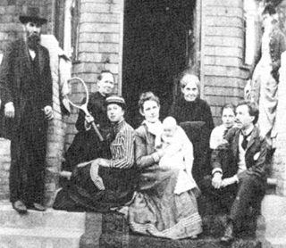
Class Differences: The Middle Class
The growth of new industries increased the urban middle class
Needed professional, educated, and qualified workers

Slide 28
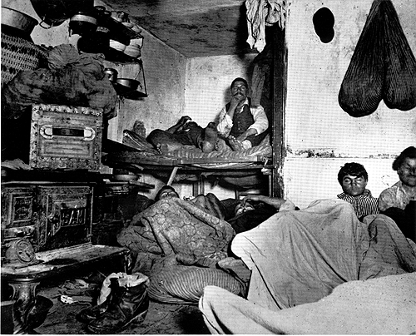
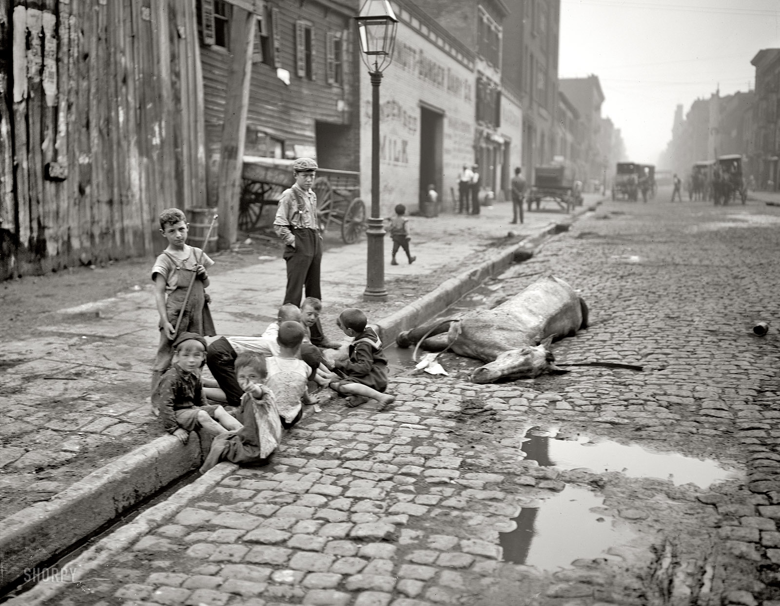
Class Differences: The Working Class
Many lived in poverty
Growing population kept wages low
Housing shortages
Crowded and unsanitary

Slide 29
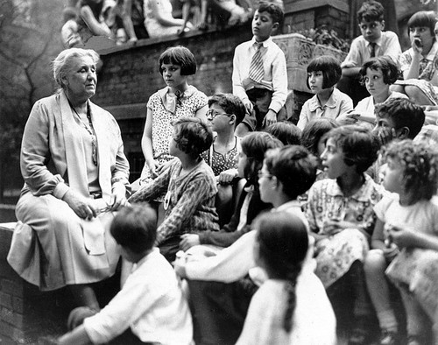
The Settlement House Movement
Settlement houses
Taught skills people could used to help themselves out of poverty
Movement spread throughout U.S.
Hull House
Jane Addams
The movement gave women the opportunity to lead, organize, and work for others

Slide 30
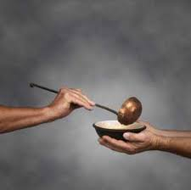
The Settlement House Movement
Social Gospel
Idea that religious faith should be expressed through good works
Churches had a moral duty to help solve society’s problems

Slide 31
Life at the Turn of the 20th Century:
Politics in the Gilded Age

Slide 32
Main Idea
Political corruption was common in the late 1800s, but reformers began fighting for changes to make government more honest.

Slide 33
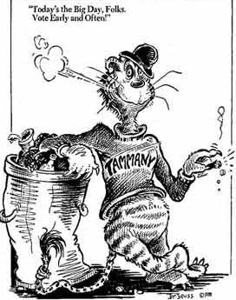
Political Machines
Political Machine
An informal group of professional politicians controlling the local government
Often resorted to corrupt methods
Late 1800s – political machines controlled
many major U.S. cities

Slide 34
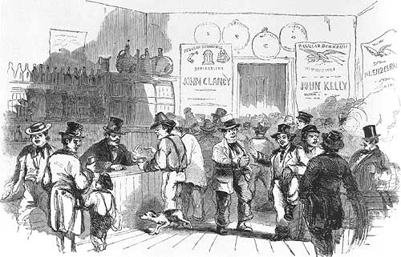
Political Machines
Made a special point of reaching out to immigrants
Helped find jobs, housing, and become naturalized citizens
Wanted their votes

Slide 35
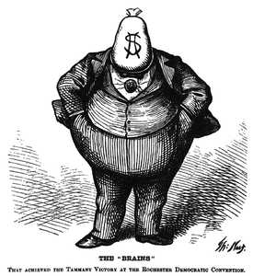
Political Machines
The Tweed Ring / Tammany Hall
A notorious political machine headed by William Marcy Tweed
Controlled elections & corrupted judges
Thomas Nast
Political cartoonist
Attacked the corruption in Harper’s Weekly
Tweed convicted for fraud and extortion

Slide 37
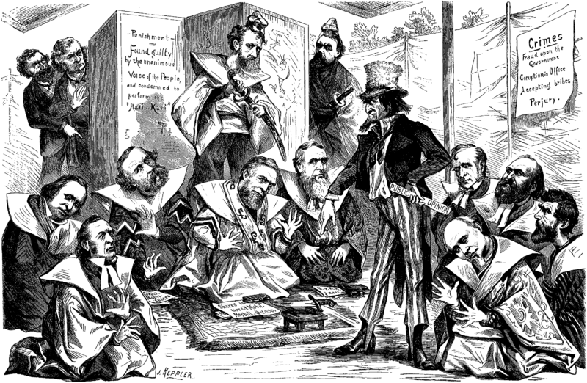
Federal Corruption
Grant’s presidency was blemished by several scandals
Crédit Mobilier
The Whiskey Ring
Diverted millions of tax dollars & tainted the nation’s leaders

Slide 38
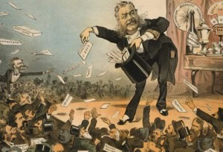
Federal Corruption
Reformers wanted to end the spoils system
President Hayes issued an executive order that prohibited government employees from managing political parties or campaigns

Slide 39
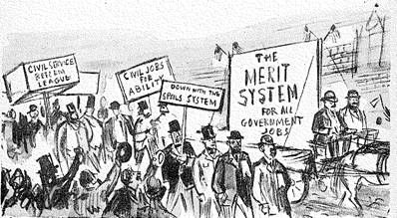
Federal Corruption
The Stalwarts wanted to continue the spoils system
President James A. Garfield
Assassination leads to reform
Vice President (now-President) Chester A. Arthur
The Pendleton Civil Service Reform Act

Slide 40
The Populist Movement
Farmers’ facing hardships
Crop prices were falling, and had to repay loans
Everyone made money but the farmer doing the work
Merchants & railroads
Outraged farmers organized

Slide 41
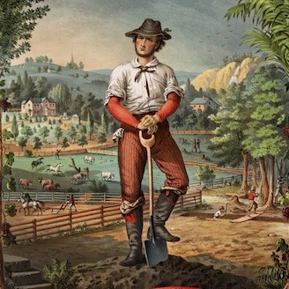
The Populist Movement
The National Grange
First major farmers’ organization
Campaigned to unite farmers from all over
Pushed for political reform and targeted railroad rates
Munn v. Illinois
Wabash v. Illinois

Slide 42
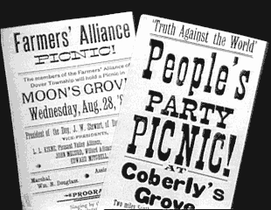
The Alliance Movement and Money Supply
The Farmers’ Alliance
Helped with practical needs
Buying equipment or marketing farm products
Lobbied for banking reform and railroad rate regulation
Wanted an expanded money supply
Became politically active

Slide 43
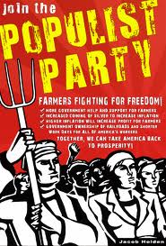
The Populist Party
Populist Party (the “People’s Party)
Coalition of farmers, labor leaders, and reformers
Platform called for an income tax, bank regulation, government ownership of railroad and telegraph companies, and unlimited coinage of silver
Won several state offices and won seats in Congress

Slide 45
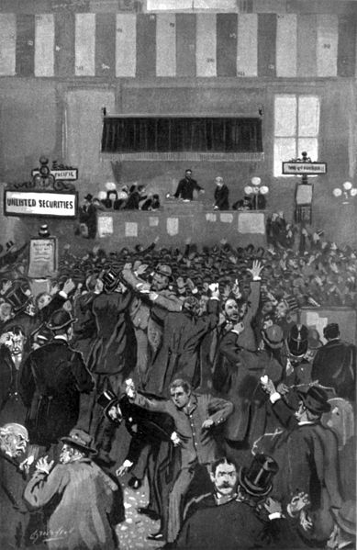
Economic Depression
The Panic of 1893
Leading railroad company fails
Investors pull out of the stock market
Thousands of businesses collapse
Over 3 million lost their jobs

Slide 46
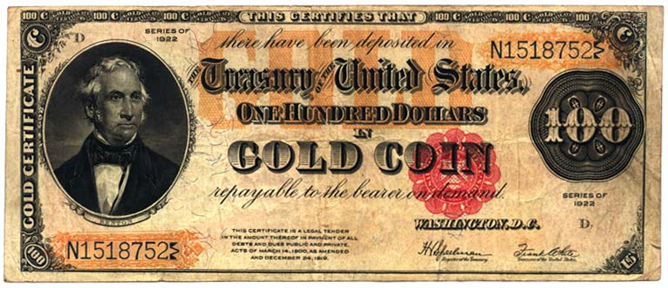
Economic Depression
President Cleveland focused on silver as a cause of the national depression
The country stayed on the gold standard

Slide 47
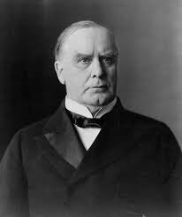
The Election of 1896
William McKinley (R)
Believed in the gold standard
William Jennings Bryan (D)
Believed the free coinage of silver
Supported by the Populists
McKinley wins the election
Populist Party soon faded away
The groundwork for reform was laid

Slide 48
Writing Assignment
Imagine you were the leader of the Populist Party 2015. Write a short speech explaining your beliefs and values. Create a propaganda poster to go with your speech that successfully represents your values.
(at least 5 sentences)

Slide 49
Life at the Turn of the 20th Century:
Segregation and Discrimination

Slide 50
Main Idea
The United States in the late 1800s was a place of great change – and a place in need of even greater change.

Slide 51
Legalized Discrimination
Poll taxes
Literacy requirements
Grandfather clause
Man could vote if he, his father, or grandfather had been eligible to vote before January 1, 1867

Slide 52
Legalized Discrimination
Jim Crow laws
Series of laws designed to create and enforce segregation
Schools, transportation, public places

Slide 53
Legalized Discrimination
Plessy v. Ferguson
Homer Plessy sat in a whites-only train compartment to test the law and was arrested
The Court ruled that “separate but equal” facilities did not violate the Fourteenth Amendment ***

Slide 54
Informal Discrimination
Racial etiquette
Strict rules of behavior that governed social and business interactions
Lynching
The murder of an individual
usually by hanging, without
a legal trial

Slide 55
Prominent Black Leaders
Booker T. Washington ***
Believed that African Americans should momentarily accept segregation
Founded the Tuskegee Institute
Believed farming and vocational skills were the key to prosperity

Slide 56
Prominent Black Leaders
W.E.B. Du Bois ***
Believed in speaking out against prejudice
Wanted full rights immediately
Helped found the National Association for the Advancement of Colored People (NAACP) ***

Slide 57
Others Suffer Discrimination
Asian Americans
Segregated neighborhoods & separate schools
Several states also forbade marriage with whites
Native Americans
Continued “Americanization”

Slide 58
Others Suffer Discrimination
Mexican Americans
They encountered hostility from white Americans, often not speaking English well and taking the most menial jobs for little pay.
Debt peonage
Workers tied to their jobs until they could pay off debts they owed their employer

Slide 60
Journal Entry- Seeing a different point of view
You and your partner will each create a journal entry. One of you will take on the role of W.E.B. Du Bois and the other student will be Booker T. Washington.
In your journal entry describe what you hope to achieve and how you will achieve it. After each of you have finished share your journal entry.

Slide 61
Click on the window to start video

