Slide 1
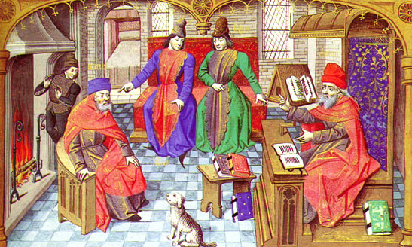
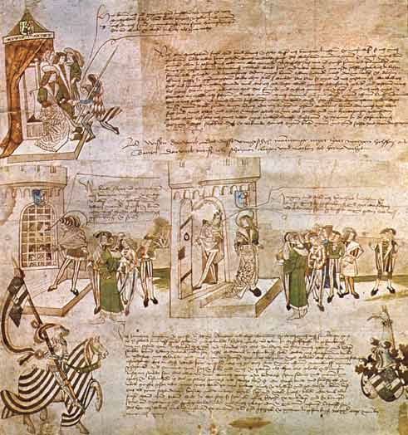
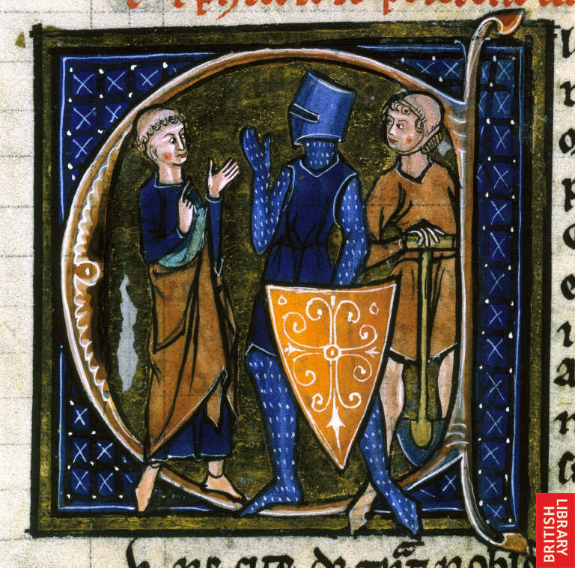
The Middle Ages

Slide 2
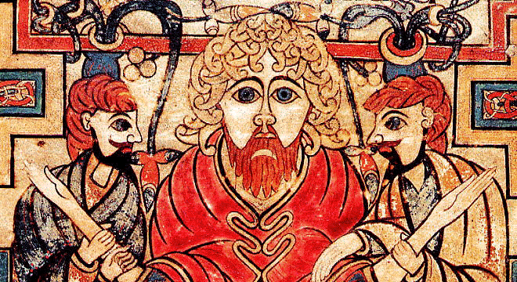
Early Middle Ages
Dark Ages (500 CE- 1000 CE)- scholars named this as a time when the forces of darkness (barbarians) overwhelmed the forces of light (Romans)
Rise of influence of barbarians as Roman Emperors had granted barbarian mercenaries land with the Roman Empire in return for military service and it was these barbarians who eventually became the new rulers

Slide 3
Expanding Influence of the Church
Christian Church has become an important political, economic, spiritual and cultural force in Europe
Leading officials of Church were the Pope and Patriarch
Banning of heresy (holding beliefs that contradict the official religion)
conversion by force
Eventually in 11th Century, Church split into two independent branches Eastern Orthodox (Greek) based in Constantinople and Roman Catholic in Rome
Notes:
Christian Church has become an important political, economic, spiritual and cultural force in Europe
Leading officials of Church were the bishops of Rome (Pope) and Constantinople (Patriarch)
As influence grew, laws were passed to forced people to become Christians and banned heresy (holding beliefs that contradict the official religion)
Fines were given against heretics, then harsher penalties and even death
Eventually, conversion by force
Eventually in 11th Century, Church split into two independent branches Eastern Orthodox (Greek) based in Constantinople and Roman Catholic in Rome

Slide 4
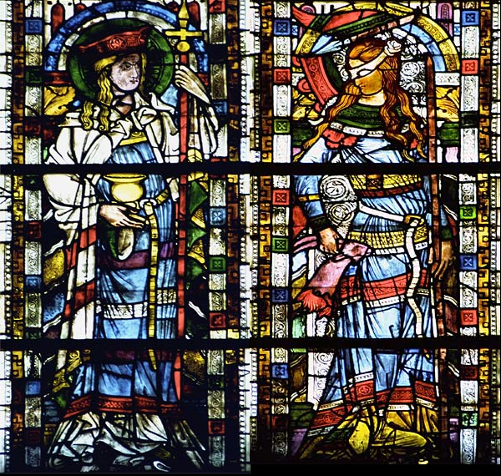
You scratch my back…
I’ll scratch yours….
Church was granted favors by
Roman Emperors / Kings (land, exemption from taxes, immunity in courts, positions in courts) and in return the Church would endorse kings to help secure their rule
Kings looked to Church to supply educated administrators to help run kingdoms and in return kings would enforce laws that prohibited other religions

Slide 5
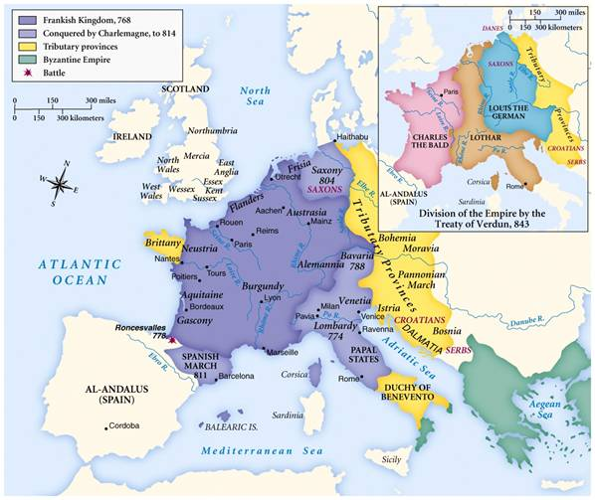

Slide 6
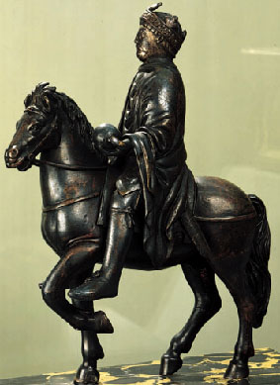
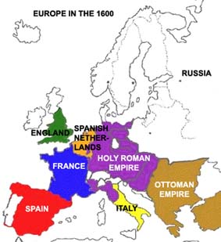
The Holy Roman Empire & Charlemagne
Charlemagne (Charles the Great) who was a military general and restored Pope Leo III who had been exiled
In return, Leo placed a crown on Charlemagne and named him the “Emperor of the Romans” which secured the relationship between Frankish kings and the papacy
Charlemagne became the first ruler of the Holy Roman Empire, a dynasty that would last for more than 700 years
Charlemagne- imposed order on empire through the Church and state
Ordered the standardization of Latin, textbooks, manuals for preaching, schools for clergy and people, new form of handwriting
All these promoted education and scholars and produced a precise written language (Latin)
Notes:
Iberbia- (present day Spain) had privileged class of estate owners called seniores; strong ties to Church; southern Spain conquered by Moors (Islamic people from North Africa) and clashes between Christians and Muslims, who were called infidels (Latin meaning unfaithful)

Slide 7
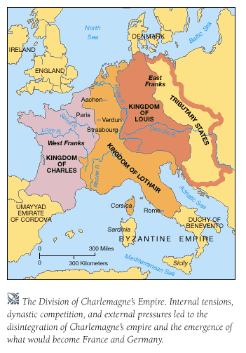
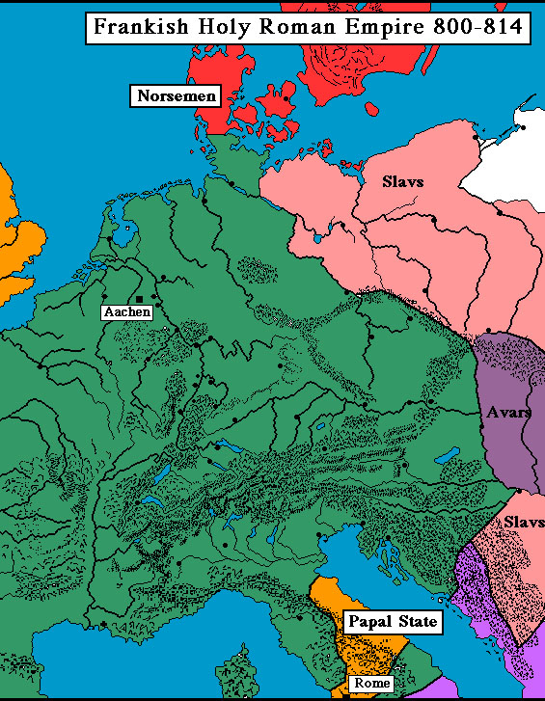

Slide 8
Slaves and Serfs
Slaves made up of conquered peoples
Some treated harshly, while other were treated fairly
Rural slaves became serfs, who worked the land and provided labor for owner (in return from protection)
Set up for system of feudalism

Slide 9
Birth of Modern Languages
Development of Middle Ages
New languages born through migration, resettlement, conflict and changes
Old English (Anglo Saxon) began to incorporate words borrowed from Latin and Old French, Old German and Old Norse
Roots of contemporary Spanish, Italian and other Romance languages

Slide 10
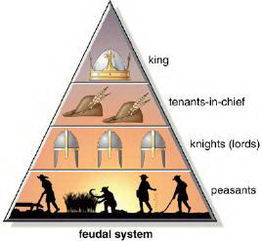
Feudalism
Increasing violence and lawless countryside
Weak turn to the strong for protection, strong want something from the weak
Feudalism= relationship between those ranked in a chain of association (kings, vassals, lords, knights, serfs)
Feudalism worked because of the notion of mutual obligation, or voluntary co-operation from serf to noble
A man’s word was the cornerstone of social life
Key terms
Fief = land given by a lord in return for a vassal’s military service and oath of loyalty
Serfs= aka villeins or common peasants who worked the lords land
Tithe = tax that serfs paid (tax or rent)
Corvee= condition of unpaid labour by serfs (maintaining roads or ditches on a manor)

Slide 11
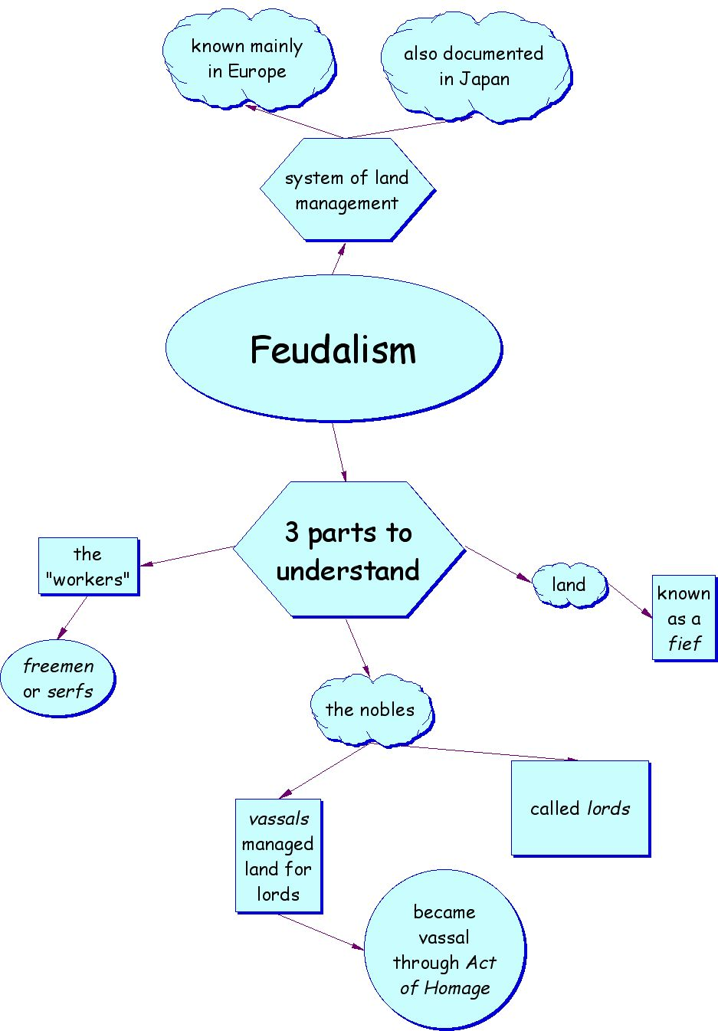

Slide 12
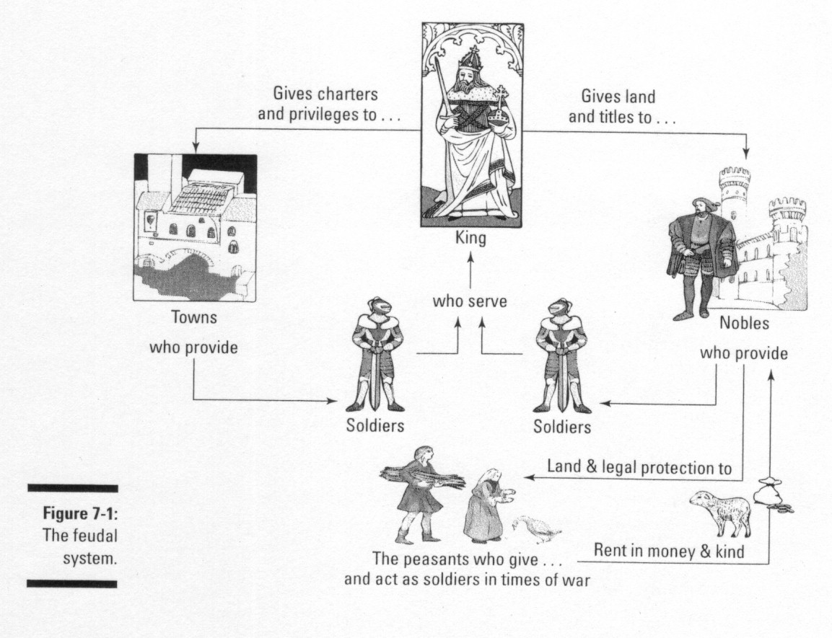

Slide 13
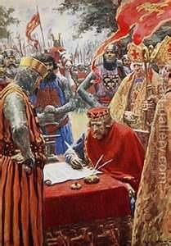
the Power of Kings grow
England was one of the first countries in Europe to develop a strong central monarchy = central government
The Magna Carta was a document that limited the power of the king = limited government
The English Monarchy
King John signing the Magna Carta,
forced by his nobles to give up some
of his power.
Magna Carta, a great step toward democratic government

Slide 14
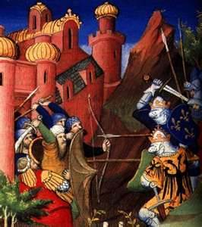
The Crusades
Were a series of attempts to gain Christian control of the Holy Land.
Pope Urban II called for Christians to join a Crusade at the Council
Of Clermont.

Slide 15
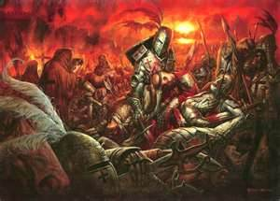
The Crusades
Trade increased
Kings gained more power
Muslim knowledge spread throughout Europe
Relations between Christians and Jews worsened
Effects

Slide 16
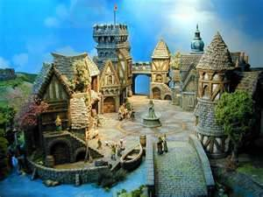
Trade fairs lead to the development of towns.
Hanseatic League...
a group of northern German cities/towns focused on promoting and protecting trade
As more people began to live in towns, craftspeople began to organize to protect their interest; primary interest was to restrict competition.
Merchants asked for charters from kings to establish new towns

Slide 17
Wars & Conflict
Hundred Years War
King of England believes that he is the rightful heir to the French throne
France declared the regent to be the new king
Even though England uses new weapons technology, France wins
War of the Roses
the Lancasters (red) & the Yorks (white) both used the rose as their family emblem; both wanted the English throne
After Edward’s death, a York, his son disappeared; his brother became king
Conflict ended when, Henry Tudor becomes king; he is related to both warring families

Slide 18
New Ideas and Culture
Effects of Crusades
Guild and communes
Towns, cities and manors
New thinkers (Thomas Aquinas) and writers
Creation of universities
New art and architecture (gothic, castles)
Knighthood and chivalry
Courtly entertainment (fables, playwrights)

Slide 19
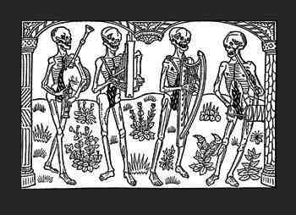
Late Middle Ages
Black Death
a devastating worldwide pandemic that first struck Europe in the mid 14th century
killed about a third of Europe’s population, an estimated 34 million people.

Slide 20
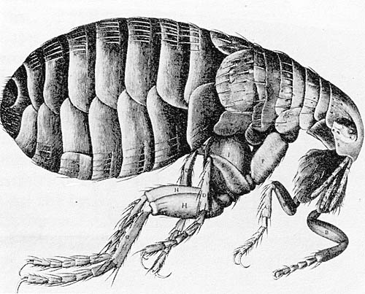
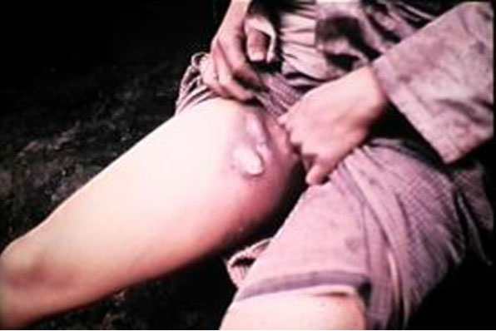
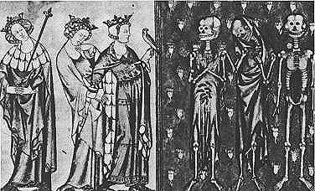
The Bubonic Plague
Called “black death” because of striking symptom of the disease, in which sufferers' skin would blacken due to hemorrhages under the skin
Spread by fleas and rats
painful lymph node swellings called buboes
buboes in the groin and armpits, which ooze pus and blood.
damage to the skin and underlying tissue until they were covered in dark blotches
Most victims died within four to seven days after infection
EFFECTS
Caused massive depopulation and change
in social structure
Weakened influence of Church
Originated in Asia but was blamed on
Jews and lepers

Slide 21
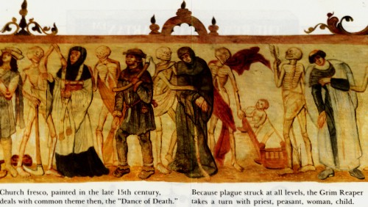

Slide 22
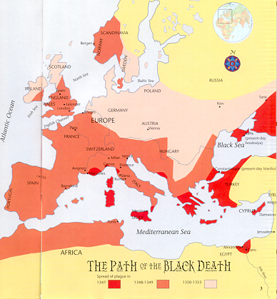

Slide 23
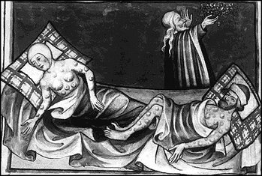
Illustration of the Black Death from the Toggenburg Bible (1411).

Slide 24
Ideas, Inventions and Key Figures
Roger Bacon (gunpowder)
Luca Pacioli (Father of Accounting)
Johannes Gutenberg (printing press)
Christine de Pisan (writer); Geoffrey Chaucer (writer)
Joan of Arc (Hundred Year’s War)
Pope Urban II (indulgences)
Pope Innocent IV and Bernard Gui (inquisitions)
Parliamentary Government in England

Slide 25
