Slide 1
The Monarchs of Europe:
The Power of Spain

Slide 2
Main Idea
Spain experienced a golden age during the 1500s, but economic problems and military struggles decreased Spanish power by the 1600s.

Slide 3
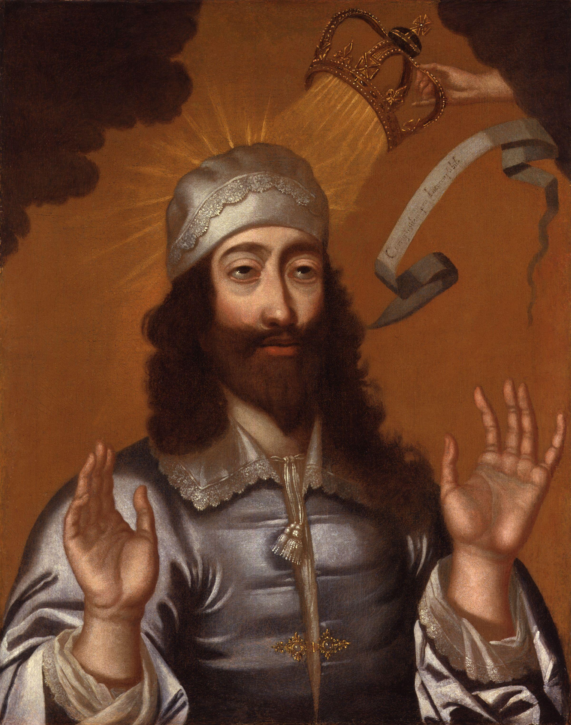
The Monarchs of Europe
Absolute monarch
Ruler whose power was not limited by having to consult with nobles, common people, or representatives
Divine Right
Monarchs received their power from God

Slide 4
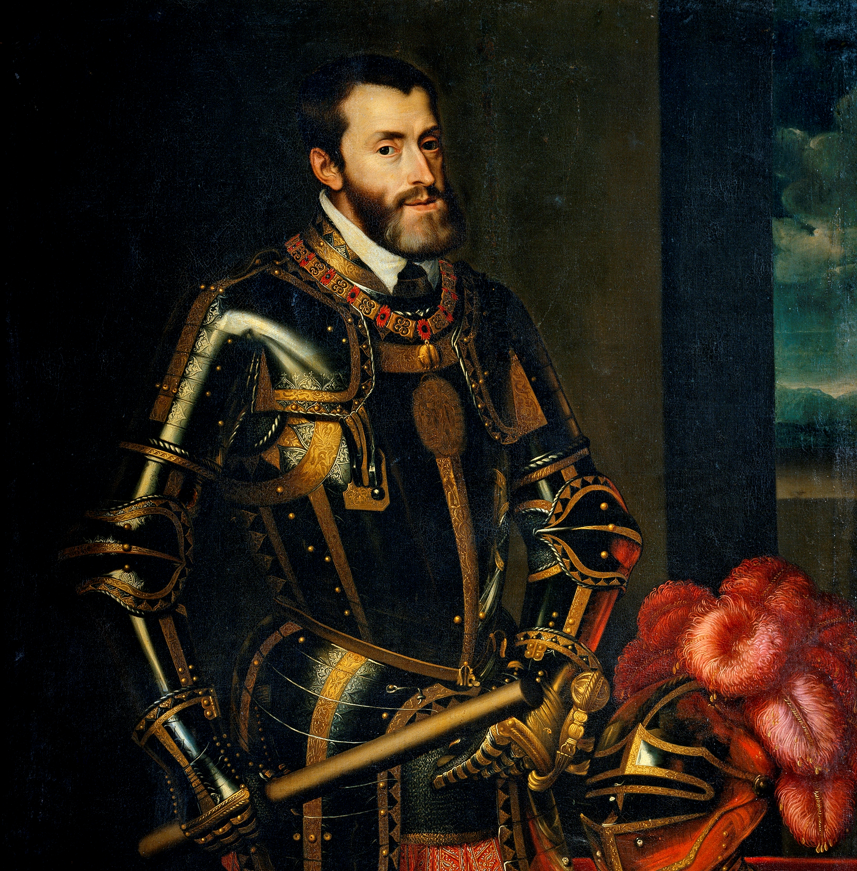
The King Becomes Emperor
Charles V
King of Spain
Elected Holy Roman Emperor
Territory: Spain, American colonies, and parts of Belgium, Netherlands, Italy, Austria, and Germany
Empire so vast “sun never set” over it

Slide 5
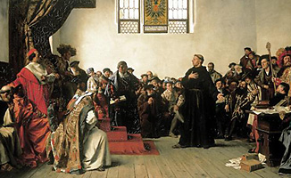
The King Becomes Emperor
Fighting for religious control of Europe
Wanted Europe to be Roman Catholic
Threatened by Protestant movement
Declared Martin Luther an outlaw

Slide 6
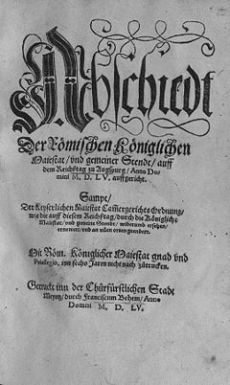
The King Becomes Emperor
Peace of Augsburg – 1555
Gave each German prince right to decide whether his state would be Catholic or Protestant
Vision of Catholic Europe never becomes reality

Slide 7
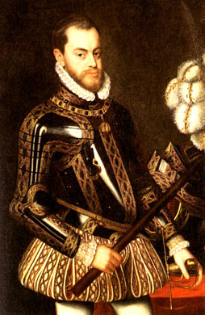
Dividing the Empire
Charles V gives up his thrones
Divides large empire between brother and son
Philip II (son of Charles V)
Rules Netherlands, Spain, Sicily, and colonies in America

Slide 8
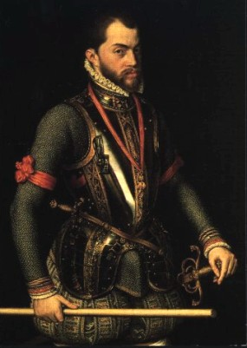
Spain Under Philip II
Spain reaches peak under Philip II
Gold and silver from American colonies
Considered himself a leader of the Counter-Reformation

Slide 9
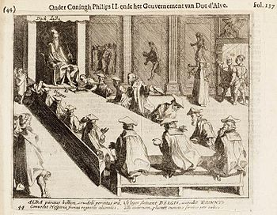
Dutch Revolt
Philip II sends an army to punish them
The Court of Blood
Tortured and executed thousands of rebels
Revolt lasted decades
1609 – Truce – Formed independent nation of the Netherlands

Slide 10
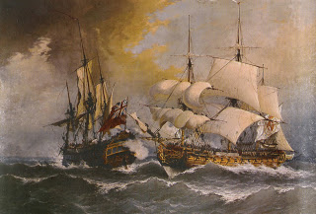
Spain and England
Spain and England rivals
England’s assistance to the Dutch
Worried about attacks on his ships
Queen Elizabeth I allowing her ship captains (sea dogs) to attack Spanish treasure ships

Slide 11
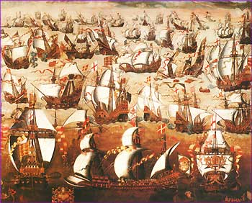
Spain and England
Philip wanted to stop England from raiding ships and return England to the Catholic church
Assembles a great naval fleet, the Spanish Armada
Called invincible & unbeatable

Slide 12
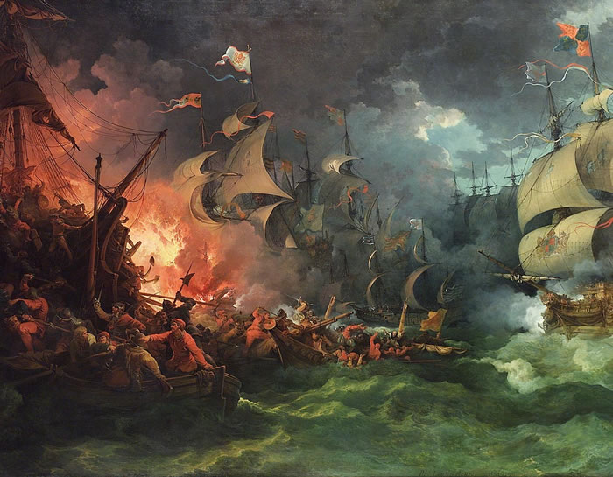
Spain and England
Sail into the English Channel (1588)
Faced series of fierce naval battles
Armada severely damaged

Slide 13
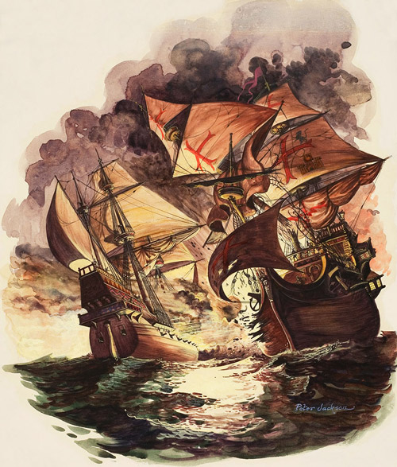
An Empire in Decline
Never recovered from the defeat of the Armada
Internal problems
Never developed industry
Inflation
Money spent on wars

Slide 14
The Monarchs of Europe:
Absolute Monarchy and France

Slide 15
Main Idea
Henry IV, Louis XIII, and Louis XIV strengthened the French monarchy, with Louis XIV setting the example of an absolute monarch for the rest of Europe.

Slide 16
Religious War and Henry IV
Huguenot
French Calvinist Protestant
One in Ten French
Threatened the Catholic French monarchy
“one king, one law, one religion”

Slide 17
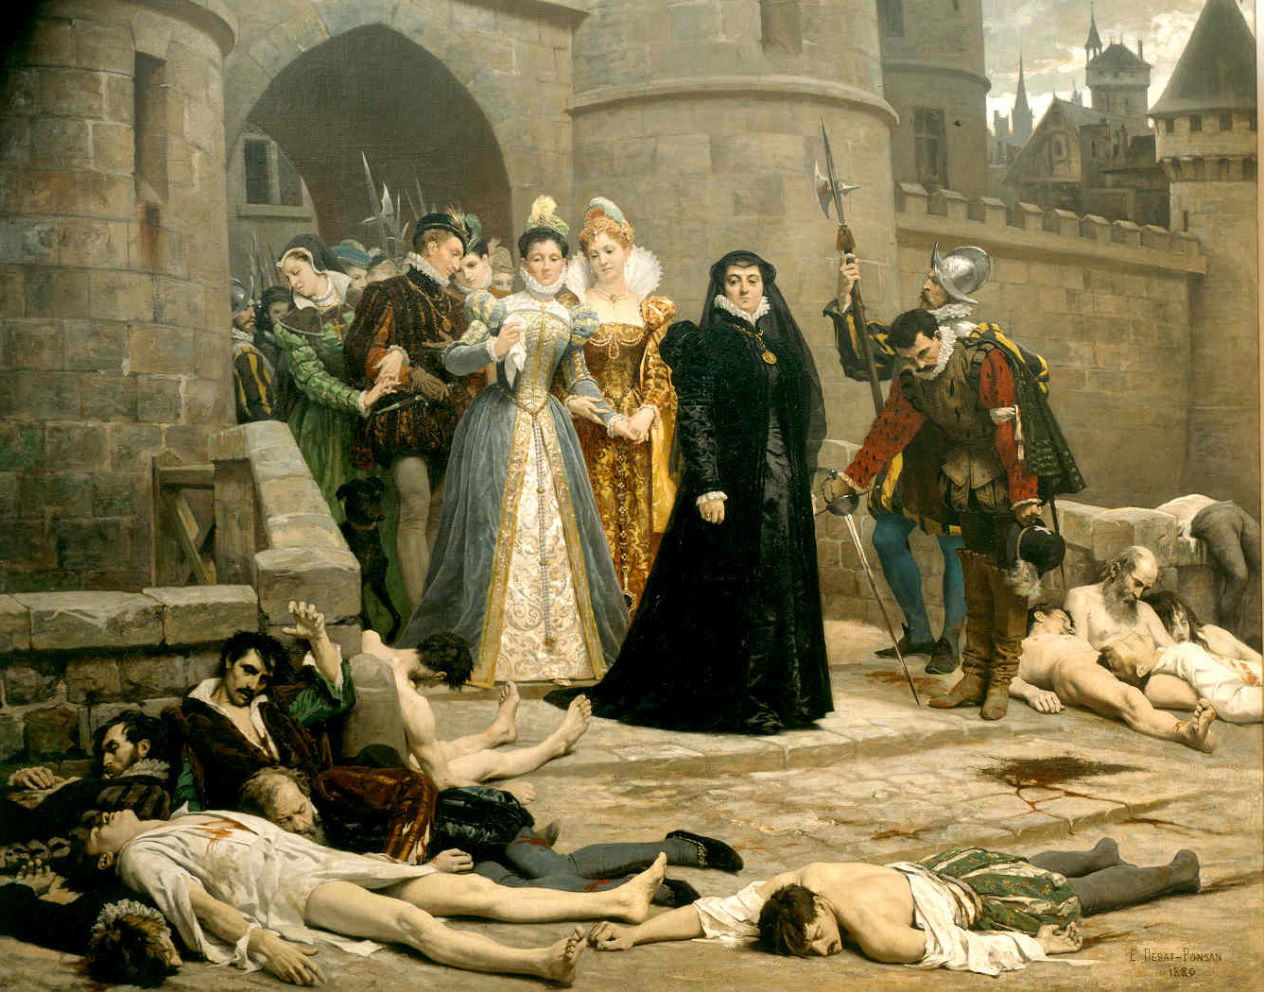
Religious War and Henry IV
Fighting between the Huguenots and Catholics
Saint Bartholomew’s Day Massacre
Catholic queen of France ordered the killing of Huguenots in Paris

Slide 18
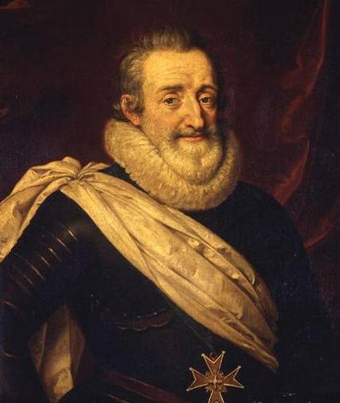
Religious War and Henry IV
Henry of Navarre
Escapes death by denying religion
Had to fight to claim the throne
Converted to Catholicism
“Paris is well worth a mass”
Crowned Henry IV

Slide 19
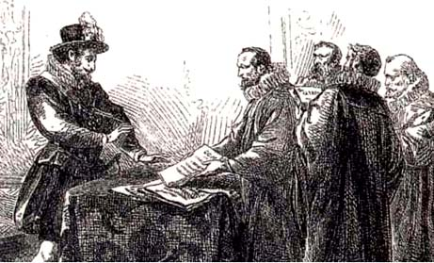
Religious War and Henry IV
Edict of Nantes
Gave Huguenots limited freedom of worship
Right to hold office
Ended the religious wars, but Catholicism still official religion

Slide 20
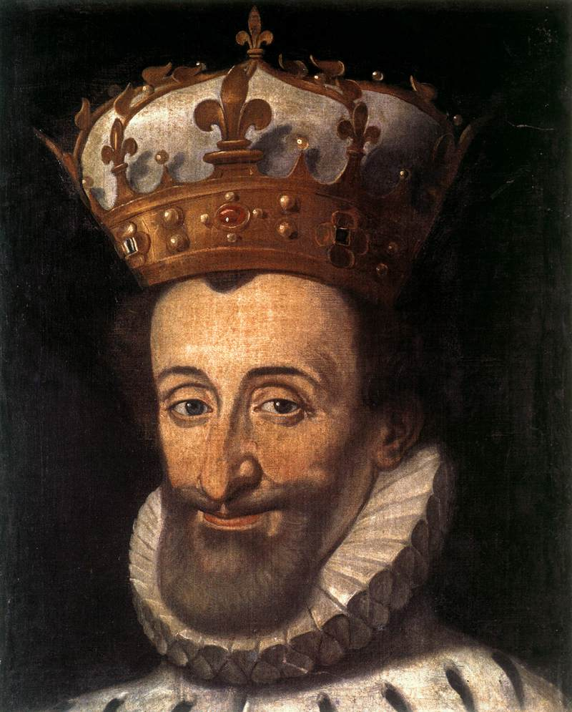
Henry IV
Eliminated France’s debt
Built a surplus
Created new industry
Stimulated trade
Encouraged agriculture

Slide 21
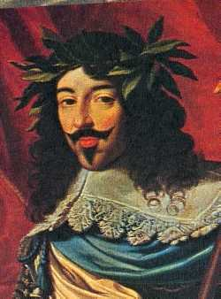
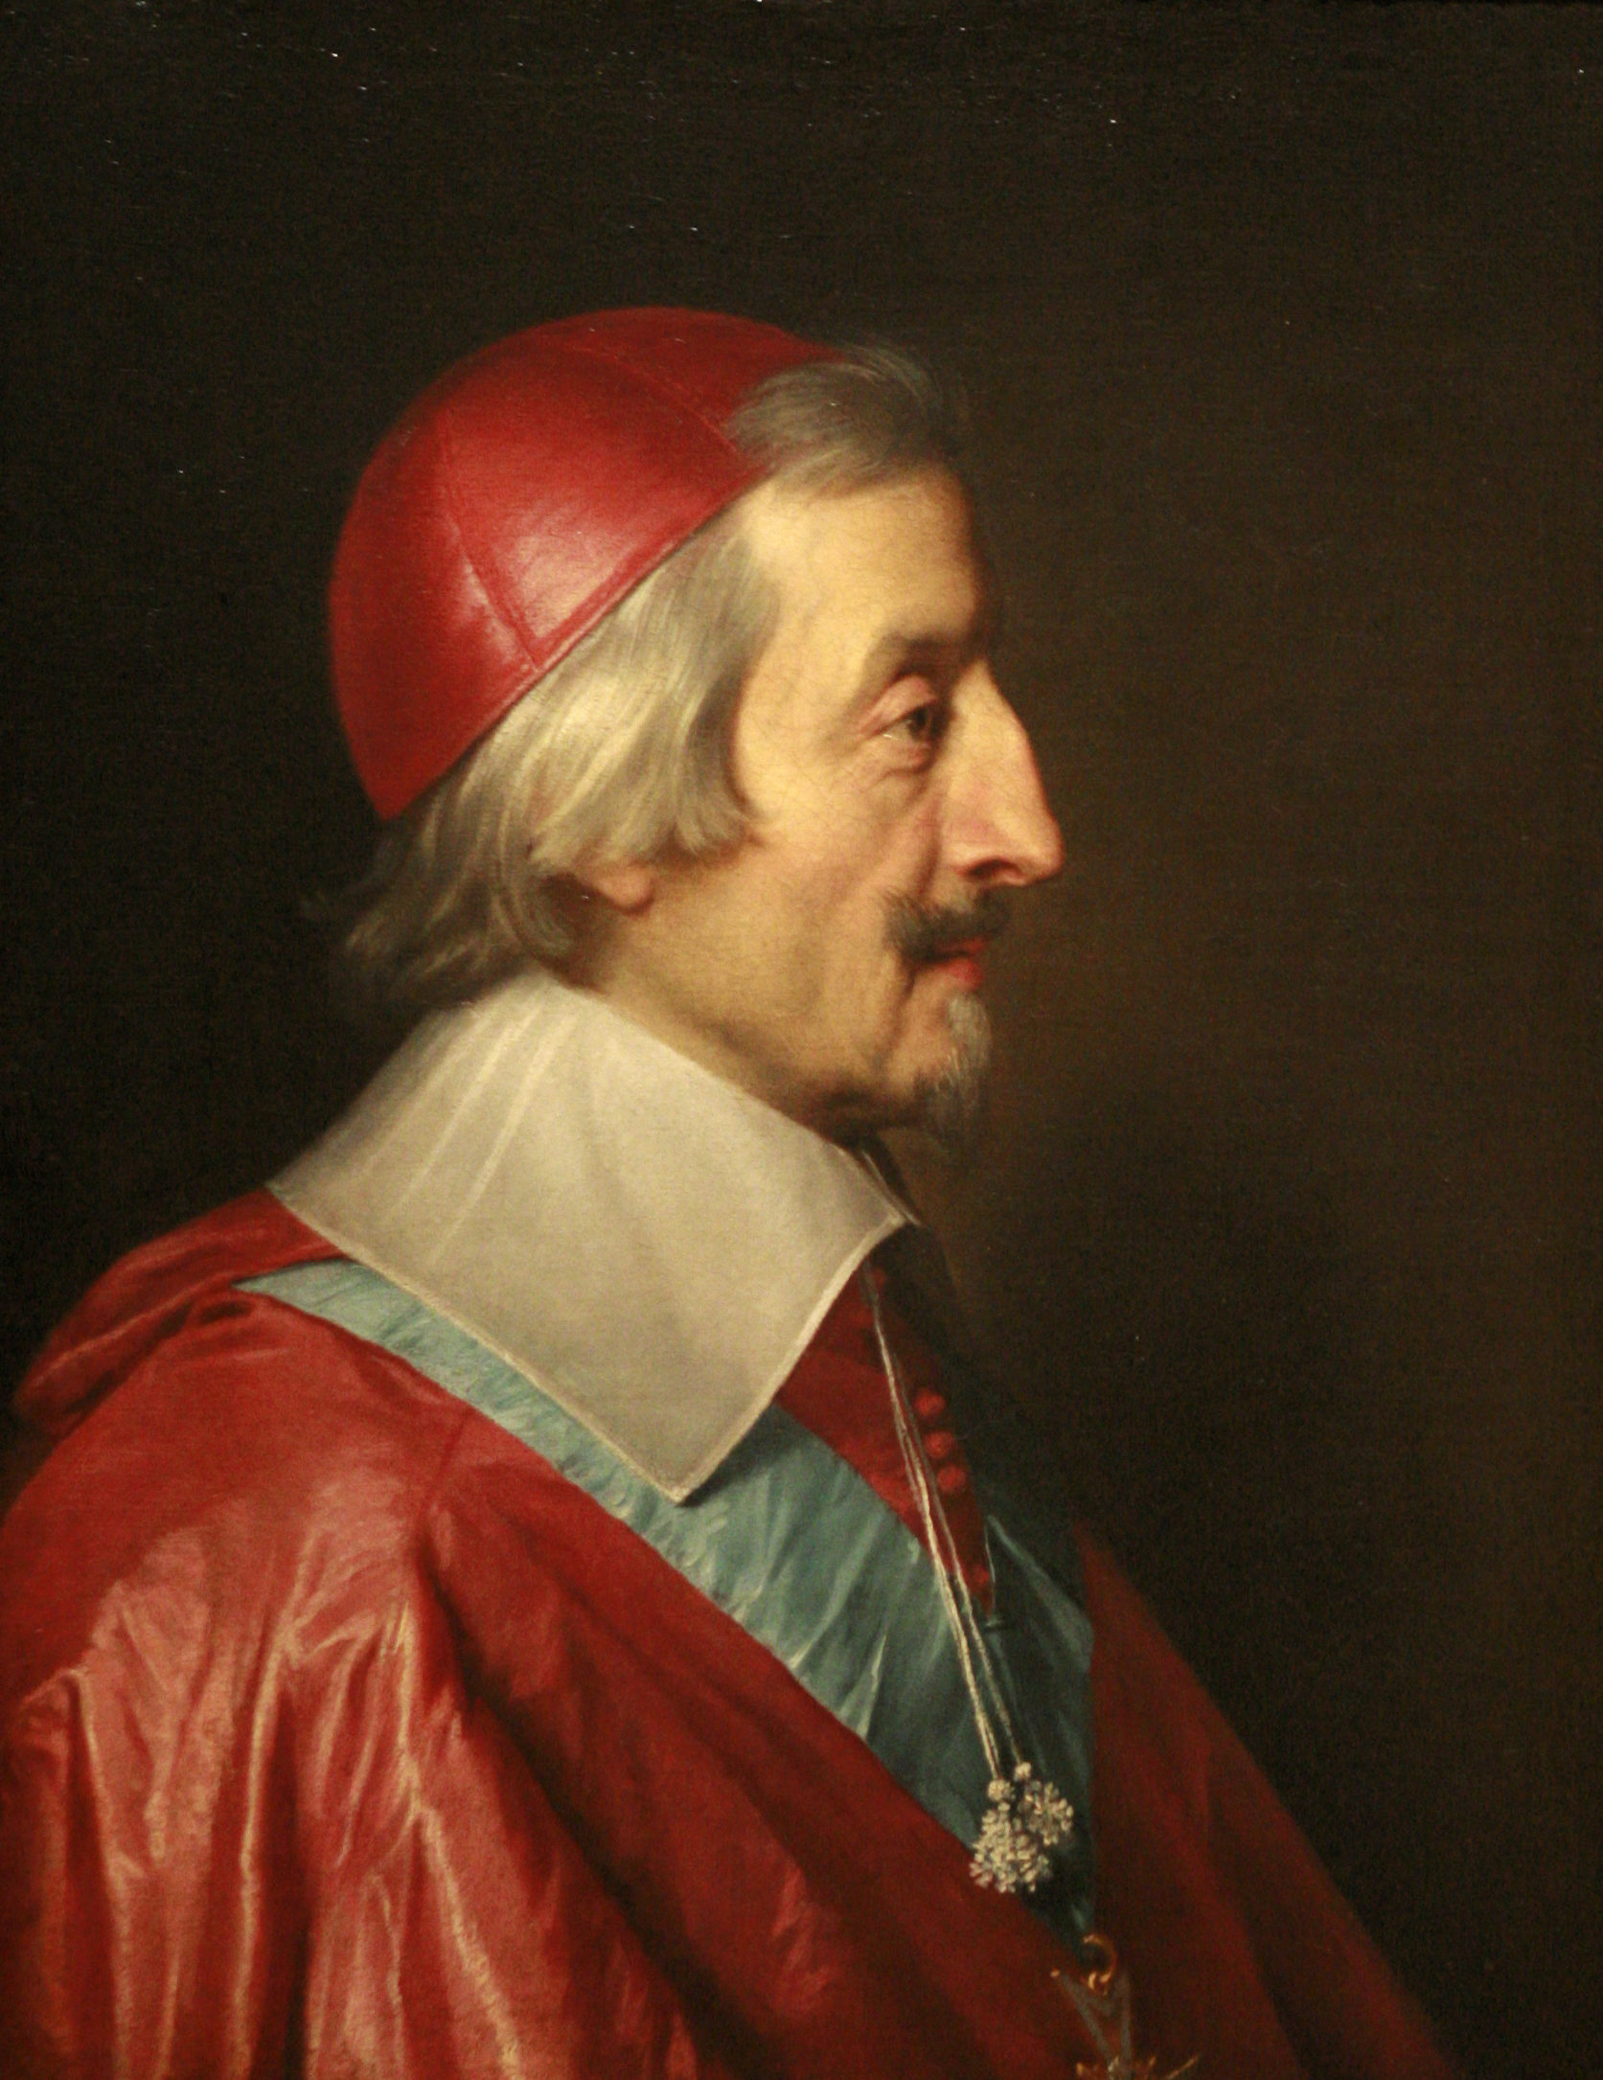
Louis XIII and Richelieu
Louis XIII
New king of France (after Henry)
Cardinal Richelieu
Chief minister/most trusted advisor
Determined to strengthen the monarchy

Slide 22
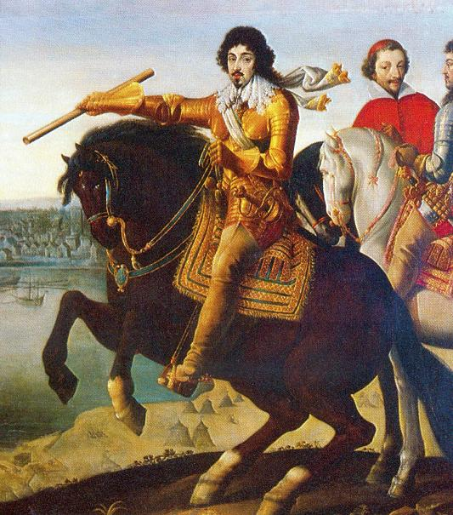
Louis XIII and Richelieu
Suppressed Huguenot nobles and cities
Attacked city of La Rochelle
Executed nobles for treason

Slide 23
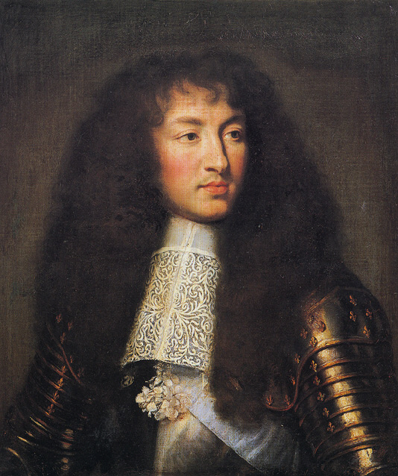
The Monarchy and Louis XIV
Louis XIV “The Sun King”
Son of Louis XIII
Perfect example of an absolute monarch
Tradition that lasted in France for over 100 years

Slide 24
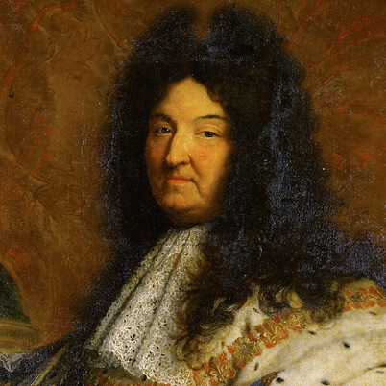
The Monarchy and Louis XIV
Raised to be king
Confident in ability to rule
At age 18, declared would run gov’t himself
The Sun King
Sun as his personal symbol (because the world revolved around him)

Slide 25
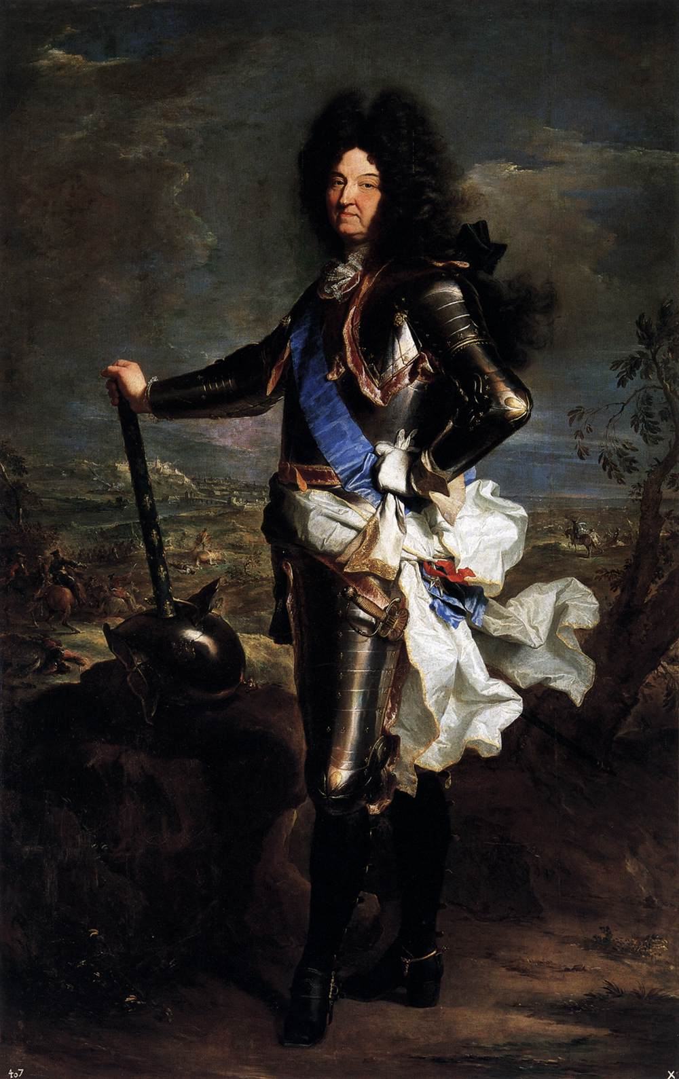
The Monarchy and Louis XIV
Retained absolute power
In charge of all military, political, religious, and economic initiatives
Deprived nobles of influence

Slide 26
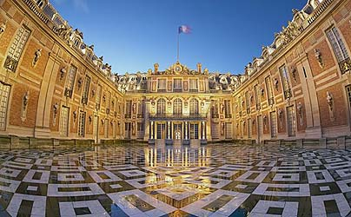
The Monarchy and Louis XIV
Palace at Versailles
http://www.youtube.com/watch?v=XxIzMr2Ekpo

Slide 27
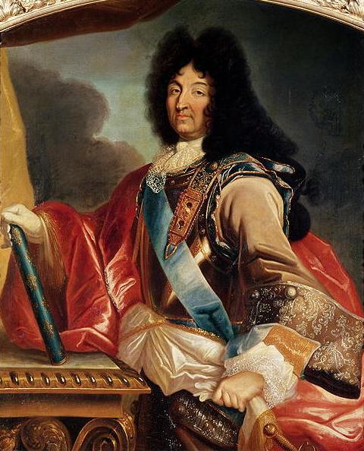
The Monarchy and Louis XIV
Revoked the Edict of Nantes
Money always a concern
Wanted to build up the military and expand French territory

Slide 28
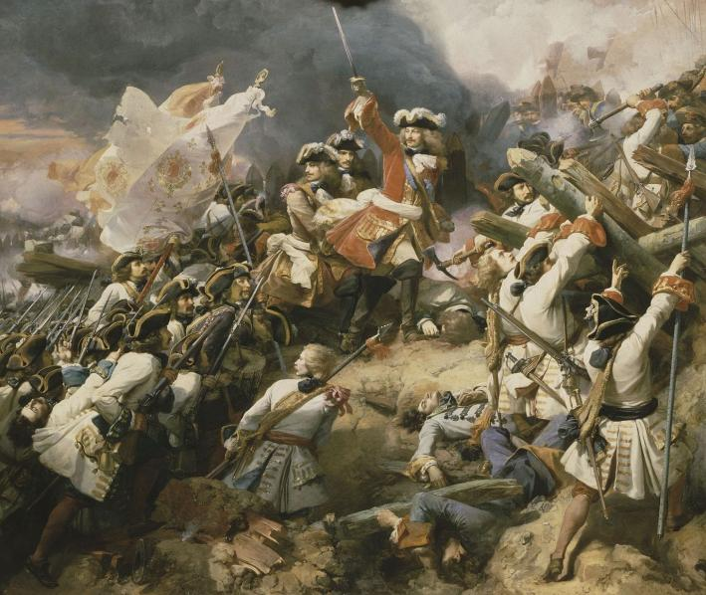
The War of Spanish Succession
Spanish king died without an heir
3 candidates (Louis one of the 3)
Other countries did not want France and Spain closely connected

Slide 29
The War of Spanish Succession
Treaty of Utrecht
France and Spain would never be ruled by same monarch
Louis’s grandson gets Spanish throne
Had to give back territory Louis had taken

Slide 30
The Monarchs of Europe:
Monarchy in England

Slide 31
Main Idea
In contrast to the absolute monarchies of Spain and France, the English monarchy was limited by Parliament; following a civil war, Parliament became even more powerful.

Slide 32
The Tudors and Parliament
Henry VIII
Created the Protestant Church of England
Elizabeth
Refused to marry - knew that marriage could limit her power & freedom
Allowed Parliament to speak without fear of punishment

Slide 33
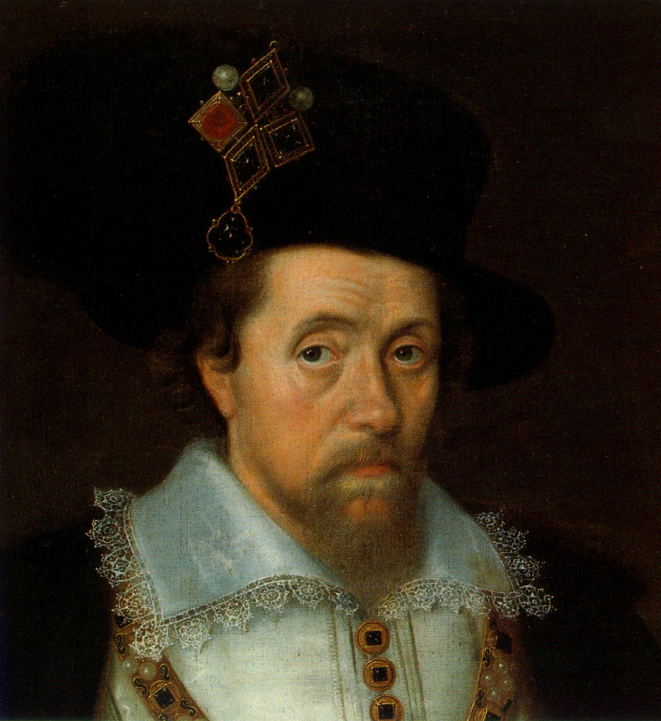
The Stuarts and Parliament
James I
From Scotland – viewed as an outsider
View of absolute monarchy caused conflict with Parliament
Rarely able to get Parliament to approve money he wanted

Slide 34
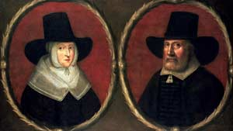
The Stuarts and Parliament
Puritans
Wanted reform in the Church of England
“purify” the English church of Catholic practices
Wanted to take power away from church officials

Slide 35
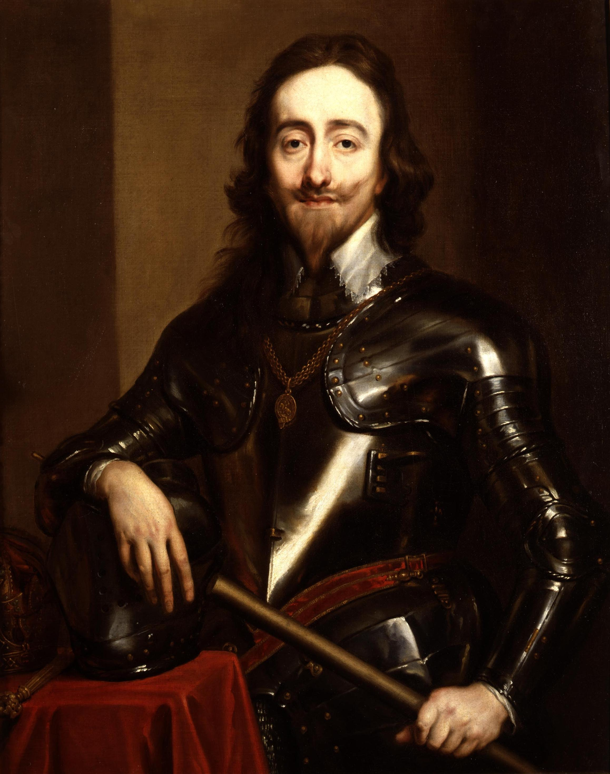
The Stuarts and Parliament
Charles I
Summoned Parliament to request money – Parliament refused until he signed the Petition of Right
Would limit the kings power, can’t levy taxes w/o permission
Charles taxed English people on his own – Parliament furious

Slide 36
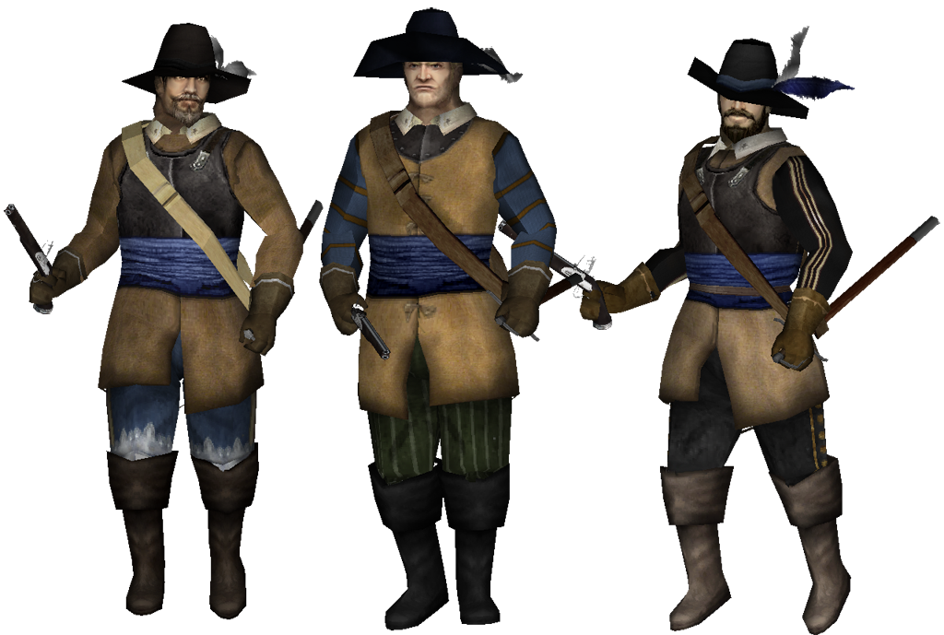
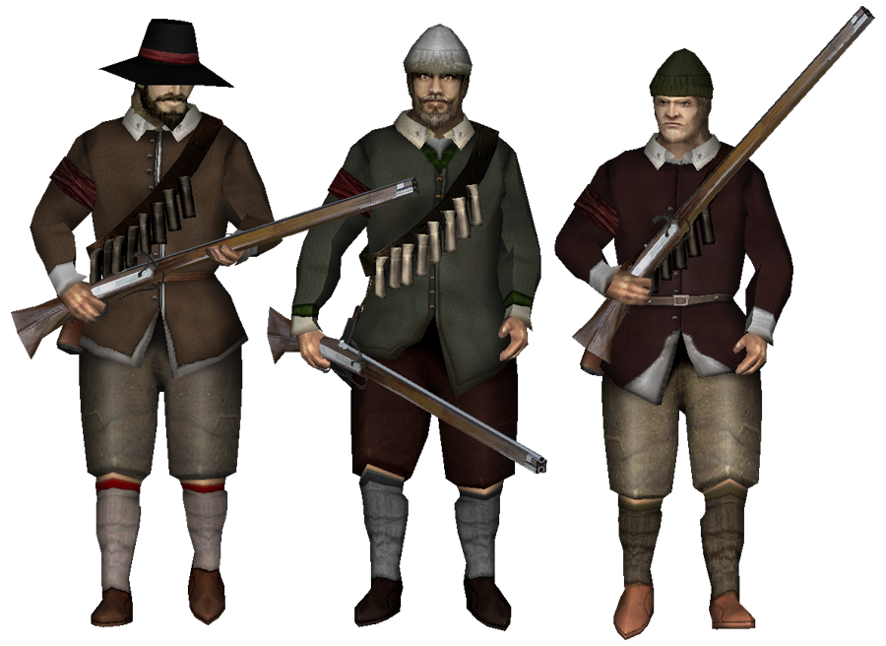
The English Civil War
War started over king Vs. Parliament
Issues over money, the church, and power
Royalists
Supported the king
Roundheads
Supported Parliament

Slide 37
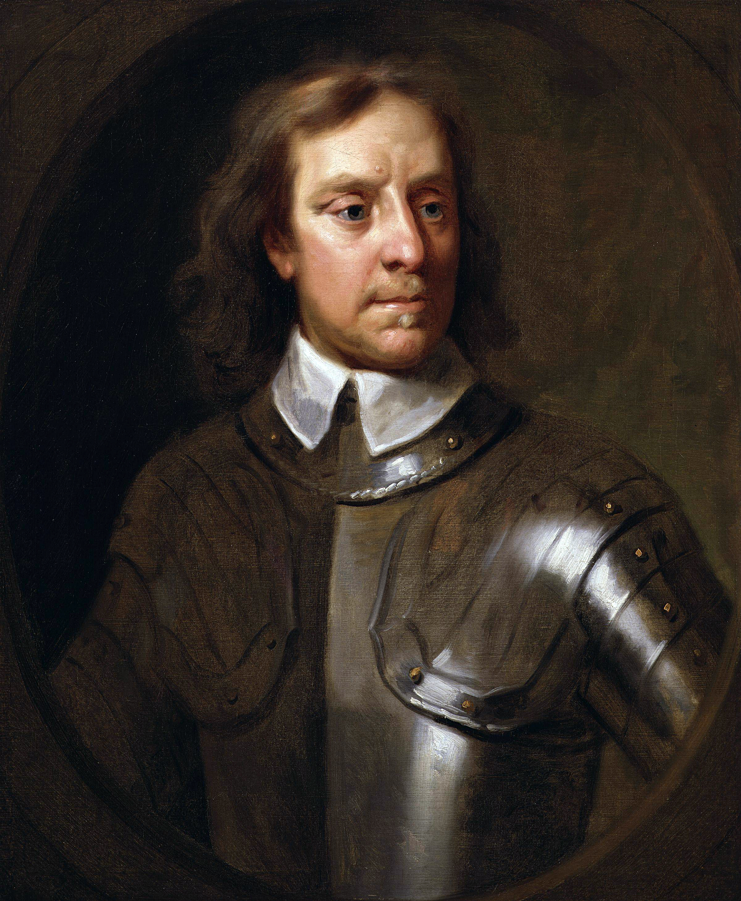
The English Civil War
Oliver Cromwell
Leader of the Roundheads
General of Parliament’s army
Dismissed all members of Parliament who disagreed with him
Rump Parliament

Slide 38
England under Cromwell
Commonwealth
Republican government based on the common good of all the people
Closed the House of Lords
Demanded complete obedience
Closed the theaters
Wars with Scotland, Ireland, Dutch, and Spain

Slide 39
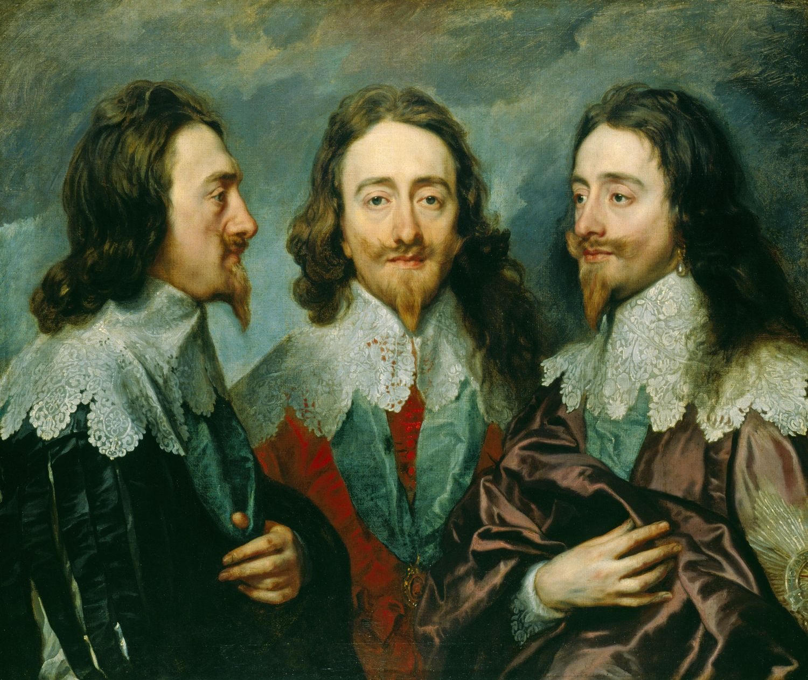
The Monarchy Returns
Restoration
Parliament agrees to bring back the monarchy
Invited Charles I son to become king (Charles II)

Slide 40
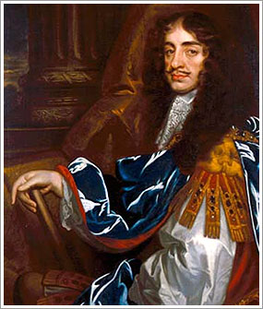
Charles II
Supported religious toleration
Reopened theaters
Construction projects
Habeas Corpus Act of 1679
Guaranteed someone accused of a crime had the right to appear in court

Slide 41
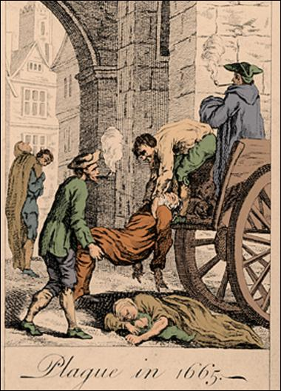
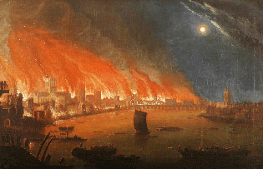
Charles II
The return of the plague
100,000 die
Great Fire of London
Conflict with the Dutch

Slide 42
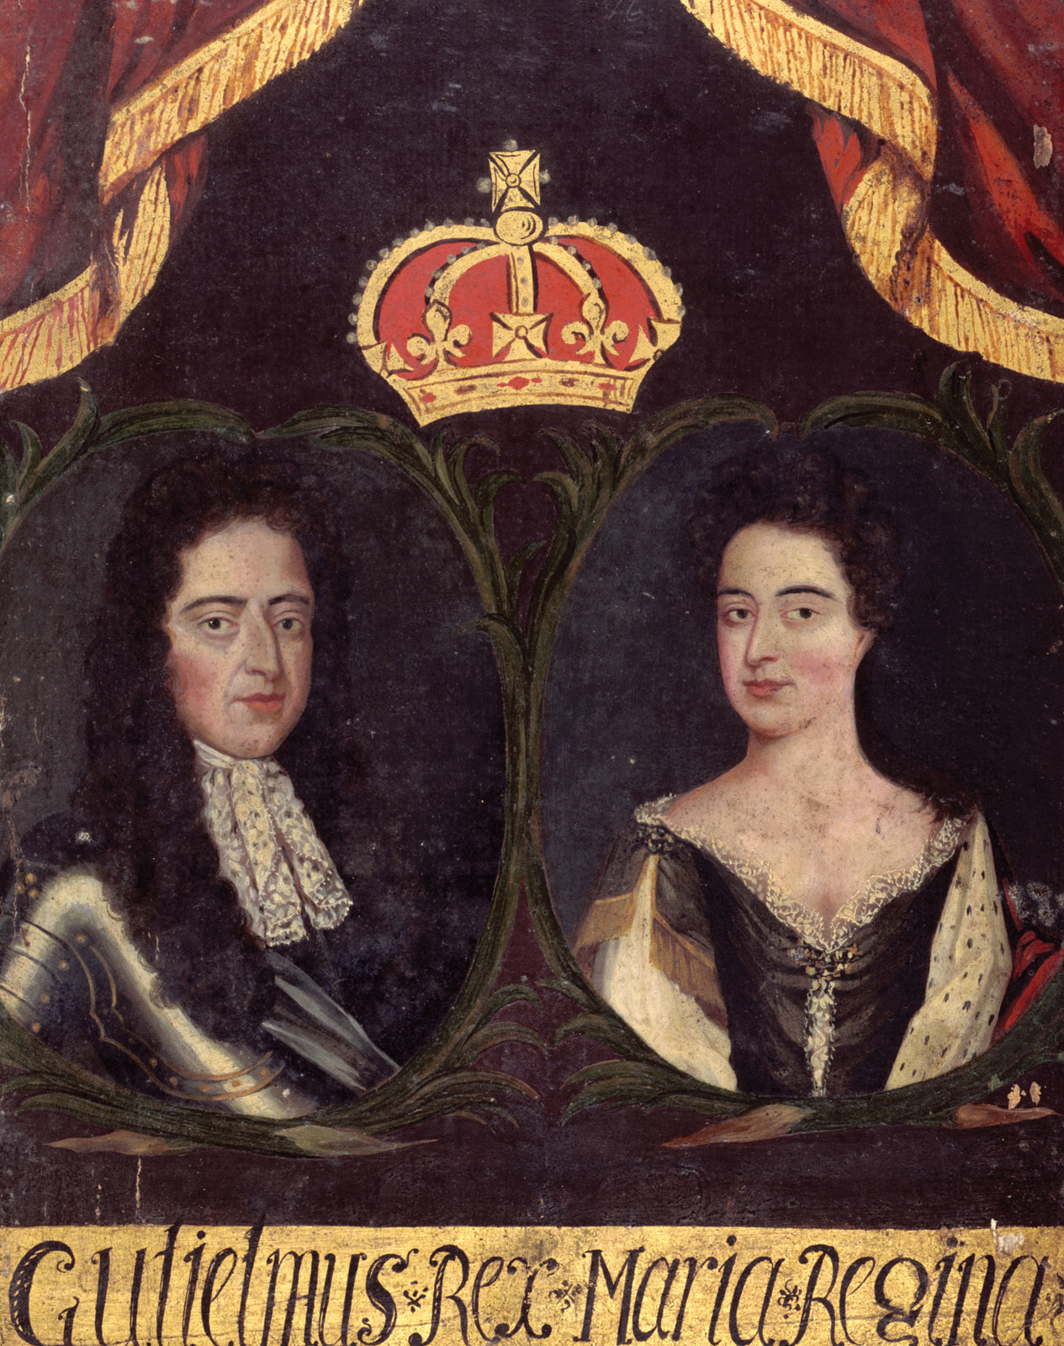
The Glorious Revolution
William and Mary
Protestants
Invited to become king and queen of England
Given power as joint rulers
Glorious Revolution

Slide 43
Changes in Government
William and Mary sign the English Bill of Rights
Prevented monarch from levying taxes without consent from Parliament
Central to England’s growth as a constitutional monarchy
Monarchy limited by law

Slide 44
The Monarchs of Europe:
Rulers of Russia and Central Europe

Slide 45
Main Idea
The czars of Russia struggled with the westernization of their empire, while powerful families battled for control of Central Europe.

Slide 46
Rulers of Russia and Central Europe
1500s Russia far behind western Europe in technology and government
Boyars
Landowners who helped run the government
Czar
Like a king/emperor (1546 – First czar)
Comes from the Latin word caesar

Slide 47
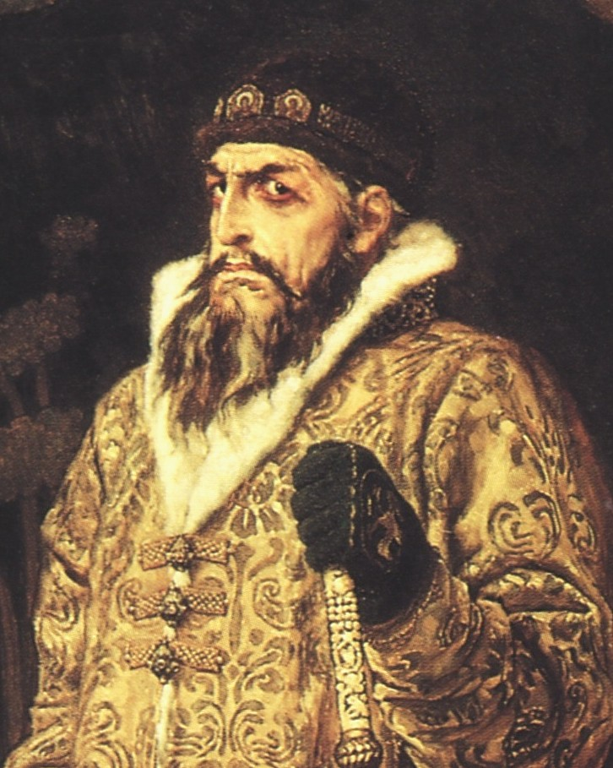
Monarchy of Ivan IV
Ivan’s “good period”:
New Legal code
Expanded Russia’s borders
Increased trade

Slide 48
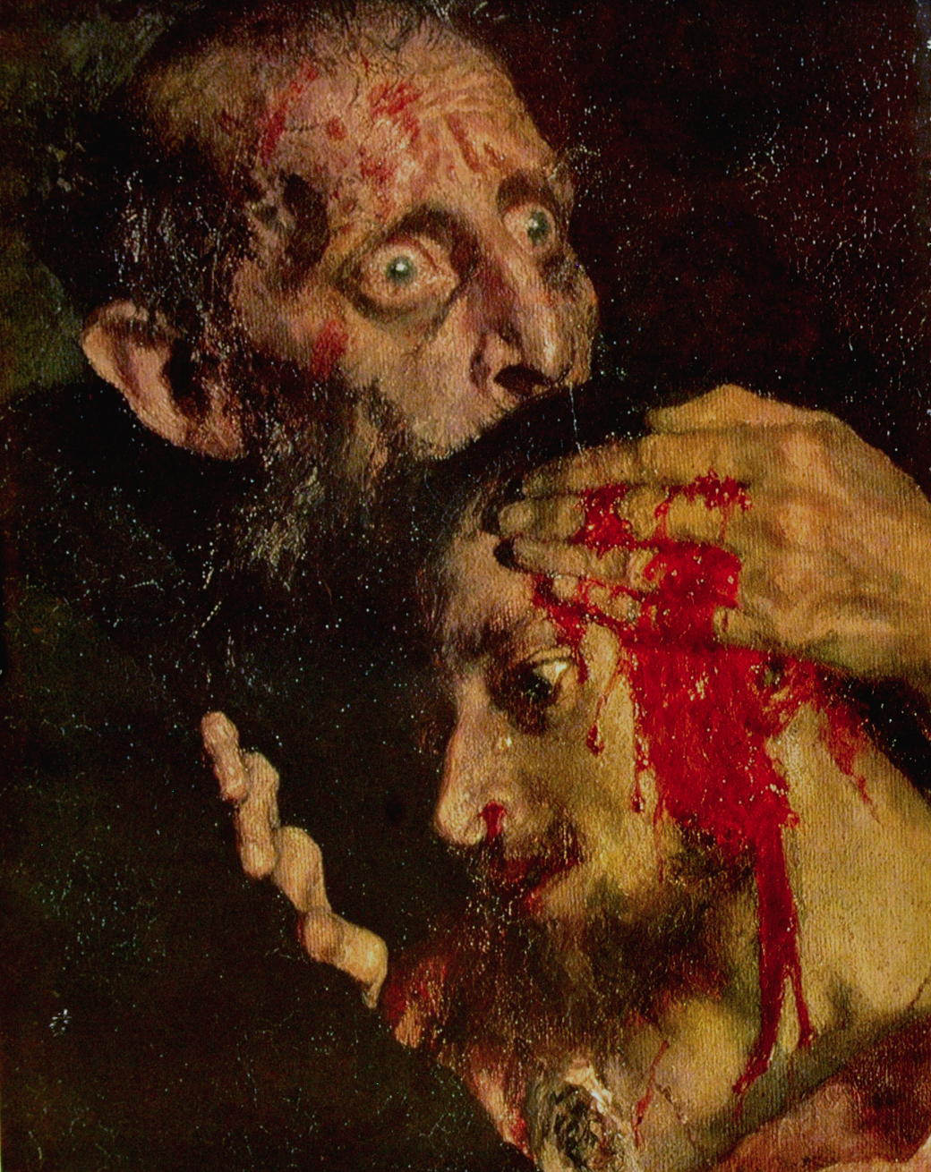
Ivan the Terrible
Strict policies & violent actions
Suspicious of advisers
Private police force
Seized land
Killed thousands (including his own son)

Slide 49
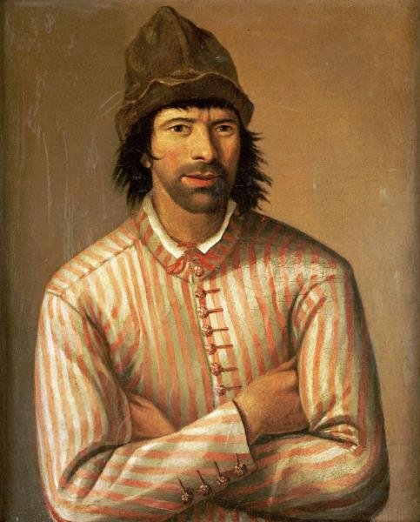
Peter the Great
Becomes czar in 1682
Realized country needed to modernize - Started westernization
Determined to bring elements of Western culture to Russia
Traveled around Europe in disguise
Recruited experts to bring to Russia

Slide 50
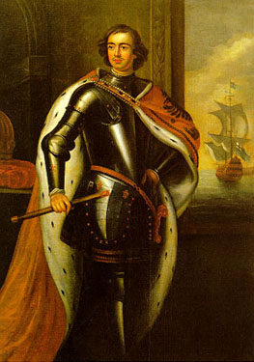
Peter the Great
Modernized the army & navy
Brought church under state control
Built up industry
New schools
Promoted officials based on service, not status

Slide 51
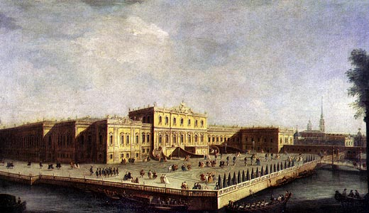
Peter the Great
Fought Sweden to obtain a warm-water port
Other ports covered by ice majority of the year
Founded the city of St. Petersburg
New capital
Western styled architecture

Slide 53
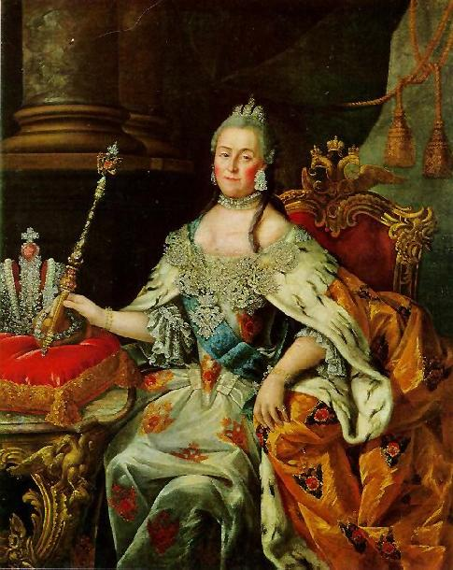
Catherine the Great
Seized power
Declared czarina of Russia
Continued Peter’s westernization efforts
Promoted science and the arts
Reformed legal and education systems
Reformed local gov’t

Slide 54
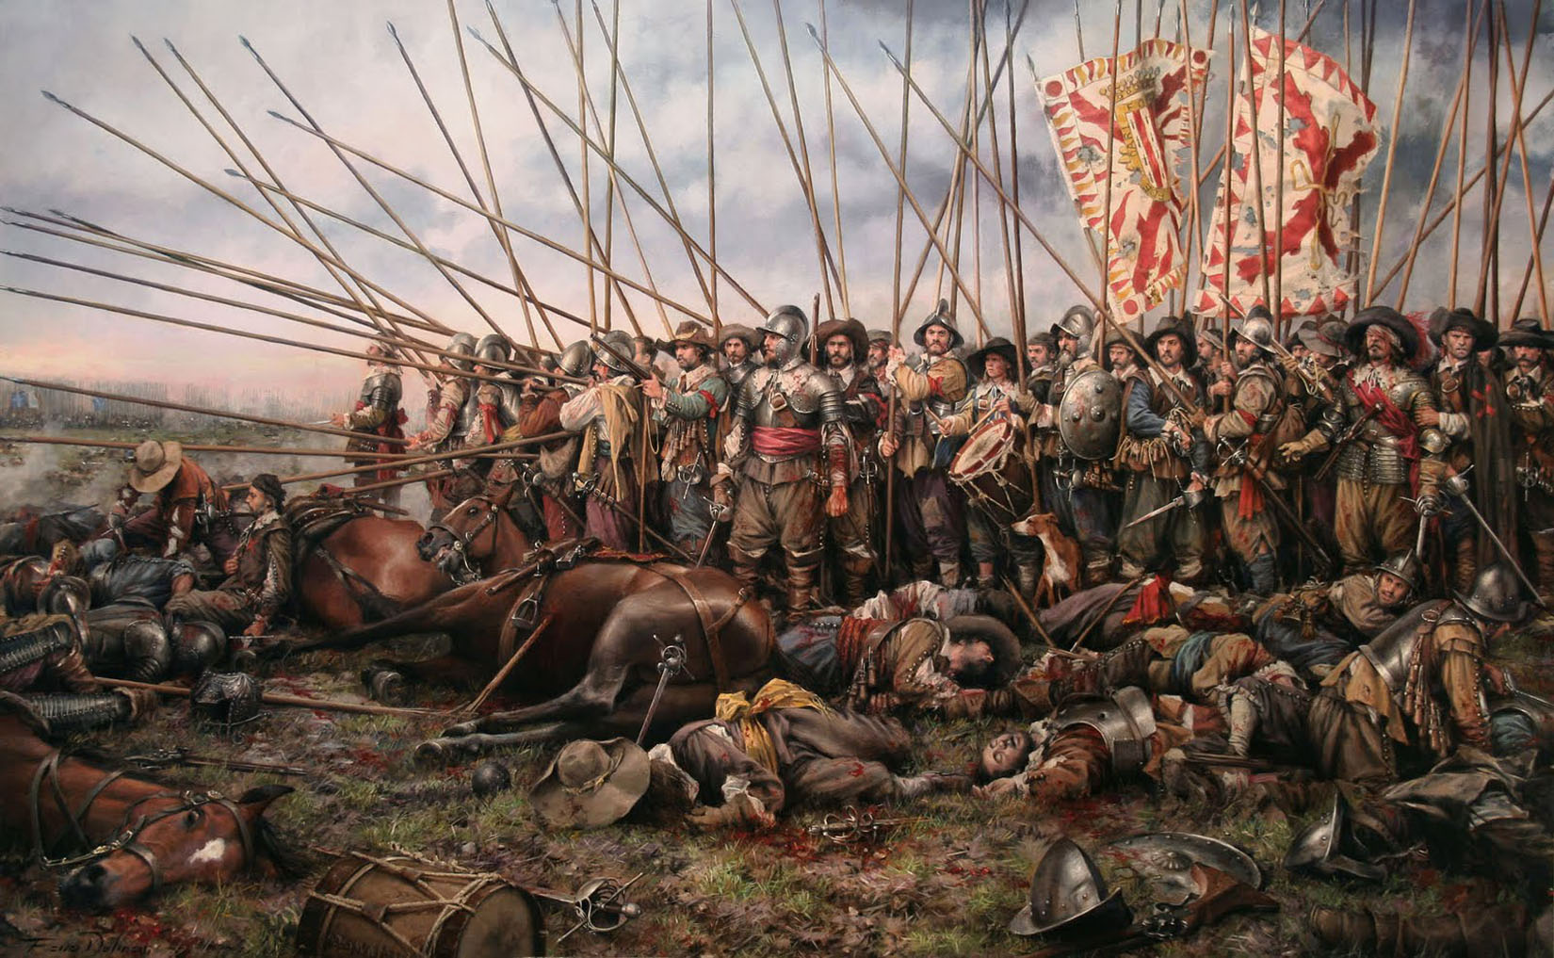
The Thirty Year’ War
1618-1648
Began as a religious dispute
Alliances between the Hapsburgs and other European monarchs

Slide 55
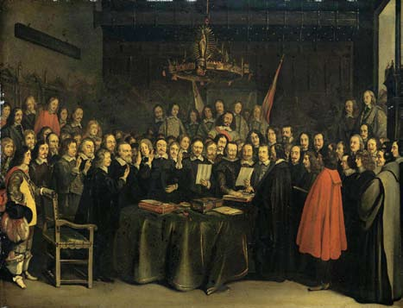
The Thirty Year’ War
Treaty of Westphalia
Ended the war
Extended religious toleration to Catholics and Protestants
Further reduced the power of the Holy Roman Emperor

