Slide 1
Nationalism: Italian Unification

Slide 2
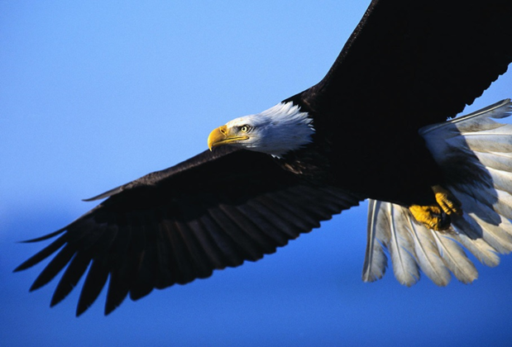
Nationalism for America

Slide 3
Main Idea
In the 1800s, Italian states rebelled against Austria and unified as the Kingdom of Italy.

Slide 4
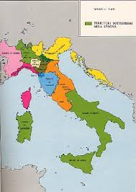
Stirrings of Nationalism
Has not been unified since the Roman Empire
Divided into several competing states
Briefly unified under Napoleon – until Congress of Vienna

Slide 5
Stirrings of Nationalism
Congress of Vienna created new political boundaries
Ignored national groups
Italians split into 3 groups
Many under control by the Austrians, Hapsburgs, or French
Italian nationalism grew in opposition to these conditions

Slide 6
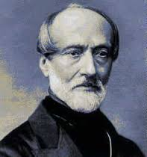
Stirrings of Nationalism
Giuseppe Mazzini
Popular writer
Launched a nationalist group called Young Italy
Wanted the lines redrawn from the Congress of Vienna
Exiled
“heart” of the unification

Slide 7
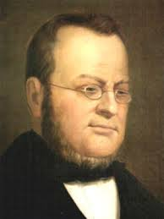
The Path Toward Unity
Camillo di Cavour
“brain” of the revolution
Started nationalist newspaper -- Il Risorgimento
Prime minister of Sardinia
Believed strong economy was needed for unification

Slide 8
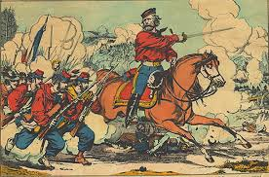
Garibaldi and the Red Shirts
Giuseppe Garibaldi
“sword” of the revolution
Leads an army in war against Austria
Red Shirts

Slide 10
Nationalism: German Unification

Slide 11
Main Idea
In the late 1800s, Otto von Bismarck transformed Germany from a loose confederation of separate states into a powerful empire.

Slide 12
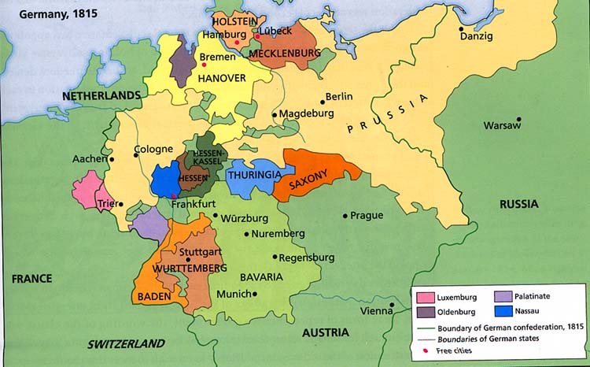
Steps Toward Unification
After Congress of Vienna
39 separate states
Common language & culture
Spread of nationalism

Slide 13
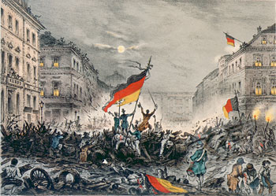
Steps Toward Unification
Revolution of 1848
Wanted a united Germany
Inspired by French Revolution
Prussian king Frederick Wilhelm IV promised change
When revolution over – king reverts

Slide 14
Steps Toward Unification
Zollverein
Allowed for the removal of tariffs on products traded between German states
Encouraged growth of railroads
Encouraged the growth of the economy

Slide 15
The Zollverein Leather, salmon, eels and matches, Cows and madder, paper, shears, Ham and cheese and boots and vetches, Wool and soap and yarns and beers; Gingerbread and rags and fennels, Nuts, tobacco, glasses, flax, Leather, salt, lard, dolls and funnels, Radish, whisky, wax; Articles of home consumption, All our thanks are due to you! You have wrought without presumption What no intellect could do; You have made the German Nation Stand united, hand in hand, More than the Confederation Ever did for Fatherland.

Slide 16
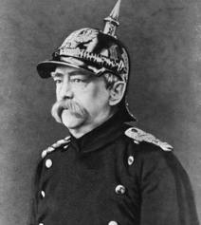
Bismarck’s Plan for Germany
Otto von Bismarck
Prussia’s prime minister
Leading force behind German unification
Conservative -- Supported king

Slide 17
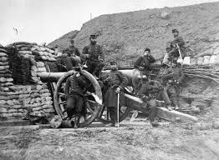
Bismarck’s Plan for Germany
Realpolitik
Belief in practical goals instead of theory and ideology
Believed unification would be achieved by “blood and iron”
Dismissed assembly and built up a strong Prussian army

Slide 18
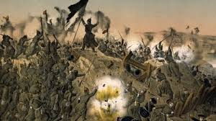
Unification and Empire
1864 - War with Denmark
Allied with Austria – Austria received territory within Prussia’s borders
Bismarck knows he had to get Austria out of the way for any chance of unification

Slide 19
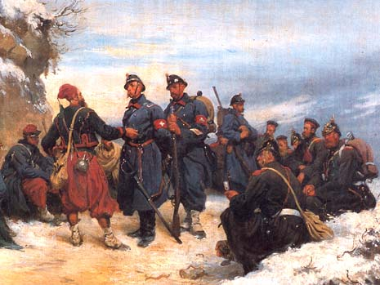
Unification and Empire
Bismarck ensures Italy and France won’t get involved
Promises land to Italy
Convinced Napoleon III to remain neutral
Sends Prussian troops into Austrian state of Holstein
Austria declares war

Slide 20
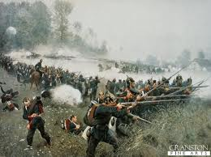
Unification and Empire
Austro-Prussian War
Blamed Austrians for starting war
Fostered nationalism
Highly skilled & well equipped
Over in 7 weeks
Dissolved the German Confederation
First major step towards unification

Slide 21
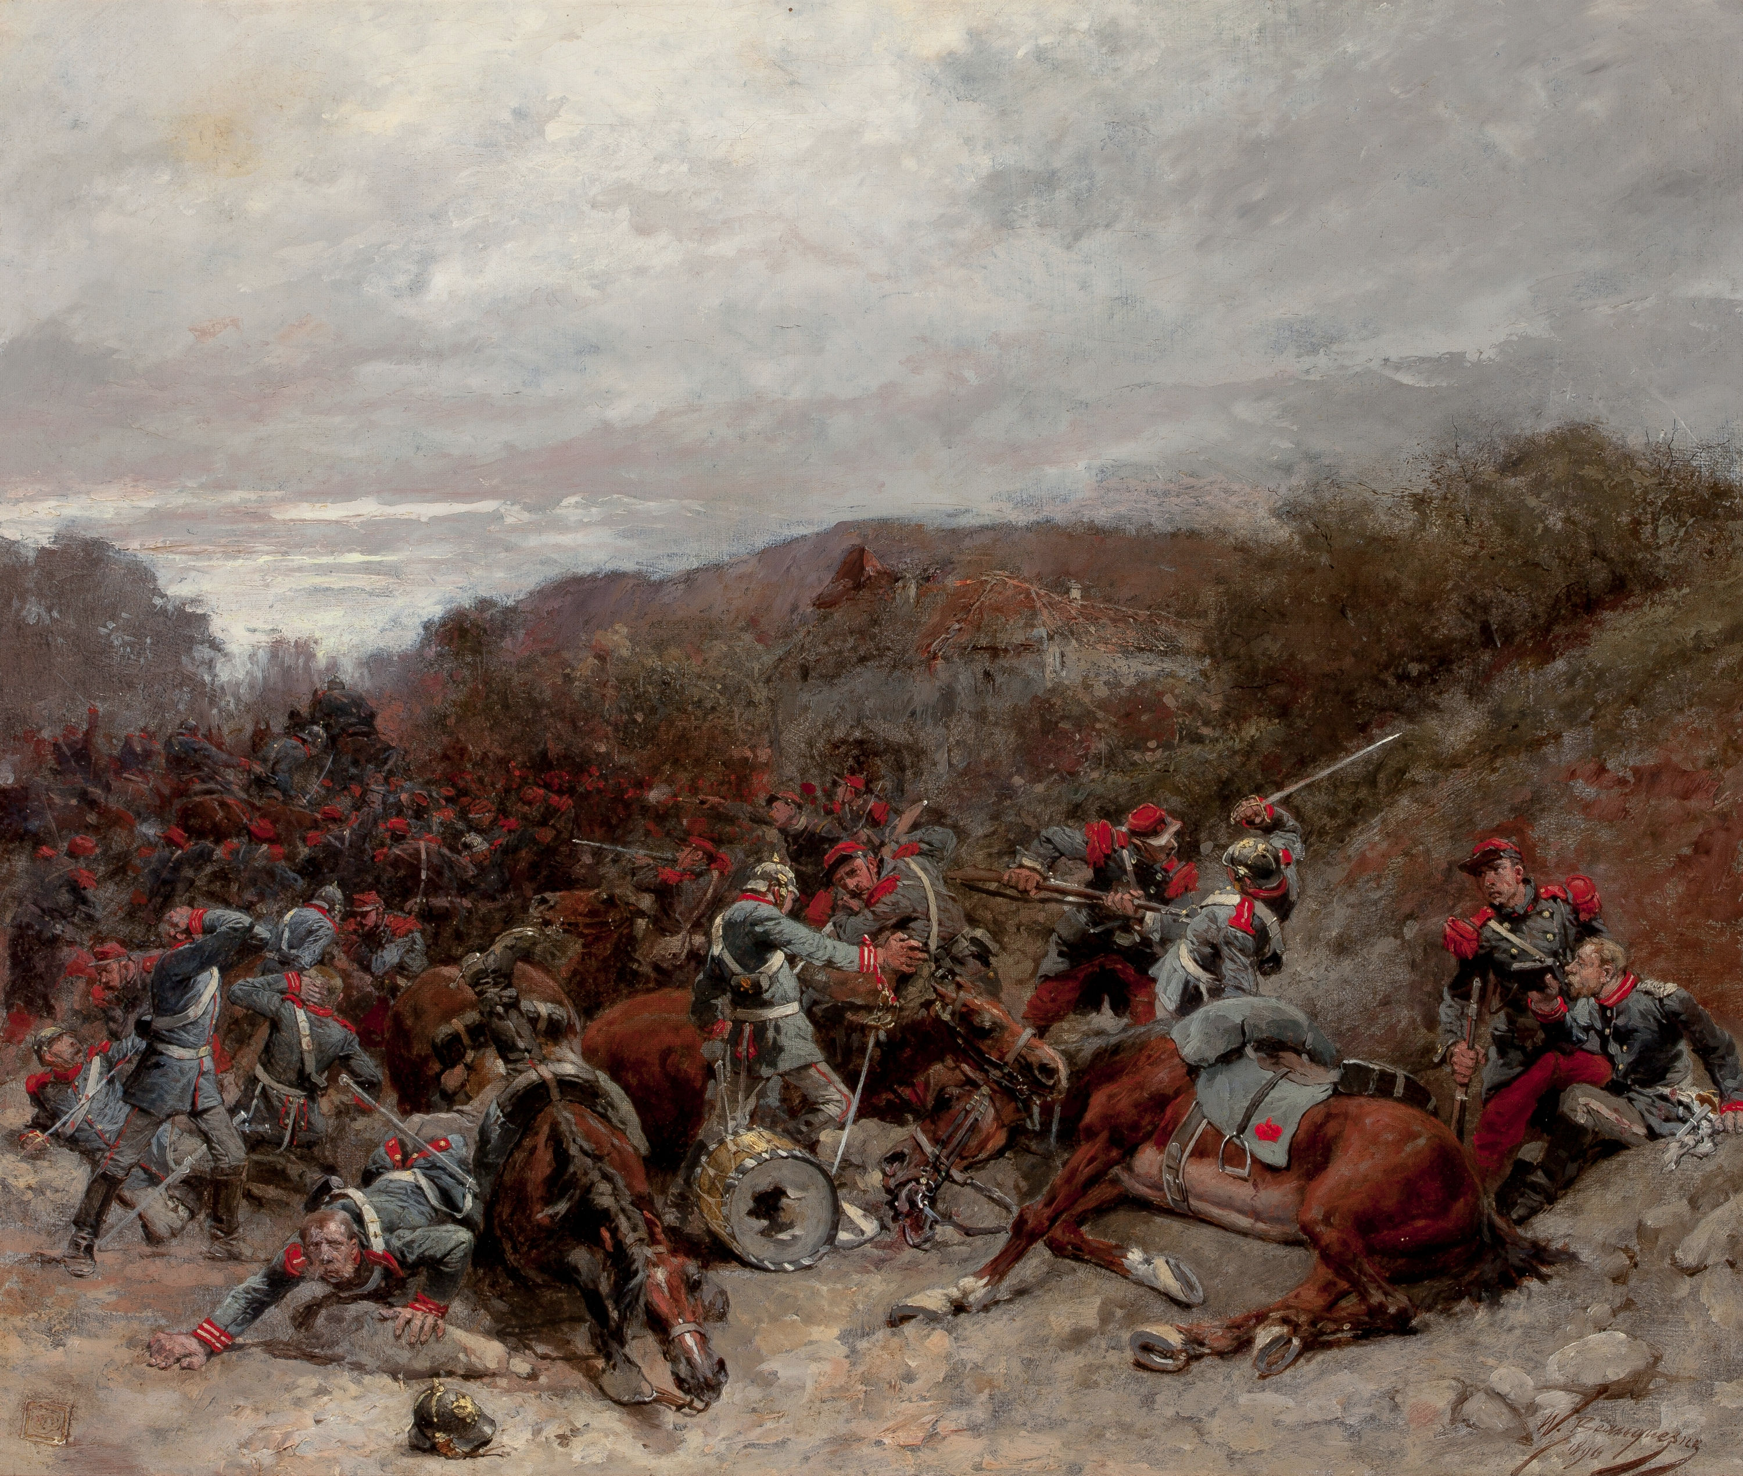
Unification and Empire
Still needed the southern German states
Franco-Prussian War
Conflict with France
Disputed territory of Alsace and Lorraine
Peace treaty established a unified German empire

Slide 22
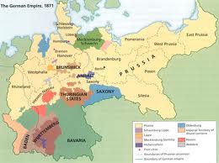
The Empire
Established the Second Reich
Government took a federalist form
Power shared between 25 states and national gov.’t
Limited the influence of the church
Economic Growth
Social Reforms

Slide 23
Nationalism: Unrest in Russia

Slide 24
Main Idea
In the 1800s and early 1900s, Russians rebelled against the absolute power of the czar and demanded social reforms.

Slide 25
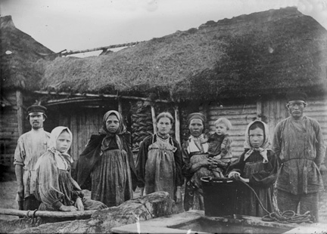
Government and Society
Mainly agricultural
Not industrialized
Mostly serfs
Agricultural workers considered part of the land on which they worked

Slide 26
Government and Society
Autocracy
Government by one ruler with unlimited power
Czar
Russians wanted more freedoms and more democracy
Czars resistant to reforms, which led to revolts

Slide 27
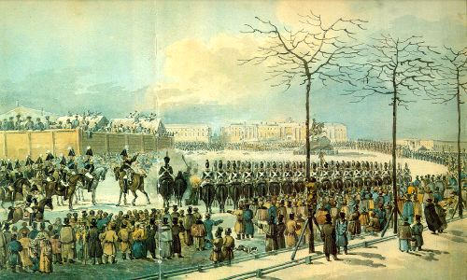
Reform and Repression
Decembrist Revolt
Group of revolutionaries, mostly military officers
Refused to declare allegiance to new czar
Failed – many captured and sent to Siberia

Slide 28
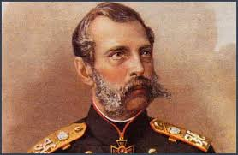
Reform and Repression
Loss of Crimean War showed how far behind Russia was in technology and industry
Czar Alexander II
Began a series of reforms
Frees serfs
New judicial system
Organized military

Slide 29
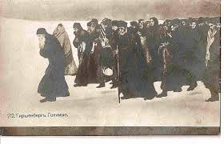
Reform and Repression
Czar Alexander III
Ended the reforms
Pogroms
Widespread violent attacks on the Jews
Killing them and destroying property
2 million Jews flee to America and Europe

Slide 30
Reform and Repression
Trans-Siberian Railroad

Slide 31
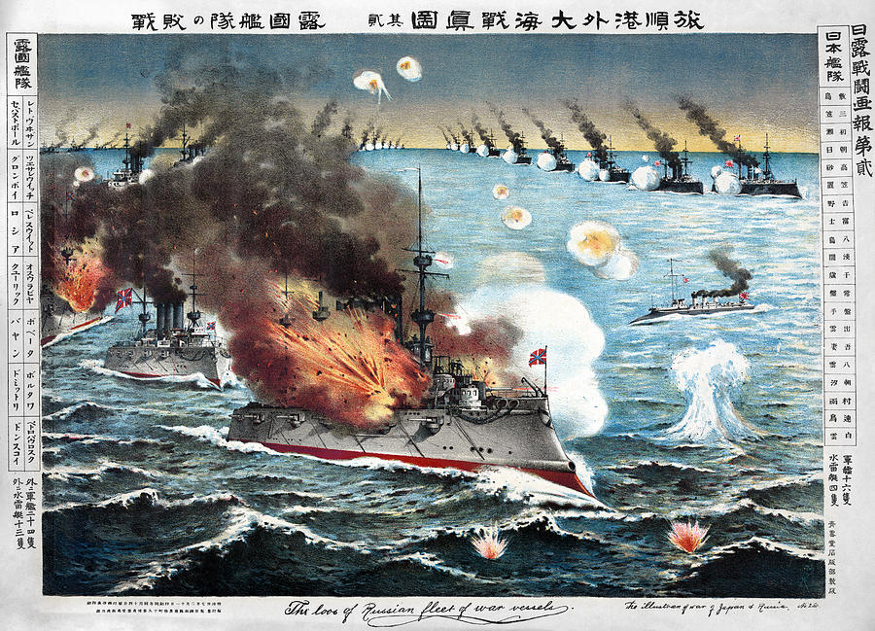
War and Revolution
Russo-Japanese War (1904)
Japan building an empire in the east – sees Russia as a threat
Defeat shocks Russians
Growing unrest & calls for change

Slide 32
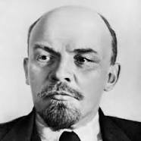
War and Revolution
Marxists
Socialist republic
Society in which there would be no private property
State would own and distribute goods
Vladimir Lenin

Slide 33
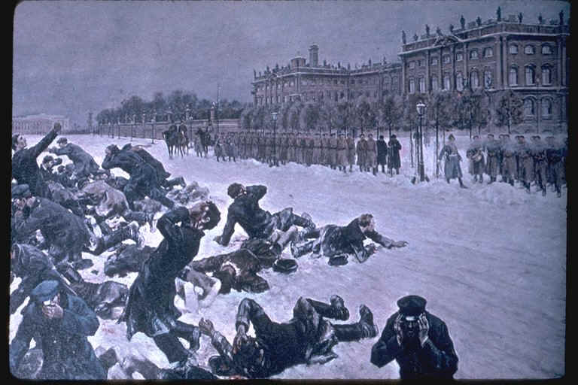
The Revolution of 1905
Protestors bring a list of demands to Winter Palace
Bloody Sunday
Troops fired at the groups – killing hundreds killed
Inspired many to rise up against the czar

Slide 34
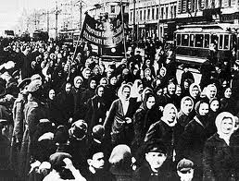
The Revolution of 1905
Rebellions break out across Russia
Workers go on strike
Students protest
Peasants rebel against landlords

Slide 35
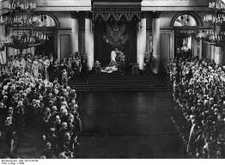
The October Manifesto
Czar Nicholas II issues the October Manifesto
Official promise for reform
More democratic government
A constitution
Individual liberties
Duma
Elected assembly that would approve all laws

Slide 36
Russian Revolution of 1905: Causes
The slow pace of reforms by Russia’s czars
Desire for better living conditions and freedoms
The growth of revolutionary groups

Slide 37
Russian Revolution of 1905: Effects
Nicholas II issues October Manifesto promising some reforms, Duma as representative body
Political parties and voting rights are allowed, but czar maintains absolute power

