Slide 1
The New Frontier and the Great Society: Kennedy and the Cold War

Slide 2
Main Idea
President Kennedy continued the Cold War policy of resisting the spread of communism by offering to help other nations and threatening to use force if necessary

Slide 3
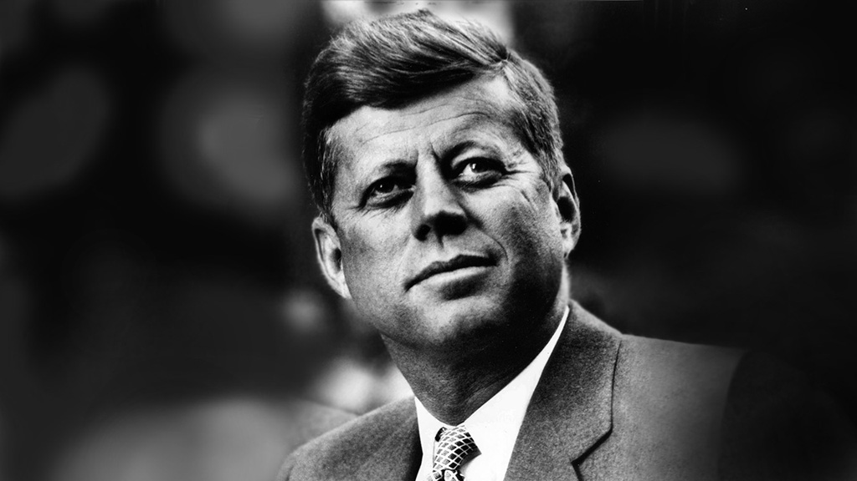
Kennedy’s Election
John F. Kennedy
From a wealthy, politically powerful family
Good looking, young, and comfortable in front of the television cameras
People felt Kennedy represented the future

Slide 4
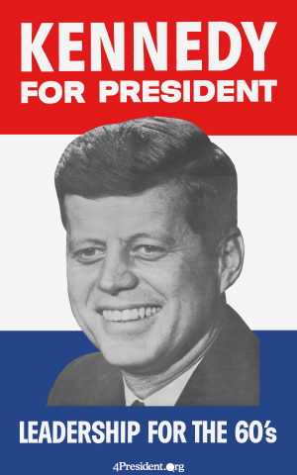
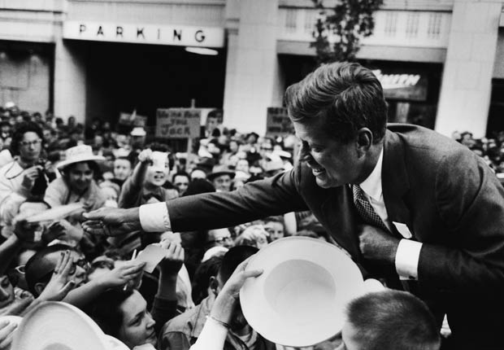
Kennedy’s Election
Election of 1960
Adopted the term “new frontier”
Played on the nation’s Cold War fears
Claimed the nation’s prosperity was not reaching the poor
Rallied the African American vote

Slide 5
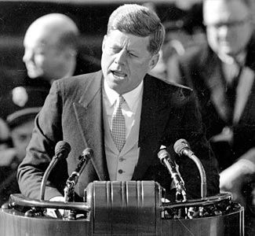
Kennedy Takes Office
Focused on change
Strong anti-Communist tone
*

Slide 6
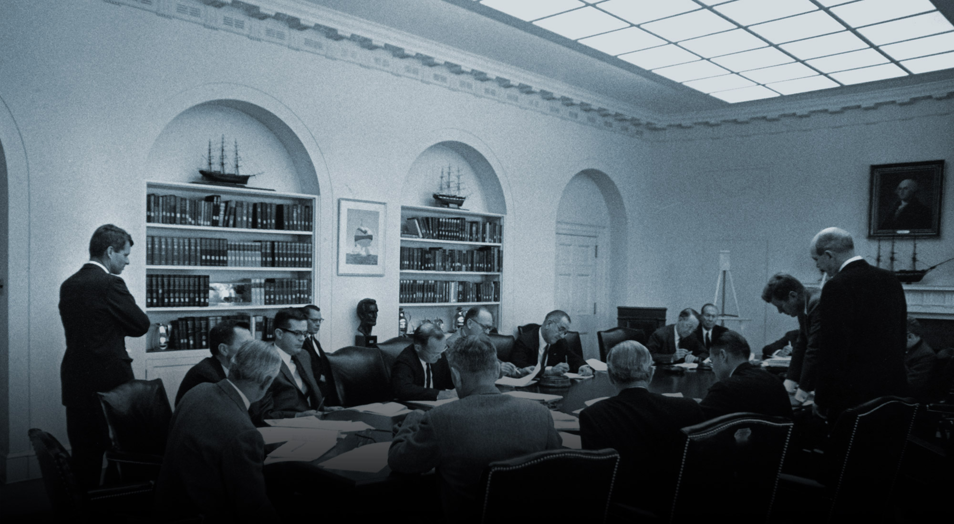
Kennedy Takes Office
JFK surrounded himself with some of the “best and the brightest” as his advisors
Robert “Bobby” Kennedy
Robert McNamara

Slide 7
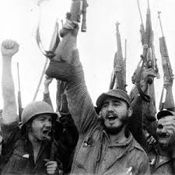
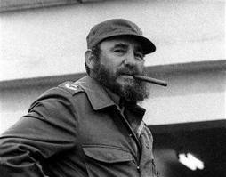
Bay of Pigs Invasion
1959 – Fidel Castro overthrows Cuba’s dictator
Establishes a Communist government
U.S. worried – only 90 miles away from U.S.

Slide 8
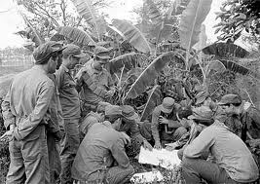
Bay of Pigs Invasion
Bay of Pigs invasion
U.S. wanted to overthrow Castro
Secretly trained an invasion force of Cubans
Hoped would start a massive Cuban uprising
Quickly defeated

Slide 9
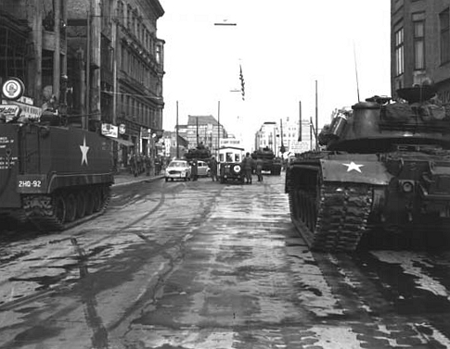
The Berlin Crisis
U.S.S.R. demanded that the U.S. recognize East Germany as an independent Communist nation
Many East Germans fled to West Germany
Kennedy sent troops into West Germany and waited for Khrushchev’s next move

Slide 10
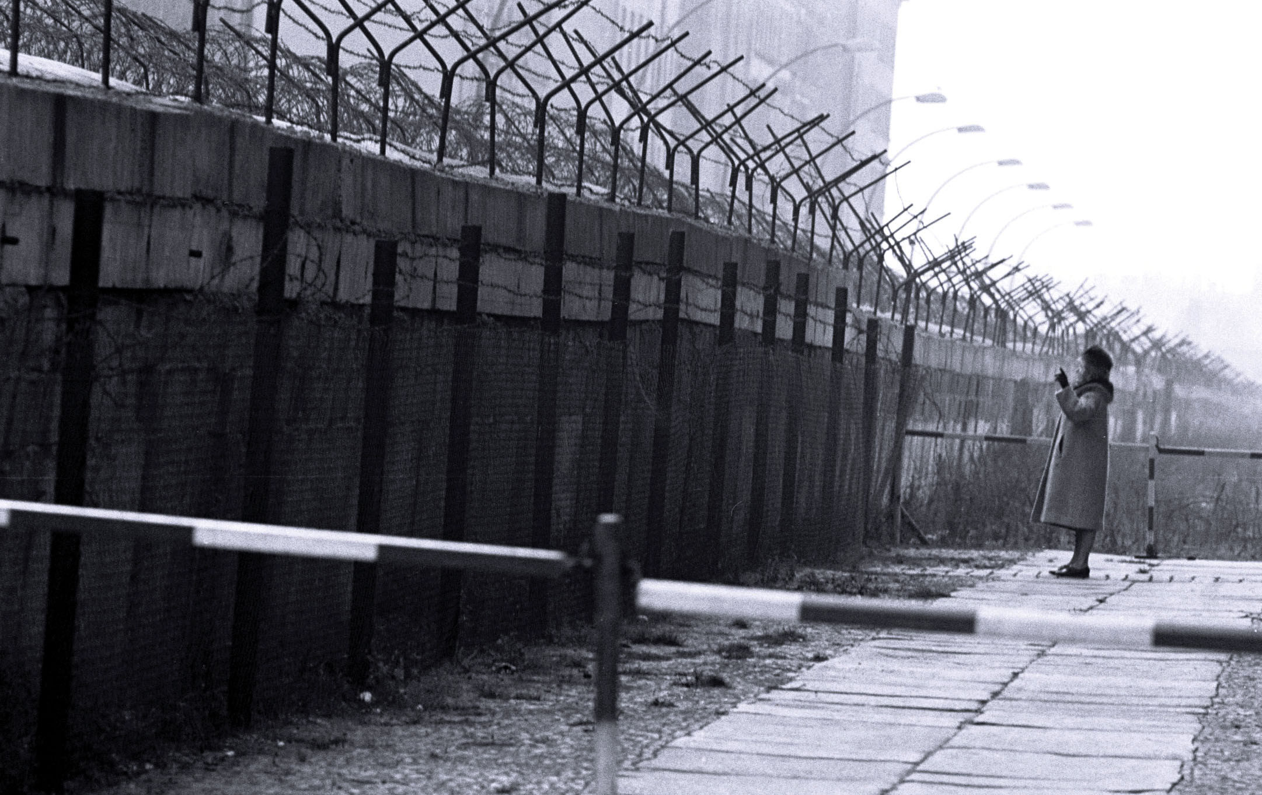
The Berlin Crisis
The Berlin Wall
August 13, 1961, Khrushchev closed the crossing points between East and West Berlin
A high concrete wall was built to prevent further escapes

Slide 11
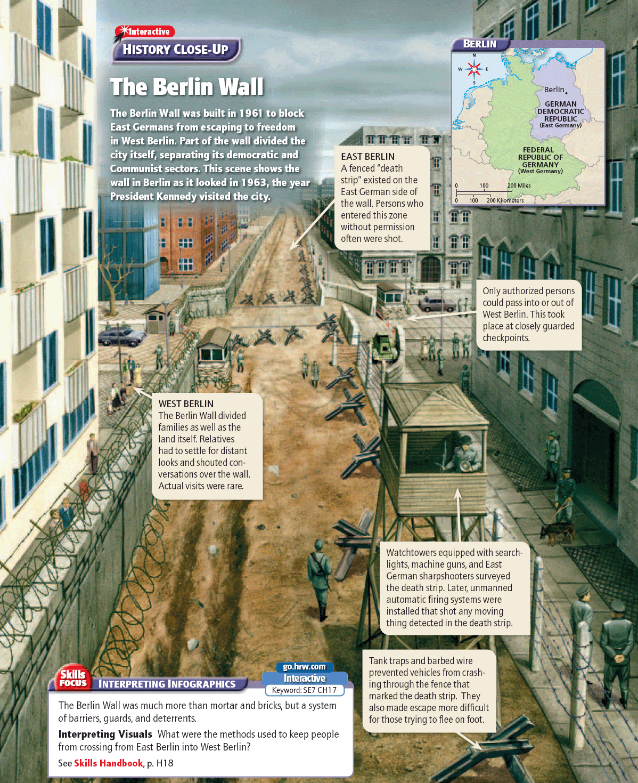

Slide 12
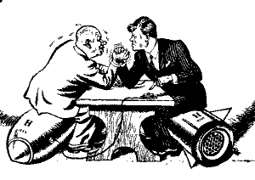
The Cuban Missile Crisis
U.S. actions in the Bay of Pigs and Berlin encouraged hard-line leaders in the Soviet Union
Soviets worried about another invasion of Cuba and U.S. nuclear missiles in Turkey
Kennedy worried about appearing “soft on communism.”

Slide 13
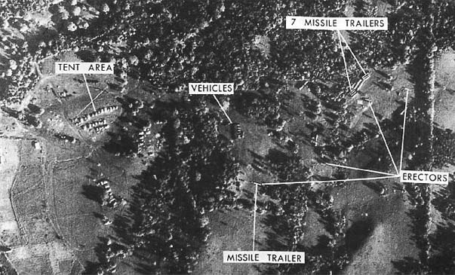
The Cuban Missile Crisis
Crisis Begins
U.S. U-2 spy plane detected Soviet surface-to-air missiles (SAMs) in Cuba
Provided first solid evidence Soviets lied

Slide 14
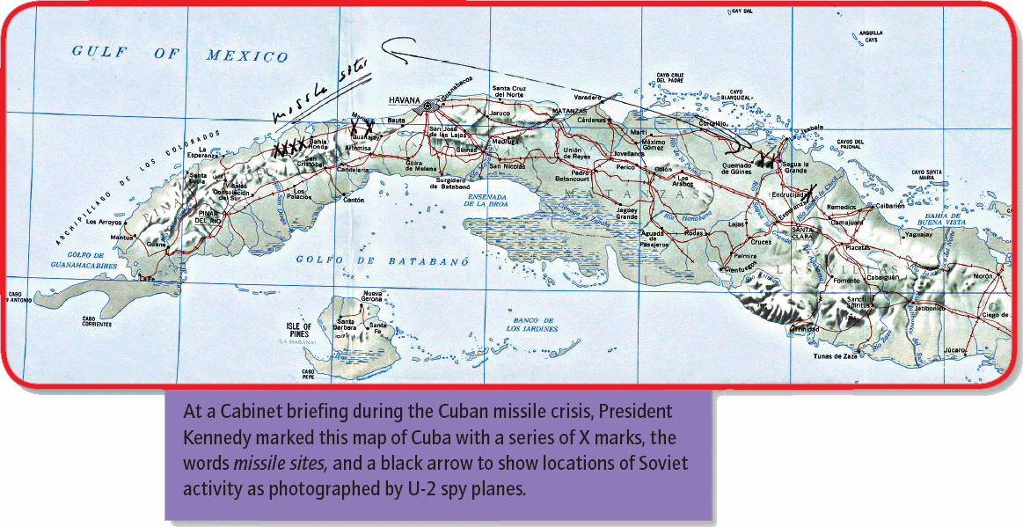

Slide 16
The Cuban Missile Crisis
Kennedy assembled a group of advisors, known as the ExComm, to help him plan a response
Split between doves (blockade and negotiations) and hawks (military attack)

Slide 17
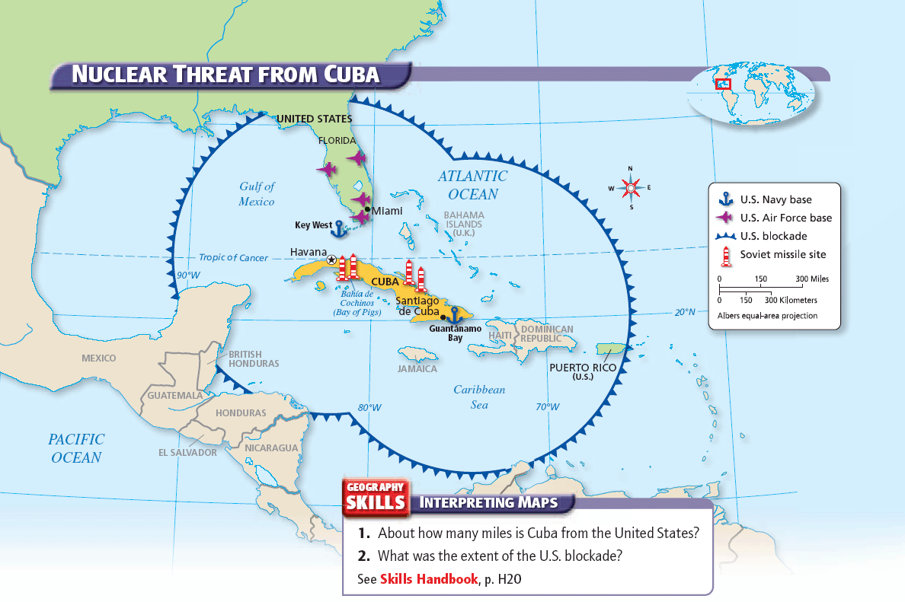

Slide 18
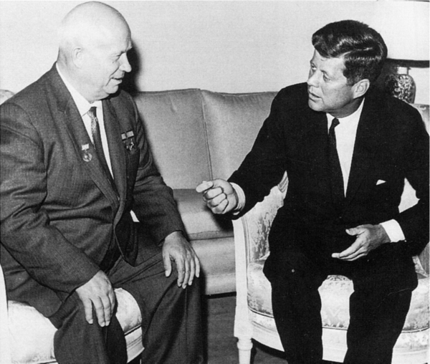
The Cuban Missile Crisis
Effects of the Crisis
Soviets remove missiles in Cuba
U.S. removed missiles in Turkey and promised to not invade Cuba
The Limited Nuclear Test Ban Treaty
-end testing of nukes in atmosphere

Slide 19
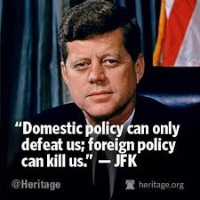
Kennedy’s Foreign Policy
Believed in peace that did not have to be enforced with weapons of war
Believed in peace for Americans and for all men and women around the world

Slide 20
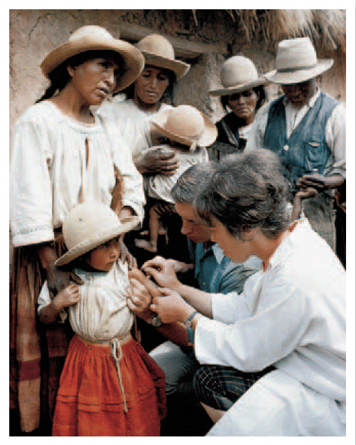
Kennedy’s Foreign Policy
The Peace Corps
Trained and sent volunteers to Africa, Asia, and Latin America to serve for two years
Increased goodwill toward the United States

Slide 21
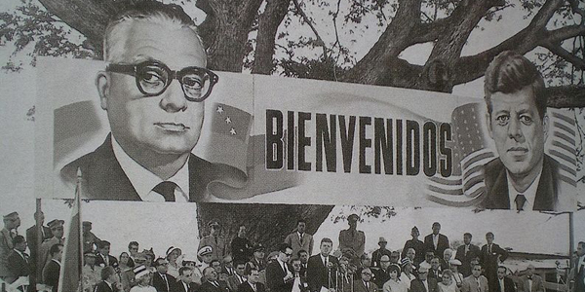
Kennedy’s Foreign Policy
Offered billions of dollars in aid to Latin America
Intended to counter communism’s influence

Slide 22
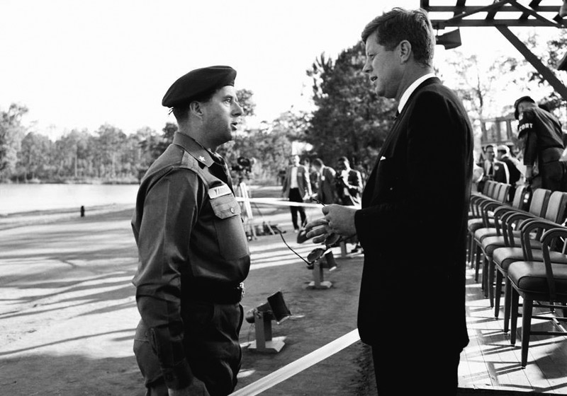
Kennedy’s Foreign Policy
He continued the nuclear arms buildup and policy of containment
Developed the strategy of flexible response
Strengthen U.S. forces so the nation would have other options than nuclear weapons in times of crisis

Slide 23
Chapter Questions
PAGE 886
1B
2B
4B
4C

Slide 24
The New Frontier and the Great Society: Kennedy’s Thousand Days

Slide 25
Main Idea
John F. Kennedy brought energy, initiative, and important new ideas to the presidency.

Slide 26
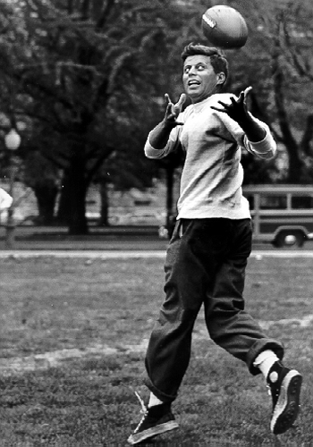
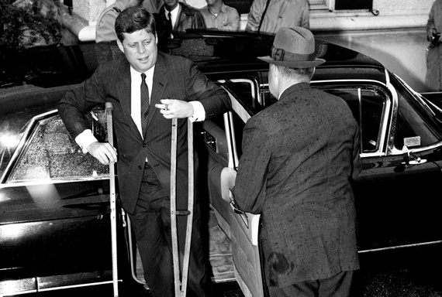
Kennedy’s New Frontier
Kennedy’s public image was often different than reality
Young & vital president
He suffered from Addison’s disease and a bad back

Slide 27
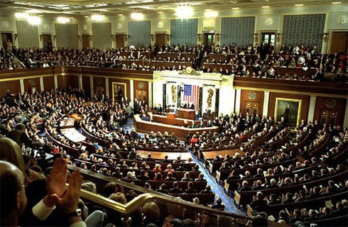
Kennedy’s New Frontier
Most in the 1960s, including Congress, not reformed minded
Didn’t approve many New Frontier proposals

Slide 28
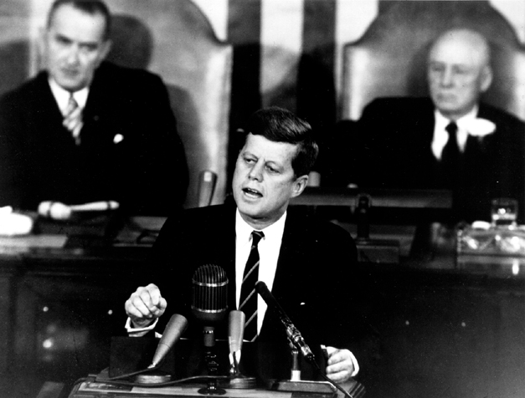
Kennedy’s New Frontier
1961 - Kennedy vowed that the U.S. would land a man on the moon *
The space race became a part of the Cold War
Symbolized the New Frontier

Slide 29
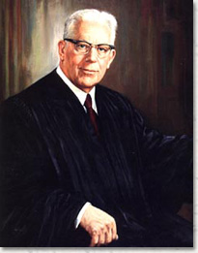
The Supreme Court in the 60s
Court rulings extended individual rights and freedoms
Voting-rights reform
The rights of the accused
Religious freedom
Chief Justice Earl Warren

Slide 30
The Warren Court
Brown v. Board of Education (1954)
Mapp v. Ohio (1961)
Gideon v. Wainwright (1963)
Reynolds v. Sims (1964)
Miranda v. Arizona (1966)
Engel v. Vitale (1962)
Baker v. Carr (1962)

Slide 31
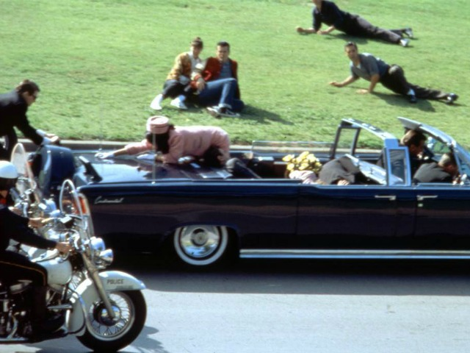
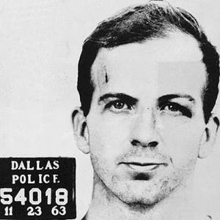
Kennedy’s Assassination
November 22, 1963 - President Kennedy was assassinated in Dallas, Texas *
Shocked the nation and the world
Lee Harvey Oswald

Slide 32
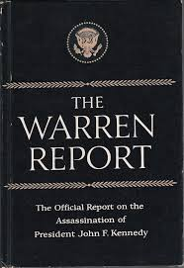
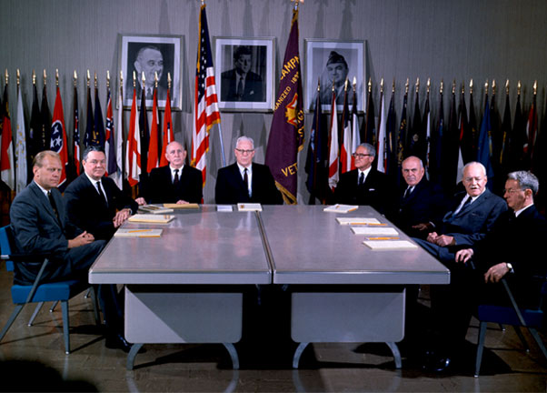
The Warren Commission
The Warren Commission
Investigated the assassination
No evidence of conspiracy

Slide 33
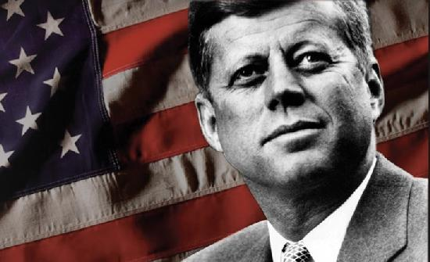
The Kennedy Legacy
Relations with the Soviet Union improved
Averted a possible nuclear war (CMC)
The Peace Corp produced goodwill toward the U.S.
Acknowledged the nation’s problems

Slide 34
Chapter Questions
PAGE 892
1A
1C
2B
3B

Slide 35
The New Frontier and the Great Society: The Great Society

Slide 36
Main Idea
President Johnson used his political skills to push Kennedy’s proposals through Congress and expanded them with his own vision of the Great Society

Slide 37
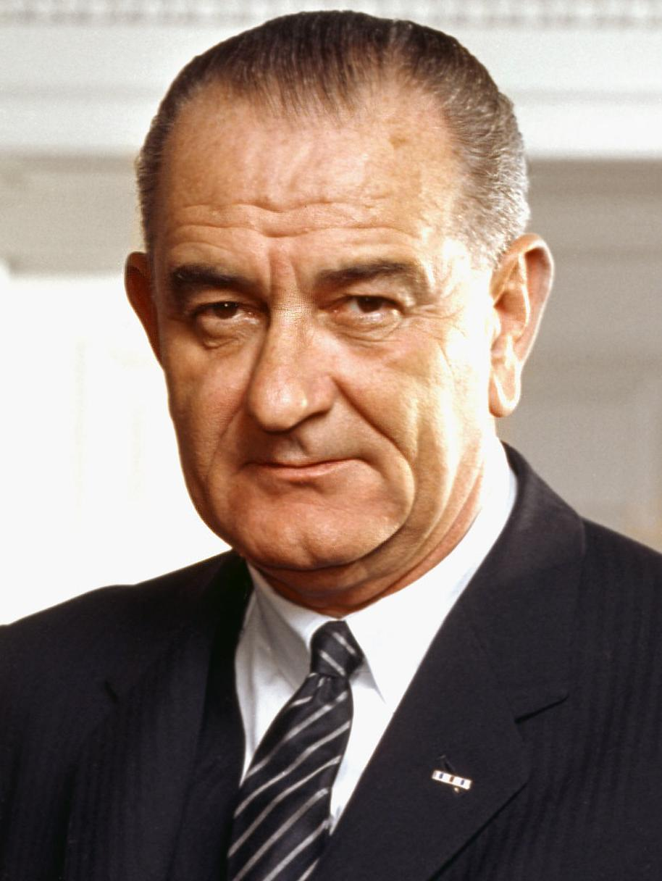
Lyndon Johnson
Hardworking and ambitious
Genuine desire to help others
Believed in an expanded role for government to make lives better

Slide 38
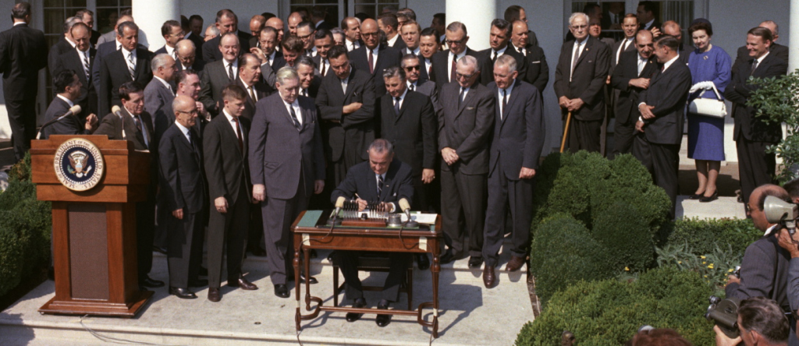
The Beginning of Johnson’s Presidency
Continue to carry on the New Frontier
Called on members of Congress to pass Kennedy’s programs
Sponsored anti-poverty programs, tax-cut bills, and civil rights legislation

Slide 39
Enacting JFK’s Agenda
War on Poverty
Economic Opportunity Act (1964)
Funded several new anti-poverty programs
The Job Corps
VISTA

Slide 40
Enacting JFK’s Programs
The Tax Reduction Act (1964)
Cut income tax rates
Helped lower-income Americans
The nation’s economy grew by more than 10 percent and unemployment declined

Slide 41
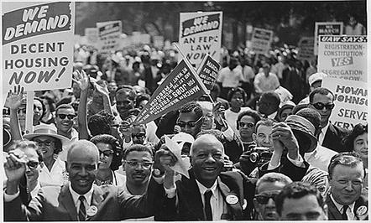
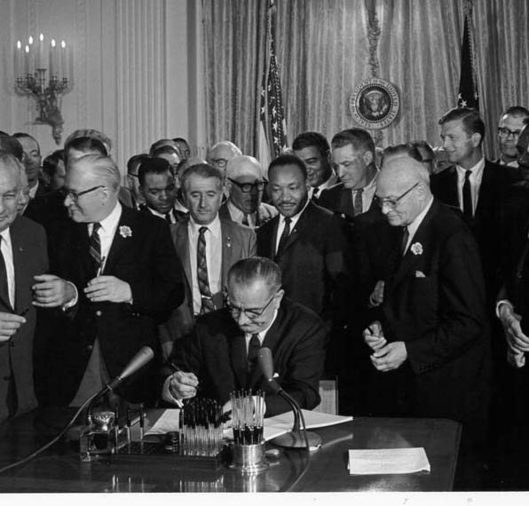
Enacting JFK’s Programs
Civil Rights Act of 1964
Outlawed discrimination in employment, housing, and public accommodations
Gave the gov.’t the right to enforce desegregation

Slide 42
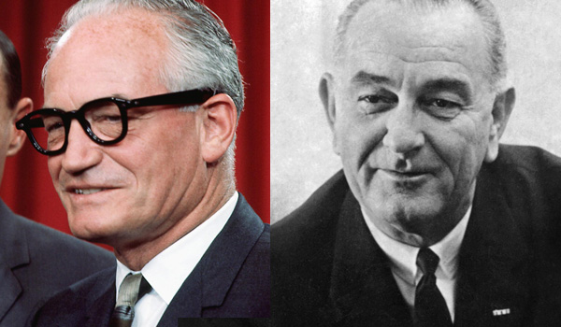
The Great Society
Johnson called his domestic programs the Great Society
Defeated Barry Goldwater (R) in the 1964 election *

Slide 43
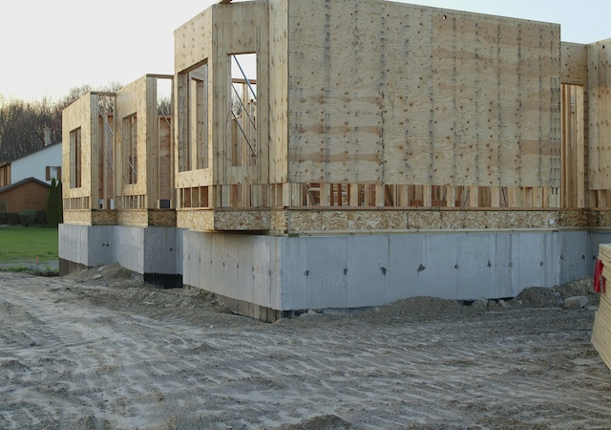
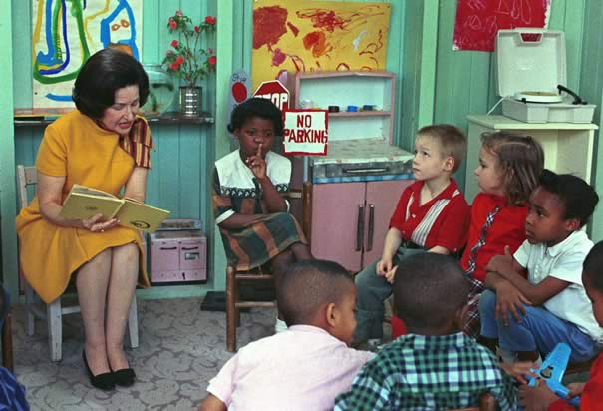
Creating the Great Society
Passed laws protecting the environment
Passed laws aiding education: Elementary & Secondary Education Act, Higher Education Act
Created the Department of Housing and Urban Development (HUD)

Slide 44
Creating the Great Society
Medicaid
Program that provides free health care for poor people
Medicare
Health care program for people over age 65

Slide 45
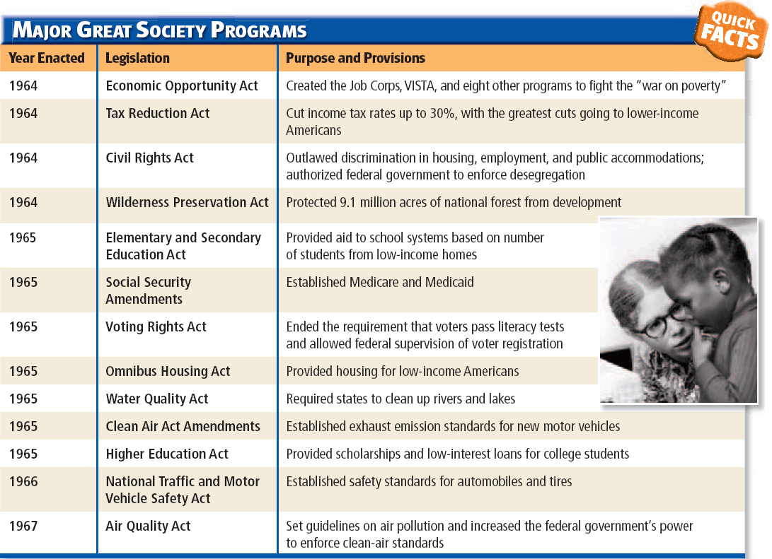

Slide 46
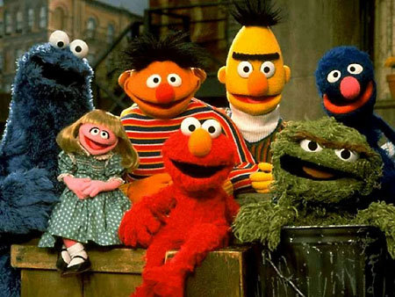
Decline of the Great Society
Members of Congress concerned about the rapid pace of reform
Republicans gained seats in both houses of Congress – which slowed down Johnson’s legislative program
Public Broadcasting Act(1967)

Slide 47
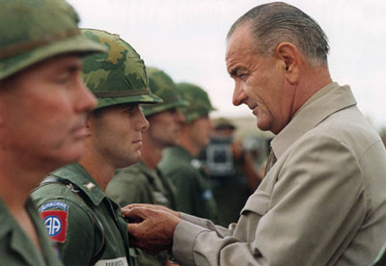
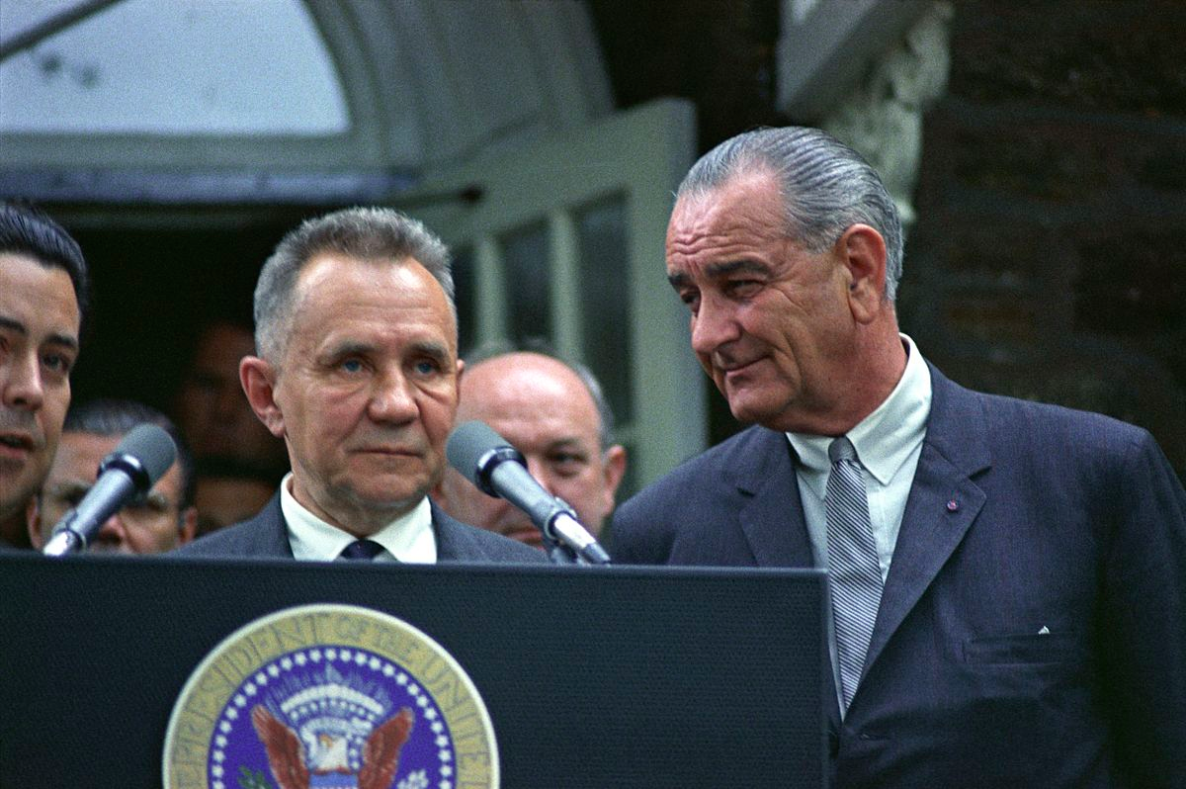
Johnson’s Foreign Policy
Wanted to end the war in Vietnam
Continued to improve relations with the Soviet Union
Johnson Doctrine
Policy dictating that if revolutions in Latin America involved communism, the U.S. would intervene

Slide 48
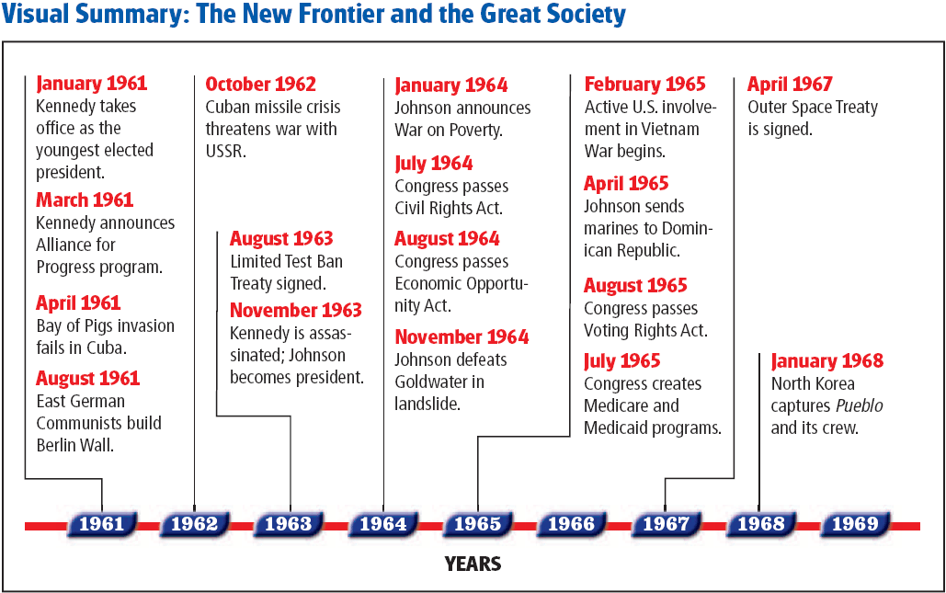

Slide 49
Click on the window to start video

