Slide 1
Financial Literacy
Part 2

Slide 2
Risk Management

Slide 3
Bellwork
What are ways people try and steal your money or identity?

Slide 4
Risk Management
Consumers receive offers almost every day that sound too good to be true.
Offers come through mail, telephone, email, and the internet.
Scam artists have one goal in mind – to get your money.
There are various types of consumer scams and fraudulent business practices. Fortunately, there are protections that exist and measures that you can take to protect yourself.
When an investment opportunity sounds too good to be true, it probably is.

Slide 5
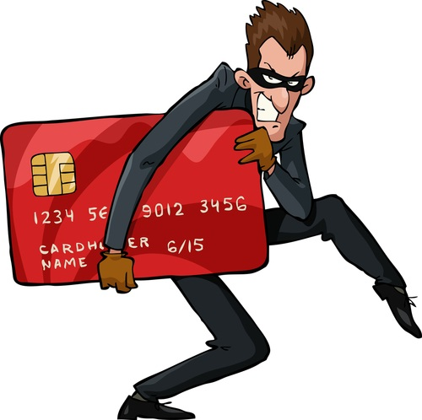
Fraud
Bait and switch
Bankruptcy fraud
Confidence trick
Embezzlement
False advertising
False billing
Forgery
Identity theft
Insurance fraud
Ponzi scheme
Security fraud
Fraud is deception by misrepresentation of material facts, or silence when good faith requires expression, resulting in material damage to one who relies on it and has the right to rely on it.
Simply stated, it is obtaining something of value from someone else through deceit.
Fraud is both a criminal act and a violation of civil law. The main distinction lies in the degree of proof required

Slide 6
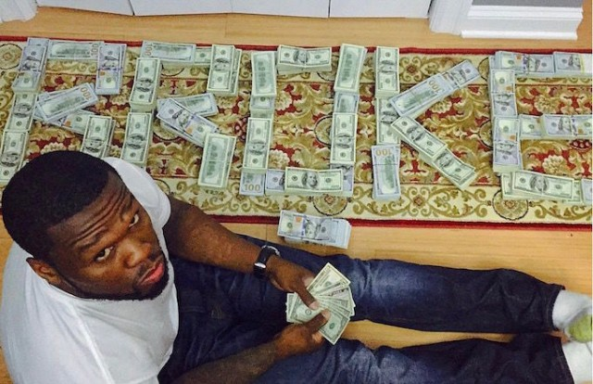
Bait and switch. Business advertises a product at a low price, but offers a more expensive product when you go to buy it. The lower priced item never existed, it was used to “bait” you.
Bankruptcy fraud. Making false claims when filing bankruptcy.
Confidence trick or confidence game. Also known as a con, scam, swindle, or scheme. An attempt to swindle you by gaining your confidence.
Embezzlement. Taking money that is not yours; may range from small amounts to large amounts taken from your employer.
False advertising. Making false claims or statements in advertising to persuade you to buy a certain product.

Slide 7
False billing. Requesting payment from someone for a product or services without fulfilling the deal; may include fake renewal notices or other seemingly legitimate services.
Forgery. Creating fake documents and signatures.
Identity theft. Stealing money or getting other benefits by pretending to be someone else.
Insurance fraud or false insurance claims. Fake insurance claims to get money from an insurance company that is not warranted.
Ponzi scheme. Promises investors abnormally high profits from the money they invest. The system is doomed to collapse because there are little or no underlying earnings from the money received by the promoter. Also known as a Pyramid scheme. http://www.youtube.com/watch?v=MW5aDmQLqVY
Security fraud. Artificially inflating the price of a stock with false and misleading statements. The goal is to sell stock that has little value at a high price.

Slide 8
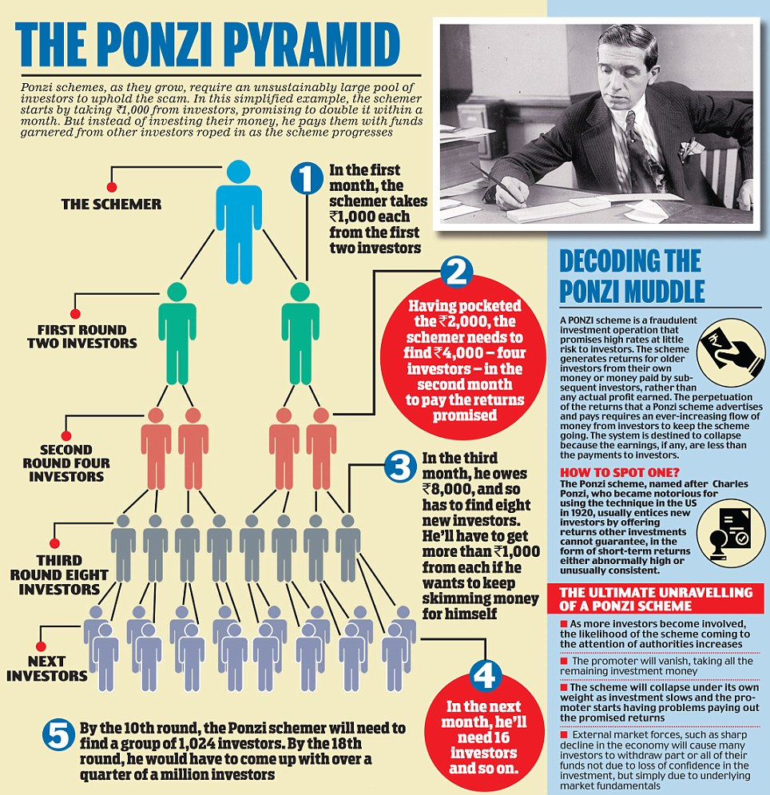

Slide 9
Identity Theft
Identity theft is one of the fastest growing crimes in the world and can be one of the most costly problems faced by consumers.
Identity theft means someone uses your personal information without your permission.
Although no one is immune from identity theft, young people are frequently targeted due to their limited experience in handling financial matters.
http://www.cnbc.com/id/101393937
http://www.consumer.ftc.gov/media/video-0023-what-identity-theft

Slide 10
Methods Used
Dumpster Diving. They simply rummage through your trash looking for bills or other paper with your personal information on it.
Skimming. They steal credit card or debit card numbers with a special device when processing your card.
Phishing. They pretend to be banks, the IRS or some other organization and send you an email or a letter (or even make a phone call) asking for personal information.
Changing Your Address. They complete a change of address card, creating a new address for you so they can receive your billing statements. Once they have the statements, they can access your account.

Slide 11
Methods Used
Stealing. They steal billfolds, purses, and even mail in your mailbox (bank statements, credit card statements, preapproved credit offers, new checks, or tax information —anything with your personal information). They may also take personnel records or bribe employees, who have access, to give them your information.
Pretexting. They use false information to get your personal information from financial institutions, telephone companies, and other sources. They pretend to be you to get the information; then they either use it against you or sell it someone else to use.
Hacking. They may hack into your computer or another computer system, including schools, credit card companies, and other places maintaining personal information.

Slide 12
Telemarketer Fraud
Phone con artists frequently know information about the person they are calling.
Sales pitches from unknown callers should always be researched before investing.
Phone swindlers are good at sounding as though they represent a legitimate business. They offer investments, describe employment opportunities, and other advantageous financial scenarios.
Fraudulent sales callers are usually
skilled liars and excellent at deceit.

Slide 13
Common telemarketer fraud characteristics
Sales pitch about little risk and high return
Demand for immediate action
No disclosure of street address
No use of U.S. mail system – use overnight delivery services
Stalling suspicious investors through letters providing numerous reasons for delay of return
Pulling a vanishing act
To protect yourself from telemarketer fraud you can add your number to the national Do Not Call Registry.
The FTC amended the rules to allow consumers to decide whether they want to receive phone calls from telemarketers.

Slide 14
Personal Protection
Most investors are at risk of becoming victims because they lack information about investment choices and are unaware of how to evaluate their investment choices.
An informed investor understands the importance of research and uses this information in their investing decisions.
You should always do research prior to investing. This includes researching and consulting a professional, contacting state securities regulator, and other various websites.
North American Securities Administrators Association
FBI Common Fraud Schemes
Internet Crime Complaint Center

Slide 15
Personal Protection
Ways consumers can protect themselves include:
Stop and think before acting
Do not disclose personal information to any non-reputable sources
Remember the person on the other end is a sales person
Study the deal and get input
Read the material about how it is supposed to make money
Read fine print
Stick to what is clearly understood
Only invest in opportunities that YOU understand
Do not sign papers before reading and understanding
Apply critical thinking skills

Slide 16
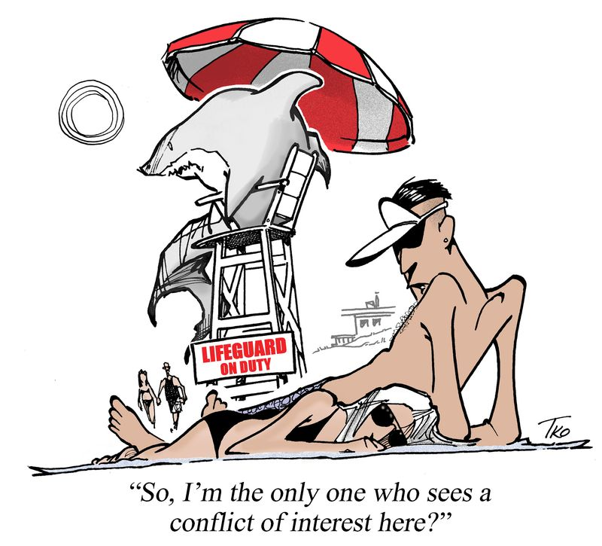
Protection
Consumer protection laws and regulations exist to protect consumers from seller and lender abuses.
Even with the regulation that provides protection, it is still the investor’s responsibility to make wise choices about the professionals with whom they work and the products they invest.
Caveat emptor ~ let the buyer beware

Slide 17
Regulatory Organizations
US Securities and Exchange Commission
Financial Industry Regulatory Authority
National Futures Association
North American Securities Administrators Securities Association to locate NC’s state securities agency information
Find out the following information for each regulatory agency
1. When and how organization established
2. Primary regulatory responsibilities of agency
3. What information does this organization require to file a complaint?
4. Where is the closest office located?

Slide 18
http://www.youtube.com/watch?v=z9vfcCmh7Qk&feature=youtu.be

Slide 19
Insurance Against Hardship

Slide 20
Bellwork
Why do you need insurance?

Slide 21
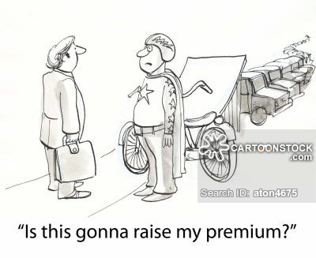
Insurance Protects You
Insurance is a system of spreading risks over large numbers of people. These people each pay a small amount to an insurance company to avoid the risk of a large loss.
The amount you pay for this protection is called a premium.
The contract that gives your this kind of protection is called an insurance policy.
If you want your insurance to cover the cost of something, you file an insurance claim.

Slide 22
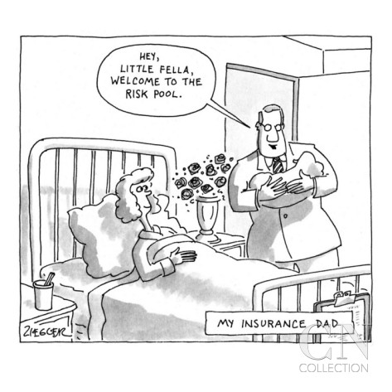
Insurance Protects You
Insurance companies can only take small amounts of money from people, yet pay them large sums of a hardship occurs because not every has a hardship.
A large insurance company has millions of policyholders who pay their premiums regularly.
Part of this money goes into a reserve fund.
Claims are paid from the reserve fund.
The voluntary insurance that individuals and companies pay to cover unexpected losses is called private insurance.

Slide 23
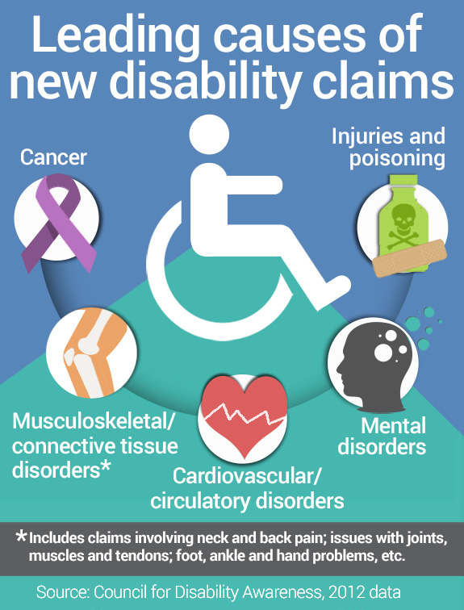
Types Insurance
Life Insurance
The main purpose is to provide the policyholder’s family with money if he or she dies.
The person that would receive the money is called the beneficiary.
Disability and Health Insurance
Disability insurance provides payments
to replace lost wages when the policyholder
cannot work
Health insurance covers medical or
hospital expenses

Slide 24
Types of Insurance
Property and Liability Insurance
Protect your property and potential liability
Car insurance
Homeowner’s insurance
Travelers insurance
Covers costs that could otherwise be out-of-pocket expenses including trip cancellation, some medical expenses, or stolen luggage.
Renters Insurance
Provides insurance for personal property and potential liability
Malpractice Insurance
Lawyers, doctors, fitness professionals, etc. in line of work

Slide 25
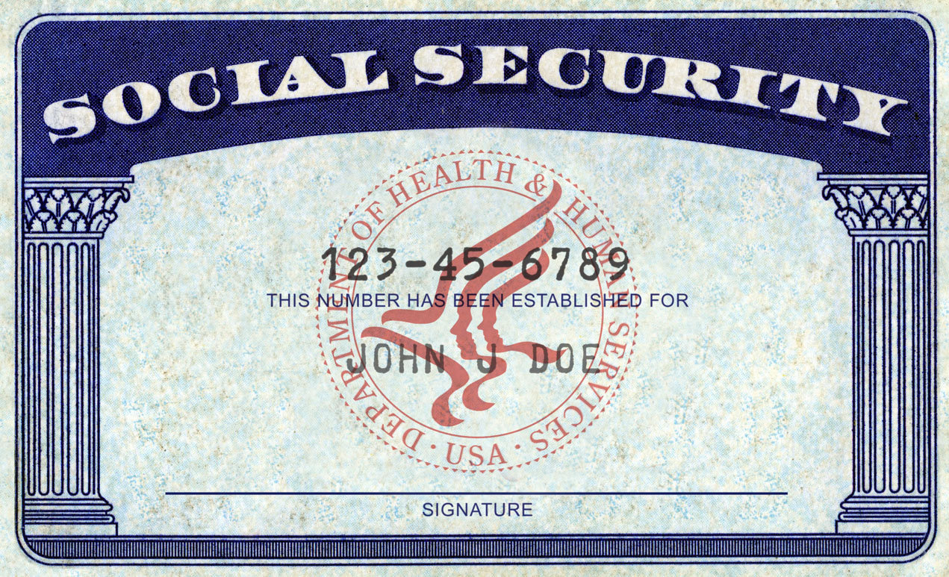
Government Programs
Government programs that are meant to protect people from future hardship are called social insurance.
The Social Security Act of 1935 set up a system of social insurance known as Social Security.
People pay a percentage of their salary each month while they work in order to receive benefits later.
Each person and his or her employer contribute to the fund.
Contributions are compulsory
Unemployment
Workers’ Compensation
Medicare and Medicaid

Slide 26
Estate Planning
Wills
Wills determine where your property goes when you die based upon your decisions.
If you do not have a will then state law determines where your assets will go.
General Power of Attorney
Selects an individual to make financial decisions if you lack sufficient mental capacity.
Living Will
You make end of life decisions ahead of time so family members do not have to make the decision.
Health Care Power of Attorney
Selects an individual to make heath care decisions if you are unable to.

Slide 27
Bellwork
What factors effect your credit score?

