Slide 1
Financial Responsibility

Slide 2
Bellwork
What is Economics?

Slide 3
Economics
In order to be a well-informed citizen, it is essential to have a good understanding of economics and the American economic system.
The choices we face are based on the fact that we do not have enough productive resources to satisfy all of our wants and needs.
Economics is the study of how we make decisions in a world where resources are limited.
The study of economics will help us think about the process of making decisions.

Slide 4
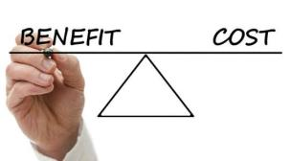
Life Decisions
The choices that people make have benefits, costs, risks, and future consequences.
Benefits: a good or helpful result
Costs: cost of the next best use of your time or money when you chose to do one thing rather than another
Risks: higher expenditures than expected
An individual’s financial plan and goals are affected by many different factors.
These factors include: education, income, career, and life choices.

Slide 5
Life Decisions
An individual’s actions affect them through both intended and unintended consequences.
A person’s choices will frequently include tradeoffs.
Tradeoff: the alternative you face if you decide to do one thing rather than another.
Such decisions include:
Job – white collar/blue collar
College/university/community college
Workforce/military
Rent/mortgage
An individual’s attitude and values also affect financial decisions.

Slide 6
Life Decisions
A person’s income and wealth is mostly dependent upon the kind of human capital that they possess.
Human capital: People, including their skills, abilities, education, training, health care, and motivation, and their ability to be economically productive.
Personal values and qualifications play a large role in making career choices.
One of the most important qualifications for a job is education.
On average, the more education you have, the higher your income during your lifetime.
Educated people have demonstrated that they are able to learn and can meet the challenges of new situations.

Slide 7
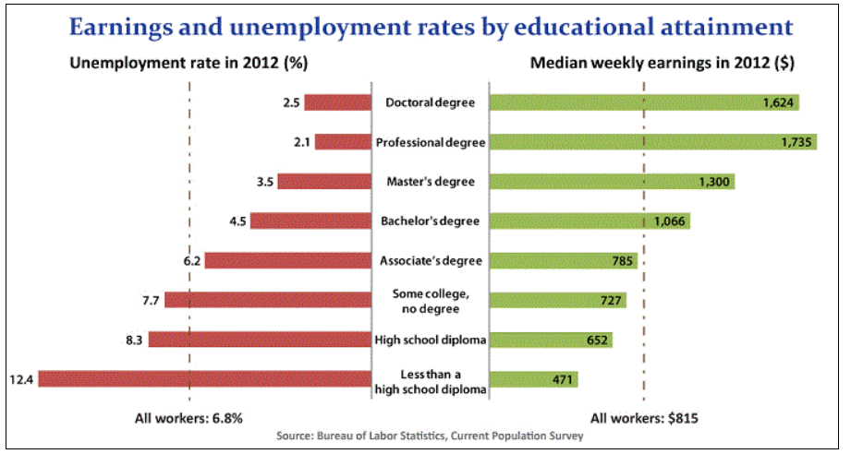

Slide 8
Budgeting
People that are fiscally responsible create and manage a personal budget.
Budget: an estimate of income and expenditure for a set period of time.
This budget should be inclusive of income, taxes, gross and net pay, fixed and variable expenses, and retirement.
Gross pay: total amount of wages earned before deductions
Net pay: amount actually paid to employee after deductions
Fixed expenses: cost the same each month
Variable expenses: expenses that change; based on daily decisions
Creating a budget requires three things:
Knowing how much money you spend
Knowing your saving goals
Managing your money

Slide 9
Bellwork
What are some factors that affect career choices?

Slide 10
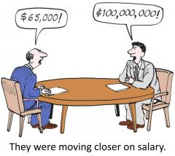
Budgeting
Your budget should balance income with expenses.
To begin you should divide your annual income into a monthly income.
Salary: a fixed compensation periodically paid to a person for regular work or services
Wage: money that is paid or received for work or services, as by the hour, day, or week
Deduct funds for fixed expenses.
Analyze variable expenses and determine whether to cut expenses or keep the same.
When creating a budget you should remember to pay yourself first.
Set money aside for future financial goals.
Should set money aside before paying other bills. This will get you used to living on a smaller budget.

Slide 11
Questions to consider…
1. What is an item that you would like to have, but can not currently afford?
2. Assuming you are starting with no money and you cannot count on anyone else to simply give it to you, how will you go about saving enough for the item?
3. How long do you think it will it take you to save enough money to buy the item?
4. What are some other expenses you need to consider while saving up? Will you make any sacrifices?

Slide 12
Financial Planning
Financial planning is a process of setting goals, developing a plan to achieve them and putting the plan into action.
The first part of financial planning requires goal setting.
Goal-setting with regard to financial planning involves thinking about what things one needs and wants in the short, intermediate, and long-term
Short (within one year)
Intermediate (1 to 5 years )
Long (over 5 years)

Slide 13
Wants vs. Needs
Examples of wants include…
Examples of needs include…

Slide 15
Financial Planning
Analyze information
Find out where your finances currently stand, so you can see how much money you are receiving, spending, and saving.
Make decisions
Personal spending record
Opportunity cost
Create and implement a plan
Monitor and modify plan

Slide 16
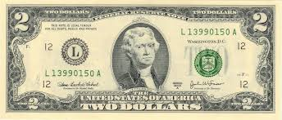
Currency
Currency is another term for coins and money.
All currencies share three common features:
Must be easy to carry
Must be durable
Must be made in a standard form and must be considered legal tender by the government that issues it.
Today, currency used in America is issued by the federal government.

Slide 17
Banking System
Most people rely on banks for checking and savings accounts.
Properly managing a checking and savings account can contribute to financial well being.
Why might people want to open a checking and/or savings account?
Safety
Convenience
Budgeting
Proof of payment
Interest

Slide 18
The Banking System
Checking Account
Do not usually earn interest
Can easily access the money in these accounts
Money is called a demand deposit
May have a monthly maintenance fee
Savings Account
Accounts will earn interest
Compounded interest - interest calculated on the initial principal and also on the accumulated interest
Can easily access money in these accounts
May limit the number of monthly transactions
May require a minimum balance

Slide 19
Banking Transactions
Deposit: Putting money into a bank of investment account.
Can use deposit slip at the bank
Can also be done automatically
Withdrawals: taking money from the account
Use ATM card or in person at the bank
Transfers: transfer money from one account to another
Automated transactions: occur without manual assistance
Fees: Amounts to be paid in connection with account
Maintenance fees
ATM withdrawal fees
Paper statement fees
Overdraft fees

Slide 20
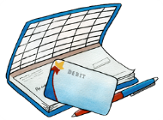
Checks and Debit Cards
Today, most people do not use coins or paper money for the majority of their purchases. Most people make payments by check or debit card.
A check is a piece of paper; it is not legal tender because it is not guaranteed by the federal government. One must have a bank account and enough money to cover the expense to write a check.
Writing a check is like a binding contract that you agree to pay the listed amount.
http://www.themint.org/teens/writing-a-check.html
Debit cards are like electronic checks. Instead of writing out a check in the store, you can give the cashier your debit card.
Can keep track of checking account through use a check register or online banking.

Slide 22
Exit Ticket
Think about your financial goals.
List one short-term, intermediate-term, and long-term goal on your index card.
Also provide at least one method of meeting EACH goal.

Slide 23
Select a lifestyle

Slide 24
Bellwork
How does your career choice effect your college choice?

Slide 25
Bellwork
What happens if you do not follow your budget?

Slide 26
Bellringer
How does gaining sudden wealth lead to people becoming broke?

Slide 27
Credit
Sometimes a consumer may want to make a purchase but does not have enough cash in his or her bank account.
Buying something on credit means that a person is able to buy something now with the promise to pay for it later.
Credit means someone is willing to loan money—called principal—in exchange for your promise to repay it, usually with interest.
Interest is the amount you pay to use someone else’s money.
Credit is a loan of money that is repaid plus interest.

Slide 28
Credit
Credit is a basic financial tool and if used properly can help the consumer
Types of loans include credit cards, mortgages, student loans, etc.
Loans payable over long periods of time are called long-term credit. If a family plans to pay for an item within a few weeks, they only need short-term credit.
LT: House, cars, and other expensive purchases
Typically loans for at least 5 years
ST: emergency purchases

Slide 30
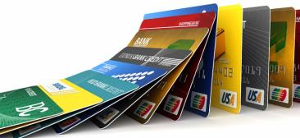
Credit Cards
Credit cards are issued by banks and other lending institutions.
A credit card can be used almost anywhere. You present the credit card when making a purchase and the store charges the credit card company. The credit card company pays the store and sends you a monthly bill.
The customer pays all or part of the bill once a month. Interest charges, which can be quite high, are added the unpaid portion of the monthly bill.

Slide 32
Credit Cards
Credit cards, if used unwisely, can cause serious financial damage.
A person might buy so much on credit, that he or she can not afford to make the payments on time.
Often the lender has the right to charge a penalty and to raise the interest rate after missed payments.
Compounded interest as it relates to debt is not favorable.
One may be sued for the outstanding balance, or may have to declare bankruptcy.
Bankruptcy: legal proceeding involving a person or business that is unable to repay outstanding debts.

Slide 33
Good debt vs. Bad debt
Most people are unable to live without any debt. The majority of people are unable to pay in cash for homes and cars.
Good debt can include anything you can not afford to buy without wiping out all cash reserves. However, make sure you can afford the monthly loan payment.
Buying a home
Paying for college
Bad debt includes going into debt for things you do not need. Credit card debt is the worst type of debt because it frequently has the highest interest rate.

Slide 34
Credit
Having a good credit score can help you get a better interest rate on your mortgage or other long term loans.
Some loans require collateral
Collateral: something pledged as security for repayment of a loan, to be forfeited in the event of a default.
When obtaining a loan, the Annual Percentage Rate (APR) is the best indicator of the cost a loan.
APR: rate that is charged for borrowing expressed as a single percentage number that represents the actual yearly cost of funds over the term of a loan.
Calculation is determined by the Truth in Lending Act
By law, credit card companies and loan issuers must show customers the APR to facilitate a clear understanding of the actual rates applicable to their agreements.

Slide 35
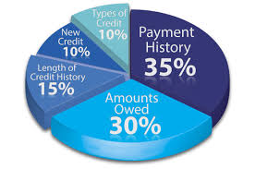
Credit
A credit report is a record of one’s financial transactions.
A credit report contains your credit payment history, loan amounts, credit you have, and identification information such as your name, addresses, and year of birth.
You can obtain a free credit report each year through annualcreditreport.com
A credit score is a score compiled by lenders to determine your creditworthiness
Credit scores are used for lending money and typically range from 300-850. The higher your score, the less risk you represent to lenders and the more favorably they’ll view your application.
Proper use of a credit card and payment of bills can help establish a good credit score.
Your credit score can be hurt by making late payments, bouncing checks, and having many credit cards and loans.

Slide 36
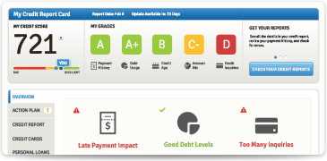

Slide 37
Credit
Rewards
Risks

Slide 38
Bellringer
What are some risks and rewards associated with credit?

Slide 39
Consider…
“It takes money to make money”
What does this saying mean?
What are some ways to turn $100 into $200?

Slide 40
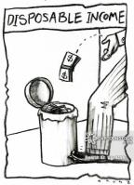
Disposable v. Discretionary
Disposable and discretionary income are tools used to analyze the spending habits of individuals and families.
Disposable Income
Income that is left after tax deductions
Similar to net pay
Discretionary Income
The amount of an individual's income available for spending after the (necessary) essentials (such as food, clothing, and shelter) have been taken care of

Slide 41
Saving and Investing
A financial investment plan is blueprint that allows a person to live within their income, identify financial priorities, and invest and save for the future.
Pay yourself first
Short term goals are those to be reached within a year. These can include paying off a credit card, saving a new TV, or building a holiday gift fund.
Average term goals are usually within the one to five year range, such as saving and investing for a first home, college expenses, and starting a family.
Long term goals are those that may not be reached for five-to-ten or more years and may include financing a new business or saving for retirement.

Slide 43
Saving v. Investing
Saving is what people often do to meet shorter term goals. Money is put aside for use later, but is accessible when it is needed.
Investing is what people do to meet longer-term goals. Money is put aside for use far into the future and is typically not accessible for a specified period of time.
Investing involves a higher degree of risk than saving because there is no guarantee that money invested will grow. However, investments have the potential to grow.

Slide 44
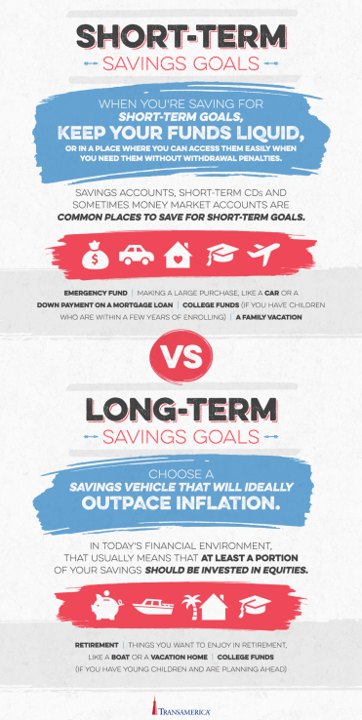

Slide 45
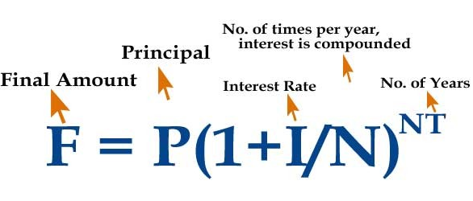
Compound Interest
Compound interest is interest calculated on the initial principal and also on the accumulated interest of previous periods of a deposit or loan.
The Rule of 72 allows you to make a quick estimate of the amount of time it will take to double your money.
Formula: 72/ Interest Rate
Example: $10,000 @ 6% Interest = 12 years to double investment
Formula for compound interest

Slide 48
Saving and investing
Saving and investing are basic ways of preparing for one’s future financial goals and financial security.
There are different methods of saving and investing. There are also different risks and benefits to various investments.
Investment strategies differ in their potential rate of return, liquidity, and level of risk.
When should you save and when should you invest?

Slide 49
Saving and Investing
Key things to keep in mind when setting up an investment plan:
Risk tolerance
Time
Diversification
Asset allocation
Methods include:
Saving accounts
Stocks
CDs
Bonds
Mutual funds
Money market accounts.

Slide 50
Savings Account
Many Americans set aside a regular amount in a savings account each week or each month.
If you save your money in a savings account, the bank or credit union will pay you interest, and you can easily get your money whenever you want it.
At most banks, your savings account will be insured by the Federal Deposit Insurance Corporation.

Slide 51
Certificates of Deposit
A certificate of deposit is a certificate issued by a bank to a person depositing money for a specified length of time.
Banks and other financial institutions offer CDs.
Savers that use CDs invest a certain amount of money for a specified amount of time.
You agree to keep your money there for a set time (not available upon demand). If you try to withdraw before the end of the period, you may have to pay a penalty.
The interest to be paid is set at the time of purchase and usually remains constant.
CDs are also protected by the FDIC allowing for relatively little risk.

Slide 52
Bond
Many companies borrow money so they can become even bigger and more successful. One way they borrow money is by selling bonds.
Bonds are certificates of debt issued by governments and corporations to people who lend them money.
When you buy a bond, you're lending your money to the company so it can grow. The company promises to pay you interest and to return your money on a date in the future.
Most bonds pay interest regularly. When the bond reaches maturity, bond holders get back the amount of their original investment.
Bonds generally provide higher returns (with higher risk) than savings accounts, but lower returns (with lower risk) than stocks.

Slide 53
Stocks
When you buy stock in a company you become one of the owners. Your share of the company depends on how many shares of the company's stock you own.
Millions of shares of stock are bought and sold every working day at a stock exchange – the market where stocks are bought and sold.
You can make money from stocks through capital gains or dividends.
Stock prices depend on expectations of how a company will perform in the future, making stocks a relatively risky investment. However, stocks have provided the highest return rate over the past 70 years.

Slide 54
Mutual Funds
To reduce risk, many people buy shares in a mutual fund. Stocks and bonds can be purchased individually, or you can buy them by buying shares of a mutual fund.
A mutual fund is a pool of money run by a professional or group of professionals who have experience in picking investments. After researching many companies, these professionals select the stocks or bonds of companies and put them into a fund.
Investors can buy shares of the fund, and their shares rise or fall in value as the values of the stocks and bonds in the fund rise and fall

Slide 55
Money Market Funds
A money market fund's purpose is to provide investors with a safe place to invest easily accessible, cash-equivalent assets.
It is a type of mutual fund characterized as a low-risk, low-return investment
Money market funds are mutual funds that buy short term bonds.
Can withdraw money at any time.
Interest rates may rise or fall
Not guaranteed by the government

Slide 57
Examples

Slide 58
Examples

Slide 59
Examples

Slide 60
Examples

Slide 61
Saving and Investing
Some people pay themselves first by having money immediately taken from their paycheck be deposited into a savings or investment fund.
Some people people pay themselves first by having money automatically deposited into an employer-sponsored retirement savings account, such as a 401(k).

Slide 62
Saving for Retirement
Employer-sponsored retirements plans are saving and investment plans that allow employees to place funds in an account for funding retirement.
A 401(k) is an example; 401(k) contributions are automatically deducted from an employee’s paycheck before taxes; contributions are invested in one or more mutual-fund like options.
An employee may set up their own Individual Retirement Account (IRA). This allows the employee to put aside up to $5500 of yearly earnings.

