Slide 1
Renaissance and Reformation:
The Protestant Reformation

Slide 2
Main Idea
Criticism of the Roman Catholic Church led to a religious movement called the Protestant Reformation and brought changes in religion and politics across Europe.

Slide 3
Catholicism in the 1400s
Roman Catholic Church had great power and wealth
As church grew – people thought it strayed too far from its spiritual roots
Triggered the Protestant Reformation in the early 1500s

Slide 4
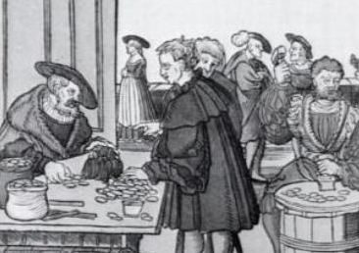
Dissatisfaction with the Church
Financial corruption
Indulgences
Pardons issued by the pope that people could buy to reduce time in purgatory
Abuse of power
Taxes

Slide 5
Dissatisfaction with the Church
Immorality
Respect for priests, monks, popes weakened
Growth of nationalism
Devotion to state/nation instead of the church

Slide 6
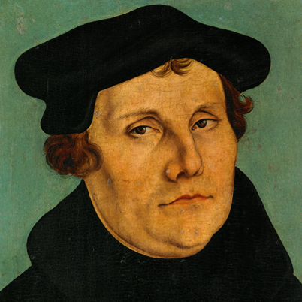
Martin Luther
1517 – Beginning of Protestant Reformation
Started when Martin Luther made public his complaints about the church

Slide 7
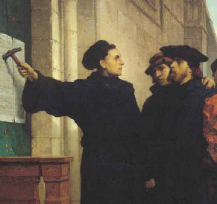
Martin Luther
The Ninety-five Theses
Indulgences sinful
Criticized power of the pope
Criticized the wealth of the church
Spread by the newly invented printing press

Slide 8
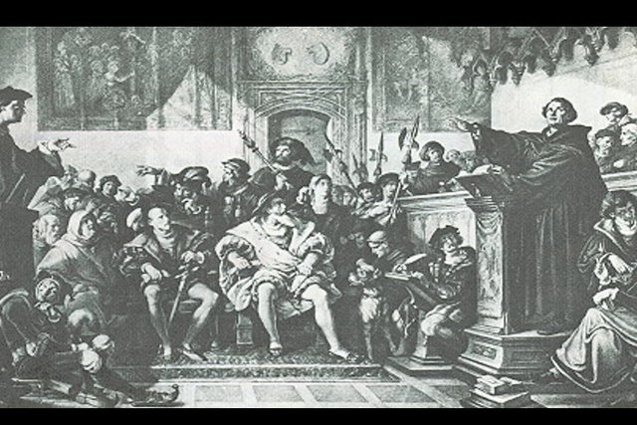
Martin Luther
Continued spreading message
Translated Bible into German
Public debates
Insisted faith alone was needed (not good works)
Only head of church is Jesus himself, not pope

Slide 9
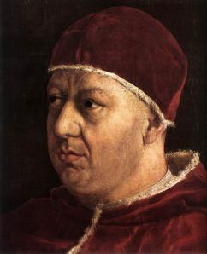
Reactions to Martin Luther
1520 – Pope Leo X – excommunicated Luther
Luther summoned to appear in front of Emperor Charles V and German Diet
Luther refused to change opinion

Slide 10
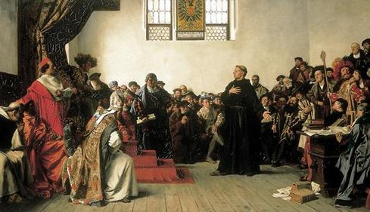
Reactions to Martin Luther
Edict of Worms
Decree declared Luther an outlaw
Condemned his writings
1530 – Lutheranism formally recognized branch of Christianity
Term Protestant comes into being

Slide 11
The Spread of Protestantism
Luther’s stand opened door for others to criticize church
New ideas on religious matters emerge throughout Europe

Slide 12
THE REFORMATION: CAUSES
Humanist values led people to question church authority
Some clergy were corrupt, worldly, or poorly educated
Martin Luther posted his Ninety-five Theses
Printing press helped spread Reformation ideas

Slide 13
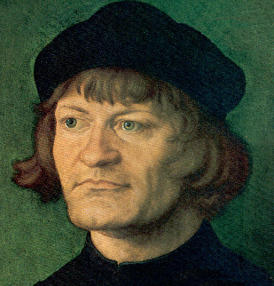
The Spread of Protestantism
Ulrich Zwingli
Switzerland
Reforms considered radical
Theocracy
Government in which church and state are joined
Officials are considered to be divinely inspired

Slide 14
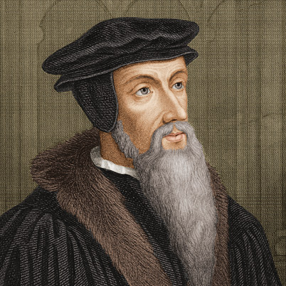
The Spread of Protestantism
John Calvin
Predestination
God knows who will be saved
Nothing you can do to change your predestined end
People sinful by nature

Slide 15
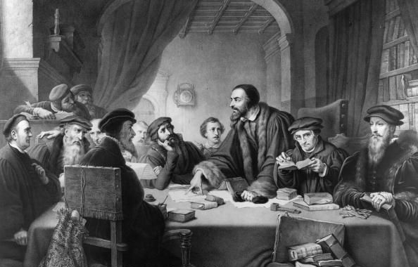
The Spread of Protestantism
Calvinism - Calvinists
Very strict
Sense of mission and discipline
Laws regulating behavior
Church attendance mandatory
Amusements forbidden

Slide 16
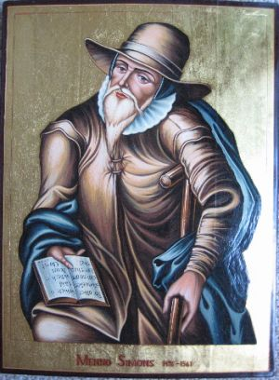
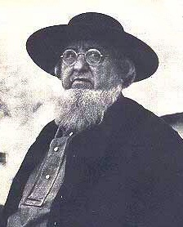
The Spread of Protestantism
Other reformers adapted their own religion/beliefs:
Presbyterian
Anabaptists
Mennonites
Amish

Slide 17
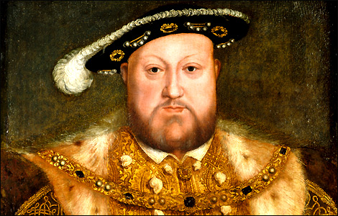
Protestantism Spreads to England
Henry VIII
Originally a devout Catholic
Opposed Luther
Married to Catherine of Aragon – only had one child, a girl (Mary)
Wants a male heir
1525 - Wanted his marriage annulled

Slide 18
The Reformation Parliament
Henry and Parliament declare England no longer under the authority of the pope
Names himself head of the Church of England
Closed Catholic monasteries & convents
Distributes land to nobles
Act of Supremacy

Slide 19
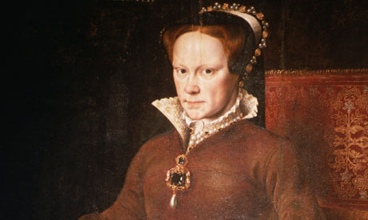
Henry’s Heirs
Had six wives
Edward VI takes throne at age 9 – dies at 16
Mary – Bloody Mary
Returns England to authority of the pope
Burns Protestants at the stake
Died at 25
Elizabeth becomes queen

Slide 20
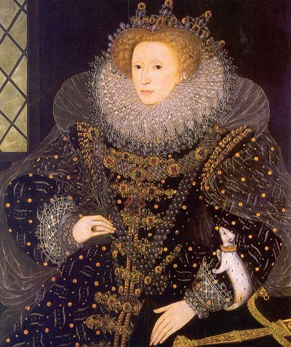
Protestantism Spreads to England
Elizabeth I
1559 – Drafts new Supremacy Act
England again splits from Rome
Persecutes Catholics
Firmly establishes the Church of England

Slide 21
Renaissance and Reformation:
The Counter Reformation

Slide 22
Main Idea
Catholics at all levels recognized the need for reform in the church. Their work turned back the tide of Protestantism in some areas and renewed the zeal of Catholics everywhere.

Slide 23
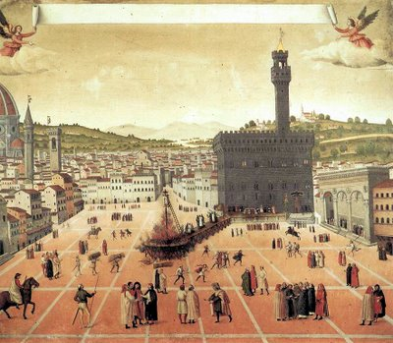
Reforming the Catholic Church
Counter-Reformation
Many Catholics dissatisfied with the Church
Church begins a series of reforms to counter the criticisms

Slide 24
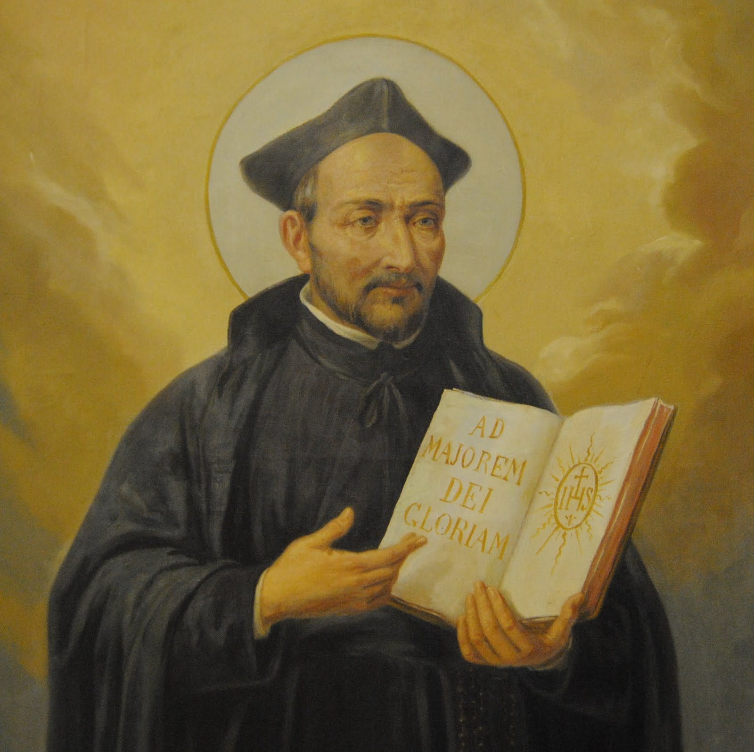
Reforming the Catholic Church
Jesuits – The Society of Jesus
New religious order – worked to reform the church
Ignatius of Loyola
Emphasis on spiritually, service, and obedience
Concentrated on education to combat Reformation

Slide 25
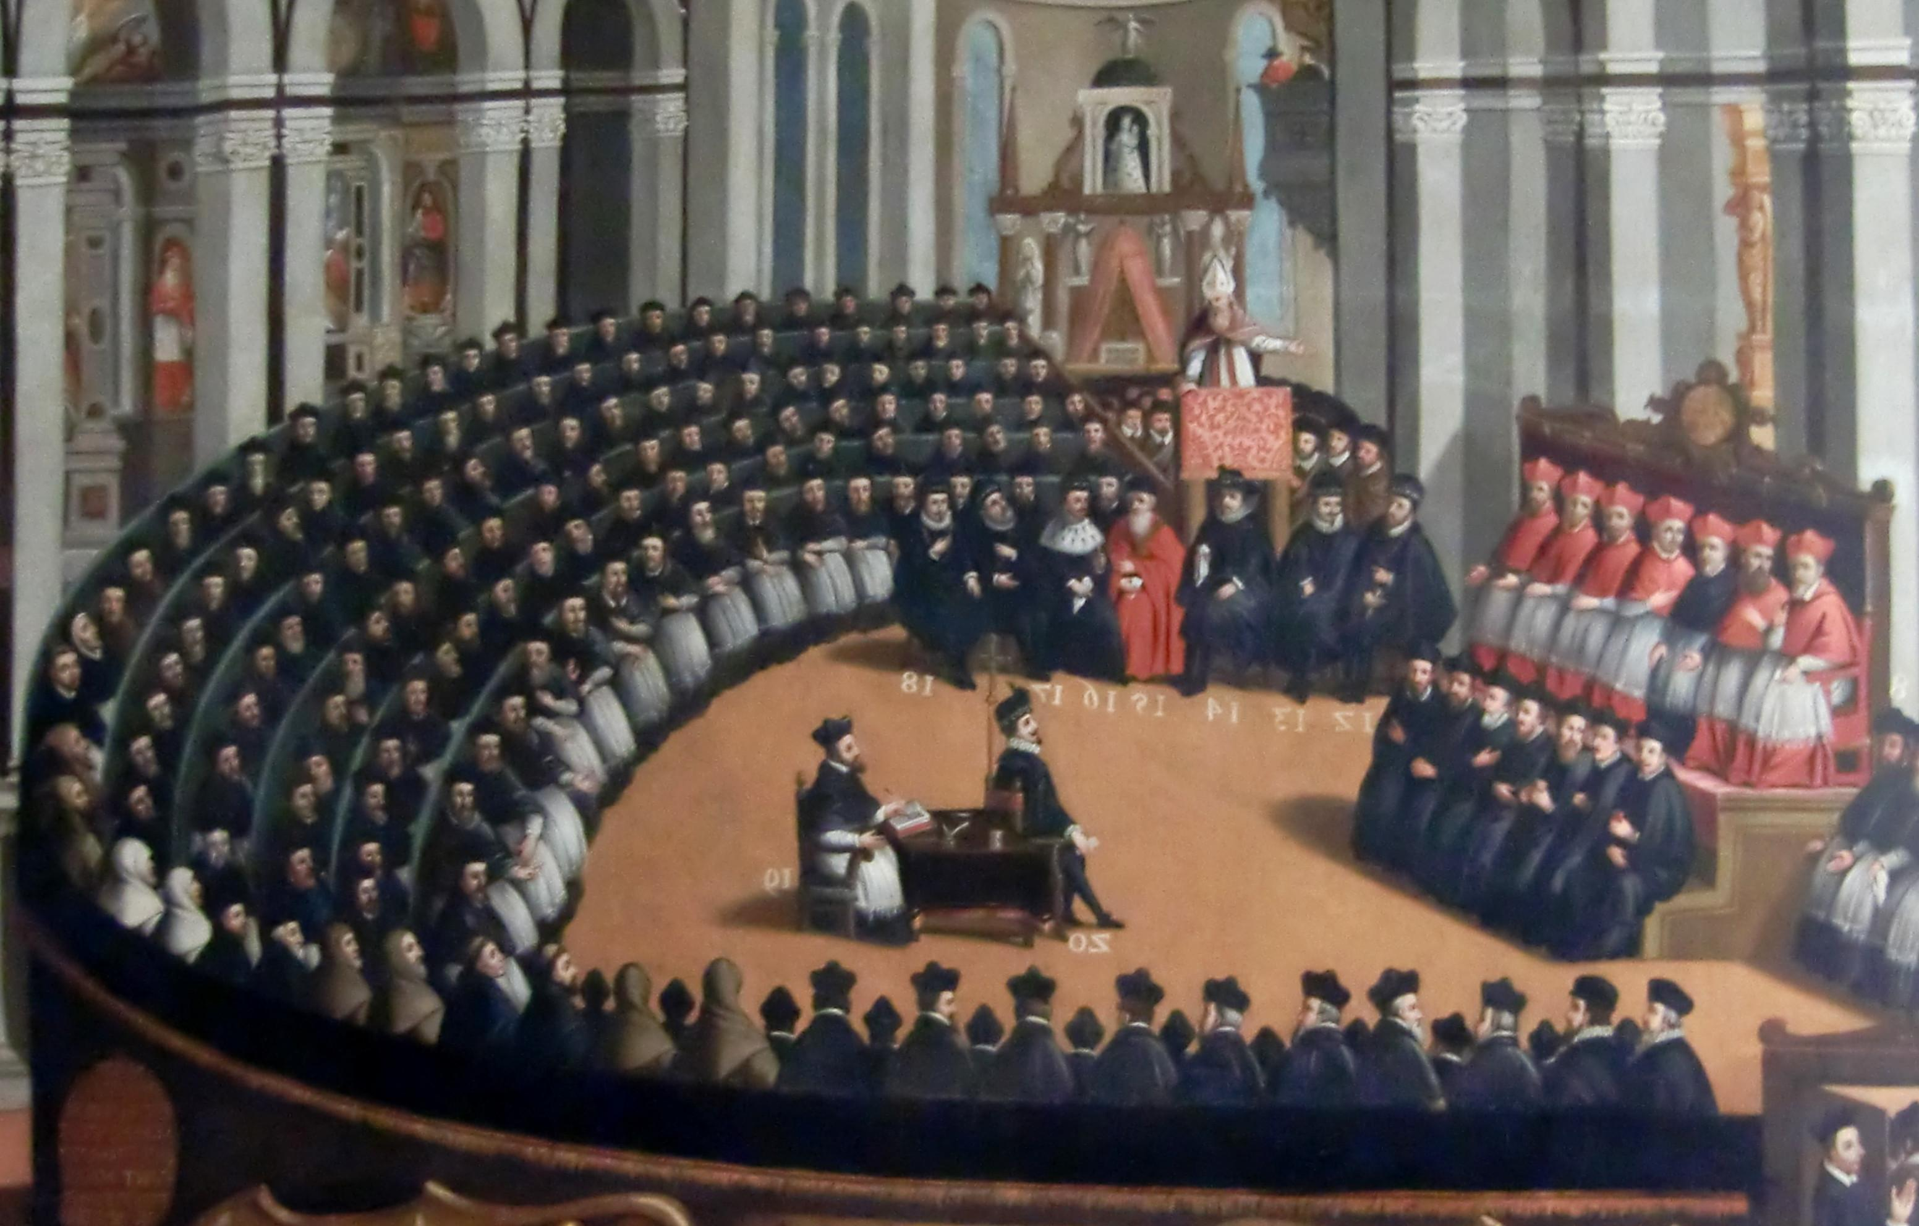
The Council of Trent
The Council of Trent
Pope Paul III sees the need to redefine the doctrines of the Catholic faith
Retrain priests
Stop financial abuse
End indulgences

Slide 26
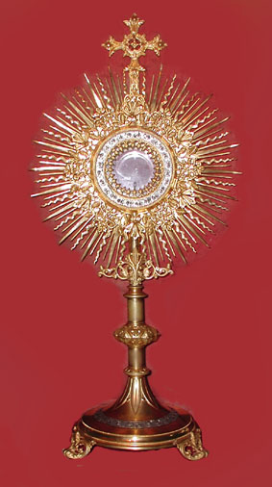
The Council of Trent
No compromise between Catholicism and Protestantism
Rejected Protestant’s emphasis on self-discipline and individual faith
Help believers achieve salvation using ceremonies
Renewed energy and confidence

Slide 27
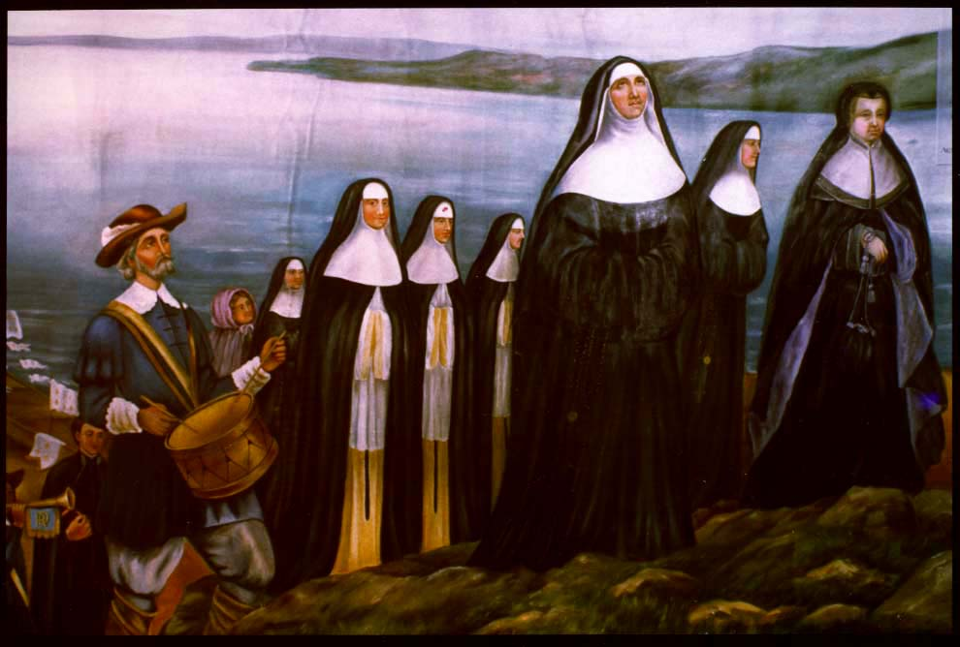
Reforming the Catholic Church
Built new school for education of priests
Began to bring Calvinist converts back to the Catholic Church
Allowed women (nuns) to take a more prominent role
Help the poor, orphaned, sick
Network of schools for girls

Slide 28
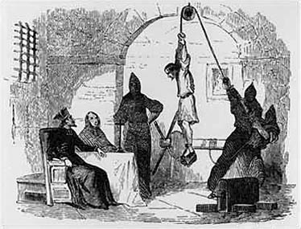
The Inquisition
Roman Inquisition
Established to counter the Reformation
Tried people who were accused of being Protestants, of practicing witchcraft, or of breaking church laws
Index of Forbidden Books

Slide 29
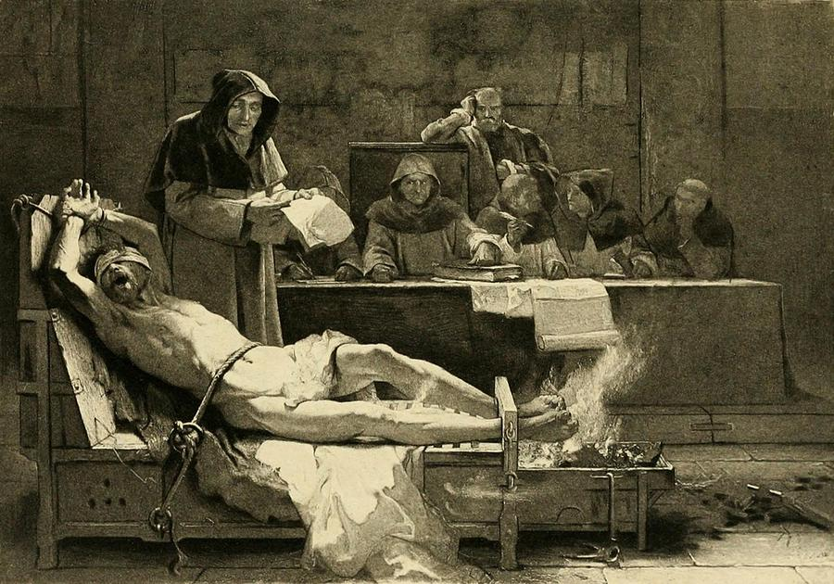
The Inquisition
Spanish Inquisition
Set up by Spanish monarchs
Harsh
Imposed religious uniformity
Attacked Jews, Muslims, Protestants
Accounts of torture and executions

Slide 30
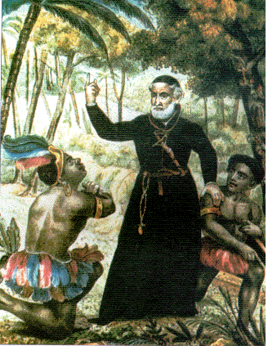
Changes in Religion
Spread religion to other continents
North America
Softened the harsh colonial rule
Religious turmoil increased
Church split into numerous factions

Slide 31
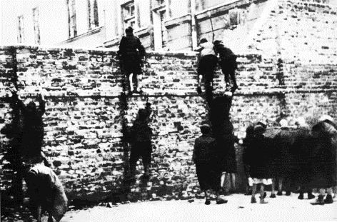
Persecution and Hysteria
Catholics & Protestants viewed Jews and Muslims as heretics
Forced to convert or leave Spain
Resettled in eastern & southern Europe
Forced to live in sections of city called a ghetto
Walled and gated
Closed at certain time each evening

Slide 32
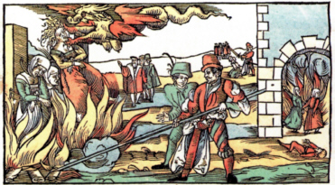
Persecution and Hysteria
Feared witches roaming the land
Killing children & cattle
Working with the devil
Fears increased during poor harvests & hardships
Accused rounded up, tried, and executed

Slide 33
Political Effects
Rising sense of national identity
Formation of independent states and nations
Many wanted Church less involved in state and business affairs
Political power became separated from churches

Slide 34
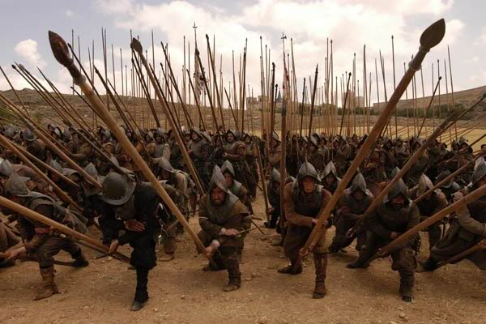
Religious Wars and Unrest
The Italian Wars
Series of wars between France and Spain for control over Italy
Expanded the Renaissance throughout Europe

Slide 35
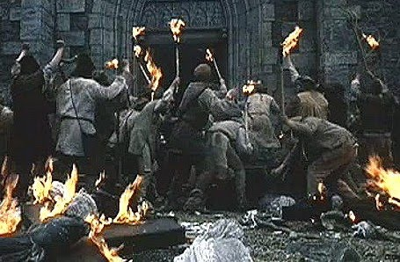
Religious Wars and Unrest
Peasants’ War (Germany)
Peasants becoming unhappy with high taxes and lack of power
Reformation preachers fostering ideas of freedom
Thousands storm castles and monasteries
Harshly suppressed

Slide 36
THE REFORMATION: EFFECTS
Many Protestant sects developed
Church leaders reformed the Catholic Church
Religious intolerance and anti-Semitism increased
Religious conflicts spread across Europe

