Slide 1
Rome and Early Christianity:
From Republic to Empire

Slide 2
Main Idea
Governmental and social problems led to the end of the Roman Republic and the creation of a new form of government.

Slide 3
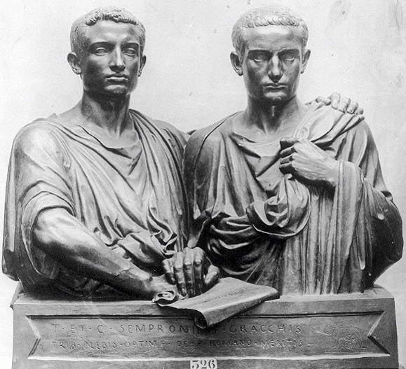
Problems in the Late Republic: Social Unrest
Soldier-farmers reduced to poverty
Gracchi brothers
Tiberius and Gaius Gracchus
Wanted to redistribute public lands
Both killed

Slide 4
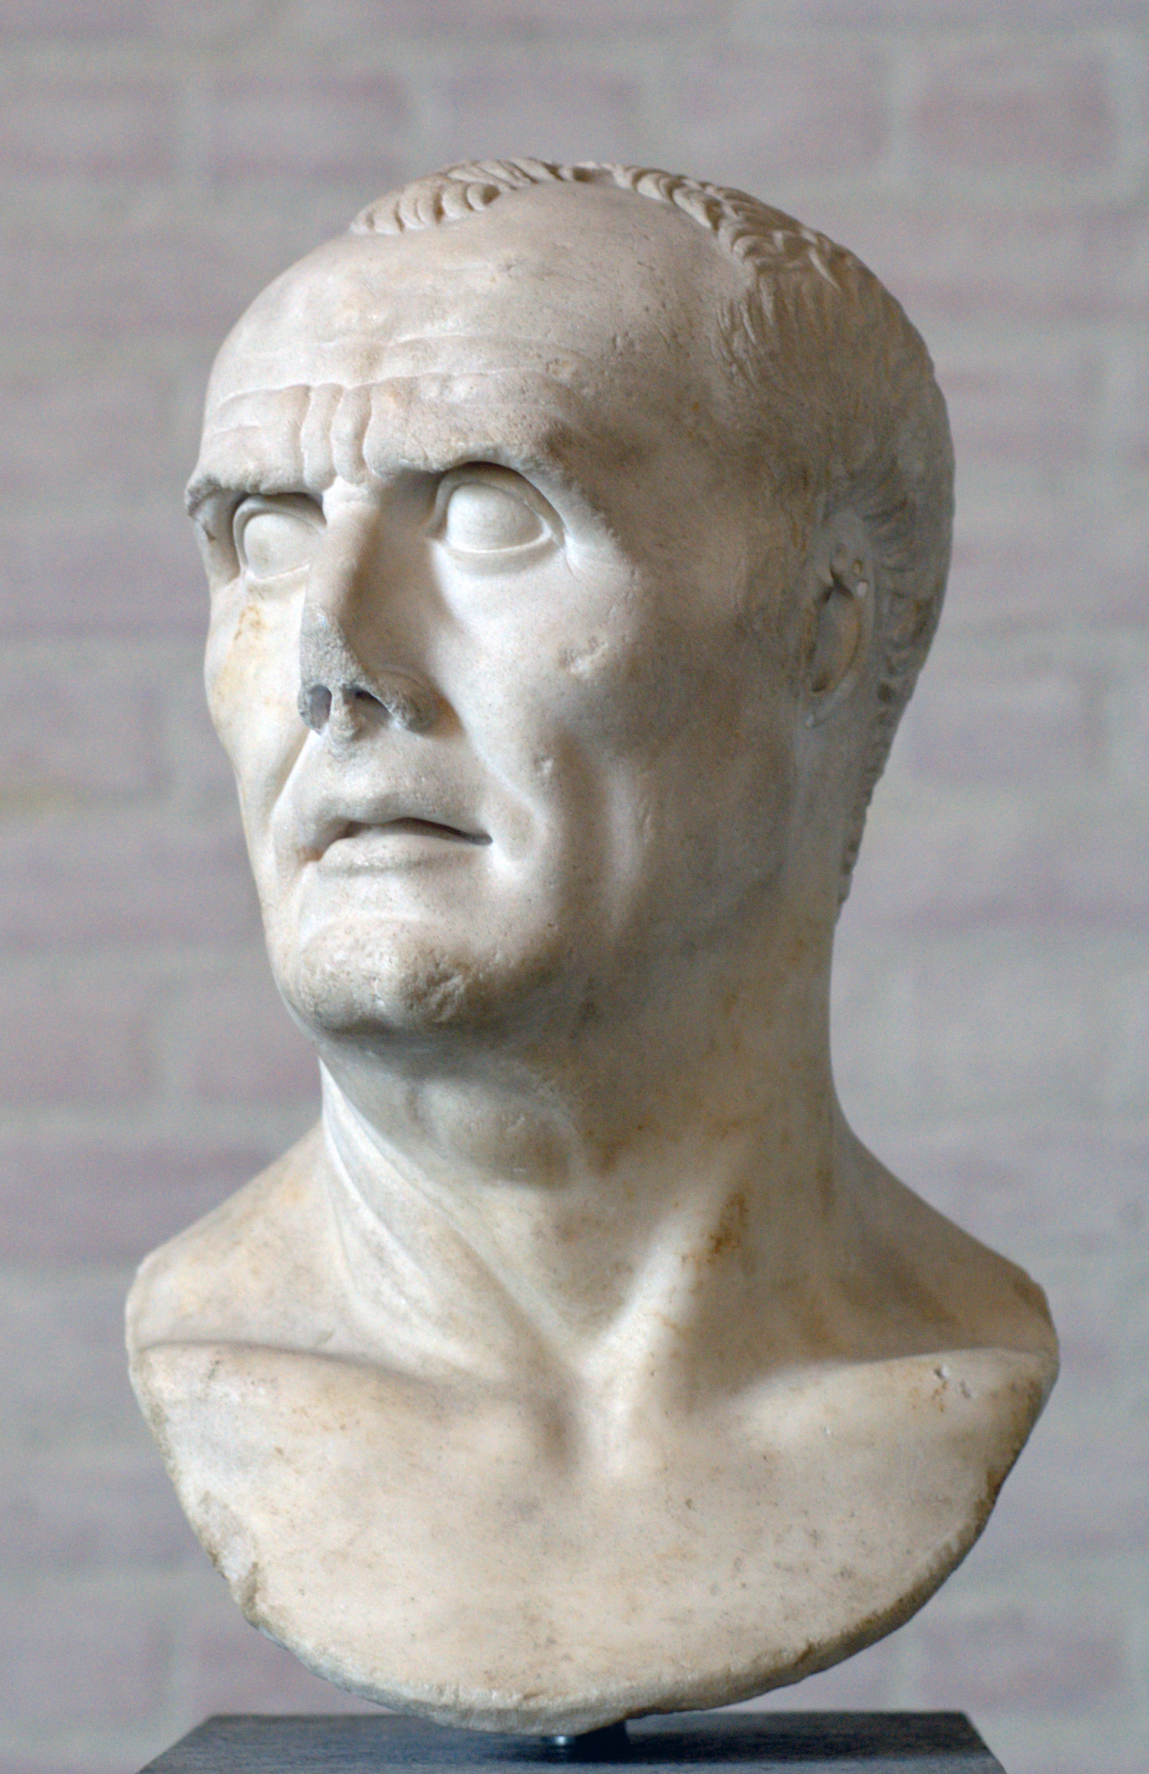
Problems in the Late Republic: Military in Politics
Gaius Marius -
Eliminated property restrictions on army

Slide 5
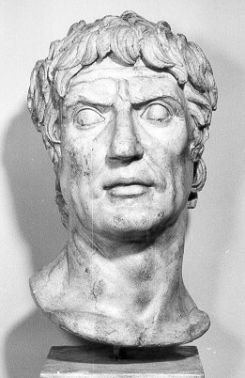
Problems in the Late Republic: Civil War
Social War
Lucius Cornelius Sulla
Became dictator

Slide 6
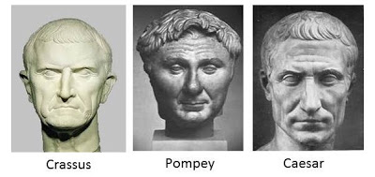
The First Triumvirate – 60 BCE
Julius Caesar, Gnaeus Pompey, Licinius Crassus
Formed a First Triumvirate – rule of 3 men

Slide 7
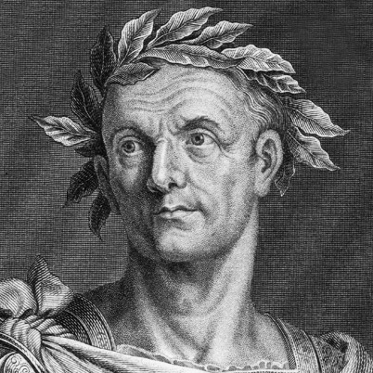
The First Triumvirate
Crassus dies
Caesar & Pompey face off in civil war
44 BCE - Senate declares Caesar dictator for life

Slide 8
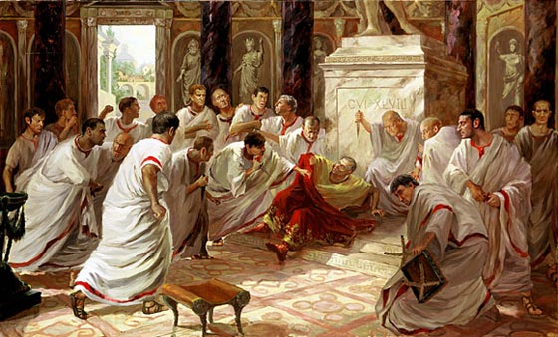
The First Triumvirate
Senators feared he wanted to become king & destroy Republic
The Ides of March

Slide 10
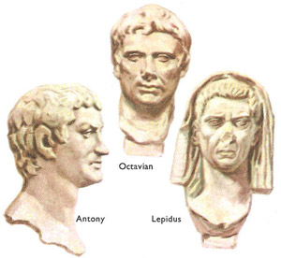
The Second Triumvirate – 43 BCE
Octavian, Marc Antony, and Lepidus

Slide 11
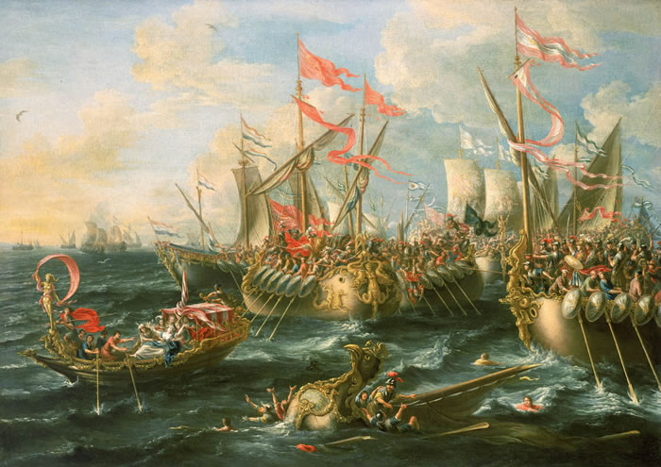
The Second Triumvirate
Lepidus forced out
Split empire between Octavian and Antony
Civil war breaks out
Republic dead, now an empire

Slide 12
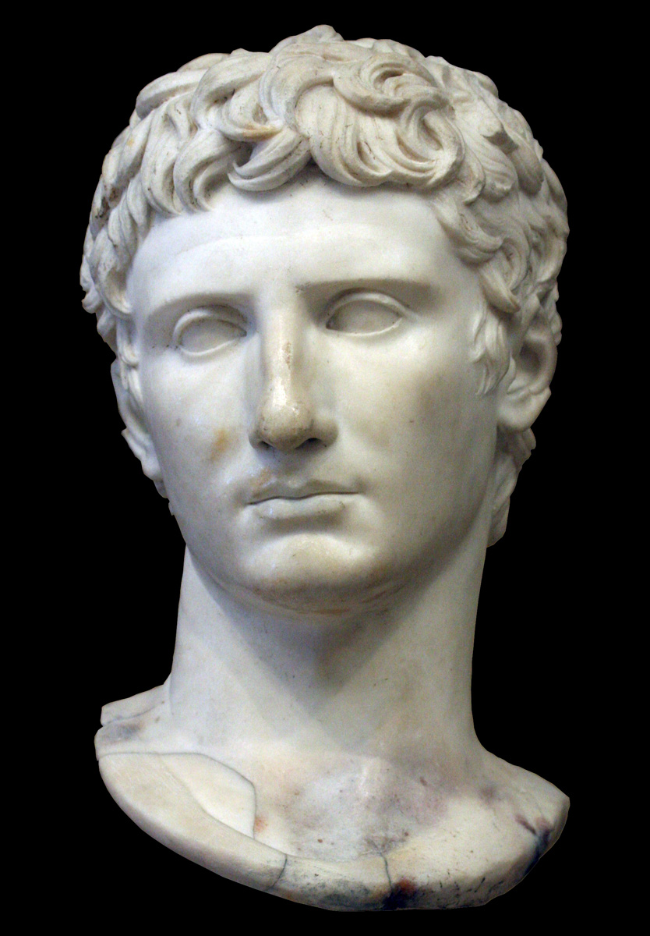
From Octavian to Augustus
Takes the title of princeps – “first citizen”
Senate gives title of Augustus

Slide 13
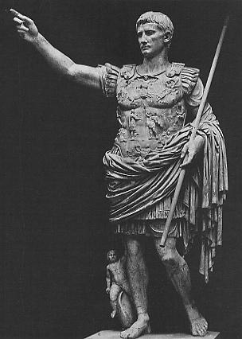
The Augustan Age
Divided power to rule Rome between himself and Senate

Slide 14
The Augustan Age
Created police force
Fire brigades
Stockpiled food & water
Building programs
Moral and religious reforms
Supported the advancement of literature

Slide 15
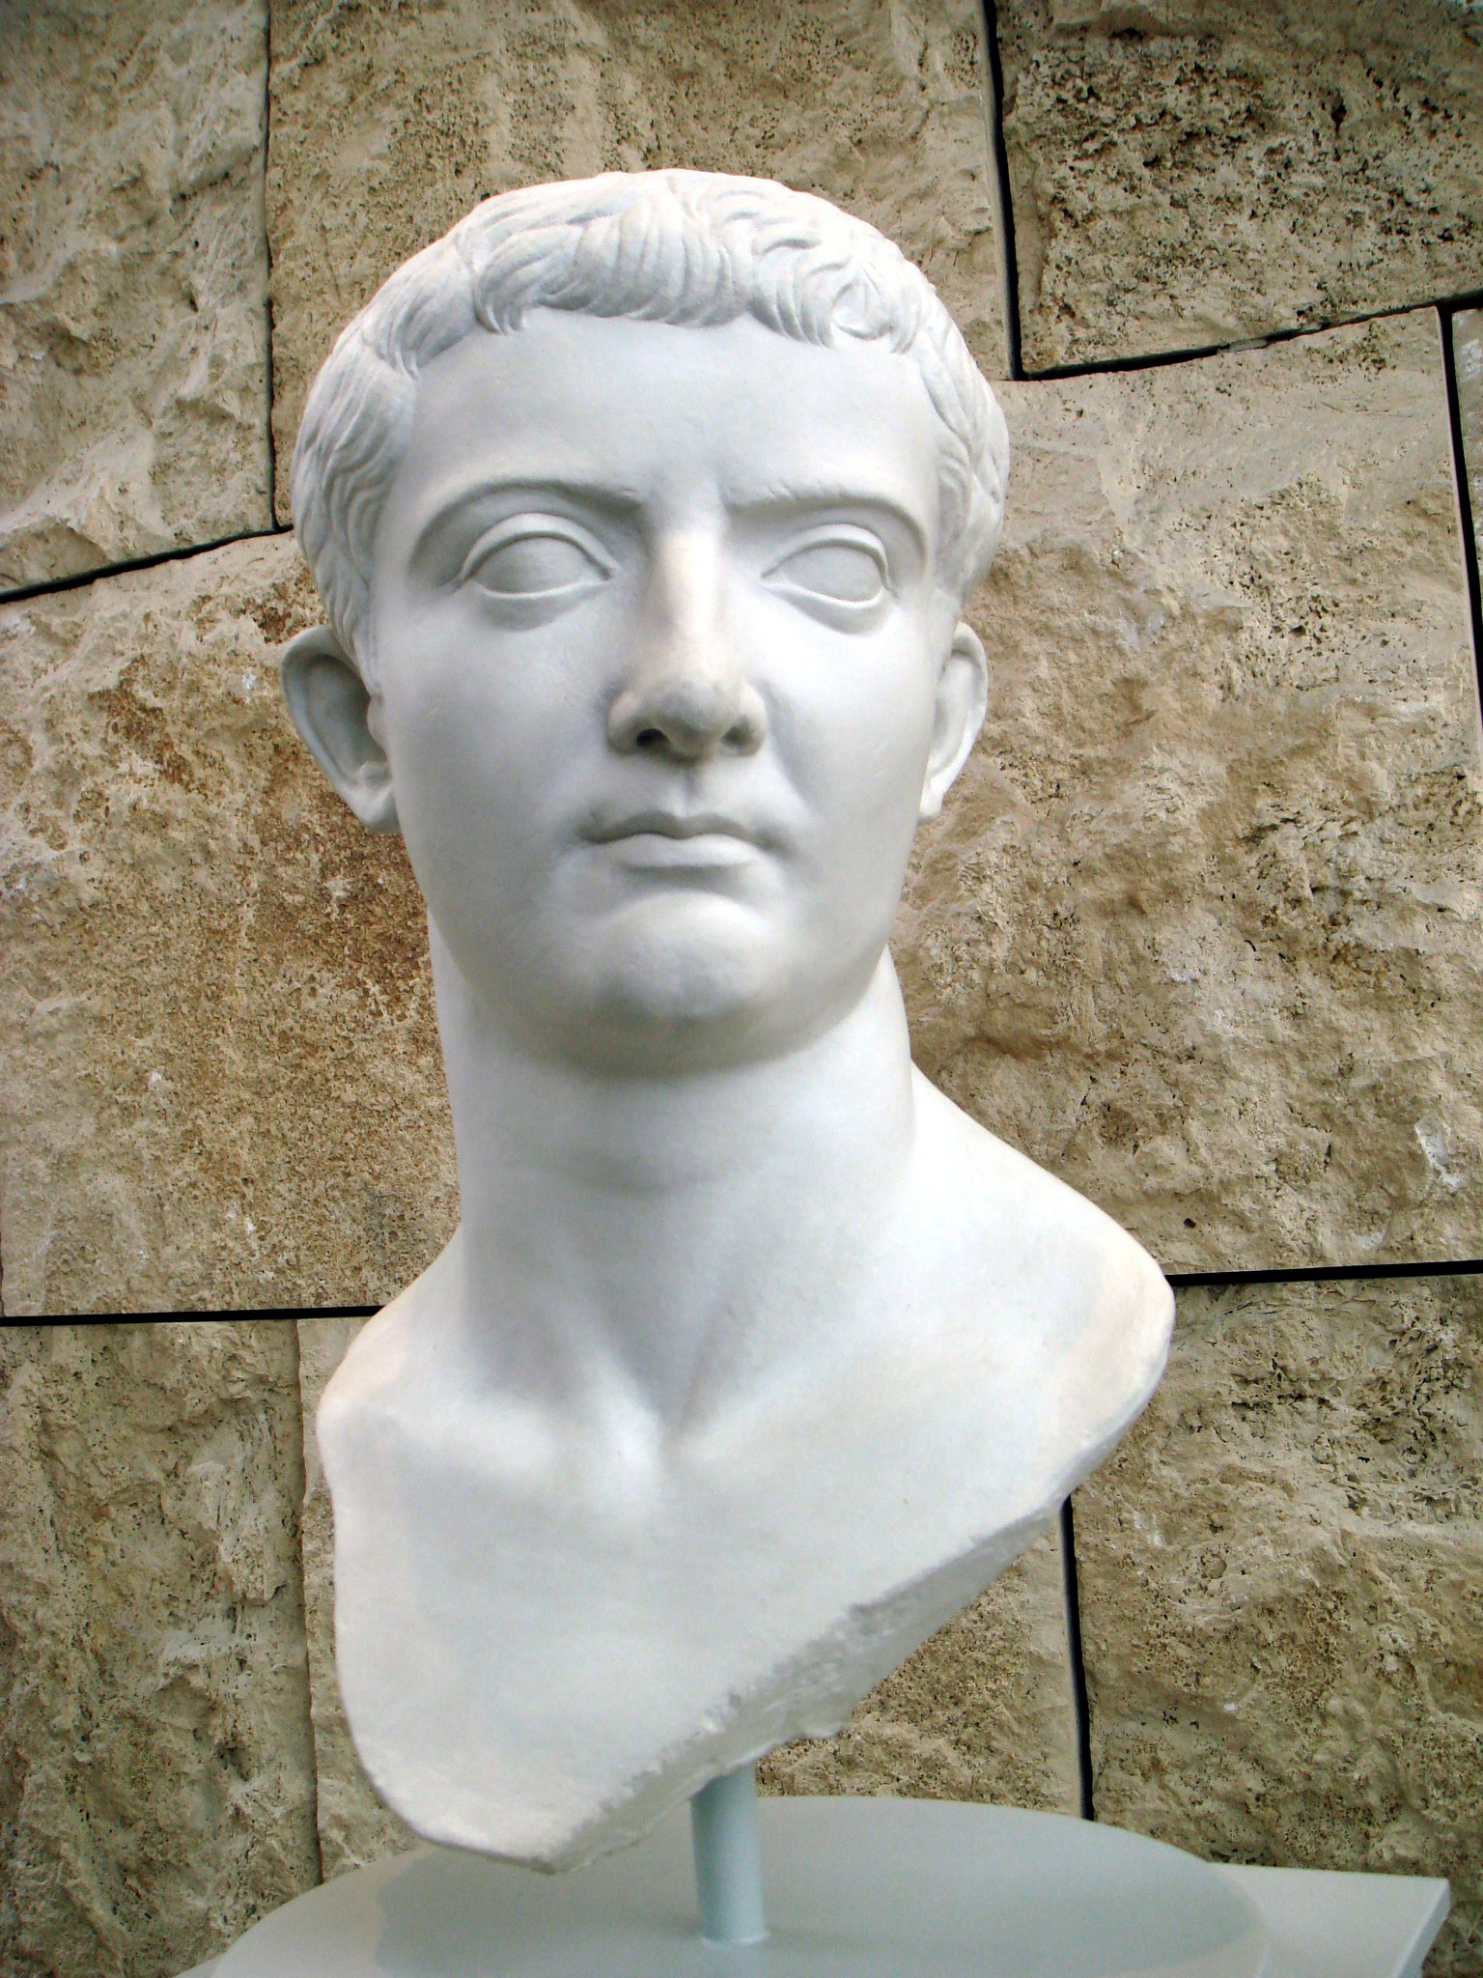
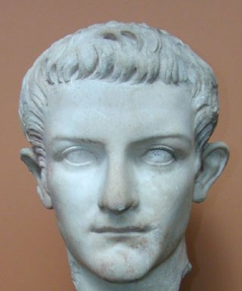
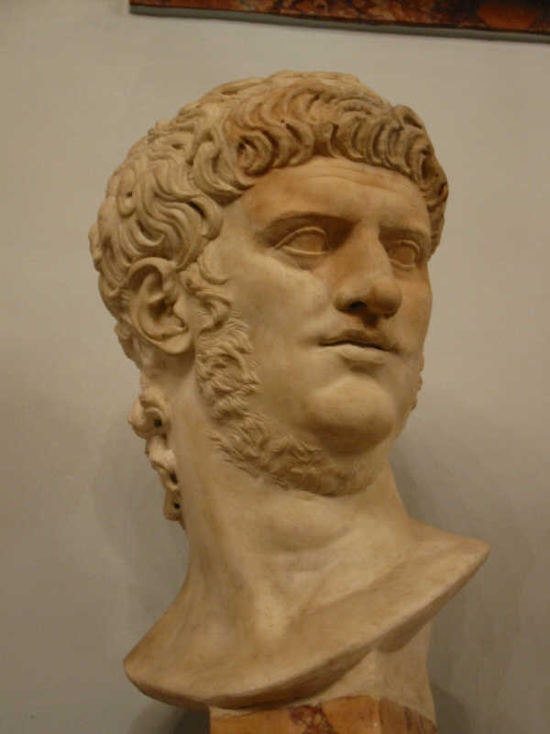
Julio-Claudians and Flavians
After Augustus’ death –
Relatives of Julius Caesar – Julio-Claudians reign
Tiberius
Caligula
Nero

Slide 16
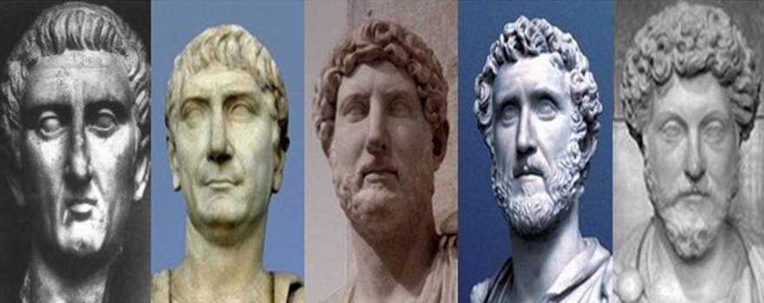
The Good Emperors
96 CE – New line of emperors
5 Good Emperors
Empire grows

Slide 18
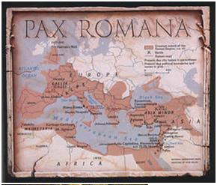
The Pax Romana
Pax Romana –
The “Roman peace”
From Augustus until the end of the Good Emperors
Stable government
Good trade

Slide 19
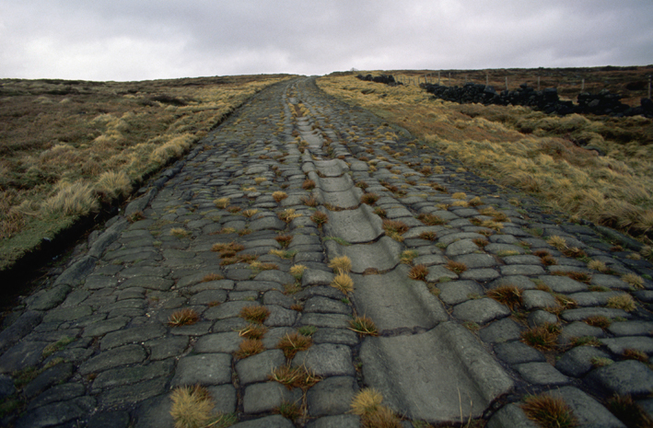
The Pax Romana
Laws passed by assemblies, Senate, or emperor
Applied to all citizens in empire
Manufacturing & trade increased
Location to Mediterranean
Extensive road network
Over 50,000 miles

Slide 20
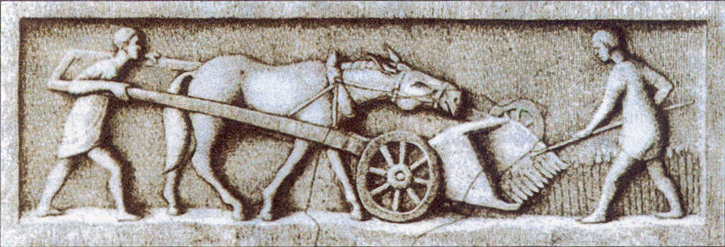
The Pax Romana
Tenant farmers
Received plot of land
Had to remain on land for set period of time

