Slide 1
The Roaring Twenties: American Life Changes

Slide 2
Main Idea
The United States experienced many social changes during the 1920s. Decade became known as the Roaring Twenties for the speedy social change it brought to the United States.

Slide 3
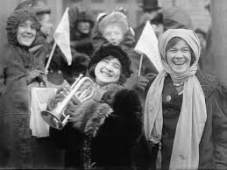
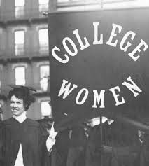
New Roles for Women
The 19th Amendment
Some elected to state and local office
Joined the workforce in large numbers
Mostly low paying professions
Attended college in greater numbers
A better sense of equality

Slide 4
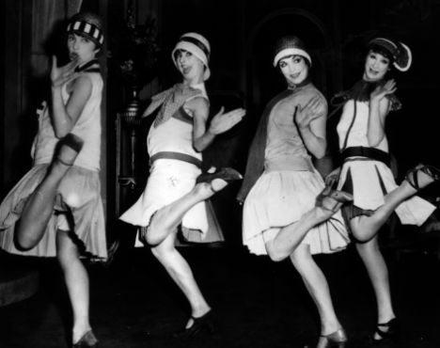
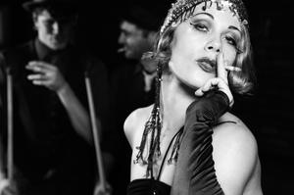
The Flapper
Flapper
Young women of the era who defied traditional ideas of proper dress and behavior
Independent, free lifestyle
Shocked society by cutting hair, raising hemlines, wearing makeup, smoking, drinking, and dancing
Mostly in cities
Many disapproved of flappers
Thought only interested in fun

Slide 5
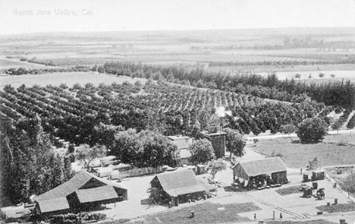
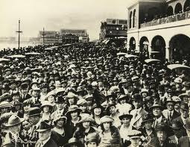
Effects of Urbanization
Growing divide between the city and countryside
Farming took a hard hit after WWI
Workers moved to industrialized cities
1920 census - first time ever, more Americans lived in cities

Slide 6
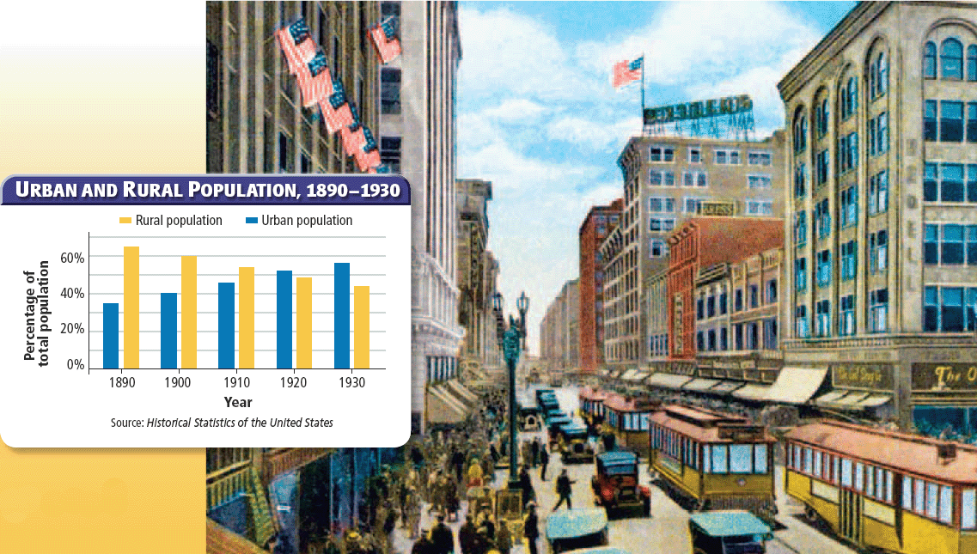

Slide 7
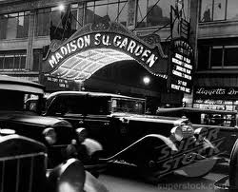
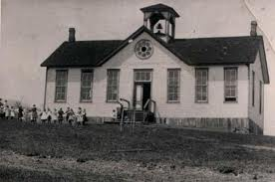
Effects of Urbanization
Automobile helped bring the cities and the country together
Education increased
New laws requiring children to attend school
More people could afford to send children to school

Slide 8
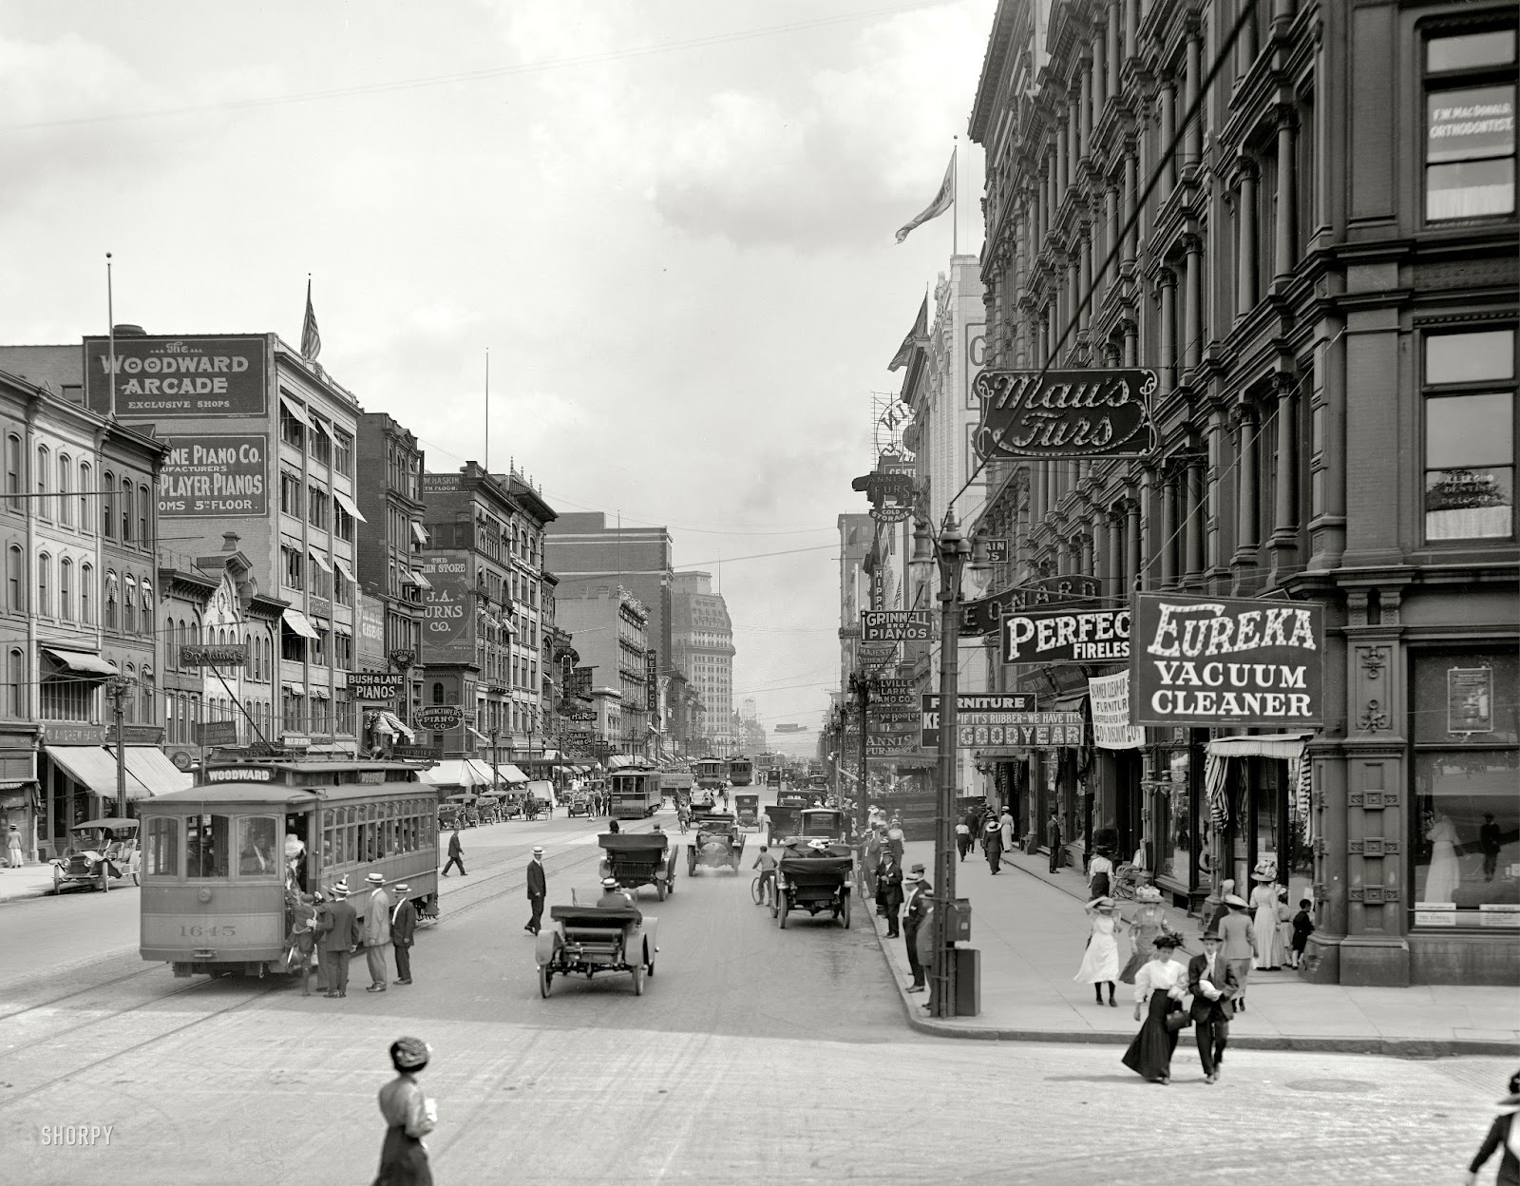
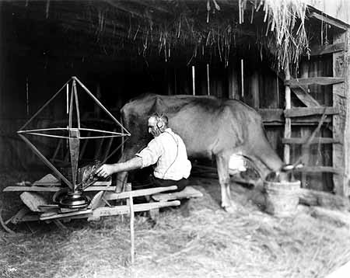
Conflicts Over Values
Americans lived in larger communities
Shift in values
A person’s key beliefs and ideas
In the 1920s, many people in urban areas had values that differed from those in rural areas

Slide 9
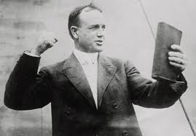
The Rise of Fundamentalism
Changing times caused uncertainty, turning many to religion for answers
Billy Sunday
Condemned radicals
Criticized the changing attitudes of women
Reflecting much of white, rural America’s ideals.
Fundamentalism
Beliefs based on a literal translation of the Bible

Slide 10
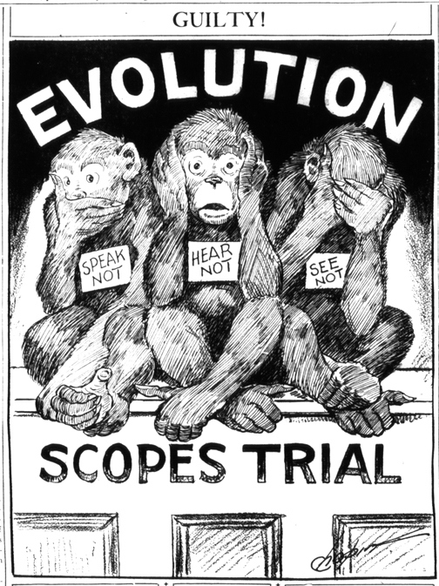
The Scopes Trial
Fundamentalism came into conflict with the teachings of modern science
Thought evolution undermined the biblical account of how God created humans
Worked to pass laws preventing evolution from being taught in schools

Slide 11
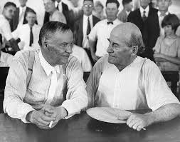
The Scopes Trial
In Tennessee - Science teacher John Scopes violated the law, was arrested, and went to trial
Obviously guilty, but trial about larger issues
Competing ideas of science and religion
Freedom of speech
Clarence Darrow & William Jennings Bryan
Scopes was convicted and fined $100
Never got a chance to appeal because the conviction was overturned due to a technical violation by the judge

Slide 12
Prohibition
Many saw alcohol as a source of unhappiness
Hurt families & promoted crime
Prohibition movement gained strength with the support of:
Religious groups, women, conservatives, Progressives, the conservation movement during WWI, and bias against immigrants (portrayed as alcoholics)
1919 - The Eighteenth Amendment

Slide 13
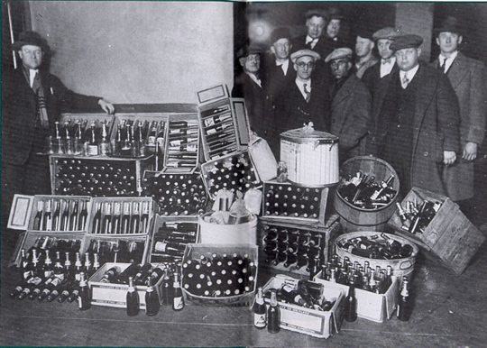
Prohibition in Practice
Enforcing the new Prohibition law proved to be virtually impossible
Making, transporting, and selling alcohol was illegal, but drinking it was not
Prohibition gave rise to huge smuggling operations
Foundation of numerous criminal empires
Al Capone

Slide 14
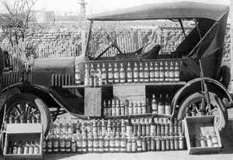
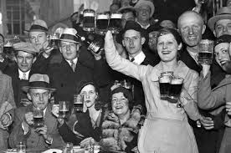
Prohibition in Practice
Bootleggers
Liquor smugglers
Many people also made their own liquor
Doctors could prescribe alcohol as medicine
Speakeasies
Illegal bars
Millions of Americans violated the laws

Slide 15
The Roaring Twenties: The Harlem Renaissance

Slide 16
Main Idea
Transformations in the African American community contributed to a blossoming of black culture centered in Harlem, New York

Slide 17
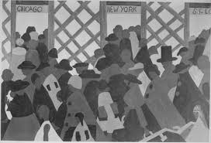
The Great Migration
Southern life was difficult for African Americans
Worked low-paying jobs and often faced racial violence
The Great Migration
The major relocation of African Americans from 1910 into the 1920s into northern cities
Looked to the North to find freedom and economic opportunities
Harlem, New York a favorite destination

Slide 18
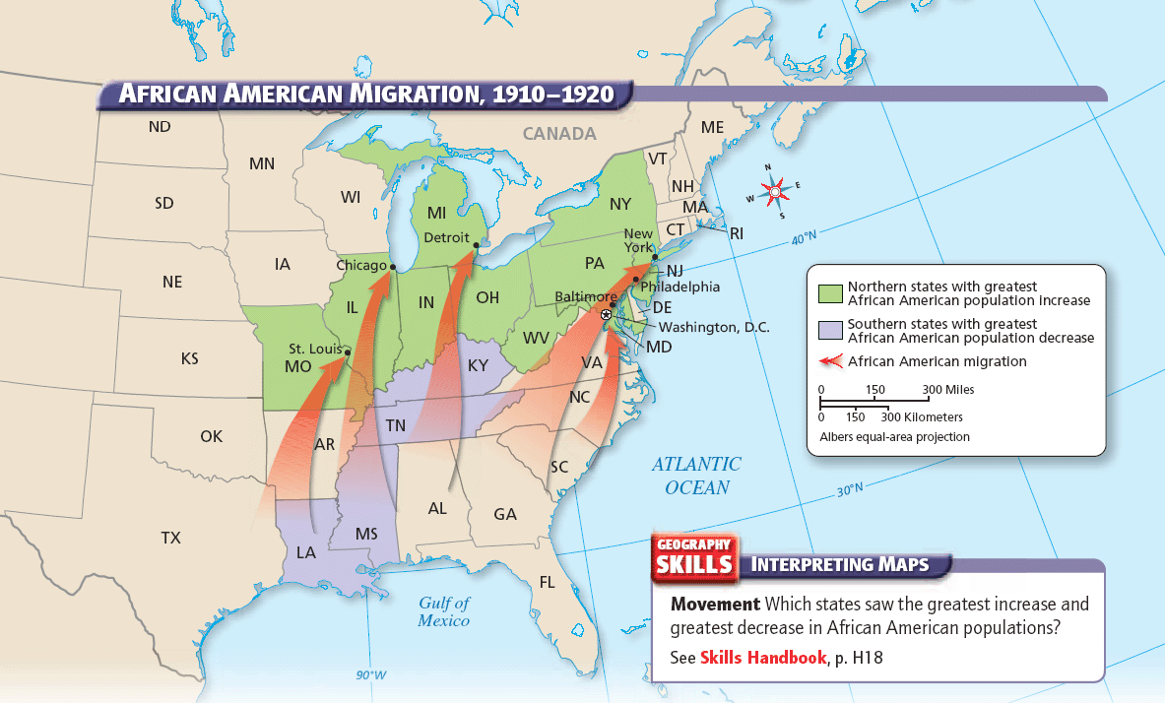

Slide 19
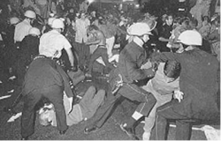
African Americans After WWI
Many found opportunities in the North but also racism
Shortage of jobs created a rift between whites and African American workers
1919 - Wave of racial violence/Chicago
About 2 dozen cities

Slide 20
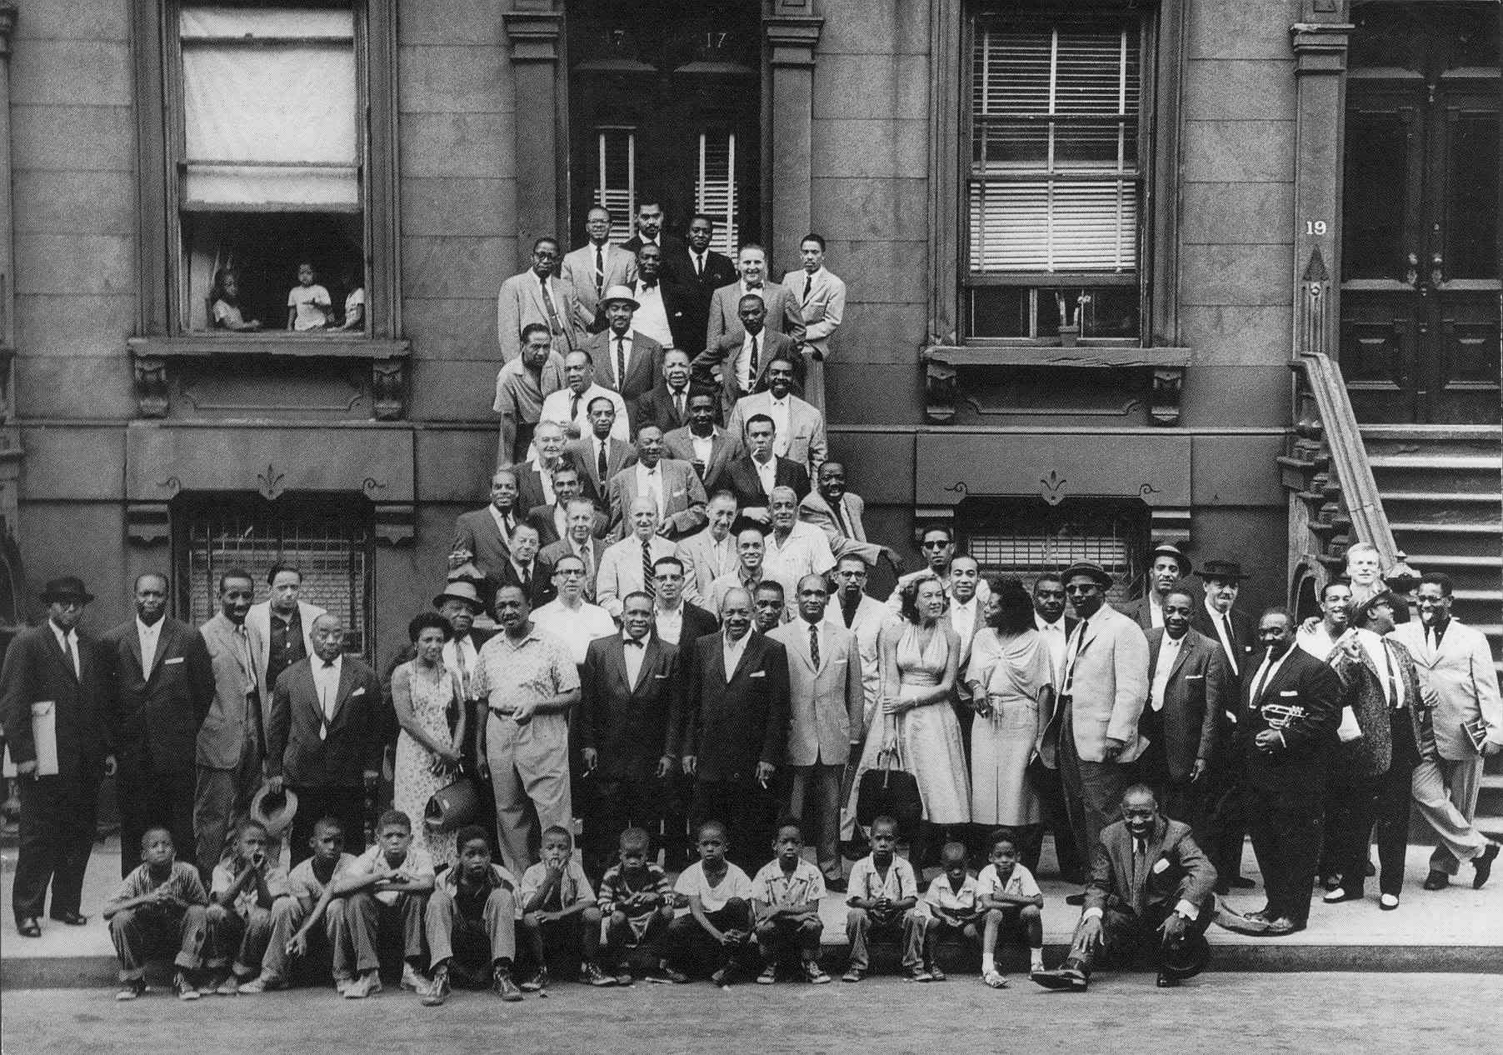
African Americans After WWI
Changing expectations of African Americans
Many believed they had earned greater freedom for helping fight for freedom overseas in WWI
Unfortunately, not everyone agreed

Slide 21
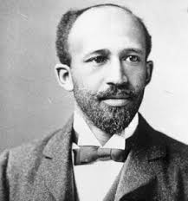
Marcus Garvey and W.E.B. Du Bois
A key figure in Harlem’s rise was W.E.B. Du Bois
Well-educated
Helped found the National Association for the Advancement of Colored People (NAACP)
Editor of a magazine called The Crisis
Promoted African American arts movement

Slide 22
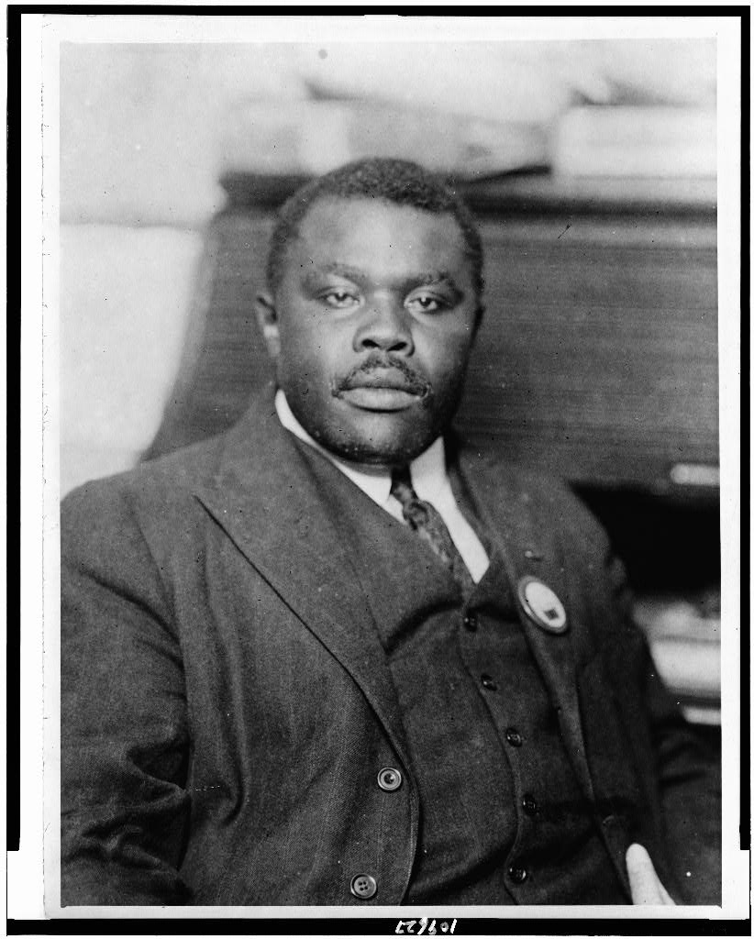
Marcus Garvey and W.E.B. Du Bois
Marcus Garvey
Formed the Universal Negro Improvement Association (UNIA)
Promoted self-reliance for African Americans without white involvement
Wanted American blacks to go back to Africa to create a new empire
Wanted African Americans to have economic success

Slide 23
Marcus Garvey and W.E.B. Du Bois
Garvey thought the NAACP discouraged African American self-confidence
Threatened African racial purity
The Crisis published an investigation of UNIA
The FBI charged UNIA
UNIA collapsed when Garvey went to prison and then left the country upon release

Slide 24
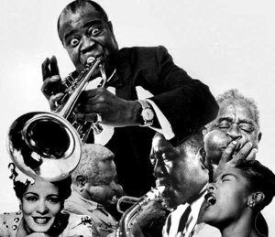
A Renaissance in Harlem
Harlem became the unofficial capital of African American culture and activism in the U.S.
Home to tens of thousands of African Americans
Felt a strong sense of racial pride and identity
Attracted talented writers, thinkers, musicians, and artists
Harlem Renaissance
Blossoming of African American art and literature that began in the 1920s

Slide 25
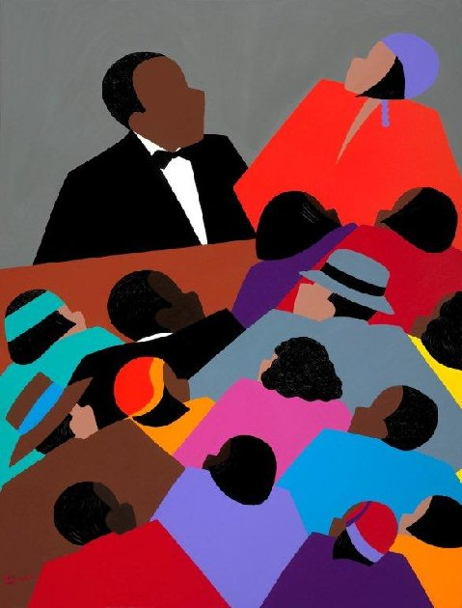
A Renaissance in Harlem
Little African American literature was published before that era
Black artists won fame during this era, often focusing on the experiences of African Americans
Recorded the distinctive culture of Harlem in the 1920s
Langston Hughes
Facing white prejudice
Black defiance and hope

Slide 26
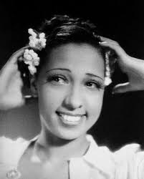
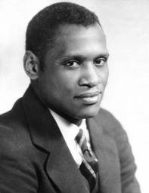
Harlem Performers and Musicians
The Harlem Renaissance helped create new opportunities for African American stage performers
Josephine Baker
Paul Robeson

Slide 27
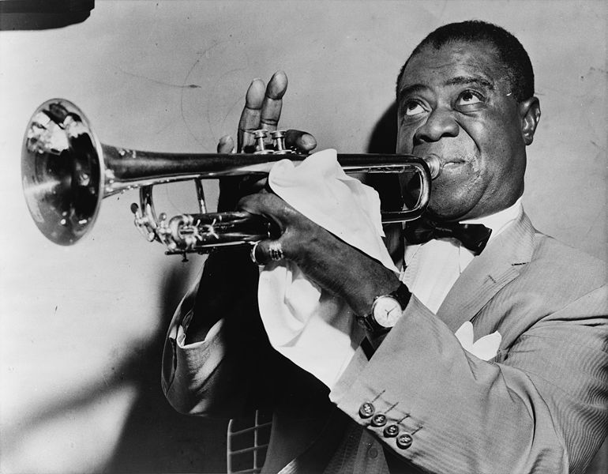
Harlem Performers and Musicians
Harlem was a vital center for jazz
Musical blend of several different forms from the Lower South with new innovations in sound.
Often improvised
Louis Armstrong
Bessie Smith
Cab Calloway
Duke Ellington
Fats Waller

Slide 28
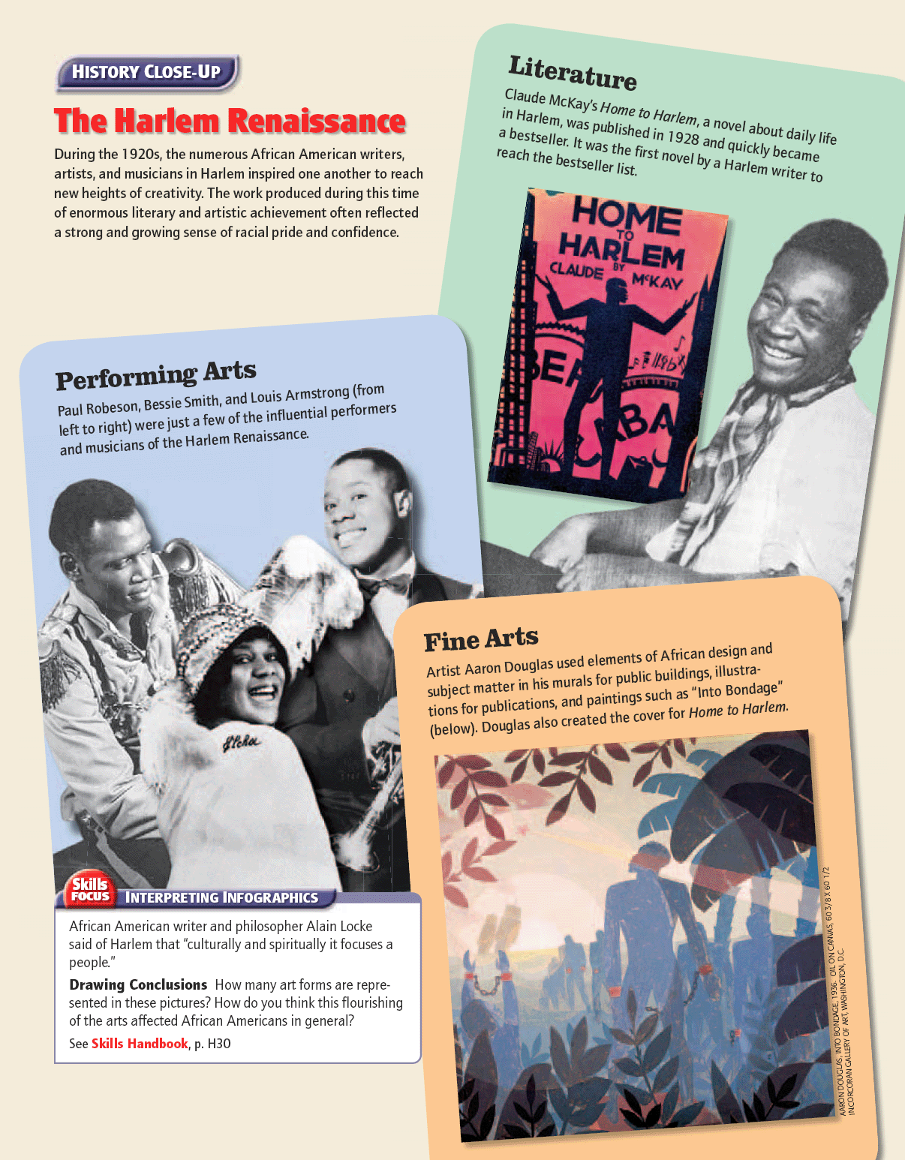

Slide 29
The Roaring Twenties: A New Popular Culture is Born

Slide 30
Main Idea
New technologies helped produce a new mass culture in the 1920s

Slide 31
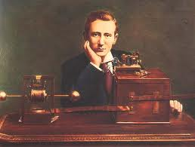
Radio Drives Popular Culture
During the 1920s, the radio went from being a little-known novelty to being standard equipment in every American home
Guglielmo Marconi
Invented the radio in the late 1800s
Early 1900s – military used radio
1920 - Most Americans didn’t own radios
No programming

Slide 32
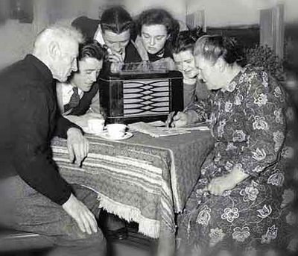
Radio Drives Popular Culture
1920 - KDKA
First radio station
1922 - U.S. had 570 stations
Technical improvements in sound and size helped popularity
Americans now had a shared experience

Slide 33
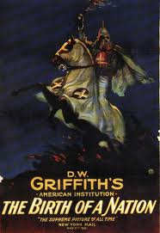
Movies
Movies exploded in popularity during the 1920s
In early years movies were short, simple pieces
D. W. Griffith
The Birth of a Nation
Controversial
Introduced innovative movie techniques
Helped establish film as an art form and widened its audience

Slide 34
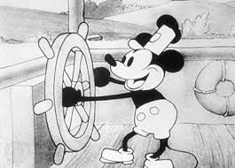
Movies
Introduction of films with sound, or “talkies.”
1927 - The Jazz Singer
Incorporated dialogue
Hugely successful
1928 – Steamboat Willie
Animated film
Introduced Mickey Mouse and cartoons
By the end of the 1920s, Americans bought 100 million movie tickets a week

Slide 35
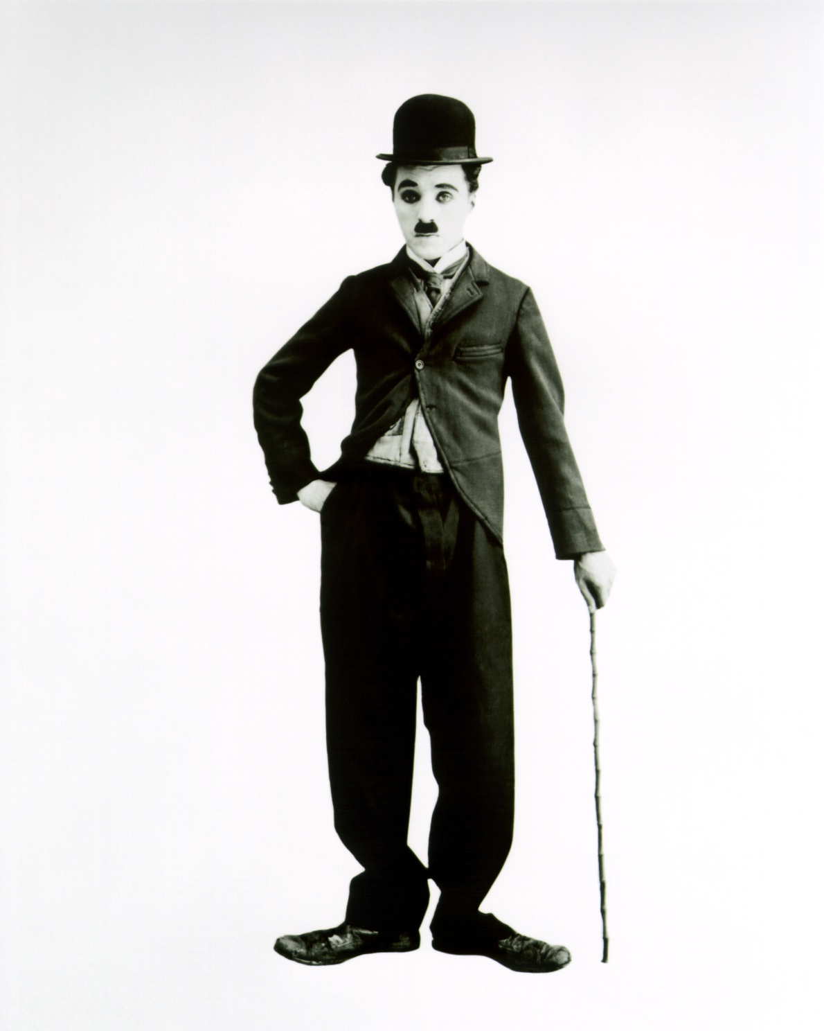
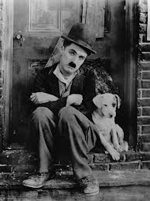
Film Star Heroes
The great popularity of movies in the 1920s gave rise to a new kind of celebrity—the movie star
Charlie Chaplin

Slide 36
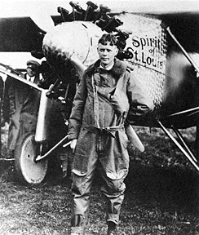
Pilot Heroes of the Twenties
Charles Lindbergh “Lucky Lindy”
Most beloved American hero of the time
First to achieve a transatlantic flight
Flight across the Atlantic Ocean
Flew from NYC to Paris
Spirit of St. Louis

Slide 38
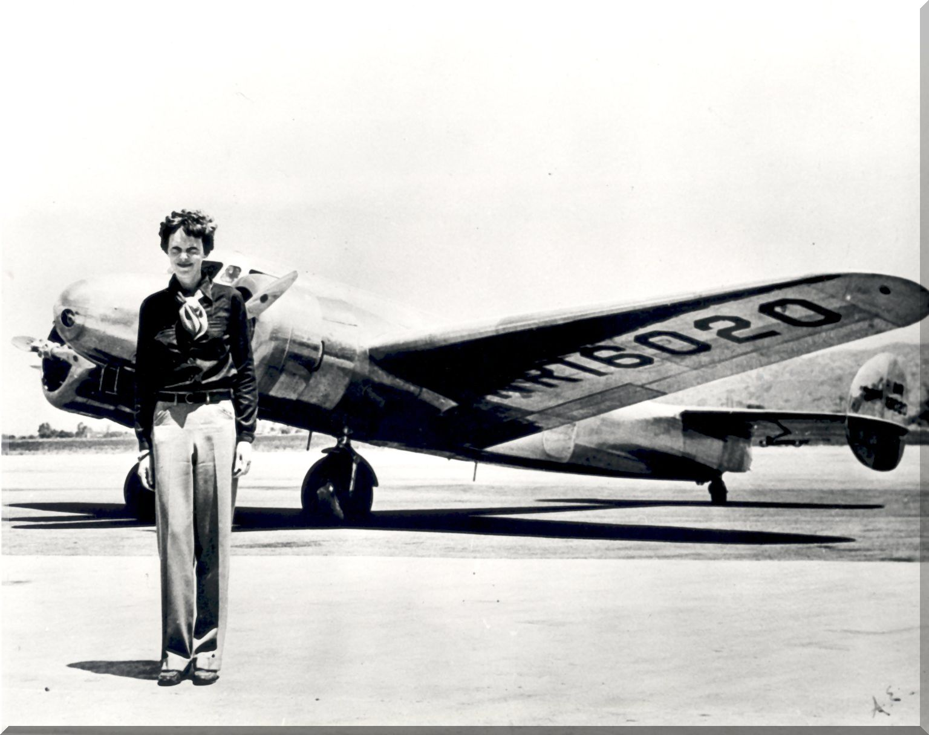
Pilot Heroes of the Twenties
Amelia Earhart
First woman to fly across the Atlantic
Returned to the U.S. as a hero.
Set numerous speed and distance records
1937 on a record-breaking flight around the world, she disappeared

Slide 39
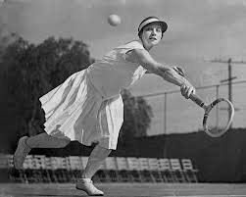
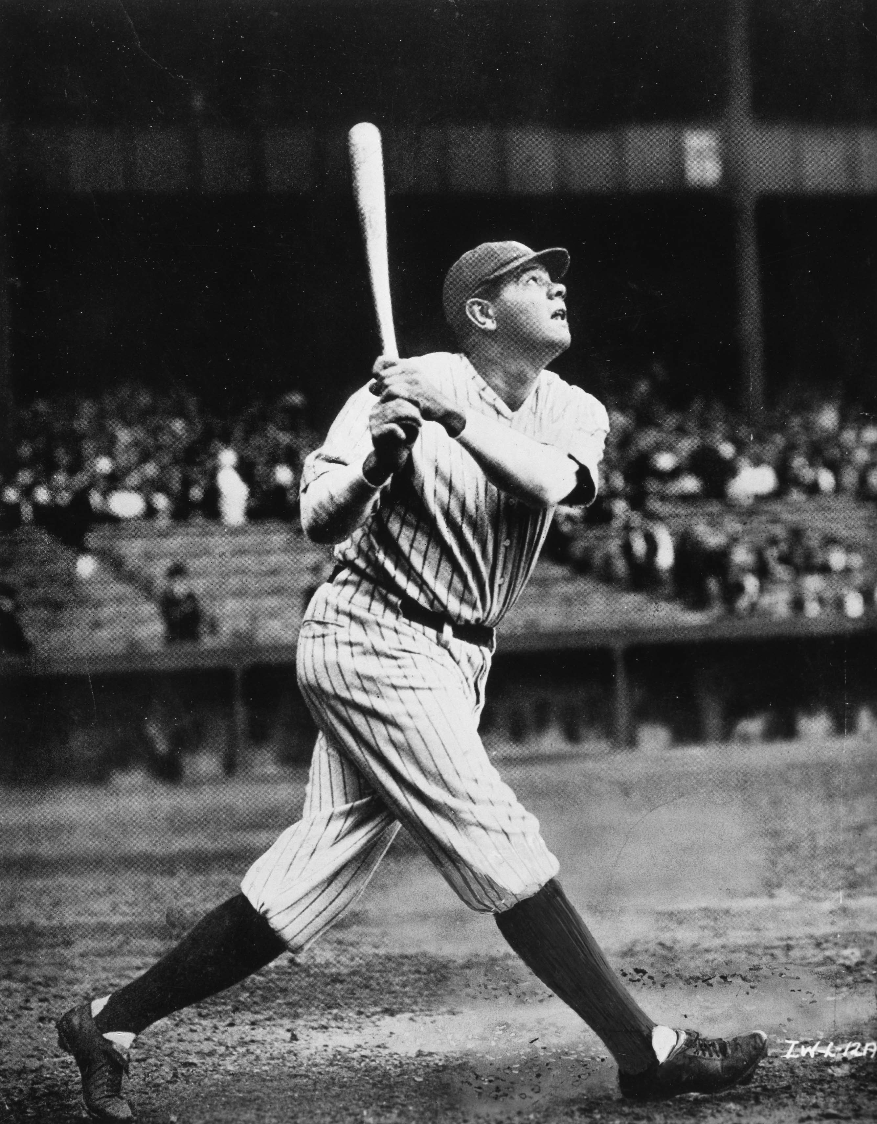
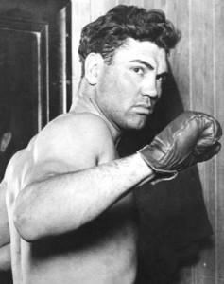
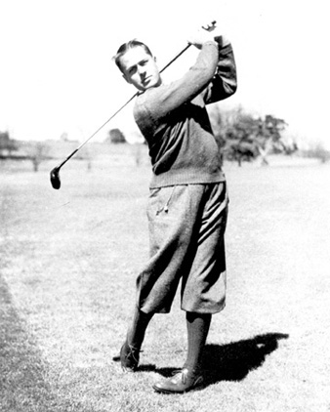
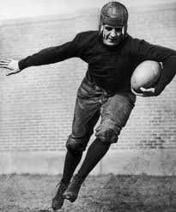
Sports Heroes
Radio helped inflame the public passion for sports
Millions of Americans tuned in to broadcasts of ballgames and prize fights featuring their favorite athletes
Helen Wills
Red Grange “Galloping Ghost”
Babe Ruth:
Bobby Jones

Slide 40
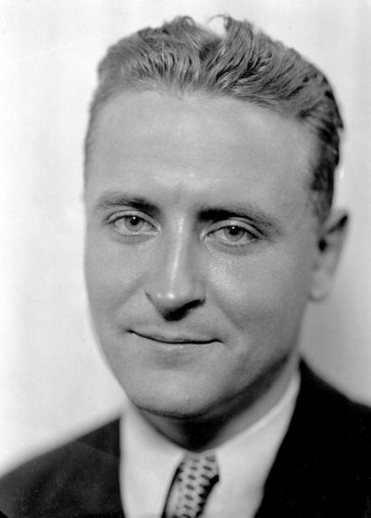
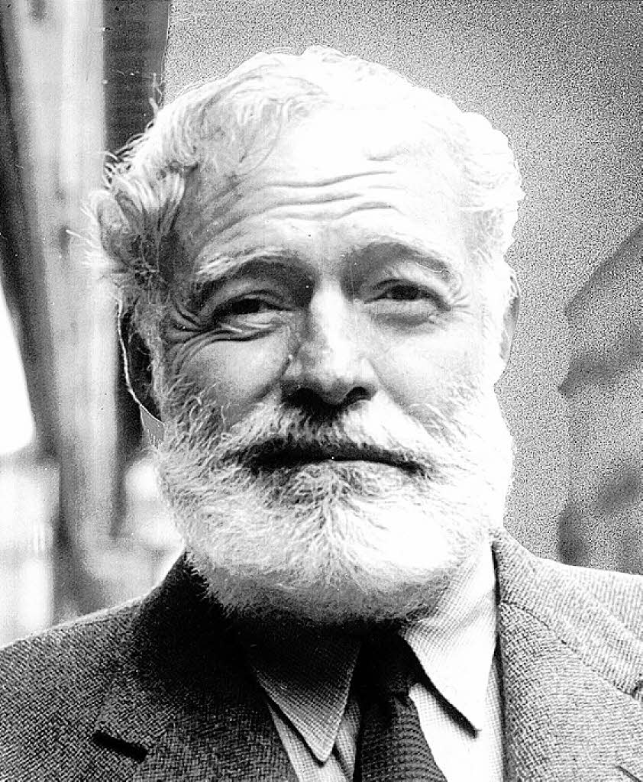
Arts of the 1920s
The great economic and social changes of the 1920s offered novelists a rich source of materials
F. Scott Fitzgerald
Sinclair Lewis
Ernest Hemingway
The “Lost Generation”
Bruce Barton
George Gershwin

Slide 42
Click on the window to start video

