Slide 1
State Government

Slide 2
Bellringer
What do you know about NC government?

Slide 3
Powers of the State
The Constitution establishes a federal system where power is divided between the federal and state government.
Which amendment states that any power not delegated to the to the federal government belongs to the states?
  This is idea of reserved powers
Reserved powers allow the state government to establish rules for the health, safety and welfare of the citizens. Of their states.
  Marriage
  Driving laws
  Education
  Voting
  Control over governments within their boundaries

Slide 4
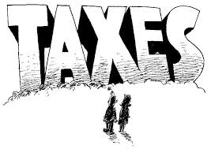
Powers of the State
Some powers are shared by both the state and federal government.
  These are called concurrent powers.
Both the state and federal government can tax their citizens.
  Federal: federal income tax
  State: sales tax; income tax, property tax
Both the state and federal government can make and enforce laws.
Both the state and federal government can establish court systems.

Slide 5
State Constitutions
Each of the 50 states has its own constitution. These constitutions are the rules that organize the state government.
Most state constitutions have the following elements:
  A preamble that states the basic principles on which the state government is founded.
  A bill of rights
  An outline of the organization of the state’s government
  Methods for amending the state constitution

Slide 6

North Carolina Constitution
North Carolina has had 3 constitutions
Constitution of 1776
  First constitution of an independent state
  “first in freedom”
Constitution of 1886
  Created after North Carolina was readmitted to the Union
Constitution of 1971
  Reorganized the entire state government in light of the requirements of the modern economy and society

Slide 7
North Carolina Constitution
North Carolina’s current Constitution was adopted in 1971.
The NC Constitution is modeled after the US Constitution and the same principles.
  Popular sovereignty
  Limited government
  Separation of Powers
  Checks and Balances
NC’s Constitution contains
  Declaration of Rights
  Structure, power & duties of the three branches
  Duties & powers of state agencies, boards & institutions
  Structure, power & duties of local governments

Slide 8
NC Constitution
Article I: Declaration of Rights
Article II: Legislative
Article III: Executive
Article IV: Judicial
Article XIII: Amending

Slide 9
Structure of NC Constitution
Preamble
Article I: Declaration of rights
Article II: Legislative
Article III: Executive
Article IV: Judicial
Article V: Finance
Article VI: Suffrage and eligibility
Article VII: Local government
Article VIII: Corporations
Article IX: Education
Article X: Homesteads and exemptions
Article XI: Punishments, corrections, and charities
Article XII: Military forces
Article XIII: Conventions, constitutional amendment and revision
Article XIV: Miscellaneous

Slide 10
Amending the NC Constitution
The NC Constitution can be amended by a constitutional convention or by legislative initiative.
There are two methods of amending the NC Constitution.
Both methods require a referendum
  A referendum is the practice of referring measures proposed or passed by a legislative body to the vote of the electorate for approval or rejection
The people have the final say in approving or rejecting a proposed legislative action in a referendum.

Slide 11
Amending the NC Constitution
Convention of the People
  2/3 of both houses of General Assembly
  Proposition for convention submitted to qualified voters
  If majority want a convention, the convention is held
  Revision adopted by convention
  Revision proposed to voters, if majority vote in favor will become effective
Legislative Initiative
  Revision may be proposed by General Assembly if 3/5 of both houses vote in favor of submitting proposed amendments to the state’s qualified voters
  Revision proposed to voters, if majority vote in favor will become effective
Changes to NC Constitution are incorporated into the document.

Slide 12
Bellwork
How is the North Carolina government similar to the federal government?

Slide 13
Separation of Powers
One of the principles reflected in the North Carolina Constitution is separation of powers.
North Carolina state government is divided into 3 branches.
Legislative
  Creates laws
Executive
  Enforces laws
Judicial
  Interprets laws

Slide 14
State Legislatures
Every state has a state legislature or lawmaking body.
Citizens elect state lawmakers to pass laws on their behalf. Legislators are representatives of the citizens in the states’ lawmaking bodies.
Most states have legislators that are divided into two houses, known as a bicameral legislature.
The larger of the chambers is typically called the House of Representatives and the smaller house is known as the Senate.
The state is divided into different legislative districts. Each member of the legislature represents the people who live in a particular district

Slide 15
North Carolina Legislature
North Carolina’s legislature is called the General Assembly.
The General Assembly is bicameral and has a House of Representatives and a Senate.
In odd- numbered years, the legislature is in long session (January through July) and in even-numbered years the legislature is in short session (May through July). However, there is no set adjournment date so the length of sessions can vary.
  2013 – long session
  2014 – short session

Slide 16
NC Legislature
Total number
  Senators: 50
  Representatives: 120
Qualifications: Every NC voter who is at least 21 years of age is eligible to run for office
  Senate:
    25 years of age
    Qualified voter of the State
    Resided in the State as a citizen for two years
    Reside district for which he is chosen for one year immediately preceding his election.
  House:
    A qualified voter of the State
    Resided in the district for which he is chosen for one year immediately preceding his election

Slide 17
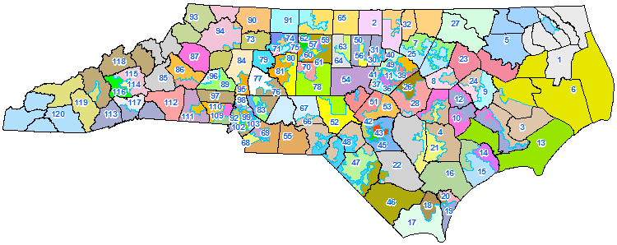

Slide 18
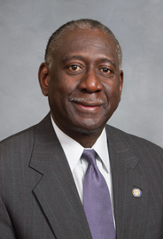
District 12
George Graham
District includes parts of Lenoir, Craven, and Greene counties.

Slide 19

District 10
John Bell
District includes parts of the Craven, Greene, Lenoir, and Wayne counties.

Slide 20

District 3
Michael Speciale
District includes parts of Craven, Pamlico, and Beaufort counties.

Slide 21
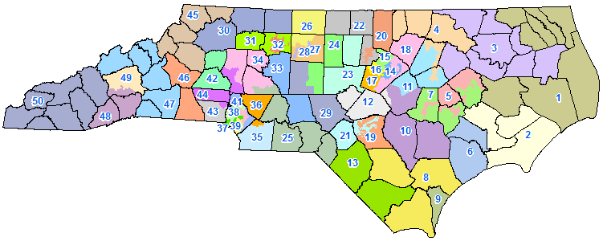

Slide 22
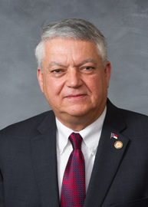
Senate District 2
Norman Sanderson
Represents Carteret, Craven, and Pamlico counties.

Slide 23
NC Legislature
Members of the NC House and NC Senate serve two year terms.
  There are no term limits on members of the General Assembly
Senate Officers
  The Lieutenant Governor is President of the Senate and presides over the Senate, but has no vote unless the Senate is equally divided.
  The Senate also elects a President Pro Tempore
House of Representatives
  The House elects its Speaker and other officers.
NC does not have term limits on the General Assembly

Slide 24
Passing State Laws
State pass laws governing all areas within their responsibility.
The law making process in the states is similar to that of the federal government.
  Bill is introduced
  Bill is sent to committee
  Bill reaches the floor
  Bill is sent to the second house
  Bill is sent to a joint committee
  Bill is sent to the governor
The governor may veto a bill he or she does not support.
In most states the governor also has the power to veto only one part, or item, of an appropriation bill. This is called an item veto.
  NC does NOT have line item veto

Slide 25
Passing State Laws - NC
The bill shall be signed by the presiding officer of each house before being presented to the Governor.
  If the Governor approves, the Governor will sign it and it will become a law
  If not, the Governor will return it with objections and a veto message stating the reasons for such objections.
The Governor’s veto may be overridden by 3/5 vote of each chamber.
If the bill is not vetoed by the governor within the prescribed time, the bill becomes law as if it had been signed.
  10 days if in session
  30 days if adjourned with no day to reconvene
  30 days if adjourned for more than 30 days

Slide 26
Find out…
Who is your representative
One bill they sponsored
One bill voted in favor of and one bill voted against
Previous occupation

Slide 27
State’s Executive Branch
The citizens of each state elect a governor to run the day-to-day affairs of their state.
  The governor is the chief executive in each state.
Governors lead the state government, set priorities, make government appointments, and implement laws to meet the needs of their states.
Although the governor is typically the chief executive, a governor may share executive powers with other executives.

Slide 28
NC Governor
NC Governor is elected for a four year term.
  Terms are limited to no more than 2 consecutive terms
Requirements
  Must be 30 years of age
  US citizen for at least 5 years
  Resident in NC for at least two years immediately preceding election
NC’s current governor is Roy Cooper

Slide 29
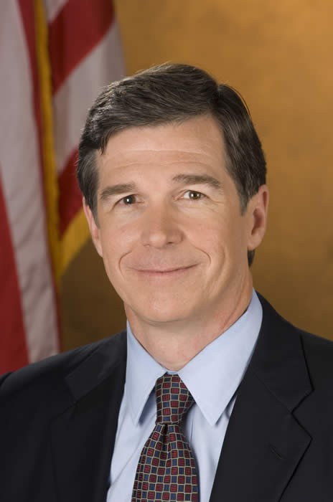
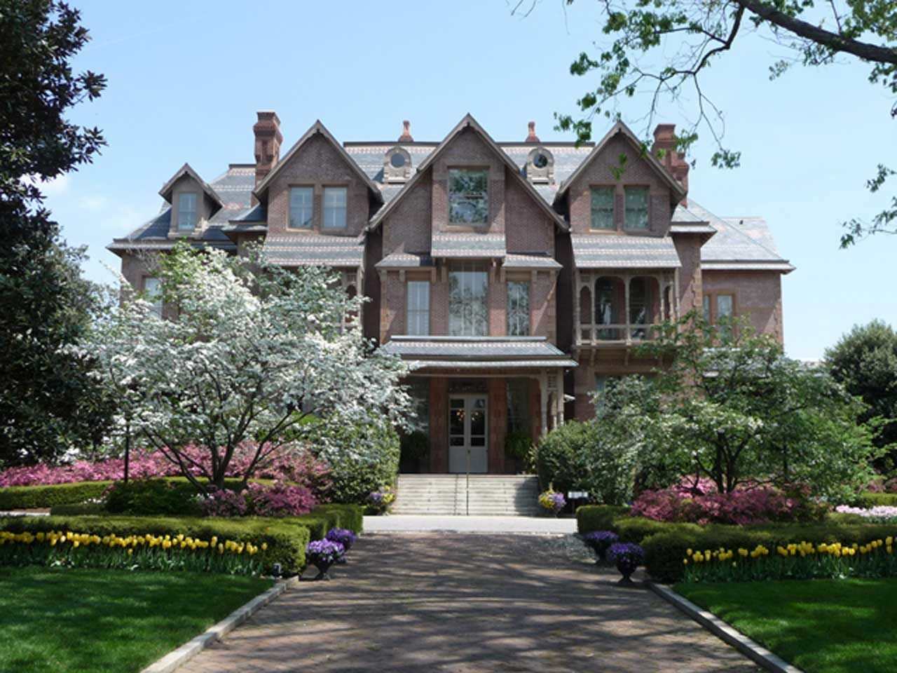
NC Governor

Slide 30
Powers and Duties of Governor
Budget
  Prepares and recommends a budget to the General Assembly
  Balanced budget
Execution of the Laws
  The Governor shall take care that the laws be faithfully executed.
  Assists in lawmaking process; received veto power in 1996
Commander in Chief
  The Governor is Commander in Chief of the military forces of the State except when called into the service of the US
Clemency
  May grant reprieves, commutations, and pardons
Appointments and administrative reorganization
  Makes appointments with advice and consent of majority of Senate

Slide 31
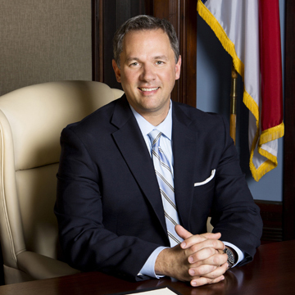
Lieutenant Governor
Lieutenant Governor is elected to a 4 year terms.
Same qualifications as governor
Part of the Council of State
President of the Senate, but shall have no vote unless the Senate is equally divided
The Lieutenant Governor shall become Governor upon the death, resignation, or removal from office of the Governor

Slide 32
NC Executive Branch
Included within the executive branch is the Council of State.
  The Council of State is a group of popularly elected executive offices.
The Council of State consists of elected department heads.
  Lieutenant Governor
  Secretary of State
  Attorney General of North Carolina
  Commissioner of Agriculture
  Commissioner of Insurance
  Commissioner of Labor
  Superintendent of Public Education
  State Treasurer
  State Auditor
Serve four year terms

Slide 33
Lieutenant governor
  Serves as presiding officer of the state senate.
Secretary of State
  Oversees business-related and economic operations
Commissioner of Labor
  Promotes the health, safety, and well being of working people
Attorney General
  Provides legal advice and representation to state agencies
  Represents the state in court when state is involved in lawsuits
State Treasurer
  Oversees financial operations of state
State Auditor
  Examines state’s financial records
Superintendent of Public Instruction
  Oversees public school systems

Slide 35
NC Executive Branch
The governor also has a cabinet consisting of the heads of various state departments.
  Cabinet – group of unelected heads of executive departments that are appointed by the governor of approved by Senate.
These positions are appointed by the governor.
Cabinet includes:
  Secretary of Administration
  Secretary of Cultural Resources
  Sectary of Health and Human Services
  Secretary of Public Safety
  Secretary of Commerce
  Secretary of Transportation
  Secretary of Environment and Natural Resources
  Secretary of Revenue

Slide 36
Bellringer
How is separation of powers represented in NC?

Slide 37
State Court System
As a citizen you are subject to two levels of law and two sets of judicial systems.
State courts are structured in levels. There are three types of courts found in most states.
Trial Courts
  Most states have a small claims court
Appellate Courts
  Person may appeal decision to an intermediate court
  Judges examine the record of the lower court and hears arguments from lawyers
State Supreme Court
  Highest court in states; decisions are final

Slide 38
NC Court
District Court
  Civil; criminal; juvenile; magistrate
  Bench trial
  Judges serve four year terms
Superior Court
  Jury trials
  Judges rotate every six months among districts within division
  Judges serve eight year terms
North Carolina Court of Appeals
  Decides questions of law
  Three judge panel
  Judges serve eight year terms
North Carolina Supreme Court
  Chief Justice and six associate justices
  Judges serve eight year terms

Slide 39
Bayard v. Singleton 1787
First legal decision dealing with the idea of judicial review.
A loyalist’s daughter, Bayard, sued the purchaser of property that was seized from her father to recover the property.
A NC law stated that those who purchased the land under the Confiscation Acts of 1777 could not be sued for recoupment of the land.
The state court held that the NC law was unconstitutional.

Slide 40
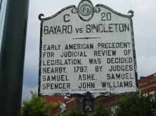
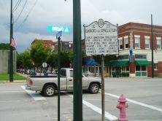

Slide 41
State v. Mann 1829
Established that masters were not subject to a criminal indictment for battery committed on slaves.
Defendant Mann shot a slave that he had hired. He was charged and convicted of battery.
State Supreme Court held that slaves were absolute property of the slave-owners and their owners could not be punished for nonfatal battery.

Slide 42
Leandro v. NC 1994
Lawsuit brought by parents, children, and school districts in five low-wealth counties. Plaintiffs argued due to lower tax revenues in these counties, the schools did not have enough money to provide education.
Leandro stands for the proposition that all children in North Carolina have a fundamental right to the opportunity to receive a sound, basic education.

Slide 43
Swann v. Charlotte-Mecklenburg BOE
Case established court-ordered busing of students as a means of desegregating public schools.
The Charlotte-Mecklenburg school system had approximately 14,000 black students who attended schools that were either totally black or more than 99 percent black.
Federal Supreme Court the existence of an all-black or all-white schools must not be shown to be the result of segregation policies. The court also held that since school buses were a traditional form of public education transportation, they could be used in busing efforts to correct racial imbalances

Slide 44
Local Government

Slide 45
Bellwork
What is the purpose of local government?

Slide 46
Local Authority
All state constitutions lay out rules for establishing local governments.
Local ordinances (laws) must follow the state & federal constitution.
“The General Assembly shall provide for the organization and government and the fixing of boundaries of counties, cities and towns, and other governmental subdivisions, and, except as otherwise prohibited by this Constitution, may give such powers and duties to counties, cities and towns, and other governmental subdivisions as it may deem advisable”
Two main types of local government in NC:
  Municipality and Counties

Slide 47
Functions of Local Governments
Education
Transportation
Social Services
Sewage & Sanitation
Zoning
Police & Fire
Recreation
Water

Slide 48
Types of Local Governments
Counties: largest subdivision of a state.
  Craven County
  NC has 100 counties
Municipalities: any urban unit of government like towns or cities.
  New Bern
  Trent Woods
  Riverbend

Slide 49
Craven County
Each county is governed by a Board of Commissioners
The Craven County board of Commissioners consists of 7 members who are elected.
  These Commissioners serve 4 year terms.
The Board of Commissioners are responsible for adoption of the County’s budget and regulation of conduct through ordinances.
  Ordinances v. statutes
The BOC also hires administration that oversees the operation of the counties departments.
  County manager

Slide 50
Craven County
The Board of Commissioners servers as the legislative branch.
The Sheriff of the county is your chief law enforcer.
  Elected; serves 4 year term
  Current Sheriff: Jerry Monette
In Craven County your judiciary consists of the Clerk of Court, Register of Deeds, and county courts.
  Clerk of Court – keeper of court records
  Register of Deeds – keeper of public records

Slide 51
Municipalities
Include cities, towns, and villages.
The type of government depends on charter submitted, but is often by size.
Most NC municipalities use the weak mayor-council-manager plan, but some give their mayor a few powers like veto.
  Weak-mayor/council-manager – mayor serves a ceremonial role or head of the council, while a city manager oversees the government.
  Strong-mayor – serves as chief executive
When an area wishes to incorporate as a municipality to form a local government, the General Assembly must approve the charter. A charter is the municipality’s plan of government.

Slide 52
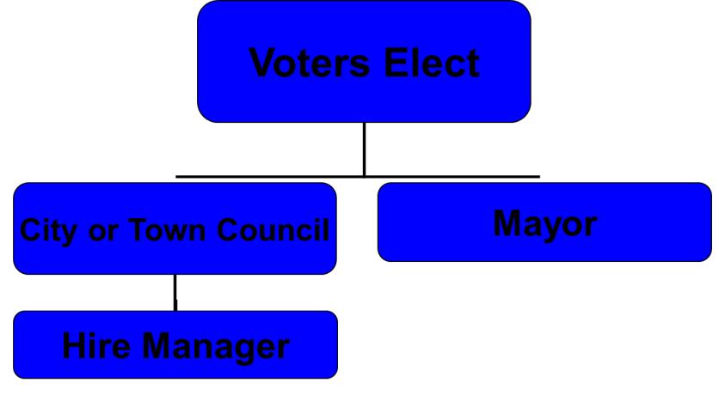

Slide 53

Municipalities
Councils: Legislative Body
  Make ordinances
  Approve personnel & budget
  Levy taxes
Mayors: Ceremonial Executive
  Make appointments to Advisory Boards
  Ceremonial Functions
Managers: Chief Executive
  Make budget
  Carry out ordinances
  Oversee non-elected personnel; hire non-elected department heads

Slide 54
New Bern, North Carolina
Board of Alderman: Six elected officials from each ward.
Mayor: the mayor is elected every four years and preside at all board meetings.
City Manager: reports directly to the Board of Aldermen, acts as the administrator to carry out City policies, and is responsible for running the day-to-day business of the City.
City clerk: Keeps minutes for the Board of Aldermen meetings, maintains official records and documents, is the Secretary to the Police Civil Service Board.

Slide 55
Special Districts
Special districts are created to meet certain needs.
Special needs include:
  Fire protection
  Parks and recreation centers
  Public transportation
  Hospitals
  Education
Special districts may include several cities.
State legislators usually sets up a commission to handle details of establishing and operating a special district.

Slide 56
State v. Mann 1829
Established that masters were not subject to a criminal indictment for battery committed on slaves.
Defendant Mann shot a slave that he had hired. He was charged and convicted of battery.
State Supreme Court held that slaves were absolute property of the slave-owners and their owners could not be punished for nonfatal battery.
State Constitution is Supreme for North Carolina

Slide 57
State Controversies

Slide 58
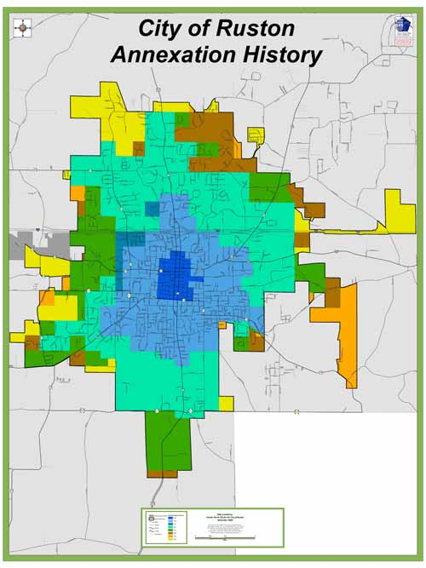
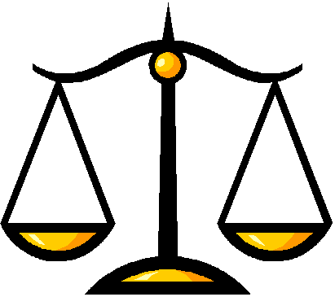
State Controversies
Annexation: city expands by incorporating outlying areas
  Proponents: utility and police/fire services
  Opponents: higher taxes
Balanced Budget: NC Constitution says government spending must equal revenue
  Not always easy; many gov’t services with manageable taxes?

Slide 59


State Controversies
State Lottery – Education Lottery: helps to pay for education
  Proponents: raise money w/o new taxes
  Opponents: Gambling is immoral, disadvantages poorer citizens

Slide 60


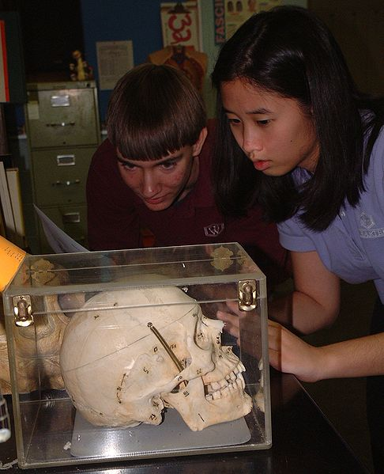
State Controversies
Charter Schools: Public schools for specific needs (behaviorally challenged or exceptional students)
  Proponents: Alternative to public education; meets special needs
  Opponents: Public taxes for small population? Take away diversity from public schools

Slide 61
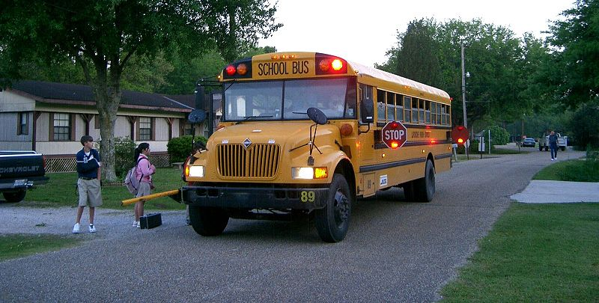
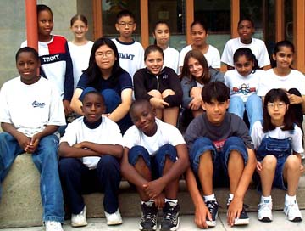
State Controversies
School Bussing: Ensure diversity in schools by bussing students from different neighborhoods
  Proponents: prevents de facto segregation
  Opponents: Inconvenience; makes race an issue

Slide 62
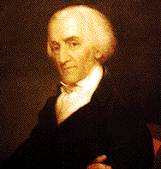
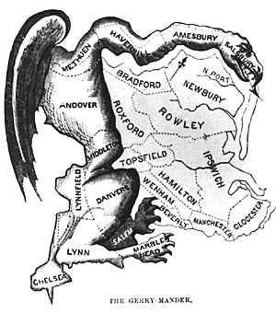
3.5 State Controversies
Redistricting: done every 10 years with new census by state legislature to reapportion
Gerrymandering: redistricting in oddly shaped voting districts to help one political party
  E. Gerry + Salamander District = Gerrymandering!
  Illegal when done against different races; but not for political purposes

Slide 63
Federal and Local Government

Slide 64
Federal System
In everyday practice the separate layers of government overlap and work together.
By signing the US Constitution the states agreed to cooperate with one another.
  “Full faith and credit shall be given in each State to the public acts, records, and judicial proceedings of every other state.” Article IV Section 1
The full faith and credit clause ensures that each state will accept the decisions of other states.

Slide 65
Federal System
The states also work with the federal government.
State and federal governments cooperate to build highways, assist the unemployed, help people with low incomes, conserve natural resources, and cooperate in times of crisis.
All actions undertaken by local government must comply with the US Constitution.
Federal government ensures cooperation by providing funds to implement important programs.
  Grants-in-aid: federal funds given to state and local government for a specific purpose
  Block grants: funds given by federal government for a broadly defined purpose.

Slide 66
Federal System
Block Grants
Grants-in-aid
Justice Assistance Grant
Head Start

Slide 67
North Carolina’s Budget
North Carolina ’s constitution requires that the budget enacted by the general assembly be balanced and include two fiscal years, beginning on July 1 of each odd-numbered year.
  Balanced budget means that expenditures cannot exceed revenues
  The governor prepares and recommends a budget and the General Assembly adopts the budget.
About half of North Carolina’s total revenue originates from tax collections and other sources comprising the General Fund and Highway Funds.
These funds are used to finance state administered programs such as education, public health, public safety, and the general services of state government.

Slide 68
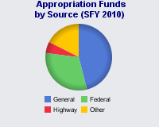

Slide 69
North Carolina’s Budget
The General Fund receives support from 12 primary sources.
  Income tax (corporate and individual)
  Sales and use tax
  Franchise tax
  Other – alcohol, tobacco, estate, gift
The Highway Fund receives support from three main sources.
  Excise tax on motor fuels
  Licenses and fees collected by the DMV
  Interest on cash balances of the state treasurer

Slide 70
Revenue Sources
Driver’s License
  State; based on benefit
Real and Personal Property Tax
  Local
Personal Income Tax
  Federal/State/Local
Hunting License Fees
Inheritance Taxes
Sales Taxes
Occupancy Taxes
Impact Fees

Slide 71
Revenue Sources

