Slide 1
The American West:
The Fight for the West

Slide 2
Main Idea
Native Americans fought the movement of settlers westward, but the U.S. military and the persistence of American settlers proved too strong to resist.

Slide 3
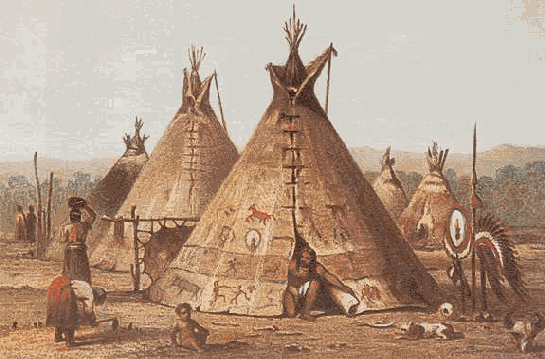
Stage Set for Conflict
Plains Indians
Sioux, Blackfoot, Cheyenne, Kiowa, Comanche
Nomadic
Did not believe land should be bought and sold
Followed migrations of buffalo herds
Main source of food, clothing, shoes, shelter, supplies

Slide 6
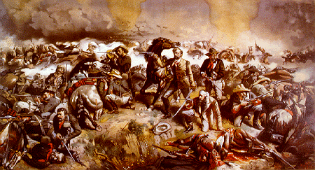
Stage Set for Conflict
Government policy
Old policy: push the Indians westward
New policy: seize Indian land and force them onto reservations

Slide 7
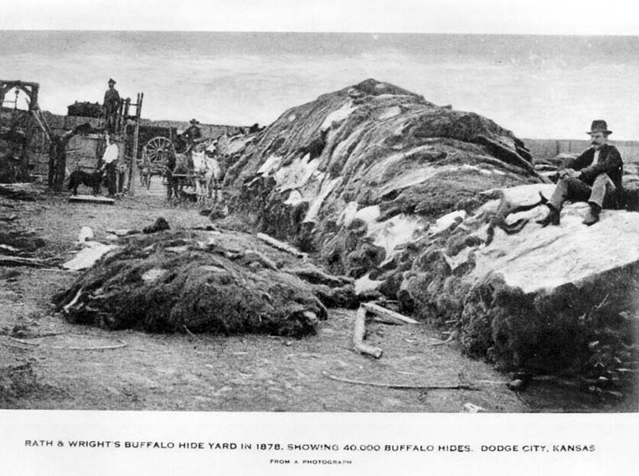
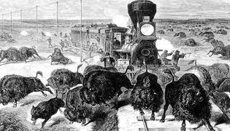
Stage Set for Conflict
Being confined to reservations threatened way of life
Buffalo being driven to extinction
Reduced grazing lands
Cut off migration routes
Disease
Hunting for sport and profit

Slide 8
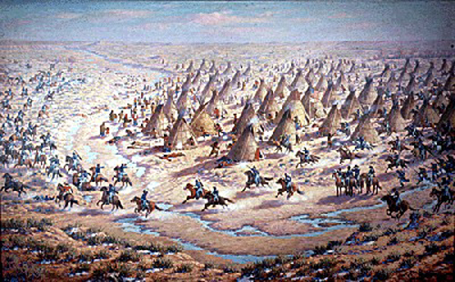
The Indian Wars
Sand Creek Massacre
Army troops attacked and massacred surrendering Cheyenne
Congressional investigators condemned the Army’s actions
No one was punished

Slide 9
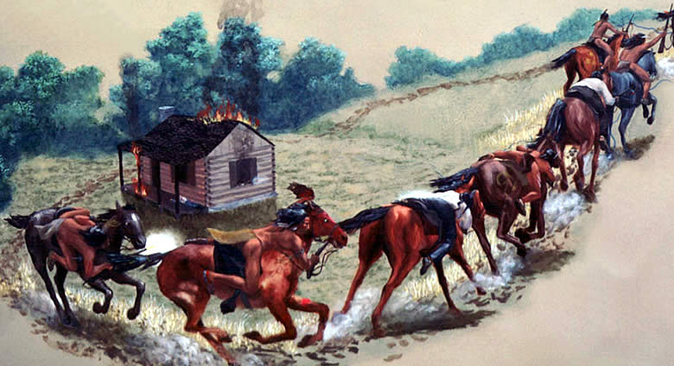
The Indian Wars
Increased Indian raids
In return for closing the Bozeman trail, the Sioux agreed to live on a reservation
Other nations signed the Medicine Lodge Treaty and were moved to reservation lands in western Oklahoma

Slide 10
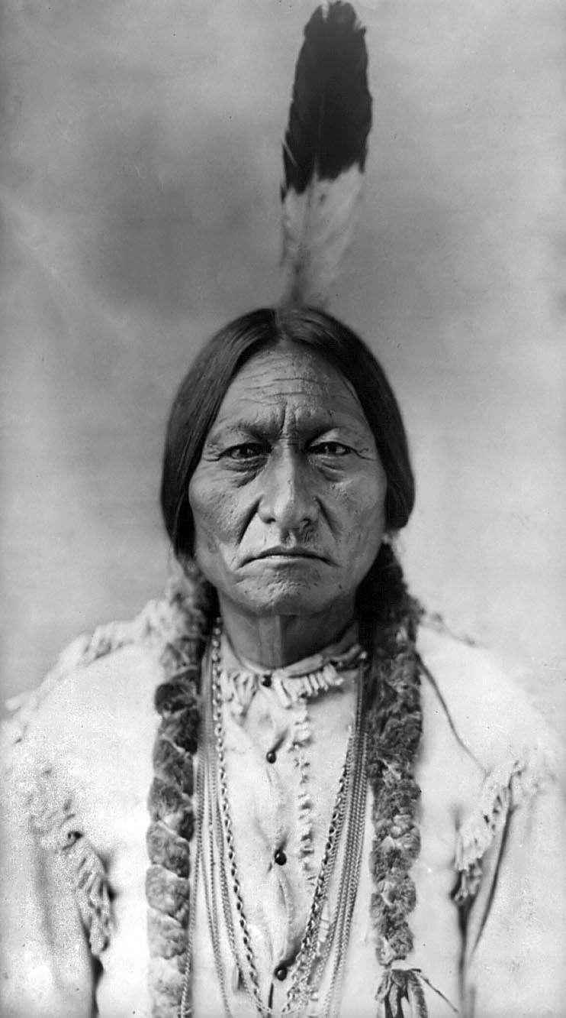
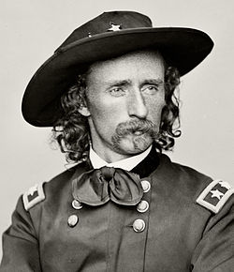
The Indian Wars
Lakota Sioux ordered to return to reservations – refused
Led by Sitting Bull
The Battle of Little Bighorn
2,000 Indians gather near the Little Bighorn River
Lieutenant Colonel George Armstrong Custer orders attack
Surrounded and slaughtered
The U.S. government was determined to put down the threat to settlers.

Slide 11
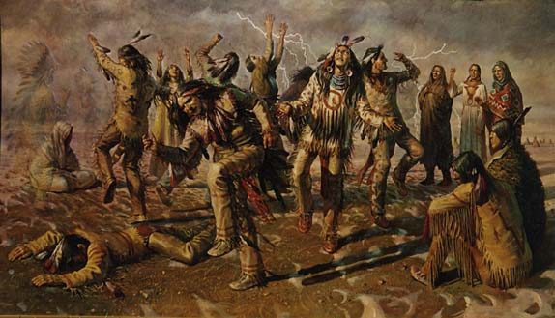
The Indian Wars
The Ghost Dance Movement
Religious movement
Inspired hope among suffering Native Americas
Newspapers begin suggesting that it signaled a planned uprising
Sitting Bull killed during arrest

Slide 12
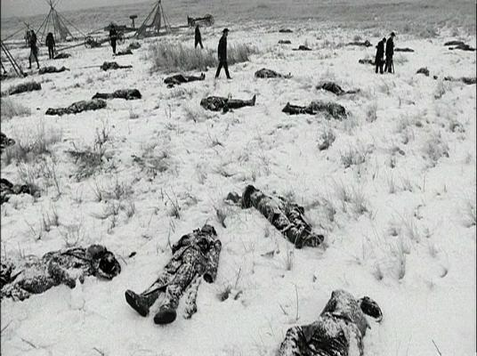
The Indian Wars
Army orders Sioux to give up rifles
The Wounded Knee Massacre
Shooting began after a gun went off, and the fleeing Sioux were massacred
Marked the end of the bloody conflict between the army and the Plains Indians

Slide 13
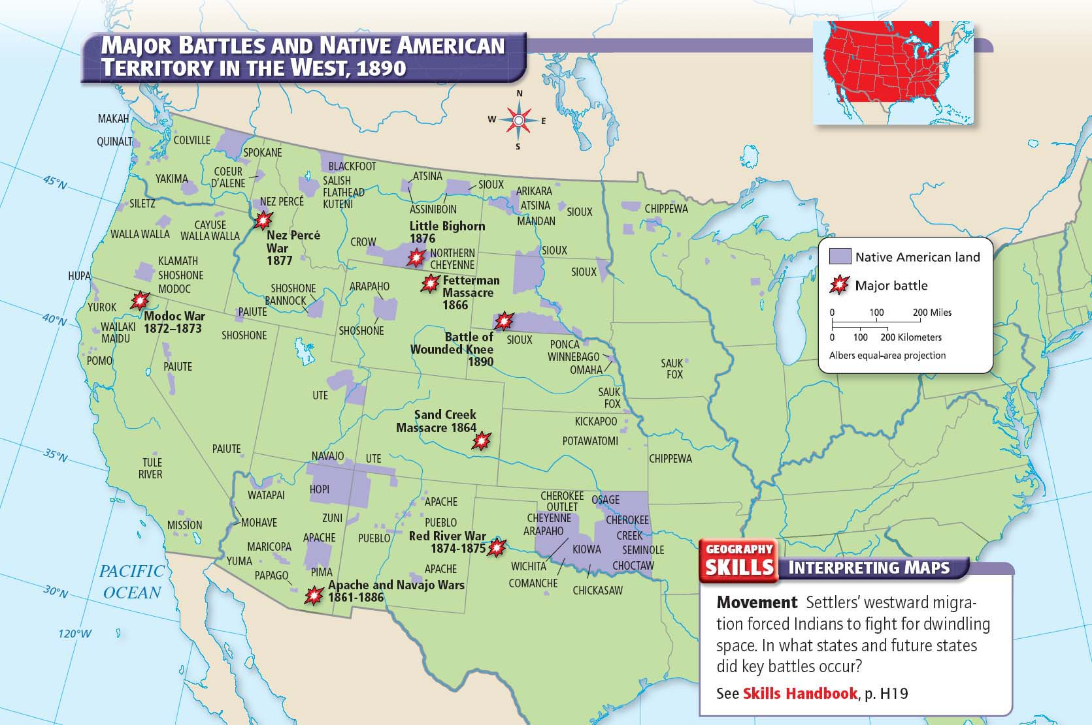

Slide 14
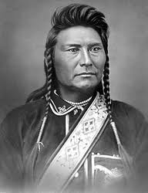
Resistance Ends in the West
Resistance in the Northwest
The government took back nine-tenths of the land when gold miners and settlers came into the area.
Fourteen years later they were ordered to abandon the last bit of that land and move to a small section of Idaho
Chief Joseph tried to take his people into Canada
Forced to surrender
Sent to Washington

Slide 15
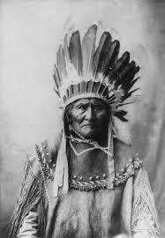
Resistance Ends in the West
Resistance in the Southwest
The Apache moved onto a reservation in Arizona
Geronimo
Fled the reservation
Raided settlements along Arizona-Mexico border
Captured in 1886
Sent to Florida as P.O.W.s
Marked the end of armed resistance in the area

Slide 16
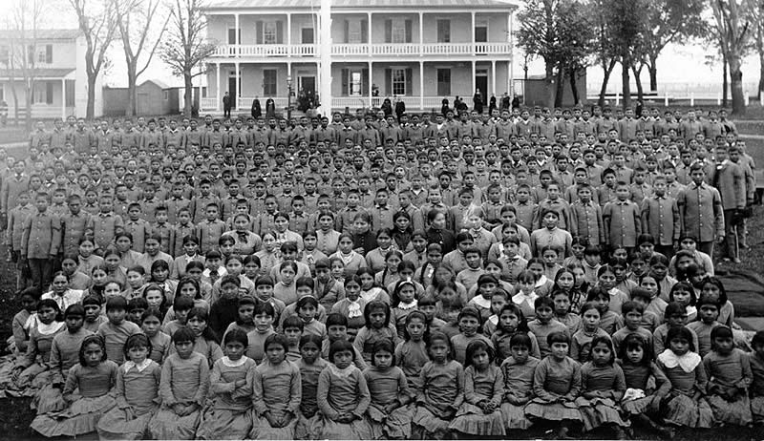
Life on the Reservations
Two reasons for Indian reservations:
1.) Control over western territories
2.) Americanization
Wanted Native Americans to abandon their traditional culture and religions and adopt culture of white America

Slide 17
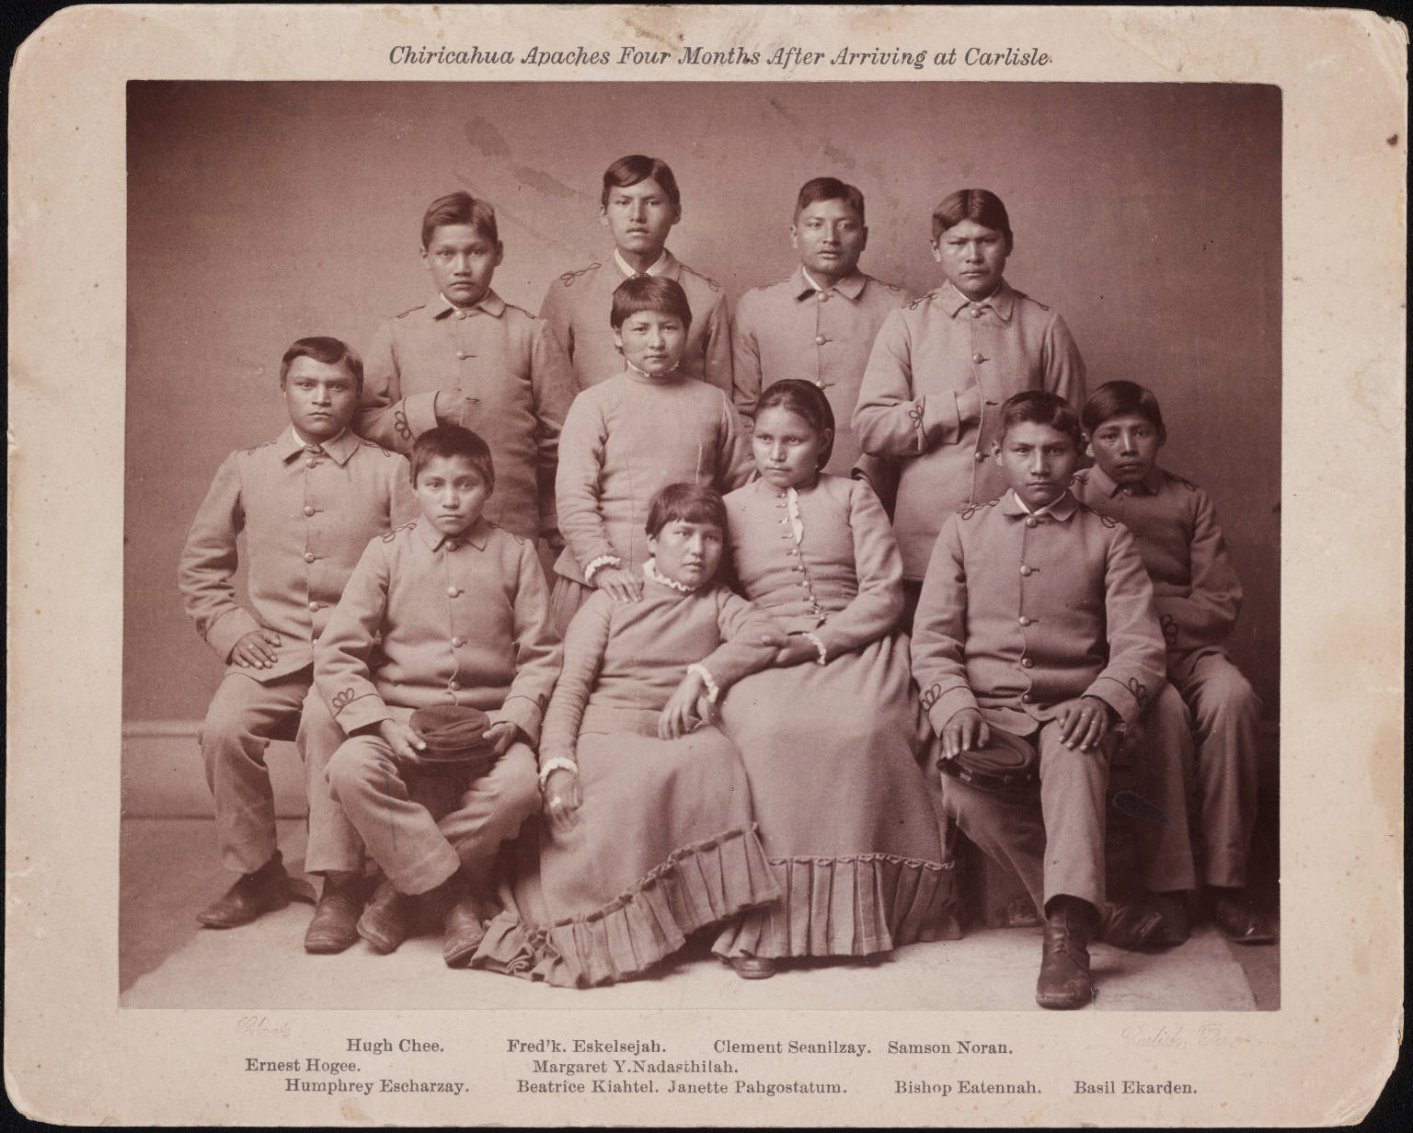
Life on the Reservations
Attacked Native American beliefs, practices, and tribal identity
Bureau of Indian Affairs
Managed the reservations
Issued wide-ranging orders that left few aspects of Indian culture untouched

Slide 18
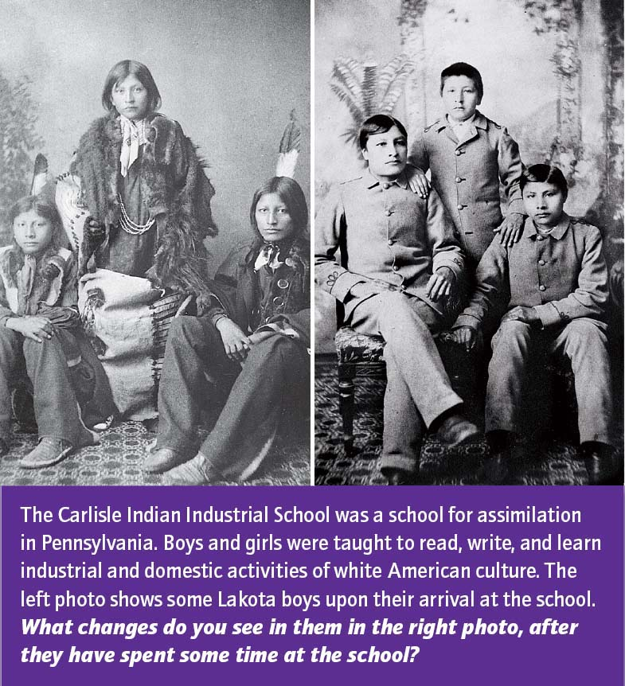

Slide 19
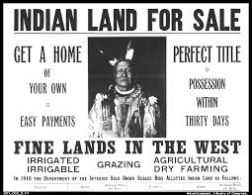
Life on the Reservations
Dawes Act of 1887
Broke up many reservations
Native Americans as individual property owners
Few had the money to start farms
Received less productive land
Unsuitable for farming

Slide 20
The American West:
Mining and Ranching

Slide 21
Main Idea
Many people sought fortunes during the mining and cattle booms of the American West.

Slide 22
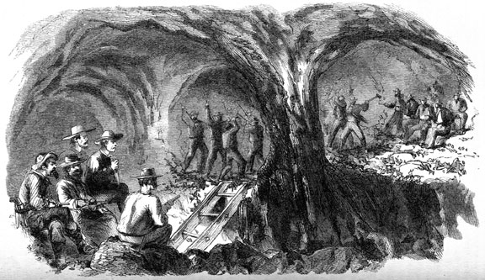
Striking Gold and Silver
News of gold and silver inspired thousands to rush West in search of fortune
1849 – California
1858 – Colorado
Many disappointed
1859 – Nevada
Comstock Lode

Slide 23
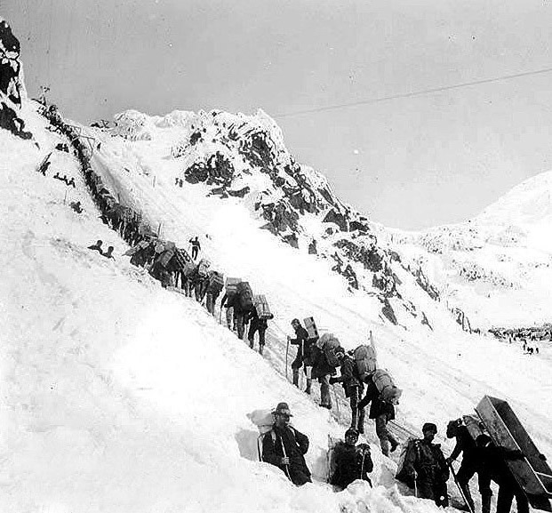
Striking Gold and Silver
1897 – The Klondike gold rush
The Yukon Territory (Canada)
Treacherous
Required to bring a year’s worth of supplies
Reports of “gold for the taking” were false

Slide 24
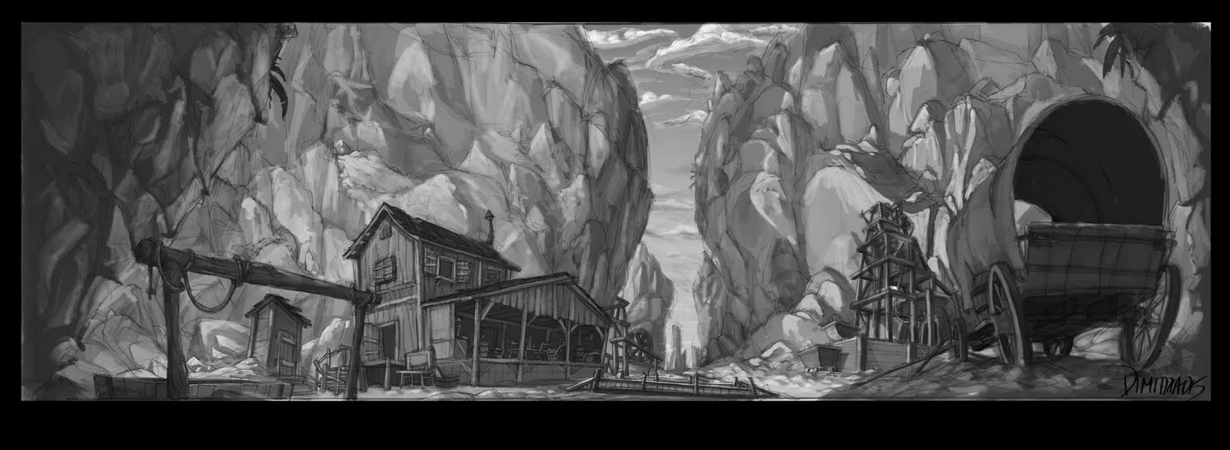
Development of communities
Mining camps and towns
Thousands of men poured into mining areas
Camps hastily built
No law enforcement
Vigilante justice

Slide 25
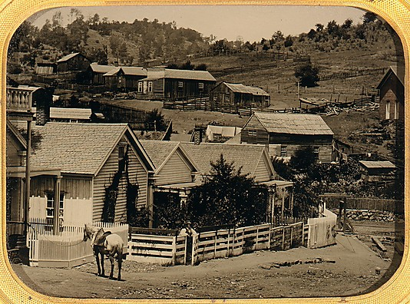
Development of communities
Camps become towns
Stores & saloons
Arrival of families = towns more respectable
Churches, newspapers, and schools

Slide 26
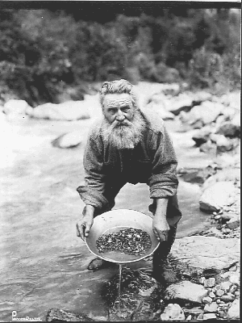
Mining as Big Business
Placer mining
Minerals found in loose sand or gravel
“pan for gold”
Cheap but tough
Needed new equipment to dig deeper

Slide 27
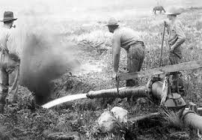
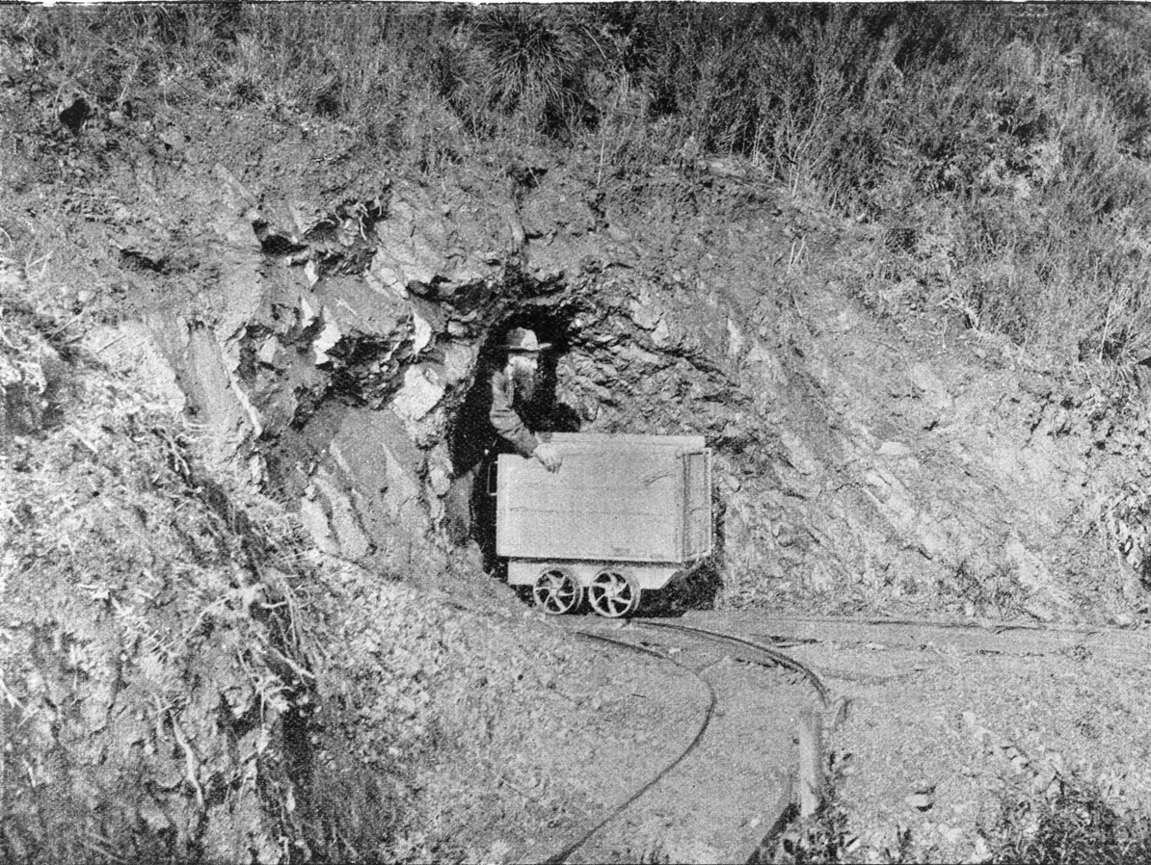
Mining as Big Business
Hydraulic mining
Used high pressure water to blast away dirt
Hard-rock mining
Cutting deep shafts in solid rock to extract the ore

Slide 28
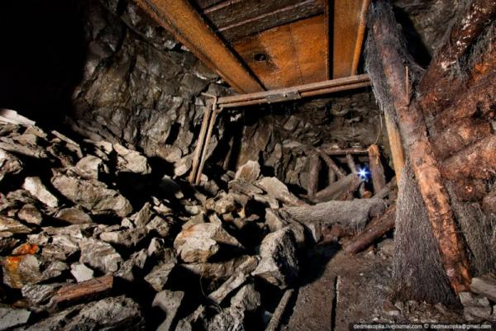
Mining as Big Business
Prospectors became employees, working dangerous jobs for these companies
Cave-ins
Fires
Explosions
Floods
Miners began to organize unions to negotiate safer working conditions and better pay
Mining companies resisted, and violence broke out
Cripple Creek, Colorado

Slide 29
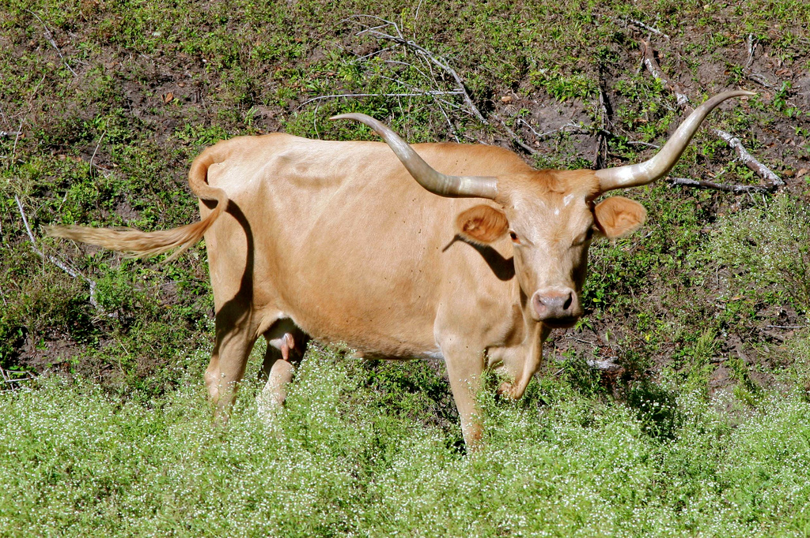
The Origins of Ranching
Spanish were the first ranchers in the West
Raised cattle under dry and difficult conditions
Bred the Texas longhorn
Started sheep ranching
Needed grazing lands

Slide 30
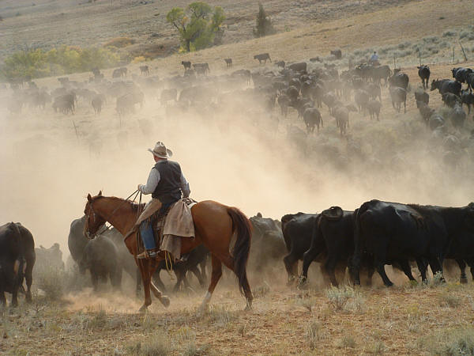
The Origins of Ranching
Growing populations in the East needed food
Demand for beef grew
The age of the cattle drive
Cowboys drove the cattle to towns with railroads to be shipped to meatpacking centers
Chisholm Trail

Slide 31
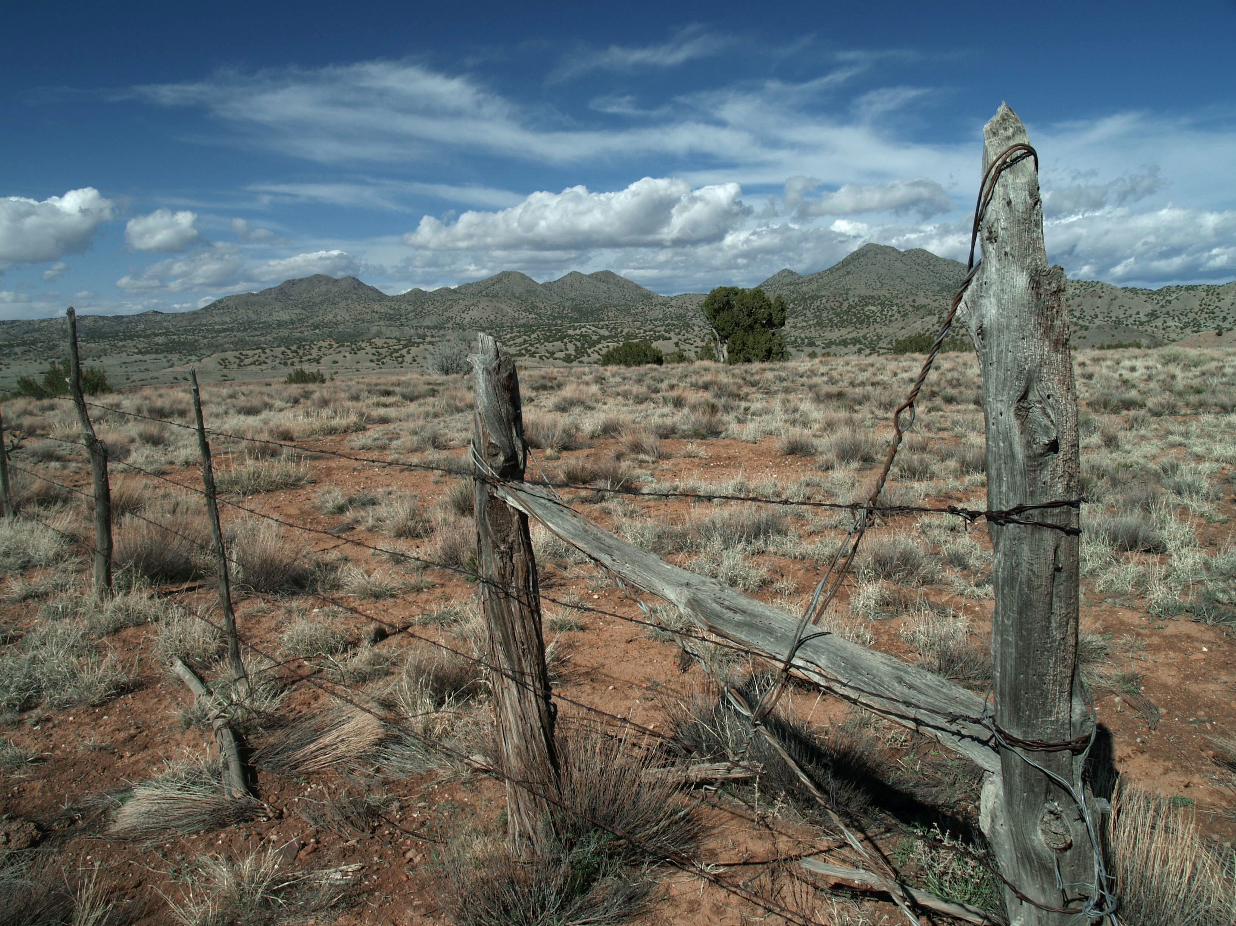
Ranching as big business
Joseph Glidden
Barbed wire
Allowed ranchers to enclose grazing lands
Privately owned ranches spread quickly
Transformed the cattle business into big business
Disputes between landless cattle owners and ranchers

Slide 33
The American West:
Farming the Plains

Slide 34
Main Idea
The government promoted the settlement of the West, offering free or cheap land to those willing to put in the hard work of turning land into productive farms.

Slide 35
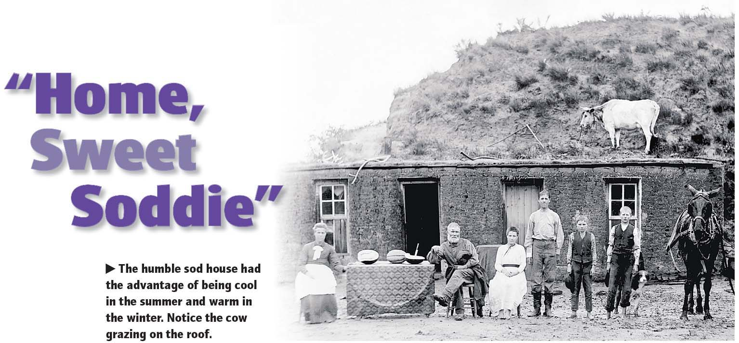

Slide 36
Incentives for Settlement
New legislation
In 1862, Congress passed three acts to turn public lands into private property
1.) The Homestead Act gave 160 acres of land to heads of household
2.) The Pacific Railway Act gave land to the railroad companies to build railroad and telegraph lines
3.) The Morrill Act gave lands to states for colleges for agriculture and the mechanic arts

Slide 37
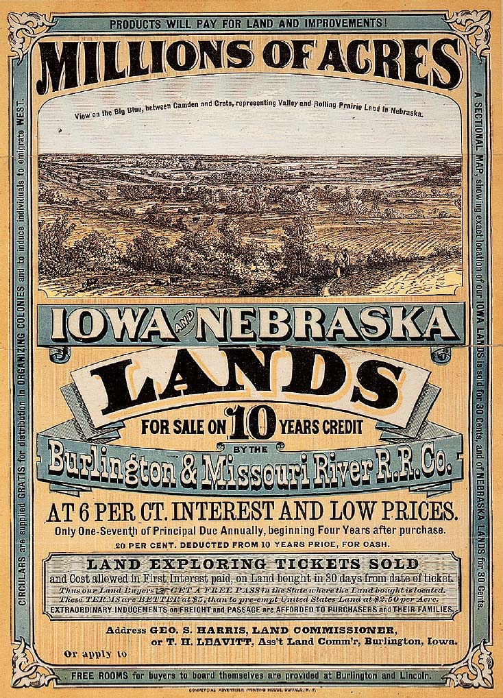
Incentives for Settlement
Railroads encourage settlement
Railroads had nearly 225 million acres of public land
Reaped profits by selling some of the land to settlers
Placed ads to lure homesteads to the West

Slide 38
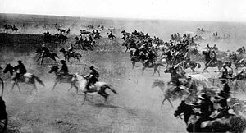
Incentives for Settlement
Millions of acres available after removing the Native Americans
The Oklahoma Land Run of 1889
Over 50,000 people took part in the rush to stake a claim on these 2 million acres of land
1889-1895 – Five different land runs
Many left discouraged

Slide 40
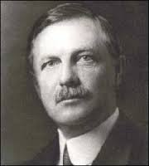
Incentives for Settlement
Closing of the frontier
In 1890 the Census Bureau issued a report, “there can hardly be said to be a frontier line.”
Frederick Jackson Turner
Frontier thesis
Existence of the frontier made the United States distinctive

Slide 41
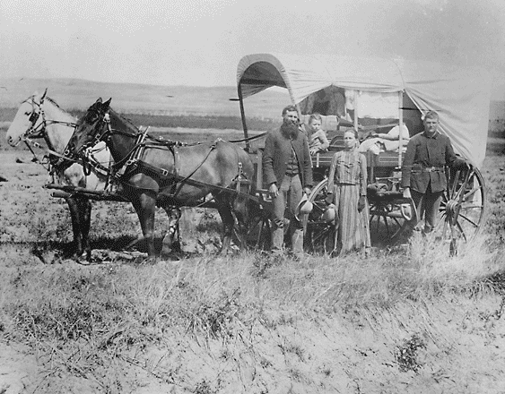
Migrating West
3 groups migrating West:
White Americans from the East
African Americans from the South
Immigrants from foreign countries

Slide 42
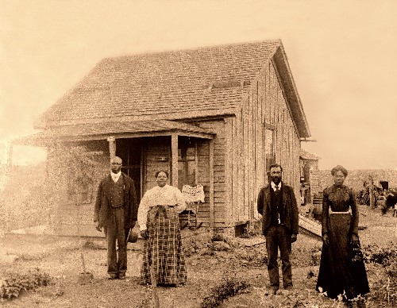
Migrating West
African American settlers
Benjamin Singleton
Former slave
urged his own people to build communities in the West
Some fled the violent and oppressive South
Rumors of land in Kansas brought 15,000 Exodusters who also settled in Missouri, Indiana, Kansas, and Illinois.

Slide 43
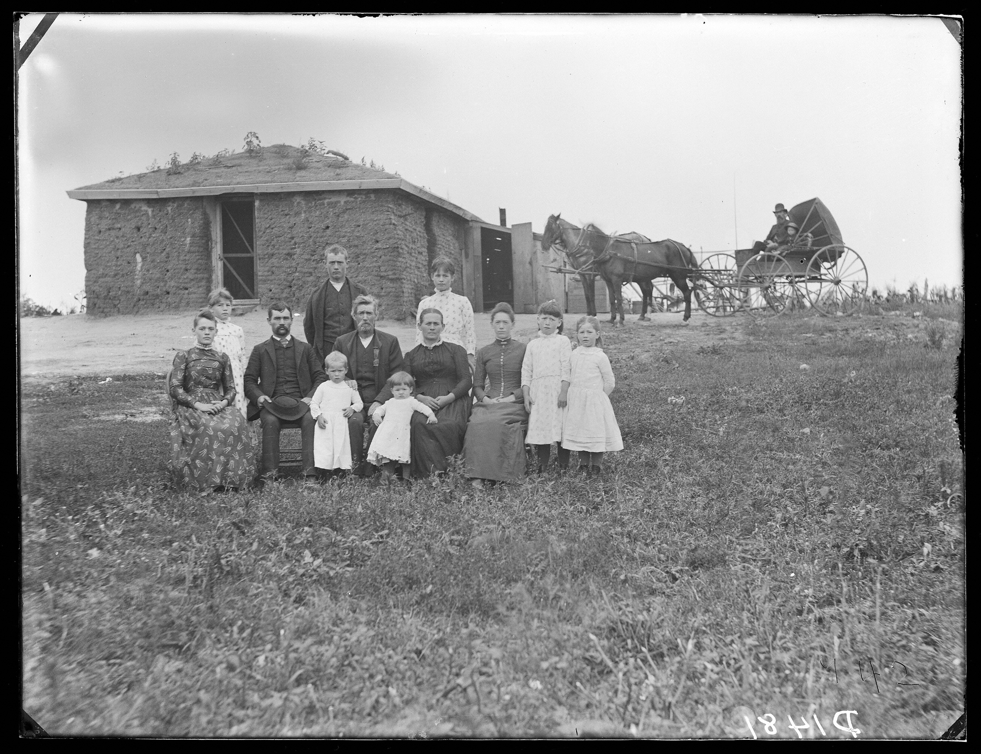
Migrating West
White settlers
Middle-class businesspeople or farmers
They could afford money for supplies and transportation.
European settlers
Lured by economic opportunity, they came from Scandinavia, Ireland, Russia, and Germany.
Brought their farming experience with them.

Slide 44
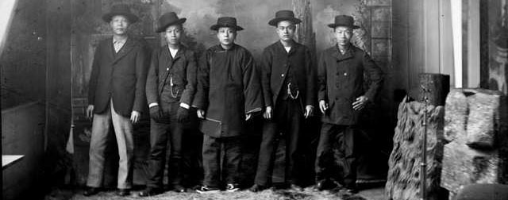
Migrating West
Chinese settlers
Initially came for the gold rush or to build railroads
They turned to farming, especially in California, establishing the fruit industry there.
Most Chinese were farm laborers because they were not allowed to own land.

Slide 46
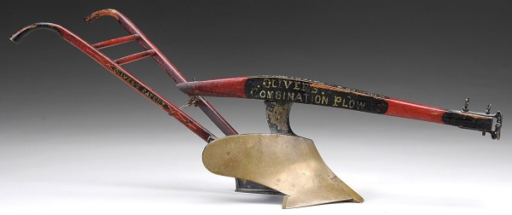
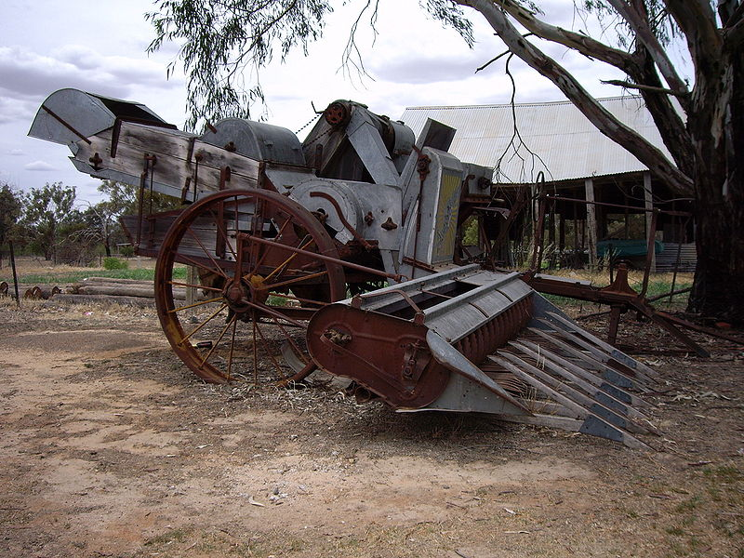
New Ways of Farming
New equipment
James Oliver
Developed new plow with sharper edge
New machines
Combine harvesters

Slide 47
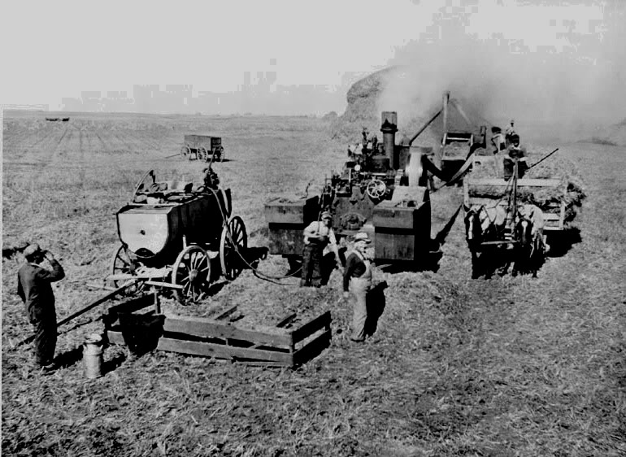
New Ways of Farming
Bonanza farms
Operated like factories
Expensive machines
Specialized tasks
Boom-and-bust farming cycles
By 1890s, most broken up

Slide 49
Click on the window to start video
http://www.youtube.com/watch?v=Q16OZkgSXfM&list=PL8dPuuaLjXtMwmepBjTSG593eG7ObzO7s

