Slide 1
The Beginnings of Civilization
The First People

Slide 2
Main Idea
Scientific evidence suggests that modern humans spread from Africa to other lands and gradually developed ways to adapt to their environment

Slide 3
Studying the Distant Past
Culture
A society’s knowledge, art, beliefs, customs, and values
Artifacts
Objects that people in the past made or used

Slide 4
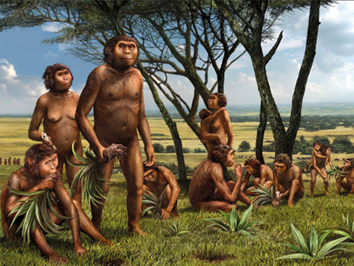
Human Origins
Hominid
Humans and early humanlike beings that walked upright

Slide 6
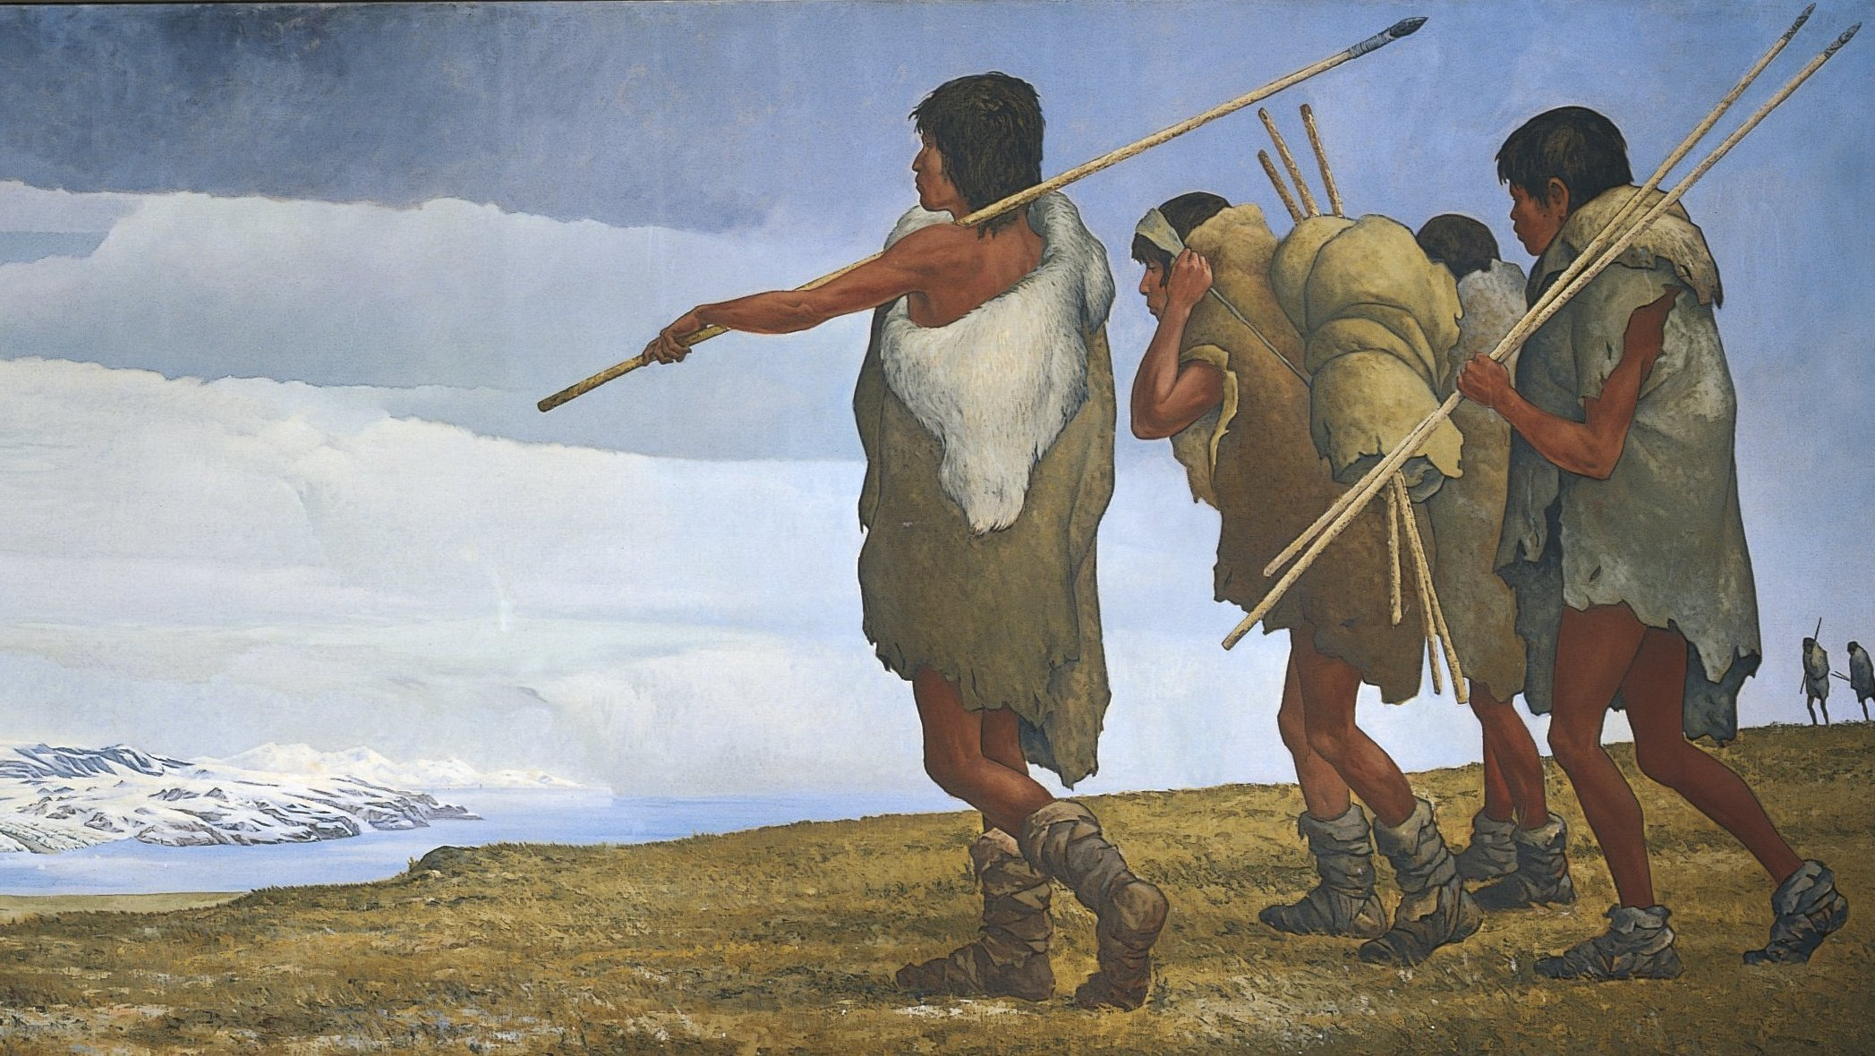
Spreading Around the World
Began to migrate
Looking for food
Changing weather
Homo Sapiens
“Wise Man”

Slide 7
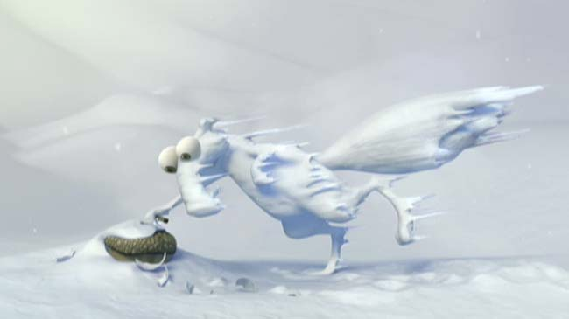
Spreading Around the World
The Ice Ages
Started 1.6 million years ago
Ocean levels fell
More land exposed

Slide 8
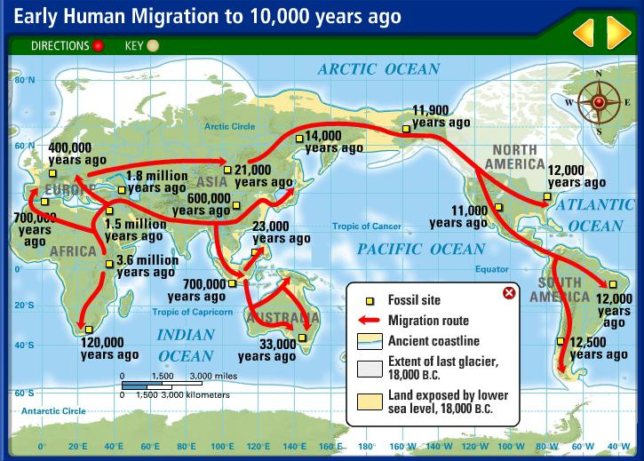

Slide 9
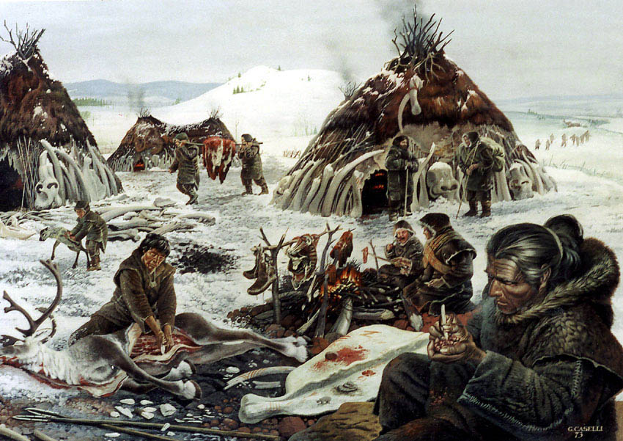
The Stone Age
Paleolithic Era
2.5 million years – 10,000 years ago

Slide 10
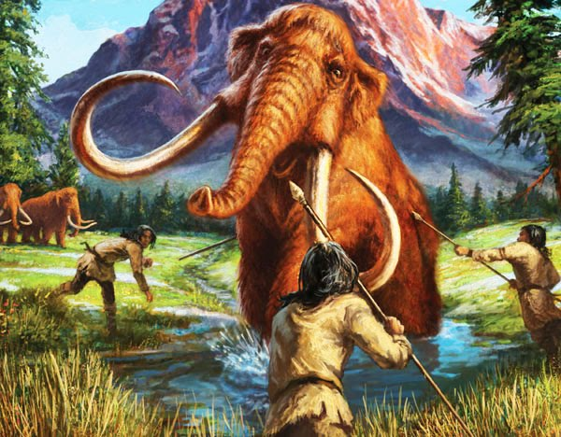
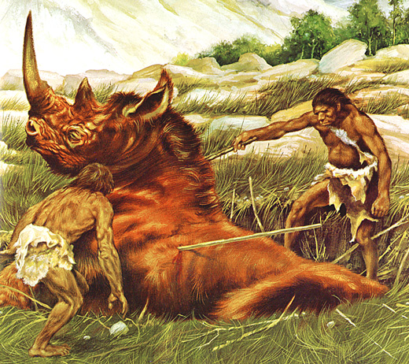
The Stone Age
Lived as nomads
Hunger-gatherers
Early people hunted animals and gathered nuts, berries, and wild plants to survive

Slide 11
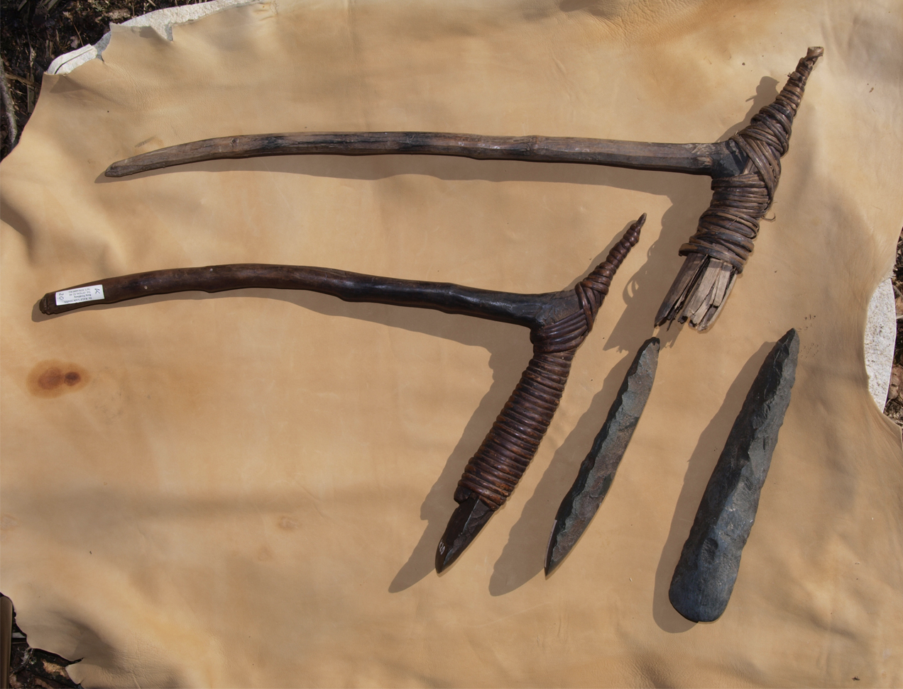
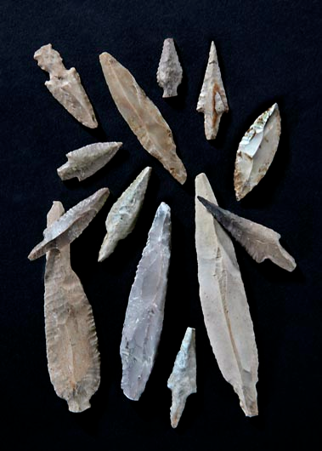
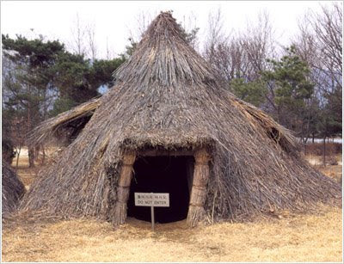
The Stone Age
Developed tools made of stone and animal parts
Spears
String & Bows
Nets & Hooks
Canoes
Clothing
Shelters

Slide 12
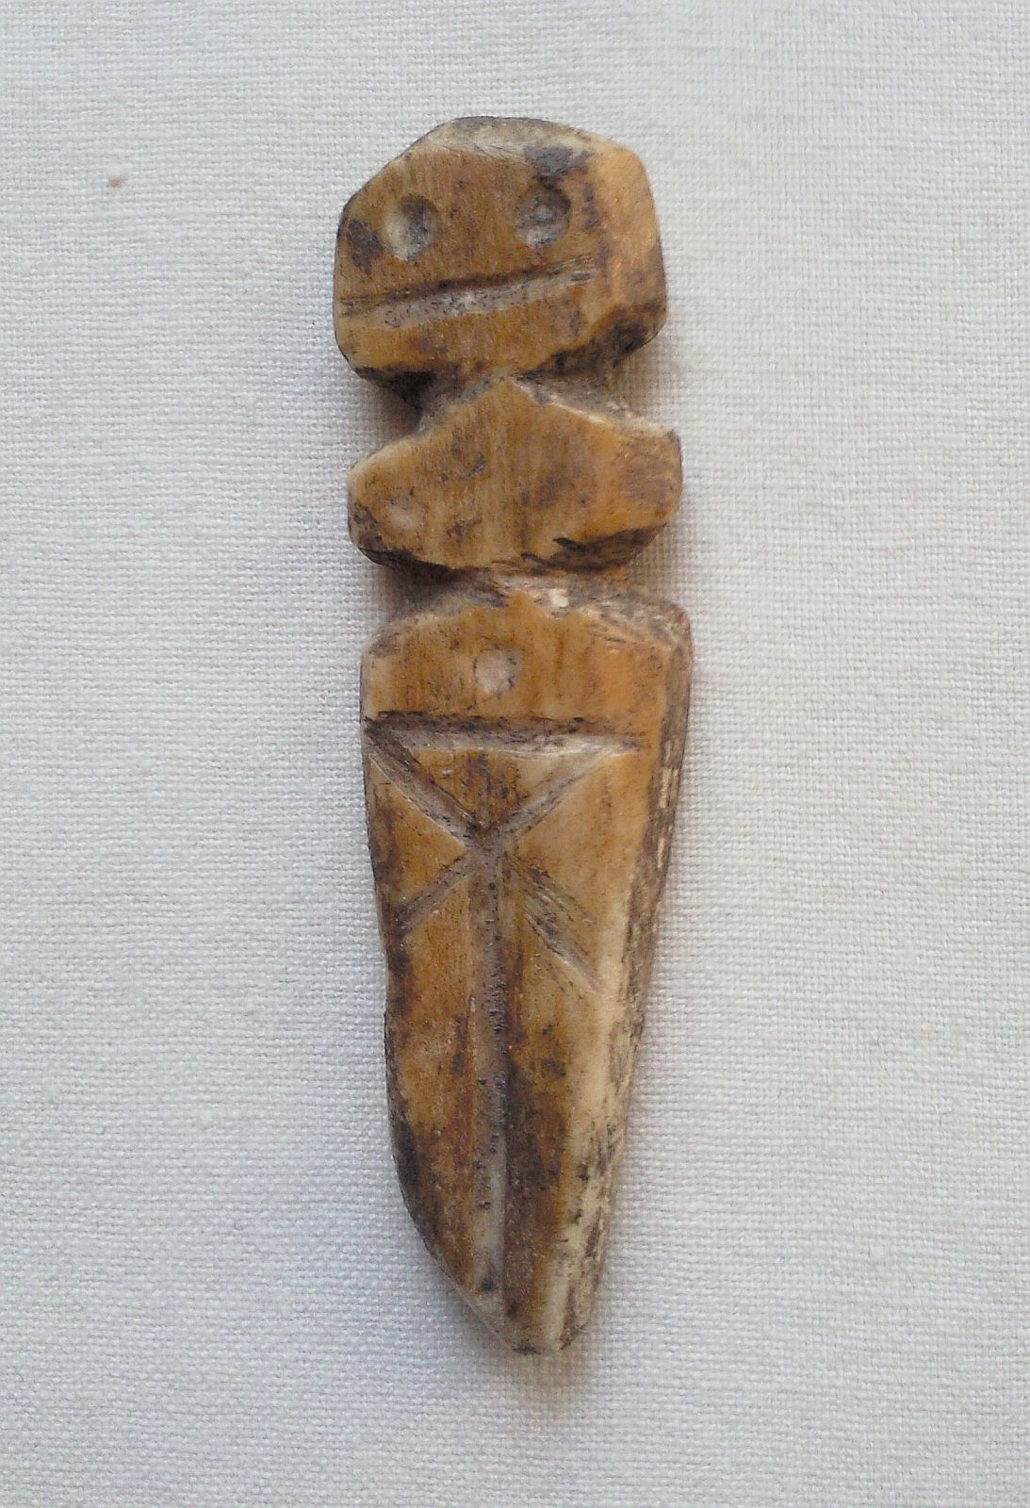
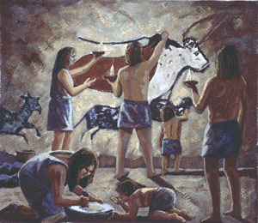
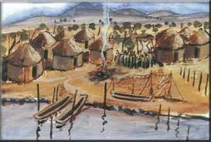
The Stone Age
Developed societies, art, and religion
Animism
All things in nature have spirits

Slide 13
The Beginning of Agriculture

Slide 14
Main Idea
The development of agriculture was on of the most important turning points in human history and significantly changed the way in which many people lived

Slide 15
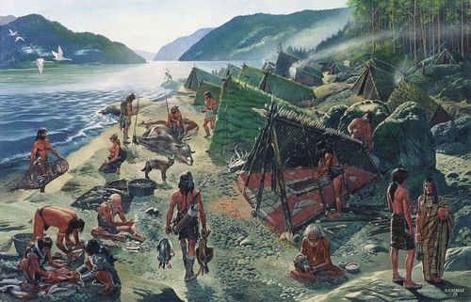
The New Stone Age
Neolithic Era
8,000 BCE – 3,000 BCE
More sophisticated and specialized tools

Slide 16
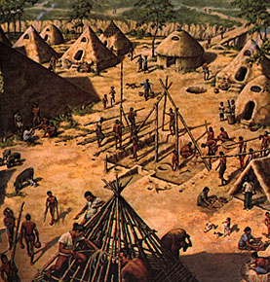
Development of Agriculture
Neolithic Revolution
10,000 years ago
People began to farm
Changed how people lived

Slide 17
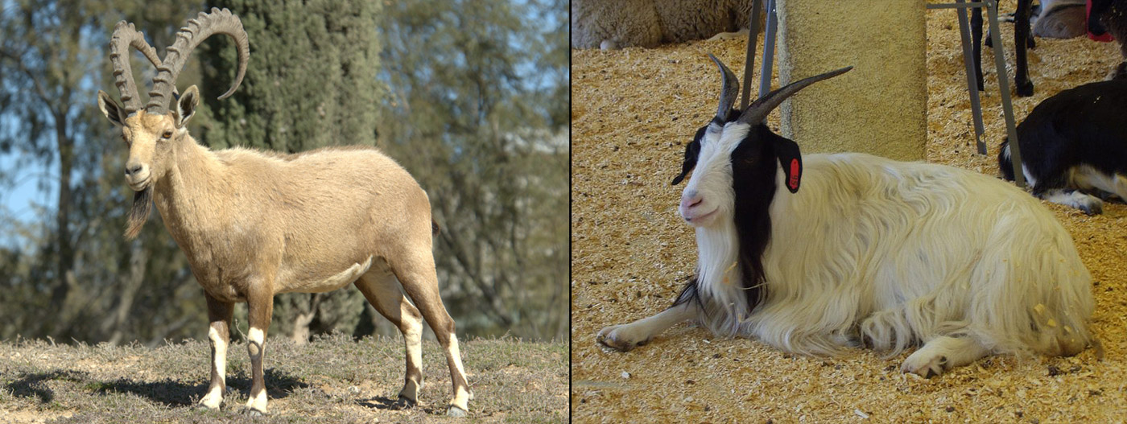
Development of Agriculture
Domestication
Selective growing and breeding of plants and animals

Slide 18
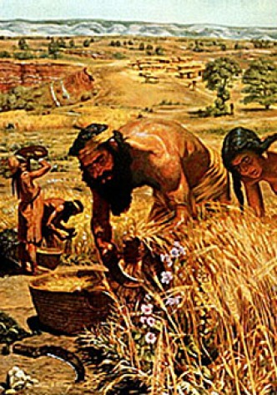
Agriculture Changes Society
World population grew
More reliable good supply
Formed settlements
Everyday activities changed

Slide 19
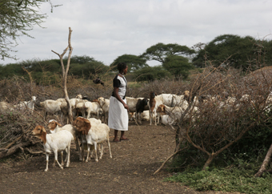
Agriculture Changes Society
Pastoralists
People who ranged over wide areas and kept herds of livestock

Slide 20
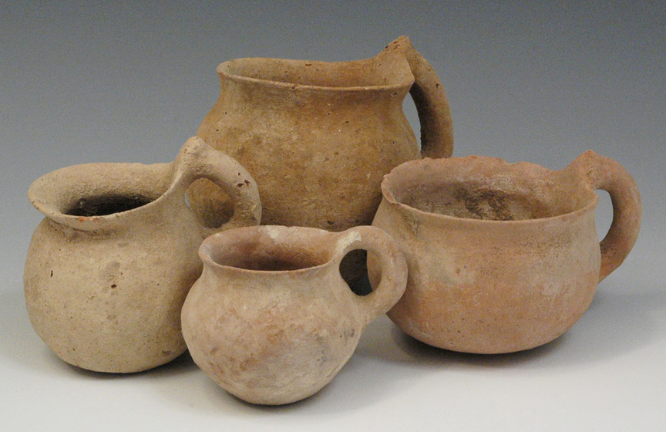
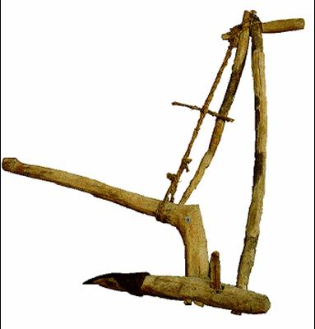
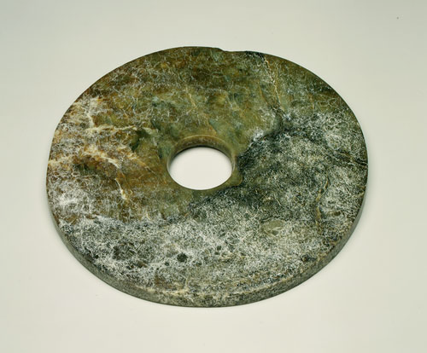
Agriculture Changes Society
New technology
The plow
Pottery
Yarn

Slide 21
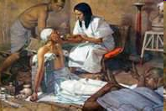
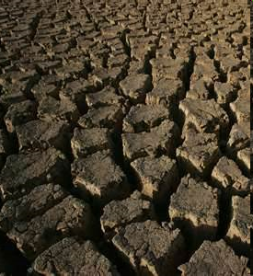
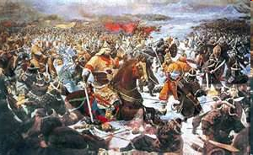
Negative Effects of the Neolithic Revolution
Diseases spread
Crop failures led to famine/starvation
Constant threat of invasion/war

Slide 22
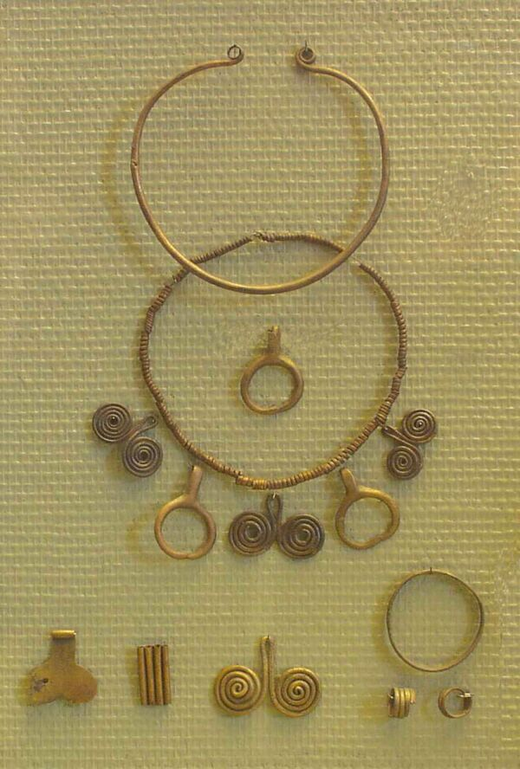
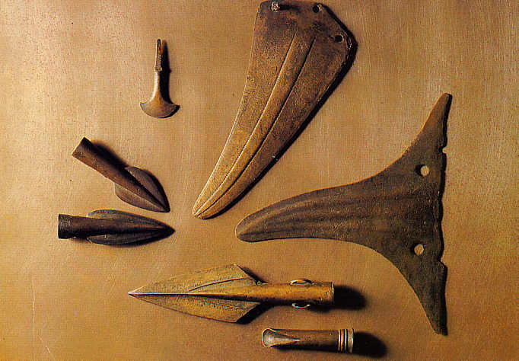
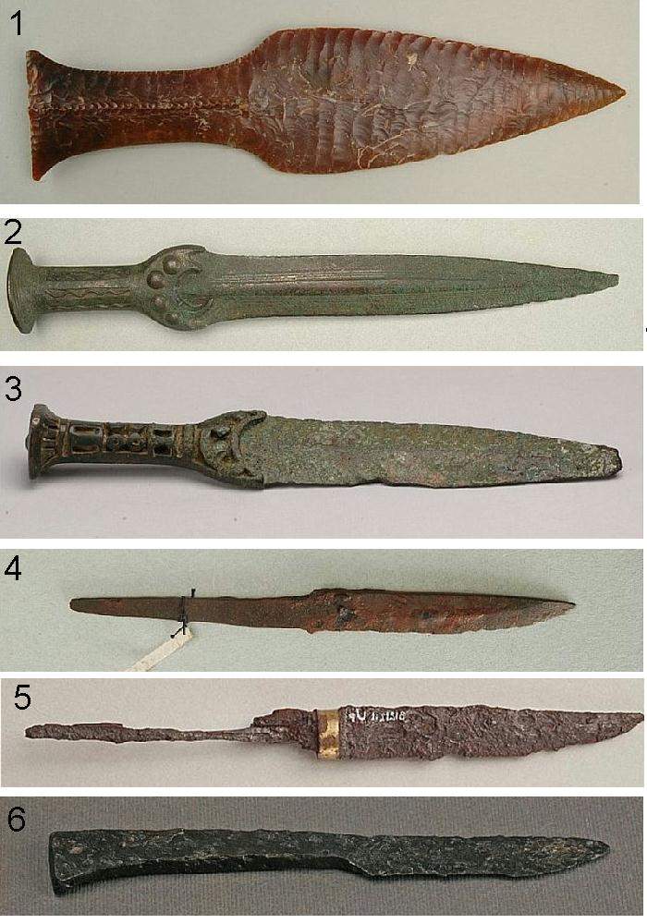
Agriculture Changes Society
Bronze Age
3000 BCE
Starting using metal for tools

Slide 23
Crash Course World History
Stories From the Stone Age

Slide 24
The Beginnings of Civilization: Foundations of Civilization

Slide 25
Main Idea
From farming villages arose cities, and with them, the first civilizations, marking the beginnings of recorded history.

Slide 26
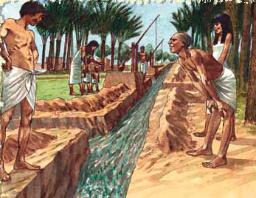
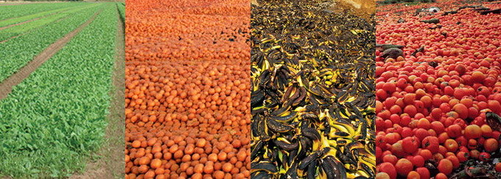
From Villages to Cities
New methods to increase production
Irrigation
Helped produce a surplus

Slide 27
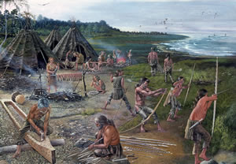
From Villages to Cities
Increased production helped create division of labor
Arrangement in which each worker specializes in a particular task or job

Slide 28
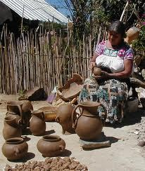
From Villages to Cities
Develop a traditional economy
Economic decisions based on custom, tradition, or ritual

Slide 29
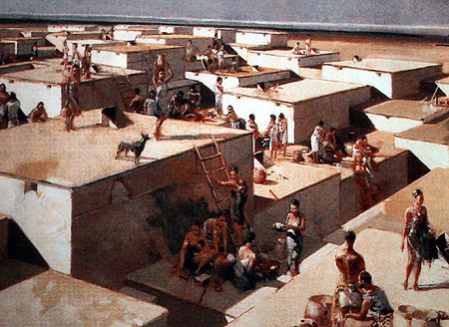
From Villages to Cities
Villages grew into cities
Higher population
More diverse
Better organization
Centers of trade

Slide 30
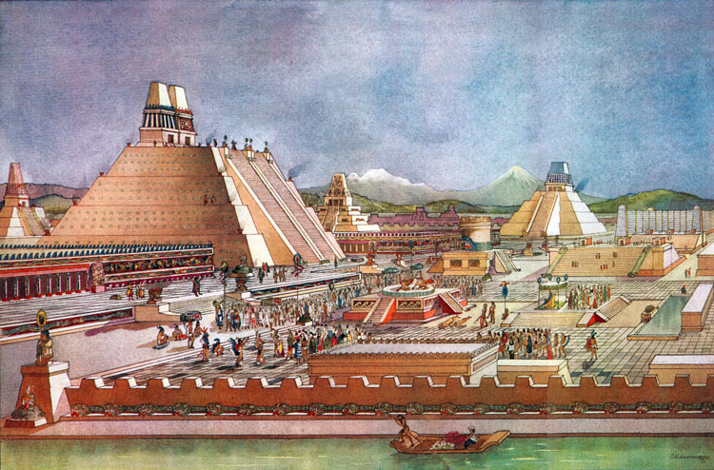
The First Civilizations
Civilization
A complex and organized society
First arose in fertile river valleys

Slide 31
Developed
cities
Art and
architecture
Organized
government
7
Characteristics
Of
civilization
Record keeping
writing
Formalized
religion
Social
Ranking of
classes
Specialization
Of
labor

Slide 32
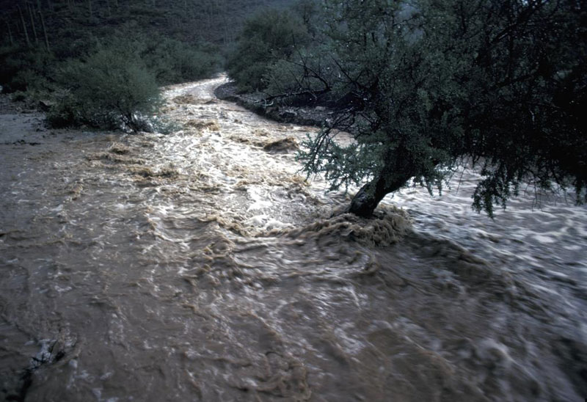
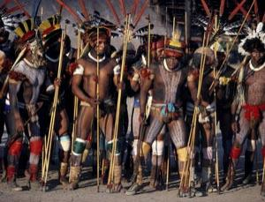
Change in Civilizations
Civilizations can be changed by:
Environment
Conflicts/Warfare
Movement of people
Spread of ideas

Slide 33
Change in Civilizations
Cultural diffusion
The spread of ideas, beliefs, skills, customs, and technology from one culture to another

Slide 34
Can be achieved…
Cultural Diffusion
Benefits
New ideas spread
New technology is shared
New cultural activities are introduced and practiced
Through trade
Through migration
Through warfare
Can you think of specific examples?

Slide 35
Quick Review
Page 28
1-10
11A&B
12A&B
13A&C

