Slide 1
The Cold War: Beginnings of the Cold War

Slide 2
Main Idea
Once partners in war, the Soviet Union and the other former Allies found it much more difficult to cooperate in peace. The result was an era of conflict and confrontation called the Cold War.

Slide 3
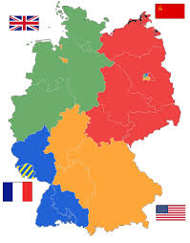
The Problems of Peace
Germany had no functioning government
Divided Germany into four zones of occupation
Controlled by Soviet Union, U.S., France, and Great Britain
Divided Berlin into four zones

Slide 4
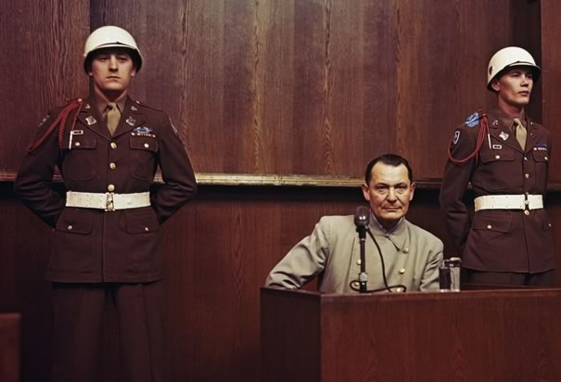
The Problems of Peace
Plan to rid Germany of any remnants of the Nazi Party
Nuremberg Trials
Tried more than 200 Nazi military officials
Plan for Germany to pay reparations

Slide 5
The Problems of Peace
Conflicts over what to do with the rest of Europe
Soviets wanted a “buffer zone” of friendly governments in Eastern Europe
American & British leaders believed Stalin planned to establish Communist governments

Slide 6
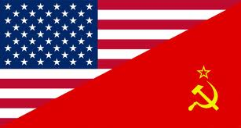
The Conflict Worsens
Cold War
Era of high tension and bitter rivalry between the United States and the Soviet Union in the decades following World War II

Slide 7
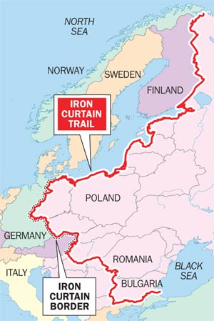
The Conflict Worsens
Conflict between communism and capitalist democracy
Pro-Soviet Communist governments established in Eastern Europe
Iron curtain
Term to describe an imaginary line dividing Communist countries in the Soviet bloc from countries in Western Europe during the Cold War

Slide 8
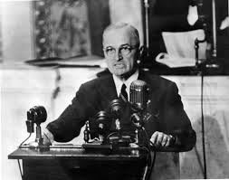
The Conflict Worsens
Conflicts in Greece and Turkey
Truman Doctrine
Pledge to provide economic and military aid to oppose the spread of communism
Believed that if conditions in Europe grew worse, more countries might turn to communism

Slide 9
The Conflict Worsens
Launched a massive program of economic aid
Marshall Plan
Provided 13 billion for rebuilding Europe
Helped Europe recover from the War
Helped preserve political stability

Slide 10
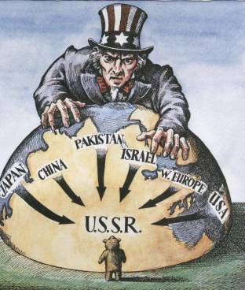
Cold War Confrontations
Containment
Cold War policy which involved resisting Soviet aggression in order to contain the spread of communism
Truman Doctrine & the Marshall Plan

Slide 11
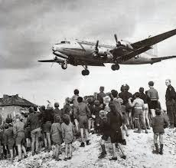
Cold War Confrontations
Western leaders begin planning the creation of an independent democratic German nation
Soviets blocked off all land, rail, and water routes into West Berlin
Residents no longer able to import food, coal, and other vital supplies
Berlin airlift
Massive effort to supply West Berlin by air

Slide 12
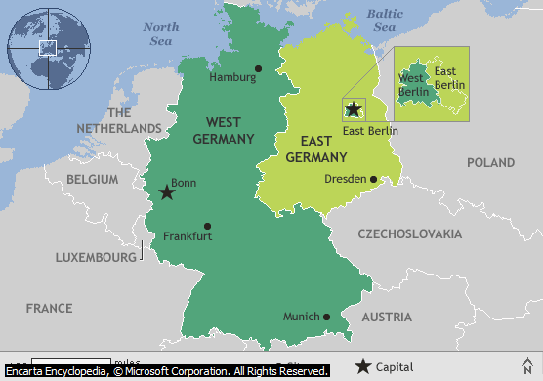
Cold War Confrontations
Western zones of Germany formed the Federal Republic of Germany (West Germany)
Soviet zone became the German Democratic Republic (East Germany)

Slide 13
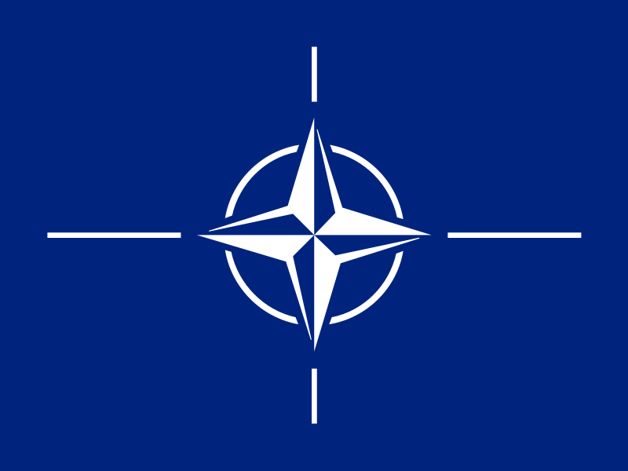
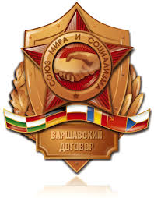
Cold War Confrontations
North Atlantic Treaty Organization (NATO)
U.S., Canada, and most Western European countries joined together in a military alliance
Designed to counter Soviet power in Europe
Warsaw Pact
Soviet Union and Communist nations of Eastern Europe formed their own alliance

Slide 14
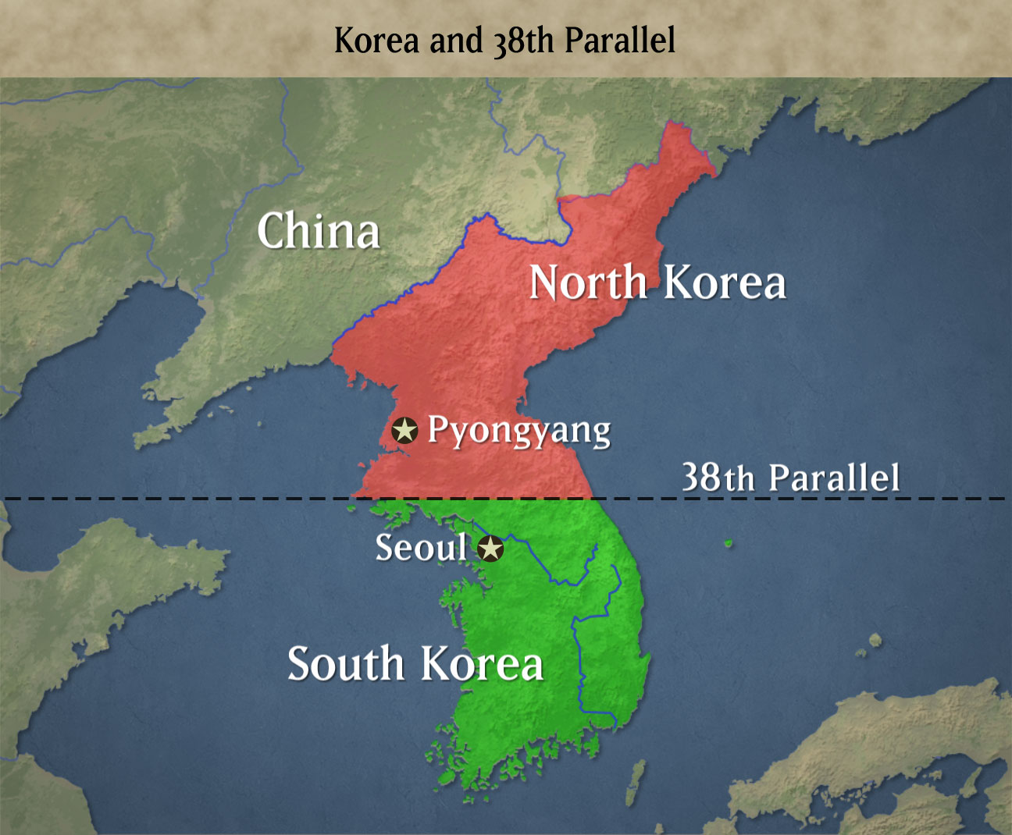
Cold War Confrontations
After WWII – Allies gained control of Korean Peninsula
Soviets and U.S. divide the country in half
North Korea – established a Communist government
South Korea – supported by the U.S. for a non-Communist regime

Slide 15
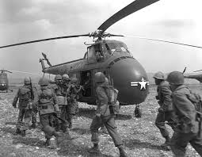
Cold War Confrontations
June 1950 – North Korea attacks South Korea
Wanted to unite the country under a Communist gov.’t
U.S. believed that if they didn’t defend the south, it could lead to Communist expansion
Starts the Korean War

Slide 16
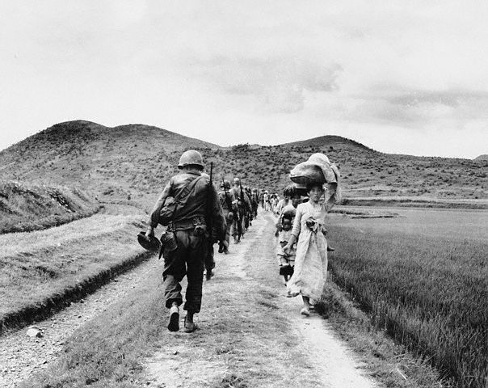
Cold War Confrontations
War settled into a stalemate
1953 – both sides agree to an armistice
3 years of fighting
4 million casualties

Slide 17
Causes of the Cold War
Disagreements between the Allies during World War II
Differing U.S. and Soviet political and economic systems
Differing goals for postwar Germany and Eastern Europe
Soviet expansion of communism in Eastern Europe
Resistance to Soviet aggression by the United States

Slide 18
Effects of the Cold War
Political and military struggles around the world
Increased military spending, leading to an arms race
The ever-present danger of nuclear war

Slide 19
The Cold War: Superpower Rivalries

Slide 20
Main Idea
As the Cold War continued, the world’s two superpowers – the Soviet Union and the United States – competed for power and influence around the world.

Slide 21
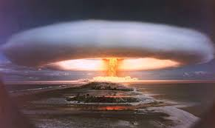
The Arms Race Begins
During the 1950s and 1960s – nuclear war seemed to draw closer
Successful Soviet test of an atomic bomb
U.S. military advantage gone
Hydrogen bombs
Fusion powered
Could produce a much larger explosion
Increased stockpiling of nuclear weapons

Slide 22
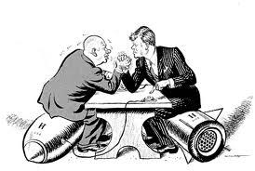
The Arms Race Begins
Deterrence
The development of or maintenance of military power to deter (prevent) and attack
Two sides locked into an arms race
Struggle between nations to gain an advantage in weapons

Slide 23
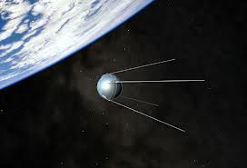
The Arms Race Begins
Soviets launch Sputnik
History’s first artificial satellite
U.S. fears Soviet military technology had leaped ahead of their own
U.S. established the National Aeronautics and Space Administration (NASA)

Slide 24
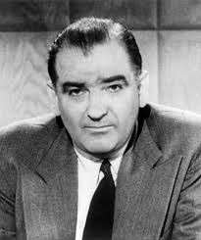
Public Fears
Red Scare
Americans feared possible Communist influence in the government
Senator Joseph McCarthy
Accused many of Communist activities

Slide 25
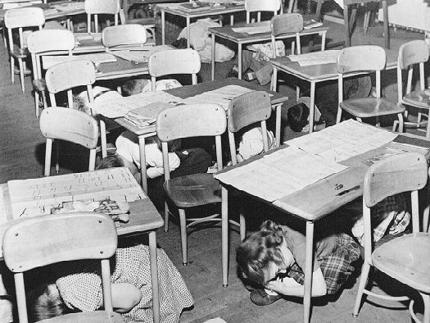
Public Fears
Building of bomb shelters
Air-raid drills
Media talks on the dangers of nuclear war *

Slide 26
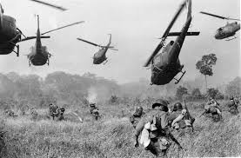
Cold War Around the World
Vietnam divided into northern and southern halves
Communists in the north
Anti-Communists in the south
U.S. concerned about the spread of communism in Vietnam
Sends military aid to the South
Triggers the Vietnam War

Slide 27
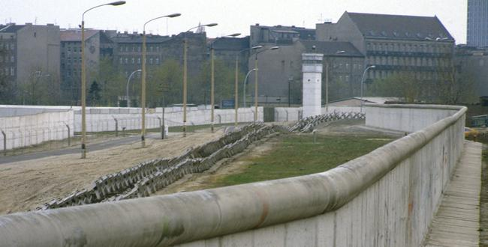
Cold War Around the World
Thousands of East Germans left their country for the West
East Germany starts building a tall barrier between the two halves of Berlin
The Berlin Wall

Slide 28
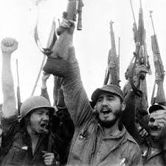
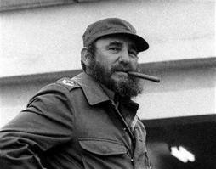
Cold War Around the World
1959 – Fidel Castro overthrows Cuba’s dictator
Establishes a Communist government
U.S. worried – only 90 miles away from U.S.

Slide 29
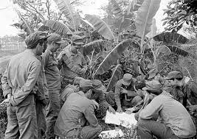
Cold War Around the World
Bay of Pigs invasion
U.S. wanted to overthrow Castro
Secretly trained an invasion force of Cubans
Hoped would start a massive Cuban uprising
Quickly defeated

Slide 30
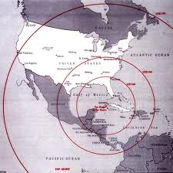
Cold War Around the World
Cuban missile crisis
Confrontation between the U.S. and the Soviet Union
Over the installation of Soviet nuclear missiles in Cuba
2 week standoff
Soviet leaders removed missiles in Cuba
U.S. removes missiles in Turkey and promised not to invade Cuba

Slide 31
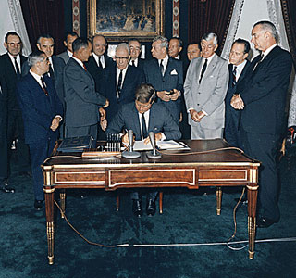
Attempts at Arms Control
U.S. and Soviet Union agree on a Test Ban Treaty
Outlaws nuclear testing in the atmosphere, in outer space, and under water

Slide 32
Attempts at Arms Control
Détente
Reduced tension between the superpowers
Salt I & II-Agreements to:
Limit the number of nuclear weapons
Stop development of weapons designed to shoot down nuclear missiles
Elimination of certain types of missiles

Slide 33
The Cold War: Changing Societies

Slide 34
Main Idea
The Cold War brought tremendous economic and social change to North America, Western Europe, Eastern Europe, and the Soviet Union.

Slide 35
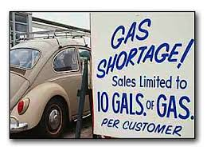
The U.S. Economy
U.S. economy most powerful in the world
Driven by consumer spending
Early 1970s –
Rapid inflation & high unemployment
Events in the Middle East disrupted the distribution of the world’s oil supply
Spike in the cost of energy

Slide 36
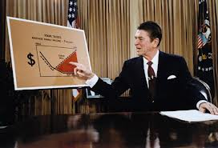
The U.S. Economy
Problems lasted until 1980s
Unemployment dropped but national debt increased
Structural changes to the economy
Previously heavy in industry
Difficult to compete with companies in other countries
Created new jobs in advanced technology and service industries

Slide 37
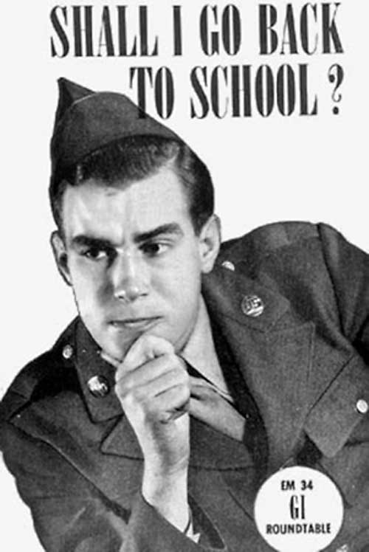
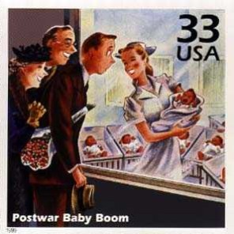
Social Changes
Country undergoing rapid social changes
Raise in living standards
G.I. Bill of Rights
Helped millions of veterans attend college
Baby boom

Slide 38
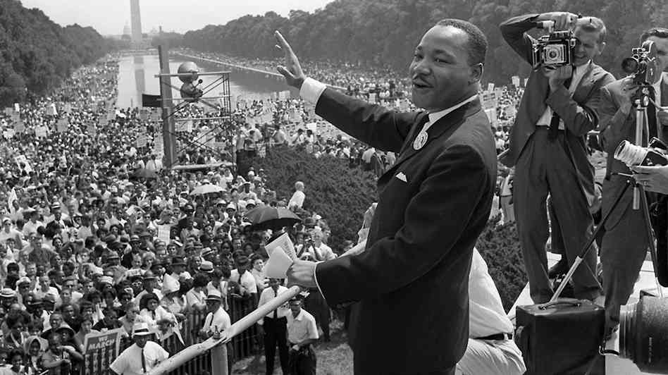
Social Changes
Desegregation of the U.S. military and public schools
Brown v. Board of Education *
Civil rights movement
Ended longstanding barriers to equality for African Americans
Renewed women’s rights movement
Wanted social, political, and economic equality

Slide 39
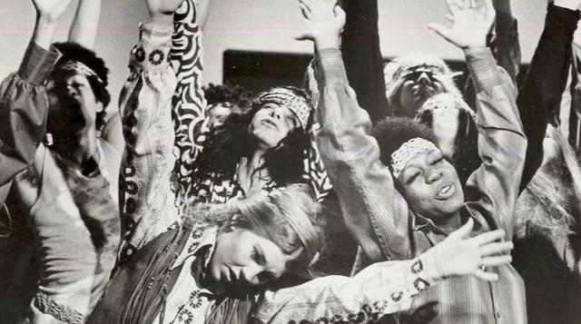
Social Changes
Counterculture *
Rebellion of teenagers and young adults against mainstream American society
Many adopted unconventional values, clothing, and behavior
Questioned the governments actions in the Vietnam War

Slide 40
The Cold War: After the Cold War

Slide 41
Main Idea
The Soviet Union collapsed in 1991 and the Cold War came to an end, brining changes to Europe and leaving the United States as the world’s only superpower.

Slide 42
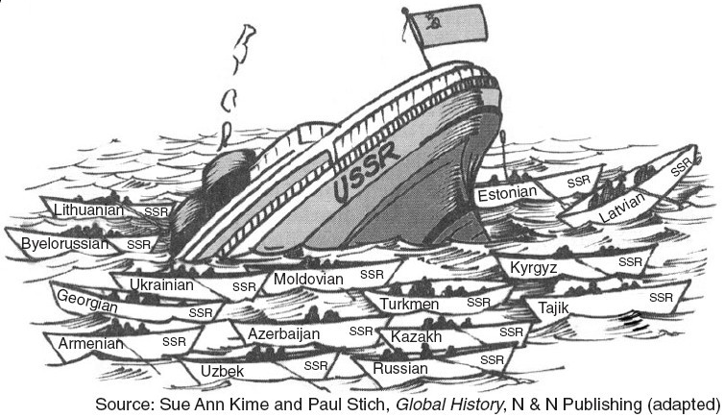
Breakup of the Soviet Union
1989 – the fall of the Berlin Wall *
1991 – The breakup of the Soviet Union
The separate republics under the Soviet Union wanted independence
Cold War finally over

Slide 44
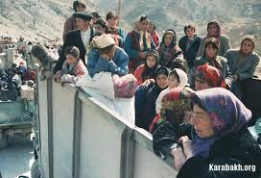
Europe After Communism
As communism collapsed – tensions between Eastern Europeans rose
Ethnic and religious tensions
Ethnic cleansing
Elimination of an ethnic group from society through killing or forced emigration
Yugoslavia, Serbia, Bosnia

Slide 45
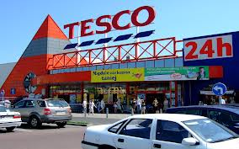
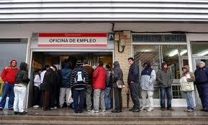
Europe After Communism
End of communism brought mixed results for the economies of Eastern Europe
New opportunities
New businesses
Wage discrepancies
High unemployment

Slide 46
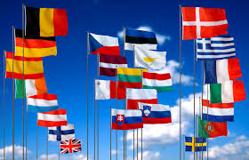
Europe After Communism
1992 – Formation of the European Union (EU)
Efforts to build an economic and political union among the nations of Europe

Slide 47
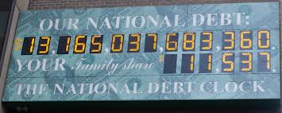
The United States Today
1990s –
Economic growth
Emergence of the Internet
2000s –
Increased government spending
Rising national debt
Increased poverty rate
Auto and housing crisis

Slide 48
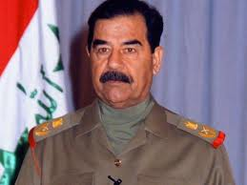
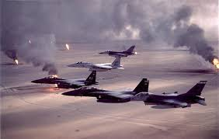
The United States Today
Conflicts in the Middle East
Dictator Saddam Hussein
Attacked Kuwait
Threatened oil supplies
Persian Gulf war (Operation Desert Storm)

Slide 49
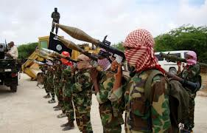
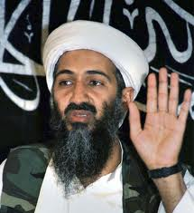
The United States Today
1990s – Beginning of a series of terrorist attacks on U.S. targets
World Trade Center & U.S. embassies
Al Qaeda
Islamist terrorist organization
Osama bin Laden

Slide 50
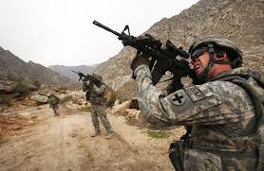
The United States Today
War on terror
Target al Qaeda, the Taliban, and Isis
War in Iraq
War in Afghanistan

