Slide 1
The Cold War Begins: The Iron Curtain Falls on Europe

Slide 2
Main Idea
At the end of World War II, tensions between the Soviet Union and the United States deepened, leading to an era known as the Cold War

Slide 3
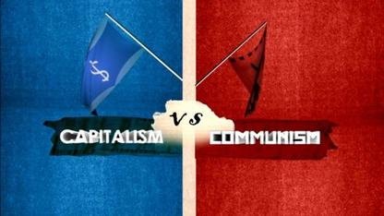
Causes of the Cold War
Philosophical differences
Soviet Union: communism, totalitarian dictatorship
United States: free-enterprise capitalism, republic

Slide 4
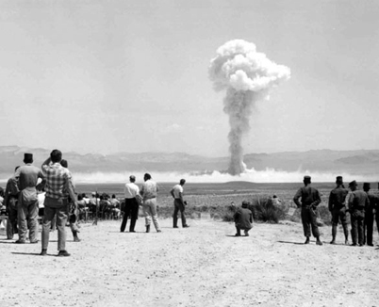
Causes of the Cold War
World War II Conflicts
Disagreements over strategy during WWII
U.S. atomic bomb plans worried Soviet Union

Slide 5
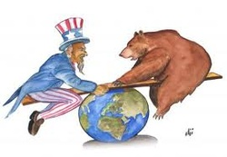
Causes of the Cold War
Postwar Conflicts
The Soviet Union refused to let Eastern Europe hold elections as promised at Yalta
The United States resisted Soviet expansion

Slide 6
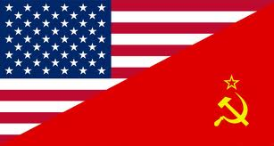
The Conflict Worsens
Cold War
Era of high tension and bitter rivalry between the United States and the Soviet Union in the decades following World War II

Slide 7
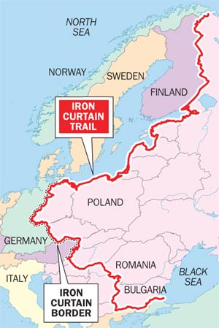
The Iron Curtain
The Iron Curtain
Term to describe an imaginary line dividing Communist countries in the Soviet bloc from countries in Western Europe during the Cold War

Slide 8
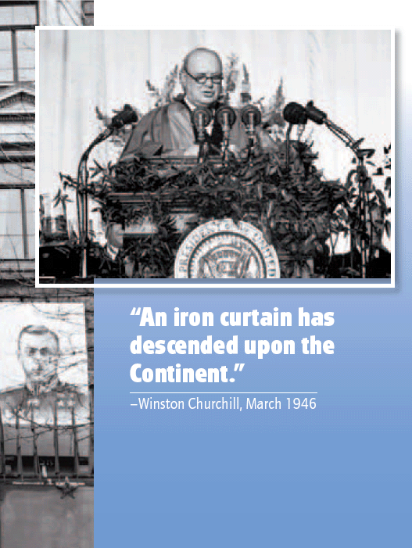
“A shadow has fallen upon the scenes so lately lighted by the Allied victory. Nobody knows what Soviet Russia and its Communist international organization intends to do in the immediate future, or what are the limits, if any, to their expansive…tendencies…it is my duty to place before you certain facts about the present position in Europe. From Stettin in the Baltic to Trieste in the Adriatic an iron curtain has descended across the Continent.” –Winston Churchill

Slide 9
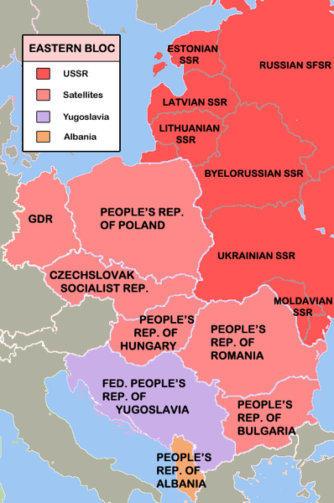
The Iron Curtain
Soviet View of The Iron Curtain
Iron Curtain was necessary to protect the Soviet Union from western attacks
“buffer zone” or “satellite states”
Pro Soviet or communist gov’ts
established throughout western
Europe

Slide 10
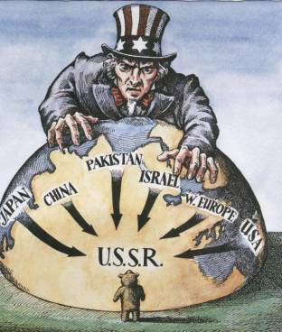
Cold War Confrontations
Containment
Cold War policy which involved resisting Soviet aggression in order to contain the spread of communism
Includes economic aid, sanctions, and military force

Slide 11
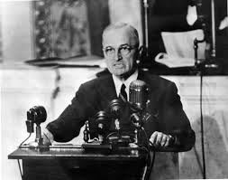
The Conflict Worsens
Conflicts in Greece and Turkey
Truman Doctrine
Pledge to provide economic and military aid to oppose the spread of communism
Believed that if conditions in Europe grew worse, more countries might turn to communism

Slide 12
The Conflict Worsens
Marshall Plan
Economic aid program to rebuild European countries
Would help recover from WWII
Would create stable political conditions for democracies
Provided 13 billion for rebuilding Europe

Slide 13
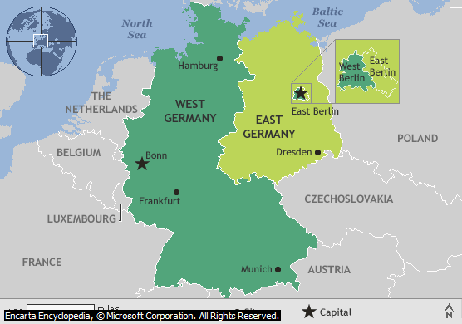
Crisis in Berlin
Western zones of Germany formed the Federal Republic of Germany (West Germany – free, democratic)
Soviet zone became the German Democratic Republic (East Germany – communist)

Slide 14
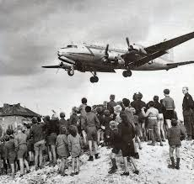
The Crisis in Berlin
Soviets blocked off all land, rail, and water routes into West Berlin
Residents no longer able to import food, coal, and other vital supplies
Berlin airlift
Massive effort (by U.S. and Britain) to supply West Berlin by air
Soviets eventually lift blockade

Slide 15
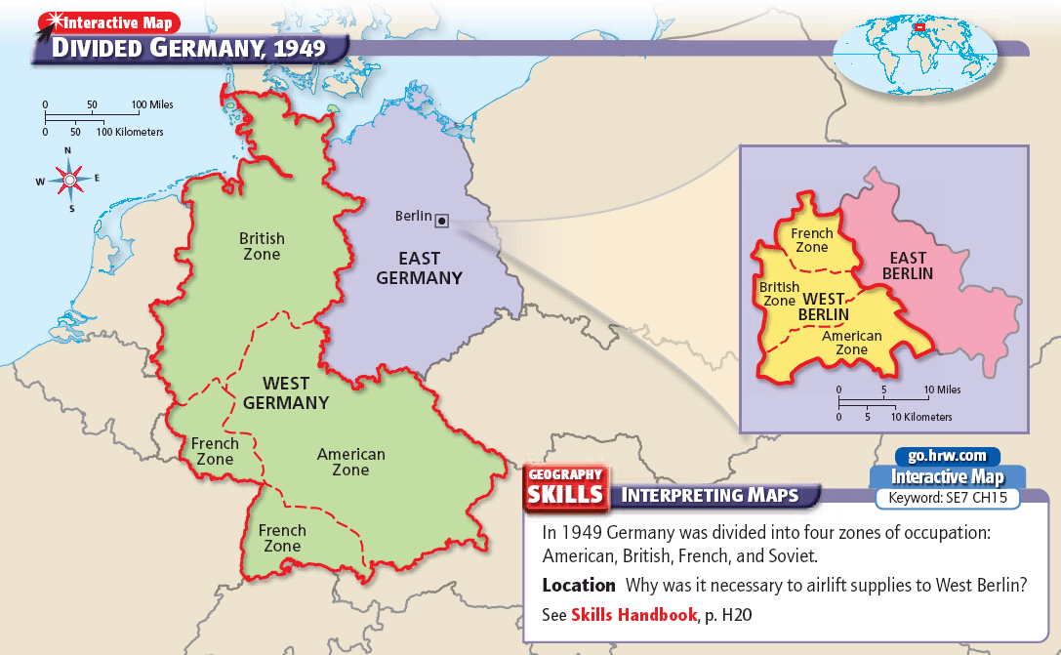

Slide 16
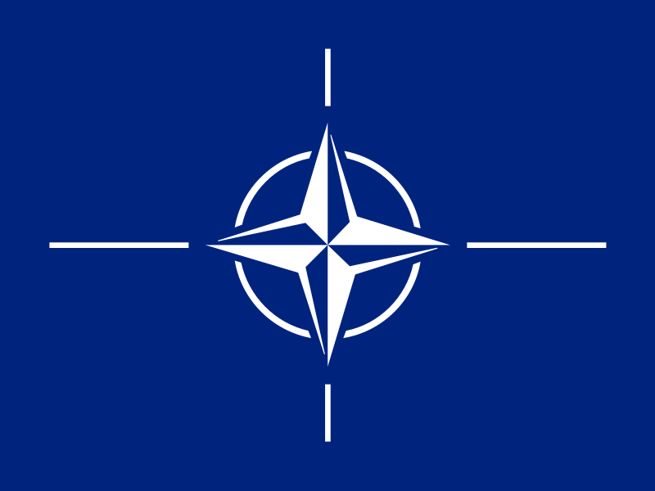
The Crisis in Berlin
1949 - North Atlantic Treaty Organization (NATO)
U.S., Canada, and most Western European countries joined together in a military alliance
Armed attack against one would be considered an attack against all
Designed to counter Soviet power in Europe
26 countries today

Slide 17
The Crisis in Berlin
Warsaw Pact
Soviet Union and Communist nations of Eastern Europe formed their own alliance

Slide 18
Causes of the Cold War
Disagreements between the Allies during World War II
Differing U.S. and Soviet political and economic systems
Differing goals for postwar Germany and Eastern Europe
Soviet expansion of communism in Eastern Europe
Resistance to Soviet aggression by the United States

Slide 19
Effects of the Cold War
Political and military struggles around the world
Increased military spending, leading to an arms race
The ever-present danger of nuclear war
* *

Slide 20
Chapter Questions
PAGE 822
2A
2B
3B
4B

Slide 21
The Cold War Begins: Healing the Wounds of War

Slide 22
Main Idea
Following the end of World War II, U.S. military forces—and the rest of the country—faced the challenge of returning to life during peacetime

Slide 23
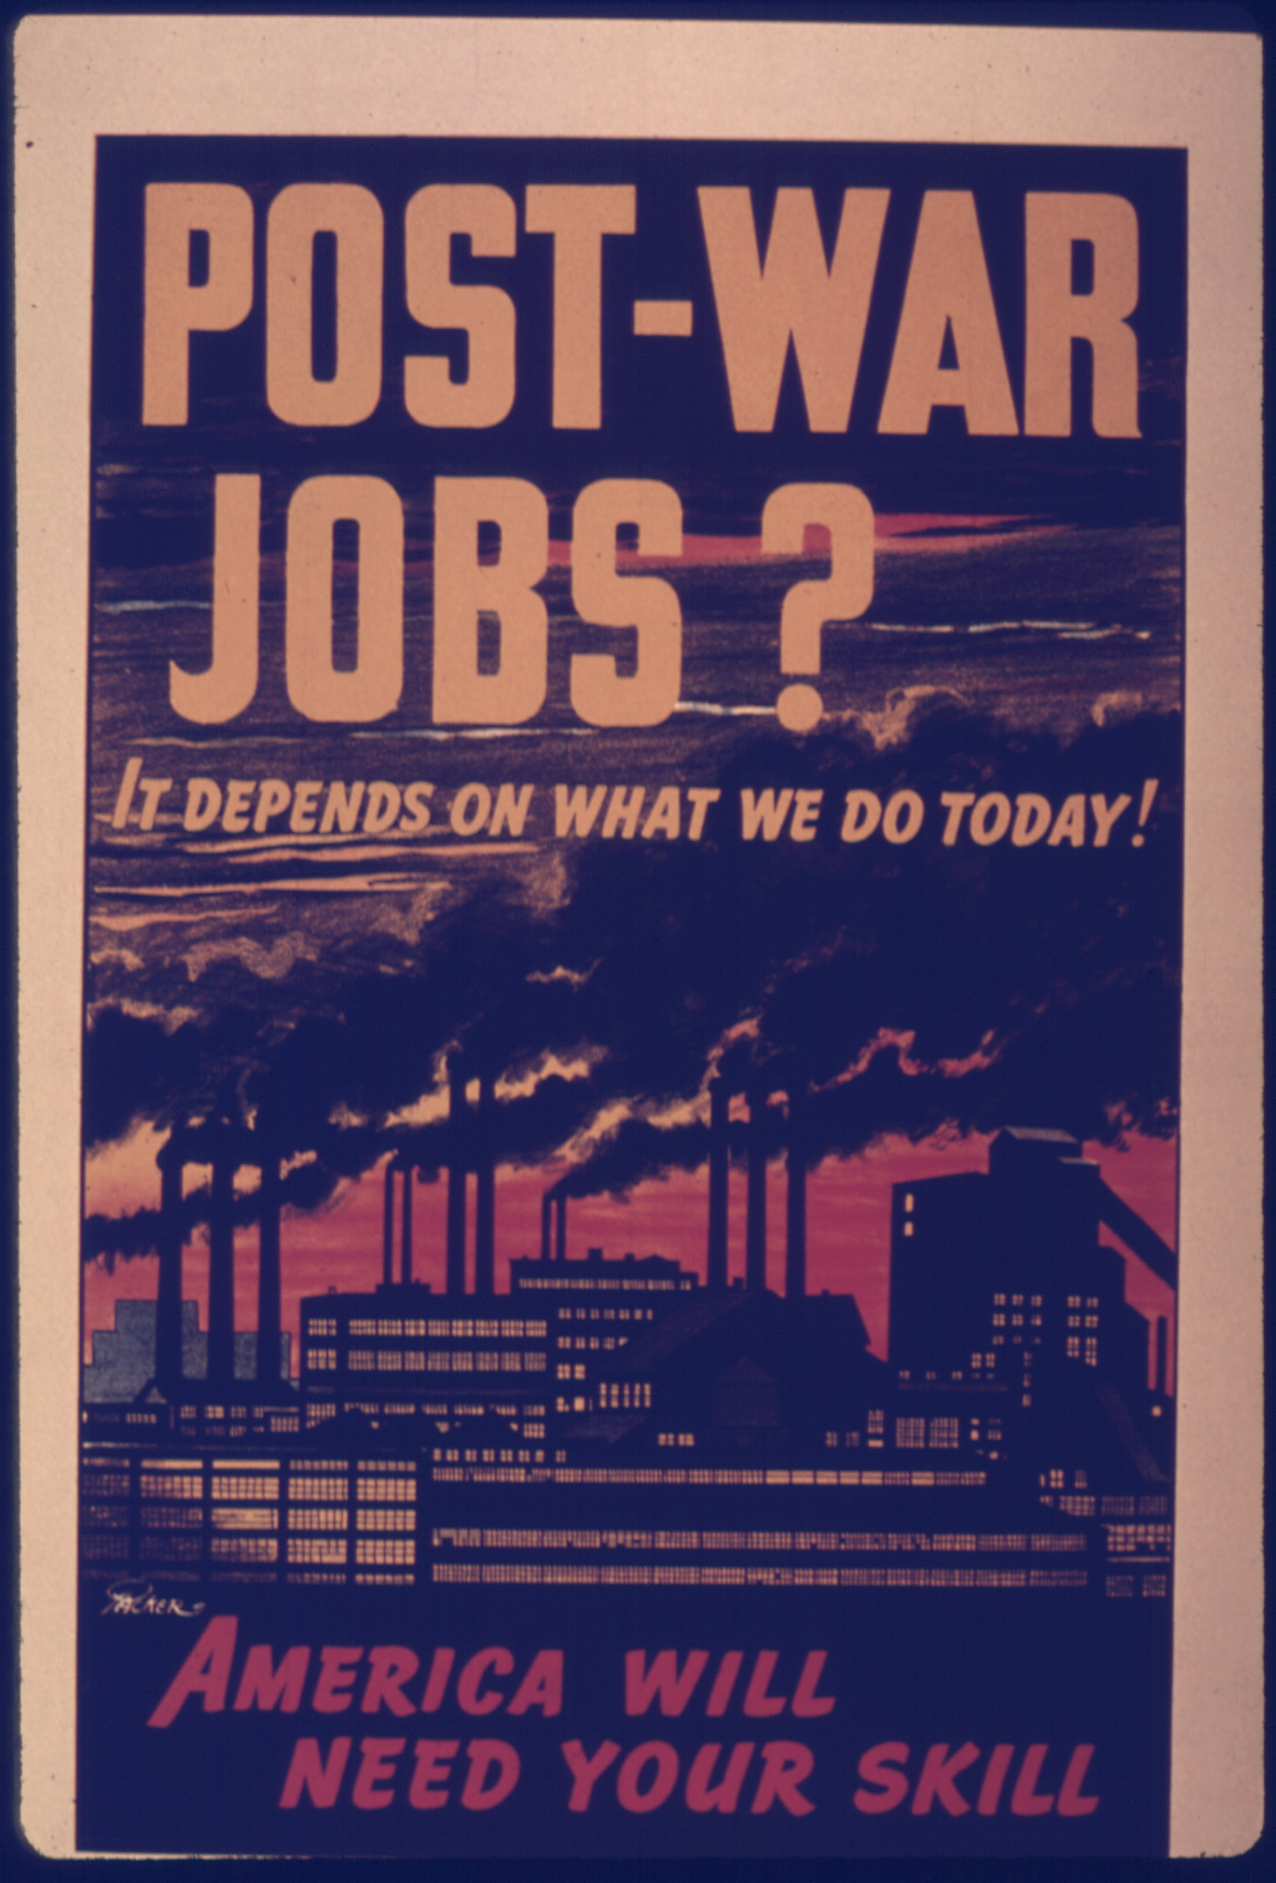
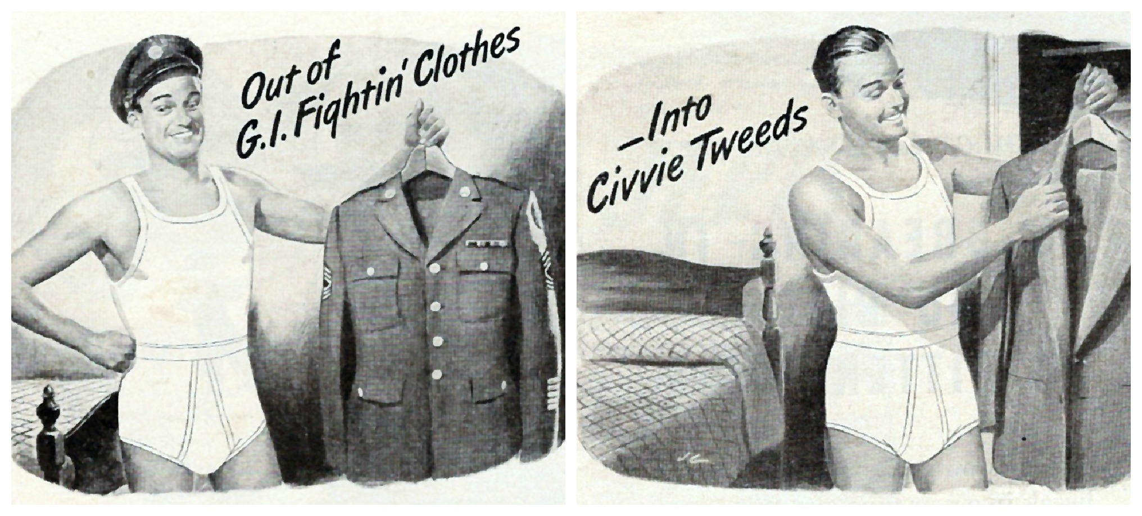
Life in America After WWII
Many worried that the postwar drop in industry would hurt the economy
Nearly 12 million men and women who had been serving in the armed forces were returning

Slide 24
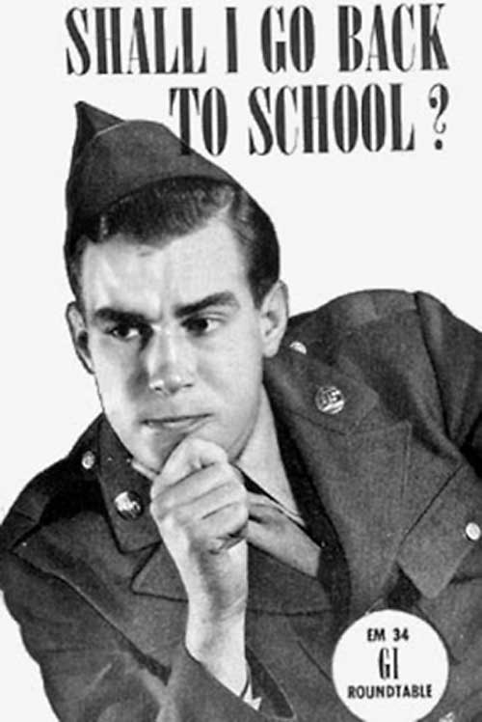
Life in America After WWII
GI Bill (Servicemen’s Readjustment Act of 1944)
Helped veterans transition to civilian life
Money to attend college or receive advanced job training
Helped arrange loans
Help finding work
Unemployment benefits

Slide 25
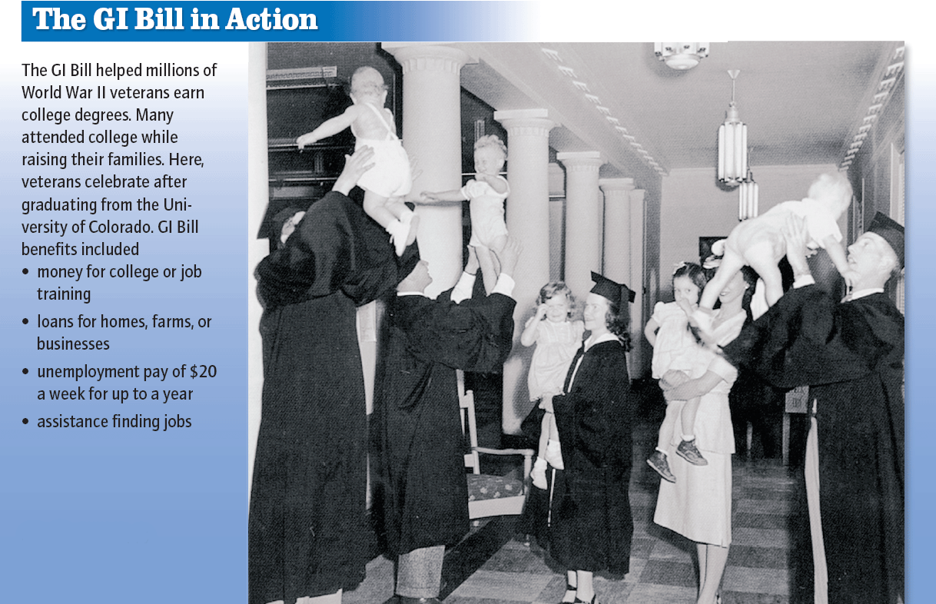

Slide 26
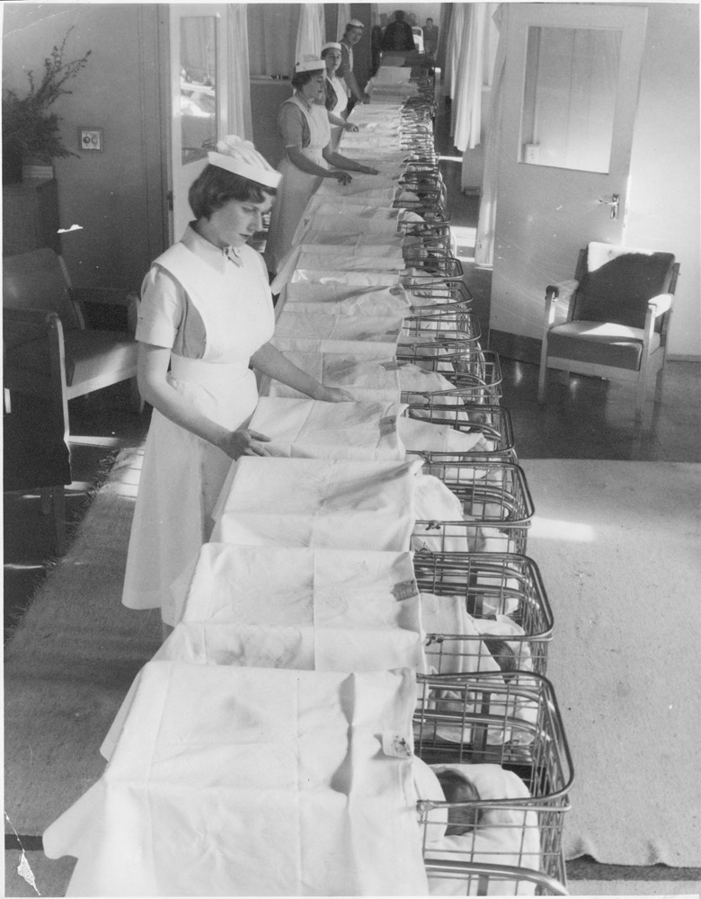
Life in America After WWII
Demand for consumer goods rose sharply
Returning vets built houses
The baby boom

Slide 27
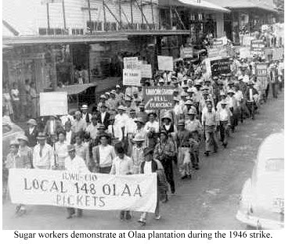
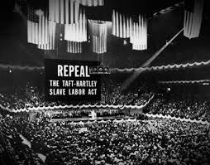
Life in America After WWII
Labor unions began to seek the increases in wages
The number of strikes rose sharply
1947 - Taft-Hartley Act
Greatly reduced the power of labor unions

Slide 28
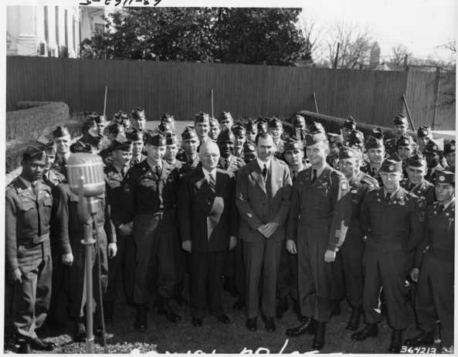
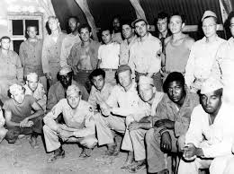
Life in America After WWII
Truman issued Executive Order 9981
Ended segregation in the U.S. armed forces
Hispanic veterans joined the American GI Forum

Slide 29
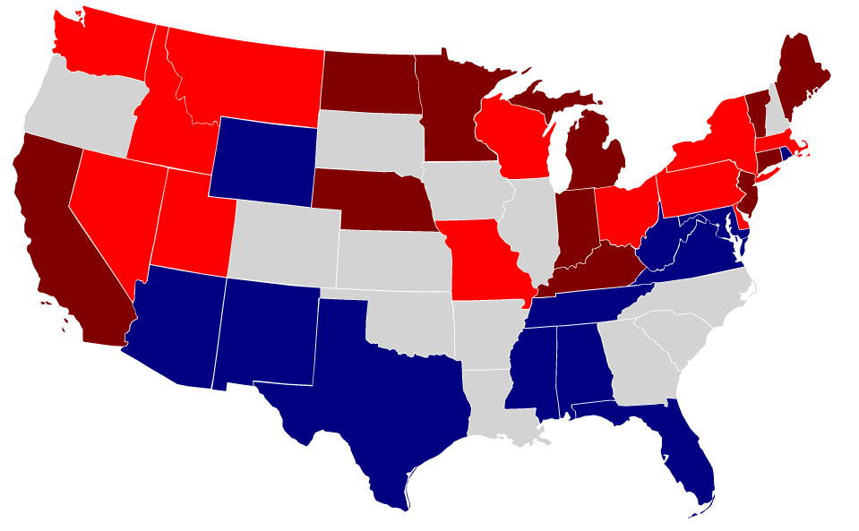
Postwar American Politics
1946 Congressional Elections
Inflation was a big issue
Republicans gained a majority in Congress
Made it difficult for Truman

Slide 30
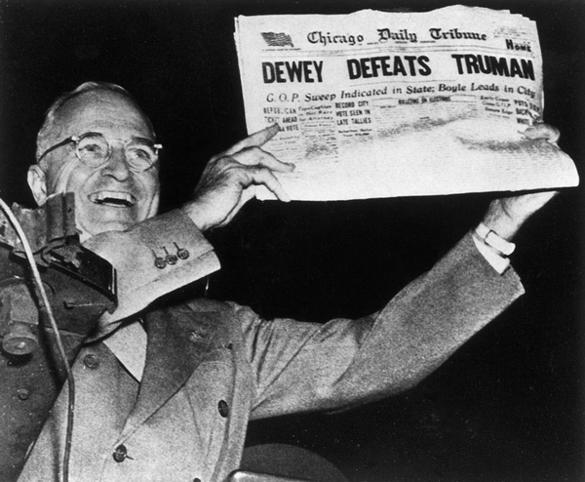
Postwar American Politics
1948 Presidential Election
Truman’s popularity was low
Truman set off on a whirlwind campaign across the country
“do nothing Congress”
Truman won the election

Slide 31
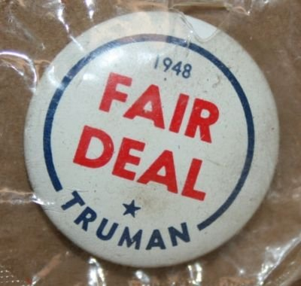
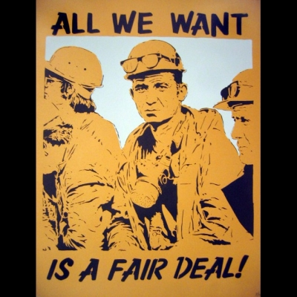
Postwar American Politics
Truman’s Fair Deal program
In tradition of the New Deal
Federal health insurance program
Funding for education
Few programs actually became law

Slide 32
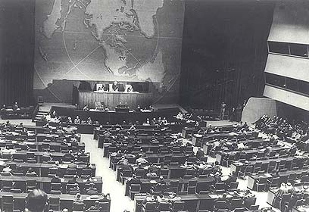
Building a Better World
Establishment of the United Nations (UN).
Members should respect fundamental human rights, respect treaties and agreements, and to promote the progress and freedom of all people
Called for the use of international organizations to promote peace and economic and social advancement

Slide 33
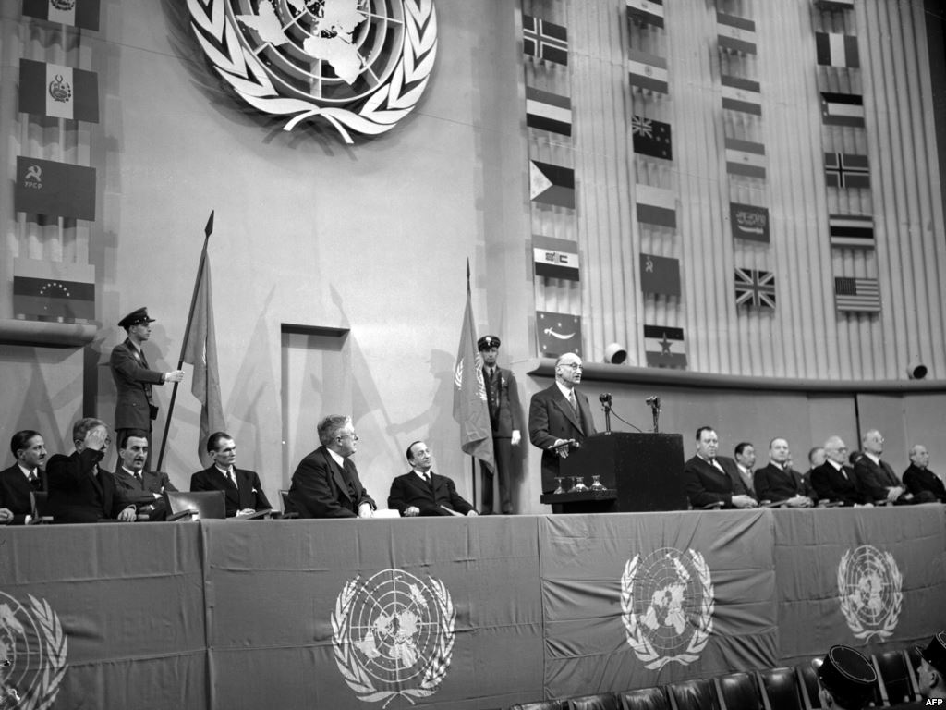
Building a Better World
1948 –UN passes the Universal Declaration of Human Rights
All human beings are born free and equal
Called for an end to slavery, torture, and inhumane punishment
Demanded a variety of civil rights

Slide 34
Building a Better World
Trade and Economic Development
World Bank
Provided loans and grants to countries for the purpose of reducing poverty

Slide 35
Building a Better World
Trade and Economic Development
The International Monetary Fund
Promoted orderly financial relationships between countries
Designed to prevent economic crises and to encourage trade and economic growth

Slide 36
Building a Better World
Trade and Economic Development
The General Agreement on Tariffs and Trade
Set rules and regulations for international trade

Slide 37
Chapter Questions
PAGE 828
1B
3A
3B

Slide 38
The Cold War Begins: The Second Red Scare

Slide 39
Main Idea
The start of the Cold War and events at home helped trigger a second Red Scare in the late 1940s and early 1950s

Slide 40
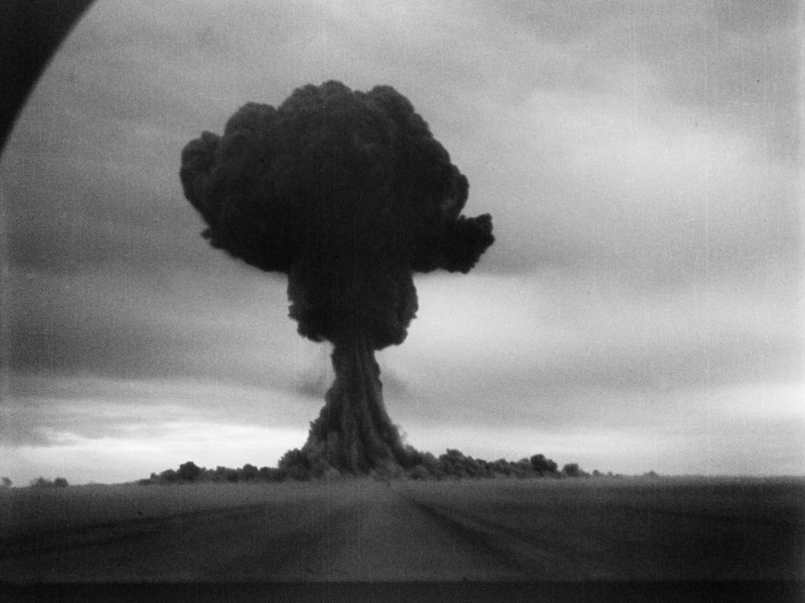
The Growing Fear of Communism
1949 - Soviet Union had detonated an atomic bomb
Shocked the nation
U.S. began to strengthen the military

Slide 41
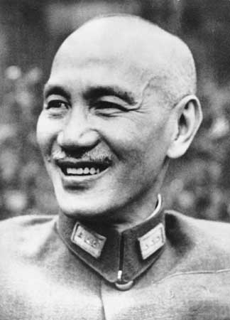
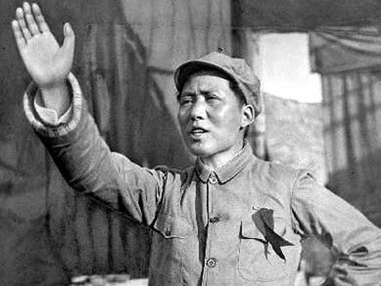
The Growing Fear of Communism
Communists gained control in China
Chiang Kai-shek
Mao Zedong
Americans worried that China increased the Communist threat in America

Slide 42
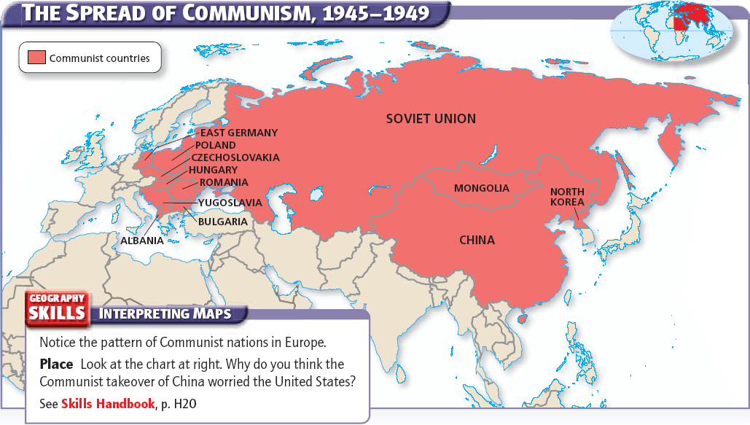

Slide 43
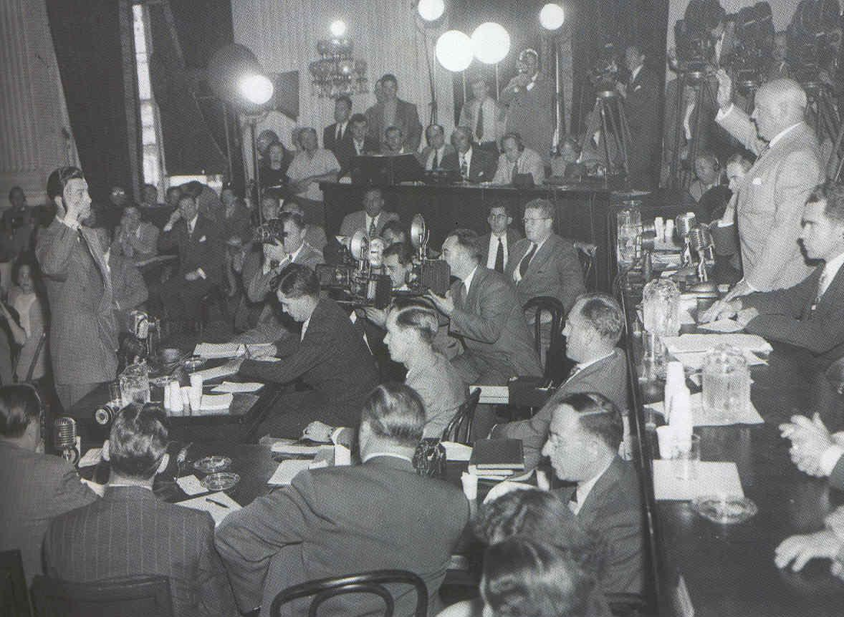
Communism in the U.S.
The House Un-American Activities Committee (HUAC)
Investigated the full range of radical groups in the United States, including Fascists and Communists
Investigated the American film Industry
The Hollywood Ten

Slide 44
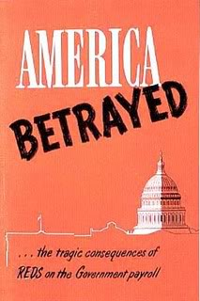
Fighting Communism at Home
Truman investigated all federal employees
Wanted to ensure their loyalty

Slide 45
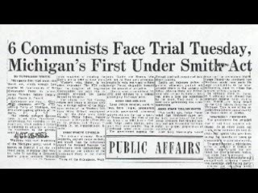
Fighting Communism at Home
The Smith Act
Made it a crime to call for the overthrow of the U.S. government
Several Communist Party (U.S.) leaders charged

Slide 46
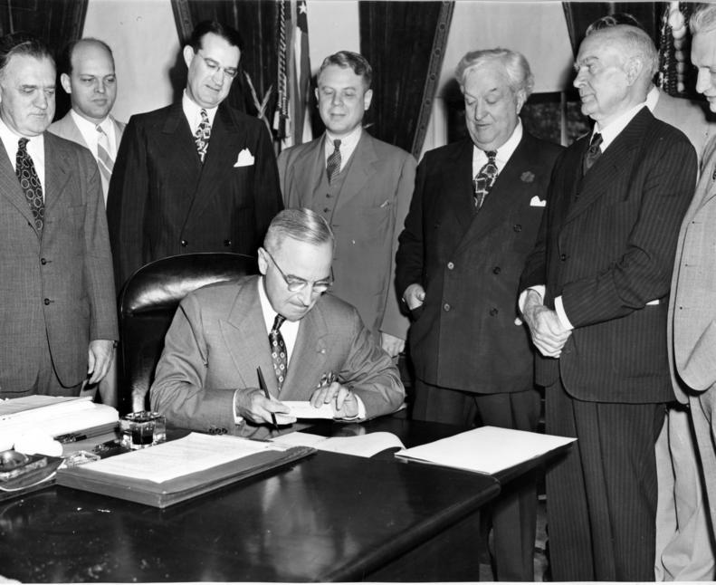
Fighting Communism at Home
The McCarran Act
Required Communist organizations to register with the government
Investigated Communist involvements
Prevented Communists from entering the United States

Slide 47
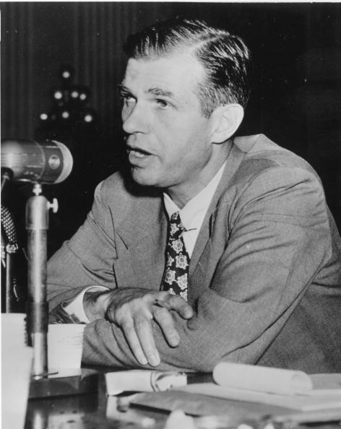
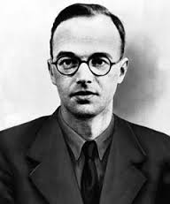
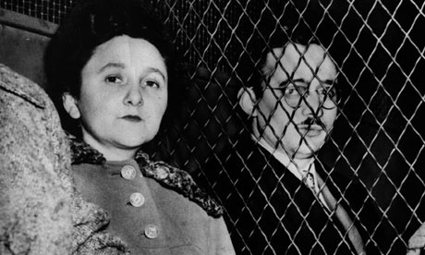
Fighting Communism at Home
Spy Cases
Alger Hiss
Klaus Fuchs
Ethel and Julius Rosenberg

Slide 48
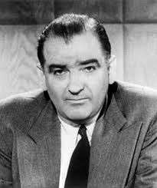
Joseph McCarthy and the Second Red Scare
Senator Joseph McCarthy
Claimed that there were 205 known Communists working for the U.S. Department of State
Had little or no evidence
Reputation as the nation’s top Communist fighter

Slide 49
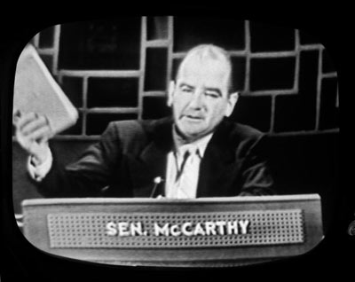
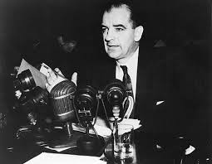
Joseph McCarthy and the Second Red Scare
McCarthyism
Tactic of spreading fear and making baseless charges
Spread into other branches of government, universities, labor unions, and private business *

Slide 50
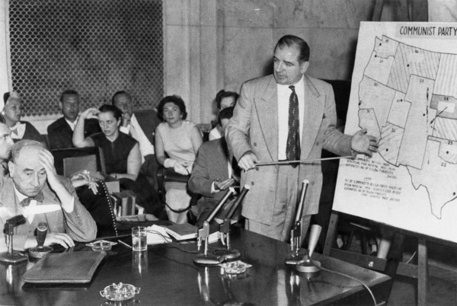
McCarthy’s Fall
McCarthy began attacking fellow party members and the military
The public came to view McCarthy’s tactics as unfair
McCarthyism faded

Slide 51
Chapter Questions
PAGE 834
1C
2B
3C

Slide 52
The Cold War Begins: The Korean War

Slide 53
Main Idea
Cold War tensions finally erupted in a shooting war in 1950. The United States confronted a difficult challenge defending freedom halfway around the world

Slide 54
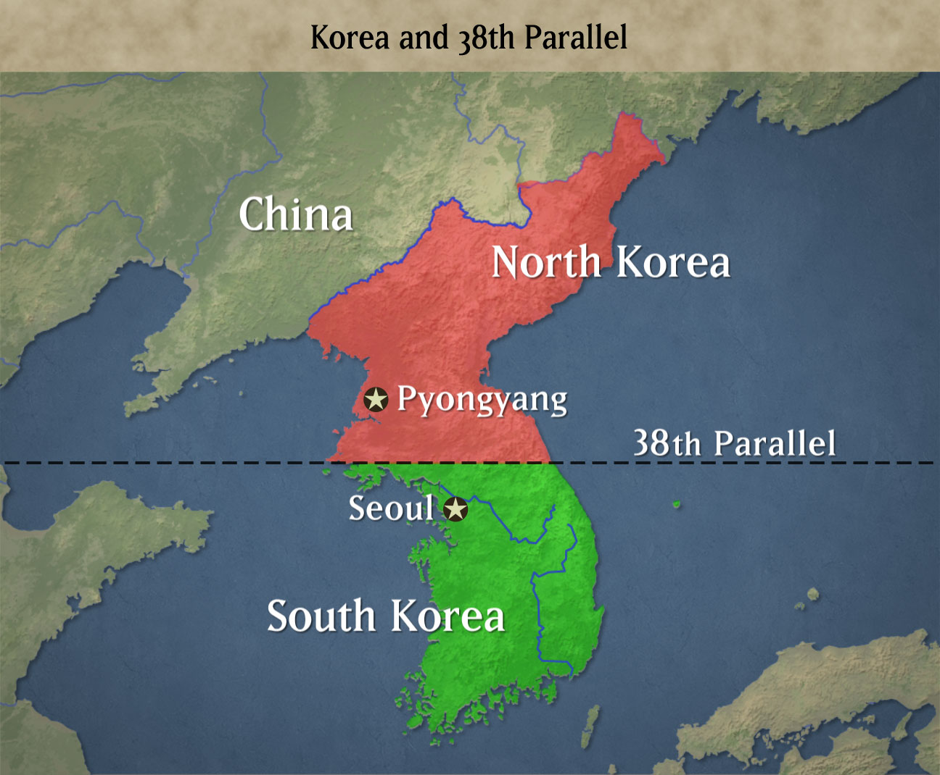
Korea Before the War
After WWII – Allies gained control of Korean Peninsula
Soviets and U.S. divide the country in half on the 38th Parallel
North Korea – established a Communist government
South Korea – supported by the U.S. for a non-Communist regime

Slide 55
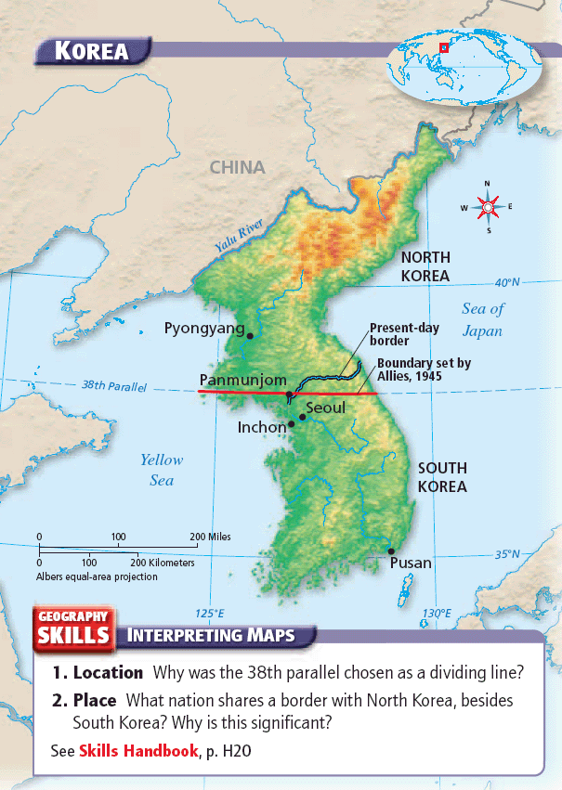

Slide 56
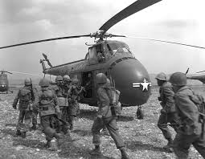
The Start of the Korean War
June 1950 – North Korea attacks South Korea
Wanted to unite the country under a Communist gov.’t
U.S. believed that if they didn’t defend the south, it could lead to Communist expansion
Starts the Korean War

Slide 57
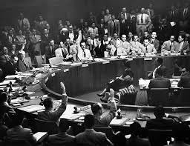
The Start of the Korean War
The U.S. & the UN Security Council supported the use of force in Korea
Both send troops to Korea
Instead of calling this a war, the whole effort was referred to as a UN “police action”

Slide 58
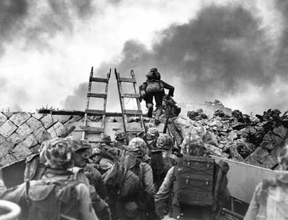
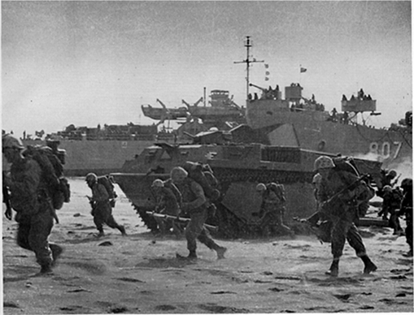
Combat in the Korean War
The Inchon Landing
UN forces made an amphibious landing behind North Korean lines
Invasion at Inchon was a key victory for UN forces

Slide 59
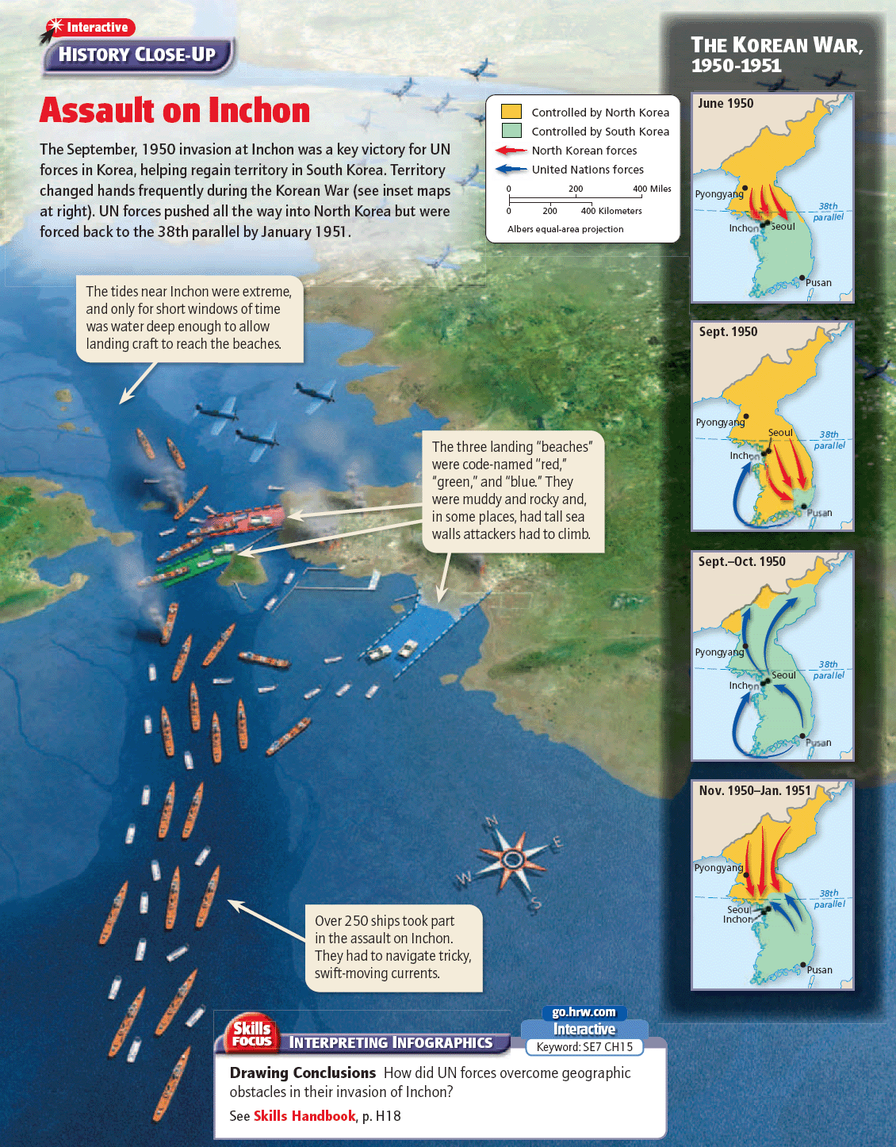

Slide 60
Combat in the Korean War
Offensives resulted in the destruction or surrender of huge numbers of North Korean troops
October 1950 - all of South Korea was back in UN hands

Slide 61
Combat in the Korean War
UN forces had begun to move into North Korea
260,000 Chinese troops joined the North Koreans
The UN began to retreat

Slide 63
General MacArthur is Fired
MacArthur disagreed with Truman
Challenged the authority of the president
MacArthur wanted to expand the war
Wanted to bomb China
Truman fired MacArthur
Many Americans were outraged

Slide 64
Fighting Ends in Korea
War settled into a stalemate
1952 – Eisenhower – who promised to end the war – was elected president
1953 – both sides agree to an armistice
3 years of fighting
37,000 Americans K.I.A.
60,000 UN K.I.A.

Slide 66
Click on the window to start video

