Slide 1
Medieval Europe – The Early Middle Ages:
Charlemagne’s Empire

Slide 2
Main Idea
Through conquest and social change, Charlemagne brought much of western Europe together into a single empire.

Slide 3
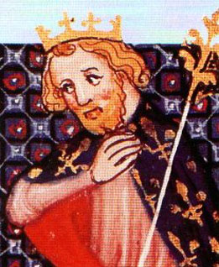
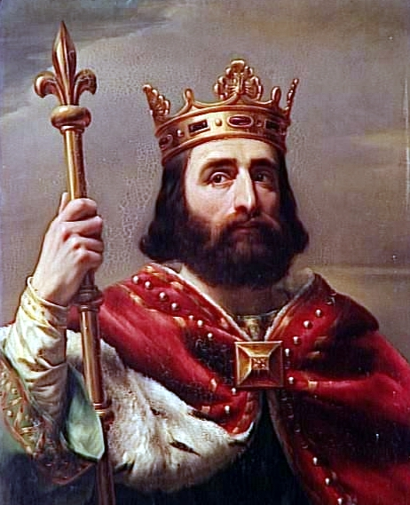
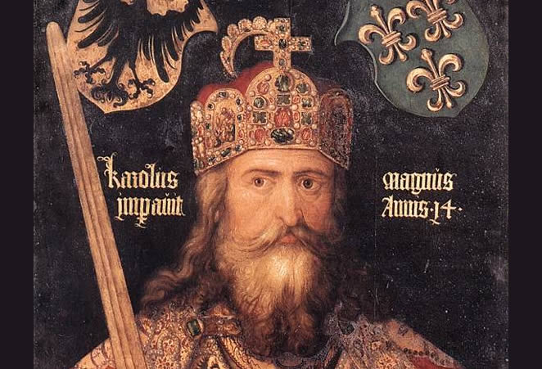
The Early Carolingians
Carolingian family gains power:
Charles Martel
Pippin III
Charles the Great AKA Charlemagne

Slide 4
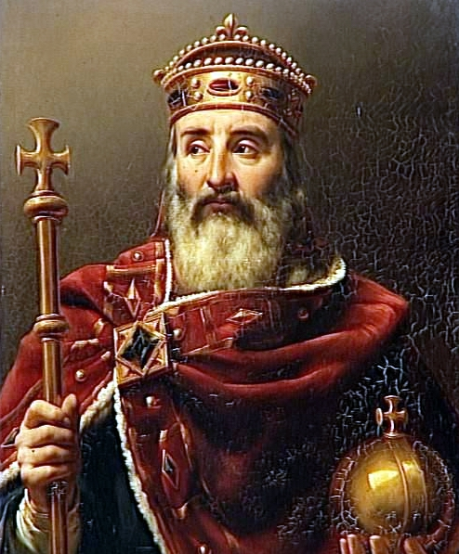
Charlemagne
Charlemagne = Charles the Great
One of most important leaders in European history
Success from his military power

Slide 5
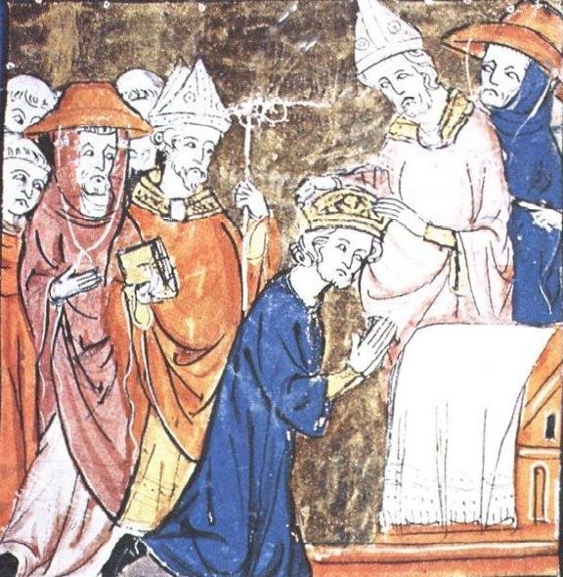
Charlemagne
Pope Leo III –
Asked for help to defeat the Lombards
Named him Emperor of the Roman People – which implied:
Restored glory of the Roman Empire in Europe
Rule had the full backing of the church and of God

Slide 6
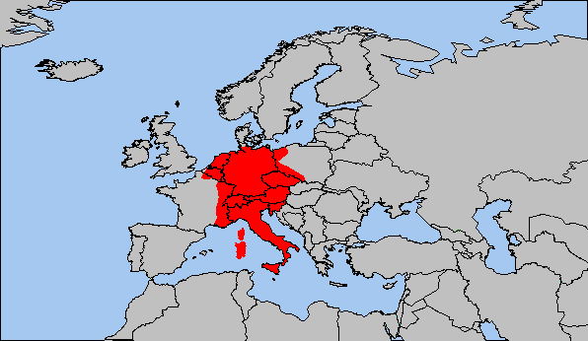
Charlemagne
Large empire = not easy to rule
Personally oversaw entire empire

Slide 7
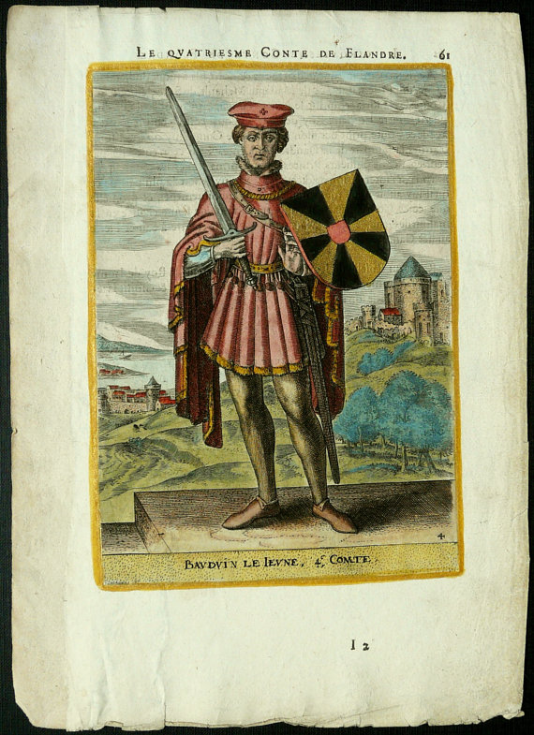
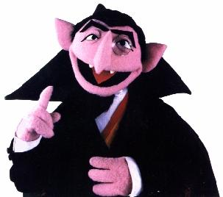
Charlemagne
Counts
Officials chosen to rule parts of the empire in his name
Inspectors

Slide 8
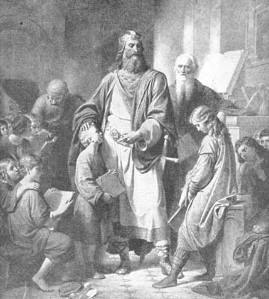
A New Society - Education
Spent most of his time studying
Wanted leaders to be literate
Invited scholars from around the world

Slide 9
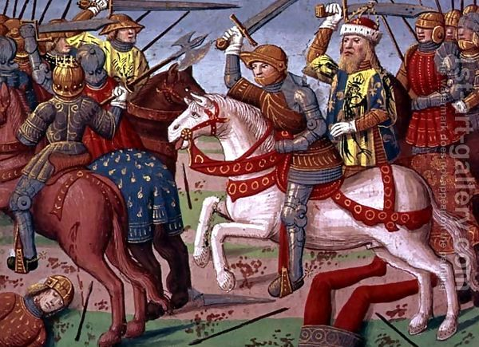
A New Society - Religion
Wanted to preserve and spread Christian teachings
Wanted to create a unified Christian empire
Conquered had to convert

Slide 10
After Charlemagne
After Charlemagne’s death:
Empire split in two
West = France
East = Germany (several small states)

Slide 11
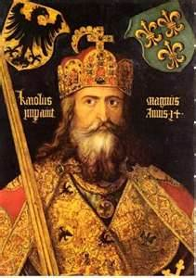
Charlemagne...
embarked on a mission to unite all Germanic peoples into one kingdom, and convert his subjects to Christianity. A skilled military strategist, he spent much of his reign engaged in warfare in order to accomplish his goals. In 800, Pope Leo III (750-816) crowned Charlemagne emperor of the Romans. In this role, he encouraged the Carolingian Renaissance, a cultural and intellectual revival in Europe. When he died in 814, he had ensured the survival of Christianity in the West. Today, Charlemagne is referred to by some as the father of Europe.
https://www.youtube.com/watch?v=hnFctcpZIKM

Slide 12
Medieval Europe – The Early Middle Ages:
The Feudal and Manorial Systems

Slide 13
Main Idea
In Europe, during the Middle Ages, the feudal and manorial systems governed life and required people to perform certain duties and obligations.

Slide 14
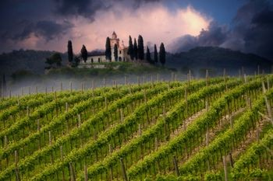
The Feudal System
Feudalism developed as a result of foreign invasions
Nobles - needed to protect themselves and defend lands

Slide 15
The Development of Feudalism
About 500 CE, much of western Europe was left without a strong centralized government due to the breakdown of the Roman Empire. With little organized resistance, Germanic invaders raided western European cities and monasteries. Because kings were often too weak to repel the invaders, many city dwellers moved into the countryside in hopes of greater safety. As a result of the invasions, and a weak central government, a new social and political system known as feudalism developed. Strong local lords formed a strict code of behavior and allegiances which became the foundation of feudal life.

Slide 16
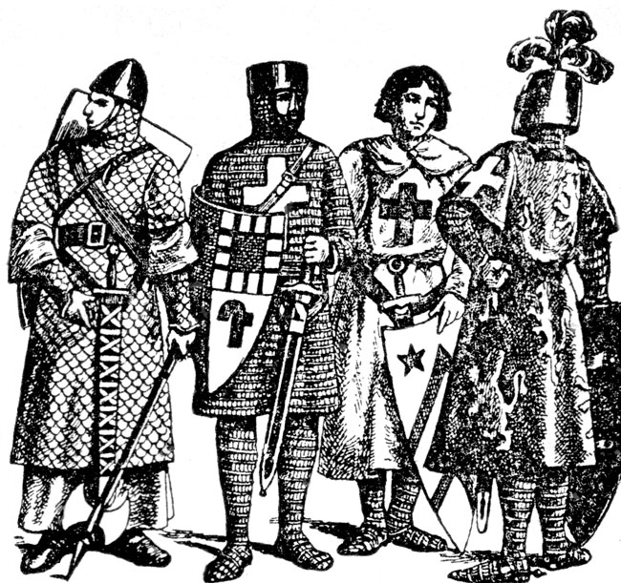
The Feudal System
Knights
Highly skilled soldiers
Expensive
Weapons, armor, horses, money, land

Slide 17
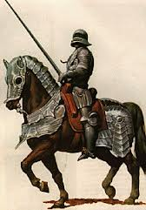
The Feudal System
Fief
Land given to a knight for his service
Vassal
Anyone who accept a fief
Person from who he accepted it was his lord
Feudal system/feudalism
System of exchanging land for service

Slide 18
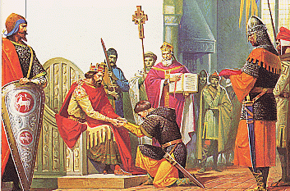
The Feudal System
Vassal’s jobs:
Provide military services
Fealty – promise to remain loyal to his lord
Financial obligations (ex: ransom)
Lord’s jobs:
Treat fairly
Protection
Act as judge

Slide 19
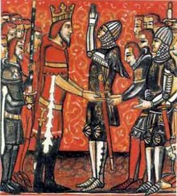
The Feudal System
Could be a lord and a vassal
Knight could serve many lords
Loyal to the king first
Rules specific to time and place

Slide 20
How did Feudalism work?
The king controlled huge tracts of land. He would give his support and a large piece of land, called a fief, to a powerful lord in return for loyalty and military support. This meant the lord was now a vassal of the king. The Lord would then divide up that land among his supporters obtaining vassals of his own. Lesser Lords would do the same, dividing up the increasingly smaller land holdings to their knights. Finally, the knights would be left in direct control of the land and the peasants or townsfolk who lived there. The peasants were expected to grow food, tend the land, and provide military support to the feudal lords. While peasants could leave the manor, serfs were legally bound and could not. Under European feudalism, there was very little opportunity for social advancement.

Slide 21
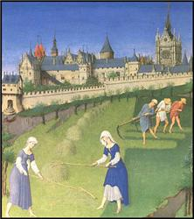
The Manorial System
Manorial system
Built around large estates called manors
Typically self-sufficient
Manors owned by wealthy lords or knights

Slide 22
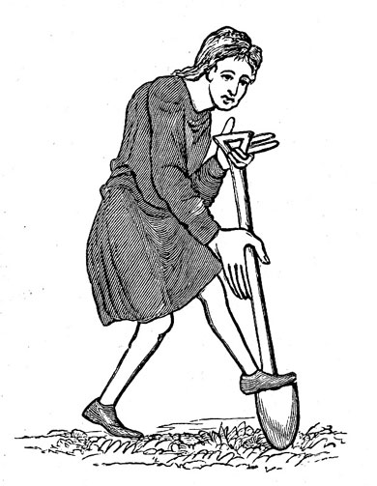
The Manorial System
Serfs
Workers legally tied to the manor
Not slaves
Not free to leave manor
Could not marry without permission
Hereditary

Slide 23
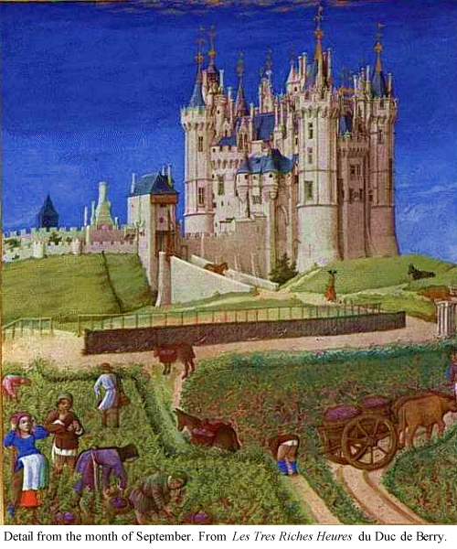
A Typical Manor
Fortified manor house
Village for peasants and serfs
Church
Mill
Blacksmith
Farmland
Three-field crop rotation system

Slide 24
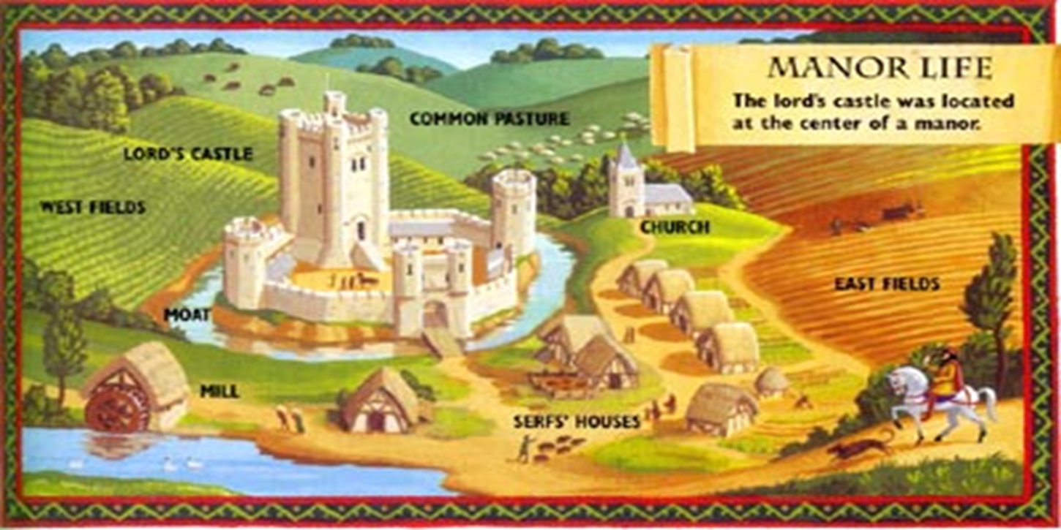

Slide 25
Medieval Europe – The Early Middle Ages:
The Growth of Monarchies

Slide 26
Main Idea
The power of kings grew and the nature of monarchy changed across Europe in the early Middle Ages.

Slide 27
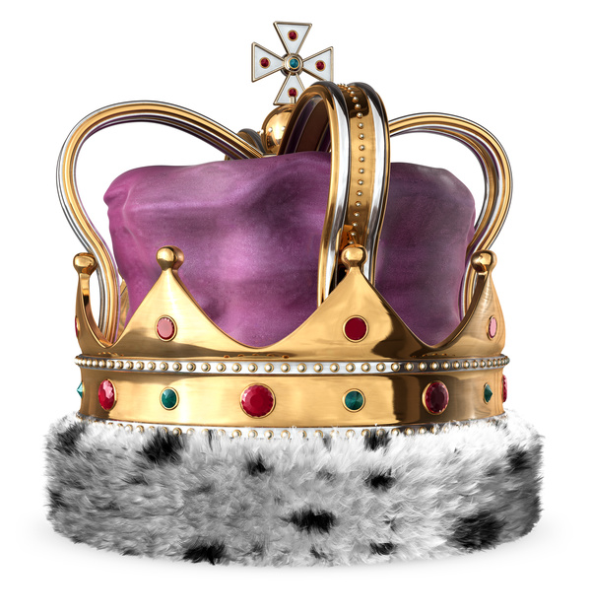
The English Monarchy
England one of first countries to develop a strong central monarchy
Kings held considerable power
Anglo-Saxons – first unified country
Normans – conquered the Anglo-Saxons

Slide 28
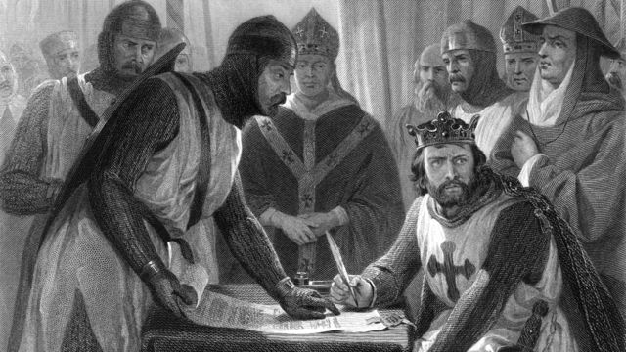
The English Monarchy
1215 - King John forced by nobles to sign the Magna Carta
Needed consent of nobles to raise taxes
Ended ability to arrest & punish without cause
Set forth ideas about limiting government and executive power

Slide 29
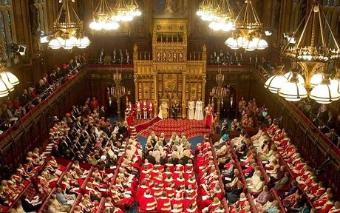
The English Monarchy
Rebellion of 1260s
Established Parliament
Governing body of England
Nobles, clergy, representatives from every county

Slide 30
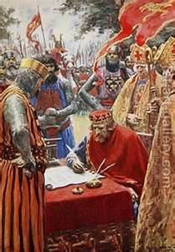
the Power of Kings grow
The English Monarchy
England was one of the first countries in Europe to develop a strong central monarchy = central government
The Magna Carta was a document that limited the power of the king = limited government
King John signing the Magna Carta,
forced by his nobles to give up some
of his power.
Magna Carta, a great step toward democratic government

Slide 31
Other European Monarchies
France
Spain
Portugal
Holy Roman Empire (Germany)

