Slide 1
Rome and Early Christianity:
The Fall of Rome

Slide 2
Main Idea
Events and conditions inside as well as outside the Roman Empire weakened it and led to its collapse in the west in the 400s.

Slide 3
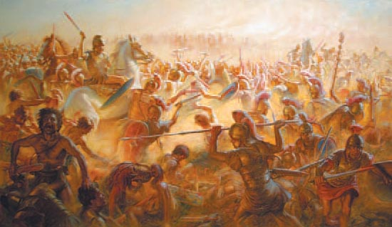
Weak Leaders
Lack of strong leaders led to civil wars
Threat of invasion on both frontiers
Increased size of the army

Slide 4
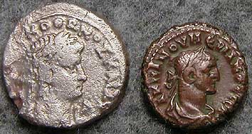
Economic Troubles
Inflation
Devalued money and a rise in prices
No longer expanding territories

Slide 5
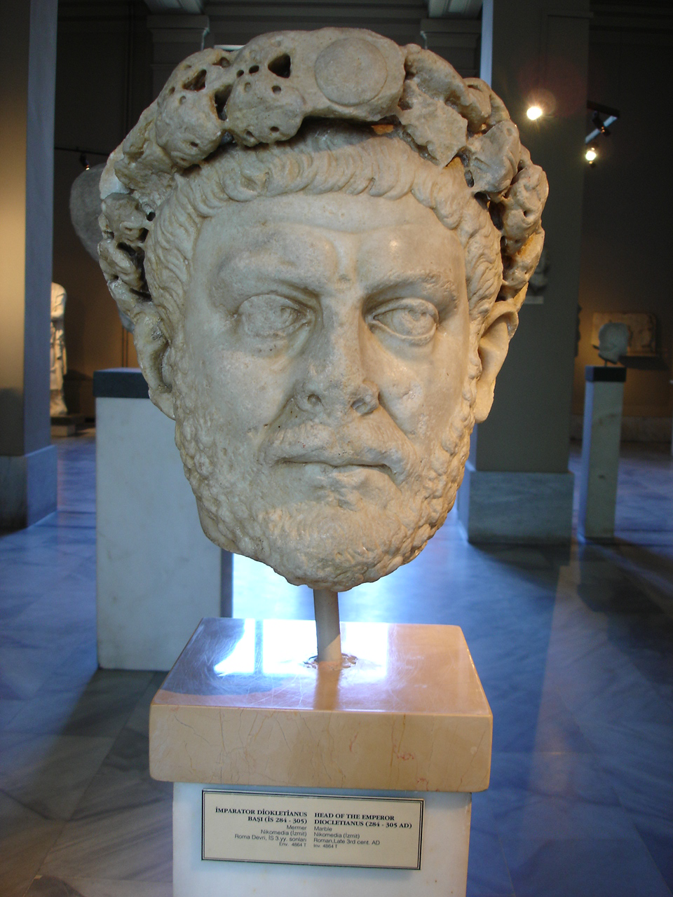
Attempts at Reform
Diocletian – 284 CE
Changed empire to absolute monarchy
Divided empire into 2

Slide 6
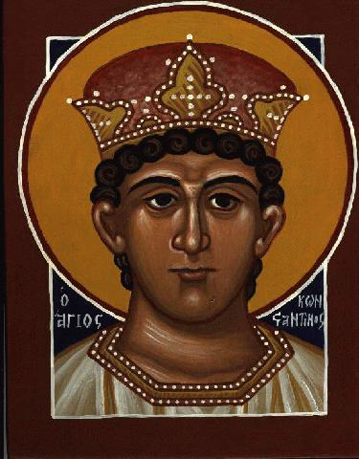
Attempts at Reform
Constantine – 312 CE
Proclaimed new emperor by his troops
Supported Christianity
New capital - Constantinople

Slide 7
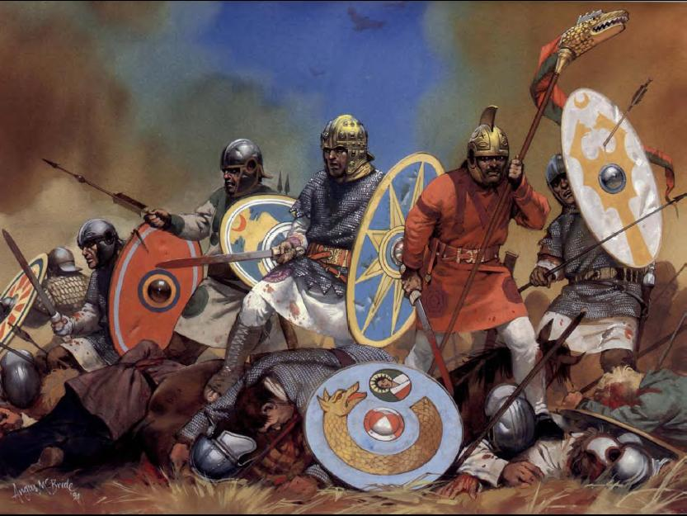
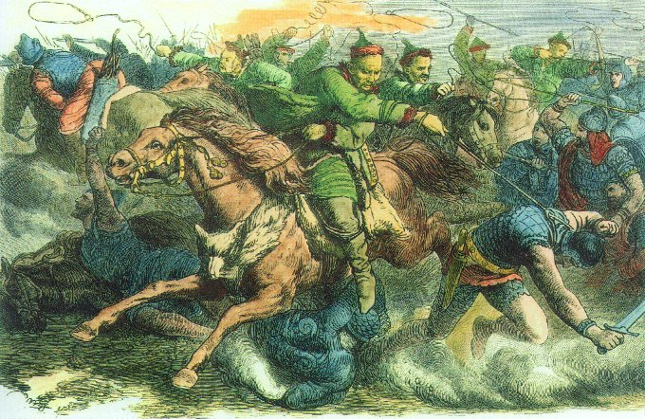
Invasions
Germanic tribes
Visigoths-Alaric
Ostrogoths
The Huns
The Vandals

Slide 8
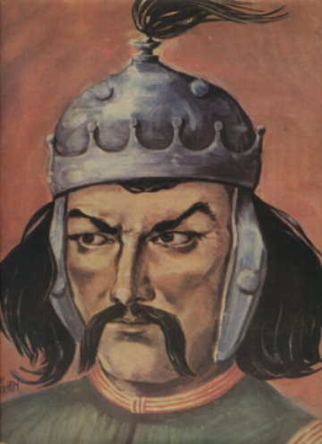
Invasions
Attila the Hun
Romans ally with Visigoths
Defeat the Huns
Convinced by Pope Leo I to leave Italy

Slide 9
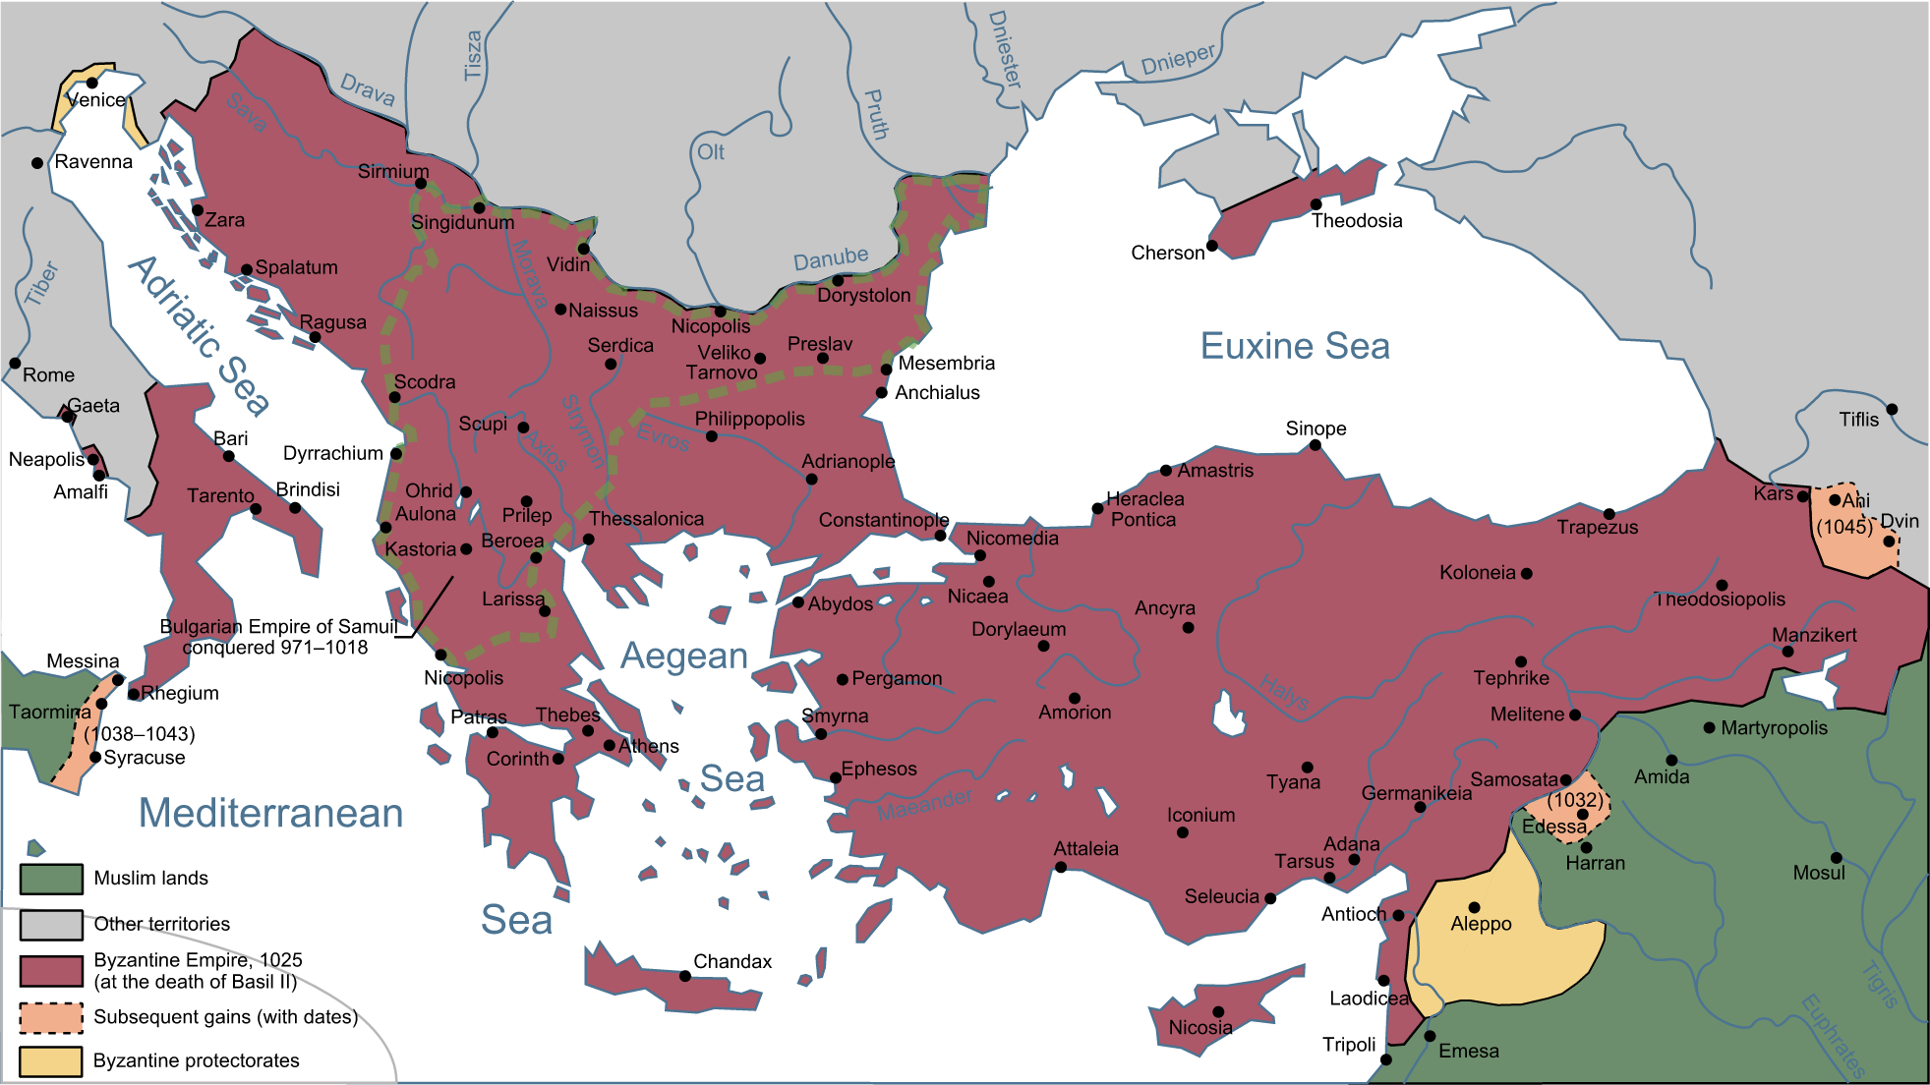
The Fall of the West
West left in shambles after the Huns
476 CE – Last emperor overthrown
Marks the end of the Western Roman Empire
East remains – becomes the Byzantine Empire

Slide 10
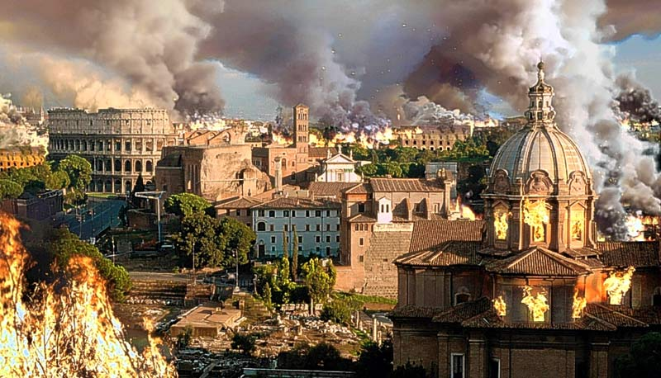
RECAP: REASONS FOR FALL?
Grew too large
Couldn’t sustain army
Civil Wars
Drained finances
Weak Leaders
Foreign Invasions
Disease

