Slide 1
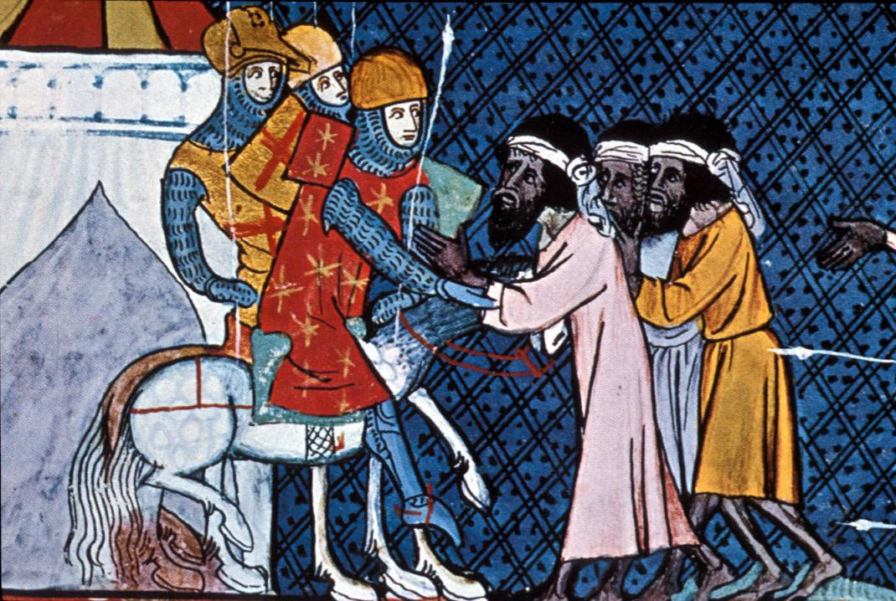
Medieval Europe – The High Middle Ages:
The Crusades

Slide 2
Main Idea
The Crusades, a series of attempts to gain Christian control of the Holy Land, had a profound economic, political, and social impact on the societies involved.

Slide 3
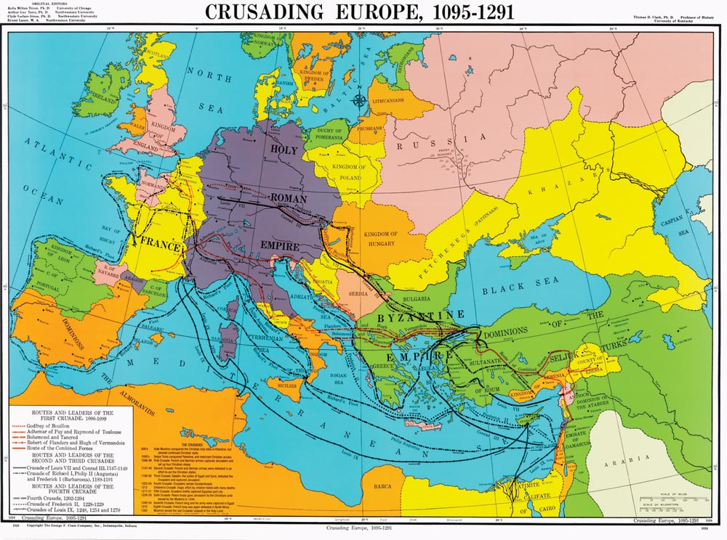

Slide 4
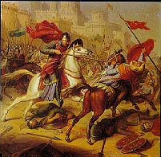
Launching the Crusades
Crusades
  Series of religious wars
Goal: take the Holy Land away from the Muslims – Jerusalem and the area around it
9 Total

Slide 5
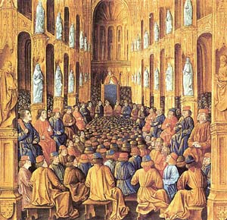
Launching the Crusades
Rumors/stories of Christians being persecuted by the Muslims
Council of Clermont
  Pope Urban II

Slide 6
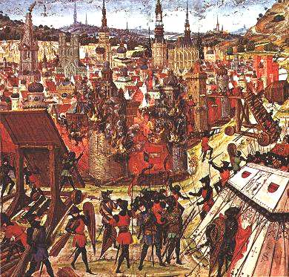
First Crusade - 1096
Two groups:
  Peasants
  Trained knights

Slide 7
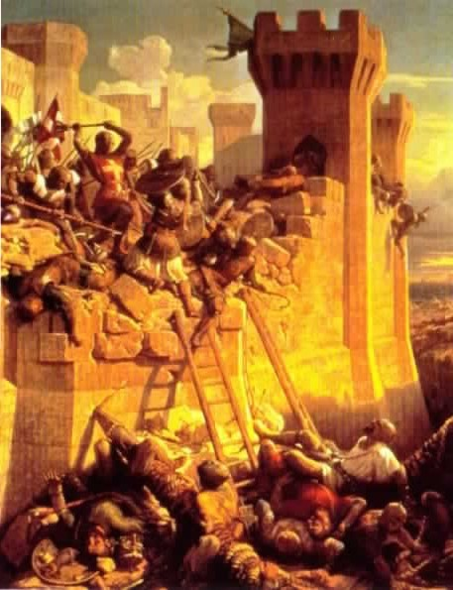
First Crusade
Both groups unprepared for the long journey
Terrible fighting
Created four states in the Holy Land intended to be Christian strongholds

Slide 8
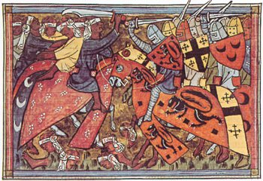
Second Crusade - 1147
Muslims recapture lands lost in First Crusade
Europeans call for a Second Crusade
Failure = took no lands, forced to return

Slide 9
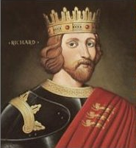
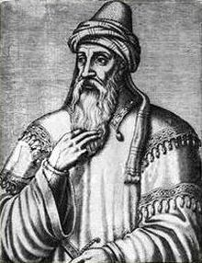
Third Crusade
Muslims now led by Saladin
  Drove out European Christians from Holy Land
Richard the Lion-Hearted
Crusade was a draw

Slide 10
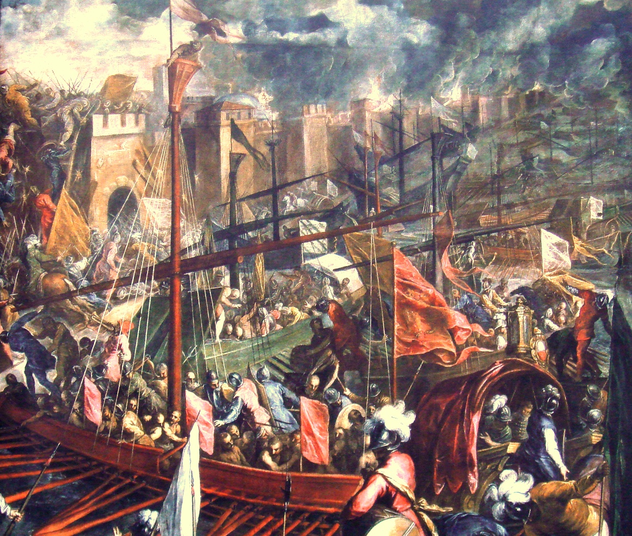
Fourth and Later Crusades
Giant failures
Sack Constantinople
Attack Christians
1291 – Muslims completely drive out Christians from the Holy Land

Slide 11
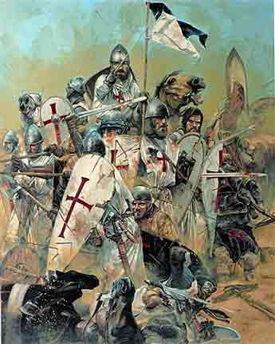
Effects of the Crusades
Changed Europe economically, politically, and socially
  Increased trade
  Kings gained more power
  Spread of Muslim knowledge and culture
  Increased persecution of non-Christians

Slide 12
SUMMARY
Causes
Effects
Muslims controlled the Holy Land
Byzantine emperor feared Muslim Turks would destroy Constantinople
Pope Urban II called for Christians to join a Crusade at the Council of Clermont
Trade increased
Kings gained more power
Muslim knowledge and culture spreads throughout Europe
Relations between Christians and Jews become increasingly strained

Slide 13
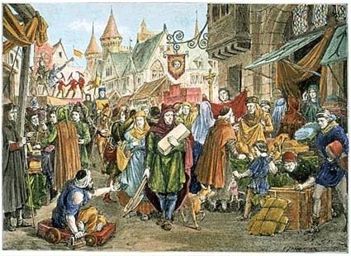
Medieval Europe –
The High Middle Ages:
Trade and Towns

Slide 14
Main Idea
Towns and cities grew during the Middle Ages as the amount of trade increased between Europe and other continents.

Slide 15
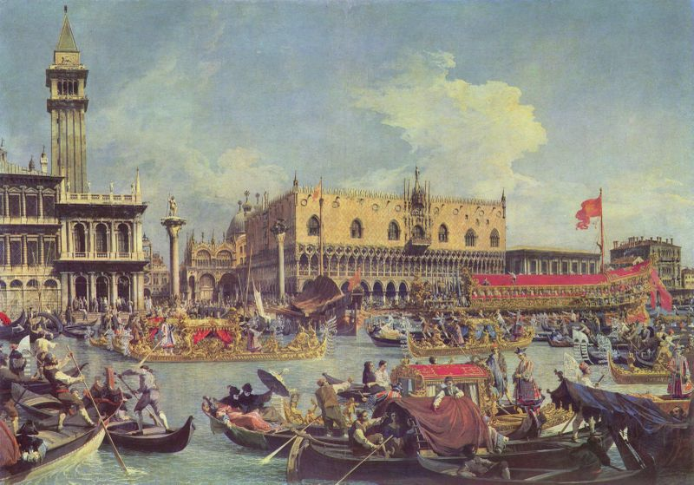
Growth of Trade
Large cities become more common
  London
  Venice
  Florence
Most trade controlled by Italy and northern Europe

Slide 16
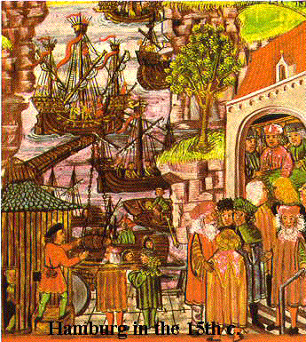
Growth of Trade
Hanseatic League
  Group of northern German cities and towns
  Worked together to promote and protect trade

Slide 17
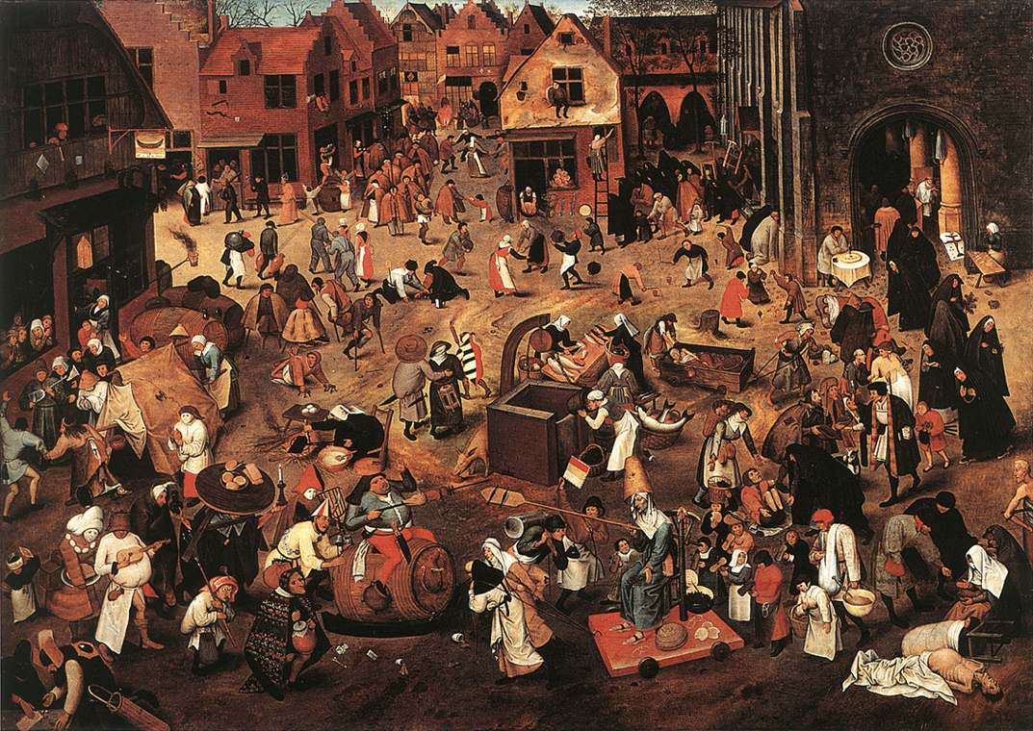
Growth of Trade
Trade fairs
Markets

Slide 18
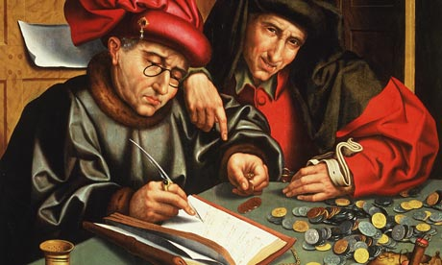
Growth of Trade
Trade encouraged use of money (no longer goods)
Credit
  Promise of later payment
Creation of first banks
  Mostly Jewish

Slide 19
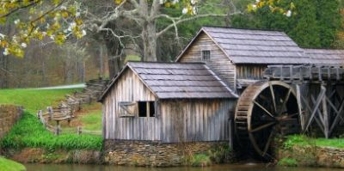
Growth of Towns and Cities
Towns grew from:
  Increased trade
  Use of money/chance to make money
  New and improved technologies

Slide 20
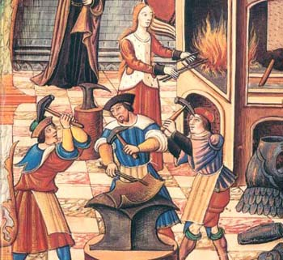
Growth of Towns and Cities
Craftspeople begin to organize:
Guilds
  Trade organizations
  Restrict competition
  Set standards and prices
  Insured quality

Slide 21
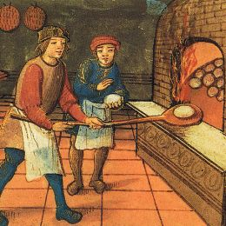
Growth of Towns and Cities
Master
Apprentice
  Spent years learning under a master
Journeyman
  Finished apprenticeship
  Traveled from shop to shop to continue to learn
  Difficult to become masters

Slide 22
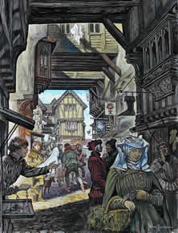
Growth of Towns and Cities
Cons of the growth of cities:
  Small and crowded
  Narrow and winding streets
  Dark
  Trash & waste
  Threat of disease, fire, and crime

Slide 23
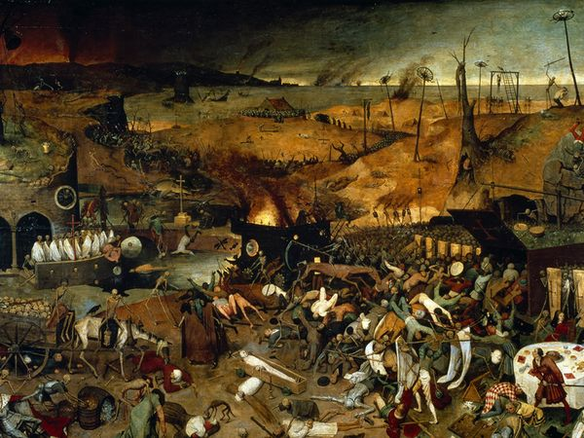
Medieval Europe –
The High Middle Ages:
Challenges of the Late Middle Ages

Slide 24
Main Idea
In the late Middle Ages, Europeans faced many challenges, including religious crises, wars, and a deadly plague.

Slide 25
Religious Crises
Religious crises = threat to all of society
Heresy
  Believes that opposed official teachings of the church

Slide 26
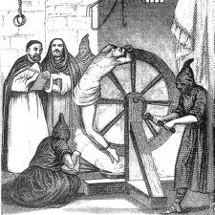
Religious Crises
Inquisitions
  Legal procedures supervised by special judges who tried suspected heretics

Slide 27
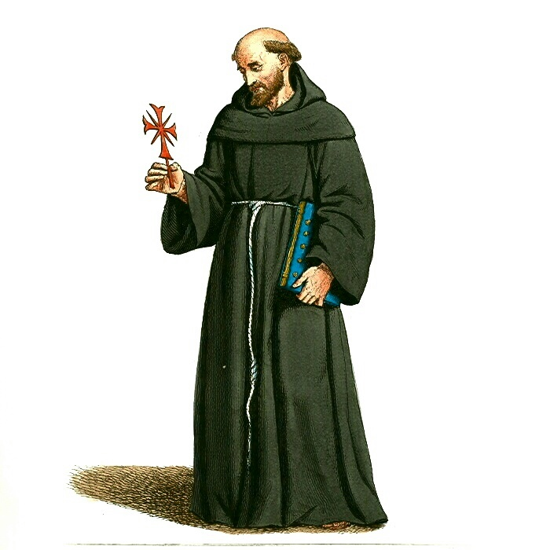
Religious Crises
Education
  Friars
War
  Crusades
Dispute over the papacy

Slide 28
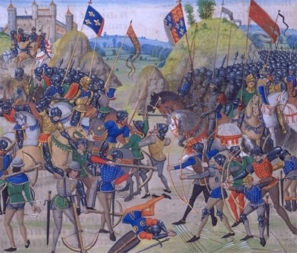
Hundred Years’ War
1328 – French king died without a son
Closest relative – King Edward III of England
French did not want to be ruled by English – name a regent king – King Phillip VI
1337 - Edward invades France
Hundred Years’ War

Slide 29
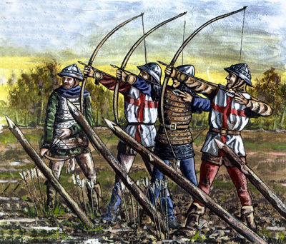
Hundred Years’ War
English had advantage - better weapons
  Long bow
  Cannon

Slide 30
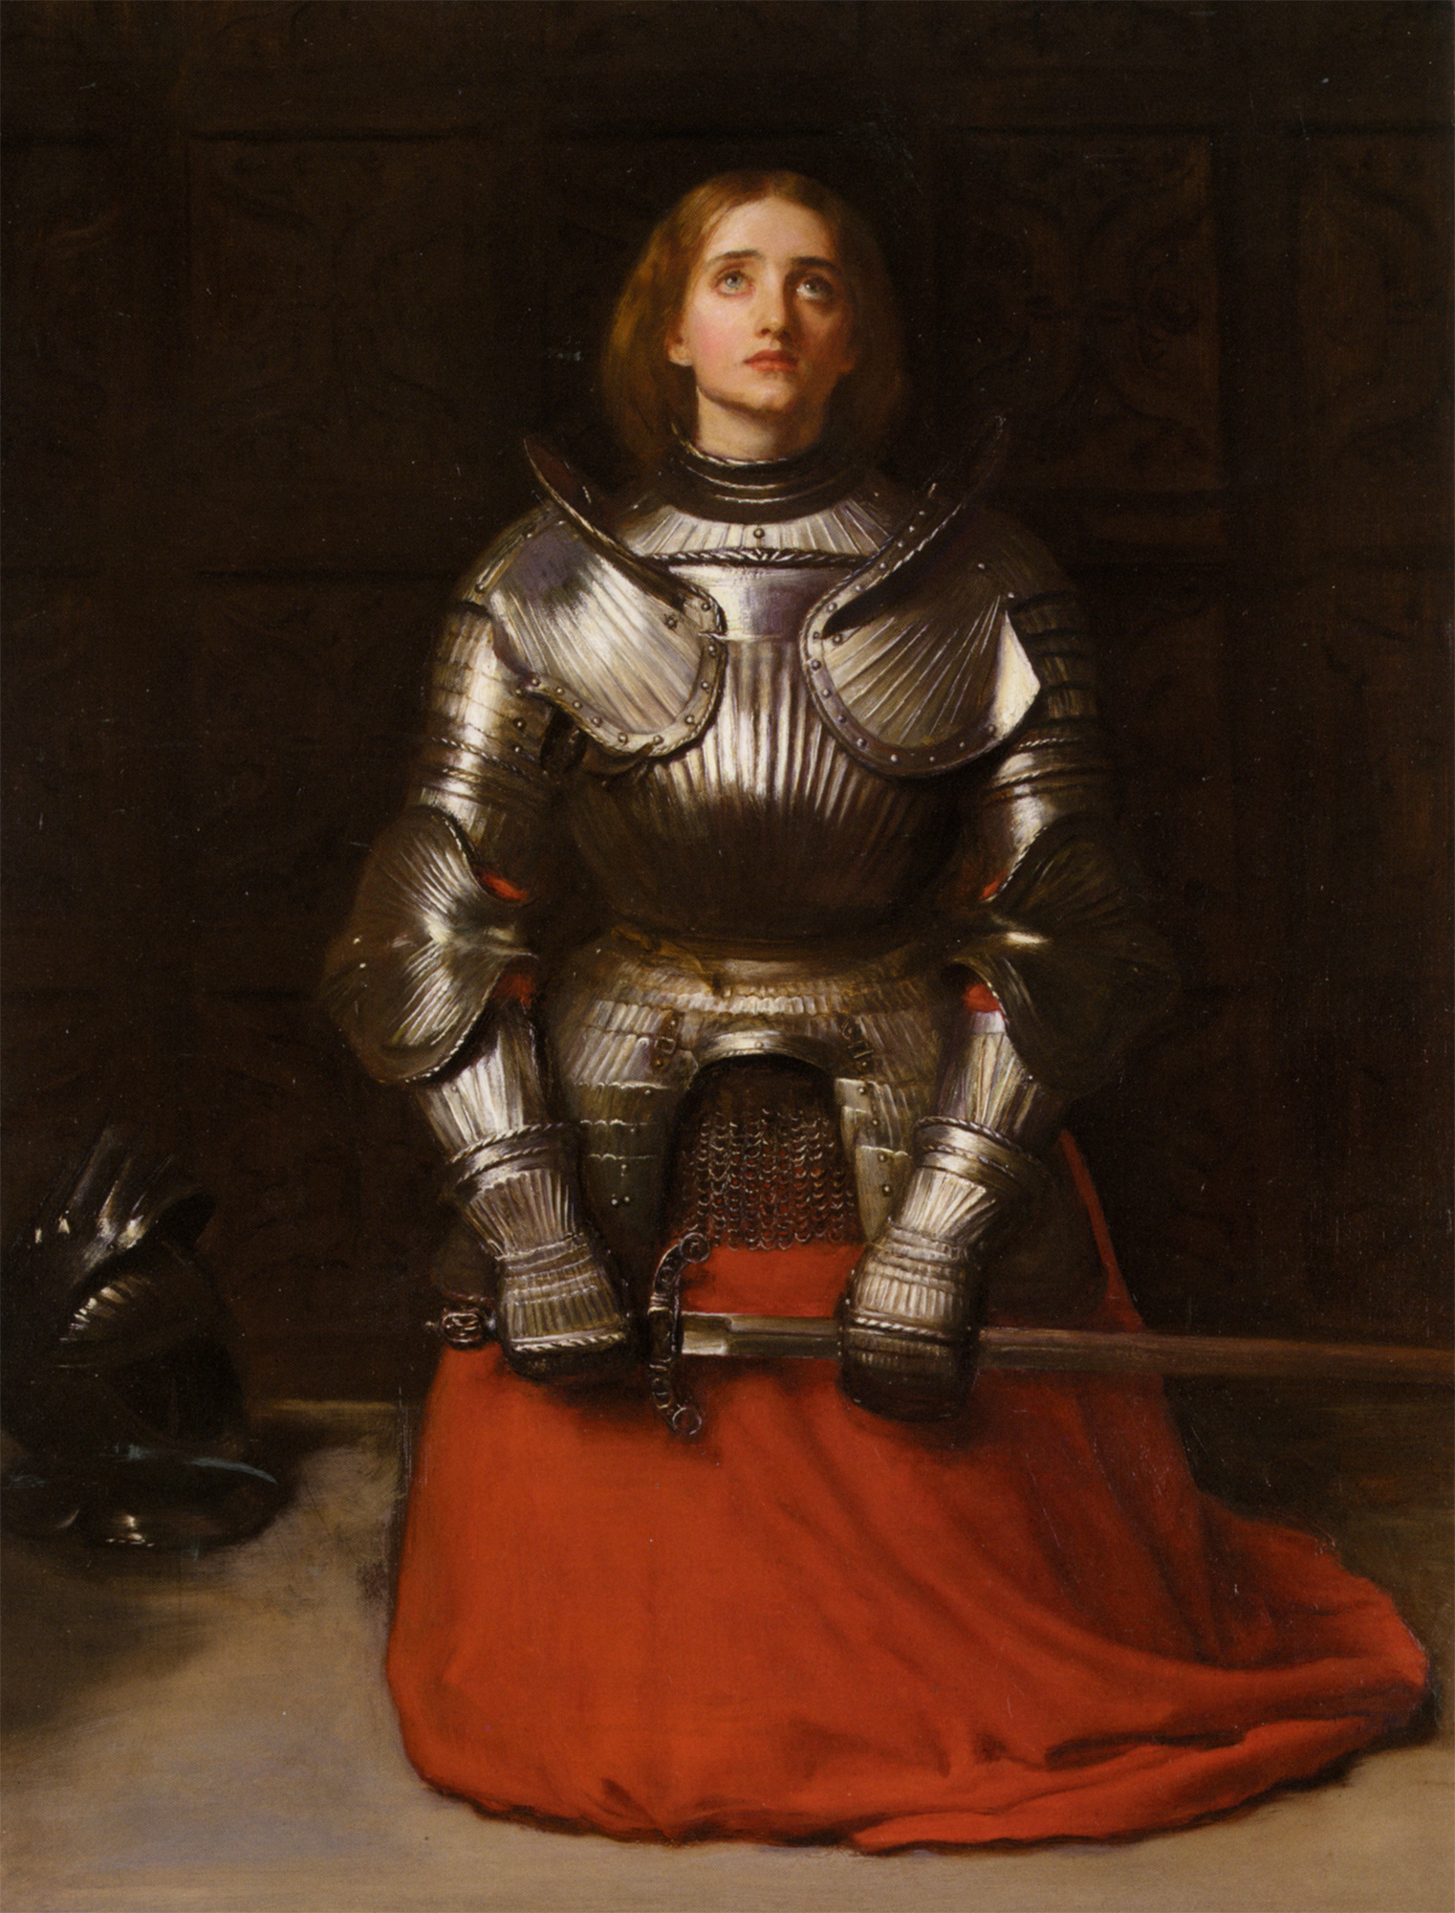
Hundred Years’ War
Joan of Arc
  Takes command of the French army
  Captured, tried, executed by the English

Slide 31
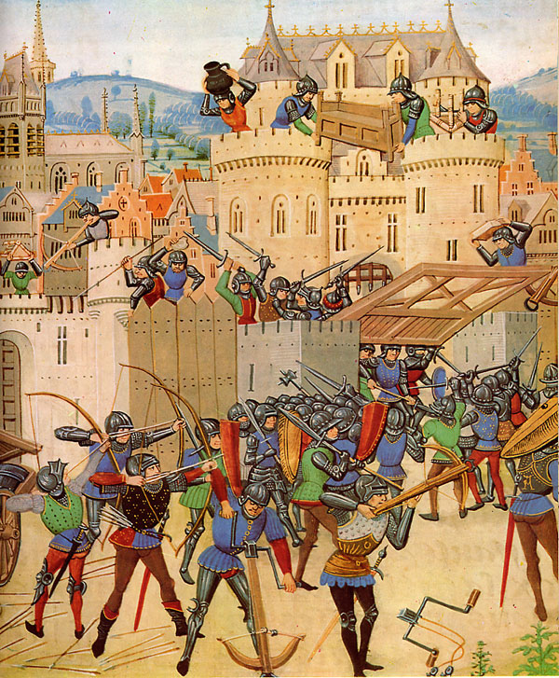
Hundred Years’ War
King Charles VII rallies French army
Takes back lost land and drives back the English

Slide 32
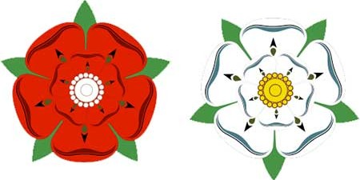
War of the Roses
Two families fight over the English throne
  Lancasters (red rose)
  Yorks (white rose)
Since both families had roses for symbols, became know as the Wars of the Roses

Slide 33
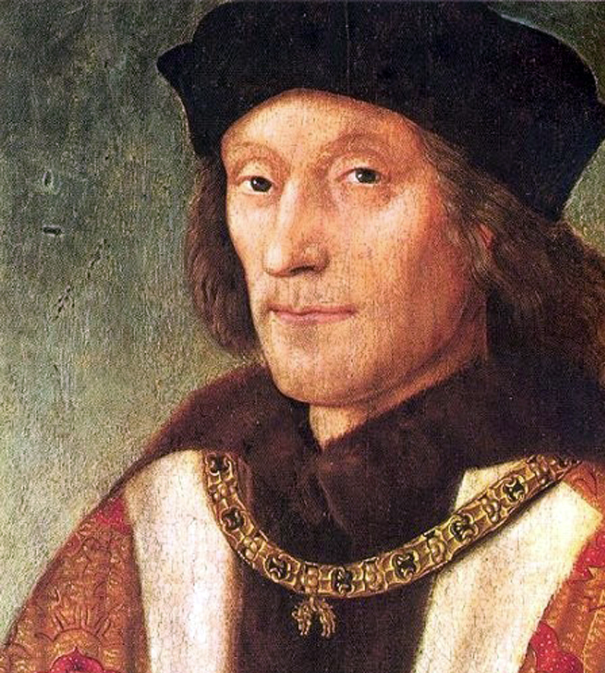
War of the Roses
Tudor family takes control
  Henry Tudor/Henry VII
Marks end of the Wars of the Roses

Slide 34
Wars & Conflict
Hundred Years War
King of England believes that he is the rightful heir to the French throne
France declared the regent to be the new king
Even thought England uses new weapons technology, France wins
War of the Roses
the Lancasters (red) & the Yorks (white) both used the rose as their family emblem; both wanted the English throne
After Edward’s death, a York, his son disappeared; his brother became king
Conflict ended when, Henry Tudor becomes king; he is related to both warring families

Slide 35
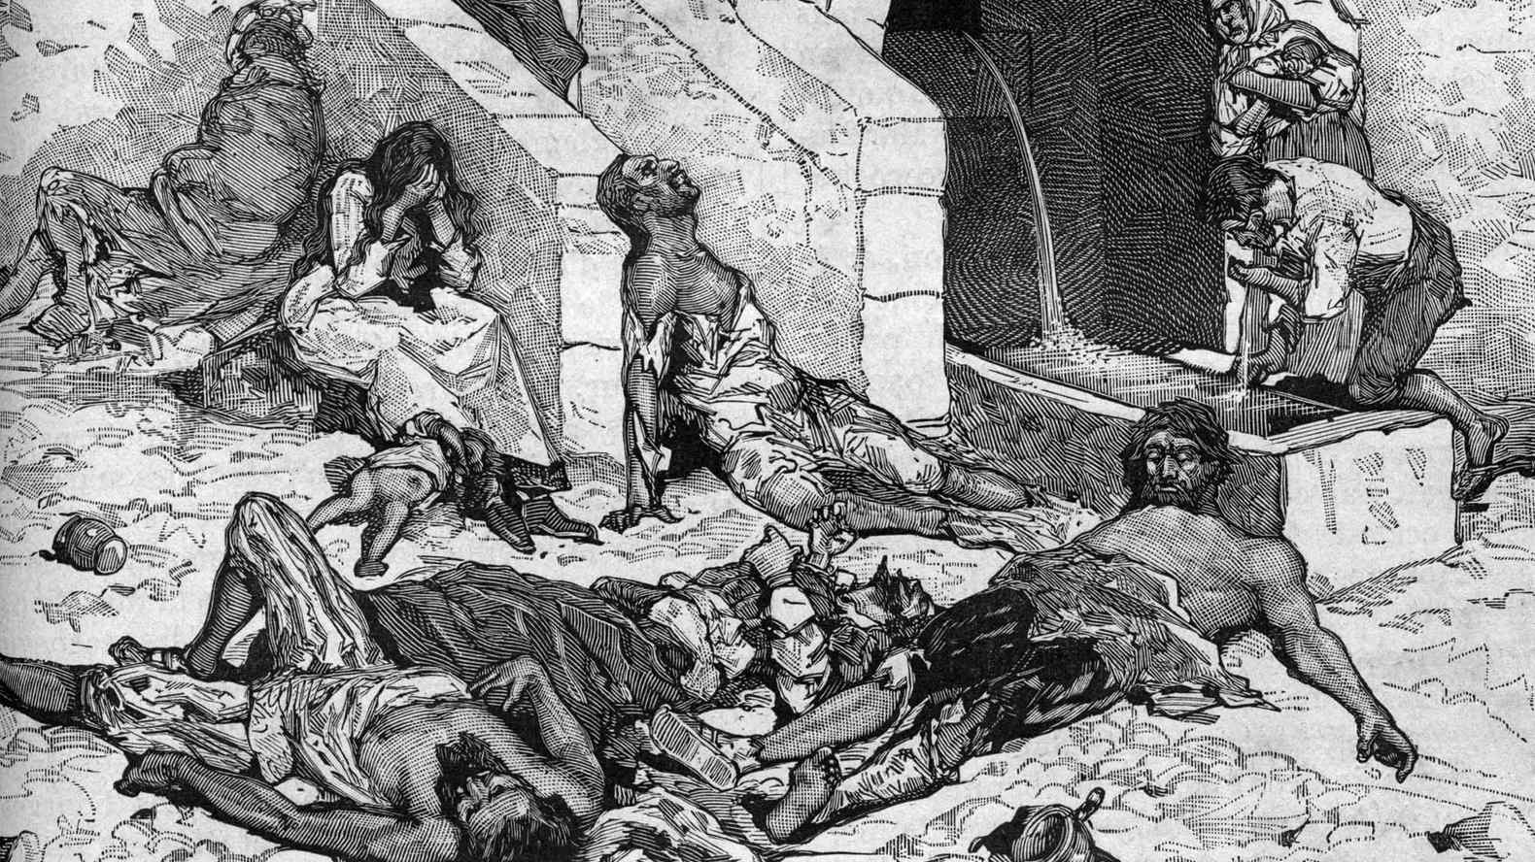
The Black Death
Black Death (1347-1351)
  Devastating plague
Bubonic and Pneumonic plague

Slide 36
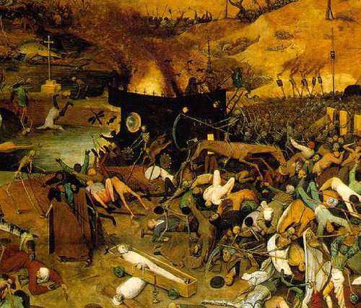
The Black Death
Symptoms:
  Large dark splotches on skin
  High fever
  Vomiting
  Headaches
  Most died within few days

Slide 37

The Black Death
Estimated that Europe and China both lost one-third of the population
People blamed God for the plague
Anti-Semitic beliefs increased in Europe
Manorial system collapsed

