Slide 1
The New Deal:
Launching the New Deal

Slide 2
Main Idea
In 1933 Franklin Delano Roosevelt became president of a suffering nation. He quickly sought to address the country’s needs, with mixed results.

Slide 3
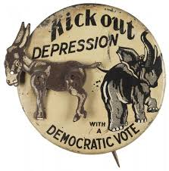
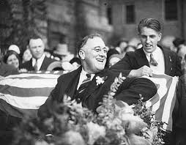
The Election of 1932
Americans blamed Hoover for the country’s economic woes
Franklin Delano Roosevelt
Promised relief for the poor and more public works (gov.’t funded building projects) programs to provide jobs

Slide 4
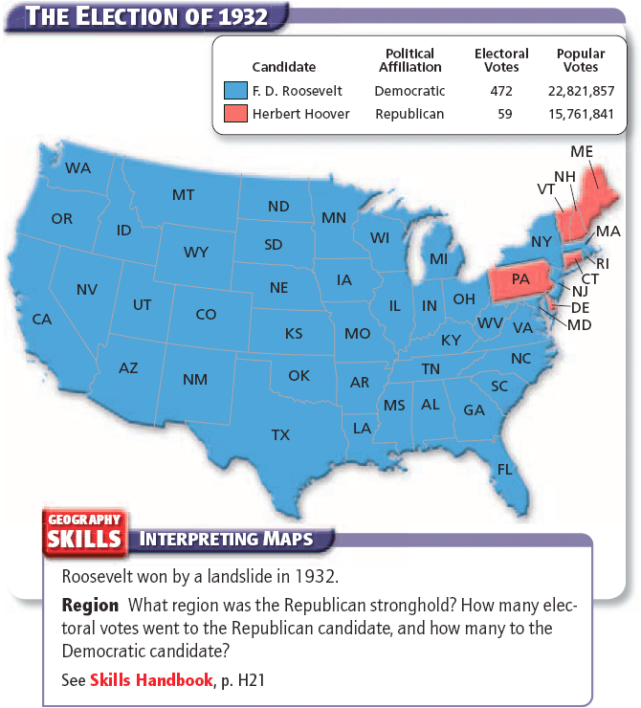

Slide 5
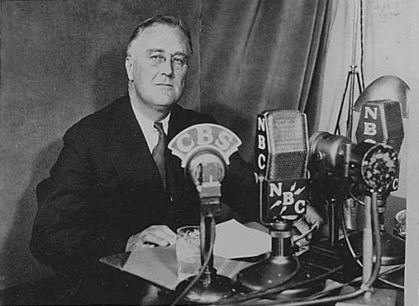
The Roosevelts
FDR believed that the government could solve economic and social problems
Gov’t should take direct action to help its people
Effective communicator
Fireside chats *
Conversational radio addresses given by FDR
Survived polio

Slide 6
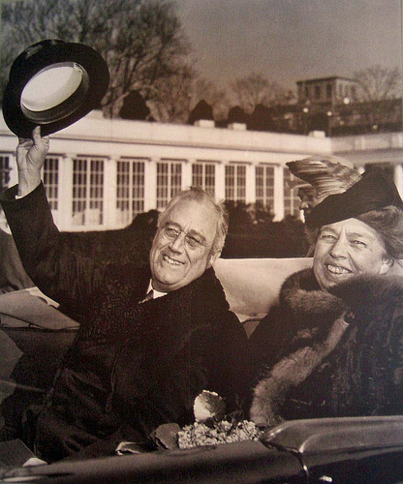
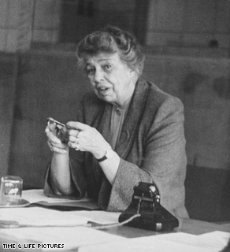
The Roosevelts
Eleanor Roosevelt
Helped to change the role of the First Lady
Directed efforts to solve several major social issues
“Eyes and ears” of FDR
Had trust and affection of many Americans

Slide 7
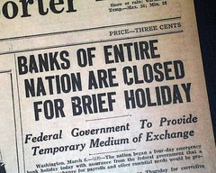
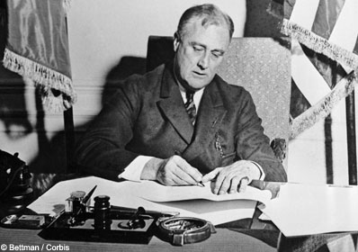
Franklin Roosevelt as President
Quickly addressed the banking crisis
Temporarily closed all the nation’s banks
Passed the Emergency Banking Act
Glass-Steagall Act created the FDIC

Slide 8
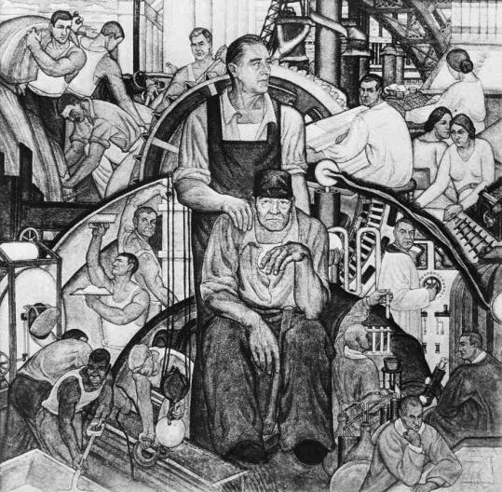
Franklin Roosevelt as President
Hundred Days
The first 100 days of FDR’s presidency
Roosevelt pushed Congress to put most of his “New Deal”
FDR’s plan to bring economic relief, recovery, and reforms to the country after the Great Depression

Slide 9
The New Deal
Civilian Conservation Corps (CCC)
Agriculture Adjustment Act (AAA)
Gave farmers a subsidy
Government payment to grow fewer crops
National Industrial Recovery Act (NIRA)
Required that businesses in the same industry cooperate with each other
Started Public Works Administration (PWA)

Slide 10
The New Deal
Federal Securities Act
Helped investors, restored confidence in the markets
Securities and Exchange Commission (SEC)
Tennessee Valley Authority (TVA)
Created the Civil Works Administration
Passed the Indian Reorganization Act

Slide 11
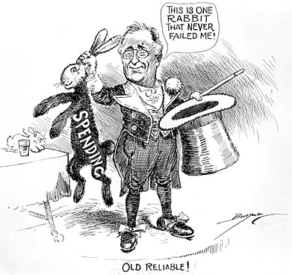
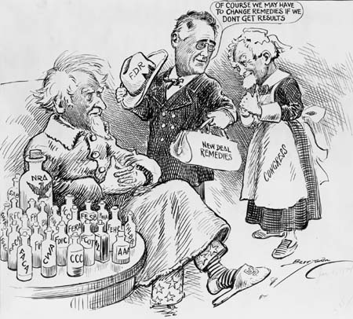
Trouble for the New Deal
Radicals believed the New Deal did not go far enough in reforming the economy
Conservatives attacked the New Deal as a radical break with traditional American ideals

Slide 12
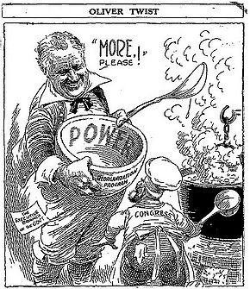
Leading Critics of the New Deal
Critics of the New Deal:
Policies too friendly to banks
Didn’t do enough for older Americans
Believed that the New Deal went too far and was anti-business
Feared that it gave the president too much power over other branches of government

Slide 13
The New Deal:
The Second New Deal

Slide 14
Main Idea
A new wave of government initiatives starting in 1935 resulted in some strong successes and stunning defeats for President Roosevelt

Slide 15
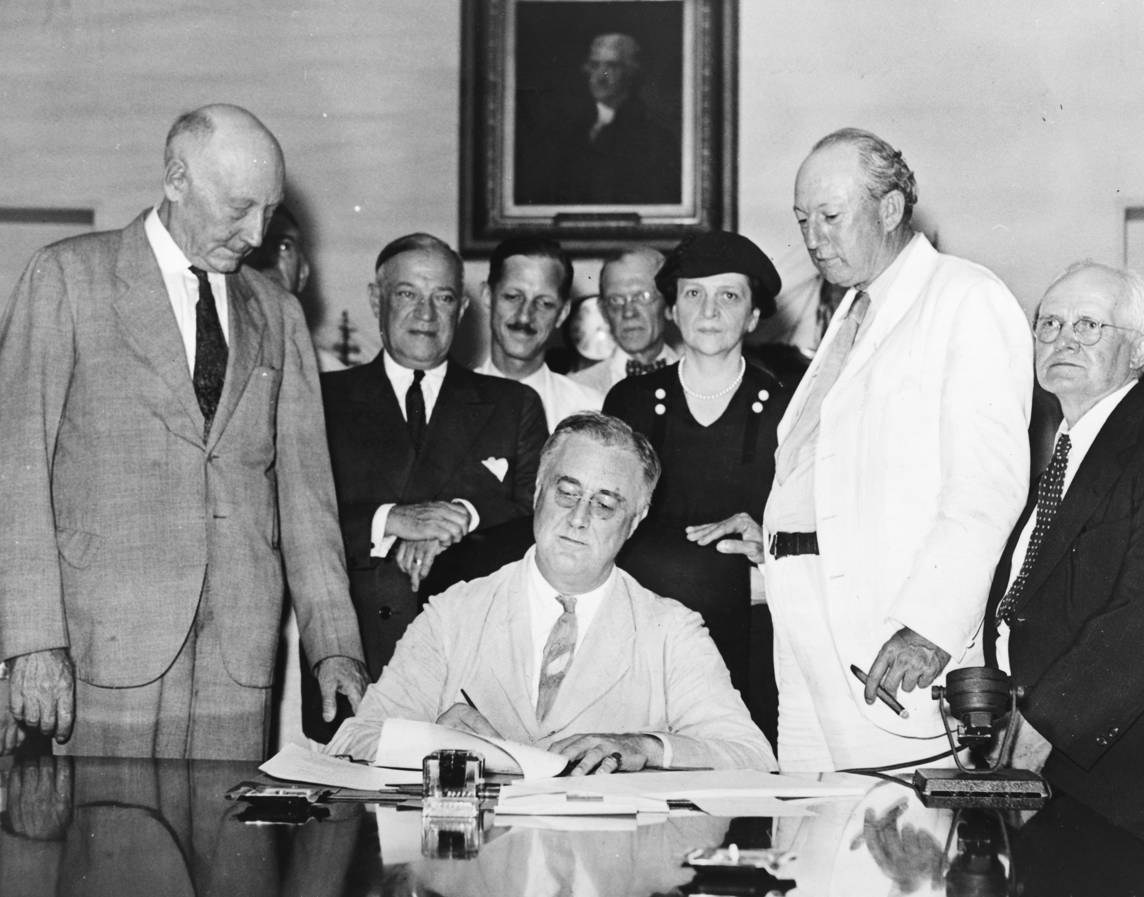
The Second Hundred Days
Second Hundred Days/ The Second New Deal
Laws extending government oversight of the banking industry
Raised taxes on the wealthy
New relief programs

Slide 16
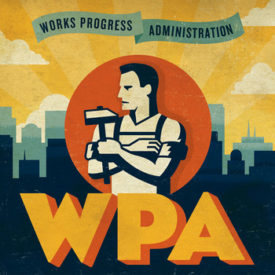
The Second Hundred Days
Emergency Relief Appropriations Act –
Stopped direct payments to Americans in need
Should work for pay
Works Progress Administration (WPA)
Largest peacetime jobs program in U.S. history

Slide 17
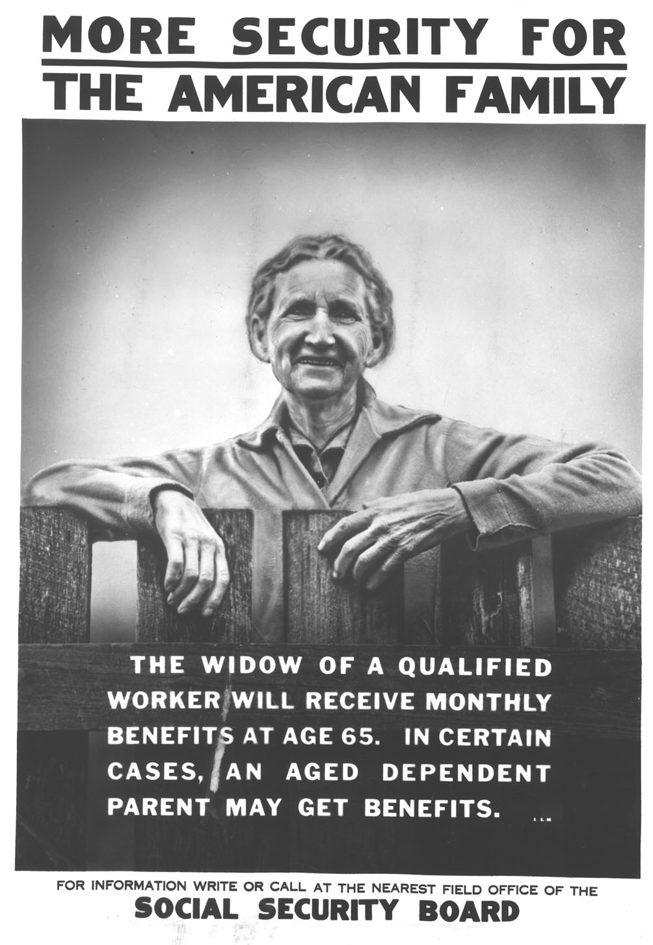
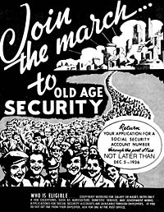
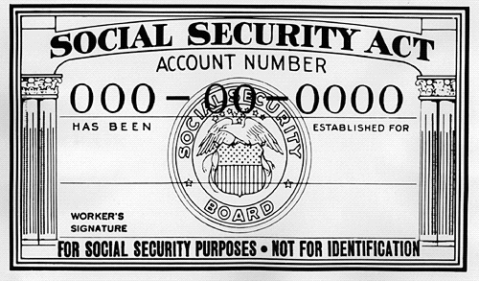
The Second Hundred Days
Social Security
Provided guaranteed, regular payments for many people 65 and older
Included a system of unemployment insurance

Slide 18
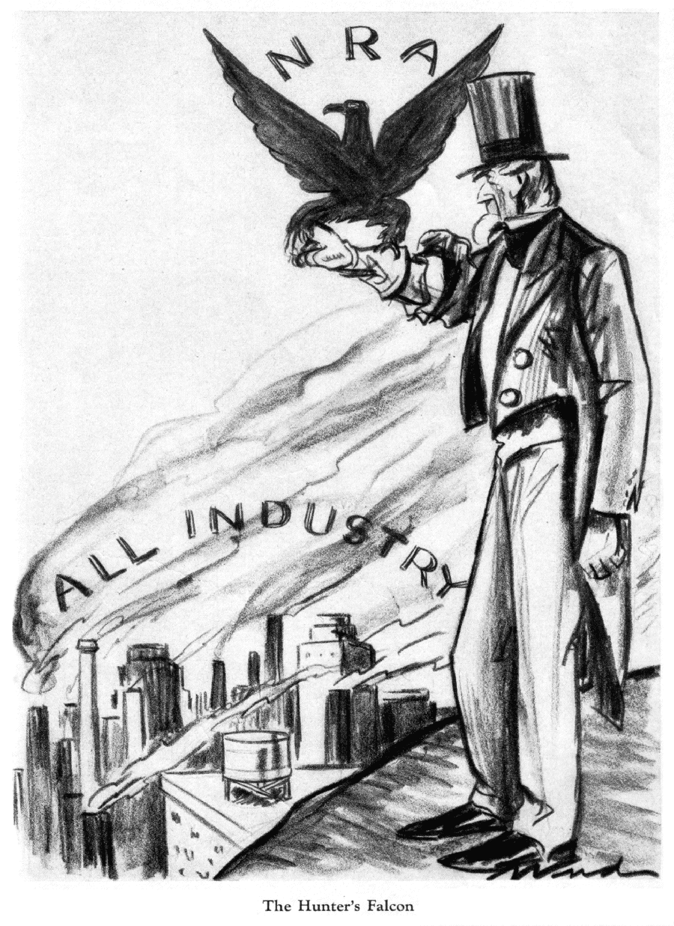
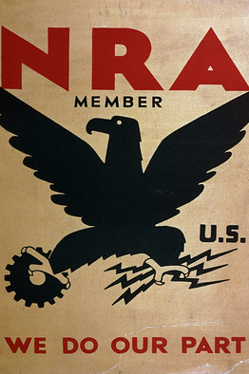
The New Deal Revives Organized Labor
National Industrial Recovery Act (NIRA)
Guaranteed workers the right to form unions and bargain collectively (collective bargaining)
Difficult to enforce

Slide 19
The New Deal Revives Organized Labor
2. The Wagner Act, or the National Labor Relations Act (NLRA)
Outlawed a number of anti-labor practices
Established the National Labor Relations Board
Authority to conduct voting in workplaces to determine whether employees wanted union representation

Slide 20
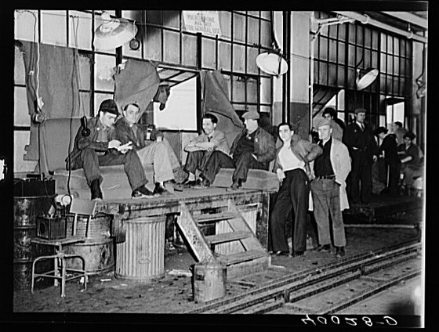
The New Deal Revives Organized Labor
3. 1935 - The Committee for Industrial Organization (CIO)
The United Auto Workers (a division of the CIO) launched the first successful sit-down strike

Slide 22
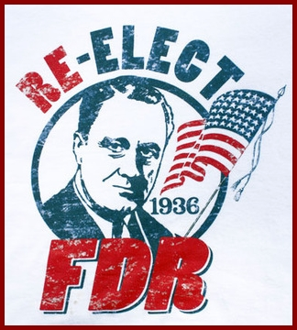
The Election of 1936
FDR
Showcased his achievements:
Unemployment cut in half, income and business earnings were up, passed the Rural Electrification Act (REA), New Deal programs provided hope and help
Spoke out against big business

Slide 23
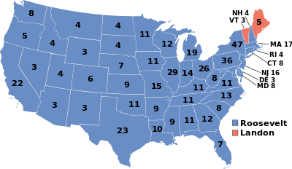
The Election of 1936
The Results:
A tremendous victory for Roosevelt
The Democrats again gained seats in both houses

Slide 24
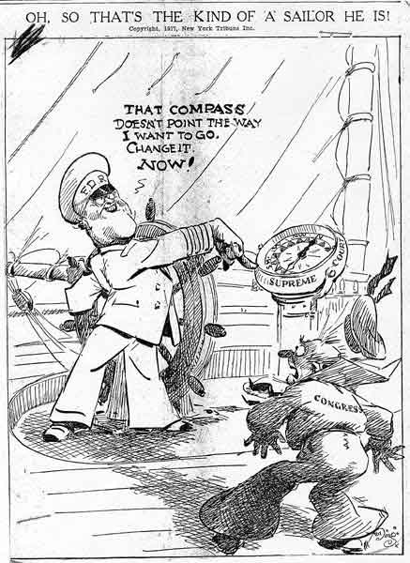
A Troubled Year
FDR makes a plan to reorganize the nation’s courts
Frustrated that courts had struck down many New Deal programs
The positive feelings about FDR and the New Deal had begun to fade

Slide 25
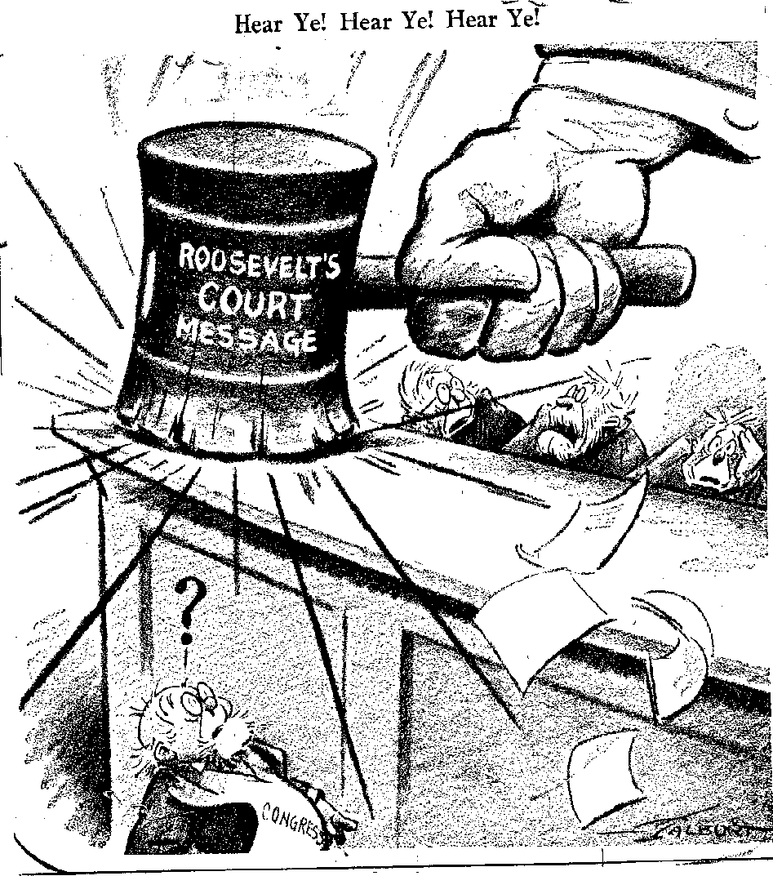
The Court-Packing Plan
Roosevelt’s Plan:
Expand the Supreme Court
Gave the president power to appoint new judges
Most observers saw plan as effort to “pack” the court with friendly justices

Slide 26
The Court-Packing Plan
The Result:
Plan did not pass
Supreme Court made some rulings that favored New Deal legislation
Upheld a minimum wage law in Washington state
Ruled in favor of a key element of the Wagner Act
Declared Social Security plan to be constitutional

Slide 27
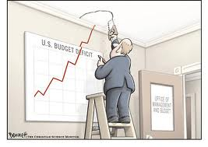
Economic Downturn of 1937
Sharp drop in the stock market
Rise in unemployment
Roosevelt had hoped to cut back on government spending
Deficit
Occurs when government spends more money than it takes in

Slide 28
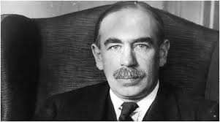
Economic Downturn of 1937
John Maynard Keynes
Argued that deficit spending could provide jobs and stimulate the economy
Government begins spending large sums of money to help the unemployed
The economy did begin to rebound in the summer of 1938

Slide 29
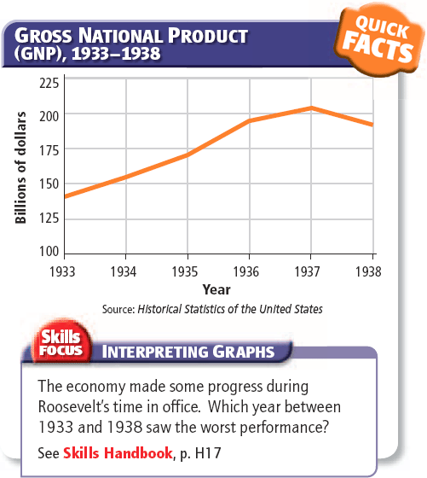

Slide 30
The New Deal:
Life During the New Deal

Slide 31
Main Idea
The Great Depression and the New Deal had a deep impact on American culture during the 1930s

Slide 32
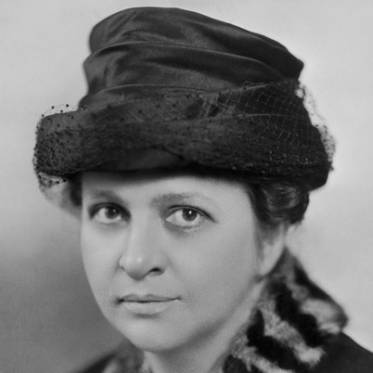
New Roles for Women
Roosevelt promoted and recognized women
Frances Perkins
Women served as leaders in several New Deal agencies
Still faced challenges and discrimination
Lower wages
Less opportunities
Hostility in the workplace

Slide 33
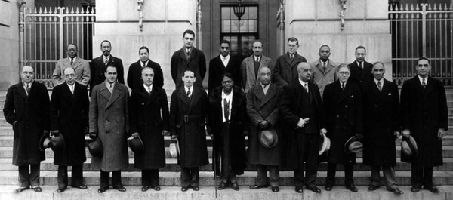
New Roles for African Americans
Roosevelt’s administration also appointed many African Americans
William Hastie
The Black Cabinet
African Americans hired to fill government posts
Unofficial advisors to the president
Symbol of rising African American influence

Slide 34
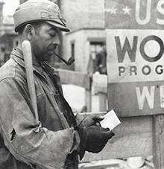
New Roles for African Americans
Continued to face tremendous hardships
Severe discrimination
Thousands were not helped by New Deal programs
Many African Americans switched from the Republican Party to the Democratic Party during the 1930s

Slide 35
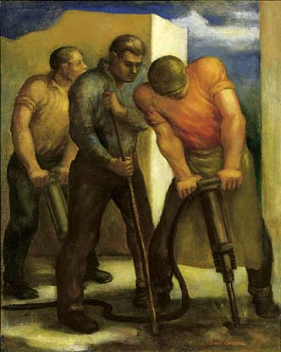
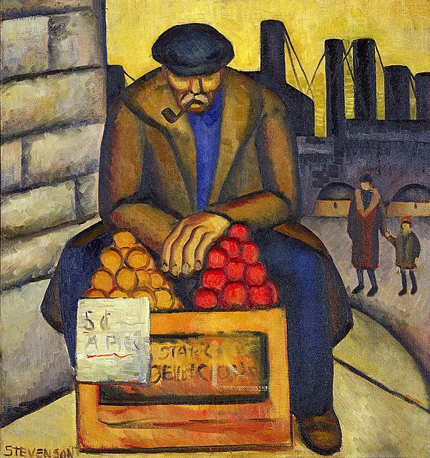
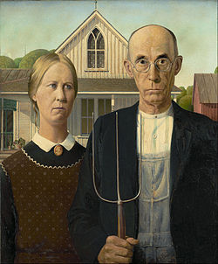
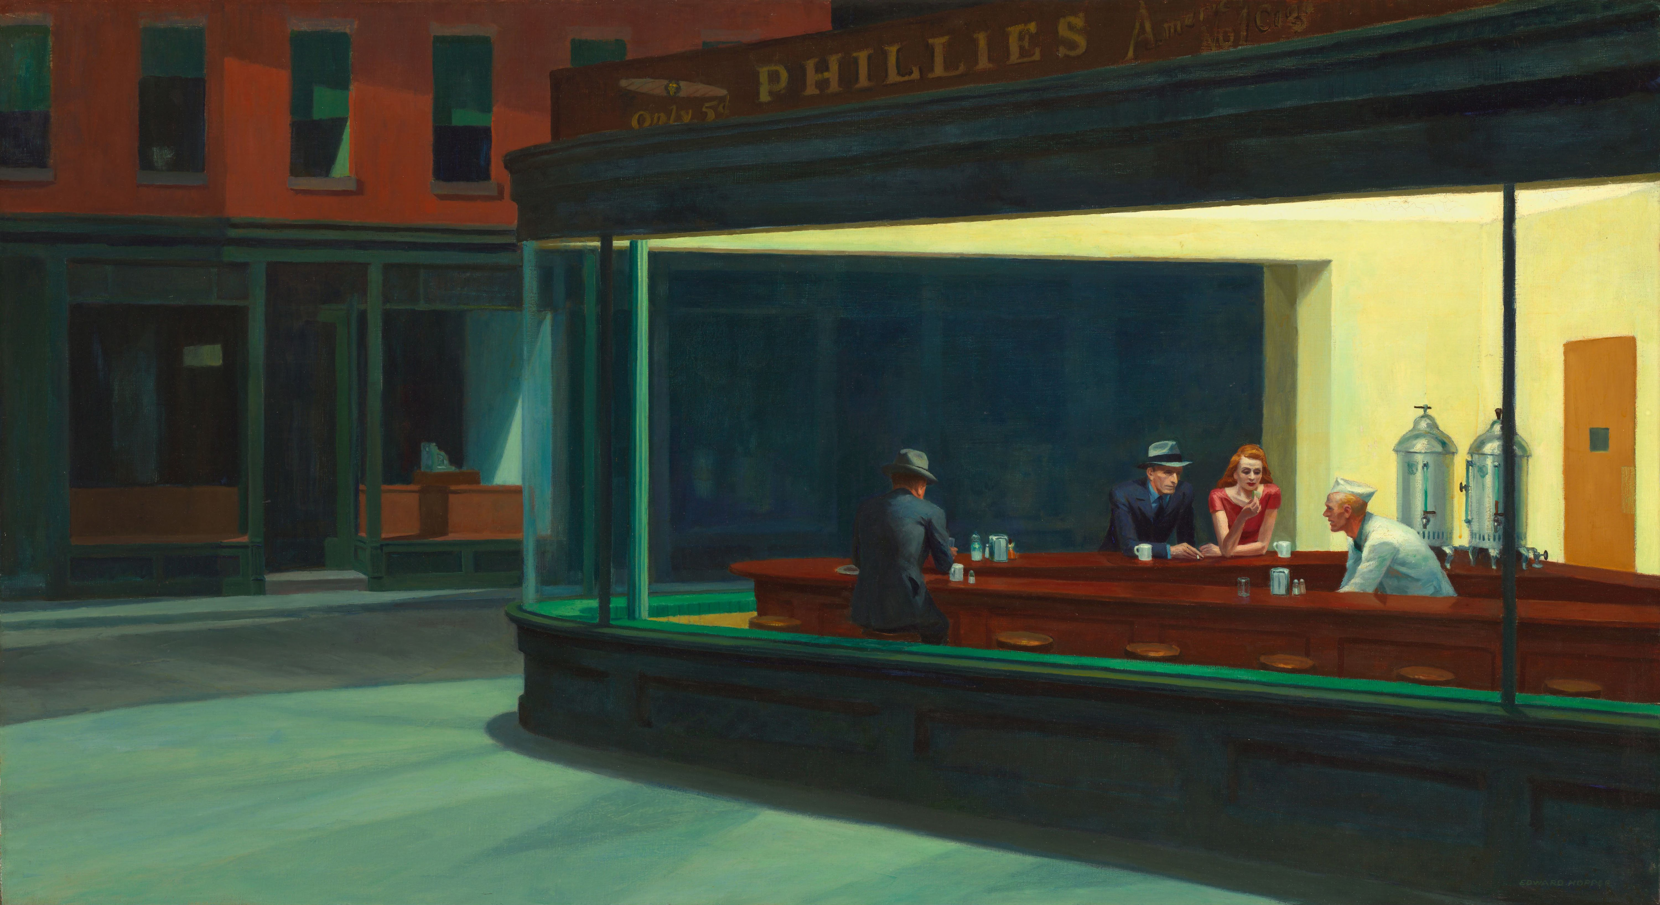
Art of the Great Depression
Works depicted the struggles of the working class and the plight of the rural and urban poor

Slide 36
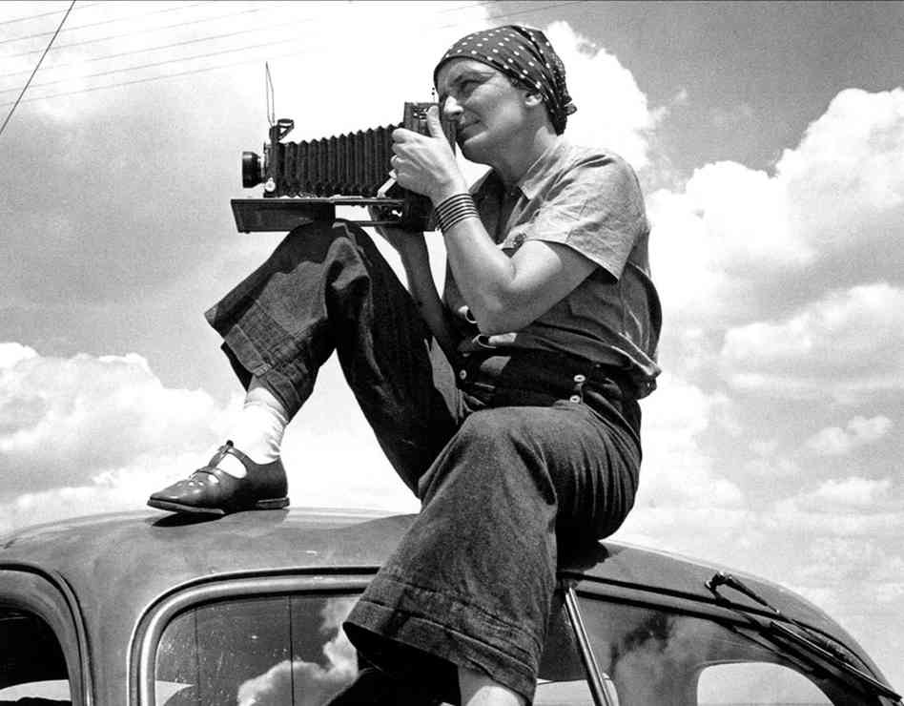
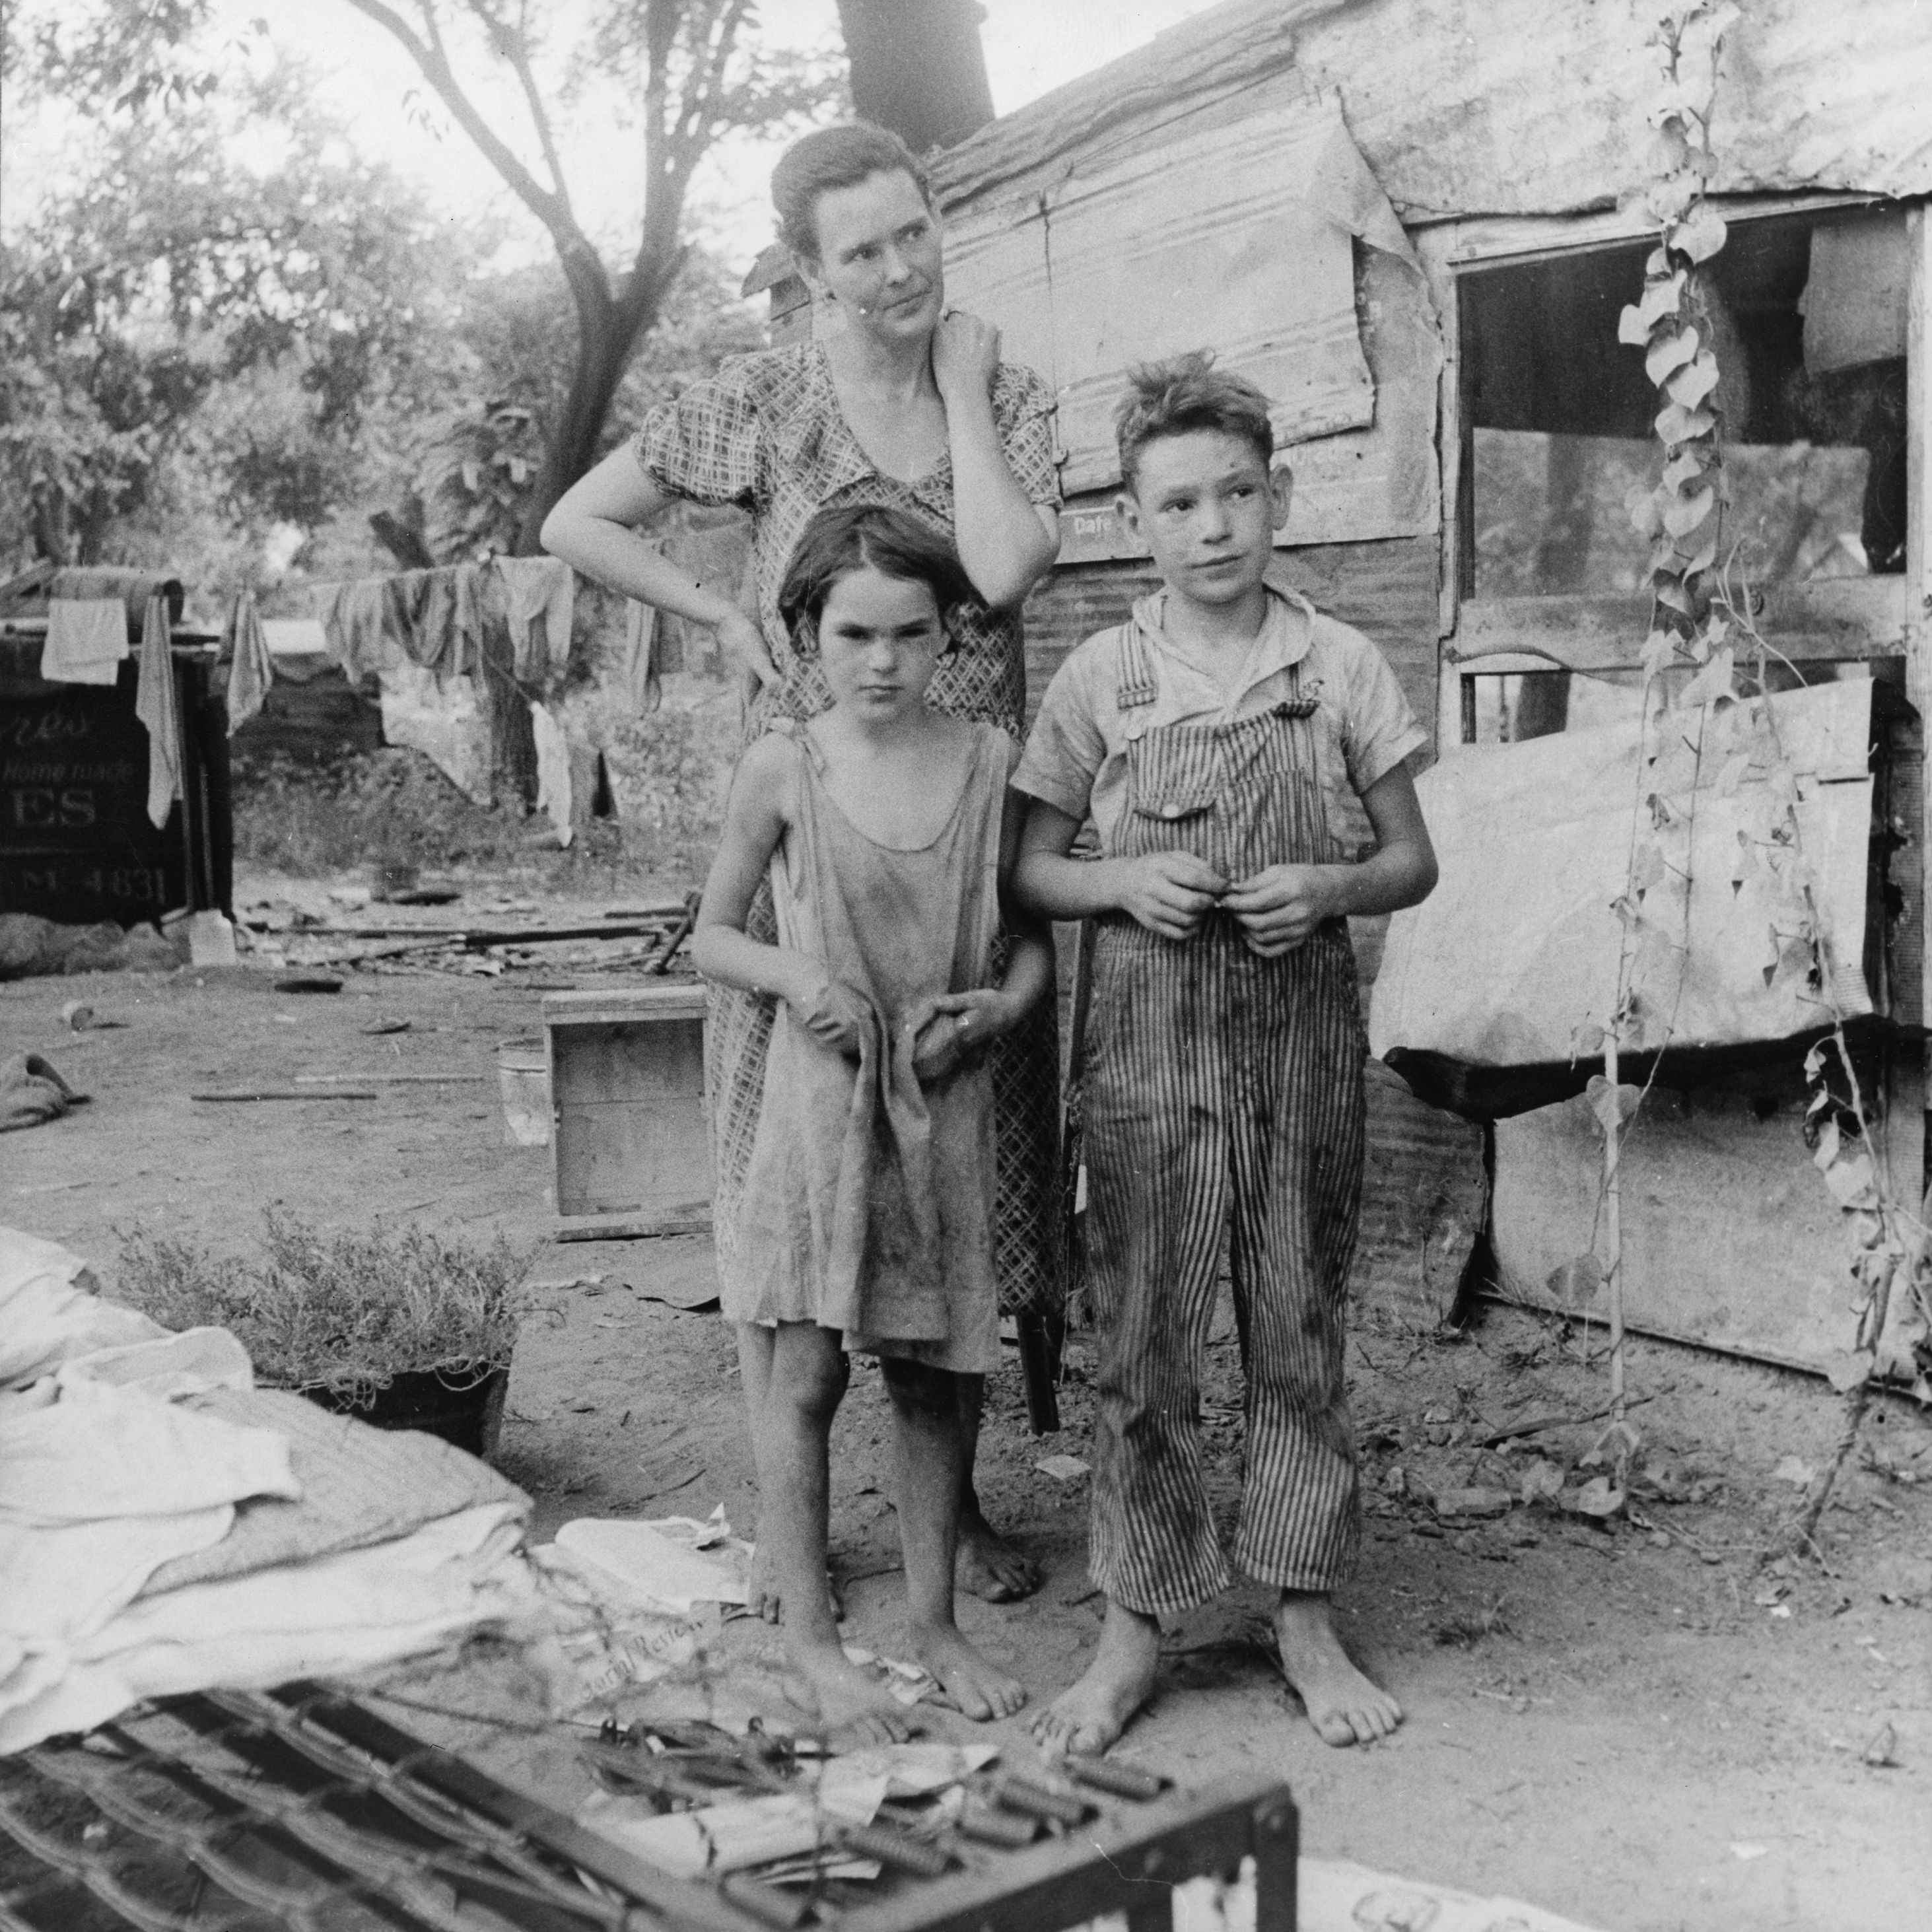
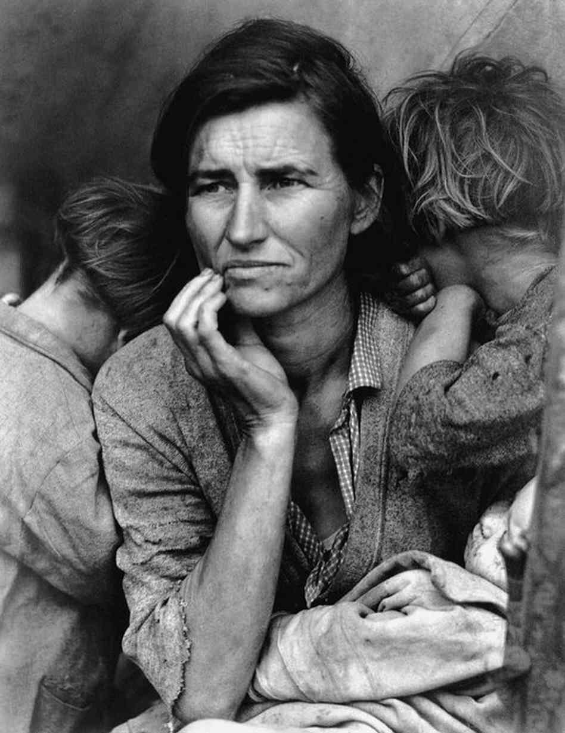
Art of the Great Depression
Dorothea Lange
Worked for the Farm Security Administration
Hired to document the plight of the poor and jobless
Hoped to gain public support for New Deal programs and raise awareness

Slide 37
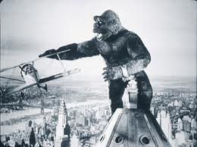
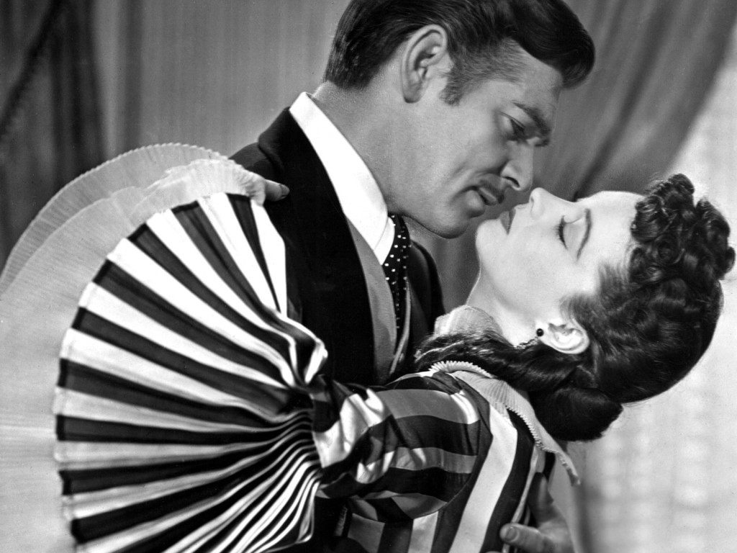
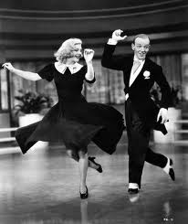
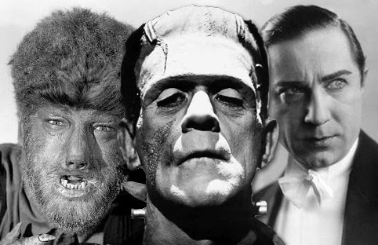
Popular Entertainment of the Great Depression
Movies
Millions of Americans went to the movies each week
Most films were upbeat and allowed viewers to “escape” the depression

Slide 38
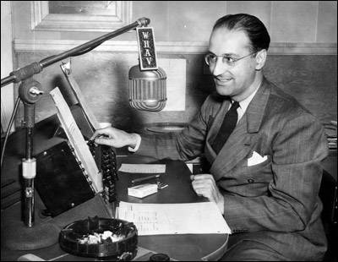
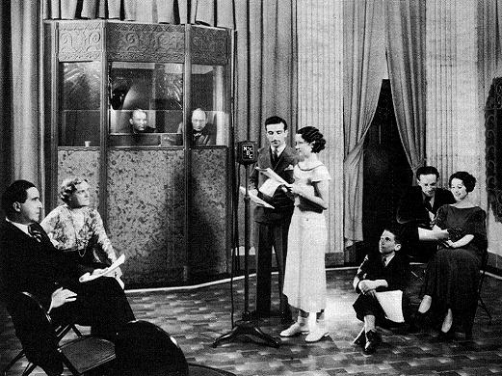
Popular Entertainment of the Great Depression
Radio
Provided politics, religion, music, sports, and other forms of entertainment

Slide 39
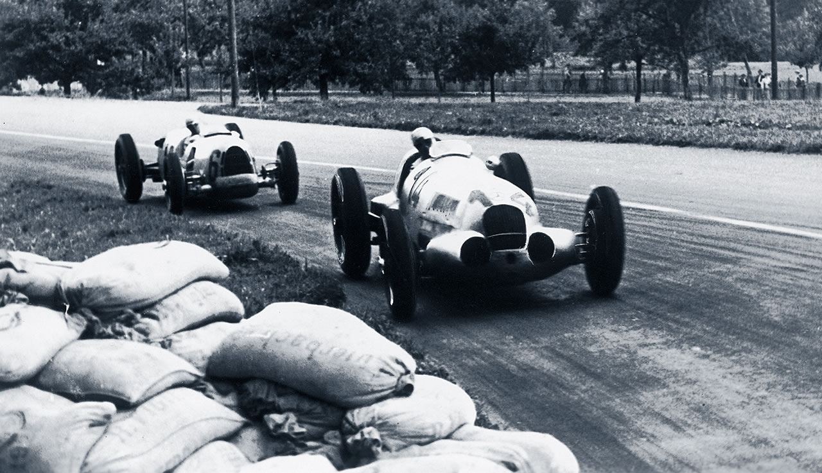
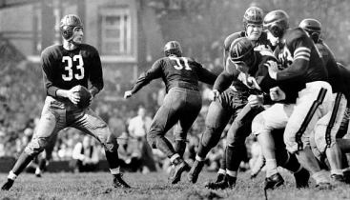
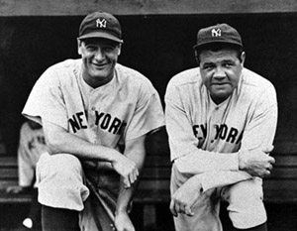
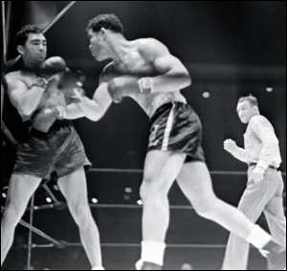
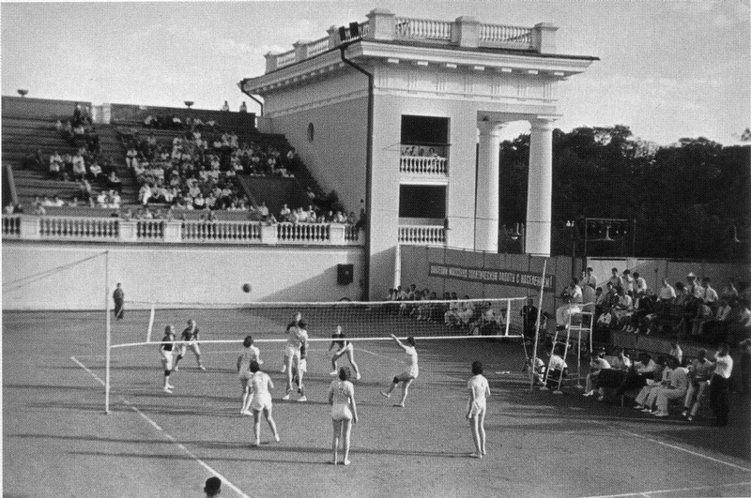
Popular Entertainment of the Great Depression
Sports
Baseball and boxing

Slide 40
The New Deal:
Analyzing the New Deal

Slide 41
Main Idea
The New Deal had mixed success in rescuing the economy, but it fundamentally changed Americans’ relationship with their government

Slide 42
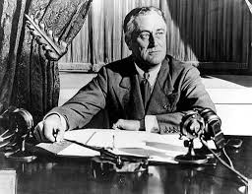
The Impact of the New Deal
The New Deal changed the link between the American people and their government
Required a much bigger government
Americans now began to look regularly to government for help
The New Deal promised relief, recovery, and reform

Slide 43
The Impact of the New Deal
Relief
Millions of Americans enjoyed some form of help
Programs such as Social Security and unemployment insurance
Recovery
Unemployment remained high
Critics argued that FDR didn’t spend enough money and needed the support of big business

Slide 44
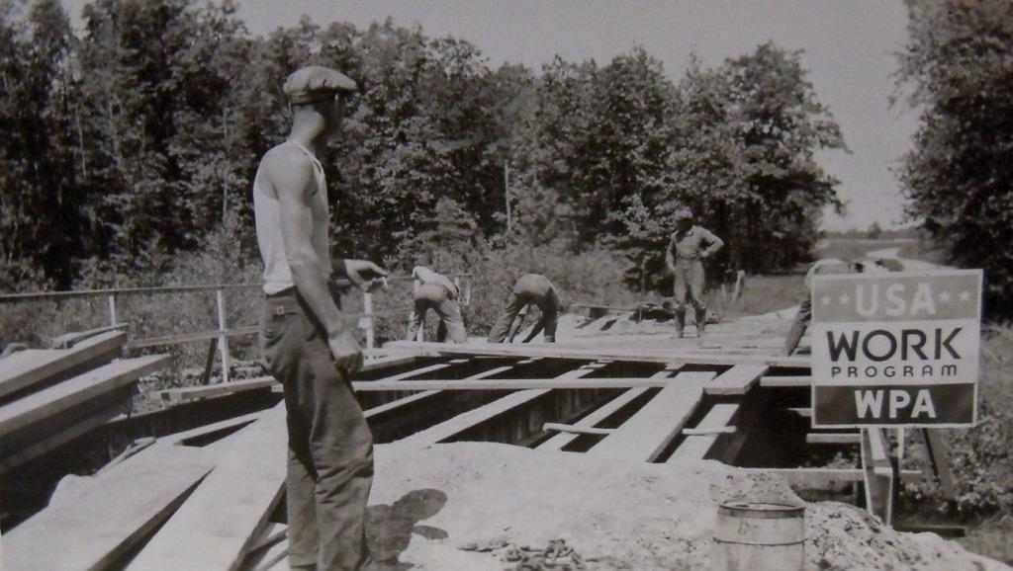
The Impact of the New Deal
Reform
FDIC restored public confidence in the nation’s banks
SEC restored public confidence in stock markets
New Deal left thousands of roadways, bridges, dams, public buildings, and works of art

Slide 46
Limits of the New Deal
Relief programs were not meant to be a permanent solution
The level of government assistance varied by state
Discrimination

Slide 47
The End of the New Deal
Setbacks:
Court-packing fight
1937 economic downturn
Opposition in Congress
Only one piece passed in 1938: the Fair Labor Standards Act
Set up a minimum wage
The lowest wage an employer can legally pay a worker

Slide 48
The End of the New Deal
1938 Elections
The Republicans made gains in the both houses
Roosevelt lacked the congressional support he needed to pass New Deal laws
The New Deal ended in 1938
Americans turned their attention to the start of WWII

