Slide 1
The Progressives:
Progressivism

Slide 2
Main Idea
Progressives focused on three areas of reform: easing the suffering of the urban poor, improving unfair and dangerous working conditions, and reforming government at the national, state, and local levels.

Slide 3
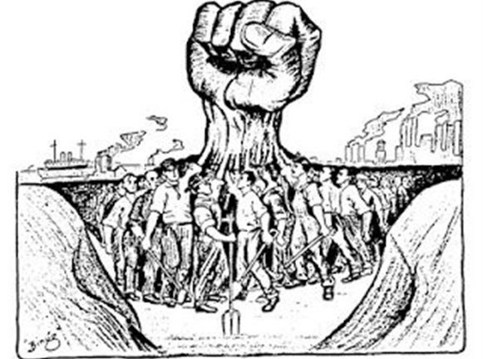
What Was Progressivism?
Progressivism
A wide-ranging reform movement targeting the social problems industrialization created
Wanted to improve living conditions
Questioned power and practices of big business

Slide 4
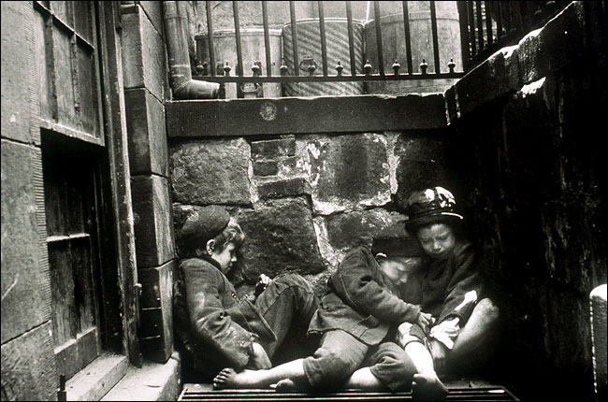
What Was Progressivism?
Muckrakers
Journalists and urban photographers who exposed people to the plight of the unfortunate in hopes of sparking reform
“raked up” (exposed) the filth of society

Slide 5
What Was Progressivism?
Jacob Riis
Exposed the slums through magazines, photographs, and a best-selling book
Ida Tarbell
Exposed the corrupt Standard Oil Company and its owner, John D. Rockefeller
Lincoln Steffens
Shame of the Cities (1904) exposed corrupt city governments

Slide 6
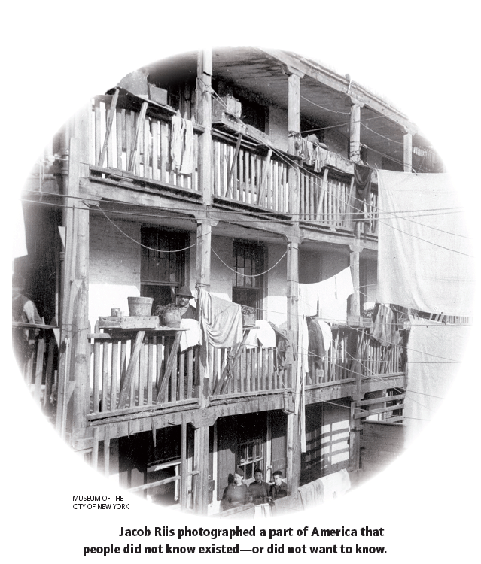

Slide 7
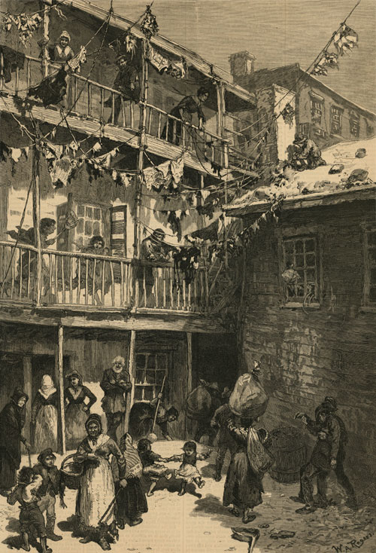
Reforming Society
Growing cities couldn’t provide people necessary services like garbage collection, safe housing, and police and fire protection
Reformers saw this as an opportunity to expand public health services
Tenement Act of 1901

Slide 8
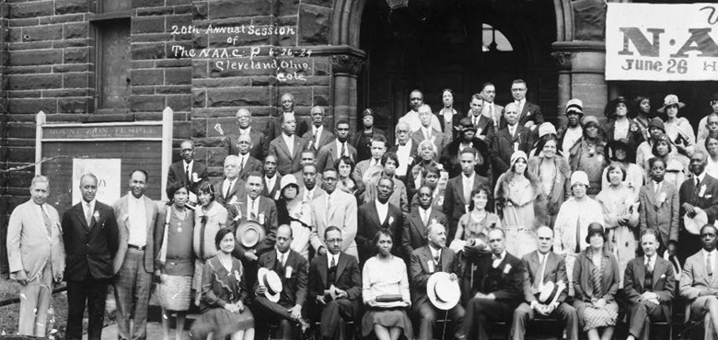
Reforming Society
Progressive fought prejudice in society
National Association for the Advancement of Colored People (NAACP)
Formed in 1909 by a multiracial group of activists to fight for the rights of African Americans
Protested the official introduction of segregation in federal government

Slide 9
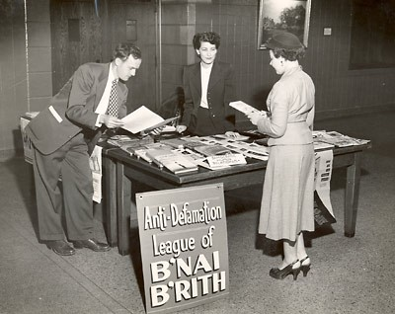
Reforming Society
Anti-Defamation League (ADL)
Formed by Sigmund Livingston in 1913
Fought anti-Semitism, or prejudice against Jews
Fought to stop negative stereotypes of Jews in media

Slide 10
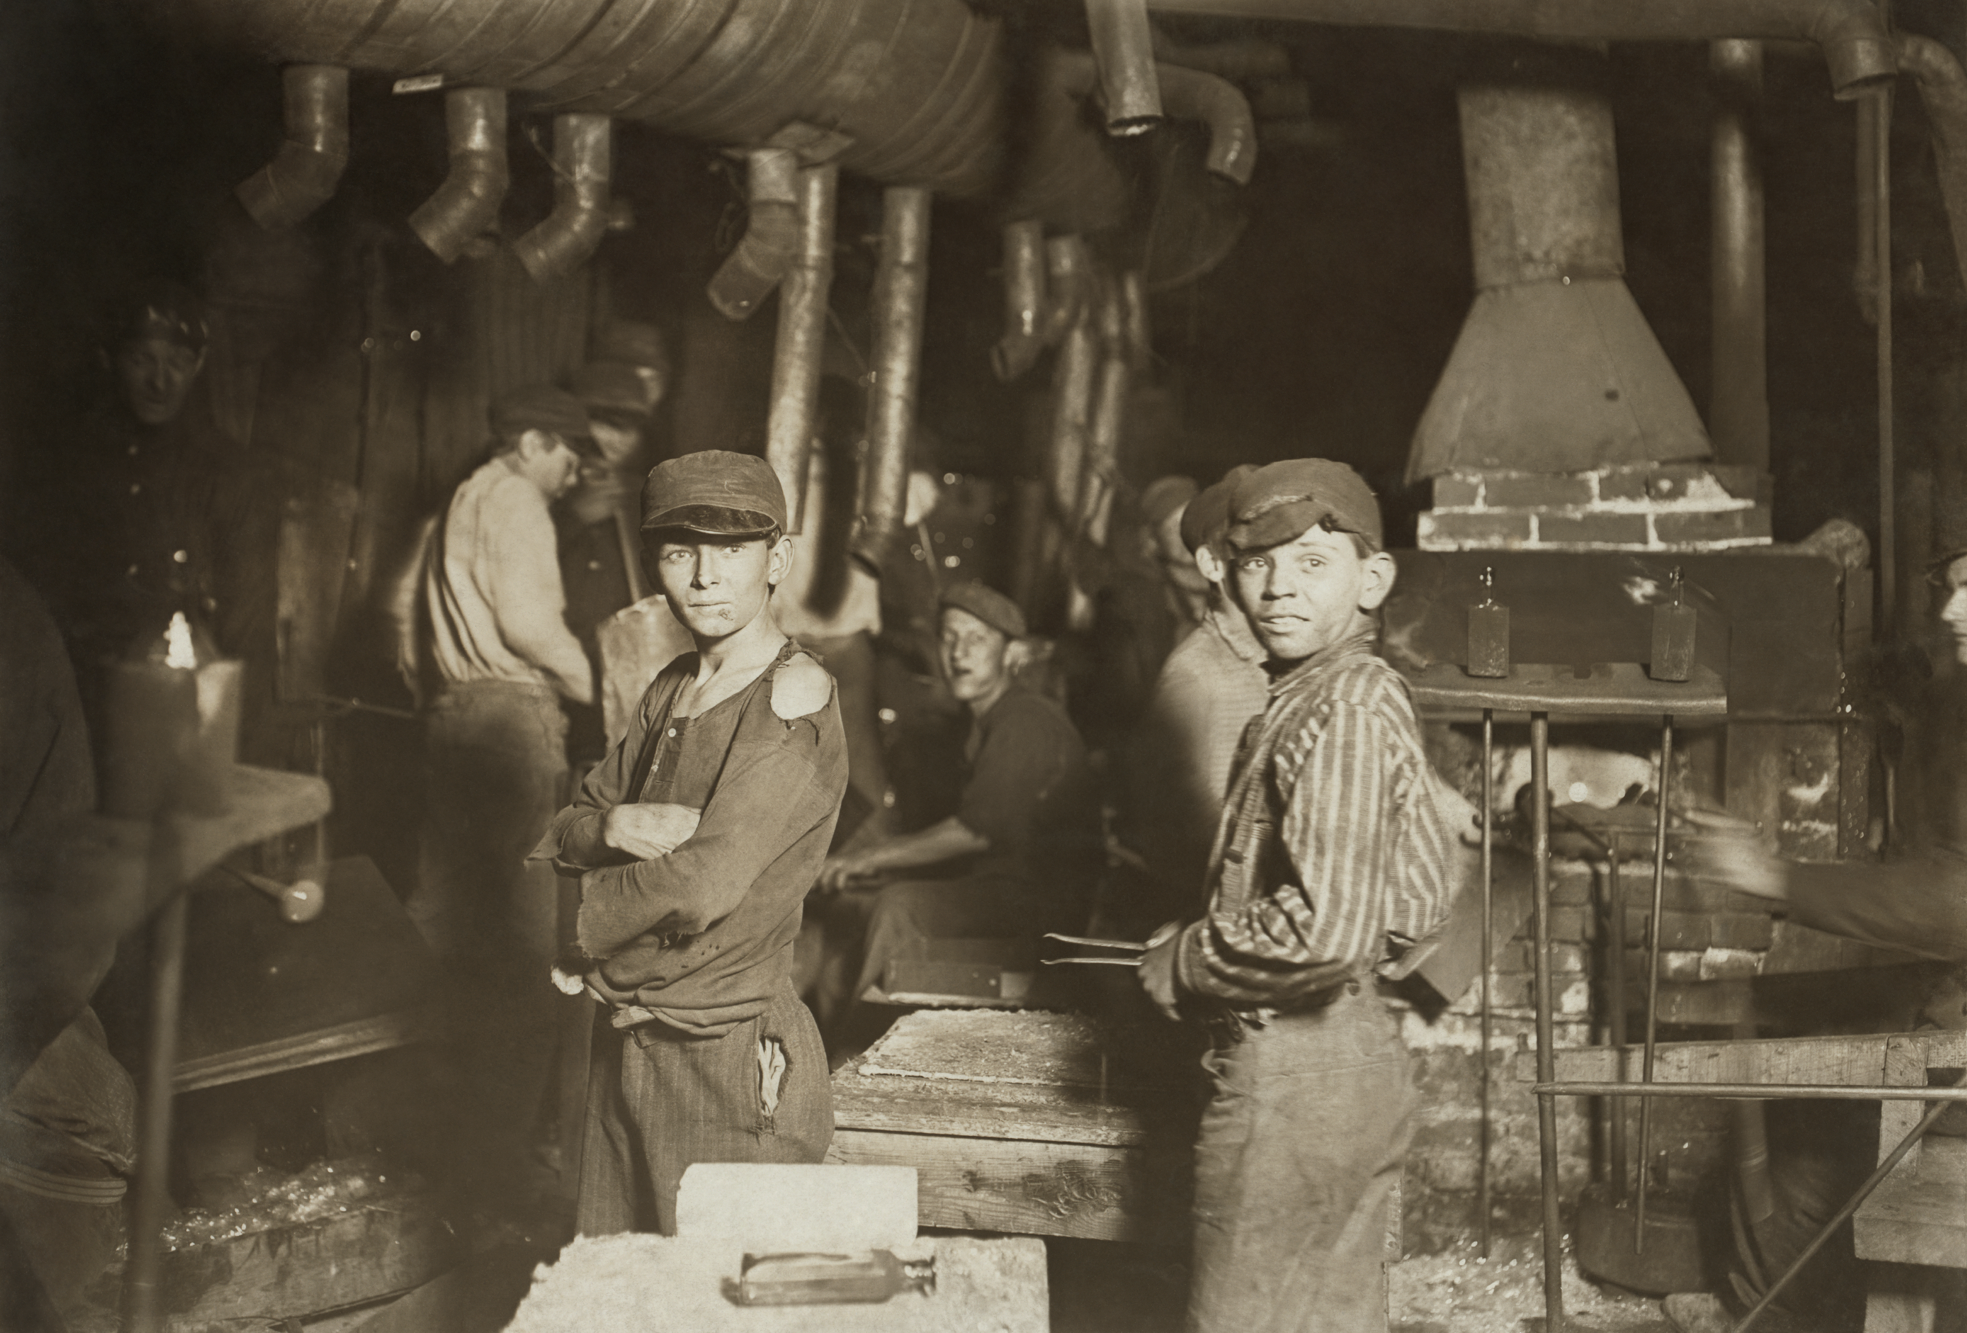
Reforming the Workplace
Labor unions fought for adult male workers but didn’t advocate enough for women and children
Campaigns to limit workdays for women
Fought for a minimum wage
The National Child Labor Committee
Wanted state legislatures to ban child labor
Nearly 40 states passed child-labor laws
Not strictly enforced

Slide 11
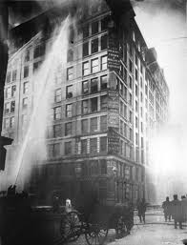
Reforming the Workplace
The Triangle Shirtwaist Company Fire
High-rise building sweatshop that made women’s blouses
Fire broke out
Escape was nearly impossible
Doors were locked to prevent theft
Fire escape broke under pressure
Fire was too high for fire truck ladders to reach
More than 140 women and men died in the fire*

Slide 12
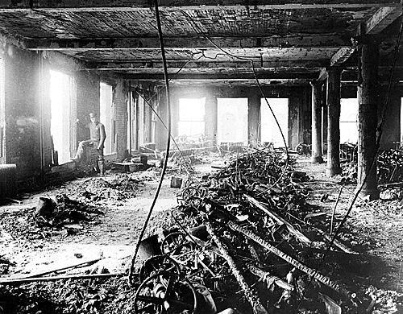
Reforming the Workplace
The Triangle Shirtwaist Company Fire (cont.)
Inspired progressives to fight for safety in the workplace
New York State passed the toughest fire-safety laws in the nation
Also factory inspection and sanitation laws
Laws became a model for workplace safety

Slide 13
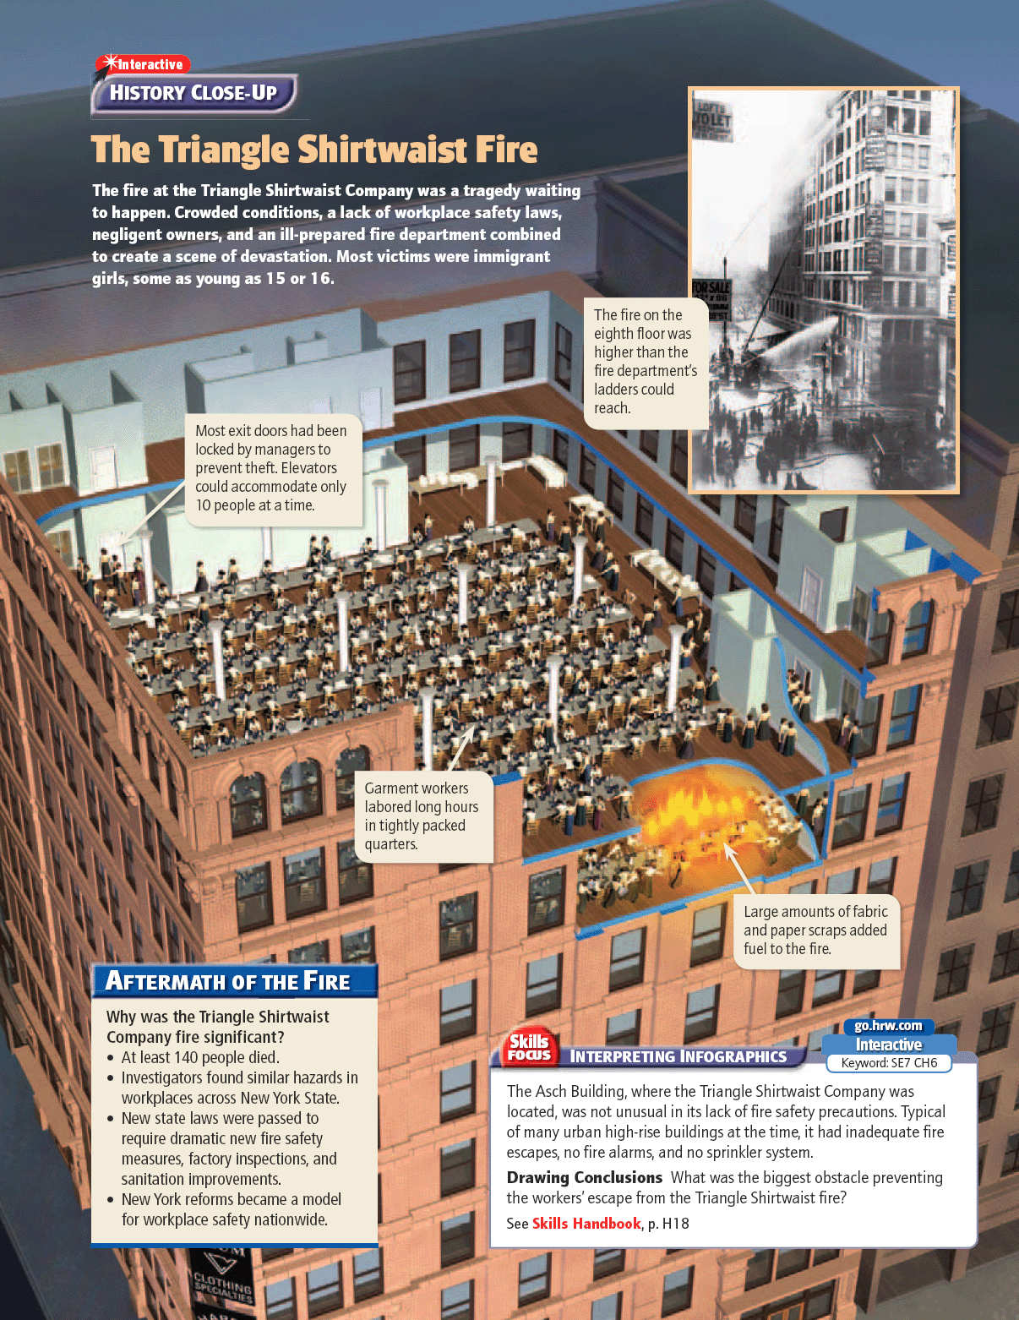

Slide 14
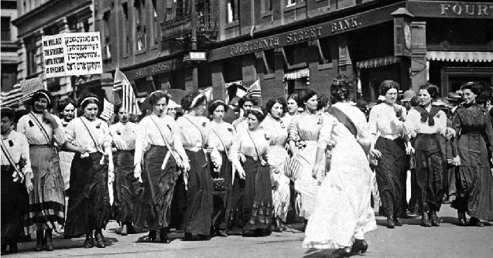
Reforming the Workplace
Labor unions joined the fight for working conditions
International Ladies’ Garment Workers Union (ILGWU)
Organized unskilled workers
Called a general strike known as the Uprising of 20,000
Won a shorter workweek and higher wages and
Attracted thousands of workers to the union.

Slide 15
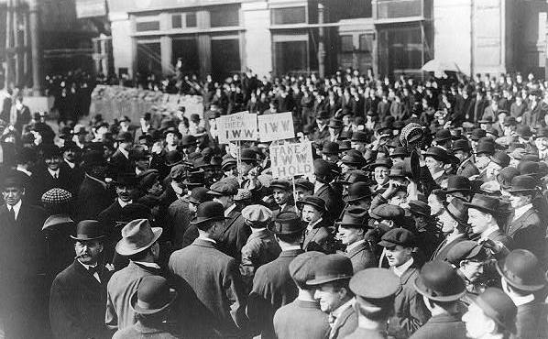
Reforming the Workplace
Industrial Workers of the World (IWW)
Opposed capitalism
Organized unskilled workers
William “Big Bill” Haywood
Used strikes, boycotts, and industrial sabotage
The government cracked down on the organization, causing dispute among its leaders and leading to its decline a few years later.

Slide 16
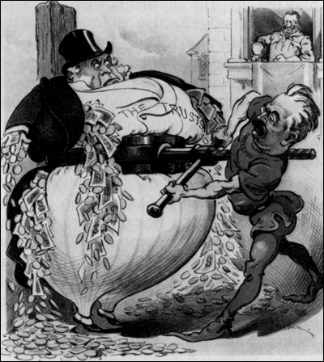
Reforming Government
Progressives targeted government for reform
Wanted to eliminate political corruption
Wanted to make more efficient
Reforming often meant winning control of it
Local, State, and Federal level

Slide 17
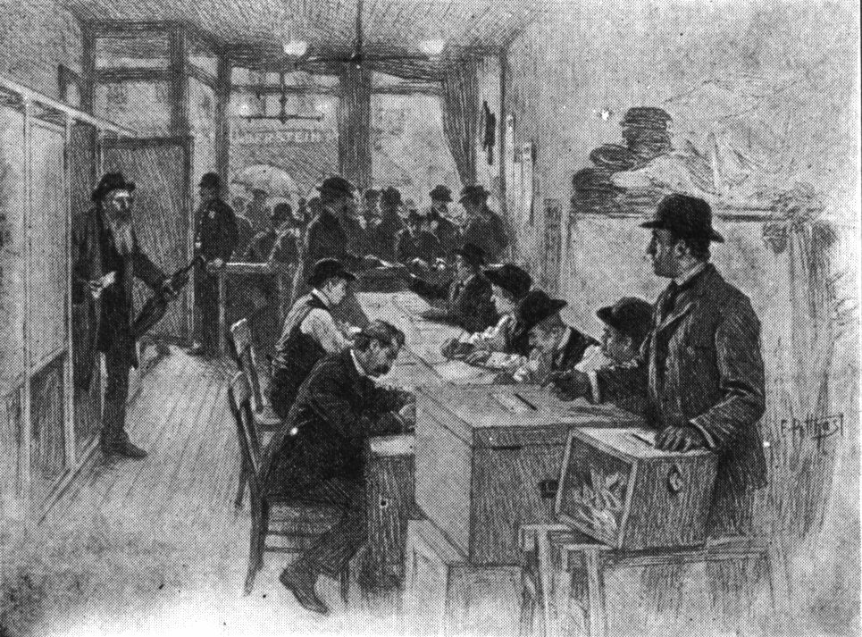
Reforming Government
Progressives wanted fairer elections and to make politicians more accountable to voters
Proposed a direct primary
Backed the Seventeenth Amendment
Gave voters, not state legislatures, the power to elect their U.S. senators

Slide 18
Reforming Government
Some measures Progressives fought for include:
Direct primary: voters select a party’s candidate for public office | 17th Amendment: voters elect their senators directly | secret ballot: people vote privately without fear of coercion
initiative: allows citizens to propose new laws | referendum: allows citizens to vote on a proposed or existing law | recall: allows voters to remove an elected official from office

Slide 19
The Progressives:
Women and Public Life

Slide 20
Main Idea
Women during the Progressive Era actively campaigned for reforms in education, children’s welfare, temperance, and suffrage.

Slide 21
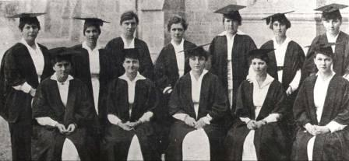
Opportunities for Women
Women finding more opportunities for education
1870 – 20% of all college students were women
Mostly upper or middle class
Greater involvement in community
More employment opportunities
Journalists, artists, teachers, nurses & industry
Denied access to certain professions, many women joined the reform movement

Slide 22
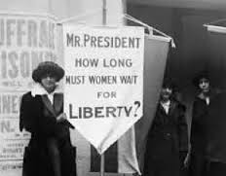
Gaining Political Experience
Women became the backbone of many of the Progressive Era reform movements
Learned how to organize, how to persuade people, and how to publicize their causes
Taught women that they had the power to improve life for themselves, their families, and their communities
Children’s rights, child labor, health, education

Slide 23
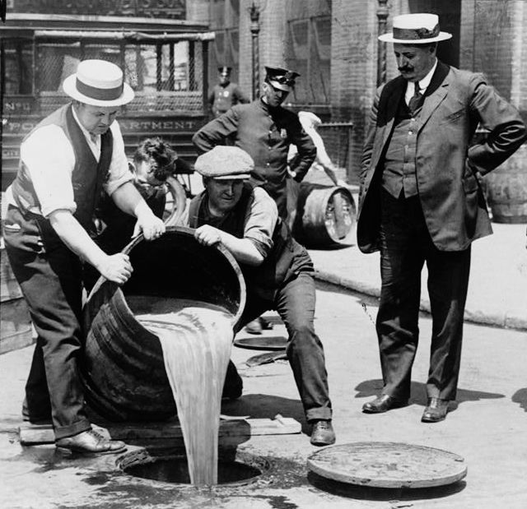
Gaining Political Experience
Prohibition movement
Called for a ban on making, selling, and distributing alcoholic beverages
Reformers thought alcohol was responsible for crime, poverty, and violence

Slide 24
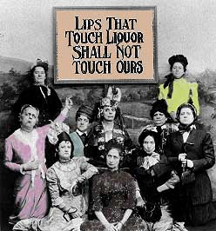
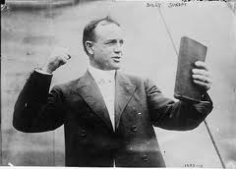
Gaining Political Experience
Major national organizations led the crusade against alcohol:
The Anti-Saloon League
The Women’s Christian Temperance Union (WCTU)
Powerful force for both temperance and women’s rights
Evangelists

Slide 25
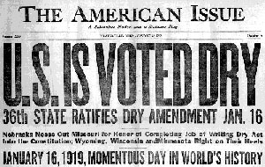
Gaining Political Experience
The Eighteenth Amendment
Prohibited the manufacture, sale, and distribution of alcohol
Ratified in 1919
Very unpopular
Repealed in 1933

Slide 26
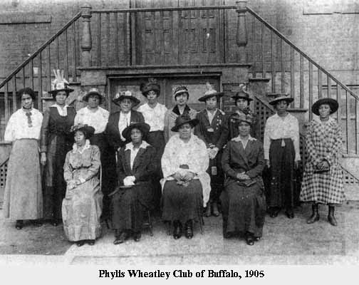
Gaining Political Experience
Faced with discrimination, African American women formed their own reform group
National Association of Colored Women (NACW)
Campaigned against poverty, segregation, lynching, the Jim Crow laws, and eventually for temperance and women’s suffrage

Slide 27
Rise of the Women’s Suffrage Movement
Many were angered that the Fifteenth Amendment granted voting rights to African American men but not to women.
Women organized into two major suffragist groups:
1.) National Woman Suffrage Association (NWSA)
Campaigned for a constitutional amendment letting women vote
2.)American Woman Suffrage Association (AWSA)
Focused on winning the vote state-by-state

Slide 28
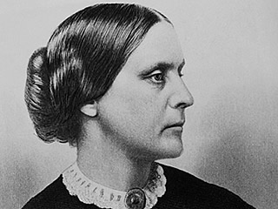
Rise of the Women’s Suffrage Movement
Susan B. Anthony
Wrote pamphlets, made speeches, and testified before Congress in support of women’s rights
1872 - She and three of her sisters registered to vote, voted, was arrested and fined
1873 - Supreme Court ruled that even though women were citizens, they did not have the right to vote

Slide 29
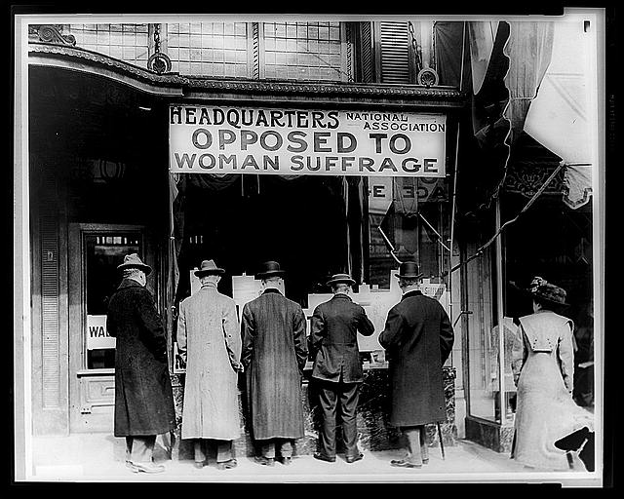
Anti-Suffrage Arguments
Social
Some believed voting would interfere with a woman’s duties at home or destroy families
Some claimed that women did not have the education or experience
Economic
Feared that giving the women the vote would lead to Prohibition and regulations
Religious
The entire family was represented by the husband’s vote

Slide 30
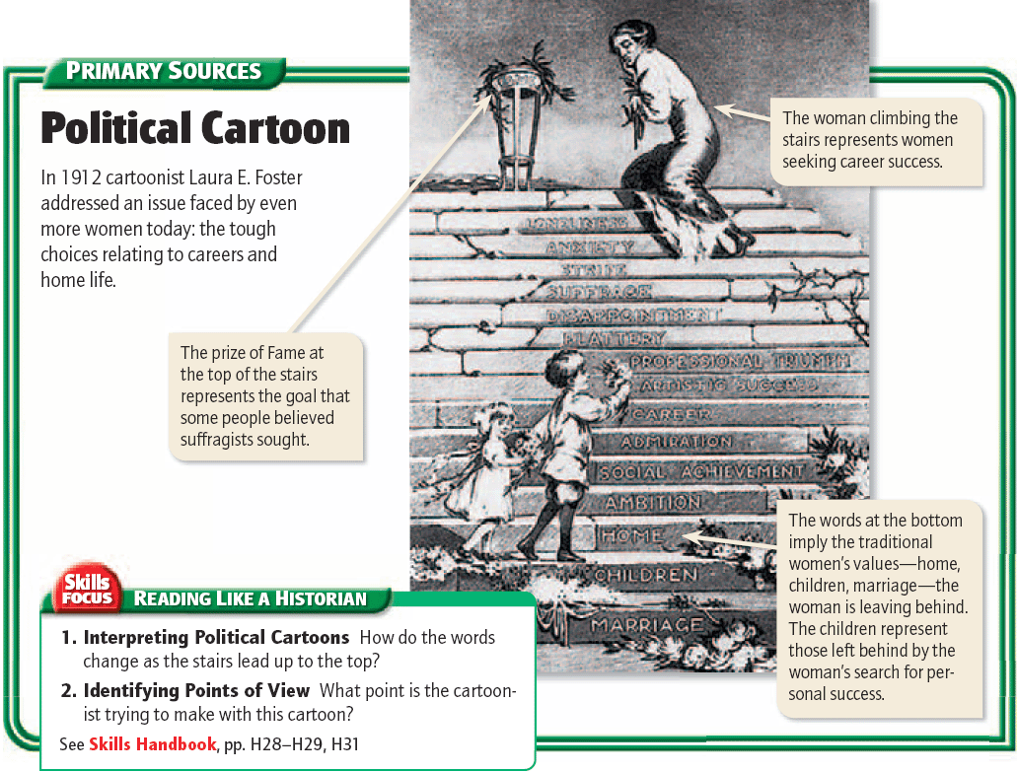

Slide 31
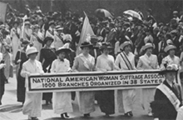
Rise of the Women’s Suffrage Movement
In 1890 the National Woman Suffrage Association and the American Woman Suffrage Association merged to form the National American Woman Suffrage Association (NAWSA)
Most of the early suffragists did not live long enough to cast their ballots.
Finally won the vote in 1920

Slide 32
The Progressives:
Theodore Roosevelt’s Square Deal

Slide 33
Main Idea
Theodore Roosevelt used the power of the presidency to push for progressive reforms in business and in environmental policy.

Slide 34
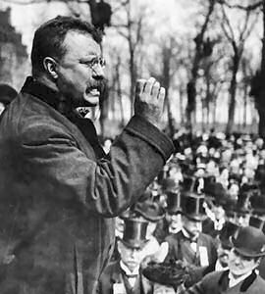
Roosevelt’s View of the Presidency
President William McKinley was shot and killed in 1901
Roosevelt saw the presidency as a bully pulpit
A platform to publicize important issues and seek support for his policies on reform

Slide 35
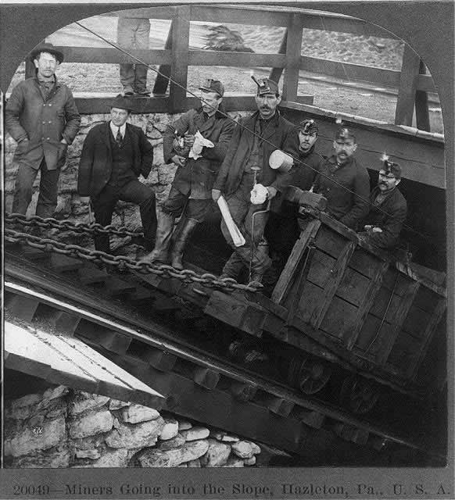
The Coal Strike of 1902
Pennsylvania coal miners went on strike for higher wages, shorter hours, and recognition of their union
Eastern cities needed PA

Slide 36
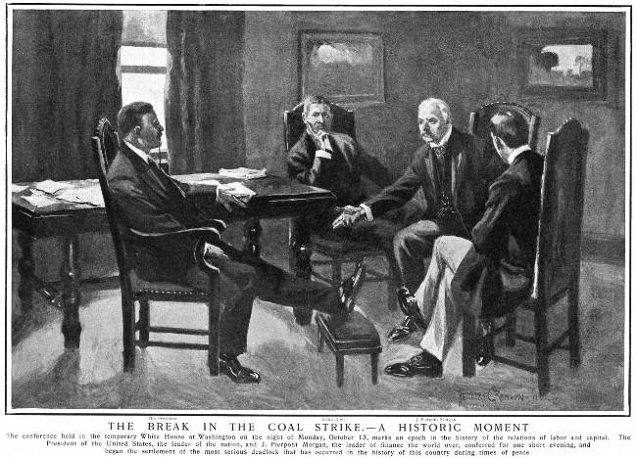
The Coal Strike of 1902
Roosevelt threatened to take over the mines if the owners didn’t agree to arbitration
Marked the first time the federal government had intervened in a strike to protect the interests of the public

Slide 37
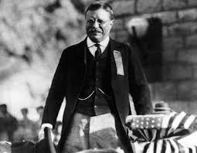
The Square Deal
The Square Deal
Roosevelt’s 1904 campaign slogan and the framework for his entire presidency
The needs of workers, business, and consumers should be balanced
Called for limiting the power of trusts, promoting public health and safety, and improving working conditions

Slide 38
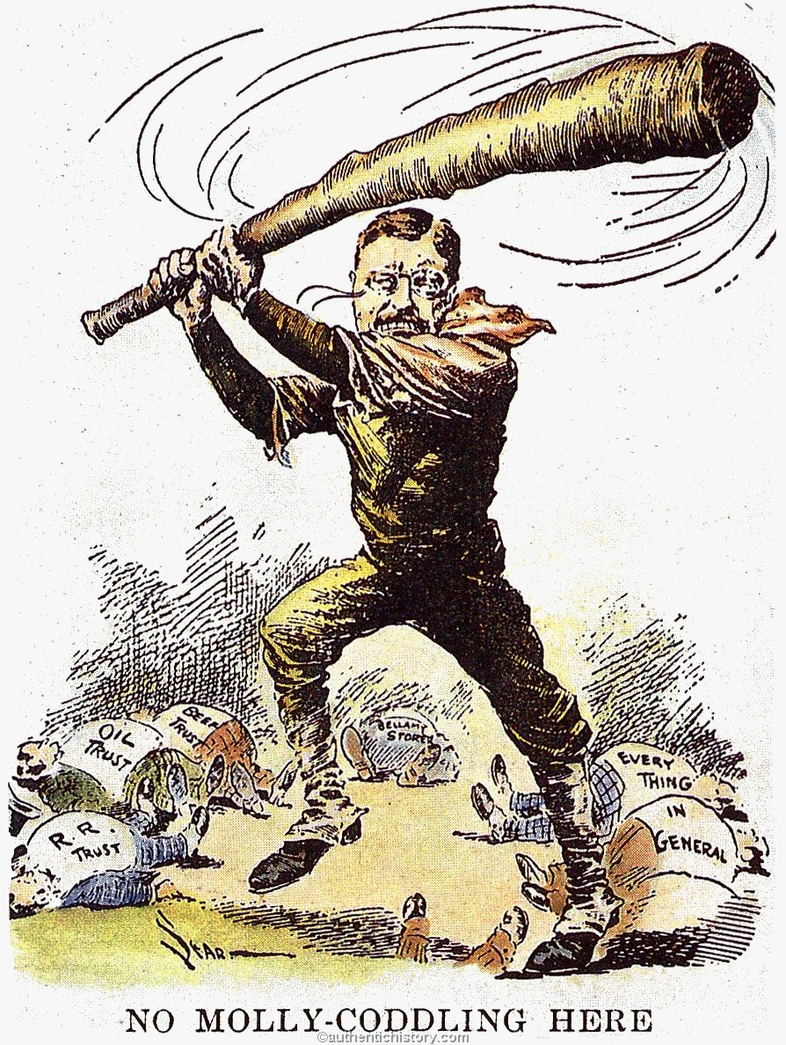
Regulating Big Business
Trust-busting campaign
Went after bad trusts that sold inferior products, competed unfairly, or corrupted public officials
The Northern Securities Company

Slide 39
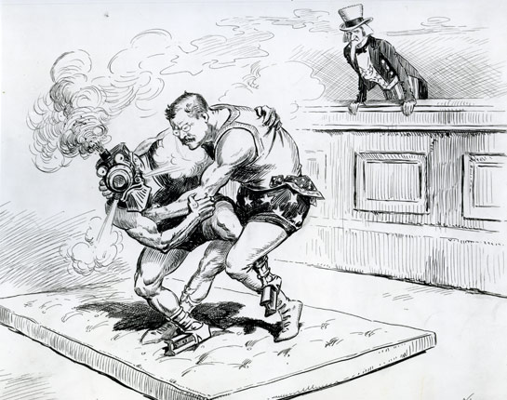
Regulating Railroads
The Elkins Act
The Hepburn Act

Slide 40
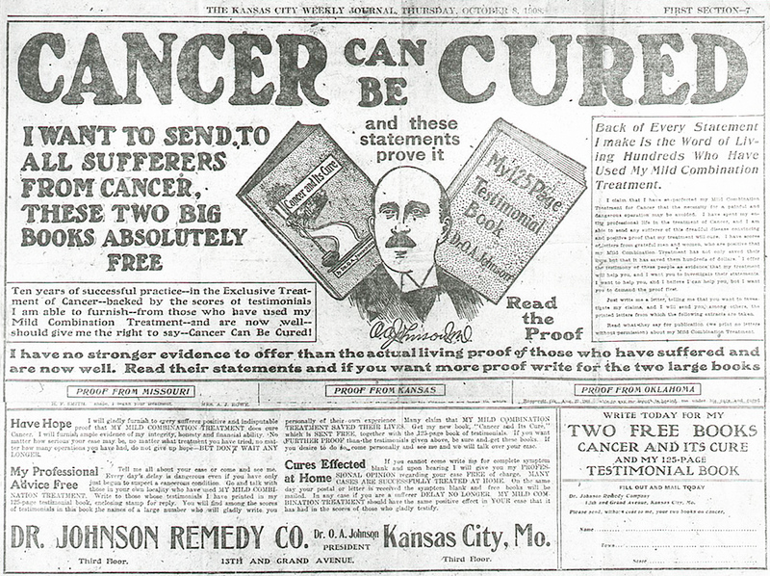
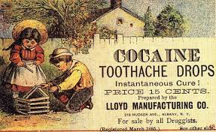
Protecting Consumers
Growing public dismay about practices of the food and drug industries
Selling dangerous products to unknowing public
Used tricks to pass of tainted foods
Sold medicines that didn’t work
Marketed dangerous medicines

Slide 41
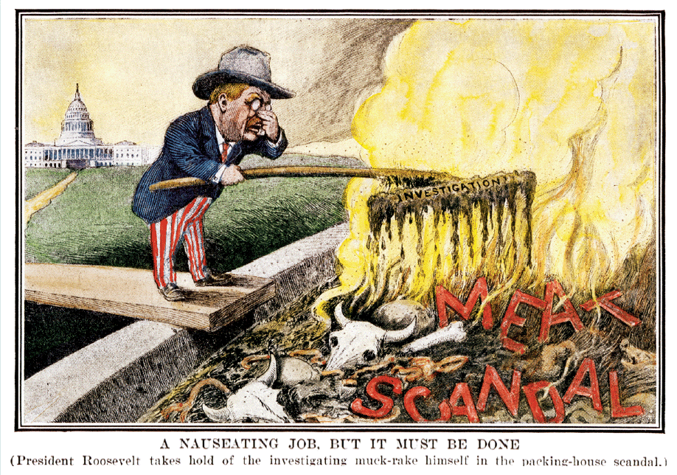
Protecting Consumers
The Meat Inspection Act
Required federal government inspection of meat shipped across state lines
The Pure Food and Drug Act
Outlawed food and drugs containing harmful ingredients
Required that containers carry ingredient labels

Slide 42
Environmental Conservation
In the late 1800s natural resources were used at an alarming rate
Foresting, plowing, polluting, and overgrazing
Roosevelt recognized that natural resources were limited and that government should regulate resources
Preservations

Slide 43
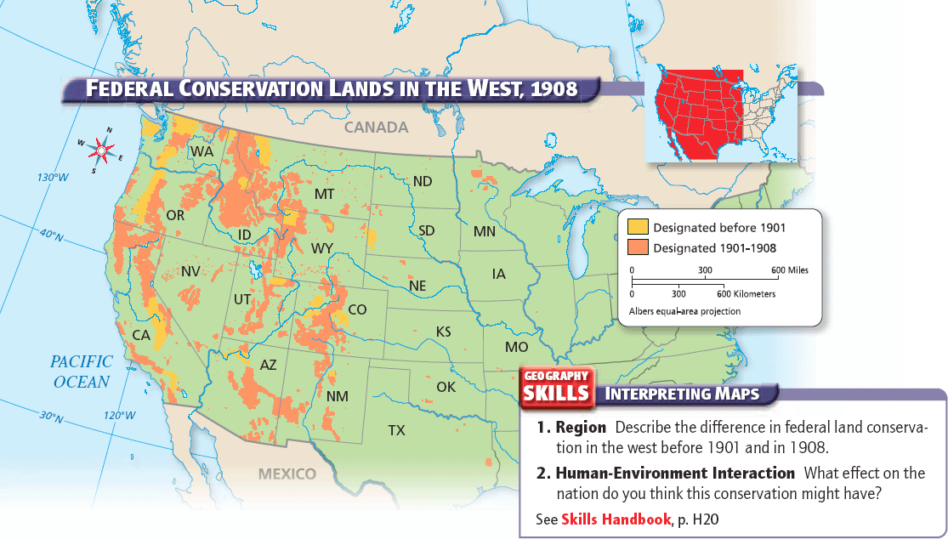

Slide 44
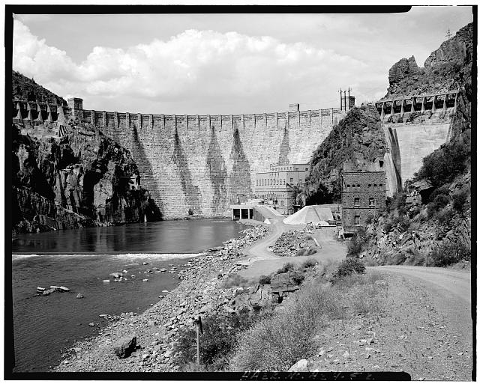
Environmental Conservation
The Newlands Reclamation Act of 1902
The law allowed federal government to create irrigation projects to make dry lands productive
The projects would be funded from money raised by selling off public lands

Slide 45
The Progressives:
Taft and Wilson

Slide 46
Main Idea
Progressive reforms continued during the Taft and Wilson presidencies, focusing on business, banking, and women’s suffrage.

Slide 47
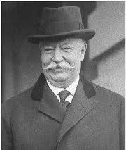
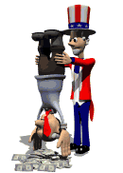
Progressivism under Taft
William Howard Taft worked to secure Roosevelt’s reforms
Created a Labor Department to enforce labor laws
Increased national forest reserves
Sixteenth Amendment
Granted Congress the power to levy taxes based on individual income

Slide 48
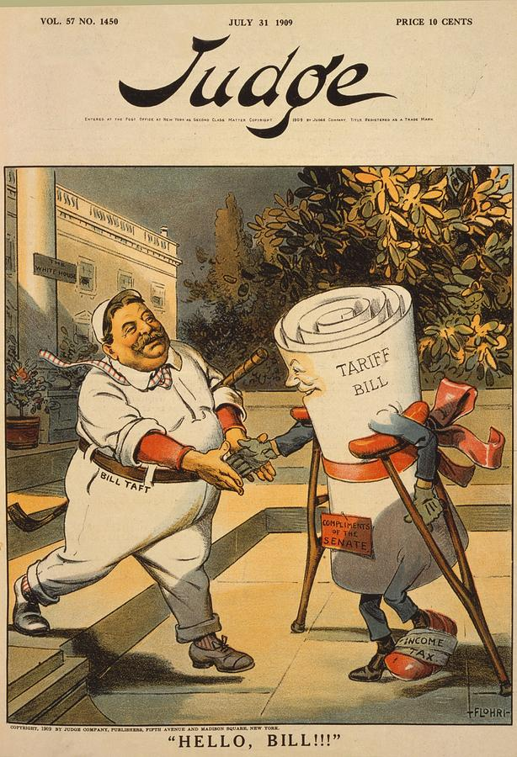
Trouble in Taft’s Presidency
President Taft lost the support of most of the Progressive Republicans
Taft signed the Payne-Aldrich Tariff
Progressives thought Taft was not committed to conservation
Roosevelt refused to support Taft from that point on

Slide 49
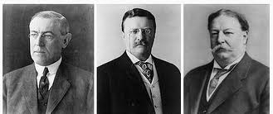
The Republican Party Splits
The presidential election of 1912
The Republican party nominated President Taft
The Progressives split to form their own party, the New Progressive (“Bull Moose”) Party, with Roosevelt as its candidate
With the Republicans split, Democrat Woodrow Wilson easily took the election

Slide 51
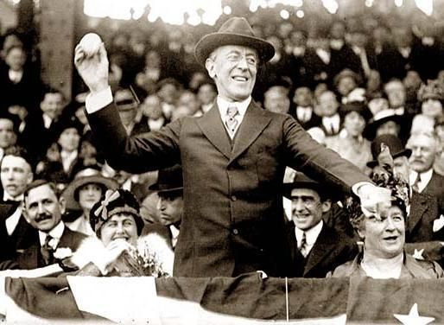
Wilson’s New Freedom
During his presidential campaign, Wilson proposed an ambitious plan of reform
New Freedom
Called for tariff reductions, banking reform, and stronger antitrust legislation

Slide 52
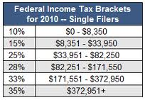
Wilson’s New Freedom
1913 - the Underwood Tariff Act
Lowered taxes to their lowest level in 50 years
Introduced a graduated income tax

Slide 53
Banking Reform
Federal Reserve Act (1913)
Created a central fund from which banks could borrow to prevent collapse during a financial panic
Banking system under the supervision of the federal government
Created a three-tier banking system:
1.Federal Reserve
2. 12 Federal Reserve banks
3. Private banks

Slide 54
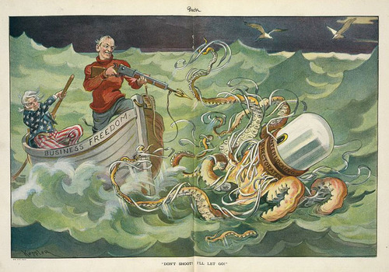
Stronger Antitrust Laws
Clayton Antitrust Act (1914)
Prohibited companies from buying stock in competing companies in order to form a monopoly
Made strikes, boycotts, and peaceful picketing legal

Slide 55
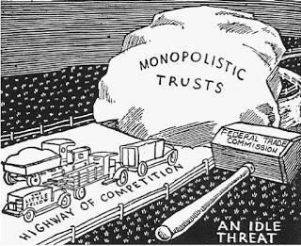
Stronger Antitrust Laws
The Federal Trade Commission (FTC)
Enforced antitrust laws and was tough on companies that used deceptive advertising
Could undertake special investigations of businesses

Slide 56
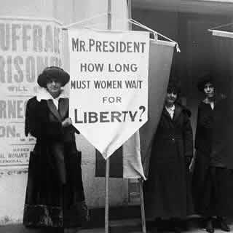
Women Gain the Vote
Frustrated by the slow progress the newly formed National Woman’s Party focused on passing a federal constitutional amendment
New tactics:
Picketing the White House
Hunger strikes
Campaigned on state and federal levels

Slide 57
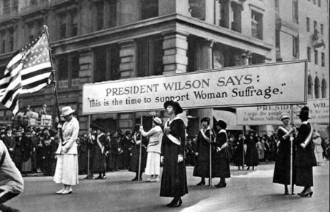
Women Gain the Vote
Participation of women in the World War I efforts helped weaken opposition to suffrage
The Nineteenth Amendment (1920)
Granted women the right to vote

Slide 58
Progressivism and the Rights of African Americans
Though the Progressive movement achieved much, African American rights were still extremely limited
Shaky on supporting civil rights laws
Brownsville Incident
The Outbreak of WWI in Europe helped end the Progressive movement
People were more interest in the war than reform

Slide 60
Click on the window to start video

