Slide 1
Rome and Early Christianity:
The Rise of Christianity

Slide 2
Main Idea
A new religion called Christianity developed within the Roman Empire and gradually spread throughout the Roman world.

Slide 3
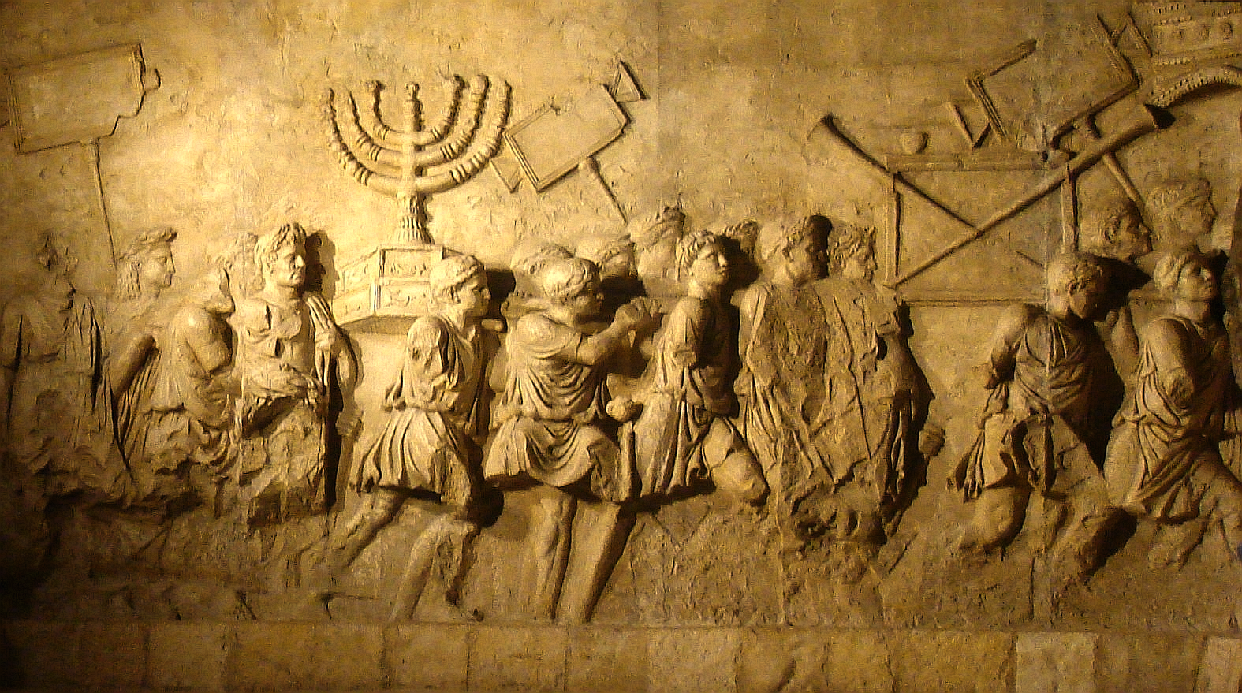
Judaism in the Roman World
Rome conquers Judea
Allowed to practice religion as long as paid tributes & maintained order

Slide 4
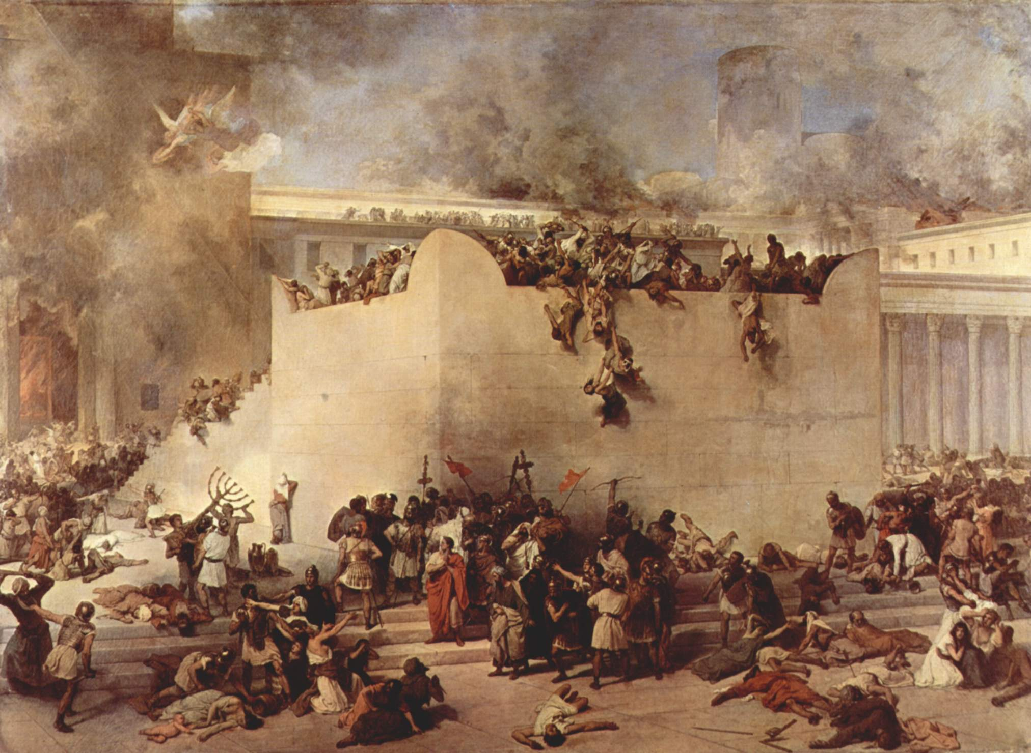
Judaism in the Roman World
Different branches
Zealots – wanted to rebel
Others – wait for the Messiah
66-70 BC: Romans sack Jerusalem – destroy temples
130s BC: Jews banned from Jerusalem

Slide 5
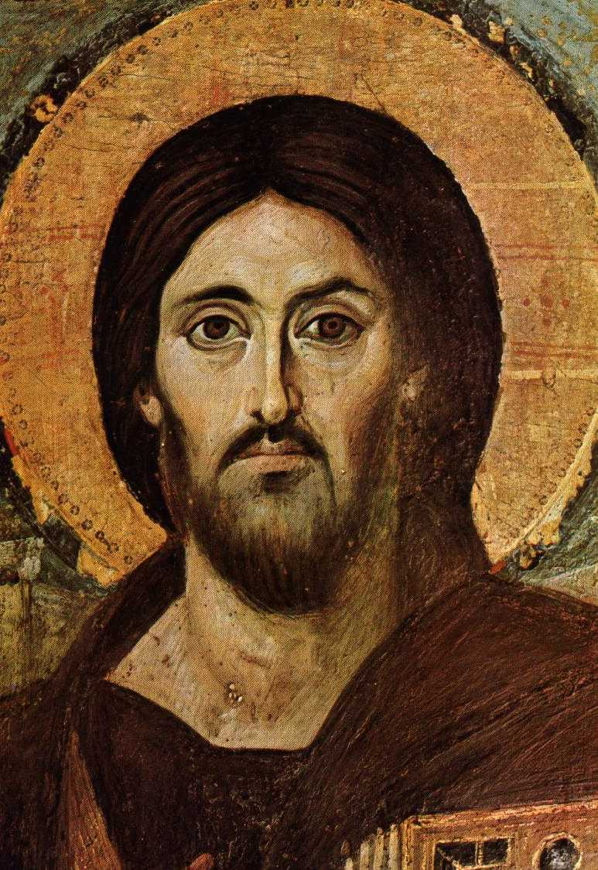
Jesus of Nazareth
Knowledge comes from the Gospels
First four books of the New Testament
Preached redemption & forgiveness
Defended poor & oppressed
Disciples

Slide 6
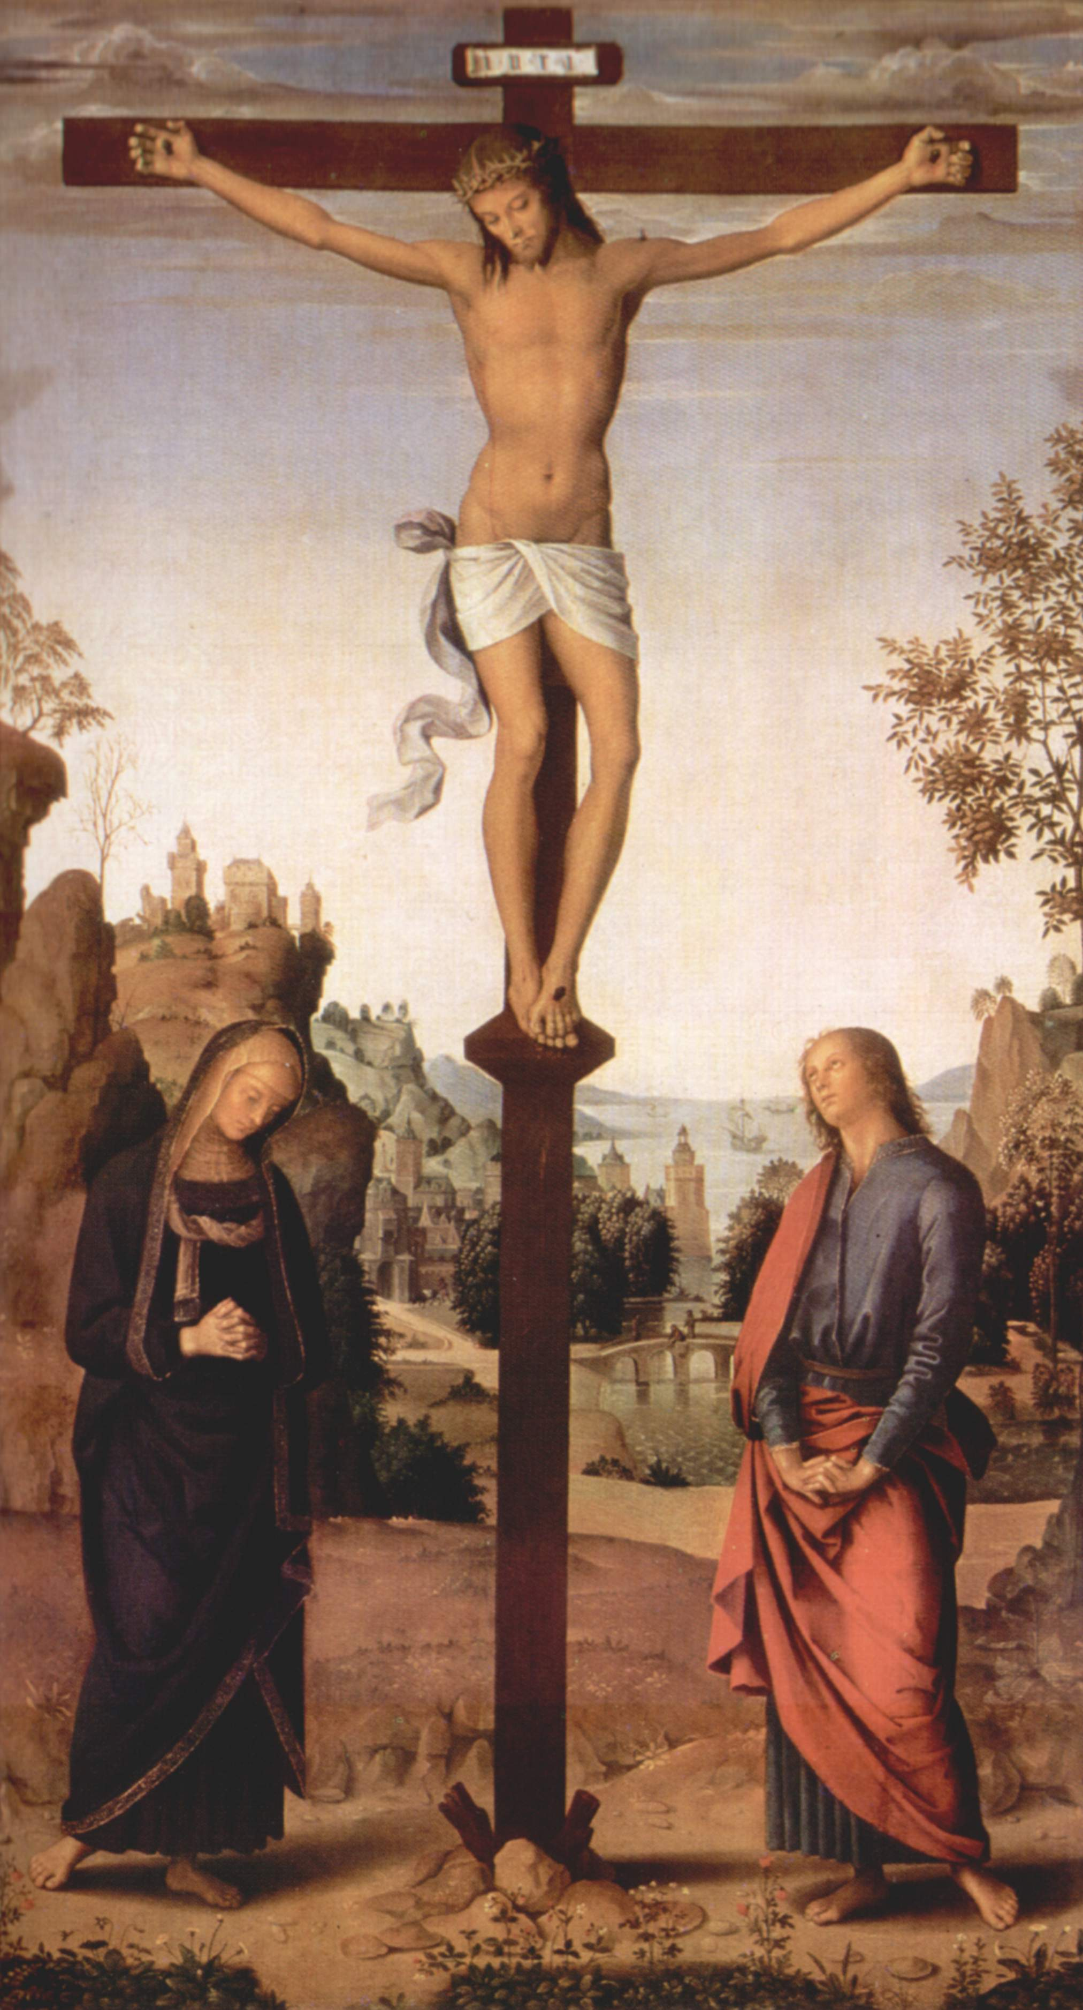
Jesus of Nazareth
According to New Testament:
Crucified
Rose from the dead
Ascended into heaven

Slide 7
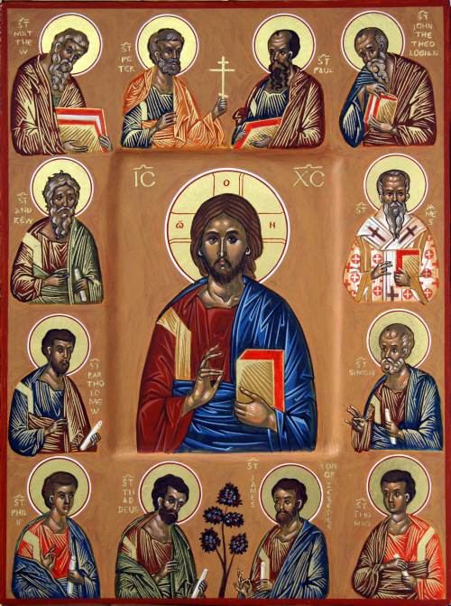
The Spread of Christianity
Christianity
The teachings of Jesus of Nazareth
All people can achieve salvation
Apostles
12 Original followers
Spread message

Slide 8
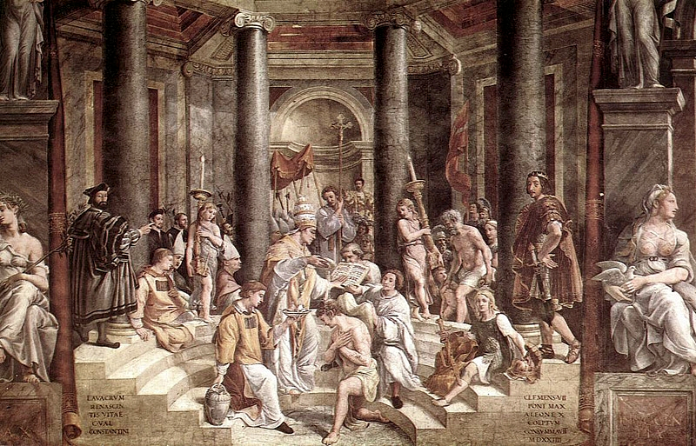
The Spread of Christianity
Roman religious toleration
300 BC – 10% of Romans Christian
Message of love and eternal life
Regardless of social class

Slide 9
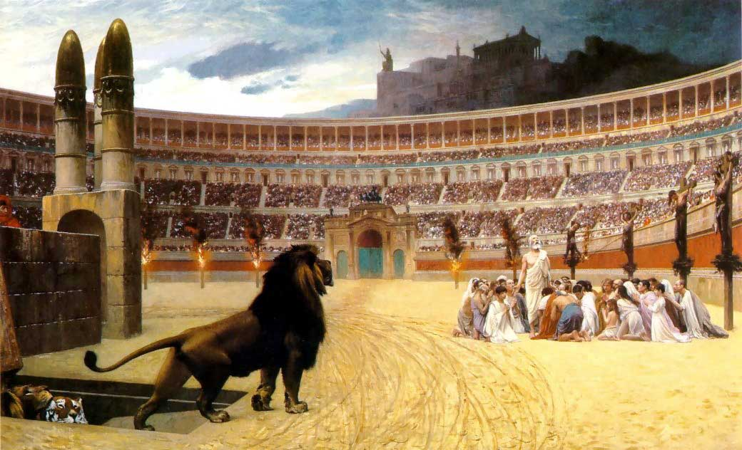
Persecution
Martyrs
People who die for their faith
Leaders saw Christianity as a threat

Slide 10
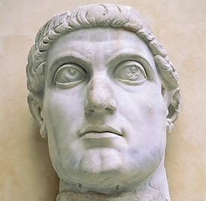
Imperial Approval
Emperor Constantine converted
Edict of Milan
Christianity made legal
Polytheism gradually disappears

Slide 11
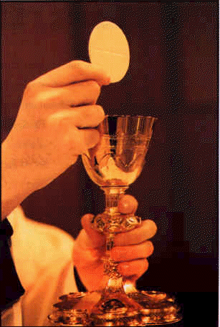
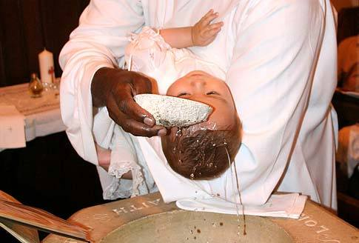
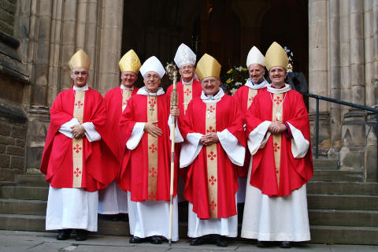
The Early Christian Church
Development of ceremonies:
Eucharist
Baptism
Development of administrative structure:
Priests
Bishops
Popes

