Slide 1
The Second Industrial Revolution:
Industry and Railroads

Slide 2
Main Idea
During the late 1800s, new technology led to rapid industrial growth and the expansion of railroads.

Slide 3
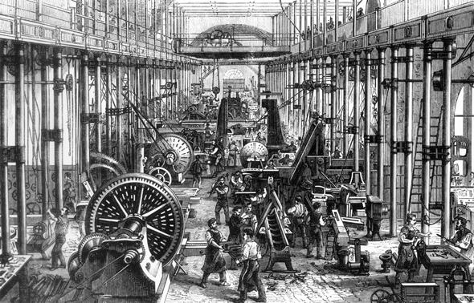
New Industries Emerge
Electrical power replaced steam and water power
Larger factories produced more goods
Faster and cheaper transportation
Dramatic industrial growth

Slide 4
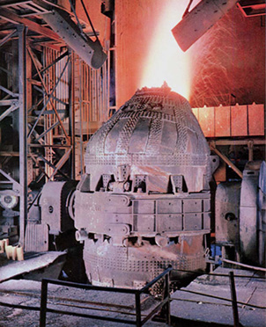
New Industries Emerge: Steel
Bessemer process
Faster, cheaper process to turn iron into steel

Slide 5
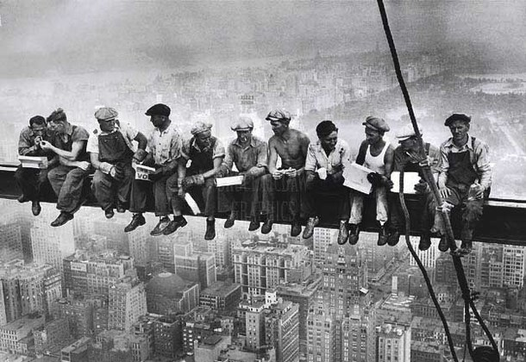
New Industries Emerge: Steel
Helped transform America into a modern industrial economy
World’s top producer of steel

Slide 6
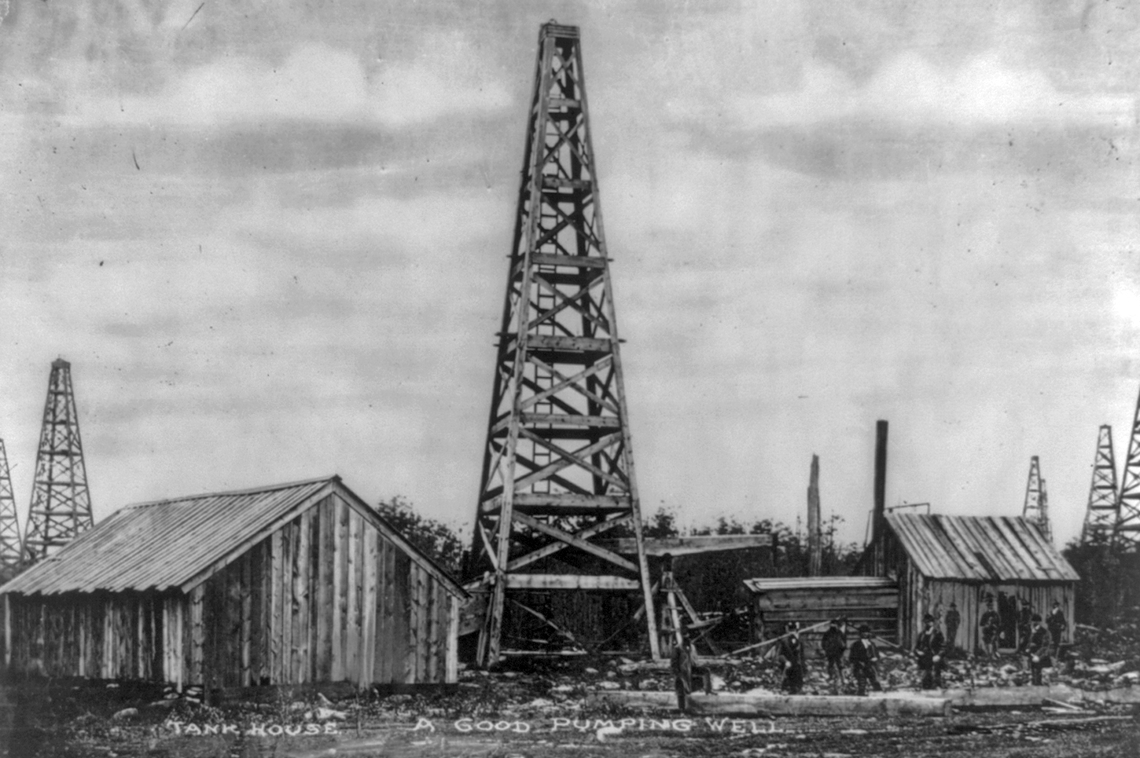
New Industries Emerge: Oil
Oil was a key commodity as a fuel source and for lubrication
“Black gold”
Edwin L. Drake
Drilled first commercial oil well

Slide 7
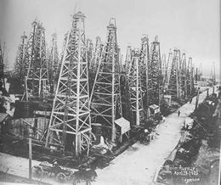
New Industries Emerge: Oil
Wildcatters
Oil prospectors
1901 - Spindletop Hill
First oil boom in Texas
Oil fueled a revolution in transportation and industry

Slide 8
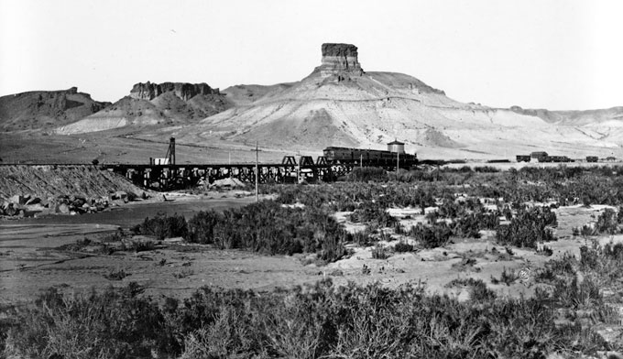
Railroads Expand
Between 1865 and 1890, the number of miles of railroad track increased nearly fivefold

Slide 9
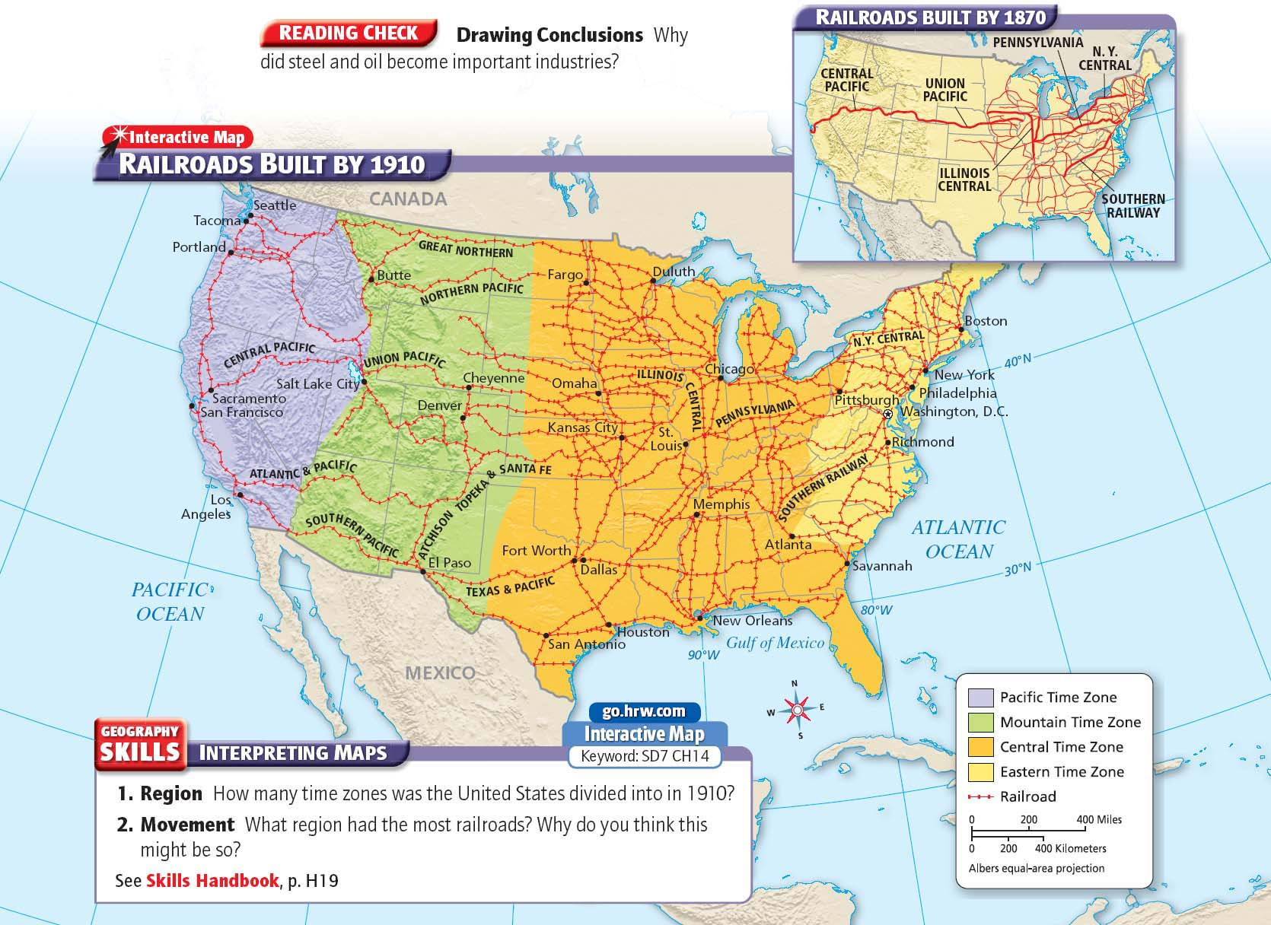

Slide 10
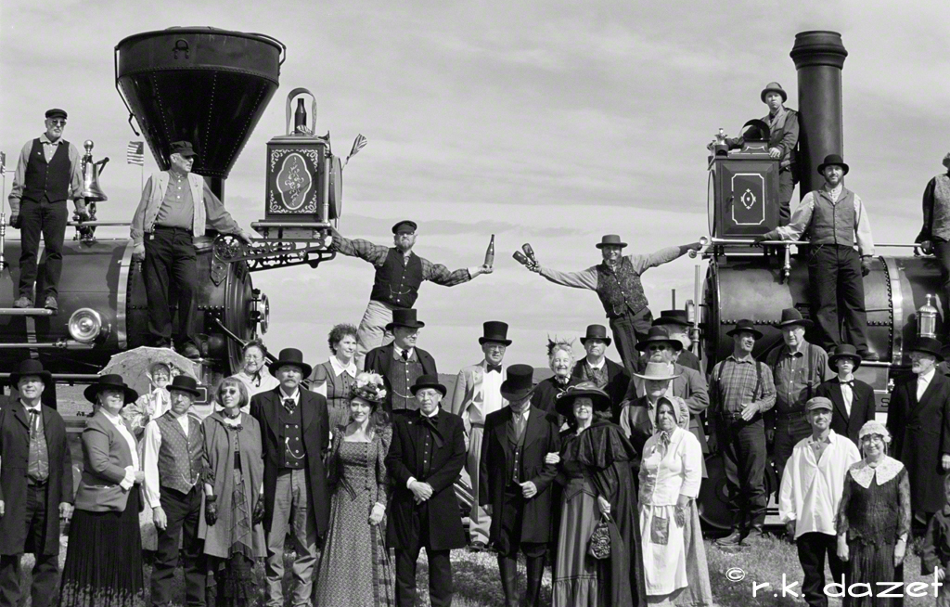
Railroads Expand
Transcontinental Railroad
Uniting the country physically and economically, two rail lines (the Central Pacific and the Union Pacific) met on May 18, 1869

Slide 11
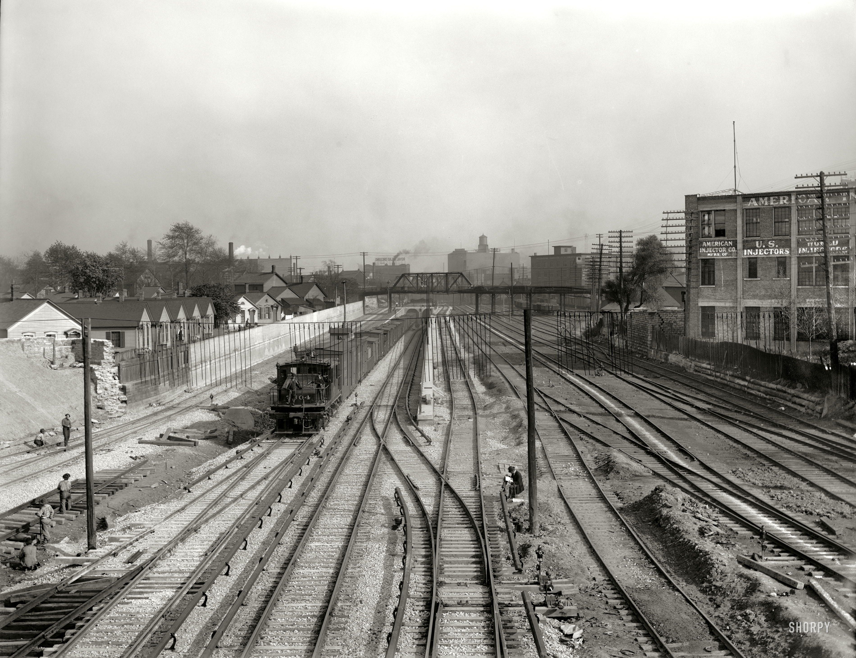
Railroads Expand
Creation of rail network:
Promoted trade
Provided jobs
Boosted steel industry and train manufacturers
Sped up the settlement of the West

Slide 12
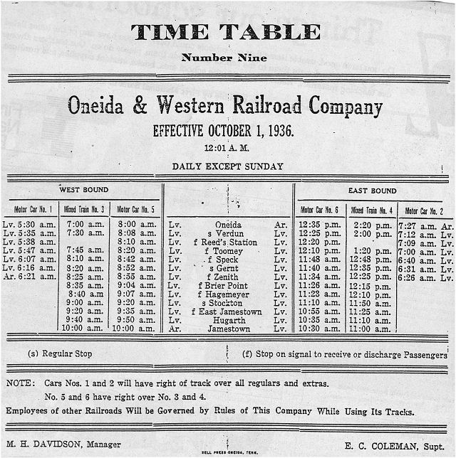
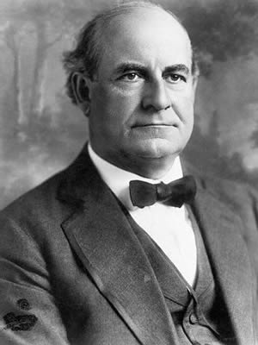
Railroads Expand
Railroads led to the adoption of standard time
Needed accurate timekeeping

Slide 14
The Second Industrial Revolution:
The Rise of Big Business

Slide 15
Main Idea
Corporations run by powerful business leaders became a dominant force in the American economy.

Slide 16
A Favorable Climate for Business
The American ideal was one of self-reliant individualism
Strong work ethic made one successful
Entrepreneurs
Risk takers who used their money and talents in new business ventures

Slide 17
A Favorable Climate for Business
Capitalism
Economic system
Private business control industry
Competition determines prices and wages

Slide 18
A Favorable Climate for Business
laissez-faire (“to let do”)
Companies can conduct business without intervention by the government

Slide 19
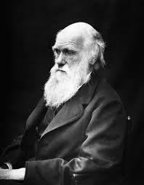
A Favorable Climate for Business
Many thinkers believed that inequalities were part of the natural order
Social Darwinism
“survival of the fittest” applied to society
stronger people, businesses, and nations would prosper, and weaker ones would fail

Slide 20
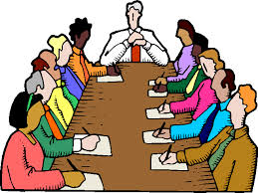
Business Structures Change
As industry grew, structure of ownership changed
Corporations
Owned by stockholders
Investment money raised by selling stock
Decisions made by a board of directors

Slide 21
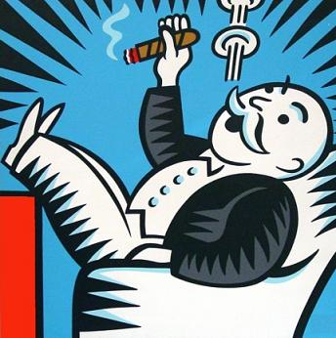
Business Structures Change
Trusts
Companies merged
Ran as a single corporation
Monopoly
When a trust gained complete control of an industry

Slide 22
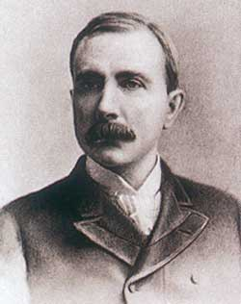
Industrial Tycoons: Oil
John D. Rockefeller
Vertical integration
Acquired companies that supplied his business
Horizontal integration
Taking over other companies producing the same product
By 1879 – Standard Oil captured 90% of the U.S. oil refinery business

Slide 23
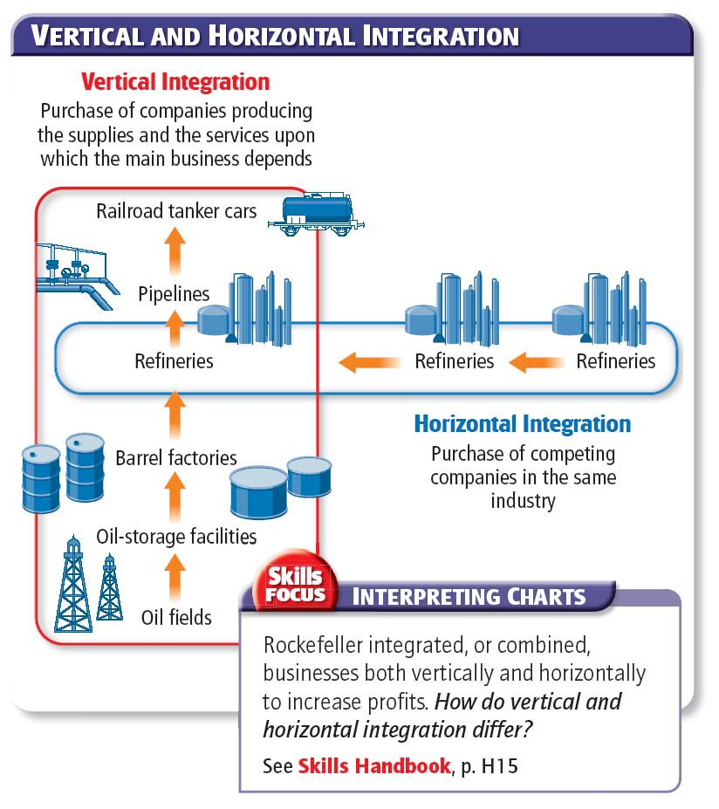

Slide 24
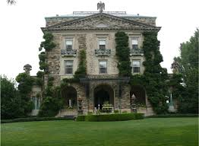
Industrial Tycoons: Oil
Rockefeller gave away over half of his fortune to charity
He donated millions to education and good works through his Rockefeller Foundation

Slide 26
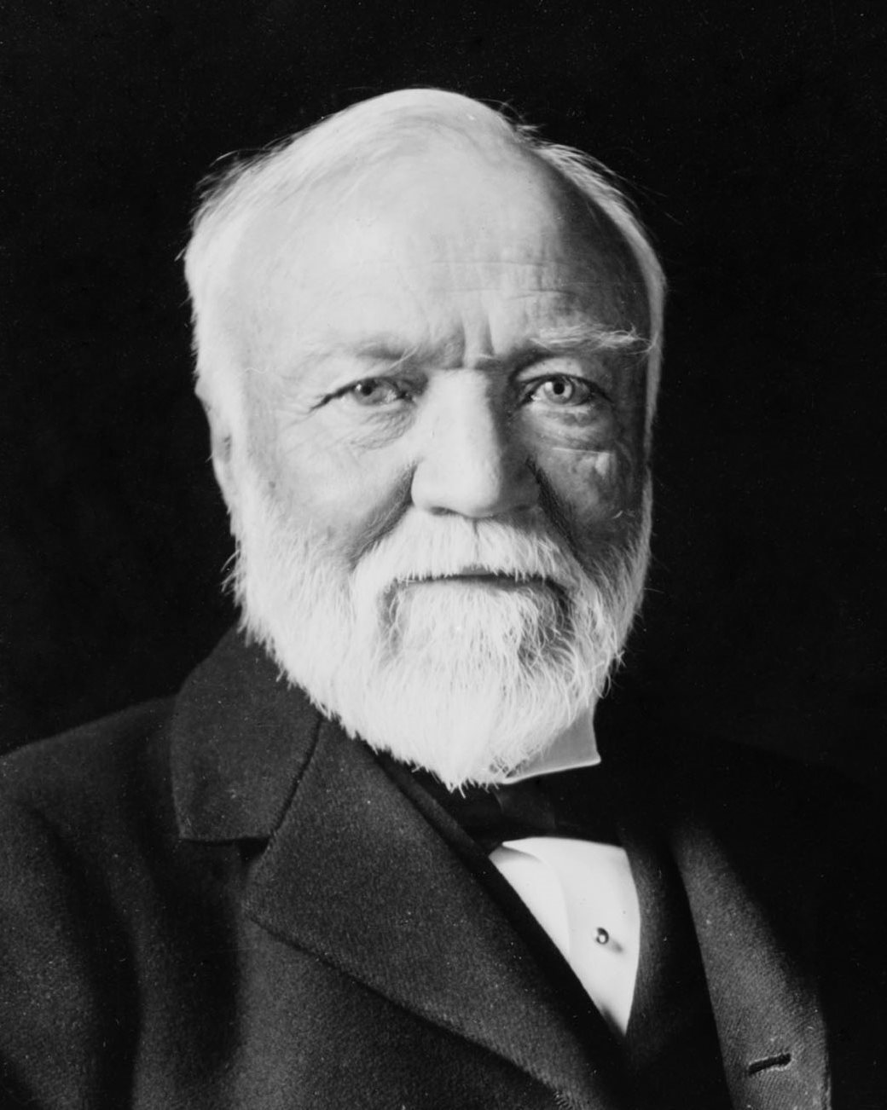
Industrial Tycoons: Steel
Andrew Carnegie
Rose from immigrant child to steel magnate
He used profits from various business investments to found his own company
By the end of the century the Carnegie Steel Company dominated the U.S. steel industry

Slide 27
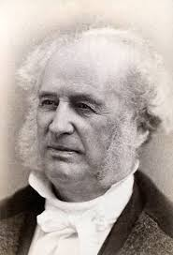
Industrial Tycoons: Railroads
Cornelius Vanderbilt
Began investing in railroads during the Civil War
At the height of his career he controlled 4,500 miles of track

Slide 28
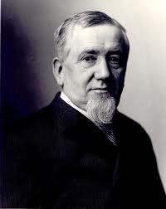
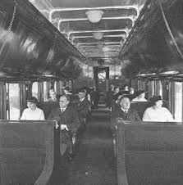
Industrial Tycoons
George Pullman
Made his fortune designing and building railroad cars
Sleeper cars
Built a town south of Chicago to house workers
The Pullman Company controlled aspects of life in the town
Criticism was not tolerated

Slide 29
A Mixed Legacy
Proponents:
Business tycoons were “captains of industry”
Used their business skills to make the American economy stronger and more productive
Contributions to charity

Slide 30
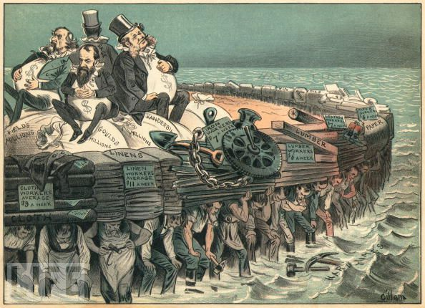
A Mixed Legacy
Critics:
Business tycoons were “robber barons”
Profited unfairly by squeezing out competitors
Lavish lifestyles from their ill-gotten rewards

Slide 31
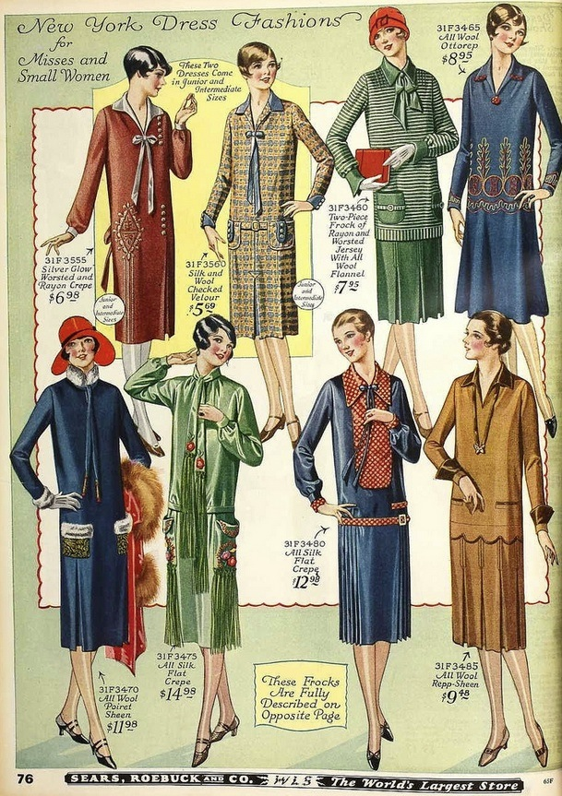
Mass Marketing
Retailers looked for new ways to maximize their profits
Household goods were targeted toward women
Brand names helped customers remember products

Slide 32
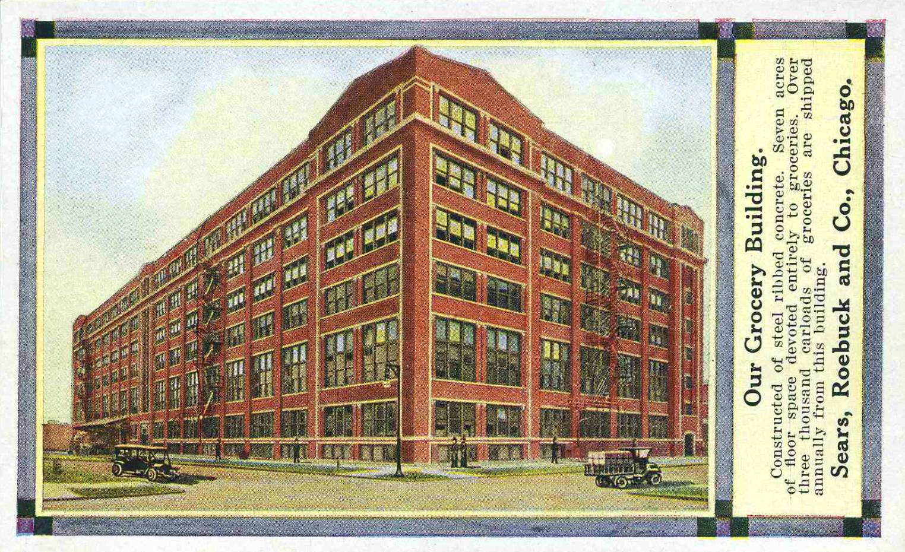
Mass Marketing
The convenient department store emerged
Provided a variety of goods
The stores bought in bulk, passing the savings on to the customers

Slide 33
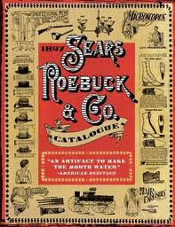
Mass Marketing
Mail-order companies gave rural dwellers access to a huge variety of goods

Slide 34
The Second Industrial Revolution:
Workers Organize

Slide 35
Main Idea
Grim working conditions in many industries led to workers to form unions and stage labor strikes.

Slide 36
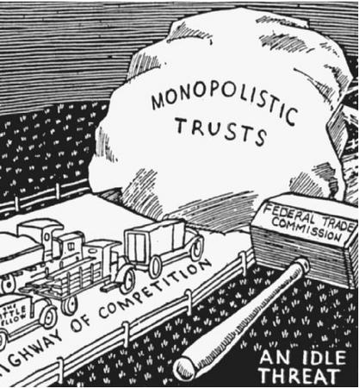
Government and Business
Hands-off policy
Government did not interfere with business
Sherman Antitrust Act (1890)
Illegal to form trusts that interfered with free trade
Prohibited monopolies and activities that hindered competition
Vague and seldom enforced

Slide 37
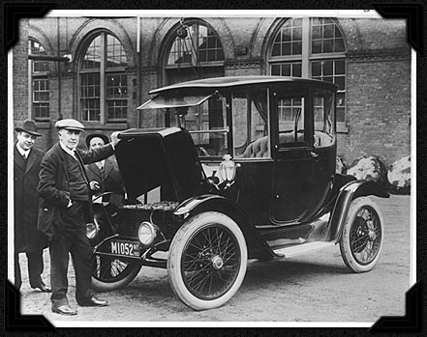
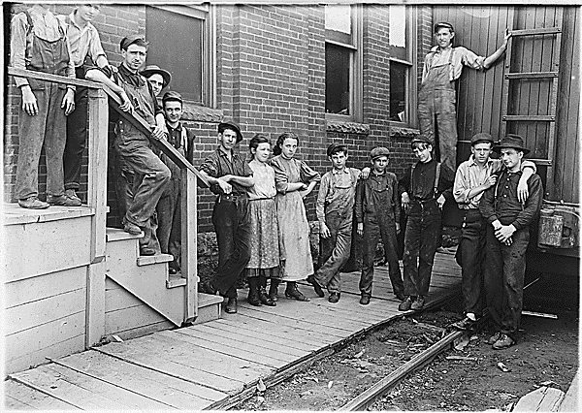
Government and Business
Income inequality increasing
1890 - 10% of the population controlled 75% of the nation’s wealth
Most industrial workers made less than $500 per year

Slide 38
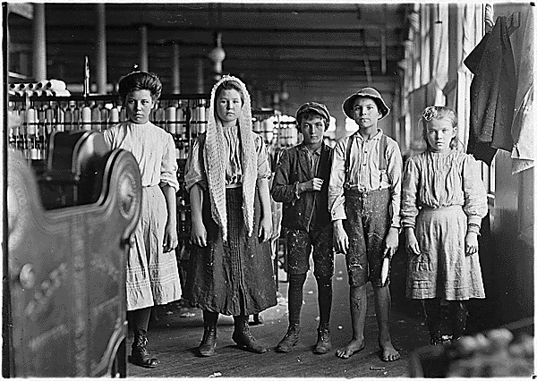
Industrial Workers
Many factory workers were immigrants or rural Americans
The best jobs went to native-born whites or European immigrants
1900 - 1 in 6 children between the ages of 10 and 15 held factory jobs

Slide 39
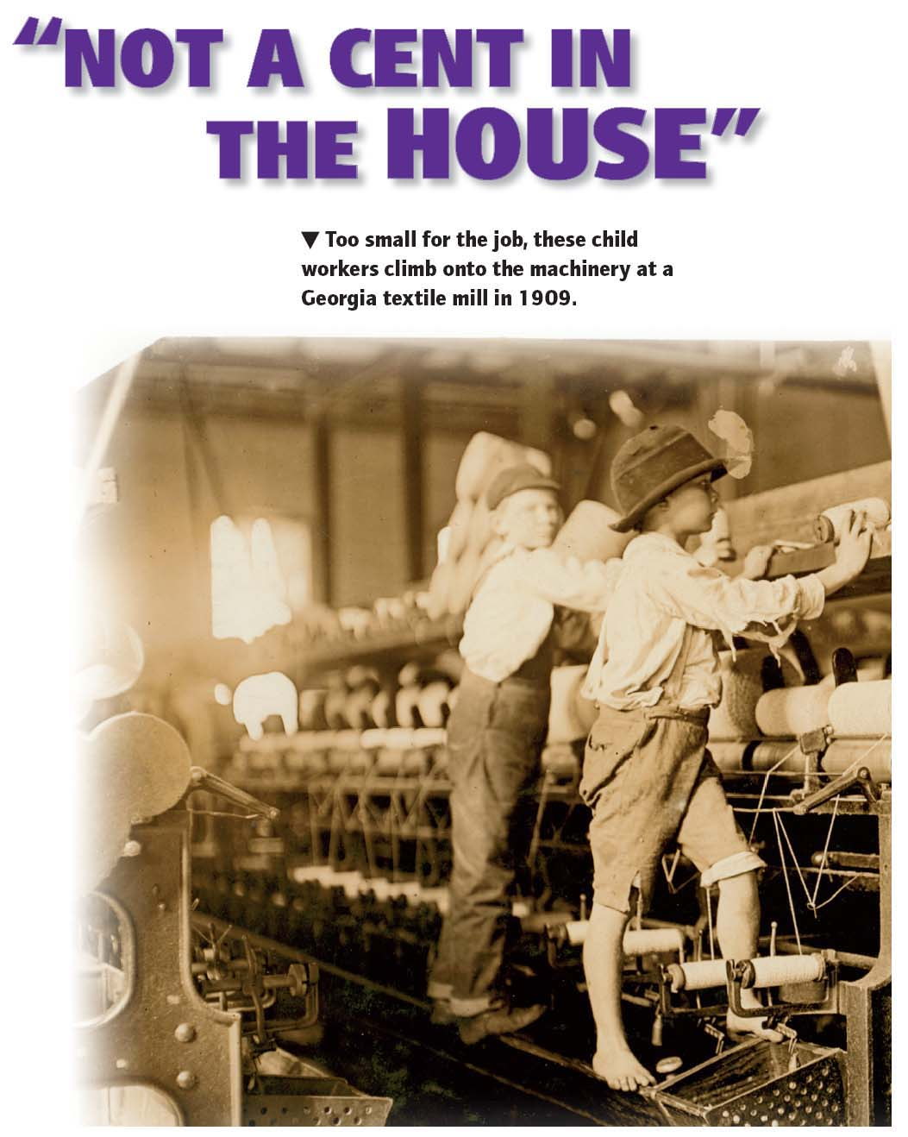

Slide 40
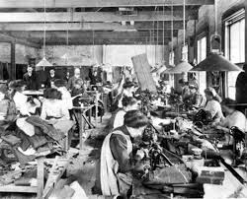
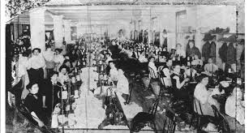
Industrial Workers
Most unskilled laborers worked 10-hour days, six days a week
No: paid vacation, sick leave, workers compensation
Injured workers replaced
Sweatshops
Cramped workshops set up in shabby tenement buildings

Slide 41
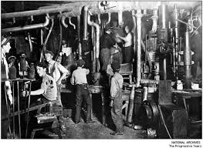
Workers Seek Changes
1800s – Working conditions horrible
Workers began organizing to pressure employers
Wanted better wages, shorter hours, a safer workplace, and the end of child labor

Slide 42
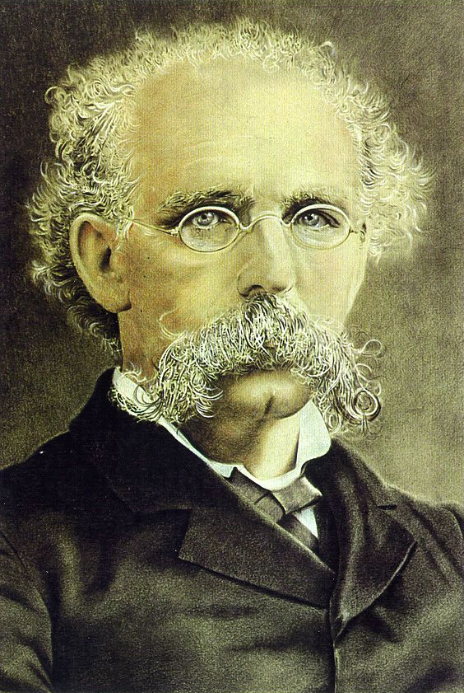
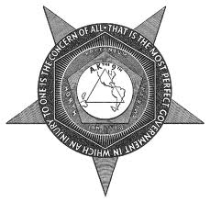
Workers Seek Changes
After Civil War – labor movement began to grow
1866 - National Labor Union (NLU)
1869 - The Knights of Labor
Terence V. Powderly
Began to accept unskilled workers, women, and African Americans

Slide 43
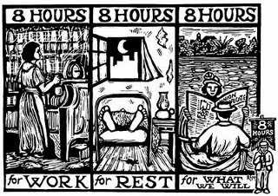
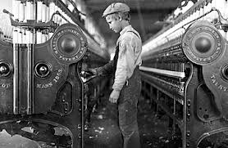
Workers Seek Changes
The Knights of Labor (continued)
Campaigned for reforms
8 hour workdays
End of child labor
Used boycotts & negotiations

Slide 44
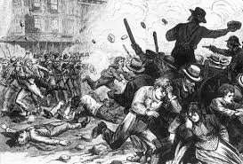
Strikes and Turmoil
The Great Railroad Strike
After wage cuts, the first railroad strike occurred in 1877
Strikes quickly spread, and state militias were called out
Violence ensued, lives were lost, and costly damage was done
The arrival of U.S. Army troops put an end to the strike

Slide 45
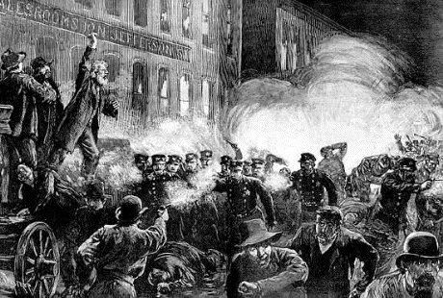
Strikes and Turmoil
The Haymarket Riot
Haymarket Square in Chicago
Bomb was thrown in a crowd of protestors
Panic and gunshots
11 killed, hundreds injured

Slide 46
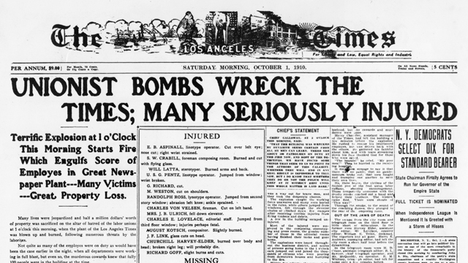
Strikes and Turmoil
The Haymarket Riot (continued)
Foreign-born unionists were blamed for the violence
Xenophobia
The fear of foreigners
8 men charged with conspiracy
No evidence
All eight convicted and sentenced to death
4 hangings, 1 suicide, last 3 pardoned

Slide 47
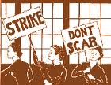
Strikes and Turmoil
Employers struck back at organized labor
Forced employees to sign documents saying they would not join a union
Blacklists
Lists of people deemed troublemakers were made and shared by employers, who refused to hire anyone listed
Striking workers were replaced with “scabs”

Slide 48
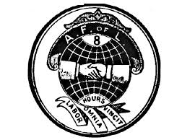
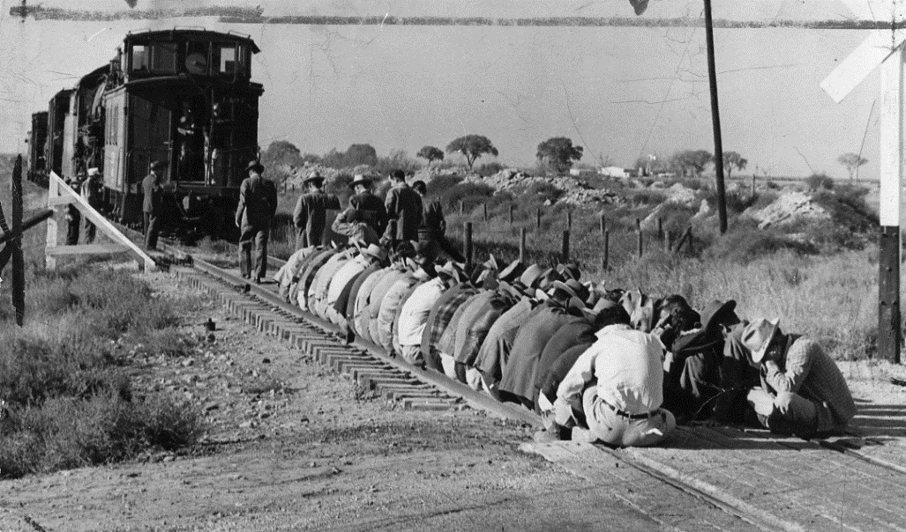
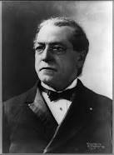
Strikes and Turmoil
American Federation of Labor (AFL)
Samuel Gompers
Used strikes and other tactics
Won wage increases and shorter workweeks

Slide 49
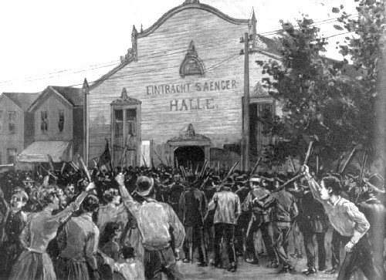
Strikes and Turmoil
The Homestead Strike
Carnegie Steel workers in Homestead, Pennsylvania
Refused to work faster – locked out by the manager – workers seize the plant
Private guards hired by the company tried to regain control
14-hour battle and sixteen deaths
Governor calls out the state militia
The steelworkers’ union withered within months

Slide 50
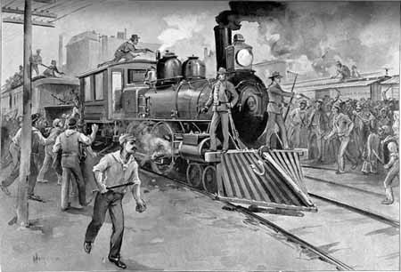
Strikes and Turmoil
The Pullman Strike
Pullman Company lays off 1/3rd of its employees and cuts wages
Workers went on strike
Eugene V. Debs
President Grover Cleveland calls in federal troops, and the strike collapsed

Slide 51
The Second Industrial Revolution:
The Age of Invention

Slide 52
Main Idea
Important innovations in transportation and communication occurred during the Second Industrial Revolution.

Slide 53
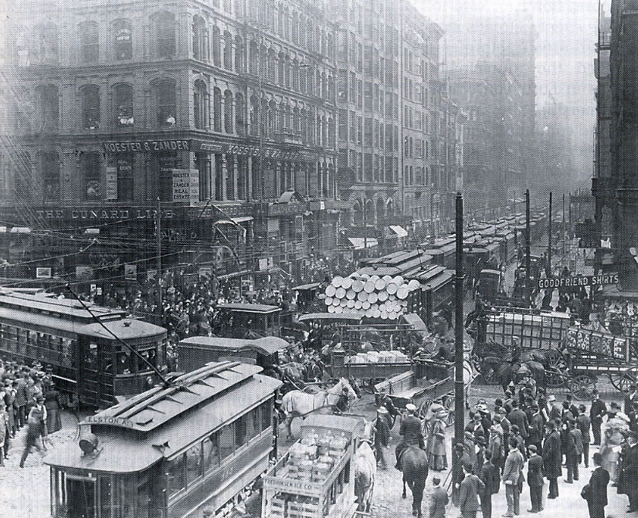
Advances in Transportation
Americans needed local forms of transportation
Mass transit
Public transportation systems

Slide 54
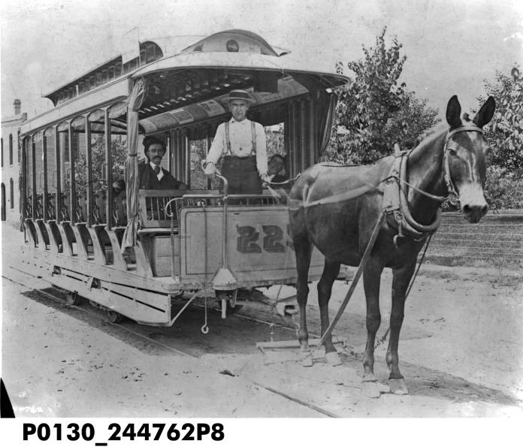
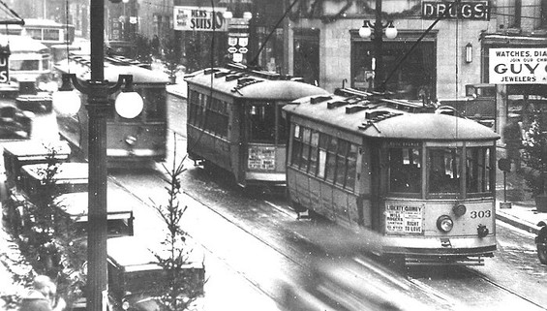
Advances in Transportation
Streetcars
Originally, horse-drawn vehicles placed on rails on the street
Needed more power than horses could provide
Cable cars
Latched on to a moving cable underground

Slide 55
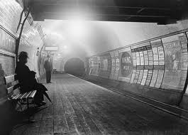
Advances in Transportation
Traffic became a series problem
Subways
1897 – Boston
1904 – New York

Slide 56
Advances in Transportation
1867 - Invention of the internal combustion engine
Automobiles
“horseless carriage”
Only for the wealthy

Slide 57
Advances in Transportation
Orville and Wilbur Wright
First to successfully fly an airplane
December 17, 1903 – Kitty Hawk, North Carolina

Slide 58
Communications Revolution
The telegraph
Samuel F.B. Morse
Sent messages over wires with electricity
Fastest way to send messages

Slide 59
Communications Revolution
The telephone
Alexander Graham Bell
Device that could transmit voices using electricity
1900 – more than 1 million telephones had been installed

Slide 60
Communications Revolution
The typewriter
Could produce legible documents very quickly
New job opportunities for women

Slide 61
Thomas Edison
Thomas Alva Edison
Inventor
Earned over 1,000 U.S. patents
Phonograph
Incandescent bulb
Motion picture

Slide 62
Thomas Edison
Developed the practical electric lighting
Designed and produced all of the parts necessary for an electricity network

