Slide 1
Civics

Slide 2
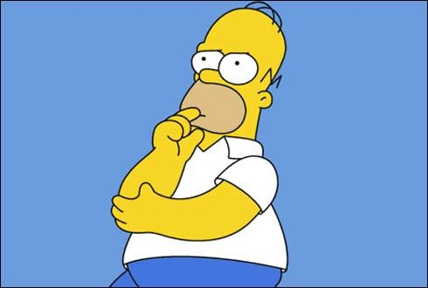
Bellwork
Why do we need a government?

Slide 3
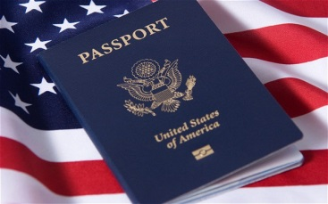
What is civics?
Civics is the Study of citizenship and government. It is the study of what it means to be a citizen.
Citizen: legal member of a country
Government: people and institutions that establish order and protect rights of citizens
The Common Good: The ultimate role of government is to do the greatest good to the greatest number of people w/o harming others
- Government is structured to meet the needs of the people.

Slide 4
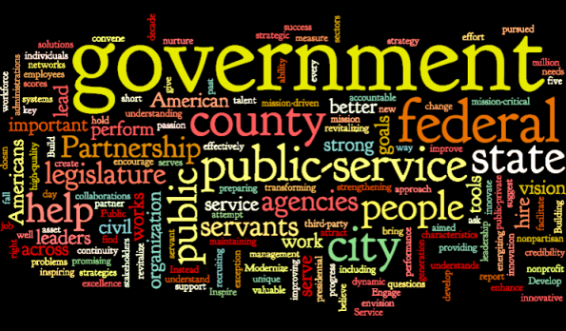
Why do we have government?
Why do we have Governments?
make laws (showing what’s acceptable)
keep order (competing interests of citizens)
provide services (education, transportation system, military, police force)
prevent anarchy: lawless society with no government

Slide 5
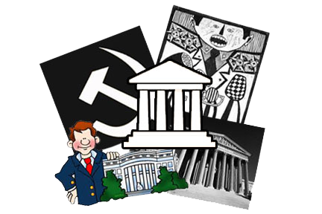
Types of Government
Governments differ in the way their leaders are chosen and in the amount of power held by the people.
Each country’s government has been shaped by the traditional beliefs of its people and by their history.

Slide 6
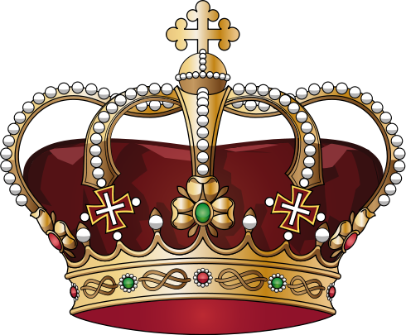
Monarchy
Monarchy: a form of government led by a king or queen
Absolute Monarchy: king or queen has total authority among his people.
No citizen choice in government
Britain before the Magna Carta
Limited Monarchy: king or queen has limited authority and must act within the bounds of a constitution.
Glorious Revolution made England a constitutional monarchy

Slide 7
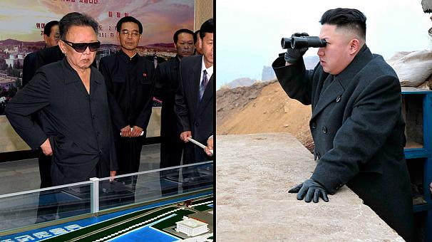
Authoritarian
Dictatorship: type of government that is usually controlled by one person who rules with complete and absolute power; ruling party has no restrictions.
Totalitarian: form of government where little freedom or opposition is allowed; state more important than individual citizens; control every aspect of citizen’s lives
Oligarchy: type of dictatorship in which all power is concentrated in a small group of people.

Slide 8
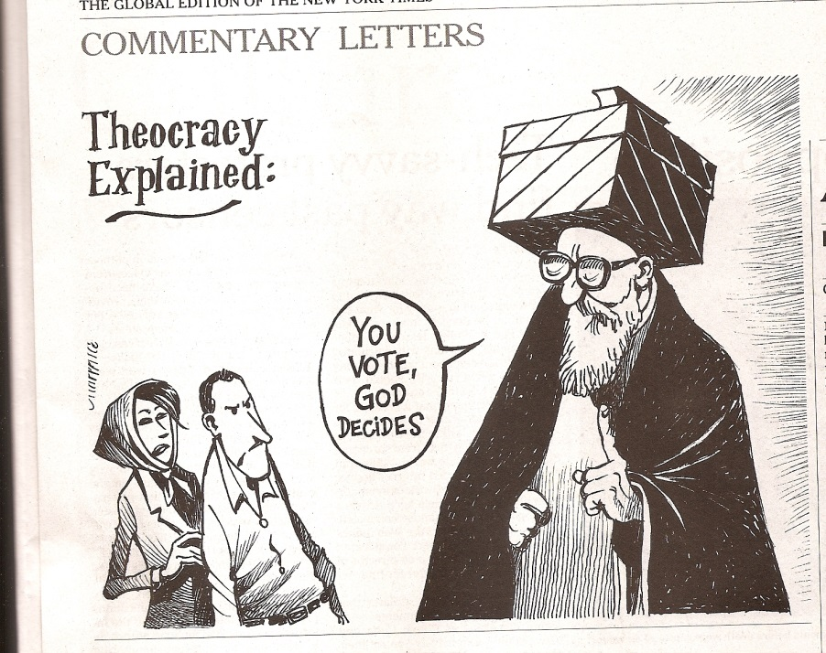
Theocracy
Theocracy is a type of government controlled by one or more religious leaders who claim to rule on behalf of God or the gods worshiped in their country.
Rulers may be elected, but rulers respond to divine guidance and not wishes of the people

Slide 9
Democracy
Democracy is a form of government where people participate and have a choice. Principles and ideals underlying democracy are designed to promote the freedom of the people in a nation
Democracy = Government by the people
Direct Democracy: form of government where each citizen has an actual say in the affairs of the government.
Representative Democracy: citizens vote for elected government officials

Slide 11
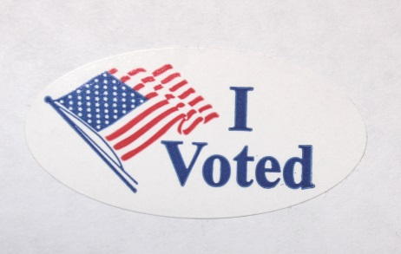
Representative democracy or republic?
After the Constitutional Convention, Benjamin Franklin was asked what type of government was created. His response was “A republic if you can keep it.”
Republic: people elect representatives to govern them
The American Republic is synonymous with representative democracy.
How is it democratic?
How is it representative?
The purpose of a republic is to protect the individual’s rights.

Slide 12
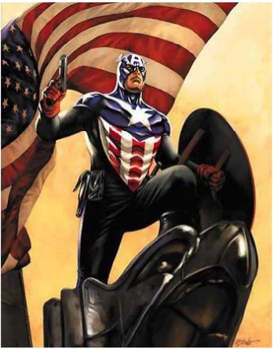
American Government
Principles of American government are:
Rule of Law
Limited Government
Consent of the Governed
Individual Rights
Representative Government
America’s basic values are equality, liberty, and justice for all people.
A nation may agree on values and principles philosophically, but disagree on application of those principles.

Slide 13
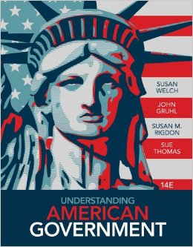
Government in US
The basic plan under which Americans live is contained in a constitution.
Government laws must be constitutional to be valid. They are recorded so people can know what the laws are.
The government of the US has the purpose of guaranteeing the freedoms of its citizens.
The laws of US guarantee certain freedoms that cannot be taken away or restricted.
Equal rights

