Slide 1
Origins
Enlightenment-Revolution

Slide 2
Bellringer
What are at least two concepts, powers, or rights reflected in our government and where did those ideas originate?
Please turn writings into the black bin at the front

Slide 3
Enlightenment
Age of Reason – Period in the 1600-1700s in Europe of new and old ideas. Applying logic and reason to societal problems.
Main Philosophers
John Locke
Thomas Hobbes
Montesquieu
Rousseau
Voltaire
American colonists brought with them knowledge of Enlightenment theories and these theories impacted our government.

Slide 4
Thomas Hobbes
“During the time men live without a common power to keep them all in awe, they are in that conditions called war; and such as war, as if of every man, against every man.”

Slide 5
Thomas hobbes
Hobbes believed that in nature people were cruel, greedy, and selfish. They would fight, rob, and oppress one another.
To escape this people would enter into a social contract, they would agree to give up their freedom in return for the safety and order of an organized society.
Hobbes believed that a powerful government like an absolute monarchy was best for society – it would impose order and compel obedience. It would also be able to suppress rebellion.
Wrote Leviathan

Slide 6
John Locke
“The state of nature has a law of nature to govern it, which obliges every one: and reason, which is that law, teaches all mankind, who will but consult it, that being all equal and independent, no one ought to harm another in his life, health, liberty, or possessions...”
“Men being, as has been said, by nature, all free, equal, and independent, no one can be put out of this estate, and subjected to the political power of another, without his own consent.”

Slide 7
John locke
Believed in natural laws and natural rights.
We are born with rights because they are a part of nature, of our very existence – they come from god.
At birth people have the right to life, liberty, and property.
Most famous works are the Two Treatises on Government.
Governments have an obligation to protect the natural rights of the people they govern. If the government fails, the people have the right to overthrow that government.
Best form of government is one which is accepted by all of the people and has limited power.
Consent of the governed

Slide 8
Jean jacques rousseau
Everything is good as it comes from the hands of the Maker of the world, but degenerates once it gets into the hands of man”
“Man is born free, and everywhere he is in chains. Those who think themselves the masters of others are indeed greater slaves than they.”
“The social pact, far from destroying natural equality, substitutes, on the contrary, a moral and lawful equality for whatever physical inequality that nature may have imposed on mankind; so that however unequal in strength and intelligence, men become equal by covenant and by right.”

Slide 9
Jean jacques rousseau
Believed people are basically good but become corrupted by society.
For Rousseau, the social contract was the path to freedom, people should do what is best for their community.
The general will of the people as a whole should direct the state toward the common good. Hence, the good of the community is more important than individual interests.
Wrote The Social Contract.

Slide 10
Montesquieu
“Democratic and aristocratic states are not in their own nature free. Political liberty is to be found only in moderate governments; and even in these it is not always found. It is there only when there is no abuse of power. But constant experience shows us that every man invested with power is apt to abuse it, and to carry his authority as far as it will go.”
“To prevent this abuse, it is necessary, from the very nature of things, that power should be a check to power.”

Slide 11
montesQuieu
Strongly criticized absolute monarchy and was a voice for democracy.
Separation of Powers – the best way to protect liberty was to divide the powers of government into three branches: legislative, executive, and judicial.
Checks and Balances – each branch of government should check (limit) the power of the other two branches. Thus, power would be balanced (even) and no one branch too powerful.
Wrote The Spirit of the Laws.

Slide 12
Voltaire
“Think for yourself and let others enjoy the privilege of doing so too.”
“It is better to risk saving a guilty person than to condemn an innocent one.”
I do not agree with what you have to say, but I'll defend to the death your right to say it.”
“Liberty of thought is the life of the soul.”

Slide 13
Voltaire
Advocated freedom of thought, speech, politics, and religion.
Fought against intolerance, injustice, inequality, ignorance, and superstition.
Attacked idle aristocrats, corrupt government officials, religious prejudice, and the slave trade.

Slide 14
Enlightenment thinkers
John Locke
Natural rights: life, liberty, ownership of property
Social contract: between government and citizens; government protects rights and if government fails, people replace it.
Consent of the governed
Thomas Hobbes
Believed absolute monarchy was the best form of government
Social contract: gave up rights for protection
Montesquieu
Government divided into 3 branches
Checks and balances
Rousseau
Equality of citizens
Social contract
Voltaire
Individual rights

Slide 15
Revolution
American Revolution and Declaration

Slide 16
Revolution Assignment
With your partner, you will be assigned an event from the American Revolution.
Together, you will figure out when the event occurred, what the event was, and its significance.
At the end of the allotted time you and your partner will present your information to the class.

Slide 17
Topics
1 – Stamp Act
2 – Common Sense
3 – Boston Tea Party
4 – Battle of Lexington & Concord
5 – French & Indian War
6 – Boston Massacre
7 – Intolerable/Coercive Acts
8 – Tea Act
9 – Quartering Act
10 – Navigation Acts
11 – Glorious Revolution
12 – Townshend Acts
13 – Currency Act
14 – Sugar Act
15 – Salutary Neglect
16 – Great Awakening

Slide 18
Causes of the American Revolution
There are many reasons that together contributed to the American Revolution.
Increased economic pressure and ideas about self-government led the American colonists to declare independence from Great Britain.
Mercantilism was one of the main causes for many of Britain’s actions.
Mercantilism is an economic theory that states a country becomes stronger by keeping strict control over its trade.
States that a nation should have a favorable balance of trade.
Colonies provided raw materials; Britain created manufactured goods that were sold to the colonies

Slide 19
Causes of revolution
Salutary Neglect; 1600s-1700s
Used to being independent of direct British control
Developed an identity away from Britain
Britain avoided strict enforcement of laws to keep loyalty
Navigation Acts; 1660
law forcing colonies only to trade with Great Britain
Crews had to be English; certain goods shipped only to England (cotton; tobacco)
1760s Britain began to strictly enforce Navigation Acts
General Writs of Assistance: allowed customs officials to search building/ships for smuggled goods for any reason
Glorious Revolution; 1688
William and Mary take over throne with limits on monarchy
Began struggle over limits of self-government
Great Awakening; 1730-1743
Christian revitalization movement; made personal
Changes in understanding of God, self, and world

Slide 20
Causes of Revolution
French and Indian War; 1754-1763
Britain and France fought for control of colonies and trade routes.
France lost all their land in the US
As a result of the war, there were high costs from the war and expansion led to conflicts with Native Americans.
Britain tried to restrict settling on Native American’s land with the Proclamation of 1763
Do not settle west of Appalachian
In order to pay for these costs, Parliament decided to tax the colonists.

Slide 21
Causes of revolution
Sugar Act; 1764
Tax on molasses and sugar
First law designed specifically to raise money
Currency Act; 1764
Regulated paper money issued by colonies; protect British merchants and creditors from being paid with depreciated currency.
Stamp Act; 1765
Required printed materials to be printed on stamped paper
Imposed a direct tax
Colonists had no representatives in Parliament; violation of rights as Englishmen – “no taxation without representation.”
Sons of Liberty/Samuel Adams/Patrick Henry
Quartering Act; 1765
Provide British soldiers with any needed food or accommodations
Provide food for British soldiers in the area
Townshend Acts; 1767
Import tax on lead, paint, tea, paper, and glass.
Purpose was to raise revenue and establish precedent that Britain could tax colonies

Slide 22
Causes of revolution
Boston Massacre; 1770
British troops fired at crowd; killed 5 colonists
Started waves of anti-British feelings
Tea Act; 1773
Low cost of BEIC tea; goal to convince colonists purchase t
Boston Tea Party; 1773
Boston unable to force tea cosignees to return tea to England; dumped tea in harbor
Intolerable Acts; 1774
British response to Boston; set of punitive laws
Closed port in Boston; stripped Massachusetts of self-gov’t
Lexington and Concord; April 19, 1775
Beginning of American Revolution
British general decided to seize colonists’ weapons in Concord
Common Sense; 1776
Pamphlet written by Thomas Paine that called for independence
Written in everyday language

Slide 23
Committees of Correspondence
Committees of Correspondence were the American colonies' first institution for maintaining communication with one another.
First committee established by Samuel Adams
In addition to organizing protests, they also disseminated information between pro-independence colonists.
Originally were only organized temporarily but soon became permanent.
Organization led to the creation of the Continental Congress.

Slide 24
First continental Congress
Organized in September 1774 to determine how to respond to the crisis in Massachusetts and other abuses by British authorities.
Delegates recommended continued boycott of British goods
Boycott: To abstain from or act together in abstaining from using, buying, or dealing with as an expression of protest.
Assembled a list of 10 resolutions to present to King George III stating what the Congress considered to be the colonists’ rights.
Agreed to meet in May 1775 if the king did not acknowledge these rights.
King refused to consider the colonists’ demands and ordered troops to prepare to seize the colonists’ weapons.

Slide 25
Second continental congress
Met in May 1775 in Philadelphia
Voted to create the Continental Army
George Washington was appointed commanding general
Approved the Declaration of Causes outlining the reasons for taking up arms against Britain.
Tried to restore peace. Delegates signed the Olive Branch Petition requesting peace. King rejected the petition.

Slide 26
North Carolina
Before the Declaration of Independence was issued, North Carolina created their own documents.
Mecklenburg Resolves, 1775: state British laws were no longer in effect; provided for the creation of an independent local government to manage Mecklenburg County
Halifax Resolves, 1776: recommended that NC and other colonies declare independence; were read and discussed at the Continental Congress

Slide 27
Declaration of independence
The Congress, acting as government for the colonies, appointed a committee to write a document that would announce the independence of the United States.
Based on the idea of egalitarianism
Believing in the principle that all people are equal and deserve equal rights
Jefferson wrote the first draft of the Declaration
John Adams and Benjamin Franklin were a part of the committee that drafted the Declaration.
It was voted on July 2 to declare independence

Slide 28
Bellringer 2/4
How does the idea of self government apply to the Continental Congress?

Slide 29
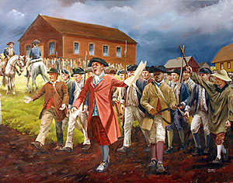

Slide 30
Articles of confederation
In 1777 the Continental Congress adopted a plan of government, The Articles of Confederation.
The Articles were ratified in 1781 by all 13 states.
The American Revolution ended in 1783. With the Treaty of Paris and Great Britain recognizing the independence of the United States.
The states were now a confederation called the United States of America.
The central government had very limited powers due to the states’ fear of a strong central government.
Federalism – division of power between federal government and the states.

Slide 31
Weaknesses of Articles
Lack of Power and Money
Congress had no power to collect taxes
Congress had no power to regulate trade
Congress had no power to enforce its laws
Lack of Central Powers
Only one branch of government
No single leader of group directed government policy
No national court system existed
Rules too Rigid
Congress could not pass laws without the approval of nine states
The Articles could not be changed without the agreement of all 13 states.

Slide 32
Weakness of articles
Economic Disorganization
Congress could not regulate trade
No uniform system of currency
No power of taxation
Lack of central leadership
No independence judiciary
No foreign affairs head
Inability to deal with external and internal threats
Legislative inefficiencies
Each state had one vote
Difficulty passing laws – needed consent of 9 states
Impractical amendment process – needed 13 states
Notes:
es

Slide 33
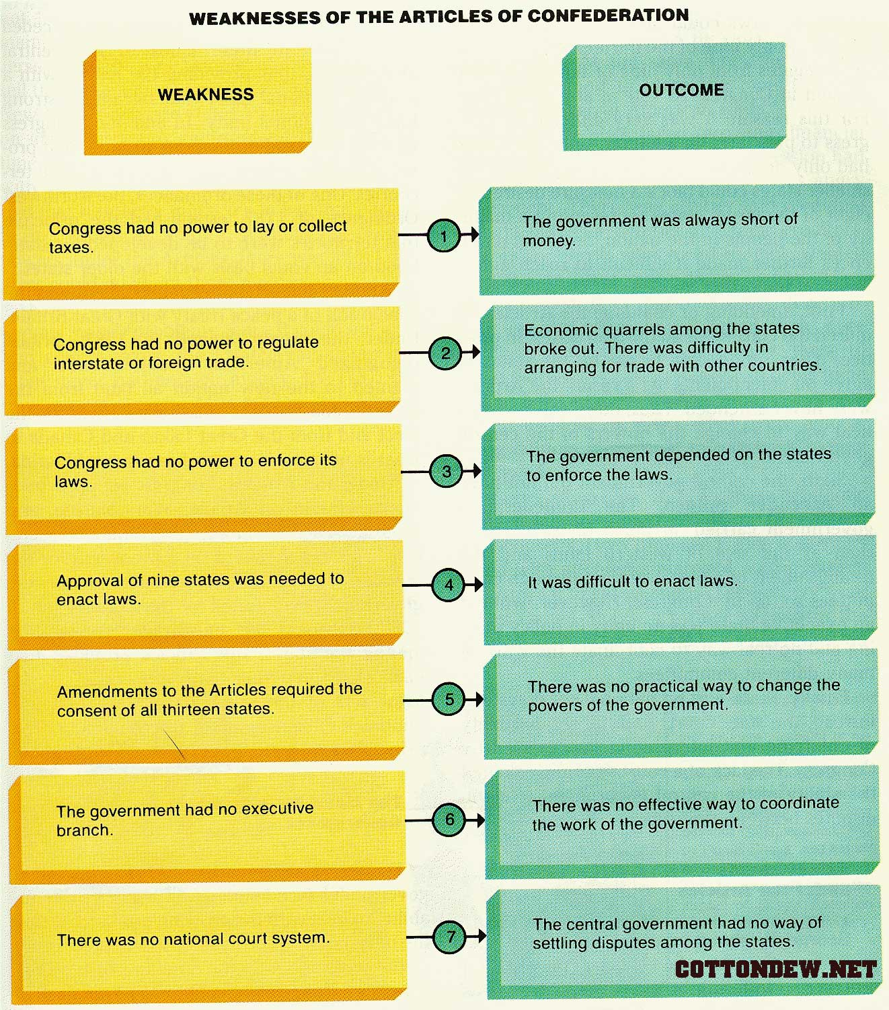

Slide 34
Shays’ Rebellion
Shay’s Rebellion was an armed uprising in Massachusetts led by farmers in 1786 against the treatment of debtors.
As a result of inability to pay taxes and debts, many farmers had their land seized and some were thrown in jail
The farmers in western Massachusetts organized their resistance in ways similar to the American Revolutionary struggle. They called special meetings of the people to protest conditions and agree on a coordinated protest.
This led the rebels to close courts by force in the fall of 1786 and to liberate imprisoned debtors from jail.
They came under the leadership of Daniel Shays.

Slide 35
Shays’ rebellion
Protests were able to shut down courts and legislative action was unsuccessful and stopping protests.
Since the federal government was unable to recruit soldiers for the army, Massachusetts created a privately funded army that was able to quash the rebellion.
Shays’ Rebellion served as an indicator of the weakness of the Articles of Confederation and the need to have a stronger federal government.

Slide 36
True or false: aoc
1. The Articles of Confederation created a President to lead the country.
2. States were still independent under the Articles.
3. The Articles were easy to change.
4. Under the Articles of Confederation, the more people a state had, the more votes it got in Congress.
5. The Congress created by the Articles did not have the power to collect taxes.
6. Under the Articles, states had to obey the laws Congress passed.
7. The Articles of Confederation created the first American government

