Slide 1
Origins

Slide 2
Bellringer
Where do you think our ideas about government came from?

Slide 3
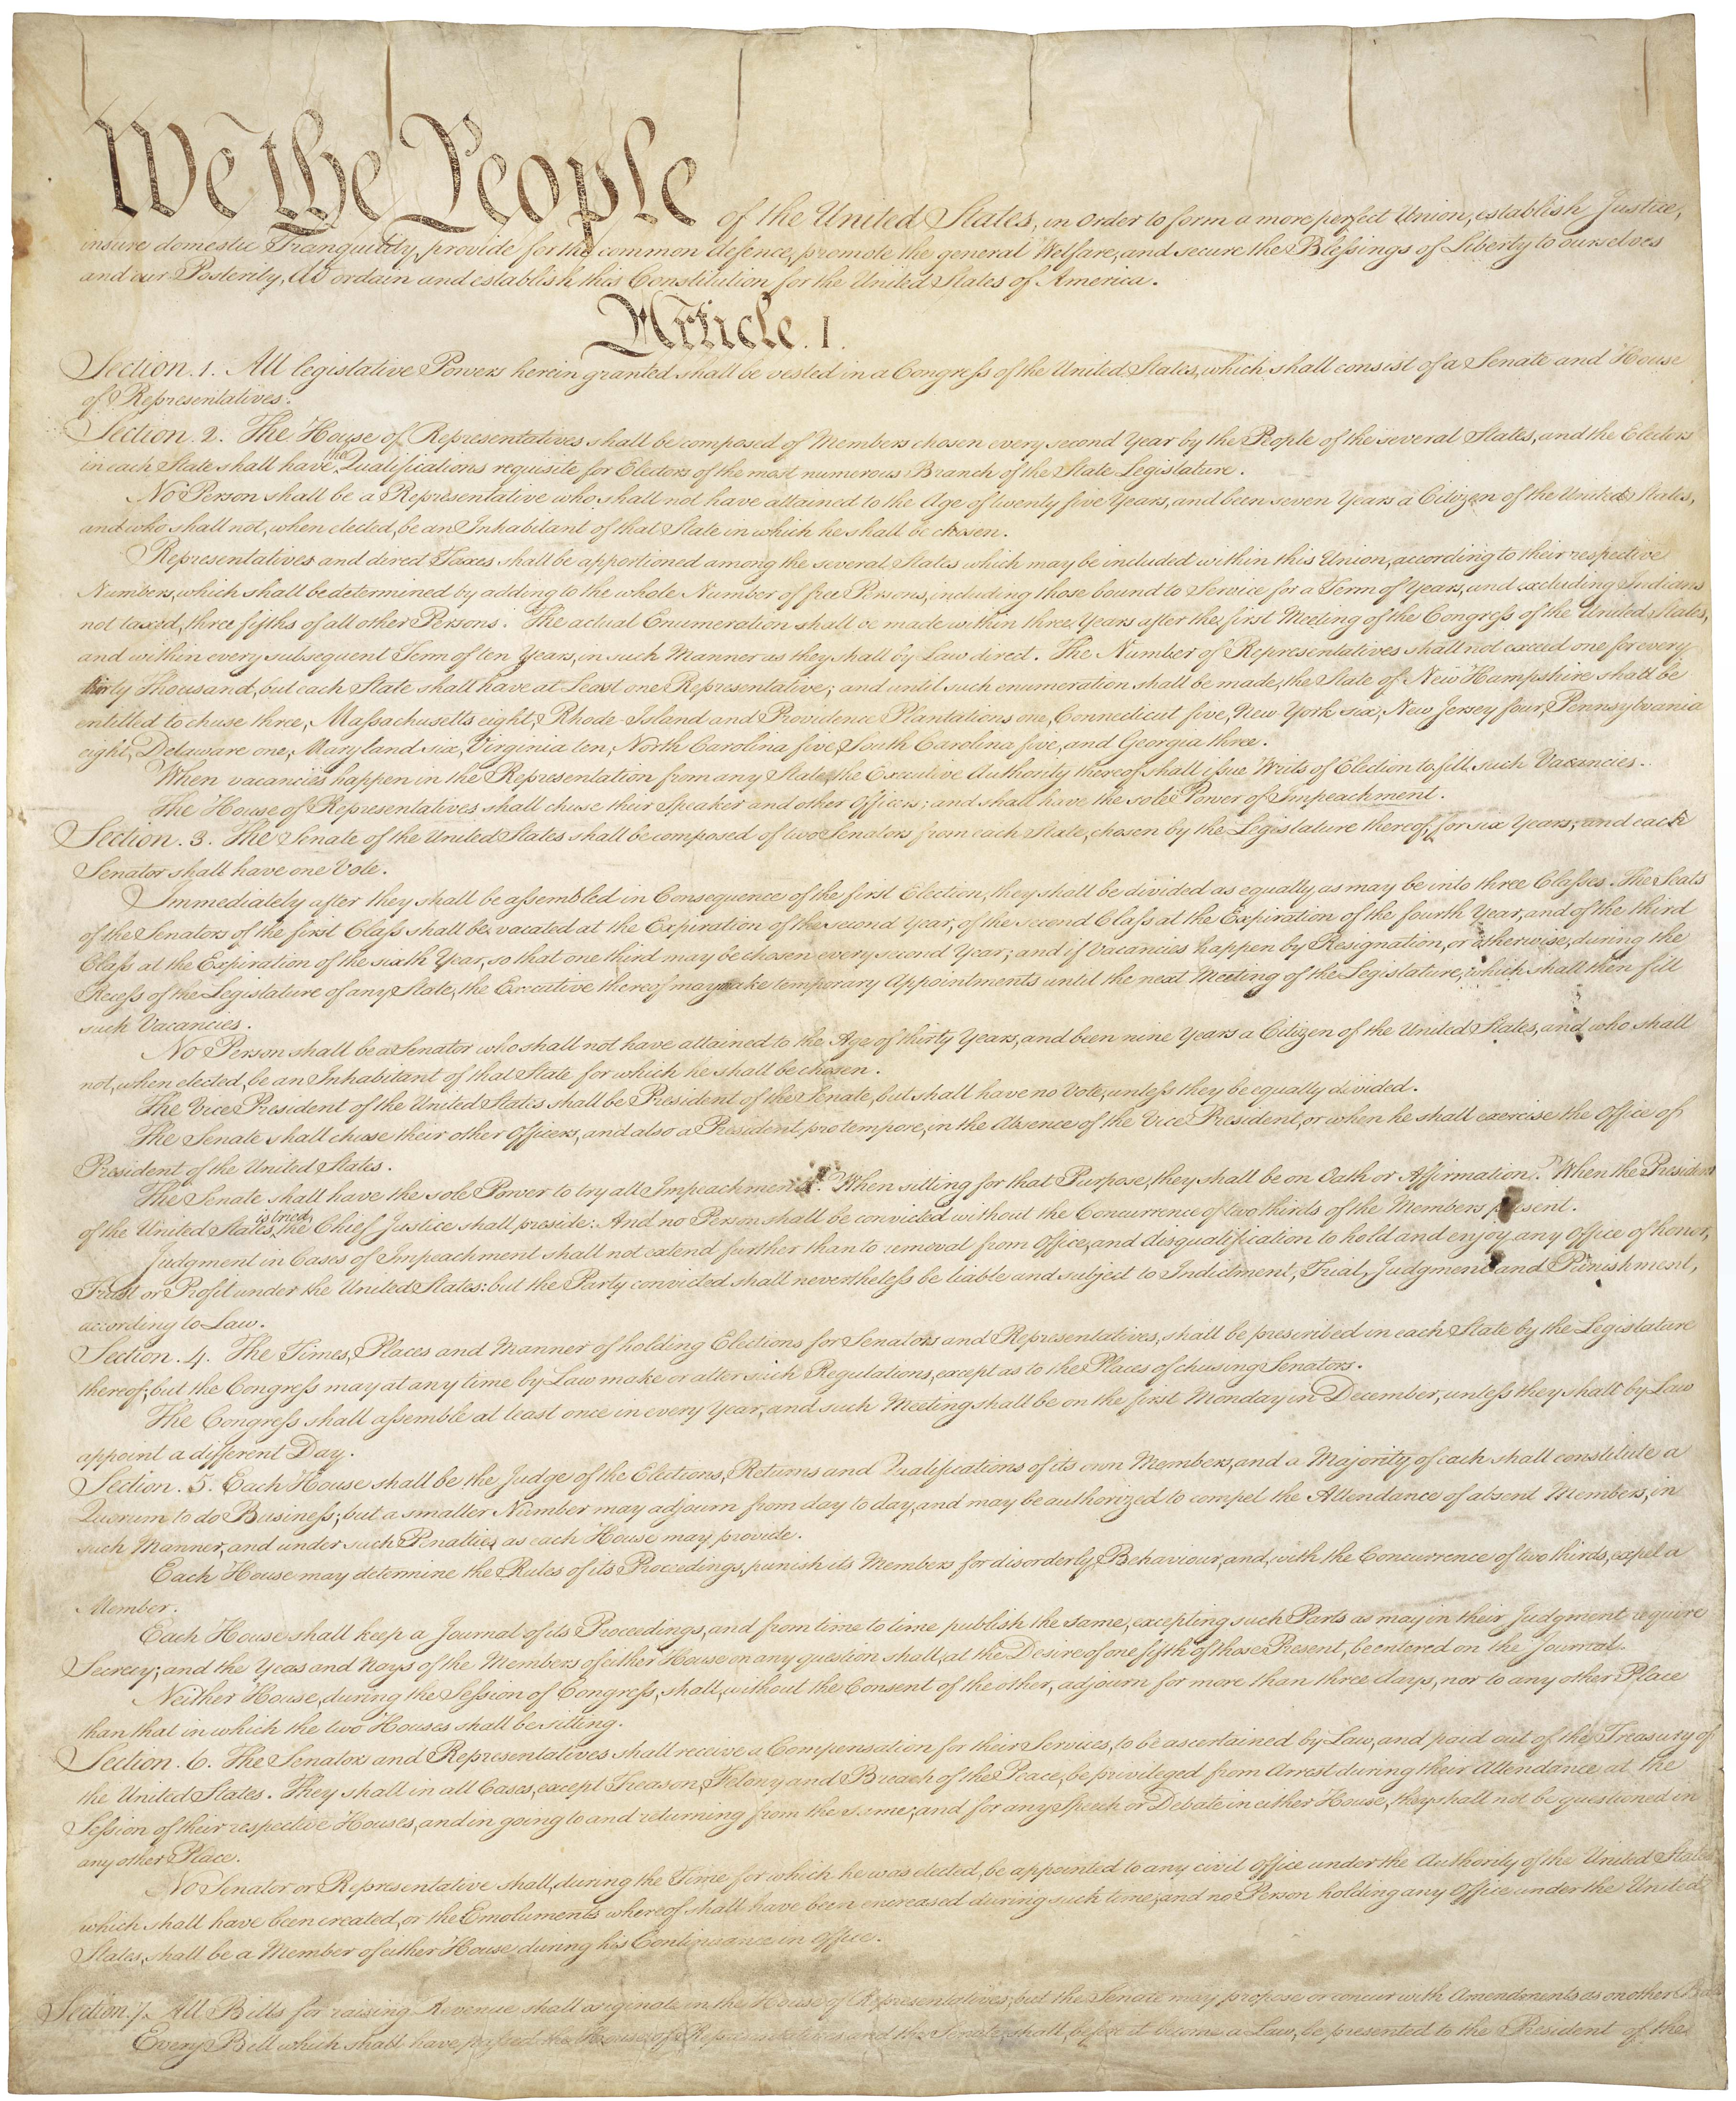
Original ideas?
A nation’s political documents are often influenced by philosophical theories. New ideas or ways of thinking are often integrated into a nation’s founding and development.
Our political documents were influenced by philosophical theories. Our political documents include:
US Constitution
Declaration of Independence
Bill of rights

Slide 4
Self-Government
The colonies rebelled and declared independence from Britain in 1776. However, the colonies had been practicing limited forms of self government since the 1600s.
Each of the thirteen colonies had a charter, or written agreement between the colony and the king of England or Parliament.
Charters of royal colonies provided for direct rule by the king
Self-government: government under the control and direction of the inhabitants of a political unit rather than by an outside authority (Merriam-Webster)
The concept of self-government means that people are able to exercise the necessary functions of government without intervention from any authority which they can not alter.

Slide 5
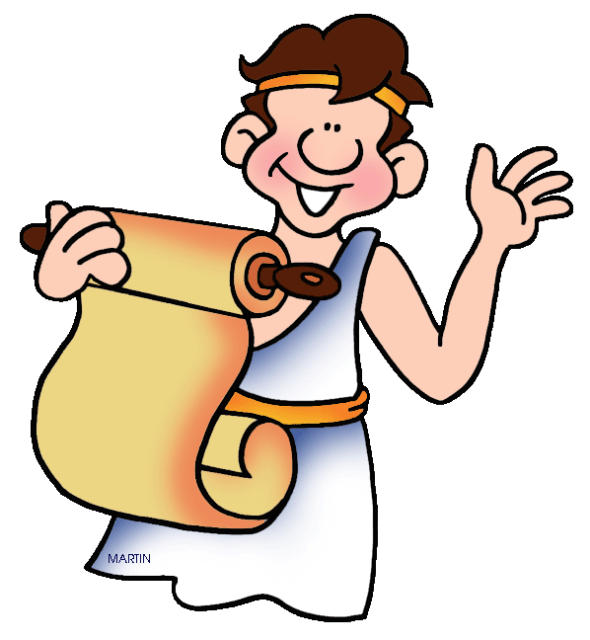
Self Government
Early examples of self government include Greece and Rome.
Ancient Greece
Assembly
Council of 500
Courts
Roman Republic
Senate
Popular Assembly
Magistrate

Slide 6
Self government in colonies
House of Burgesses: First elected body of representatives in the New World; 1619
Mayflower Compact: First agreement for self-government; 1620
Set a powerful precedent of making their own rules that later reflected itself in the town meetings that were held across colonial New England.
Fundamental Orders of Connecticut: First constitution in the New World; 1636
Government is based in the rights of an individual
Albany Plan of Union: Proposal by Benjamin Franklin to organize the colonies into one government; 1754

Slide 7
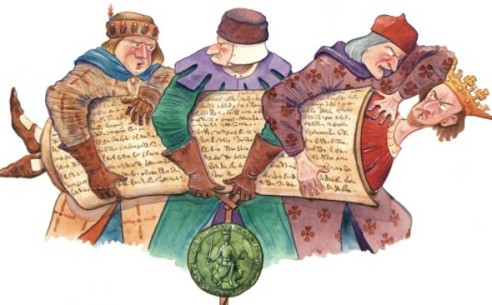
British influence
Britain also served as a role model for certain aspects of American government.
There is an unwritten British constitution that consists of common law, acts of parliament, and political customs and traditions.
There are are also British documents that were influential in the development of the British constitution.
Magna Carta
English Bill of Rights
Declaration of the Rights of Man

Slide 8
British influence
Parliament: The king who followed John to the throne, met regularly with a group of nobles and Church officials to seek their advice. This group became known as Parliament
The lawmaking body of Great Britain.
Bicameral: House of Lords and House of Commons
Head of government is Prime Minister, usually chosen from the political party that holds the most seats in the House of Commons.
Common law: the body of law developed in England primarily from judicial decisions based on custom and precedent, unwritten in statute or code, and constituting the basis of the English legal system
Different than statutory law

Slide 9
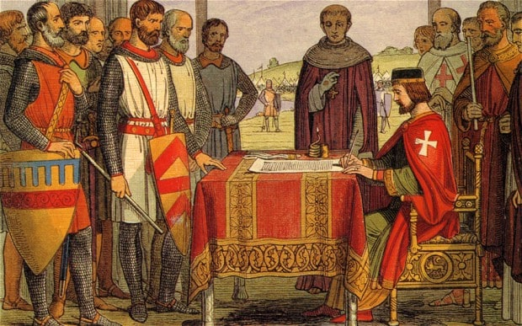
British influence
Magna Carta: A document delineating a series of laws establishing liberties which limited the absolute authority of the King of England and became the basis for the rights of English citizens.
Signed by King John in 1215
Abuses by King John caused a revolt by nobles who compelled him to formally recognize rights for both noblemen and ordinary Englishmen.
Established the principle that no one, including the king or a lawmaker, is above the law
English Bill of Rights: An act of Parliament declaring the rights and liberties of the people
The Bill of Rights combined past grievances against the king with a more general statement of basic liberties

Slide 10
Analyzing a primary source
Follow the same procedure we used in class to analyze the Magna Carta and analyze the English Bill of Rights.
Writing Prompt: How was the government of the United States influenced by the Magna Carta and English Bill of Rights? Provide at least two examples
Your writing MUST contain a topic sentence, at least two supporting details, and a concluding sentence.

Slide 11
Bellringer
Do people have a responsibility to follow their government? Why or why not?

Slide 12
Enlightenment
Age of Reason – Period in the 1600-1700s in Europe of new and old ideas.
Main Philosophers
John Locke
Thomas Hobbes
Montesquieu
Rousseau
Voltaire
American colonists brought with them knowledge of Enlightenment theories and these theories impacted our government.

Slide 13
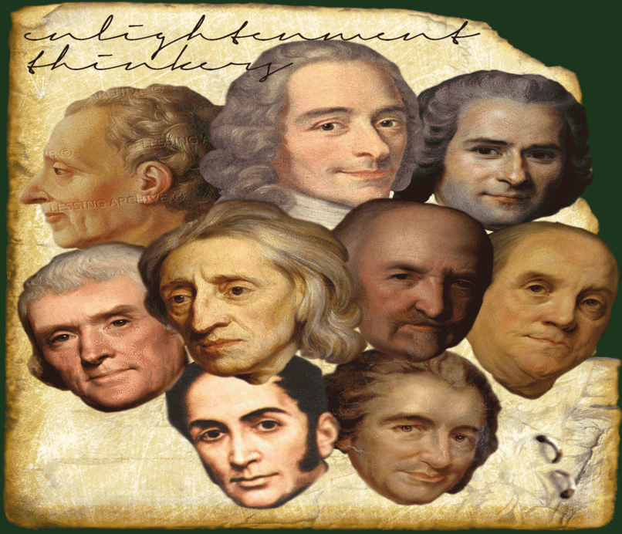
Enlightenment thinkers
John Locke
Natural rights: life, liberty, ownership of property
Social contract: between government and citizens; government protects rights and if government fails, people replace it.
Consent of the governed
Thomas Hobbes
Believed absolute monarchy was the best form of government
Social contract: gave up rights for protection
Montesquieu
Government divided into 3 branches
Checks and balances
Rousseau
Equality of citizens
Voltaire
Separation of church and state

Slide 15
Writing prompt
Which Enlightenment philosopher had the greatest impact on the United States government? Provide specific examples

Slide 16
Writing prompt
Select one of the following fundamental principles of American government.
Rule of Law
Consent of the governed
Inalienable rights
Describe how this principle is reflected in our government and where the idea originates.

Slide 17
Bellwork
How did the Enlightenment influence the American Revolution?

Slide 18
Revolution
American Revolution and Declaration

Slide 19
Revolution Assignment
With your partner, you will be assigned an event from the American Revolution.
Together, you will figure out the Who, What, When, Where, and Why of your specific event.
At the end, we will combine what we found to make a timeline of the events leading up to the American Revolution.

Slide 20
Topics
1 – Stamp Act
2 – Common Sense
3 – Boston Tea Party
4 – Battle of Lexington & Concord
5 – French & Indian War
6 – Boston Massacre
7 – Intolerable/Coercive Acts
8 – Tea Act
9 – Quartering Act
10 – Navigation Acts
11 – Glorious Revolution
12 – Townshend Acts
13 – Currency Act
14 – Sugar Act
15 – Salutary Neglect
16 - The Great Awakening

Slide 21
Bellwork
What is the purpose of the Declaration of Independence?
(Do not write to declare independence)

Slide 22
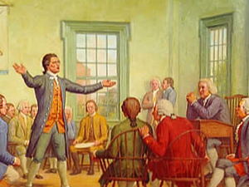
First continental Congress
Organized in September 1774 to determine how to respond to the crisis in Massachusetts and other abuses by British authorities.
Delegates recommended continued boycott of British goods and warn colonial militias.
Assembled a list of 10 resolutions to present to King George III stating what the Congress considered to be the colonists’ rights.
Agreed to meet in May 1775 if the king did not acknowledge these rights.
King refused to consider the colonists’ demands and ordered troops to prepare to seize the colonists’ weapons.

Slide 23
Second continental congress
Met in May 1775 in Philadelphia
Voted to create the Continental Army
George Washington was appointed commanding general
Approved the Declaration of Causes outlining the reasons for taking up arms against Britain.
Tried to restore peace. Delegates signed the Olive Branch Petition requesting peace. King rejected the petition.

Slide 24
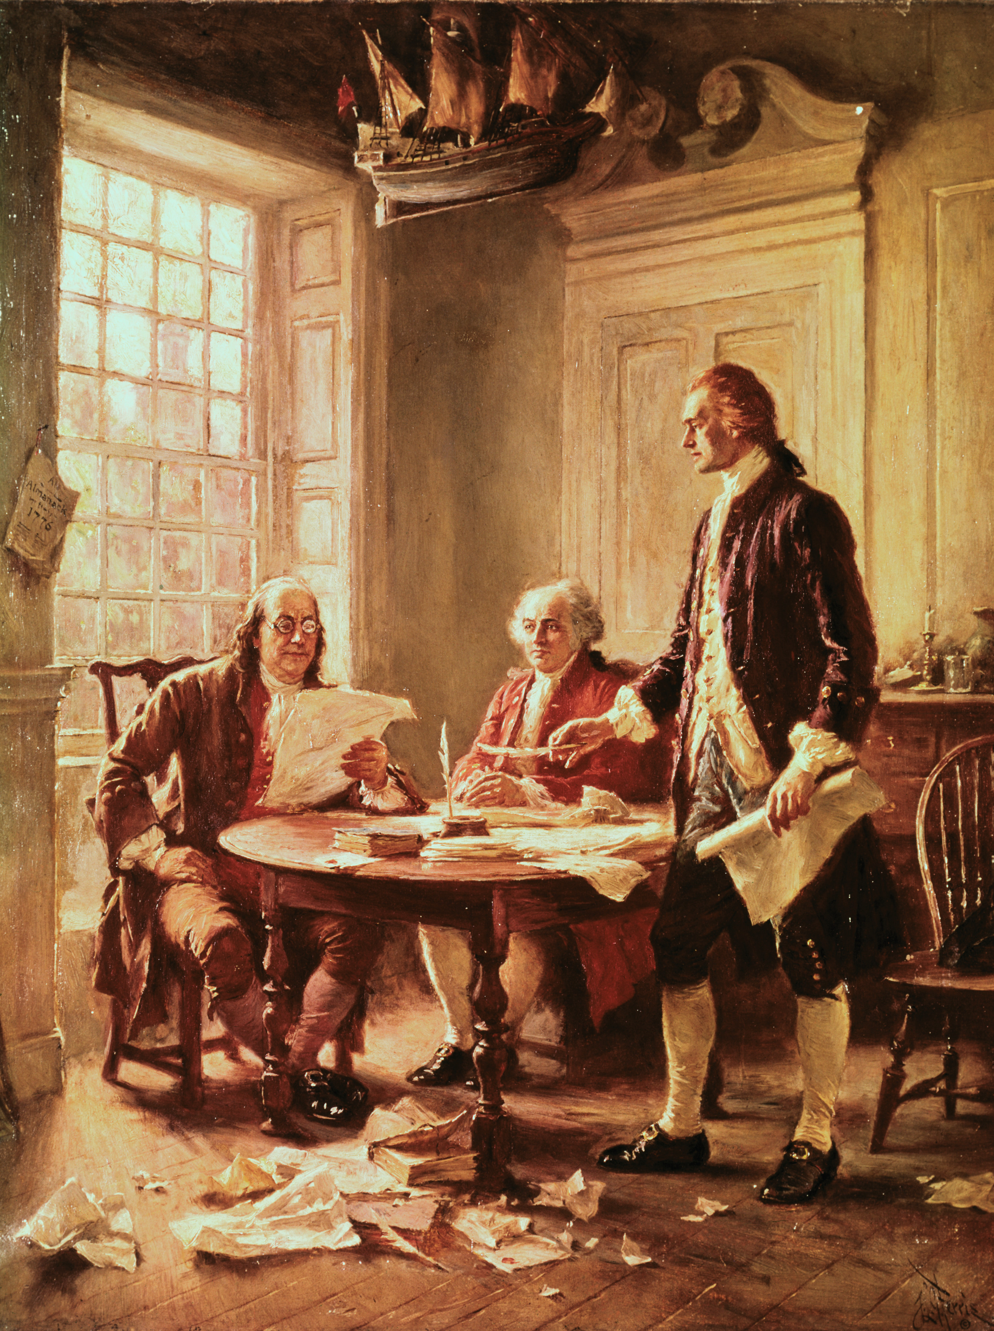
Declaration of independence
The Congress, acting as government for the colonies, appointed a committee to write a document that would announce the independence of the United States.
Based on the idea of egalitarianism
Believing in the principle that all people are equal and deserve equal rights
Jefferson wrote the first draft of the Declaration
John Adams and Benjamin Franklin were a part of the committee that drafted the Declaration.
It was voted on July 2 to declare independence

Slide 25
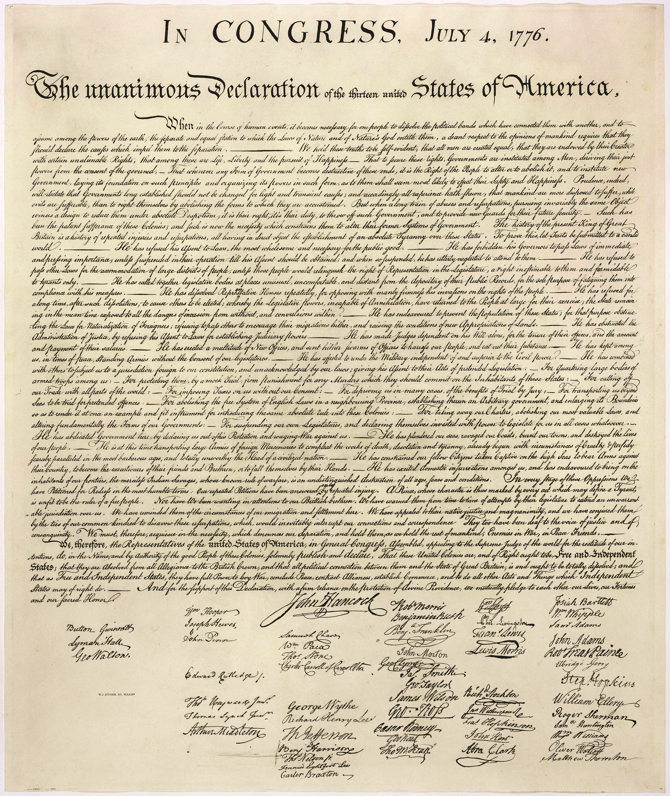
Declaration of independence
First Part - Preamble and philosophy
What is the goal of the writers?
Why are they writing this document?
What rights do they have?
What is the purpose of government?
Second Part - List of grievances
Third Part - Declaration of war; statement of independence
How did colonists try to address grievances earlier?
What words actually declare independence?
What rights to they now have?

Slide 26
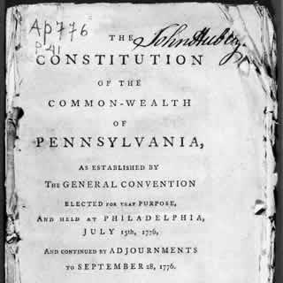
After independence
The states existed as 13 independent states with 13 different governments.
Very loose association of the 13 states; no written national government structure
Every state wrote its own constitution (government institutions and limits)
Each state had a legislature, governor, and courts.
Most state constitutions had a bill of rights

Slide 27
Bellwork
What problems does the newly formed United States face after the revolution?

Slide 28
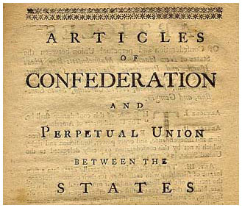
Articles of confederation
In 1777 the Continental Congress adopted a plan of government, The Articles of Confederation.
The Articles were approved in 1781 by all 13 states.
The American Revolution ended in 1783. With the Treaty of Paris of 1783, Great Britain recognized the independence of the United States.
The states were now a confederation called the United States of America.

Slide 29
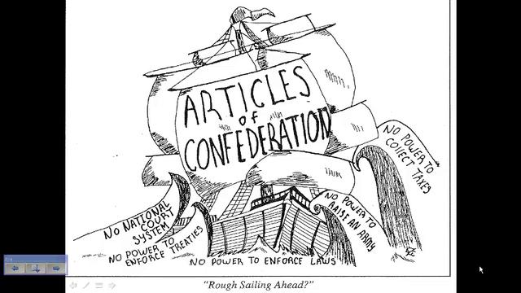
Articles of confederation
First constitution of the United States
The central government had very limited powers due to the states’ fear of a strong central government.
Set up a one house legislature with each state getting one vote.
Congress had control over the army and authority to deal with foreign countries.

Slide 30
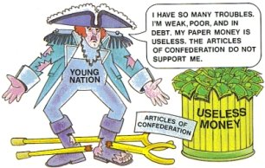
Weaknesses of Articles
Lacks of Power and Money
Congress had no power to collect taxes
Congress had no power to regulate trade
Congress had no power to enforce its laws
Lack of Central Powers
No single leader of group directed government policy
No national court system existed
Rules too Rigid
Congress could not pass laws without the approval of nine states
The Articles could not be changed without the agreement of all 13 states.

Slide 31
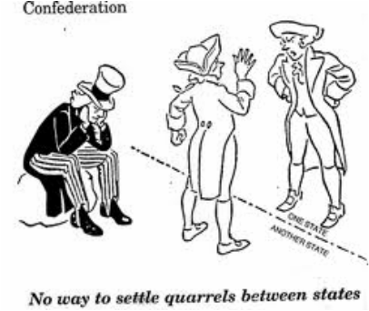
Problems Faced
Quarrels over boundary lines
Disputes over trade
Unable to collect taxes, the Congress had to borrow money to pay for the Revolutionary War.
State governments fell into debt.
They taxed their citizens heavily
Taxed goods from other states and foreign countries
Shays’ Rebellion - 1786
Daniel Shay, a farmer in Massachusetts, had fallen into debt due to high taxes. When the courts threatened to take his farm as payment, he felt the state had not right to punish him.
He led and armed uprising of 1200 famers.

Slide 33
Shays’ Rebellion
Shay’s Rebellion was an armed uprising in Massachusetts led by farmers in 1786 against the treatment of debtors.
As a result of inability to pay taxes and debts, many farmers had their land seized and some were thrown in jail
The farmers in western Massachusetts organized their resistance in ways similar to the American Revolutionary struggle. They called special meetings of the people to protest conditions and agree on a coordinated protest.
This led the rebels to close courts by force in the fall of 1786 and to liberate imprisoned debtors from jail.
They came under the leadership of Daniel Shays.

Slide 34
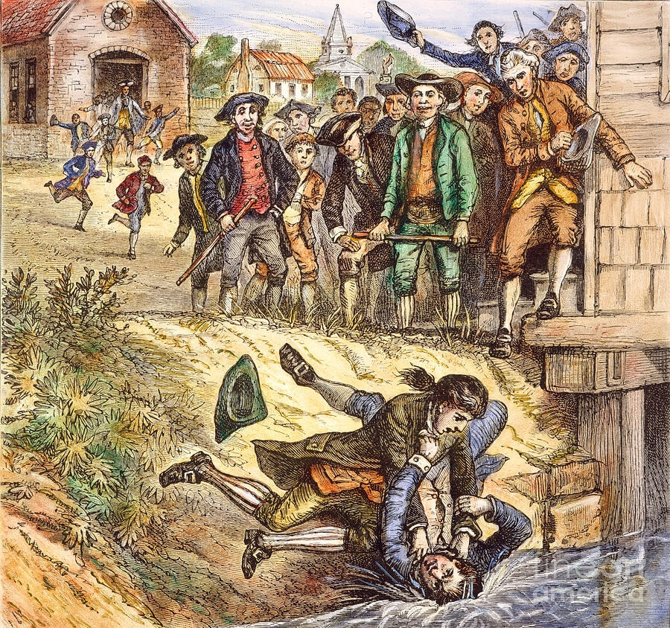

Slide 35
Shays’ rebellion
Protests were able to shut down courts and legislative action was unsuccessful and stopping protests.
Since the federal government was unable to recruit soldiers for the army, Massachusetts created a privately funded army that was able to quash the rebellion.
Shays’ Rebellion served as an indicator of the weakness of the Articles of Confederation and the need to have a stronger federal government.

Slide 36
True of false: aoc
1. The Articles of Confederation created a President to lead the country.
2. States were still independent under the Articles.
3. The Articles were easy to change.
4. Under the Articles of Confederation, the more people a state had, the more votes it got in Congress.
5. The Congress created by the Articles did not have the power to collect taxes.
6. Under the Articles, states had to obey the laws Congress passed.
7. The Articles of Confederation created the first American government

Slide 37
Constitutional convention
In 1787, 12 of the states sent delegates to a meeting in Philadelphia to revise the Articles of Confederation
Each state was asked to send a representative
The 55 men that met were well educated
George Washington presided over the convention.
Participants agreed to keep discussions secret in order to be able to speak freely.
Madison’s journals reveal the proceedings.
They ended up discarding the Articles and writing a new constitution.

Slide 38
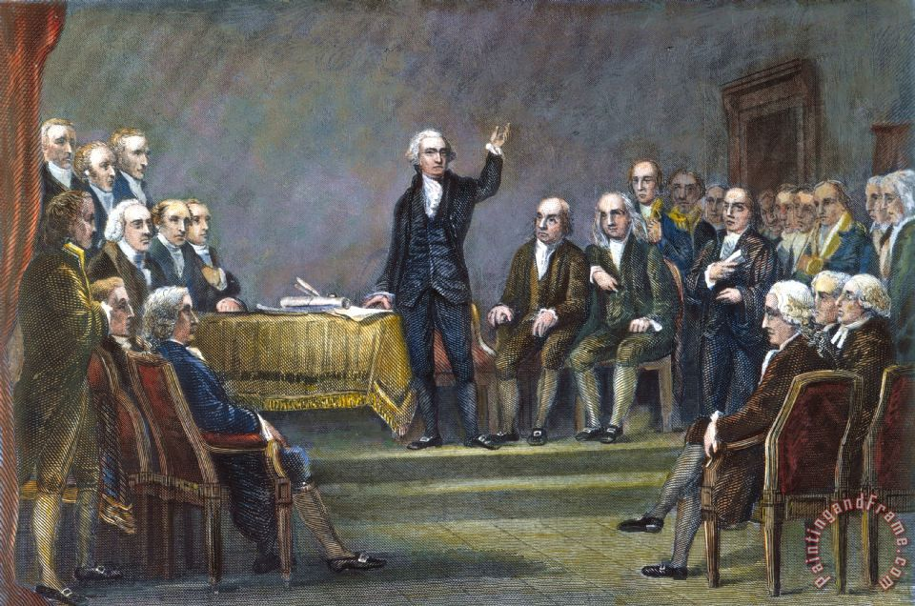

Slide 39
Constitutional Convention
Met to fix the flaws surrounding a weak central government.
Issues include: representation, slavery, and economics
Plans for Representation: Virginia Plan and NJ Plan
Virginia Plan: written by James Madison (Father of Constitution)
3 Braches (Legislative, Executive, Judicial)
Bicameral legislature (2 houses) based on population (proportional representation)
New Jersey Plan:
3 Branches
One house; Equal voting between states

Slide 40
Three Compromises
Great Compromise: Connecticut Plan
bicameral legislature with one house based on population and the other based on state equality
House of Representatives and the Senate
3/5 Compromise: for every 5 slaves a state had, 3 people added to population count
Benefited southern region the most with representation in the House of Representatives
Electoral College: President not directly elected by citizens
Done by delegates; each states’ number of Electoral votes equals its US representatives + US Senators
NC has 15

Slide 41
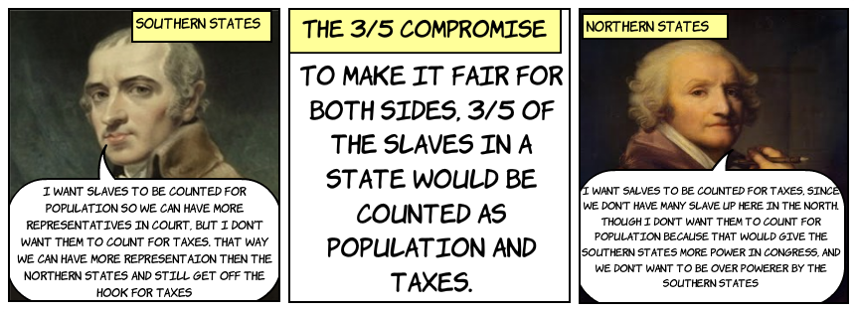

Slide 42
New government
Stronger central government
3 Branches of government/ Separation of Powers
Legislative (makes laws)
Gained the power to tax and regulate trade
Necessary and Proper Clause or Elastic Clause
Executive (enforces laws)
Judiciary (interprets laws)
Checks and Balances
Congress proposes laws, but President can sign or veto law. However, 2/3 of Congress can override President’s veto
Judicial branch makes sure laws passed by Congress and enforced by President are done according to Constitution
Federal Justices are appointed by President, and are confirmed by the Senate.

Slide 43
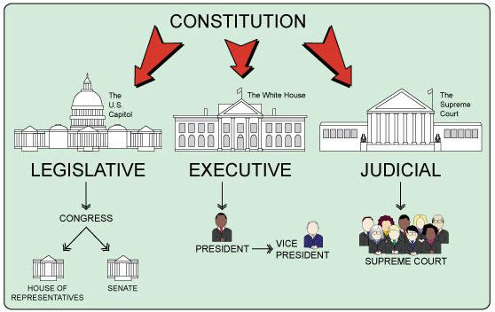

Slide 44
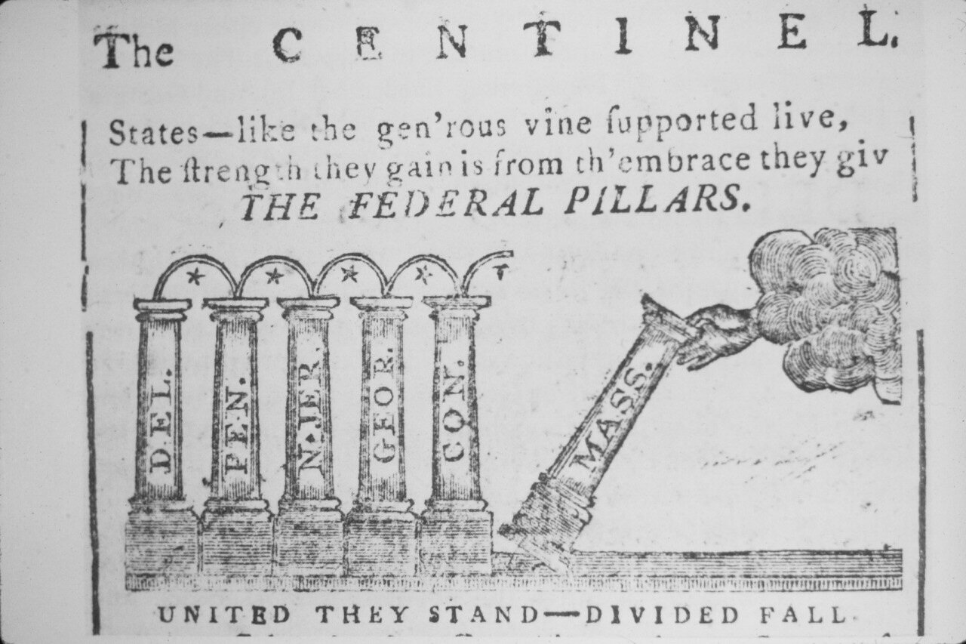
Ratification
On September 17, 1787 the Constitution was signed by 39 of the framers.
The next step was ratification.
Article VII:
“The Ratification of the Conventions of nine States, shall be sufficient for the Establishment of this Constitution between the States so ratifying the Same.”

Slide 45
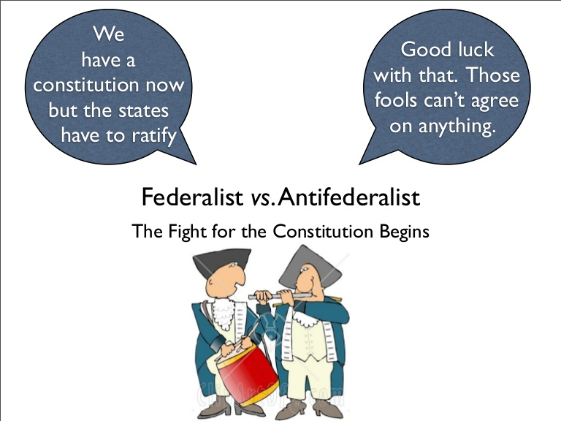
Federalists/antifederalists
Americans reacted differently to the the Constitution.
Constitution created a system of Federalism
Power is divided between national government and the states
Supporters called themselves Federalists.
Those who opposed the Constitution were the Anti-Federalists.

Slide 46
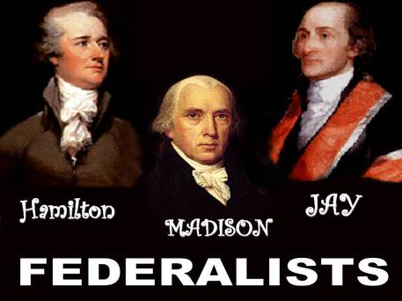
Federalists
Strong national government needed to unite the nation
Felt Separation of Powers/Checks and Balances would prevent government from getting tyrannical
Believed in a loose interpretation of the Constitution: national government could do what Constitution “meant”
Wrote the Federalist Papers to encourage acceptance and ratification of the Constitution
Federalists include:
Alexander Hamilton
John Jay
James Madison

Slide 47
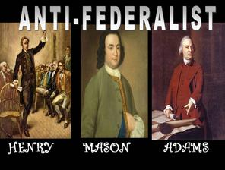
Anti-federalists
Felt the Constitution gave too much power to the national government and took too much away from the states
Wanted more protection for states’ and people’s rights
Believed in a strict interpretation of the Constitution: government can only do what Constitution says.
Anti-Federalists include:
Samuel Adams
James Monroe

Slide 50
Ratification
The Federalists eventually agreed with the Anti-Federalists that a bill of rights was a good idea.
They promised that if the Constitution was adopted, the new government would add a bill of rights.
On June 21, 1788, New Hampshire became the ninth state do vote for ratification and the Constitution took effect in 1789.

Slide 51
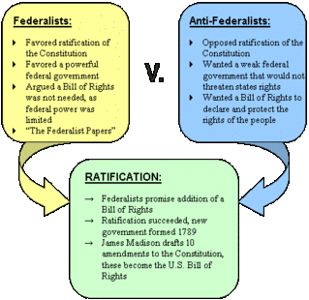

Slide 52
Modern controversies
Redistricting/ Gerrymandering
Majority Rules v. Minority Rights
Same sex marriage
Health Care
Security v. Civil Liberties
Right to bear Arms v. Gun Control
Strict versus loose constructionist views of interpreting the Constitution

