Slide 1
Unit 2: The Constitution
Bill of Rights

Slide 2
Parts of the Constitution
The Constitution is made up of three parts
Preamble
Articles
Amendments
There are 27 amendments
Article V outlines the process for amending the Constitution.

Slide 3
Article V: Amendments
An amendment may be proposed in one of 2 ways:
Congress can propose an amendment by 2/3 vote in both houses
Legislature of 2/3 of the states (34 out of 50) can ask Congress to call a national convention to propose an amendment.
An amendment must then be ratified in one of 2 ways:
The proposed amendment can be sent to state legislatures for approval by ¾ of the states
Proposed amendment can be sent to state conventions for consideration and approval by ¾ of the states
If the people do not like the effects of an amendment, another amendment can be passed to repeal it.
1933: 21st amendment was passed to repeal the 18th

Slide 5
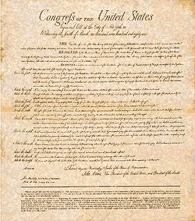
Bill of Rights
The Bill of Rights are the first 10 amendments to the United States Constitution. They were proposed to calm any fears of the anti-federalists.
The amendments were ratified in 1791
These amendments grant personal freedoms, limit government power, and reserve some powers to the state.
Initially the amendments only applied to the federal government, however most provisions apply to the states through incorporation by the 14th amendment.
Examine the Bill of Rights in you textbook – pg 70

Slide 6
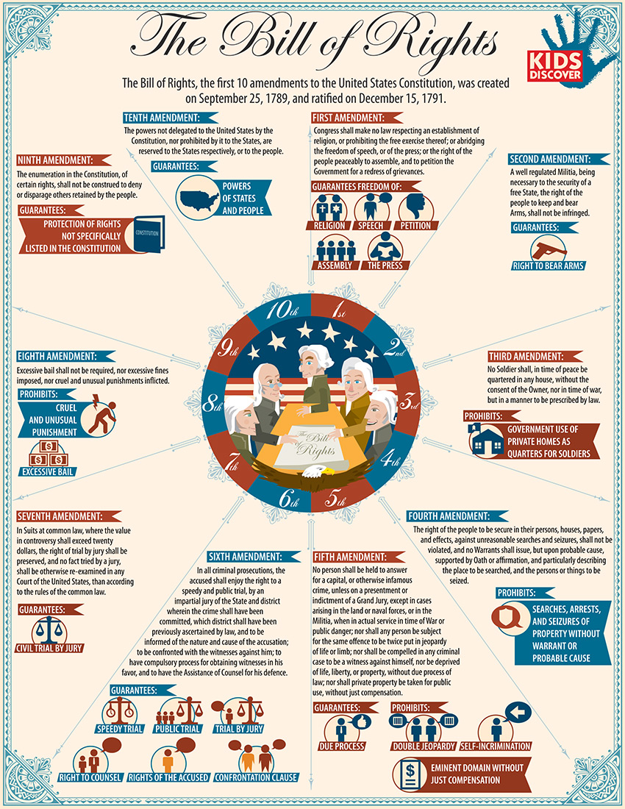

Slide 7
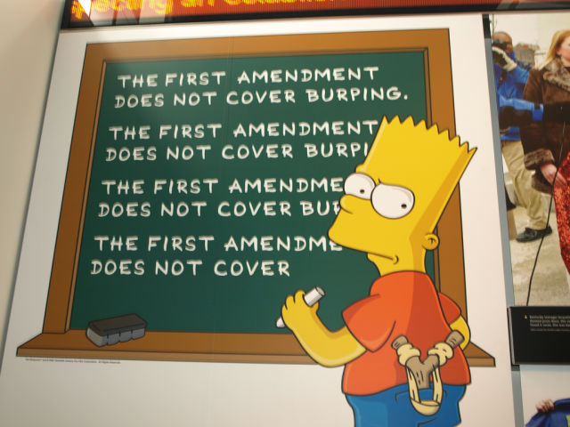
First Amendment
Freedom of Religion
Establishment clause: Congress cannot establish an official religion nor favor one religion over another
Free exercise clause: right to practice any or no religion
Freedom of Assembly
Freedom to hold peaceful meetings
Freedom of Speech
Right to express ideas and opinions
Time, place, and manner restrictions
Freedom of Press
Right to express ideas in writing
Excludes libel
Freedom of Petition
The right to ask your government to address your concerns

Slide 8
Protecting Citizens
Second Amendment
“A well regulated Militia, being necessary to the security of a free State, the right of the people to keep and bear Arms, shall not be infringed.”
Created to ensure that state militias would continue as an armed means of defense and to ensure that individual citizens had a right to own a firearm.
Third Amendment
“No Soldier shall, in time of peace be quartered in any house, without the consent of the Owner, nor in time of war, but in a manner to be prescribed by law”

Slide 9
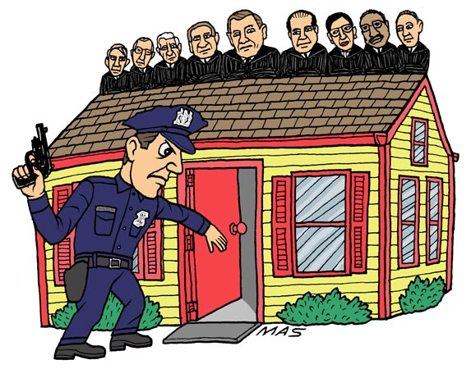
Rights of the Accused
Fourth Amendment
“The right of the people to be secure in their persons, houses, papers, and effects, against unreasonable searches and seizures, shall not be violated, and no Warrants shall issue, but upon probable cause, supported by Oath or affirmation, and particularly describing the place to be searched, and the persons or things to be seized”
Protects citizens from unreasonable searches and seizures
Generally, a search is only reasonable if there is a warrant

Slide 10
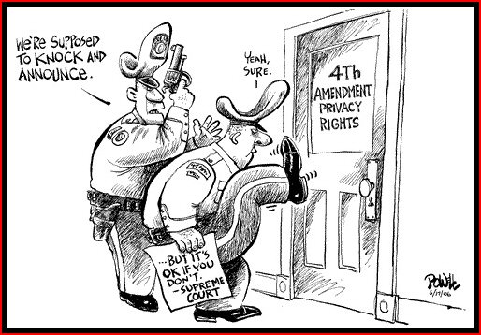

Slide 11
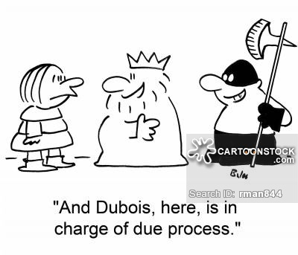
Rights of the Accused
Fifth Amendment
Grand jury indictment
Protection from self-incrimination
Double jeopardy
Due process – no person can be denied life, liberty, or property without due process of the law
Government can not take private property without giving the owner fair payment
Government does have the right of eminent domain – taking private property for public use

Slide 12
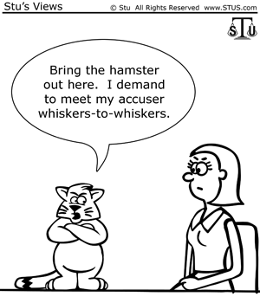
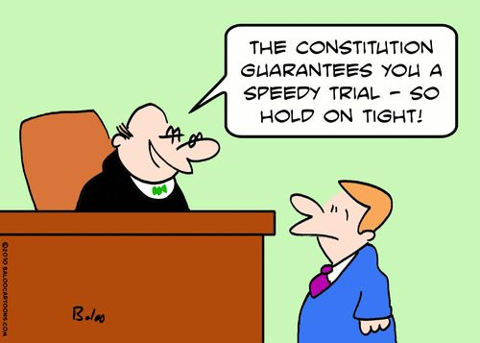
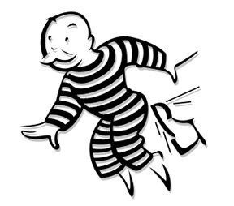
Rights of the Accused
Sixth Amendment
Right to a fair and speedy trial
Right to an attorney
Right to confront witnesses
Right to jury trial in a criminal case
Seventh Amendment
Jury trial in civil cases
Eighth Amendment
Excessive bail shall not be required, nor excessive fines imposed, nor cruel and unusual punishments inflicted

Slide 13
Rights of States and Citizens
Ninth Amendment
“The enumeration in the Constitution, of certain rights, shall not be construed to deny or disparage others retained by the people”
Implies that Americans enjoy basic rights not listed in the Constitution; “Power to the people”

Slide 14
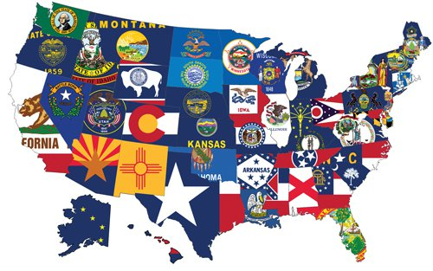
Rights of States and Citizens
Tenth Amendment
“The powers not delegated to the United States by the Constitution, nor prohibited by it to the States, are reserved to the States respectively, or to the people”
Powers not specifically given to the federal government nor forbidden to the states, belong to the people or the states.
Power to the states

Slide 15
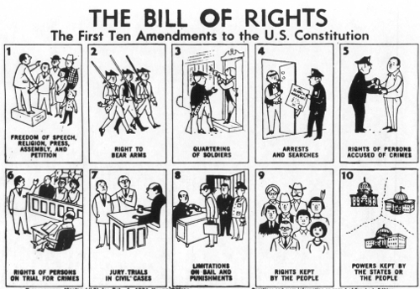

Slide 16
Since All Questions Seem Difficult, Study To Begin Passing Exams
Free Speech
Bear Arms
Quartering soldiers
Search and seizure
Due process
Speedy trial
Trial by jury in civil
Excessive bail or punishment
Protects unwritten rights of the people
Extra powers belong to the people

