Slide 1
Unit 2: The Constitution

Slide 2
Bellwork
If you were alive in 1787 would you have supported the Federalists or the Anti-Federalists? Why?

Slide 3
The Constitution
A constitution is a set of laws that people accept as fundamental and basic to the structure and operation of their government.
Our Constitution came into effect in 1789. It is still in effect today.
James Madison is considered to be the father of the Constitution.
  Heavily involved in drafting Constitution
  Co-author of the Federalist Papers
  Co-father of the Bill of Rights
The Constitution is a living document. It is still in effect today and still debated today.

Slide 4
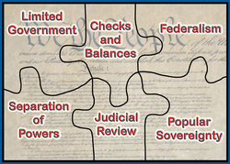
6 Fundamental Principles
Within the Constitution there are six fundamental principles.
These are:
  Popular Sovereignty
  Limited Government/Rule of Law
  Federalism
  Checks and balances
  Separation of Powers
  Judicial Review

Slide 5

Popular Sovereignty
Popular sovereignty: government by consent of the governed.
The idea that the government of the United States gets its power from the American people.
“…do ordain and establish this Constitution.” Government once established by the free choice of the people, then serves the people, who have supreme power.

Slide 6
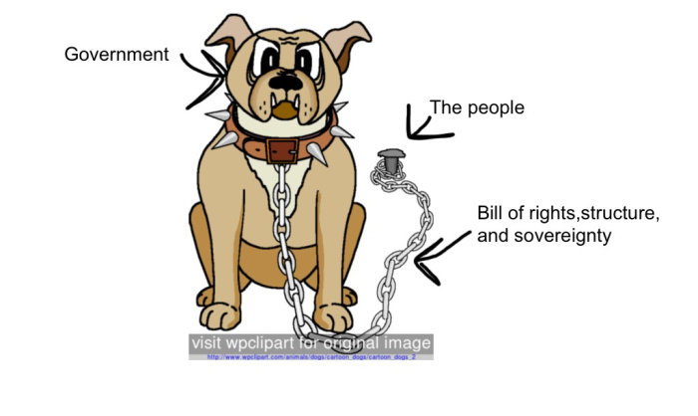
Limited Government
Limited government – one with specific restrictions on its power.
  Prior to the Magna Carta in 1215, the king had unlimited power.
The Constitution sets those limits so that citizens know what their government is allowed to do and what it is not allowed to do.

Slide 7
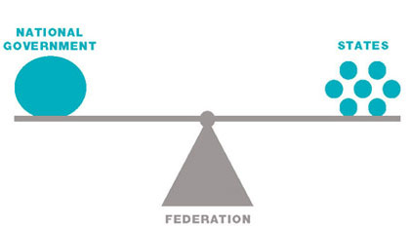
Federalism
The government is based upon federalism – the sharing of power between the national and state government.
The founders needed a strong federal government, but wanted to keep independent state governments to preserve self-government.
The top layer is the national government, or federal government, which makes laws for the nation. The second layer is the state governments. Each state government has authority only over the people who live within that state.
There are certain powers that each level has. Some powers are exclusive, while others are shared.

Slide 8
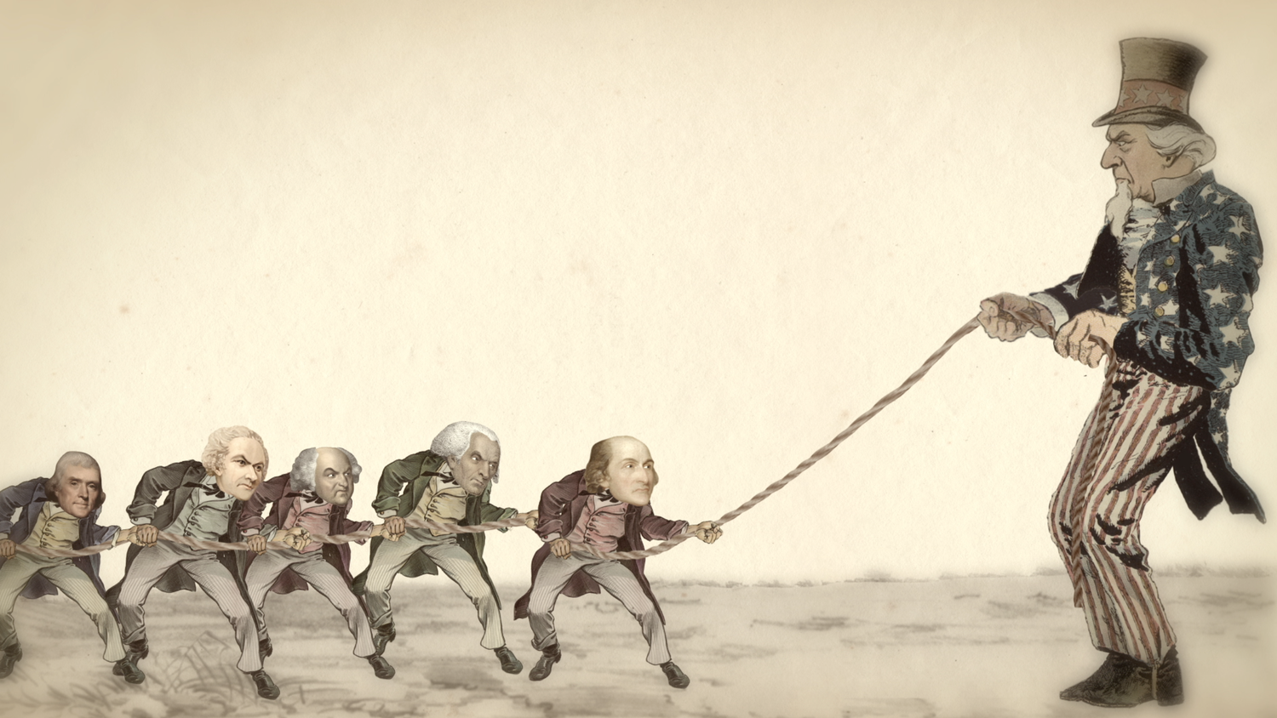
Federalism
The powers the Constitution specifically gives to the federal government are called delegated powers.
  Print money
  Control trade with other nations
  Provide for the country’s defense
The states, or the people, have all the powers that the Constitution does not give specifically to the federal government. These are known as reserved powers because they are set aside for the states.
  Elections
  Marriage
  Education

Slide 9
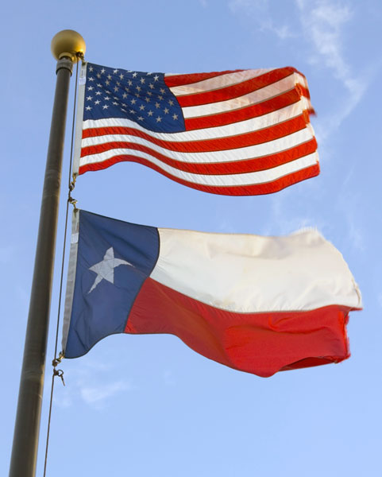
Federalism
The federal and state governments also share many powers. These powers are known as concurrent powers.
  Raise money through taxes
  Establish courts
  Enforce laws
What happens when a state law disagrees with the Constitution or with a federal law?
  The state law is invalid.
Supremacy clause: the Constitution and the laws of the federal government shall be the supreme law of the land.

Slide 10
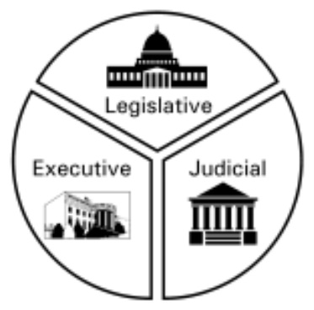
Separation of Powers
Having all government power in the same hands is “the very definition of tyranny,” according the father of the Constitution.
Separation of powers consists of a division of power among three branches of government.
It was created to prevent one group of people from having all of the power in the federal government.
The powers of one branch may not be exercised by another branch.

Slide 11

Three Branches of Government
Legislative: the lawmaking arm of the federal government.
Executive: part of government that carries out/executes the laws
Judicial: arm of government that interprets the laws

Slide 12
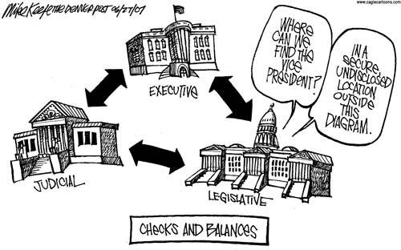
Checks and Balances
The framers provided a balance of power in the US Constitution by giving each government branch powers that limit the powers of the other branches.
This ensures that no branch of the federal government becomes too strong.

Slide 13
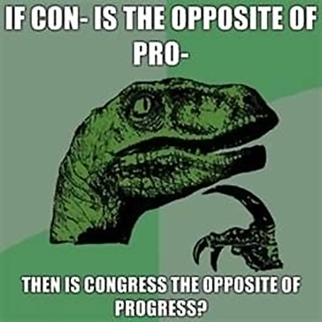
Check on Executive
  Legislative: impeach and remove president; override veto; Senate can refuse to confirm presidential appointments
  Judicial: Declare executive acts unconstitutional; judges appointed for life free from executive control
Check on Legislative
  Executive: can veto; can call special sessions; can suggest laws
  Judicial: can declare acts unconstitutional
Check on Judicial
  Executive: appoints federal judges; grant pardons
  Legislative: impeach and remove federal judges; established lower courts

Slide 14
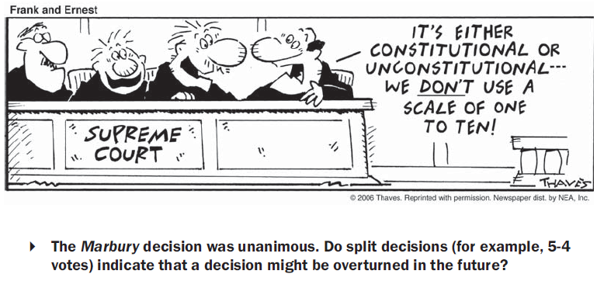
Judicial Review
The Supreme Court can check the powers of the other branches by deciding whether a law or act of the executive is constitutional.
Acts that conflict with the Constitution are not law and the courts are not bound to follow it.
Established by Marbury v. Madison

Slide 15
Marbury v. Madison
What legal principle gave Marbury a right to some remedy under law?
What reason did Justice Marshall give for refusing to hear the Marbury case?
Why is Marbury v. Madison important to the role of the Supreme Court?
What effect did Marbury v. Madison have on the system of checks and balances?

Slide 16
Political Cartoon Analysis?
Artist’s viewpoint
  What is the subject
  How is it portrayed
Symbols
Captions
Humor and Satire
  Caricature
  Satire
  Stereotype
Historical Images

Slide 17
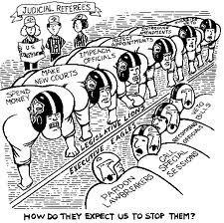

Slide 18
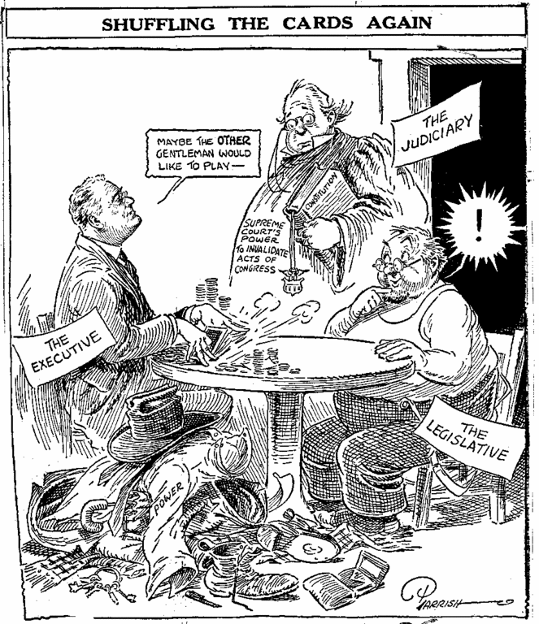

Slide 19
Bellwork
Why do we need a preamble for the constitution?

Slide 20
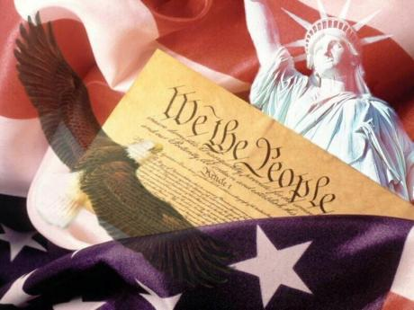
The Constitution
Made up of three main parts:
  Preamble
  Articles
  Amendments
How the Constitution is divided
  Articles
    Section
      Clause

Slide 21
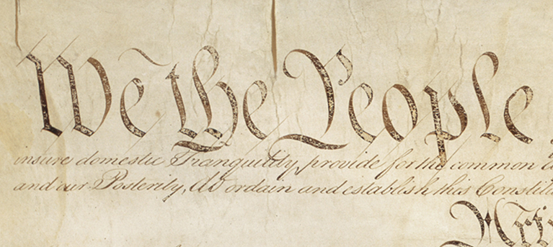
Preamble
The Preamble is an introduction that explains why the US Constitution was written.
Two main questions found in the Preamble
  Why are they writing it?
  What goals are to be reached?

Slide 22
Preamble
We the People of United States, in Order to form a more perfect Union, establish Justice, insure domestic tranquility, provide for the common defense, promote the general Welfare, and secure the Blessings of Liberty to ourselves and our Posterity, do ordain and establish this Constitution for the United States.

Slide 23
Bellwork
Why is the legislative branch the largest part of the constitution?

Slide 24
Articles of the Constitution
Article I: Legislative Branch
Article II: Executive Branch
Article III: Judicial Branch
Article IV: Relations among States
Article V: Amending the Constitution
Article VI: Supremacy of National Government
Article VII: Ratification

Slide 25
Article I Legislative Branch
House of Representatives
  435 members; based on population
  Term of 2 years
  Must be 25; reside in state in which elected; citizen for 7 years
  Voted on by people of the states
Senate
  2 senators per state
  Term of 6 years
  Must be 30; reside in state in which elected; citizen for 9 years
  Originally chosen by state legislatures until 17th amendment became elected by the people

Slide 26
Bellwork
Who has more power the House of Representatives or the Senate? Why?

Slide 27
Article I: Legislative Branch
Leadership
  Presiding officer of the House: Speaker of the House
  Presiding officer of Senate: Vice President; only votes if equally divided
Impeachment
  House: Sole power of impeachment
  Senate: Try impeachments; convicted official may be punished through removal and disqualification
The time, place, and manner of holding election for members of Congress is decided by the state legislature.

Slide 28
Bellwork
How do the president and congress interact? Why do they interact with each other more then the judicial?

Slide 29

Article I: Legislative Branch
Privileges and Restrictions
  Receive compensation
  Privileged from arrest during attendance at session
  Can not be sued for what is said on the floor
  Can not be appointed to civil office or have an increase in salary during term
Lawmaking process
  A bill must be passed in both houses and be presented to the president
  If the president does not sign the bill within 10 days (excluding Sundays) it will become law unless Congress is not in session
Bills of revenue must originate in the House.

Slide 30


Article I: Legislative Branch
Article I Section 8 sets out the powers of Congress. The powers specifically given to the federal government are called delegated powers.
  Power to lay and collect taxes
  Regulate commerce among foreign nations, the states, and Indian tribes
  Establish rules of naturalization – process to become a US citizen
  Coin money and fix the standard of weights and measures
  Declare war and raise an army and navy
  Make all laws that are necessary and proper to carry out such powers

Slide 31
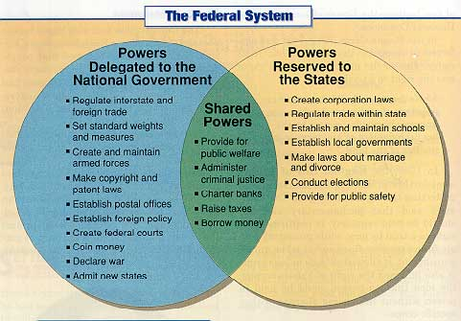

Slide 32
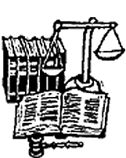
Article I: Legislative Branch
Powers denied to Congress
  Bill of Attainder: A legislative act that singles out an individual or group for punishment without a trial.
  Ex post facto: law that criminally punishes conduct that was lawful when it was done
  Writ of habeas corpus: requiring that a person holding a prisoner must demonstrate the legal and jurisdictional basis for continuing to hold the prisoner
Powers denied to states:
  Enter into treaties
  Coin money
  Grant titles of nobility

Slide 33
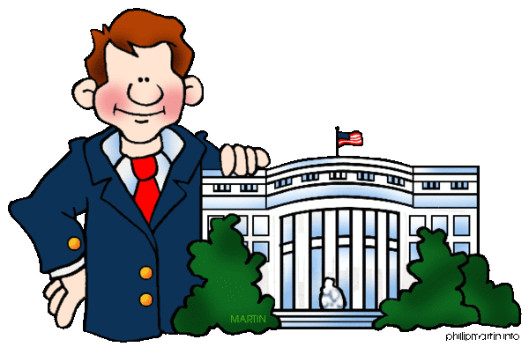
Article II: Executive Branch
Election
  Office of president and vice president were originally selected by the two names with the most votes.
  Changed by 12th amendment
  Number of electors = # of Representatives + # of senators
Office
  Term: 4 years
  Term limits: 2 terms
Qualifications for President
  Natural born citizen
  35 years of age
  Reside in US for 14 years

Slide 34


Slide 35
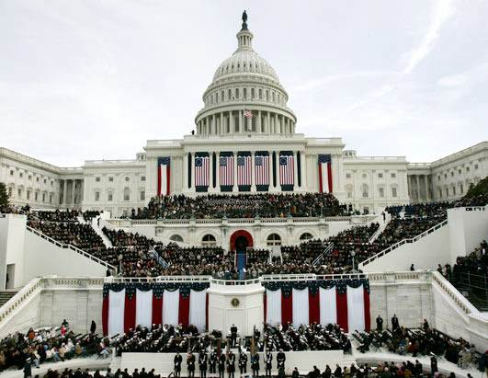
Article II: Executive Branch
Oath requires that president “preserve, protect, and defend the Constitution.”
Powers
  Military: Commander-in-Chief
  Judicial: Appoint Justices
  Legislative: State of Union; sign bills into law
  Executive: Make appointments; enter treaties
President makes treaties with nations upon consent of 2/3 of Senate and appoints Ambassadors.
Appointments must be with advice and consent of Senate

Slide 36
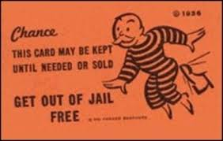
Article II: Executive Branch
President can be removed upon impeachment and conviction.
Special Powers:
  Grant reprieves – postponement of punishment
  Grant pardons – official forgiveness for a crime
  Grant Amnesty – a pardon given to certain groups of people before trial
  Convene special sessions of Congress
  Receive foreign ambassadors

Slide 37
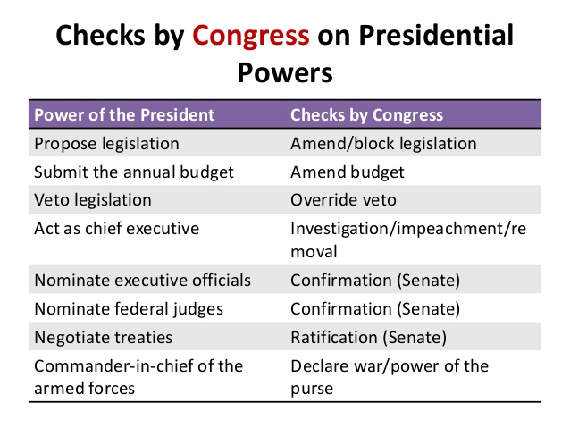

Slide 38
Bellwork
What is the greatest power of the president? Why?

Slide 39
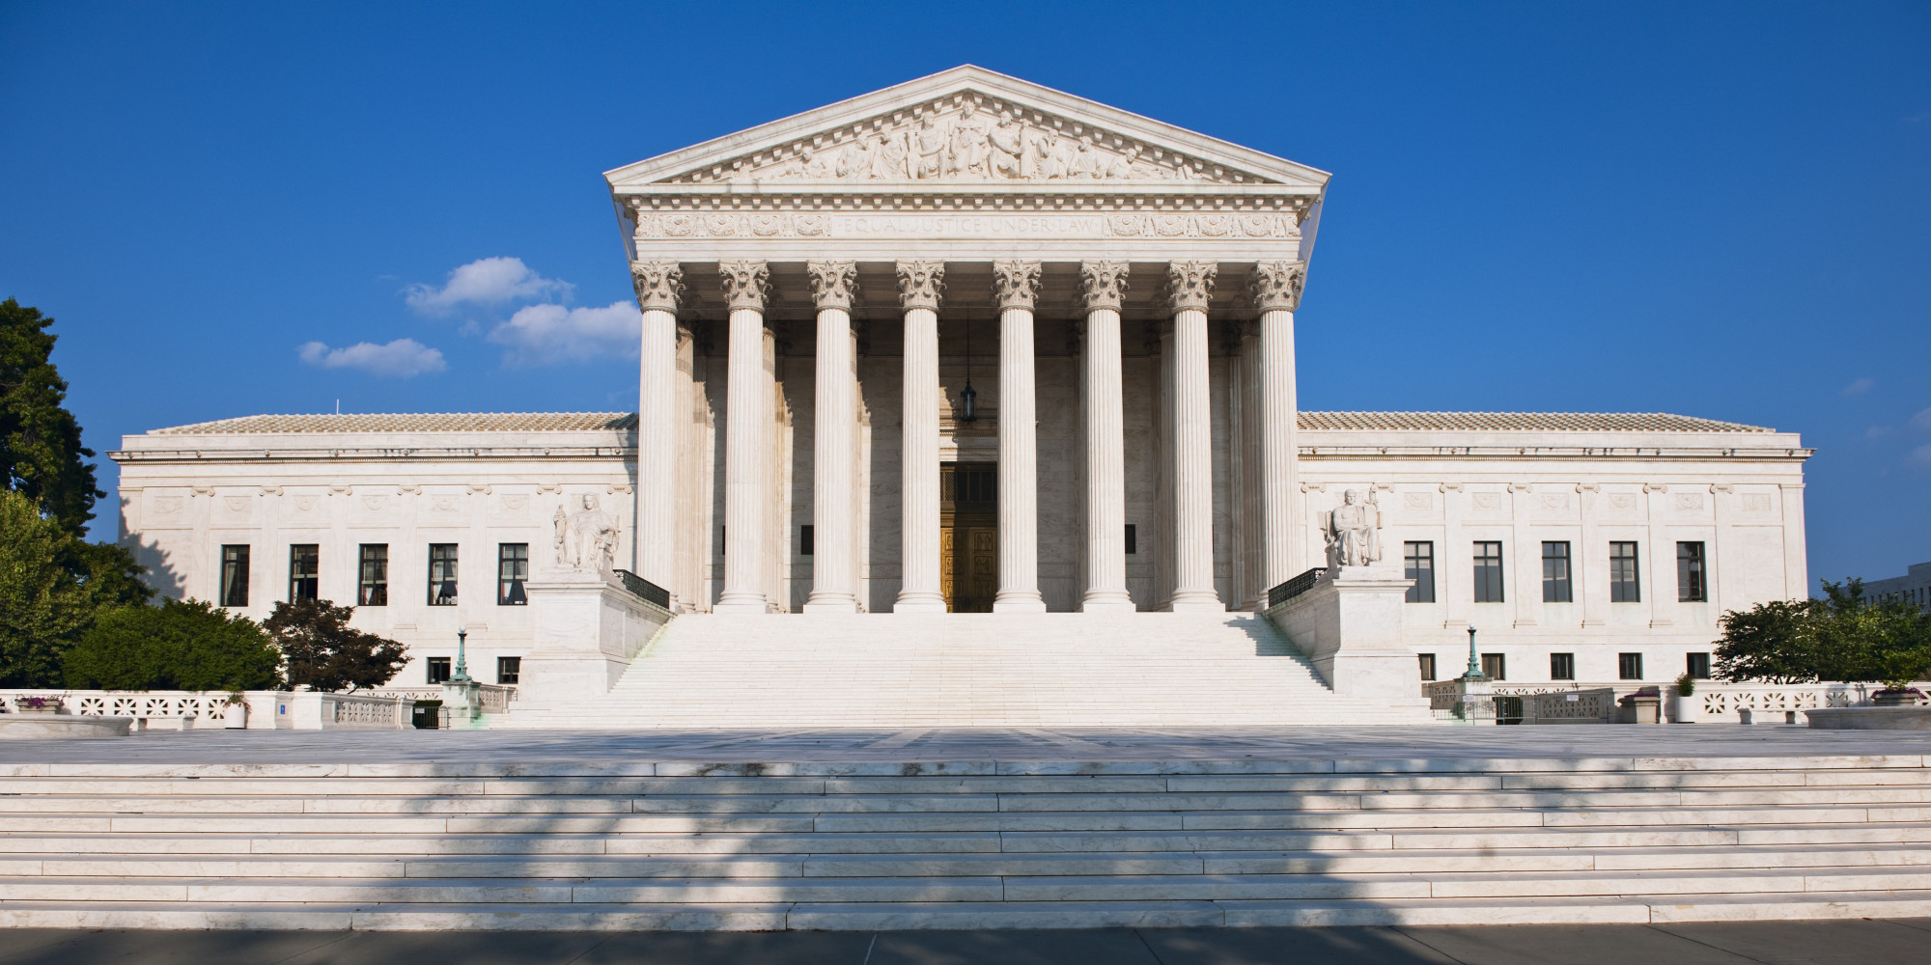
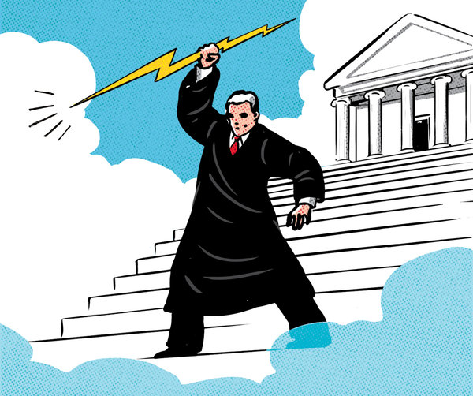
Article III: Judicial Branch
This Article establishes the Supreme Court
  Congress has the power to establish lower courts
  Congress determines the size of the Supreme Court
  There are 9 Supreme Court justices
The Supreme Court has original and appellate jurisdiction
  Original – power to hear a case for the first time
    Cases affecting ambassadors and state is a party
  Appellate – power of a court to review a decision
Federal judges are appointed and serve during good behavior.
  There are no constitutional requirements to be appointed a federal judge

Slide 40
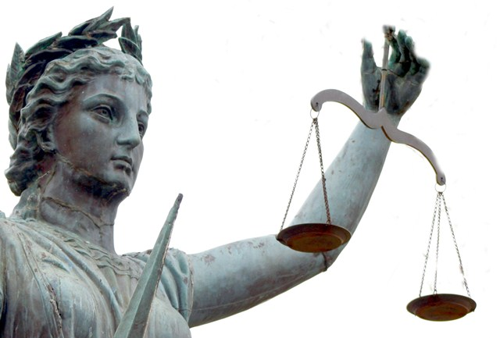
Article III: Judicial Branch
Treason is the only crime defined in Article III
  Levying war, adhering to enemies, giving them aid and comfort
  Congress determines punishment but not corruption of blood or forfeiture

Slide 41
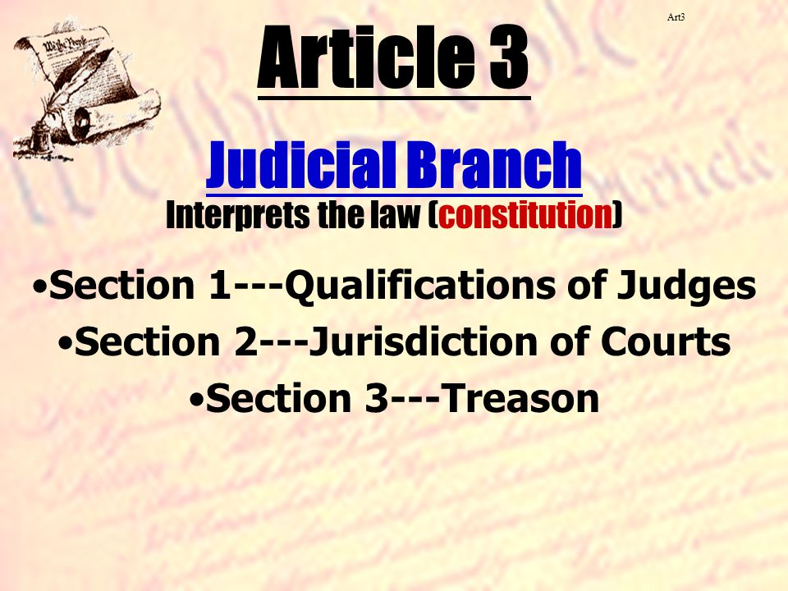

Slide 42
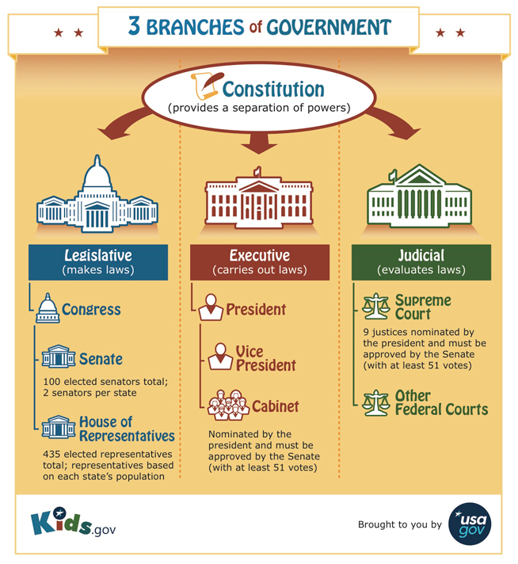

Slide 43

Article IV: Relations among States
Full faith and credit clause: public acts, records and judicial proceedings of every state given full faith and credit in every other state
Privileges and immunities clause provides that the same privileges and immunities apply in each state.
Extradition: Delivered up to be removed to the State having jurisdiction of the crime
Congress admits new states to the Union, but states cannot be formed within other states
Article guarantees a republican form of government meaning voters elect representatives to act in their best interest

Slide 44
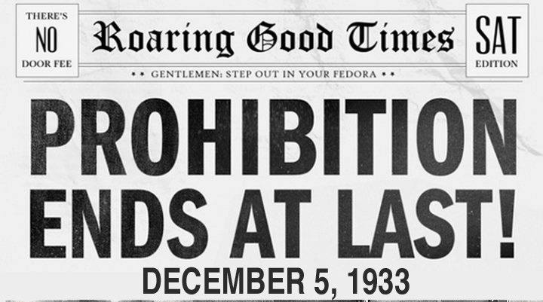
Article V: Amendments
An amendment is a written change made to the Constitution. Lawmakers have succeeded in changing the document only 27 times.
An amendment may be proposed in one of 2 ways:
  Congress can propose an amendment by 2/3 vote in both houses
  Legislature of 2/3 of the states (34 out of 50) can ask Congress to call a national convention to propose an amendment.
An amendment must then be ratified in one of 2 ways:
  The proposed amendment can be sent to state legislatures for approval by ¾ of the states
  Proposed amendment can be sent to state conventions for consideration and approval by ¾ of the states
If the people do not like the effects of an amendment, another amendment can be passed to repeal it.
  1933: 21st amendment was passed to repeal the 18th

Slide 45
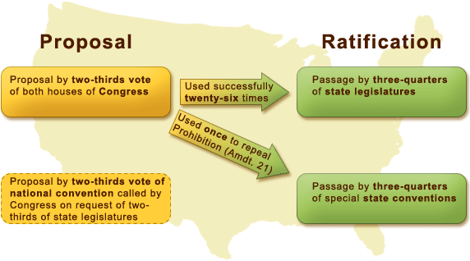

Slide 46
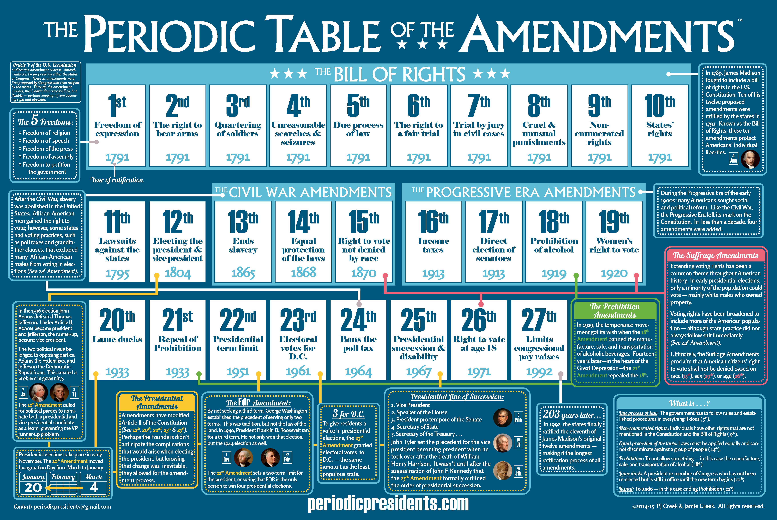

Slide 47
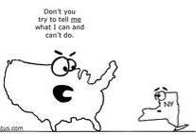
Article VI - VII
Article VI: Supremacy
  Debts contracted before the Constitution are valid against the United States
  Constitution and laws of the US are the supreme law of the land
  Congress members, state legislators, executive and judicial officers are bound by oath to support the Constitution
  No religious test shall ever be required as a qualification to any office
Article VII: Ratification
  9 states had to ratify the Constitution

Slide 48
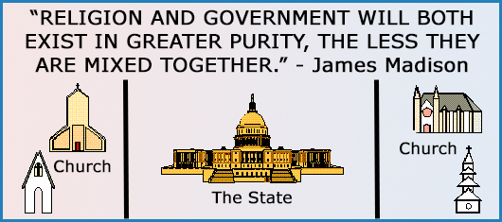

Slide 49
Interpreting the Constitution
The Constitution sets broad guidelines for governing.
There are certain traditions that are seldom written down and referred to as the “unwritten constitution.”
  Executive’s cabinet
Congress often applies the Constitution to a particular issue in society by interpreting whether some passage gives Congress the authority to pass a particular law
  Congress decided it had the power to pass laws affecting working conditions, including wage rates.
Supreme Court has the power to decide if Congress has interpreted the Constitution correctly.
  The Court’s interpretation is final.

Slide 50
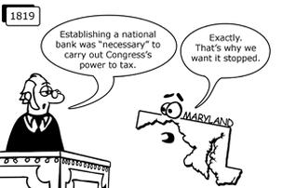
Necessary and Proper Clause
Article I, Section 8, Clause 18
  “To make all Laws which shall be necessary and proper for carrying into Execution the Powers, and all other Powers vested by this Constitution in the Government...”
  Clause that grants Congress the powers that are implied in the Constitution, but not explicitly stated
Also called the elastic clause because can be used to stretch the powers of Congress.
Alexander Hamilton argued for an expansive interpretation of the clause. His view would have authorized Congress to exercise a broad range of implied powers
  Was also an advocate for a national bank
McCullough v. Maryland was the first case where the necessary and proper clause was utilized by the Court.

Slide 51
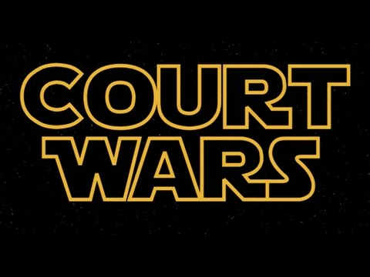
McCullough v. Maryland
Case established that Congress could use the Necessary and Proper Clause to create a bank even though the Constitution does not explicitly grant that power to Congress.
Chief Justice Marshall’s opinion upheld a broad interpretation of the federal government’s powers.
Also upheld the supremacy of the federal government under the Supremacy Clause by establishing the precedent that states could not tax an activity of the federal government.

Slide 52
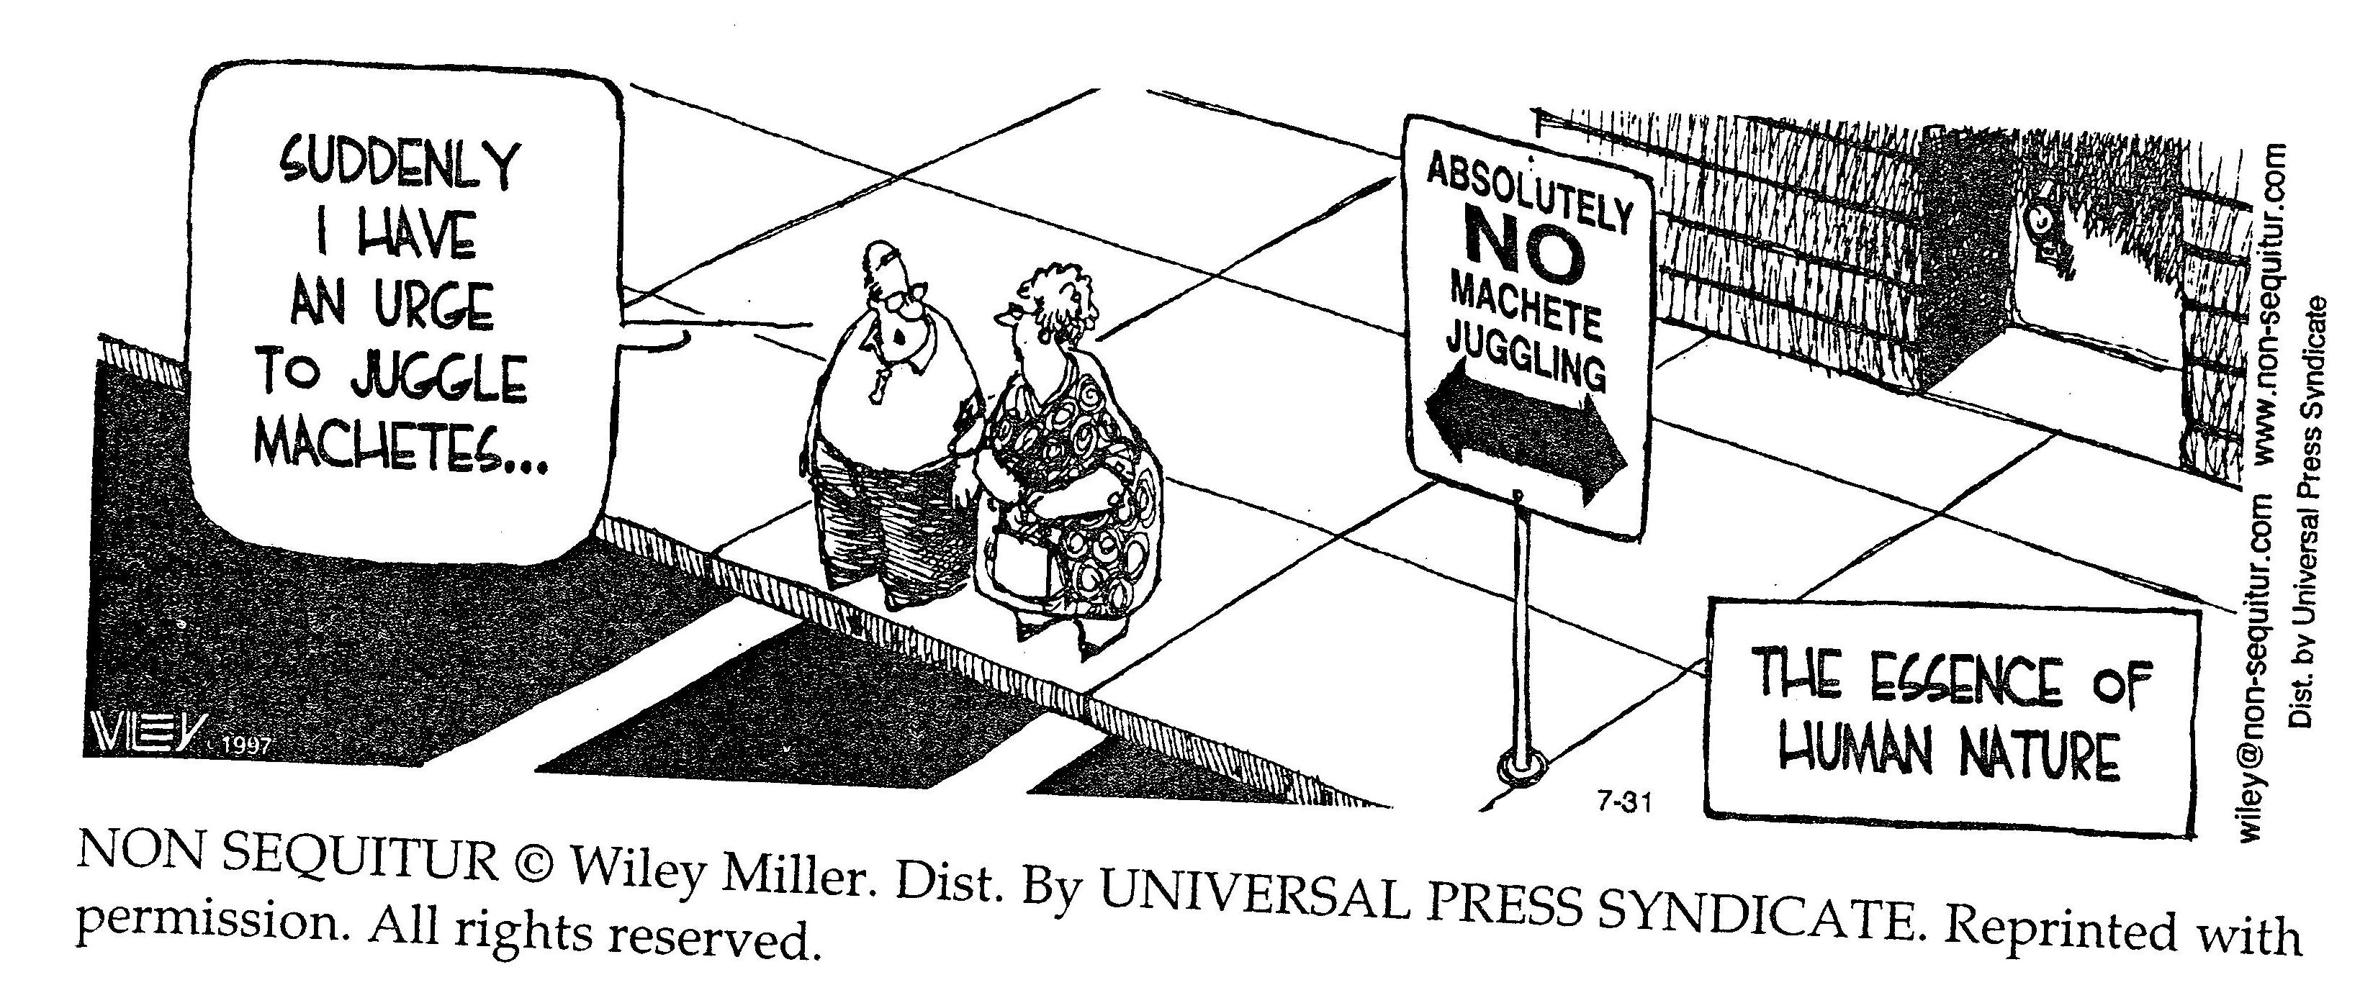
Bellringer
Which articles outline the powers of the three branches?
Why do we need more then just those three articles?

Slide 53
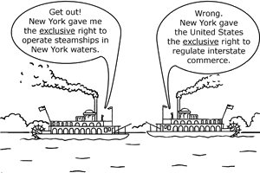
Gibbons v. Ogden
Case established the right of exclusive right of Congress to control interstate commerce utilizing both the Commerce Clause and Supremacy Clause.
Commerce Clause:
  Article 1, section 8, clause 3
  To regulate Commerce with foreign Nations, and among the several States, and with the Indian tribes
Court decided that commerce is more than trading of goods, but includes the intercourse of commerce, such as navigation.
Court also held the issuance of a federal license would supersede a state license in the spirit of the Supremacy Clause.

