Slide 1
The Constitution
Convention - Ratification

Slide 2
Bellwork
What do you already know about the creation of the Constitution?

Slide 3
The Constitutional Convention
In 1787, 12 of the states sent delegates to a meeting in Philadelphia to revise the Articles of Confederation
Each state was asked to send a representative
The delegates decided to do away with the Articles and write a new set of laws. The result was the United States Constitution.
Participants agreed to keep discussions secret in order to be able to speak freely.
George Washington presided over the convention
James Madison’s journals reveal the proceedings.
They ended up discarding the Articles and writing a new constitution.

Slide 4
States
Connecticut
Delaware
Georgia
Maryland
Massachusetts
New Hampshire
New Jersey
New York
North Carolina
Pennsylvania
South Carolina
Virginia

Slide 5
Constitutional Convention
Despite agreement on the need for a new government, deciding the new organization of the government was a matter of debate.
Issues that were debated include:
Representation
Slavery
Import/Export Tax
Election of the president

Slide 6
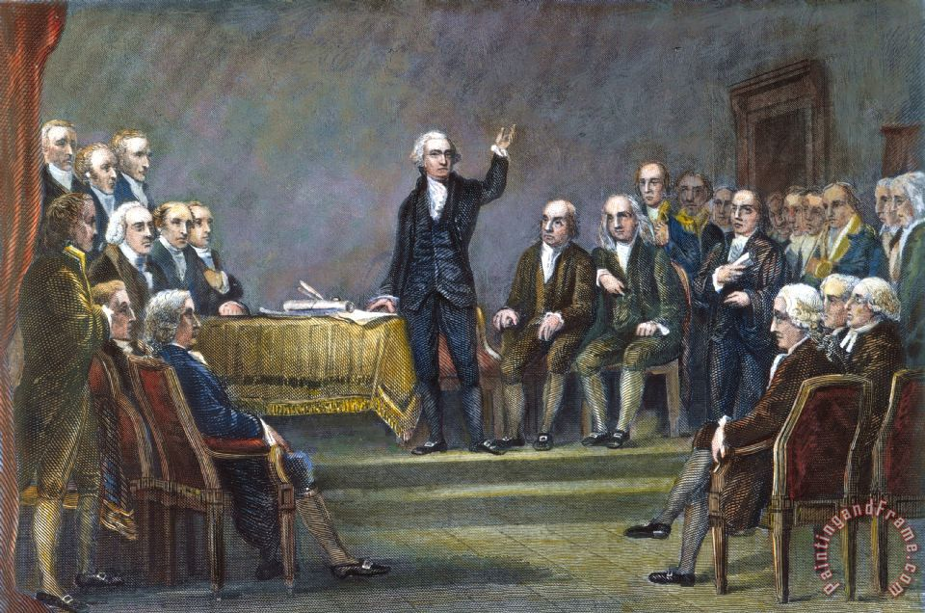

Slide 7
Compromises: Representation
Virginia Plan
Federal government made up of three branches
Two house legislature
Representatives in each house determined by population
New Jersey Plan
Federal government made up of three branches
One house legislature
Each state gets a single vote
Great Compromise/Connecticut Plan
Federal government made up of three branches
Bicameral legislature
House of Representatives – based on population
Senate – each state has 2 senators

Slide 8
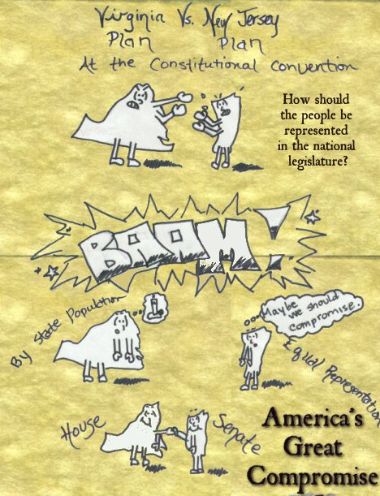

Slide 9
Compromises: Slavery
Northern States:
Since slaves were not voting citizens they should not be counted as part of the population
Southern States:
Wanted to have slaves count as part of the population
3/5 Compromise:
Every five slaves would count as three individuals in terms of population

Slide 10
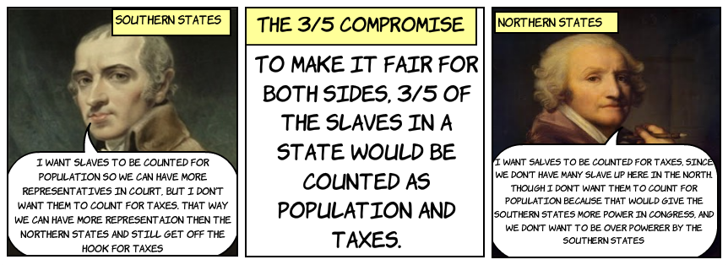

Slide 11
Compromise: Trade
Northern states:
Favored federal regulation of all trade
Wanted federal government to have power to collect duties and tariffs
Southern states:
Favored state control over regulation of trade
Feared federal ban on slave trade
Feared federal duty on exported agricultural goods
Commerce Compromise:
Federal regulation of interstate and international trade
State regulation of intrastate trade
No export duties to be passed for 20 years
No ban on slave trade for 20 years

Slide 12
Compromises: Election of President
Federal Power Supporters
Wanted direct election by qualified voters
Favored longer presidential term
State Rights Supporters
Wanted state legislature to elect president
Favored shorter presidential term
Compromise:
Indirect election by the Electoral College
Four-year presidential term

Slide 14
Three Compromises
Great Compromise: Connecticut Plan
bicameral legislature with one house based on population and the other based on state equality
House of Representatives and the Senate
3/5 Compromise: for every 5 slaves a state had, 3 people added to population count
Benefited southern region the most with representation in the House of Representatives
Electoral College: President not directly elected by citizens
Done by delegates; each states’ number of Electoral votes equals its US representatives + US Senators
NC has 15

Slide 15
Bellwork
Why would some people be opposed to the constitution?

Slide 16
New Government
Stronger central government
Branches of government/ Separation of Powers
Legislative (makes laws)
Executive (enforces laws)
Judiciary (interprets laws)
Checks and Balances

Slide 17
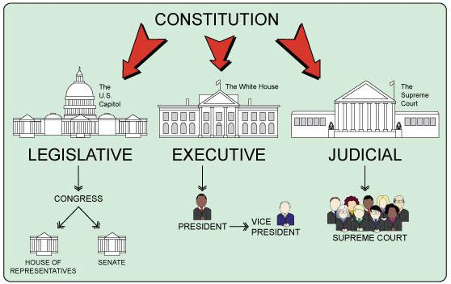

Slide 18
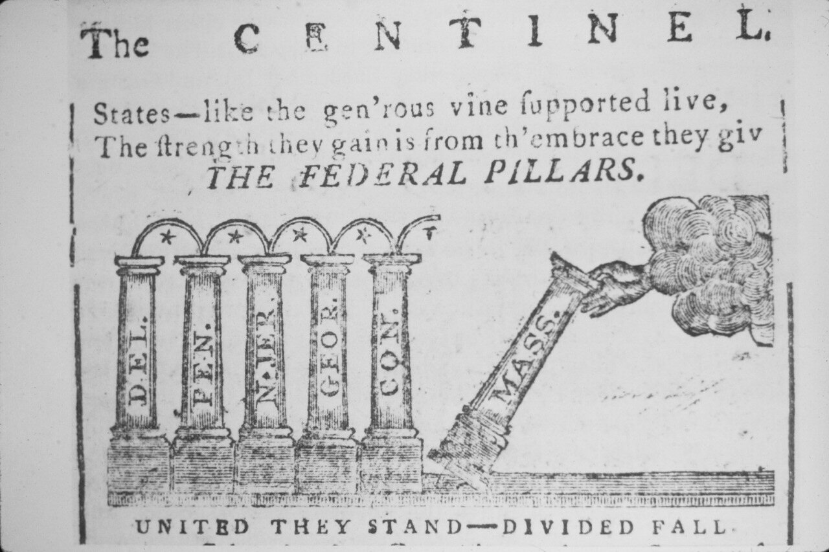
Ratification
On September 17, 1787 the Constitution was signed by 39 of the framers.
The next step was ratification.
Article VII:
“The Ratification of the Conventions of nine States, shall be sufficient for the Establishment of this Constitution between the States so ratifying the Same.”

Slide 19
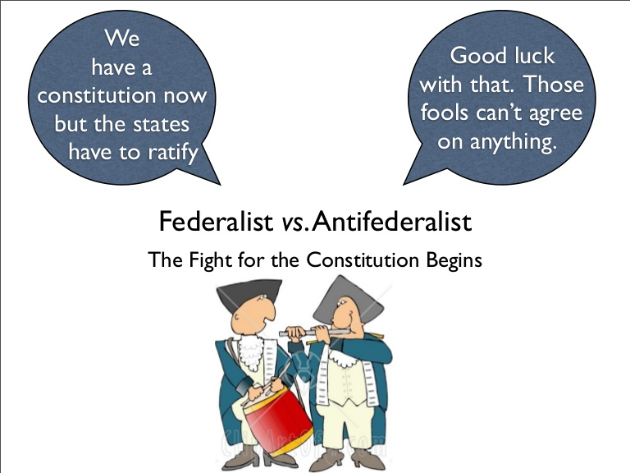
Federalists/anti-federalists
Americans reacted differently to the Constitution.
Constitution created a system of Federalism
Power is divided between national government and the states
Supporters called themselves Federalists.
Those who opposed the Constitution were the Anti-Federalists.

Slide 20
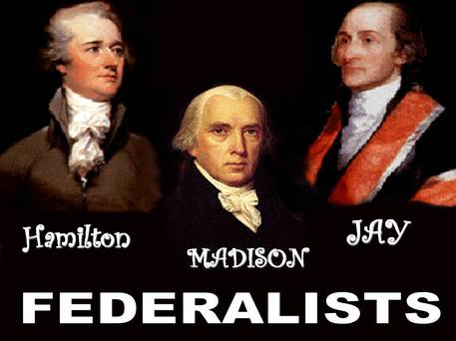
Federalists
Strong national government needed to unite the nation
Felt Separation of Powers/Checks and Balances would prevent government from getting tyrannical
Believed in a loose interpretation of the Constitution: national government could do what Constitution “meant”
Wrote the Federalist Papers to encourage acceptance and ratification of the Constitution
Federalists include:
Alexander Hamilton
John Jay
James Madison

Slide 21
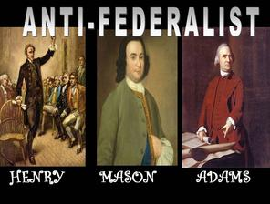
Anti-federalists
Felt the Constitution gave too much power to the national government and took too much away from the states
Wanted more protection for states’ and people’s rights
Believed in a strict interpretation of the Constitution: government can only do what Constitution says.
Anti-Federalists include:
Samuel Adams
James Monroe

Slide 24
Ratification
The Federalists eventually agreed with the Anti-Federalists that a bill of rights was a good idea.
They promised that if the Constitution was adopted, the new government would add a bill of rights.
On June 21, 1788, New Hampshire became the ninth state do vote for ratification and the Constitution took effect in 1789.

Slide 26
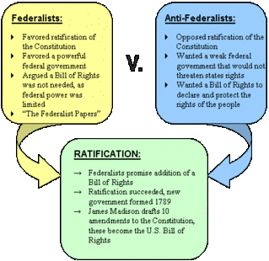

Slide 27
Modern controversies
Redistricting/ Gerrymandering
Majority Rules v. Minority Rights
Same sex marriage
Health Care
Security v. Civil Liberties
Right to bear Arms v. Gun Control
Strict versus loose constructionist views of interpreting the Constitution

