Slide 1
The Constitution

Slide 2
Bellwork:
Which compromise was most important on the long term success of the constitution? Why?

Slide 3
The Constitution
The Constitutional Convention took place from May 25, 1787 – September 17, 1787.
During these four months the Constitution decided upon, drafted, and signed by the delegates.
After the Constitution was approved by the Convention, there was still one more step.
Article VII:
“The Ratification of the Conventions of nine States, shall be sufficient for the Establishment of this Constitution between the States so ratifying the Same”

Slide 4
The Constitution
On September 28, the Confederation Congress voted to release the proposed Constitution to the states for their consideration without comment.
Each state was to hold a ratifying convention. Once a minimum of ratification by nine popularly elected state conventions occurred, the proposed constitution would become the Constitution.
The ratifying conventions served the necessary function of informing the public of the provisions of the proposed new government. They also served as forums for proponents and opponents to articulate their ideas before the citizenry.
State conventions were the agents of ratification to ensure the Constitution's authority came from representatives of the people.

Slide 5
Opposing Views
The debate over ratification became very heated.
Men used newspapers, pamphlets, and meetings to debate ratification.
Two main groups regarding ratification of the Constitution emerged:
Federalists
Published
Anti-federalists.

Slide 6
Primary Sources
Federalists Papers: series of 85 articles and essays written by James Madison, Alexander Hamilton, and John Jay promoting ratification of the Constitution.
Published under pseudonym Publius.
Anti-Federalists Papers: writings against ratification by various authors, most of whom used a pseudonym that have collectively become known as the Anti-Federalist Papers

Slide 7
Bellwork
What was one of the primary sources you read and the main idea of the reading?

Slide 8
Federalists
Felt that Articles were an ineffective government documents that made federal government too dependent upon the states.
Favored ratification of the Constitution
Strong national government needed to unite the nation with limits on state’s power.
Felt Separation of Powers/Checks and Balances would prevent government from getting tyrannical and a Bill of Rights was not necessary.
Believed in a loose interpretation of the Constitution
A large republic was seen as the best way to protect individual freedom
Federalists include: Alexander Hamilton, John Jay, and James Madison

Slide 9
Anti-Federalists
Favored amending the Articles of Confederation.
Opposed the new Constitution
Opposed strong central government as threat to state’s power.
Wanted more protection for states’ and people’s rights. This included the need for a Bill of Rights.
Believed in a strict interpretation of the Constitution
Felt only a small republic could protect the rights of people
Anti-Federalists include: Patrick Henry and Samuel Adams

Slide 10
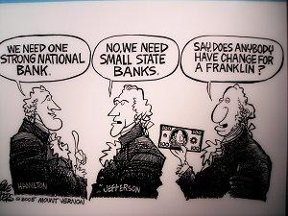
Strict vs. Loose
Different views on how the Constitution should be interpreted
Loose:
Favors stronger federal government
What the Constitution did not forbid, it allowed
Hamilton and the Federalists
Strict:
Favors State rights
Literal interpretation of the Constitution - what the Constitution did not allow it forbade
Jefferson and the Democratic-Republicans

Slide 11
___ 1. The Constitution gives the federal government enough power to overpower the states.
___ 2. It will not be possible for the federal government to overpower the states, because the states are a necessary part of the federal government.
___ 3. The Constitution contains no Bill of Rights to protect individual liberties like freedom of speech, trial by jury, and the right against searches and seizures.
___ 4. The Constitution says federal laws are “the supreme law of the land,” so the federal government could just take complete control.
___ 5. Nothing in the Constitution says the federal government has power to limit peoples’ freedoms in the first place.
___ 6.The Constitution gives the federal government just a few powers that are very well defined.
___ 7. The President created by the Constitution is really just a king.

Slide 12
___ 8. A strong President is necessary to protect the country against foreign attack and make sure laws are carried out properly.
___ 9. The Constitution creates a Supreme Court that is too powerful because the judges don’t answer to anyone.
___ 10. The Constitution already contains a few rights, so we may as well add a whole Bill of Rights.
___ 11. The Supreme Court is the weakest branch of government because it doesn’t control the military and can’t pass laws.
___ 12. The Constitution forbids creating titles of nobility like “Duke” or “King,” so the government will always belong to the people.
___ 13. The United States is too large to have a central government. People won’t know their leaders and will lose control over the government.
___ 14. The Constitution is a Bill of Rights because it guarantees citizens a role in government.

Slide 13
Constitution
Delaware was the first state to ratify the Constitution on December 7, 1787.
The first five states ratified the Constitution with relative ease.
Massachusetts and four other states contained language in their ratification instruments that recommended the Constitution be amended to include a Bill of Rights.
The ninth state to ratify was New Hampshire on June 21, 1788.
The Constitution went into effect on March 4, 1789.

Slide 14
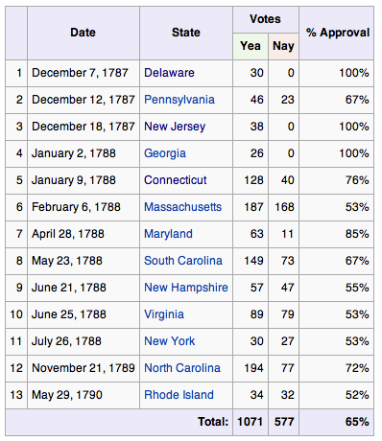

Slide 15
Constitution
The first Congress began on March 4, 1789.
President Washington was inaugurated on April 30, 1789.
The Bill or Rights were introduced by James Madison. The amendments came into effect on December 15, 1791 after ratification by the states.

